Slide 1
Jessica Jansen

Slide 2
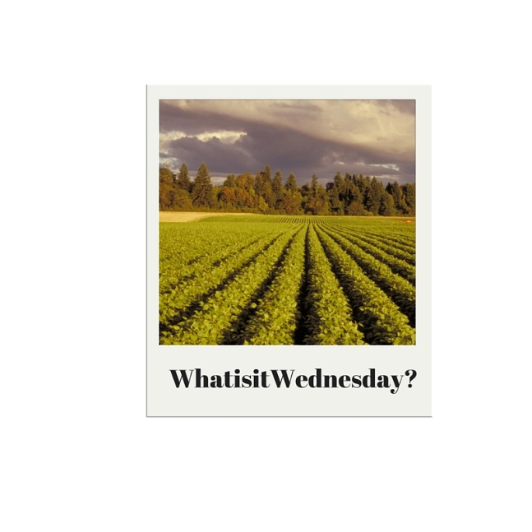
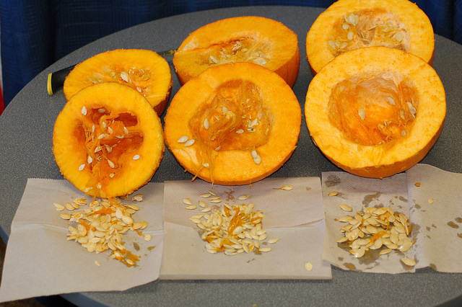
Workshop Overview
What is agriculture?
Why teach agriculture?
What is Oregon Agriculture in the Classroom (AITC)?
How do I use Oregon AITC resources in my classroom?
How do I stay connected with Oregon AITC?
Notes:
Overview of today: [read slide] We will have group hands-on lesson time and then

Slide 3
What is agriculture?
Notes:
Broad term
Diverse kinds
Innovation for how we produce what we need

Slide 4
Agriculture is…
“The science, art or practice of cultivating the soil, producing crops, and raising livestock and in varying degrees the preparation and marketing of the resulting products.”

Slide 5
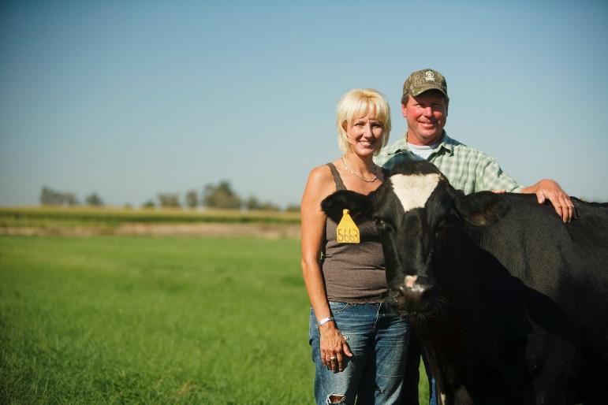
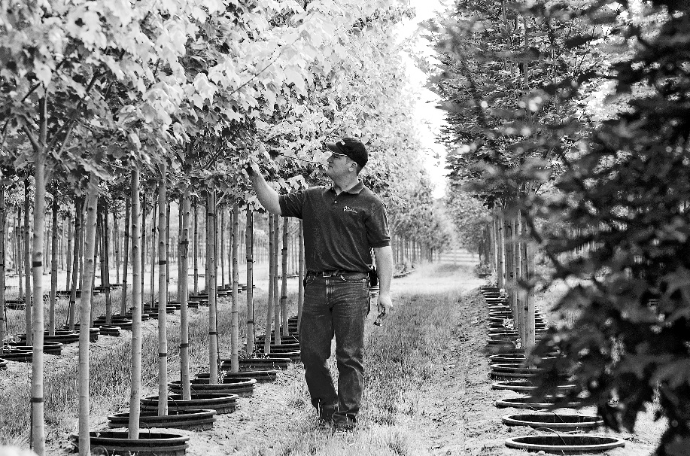
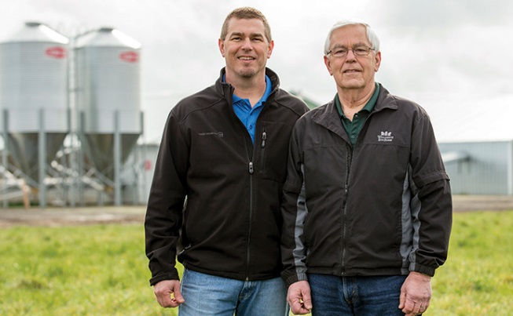
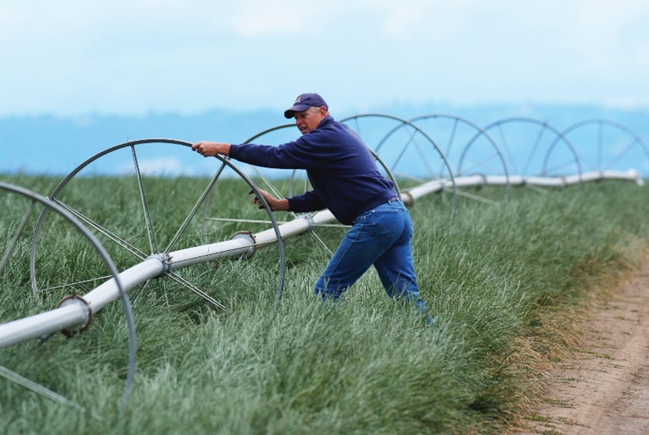
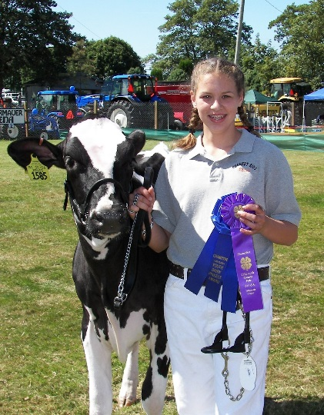
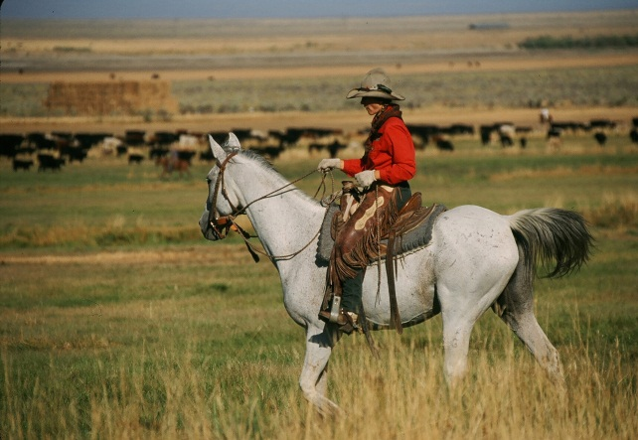
The 6 F’s of Oregon Agriculture
Farming
Notes:
2016: 1,181 farms contributed $5.7 billion to the state’s economy (FB statistics). Over 34, 000 farms in Oregon. Average farm size is 474 acres.

Slide 6
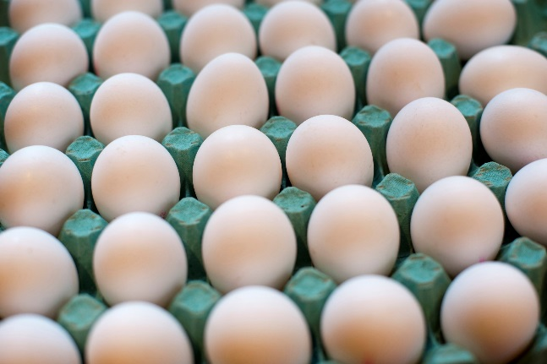
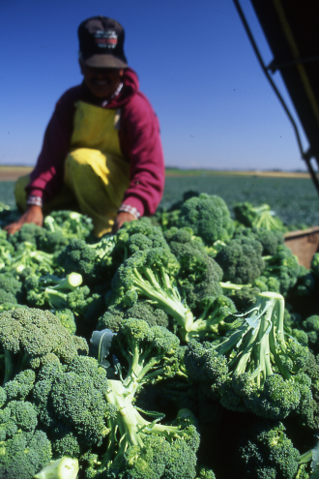
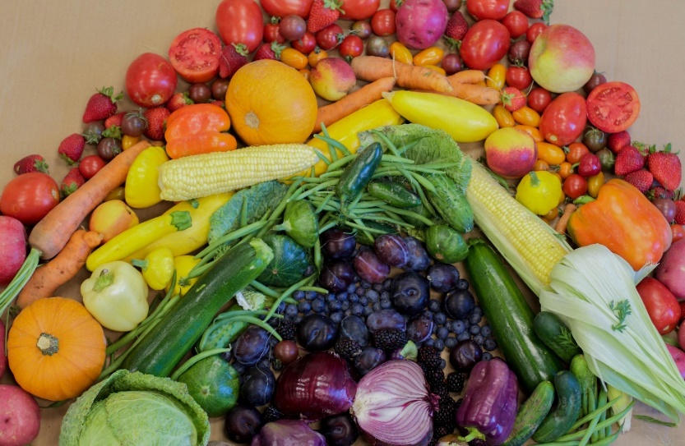
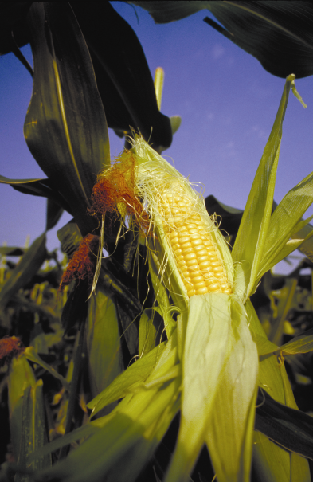
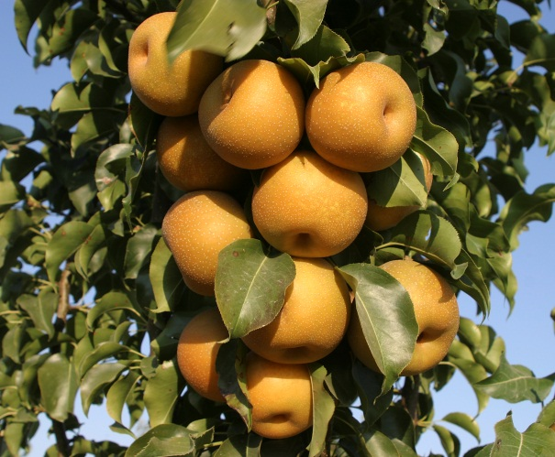
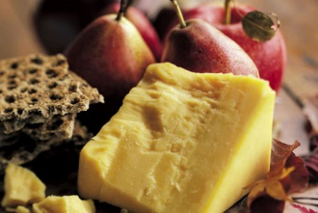
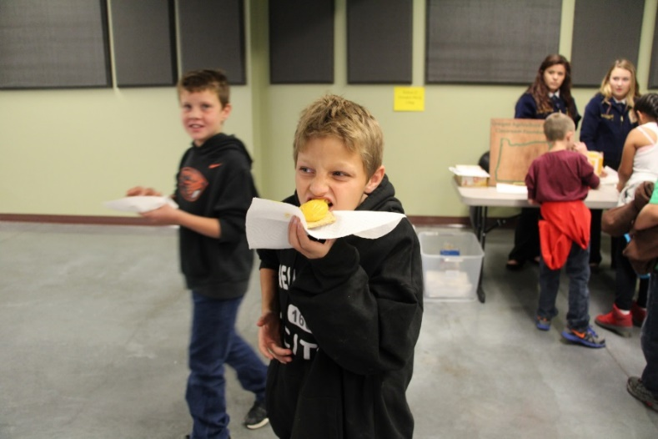
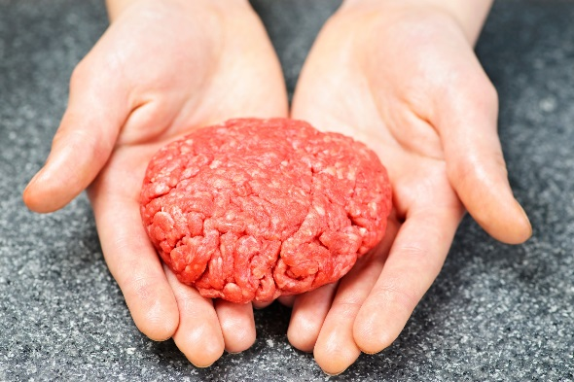
The 6 F’s of Oregon Agriculture
Food
Notes:
10 % of all jobs in Portland have to do with food. In 2010, Ag and food products made up 16% of the states $17.7 billion in exports
http://www.oregon4biz.com/Oregon-Business/Industries/Food-Beverages/Food/Members/flyer.pdf

Slide 7
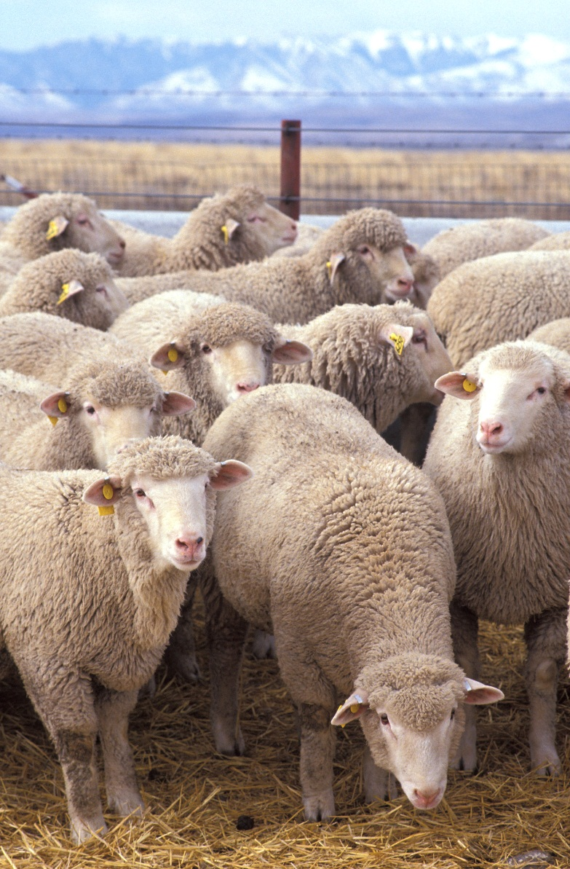
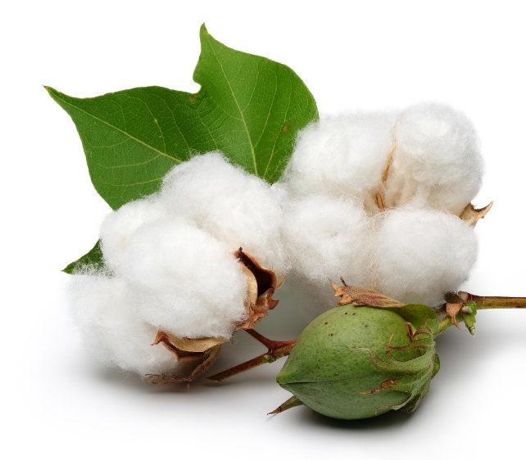
The 6 F’s of Oregon Agriculture
Fiber
Notes:
Not much of an industry, but unique to have Pendleton mills and the fiber industry. Historically, flax was grown in the Willamette valley to make linen, but ended 1950s

Slide 8
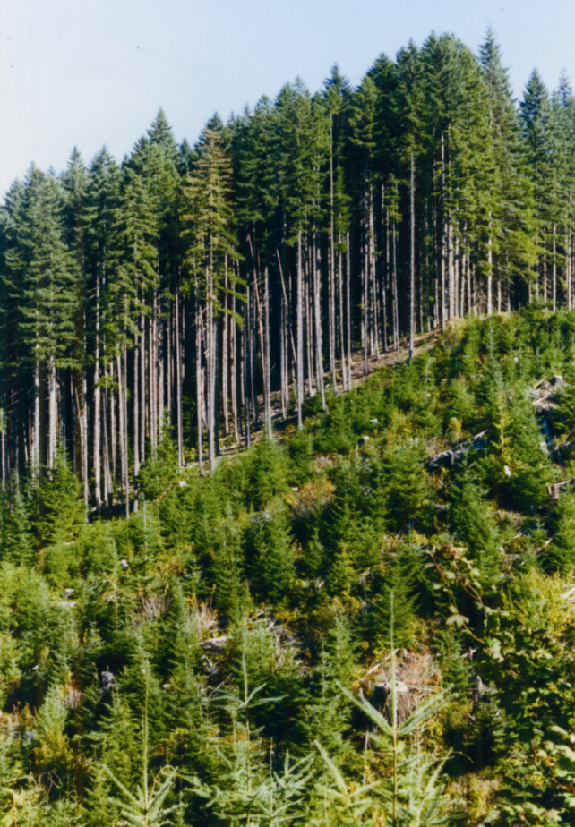
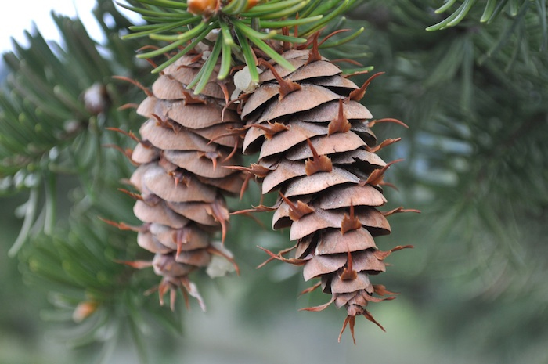
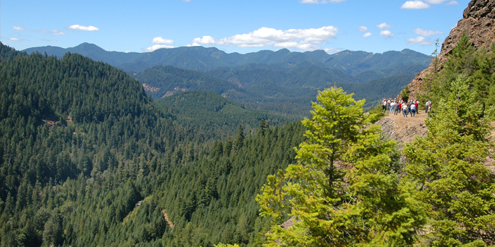
The 6 F’s of Oregon Agriculture
Forestry
Notes:
12.7 billion, 76,00 jobs oregonloggers.org. Oregon is home to some of the world’s most productive forests. Forests in Oregon cover nearly half the state.

Slide 9
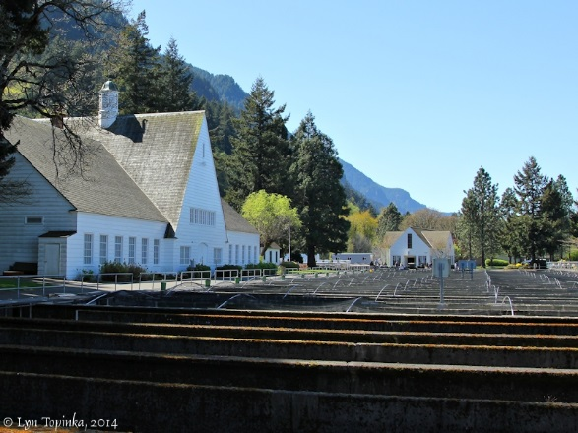
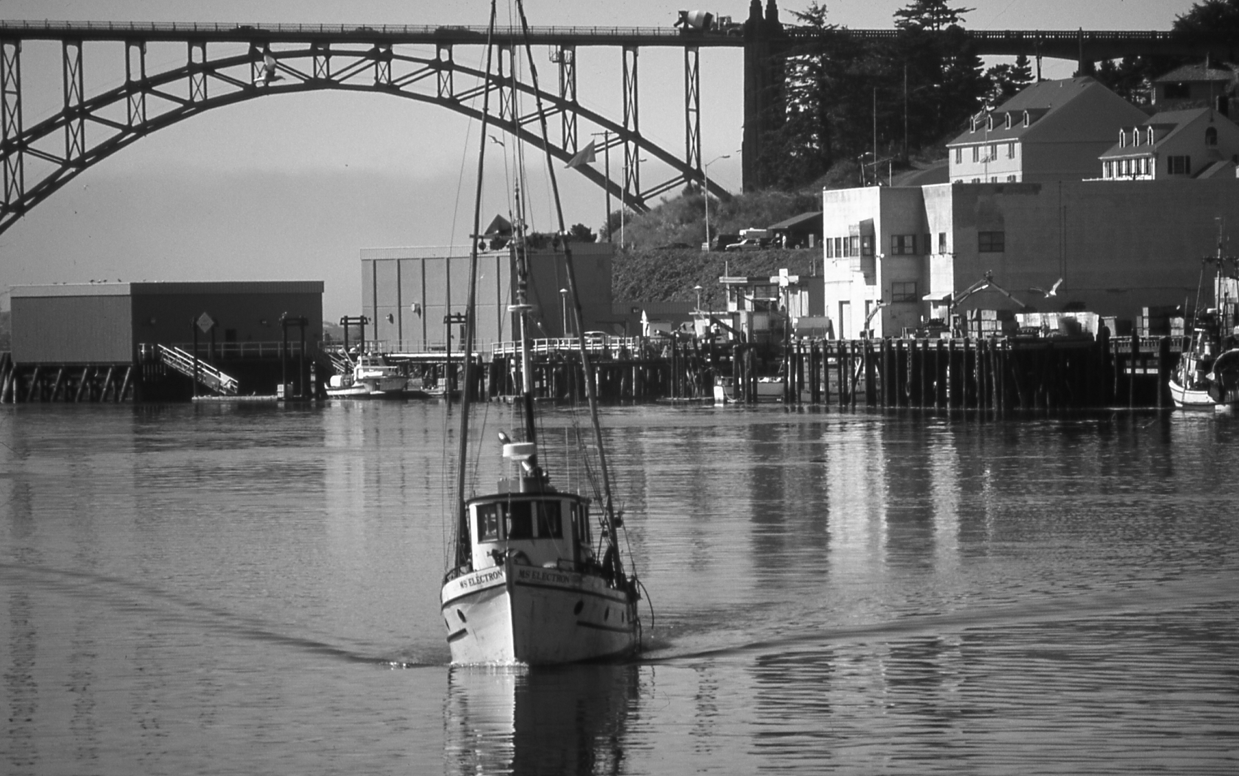
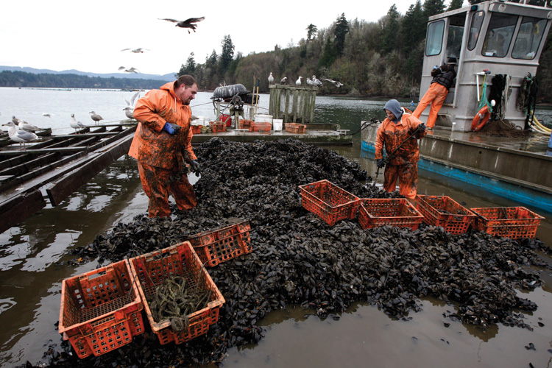
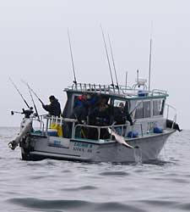
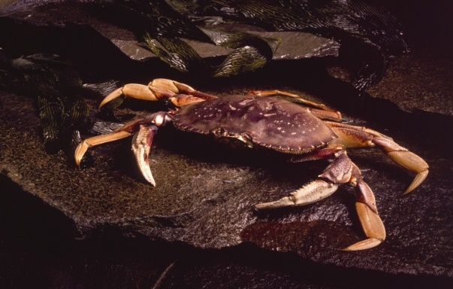
The 6 F’s of Oregon Agriculture
Fishing
Notes:
$136.2 million

Slide 10
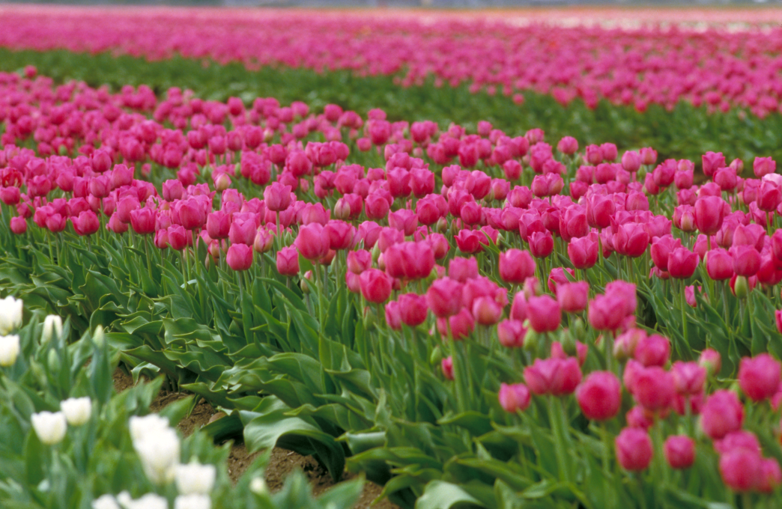
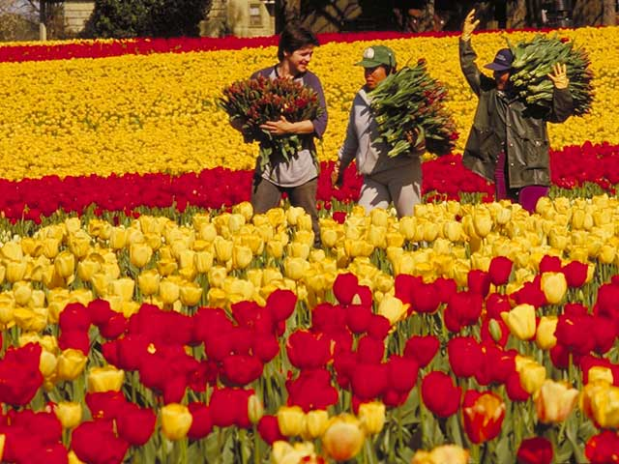
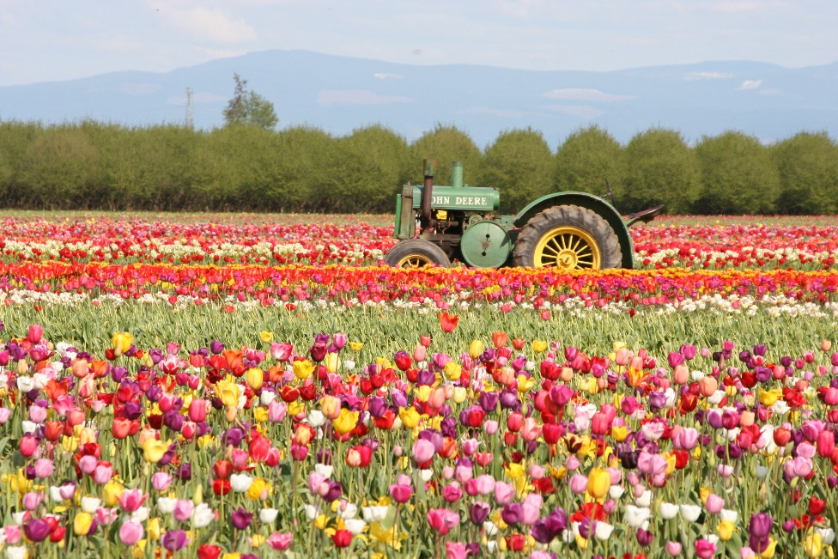
The 6 F’s of Oregon Agriculture
Flowers
Notes:
First industry, even before Oregon was a state. 2014: $805 million industry ($932 million if include Xmas trees)

Slide 11
Oregon farms & ranches
~35,500 farms in Oregon
615 organic farms
97% are family owned and operated
16.3 million acres
Average 460 acres
Source: USDA National Agricultural Statistics Service, 2012 Census of Agriculture
Notes:
QUESTION: In your free time from teaching, how many people farm? How many people were raised on a farm, maybe a family member as a farm? How many people eat? (one asking the question to see if you are paying attention, after all, I am the person standing between you and lunch) although we are not directly involved, agriculture is important to all of us
Oregon agriculture is incredibly diverse –and I am sure you will see this as the week unfolds. We are not like our Midwest counterparts where agriculture is pretty vanilla where agriculture takes places, how commodities are raised it is for example dairy farming in Tillamook is often different than dairy farming in Vale, OR. There are small farms, large farms and everything in between. Farmers that sell directly to consumers others sending products overseas. We have conventional farming, organic farming. Farmers using technologies – not that long ago GPS in tractors and now we are embarking on the use of drones to provide crop data.
The data on this source comes from the USDA NASS Ag Census that was conducted in 2012.
Farm number: The last USDA NASS Ag Census was conducted in 2007. 38,000. In 2002 – 40,000 farms.
Farm land: 2007-16.4, 2002 17.2
Number of Trends – decrease in the number of farms, decrease in number of acres. This is a trend that is not unique to Oregon, in fact this is occurring across the country.2012 – 2.1 million, 2007-2.2 million.
Land – decrease as well =UGB, often not considered non-farm development on agricultural lands

Slide 12
Farm size
Source: USDA National Agricultural Statistics Service, 2012 Census of Agriculture
Notes:
Almost 90% of the farms are “average size” or less.

Slide 13
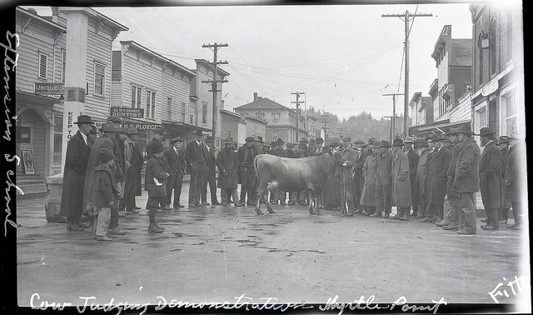
Talk about sustainability
~1,200 Century Farms
Operated continuously in the same family for 100 years
~30 Sesquicentennial Farms
Operated continuously in the same family for 150 years
Notes:
How many businesses are still around in the last 100 years let alone still operated by the same family?

Slide 14
Oregon farmers & ranchers
Average age of Oregon farmer: 60
Average years farming: 24
39% of Oregon farmers are women
>1% of the US population is directly involved in farming and ranching
The average US farmer feeds 155 people
In 1960, a farmer fed 26 people
Notes:
2007 – average age was about 57 years old.
My college major professor told me the average person changes jobs every 7 years….I guess that means farmers are not average!
Let move on to some fun…

Slide 15
Notes:
Take a piece of scratch paper, or if you need a paper, I have some, and write down the commodities that you think are grown in Oregon…..I will give you a few minutes to complete this exercise…. Now that you have the list – identify which 5 you think are Oregon’s top five commodities (basing it on value of gross sales).

Slide 16
Commodities
How many agricultural commodities are
grown/raised in Oregon?
Over 220

Slide 17
Top 10 ag commodities
Rank | Commodity | Value ($ millions)
1 | Greenhouse & nursery | 947
2 | Cattle & calves | 695
3 | Hay | 585
4 | Milk | 500
5 | Grass seed | 455
6 | Wheat | 238
7 | Potatoes | 177
8 | Pears | 176
9 | Grapes for wine | 171
10 | Blueberries | 147
Source: Oregon Agriculture Facts & Figures, July 2017
Notes:
I do want to offer a caveat about the data I am about to share. This data is based on statistics collected by OSU and NASS. NASS came out with data this Spring. So what does this mean? It means that we need to revise our rankings but NASS does not offer the level of detail that this brochure creates. However the top 5 commodities remain the same and they consistently remain the same, they just get shuffled back and forth depending on when the data was collected and what kind of year the commodity is having. So let’s jump into the table
What do you think is the number one agricultural commodity?
The recent NASS data has cattle as number 1 and greenhouse/nursery as number 2.
ODA will be looking to revise the brochure this summer and fall, so check back before the school year to see if we have a new one up.
The take home message is not which individual crop is number but what are some of the larger valued crops in the state.

Slide 18
Top ag commodities (11 – 20)
Rank | Commodity | Value ($ millions)
11 | Onions | 111
12 | Christmas trees | 92
13 | Hazelnuts | 73
14 | Cherries | 70
15 | Hops | 59
16 | Dungeness crab | 58
17 | Eggs | 50
18 | Mint for oil | 43
19 | Apples | 38
20 | Corn for grain | 35
Source: Oregon Agriculture Facts & Figures, July 2017
Notes:
I do want to offer a caveat about the data I am about to share. This data is based on statistics collected by OSU and NASS. NASS came out with data this Spring. So what does this mean? It means that we need to revise our rankings but NASS does not offer the level of detail that this brochure creates. However the top 5 commodities remain the same and they consistently remain the same, they just get shuffled back and forth depending on when the data was collected and what kind of year the commodity is having. So let’s jump into the table
What do you think is the number one agricultural commodity?
The recent NASS data has cattle as number 1 and greenhouse/nursery as number 2.
ODA will be looking to revise the brochure this summer and fall, so check back before the school year to see if we have a new one up.
The take home message is not which individual crop is number but what are some of the larger valued crops in the state.

Slide 19
Name the top 5 counties (based value of production)
2
3
1
5
4
Notes:
Farming takes place in all of Oregon’s 36 counties, in terms of value of production….what county do you think is number one in the state?

Slide 20
Top 10 ag producing counties
Rank | County | Values ($ millions)
1 | Marion | 639
2 | Umatilla | 487
3 | Morrow | 482
4 | Malheur | 373
5 | Clackamas | 343
6 | Linn | 301
7 | Washington | 292
8 | Klamath | 290
9 | Yamhill | 269
10 | Polk | 162
Notes:
There are farms located in every part of the state
Now that we have raised and grown all of these commodities, where do they go?

Slide 21
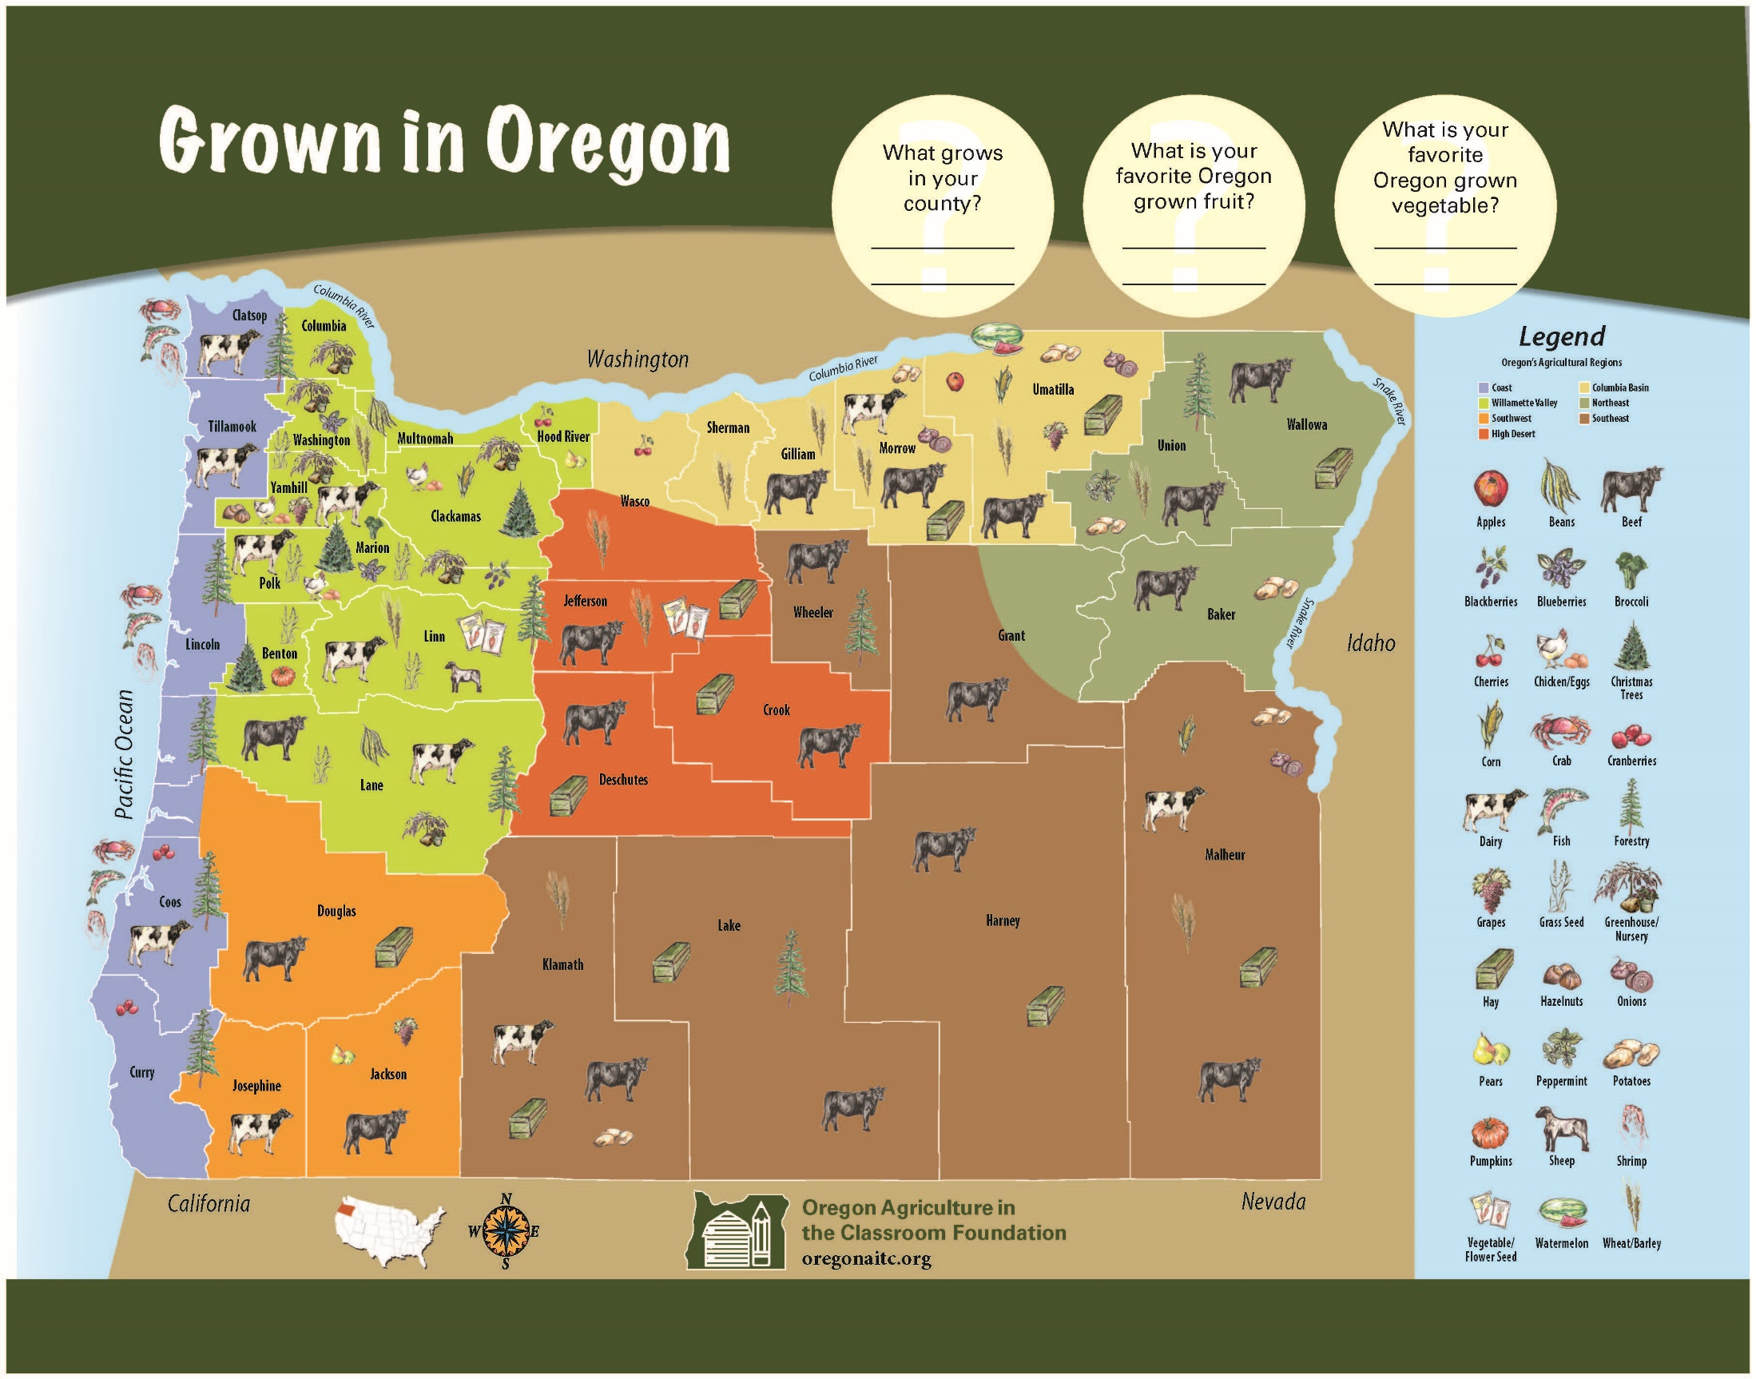

Slide 22
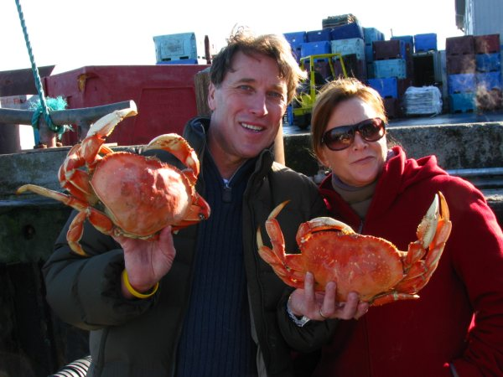
Coastal Oregon
Seafood– including salmon, halibut, Dungeness crab, oysters and more. The coast is also home to dairies, cranberries, and unique crops like lily bulbs.

Slide 23
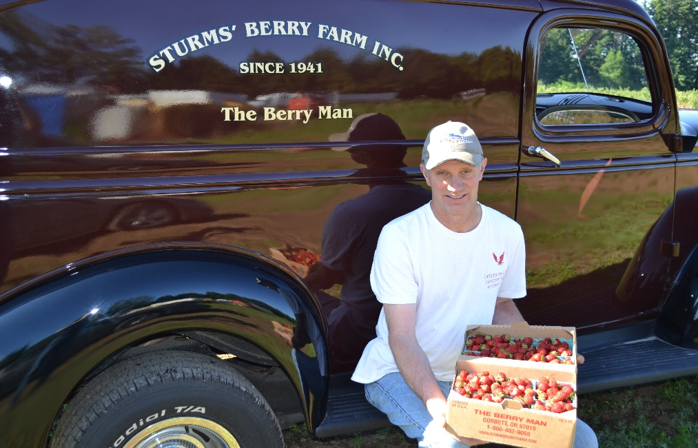
Willamette Valley
More than 170 different commodities, ranging from grain and grass seed to fresh produce, nursery products, hazelnuts to Christmas trees, cattle and poultry.

Slide 24
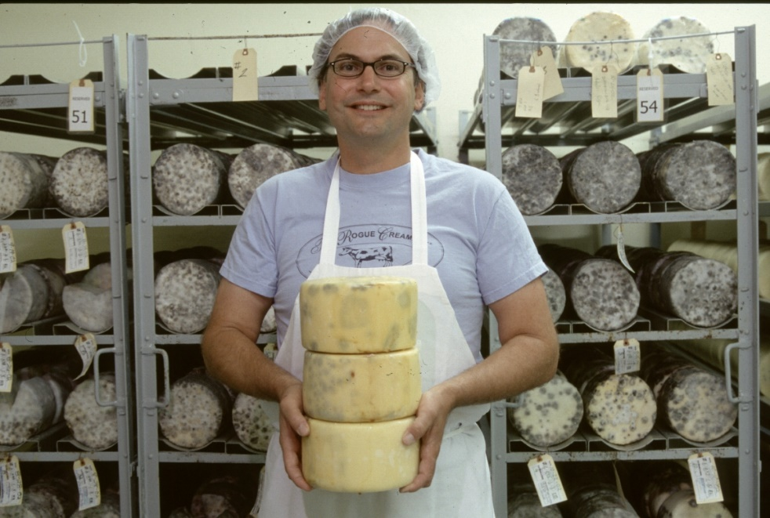
Southern Oregon
This diverse region is home to sheep and cattle, high-quality pears and other tree fruit. You’ll also find wine production, alfalfa, potatoes and cheesemakers.

Slide 25
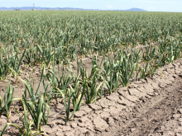
High Desert
Home to a number of specialty seed crops, garlic, hay and beef cattle. The region also produces an abundance of fresh vegetables.

Slide 26
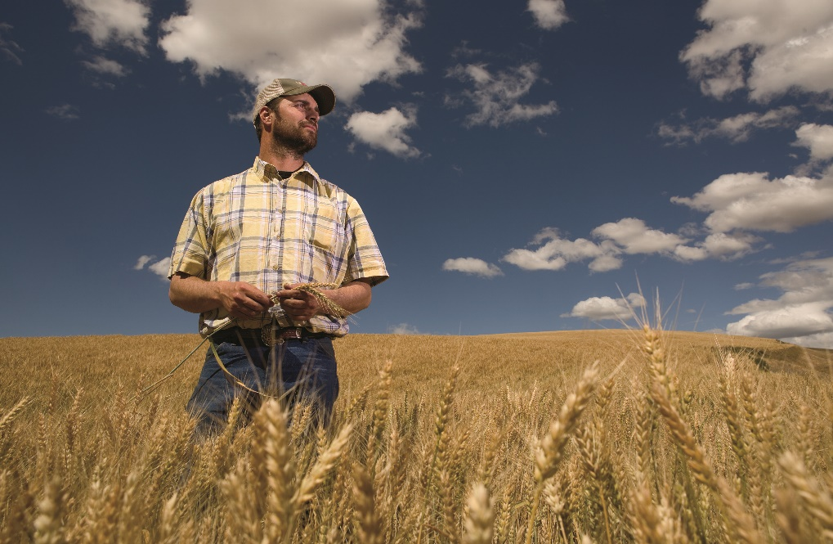
Columbia Basin
The state’s main wheat-producing area. You’ll also find potatoes, onions, dairy cattle, vegetables grown for processing, watermelon, and alfalfa.

Slide 27
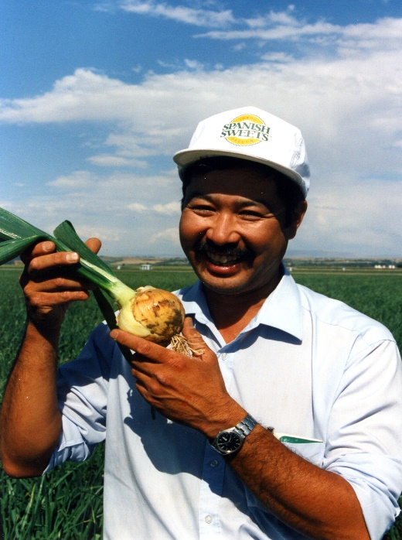
Northeast Oregon
Most of the nation’s onion production takes place along the Idaho border in Treasure Valley. Other commodities in the region include beef cattle, potatoes, mint and vegetables.

Slide 28
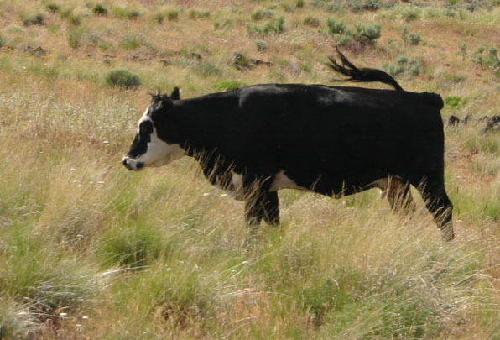
Southeast Oregon
Livestock dominates the area, with cattle grazing on thousands of acres of private rangeland. The area also produces onions, potatoes and sugar beets.

Slide 29
We’re number one!
Oregon is ranked 1st in the US for 12 commodities
Blackberries, boysenberries, hazelnuts, orchardgrass seed, ryegrass seed, crimson clover, red clover seed, fescue seed, potted florist azaleas, sugarbeet for seed, rhubarb, and Christmas trees
Source: Oregon Agriculture Facts & Figures, July 2017
Notes:
Oregon agriculture is also #1 for about 13 different commodities (review the list). We also boast producing 100% of the US supply boysenberries, Halzenuts and black raspberries (I think our handout has blackberries but CA also produces blackberries).

Slide 30
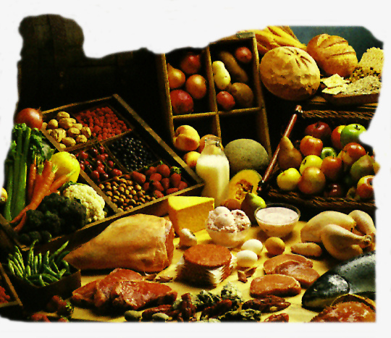
Where does it all go?

Slide 31
Oregon agriculture markets
Three-legged market stool
Local (in state)
Domestic (in country)
Export (International)
~75% leaves the state
35% leaves the country

Slide 32
Local
Farmers markets
160 markets across the state
More than 1,000 participating farmers
Community Supported Agriculture
U-pick
Farm stands
Direct sales
Notes:
50 farmer’s markets in 2006
~ 20% farmer sell all, or some, of their products via local markets

Slide 33
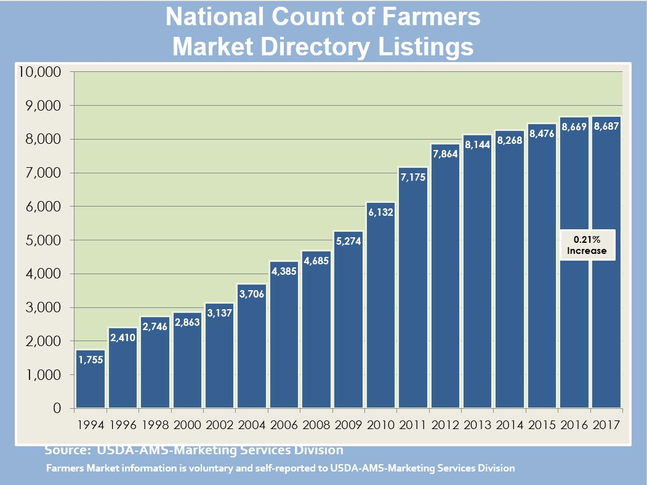
Local
Notes:
I think for many when they where local markets they automatically think farmers markets. Oregon, like the rest of the nation, has seen a growth in the number of farmer’s markets50 farmer’s markets in 2006

Slide 34
Domestic (within US)
Nursery
Beef
Dairy products
Christmas trees
Grass seed
Vegetables
Fruit
Notes:
----- Meeting Notes (6/19/15 10:54) -----
Domestic is the US - so if you are on vacation in Florida, what Oregon products would be able to find.

Slide 35
Exports
19% of total state exports
Second largest export sector in terms of value
Largest export sector in terms of volume
50% of the Port of Portland’s total tonnage of exports is agriculture

Slide 36
Where is it going?
Japan
South Korea
China
Taiwan
Brazil
EU
Middle East
Australia
New Zealand
Mexico
Canada
and more……

Slide 37
What is exported?
Hay
Grass seed
Straw
Wheat and wheat products
Potatoes (frozen, fresh)
Beef
Onions
Hazelnuts
Fish and seafood
Cheese
Wine
Cherries
Blueberries
Christmas trees

Slide 38
Ag processors
200 food processors in Oregon
Multnomah County leads Oregon in food processing
Marion County is second
Notes:
Of course, farmers and ranchers could not get it done without the help of processors
Multnomah – 22% of the state’s food processing payroll, 20% of the employees
Marion – 16% food processing payroll, 18% of the employees
When there was a downturn in 2008/2009, it was the only sector that saw job growth.
Reference USDA study.

Slide 39
The economic impact…
15% of the state’s economy
$22.8 billion
Provides 326,000 jobs (full and part-time)
About 1 in 10
$5.2 billion (farmgate value)
Notes:
Farm gate value – in general this is the value that the farmer receives for the crop
One point of interest is that when the Oregon economy when through the recent recession, the Oregon agricultural industry, as a whole, stayed strong. There were sectors that certainly struggles, for example, when the housing bubble “burst” so did the nursery sales. If there are no new homes being built than there less landscaping materials being used. Others industries saw strong prices – for example beef prices have increased over the last couple of year. A shrinking beef herd with strong demand and increased prices for Oregon’s cattleman and ranchers. So the diversity that Oregon agriculture is so well known for, does not only benefit the consumers (because we can take advantage of the bounty produced by Oregon’s farmers and ranchers) but it helps create stability for Oregon’s economy.

Slide 40
Challenges
Prices
‘Price takers’ not ‘price makers’
Volatility
Weather
Drought
Finding help
Transportation
Global competition
Notes:
My step- grandpa used to say that “if it were easy, everybody would be doing it.”
It is hard to see the down side of farming when you are stuck in a classroom and outside the window it is a beautiful day! But there are some challenges for farmers.

Slide 41
Key points
Oregon agriculture is incredibly diverse
Diversity in crops, production systems, farm sizes, and markets keeps the industry resilient
Oregon agriculture is important to Oregon’s economy

Slide 42
Why teach agriculture?
Everyone eats, we are all involved in agriculture- easily transferred to students’ everyday lives
Today’s kids are far-removed from production agriculture (1% of Oregonians are farmers)
Agriculture provides an arena for real-world discovery and problem-solving
Powerful context for experiential learning

Slide 43
Why teach agriculture?
Teach students about:
Where their food/fiber comes from

Slide 44
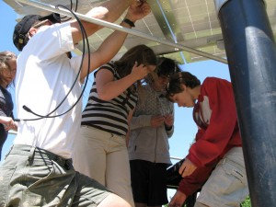
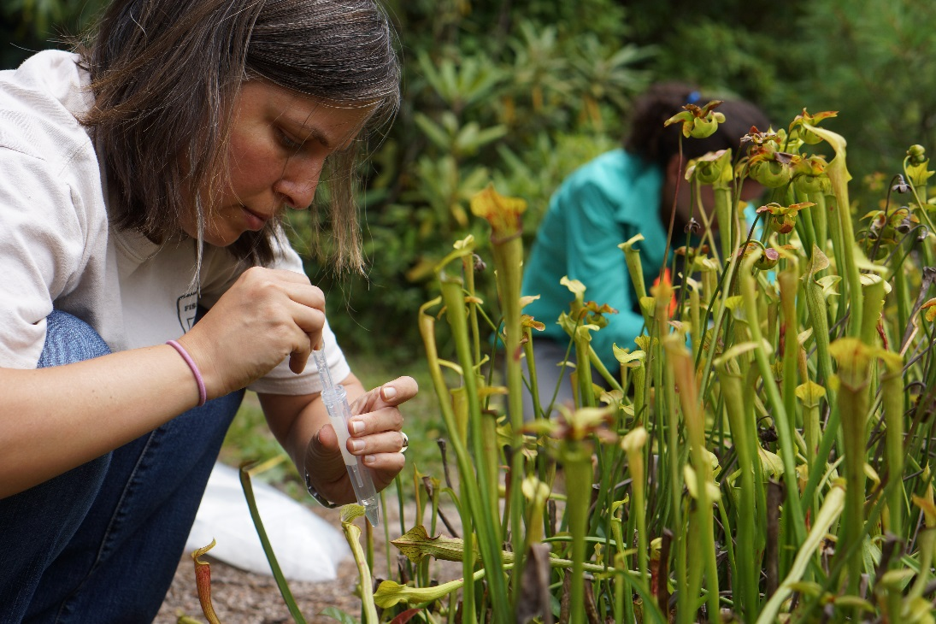
Why teach agriculture?
Teach students about:
Where their food/fiber comes from
Jobs/Careers
Notes:
Careers- nearly 60,000 job openings expected within next five years.

Slide 45
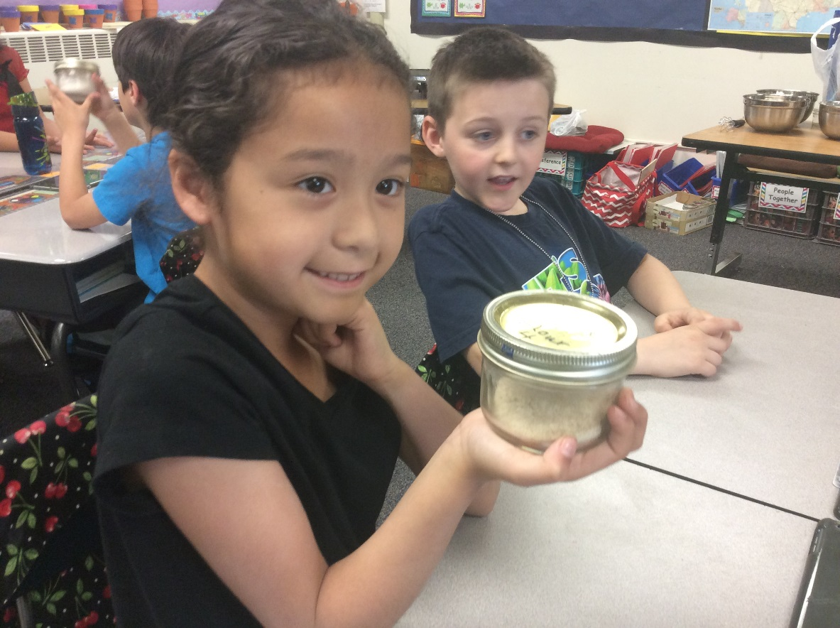
Why teach agriculture?
Teach students about:
Where their food/fiber comes from
Jobs/Careers
Hands-On Learning is fun!

Slide 46
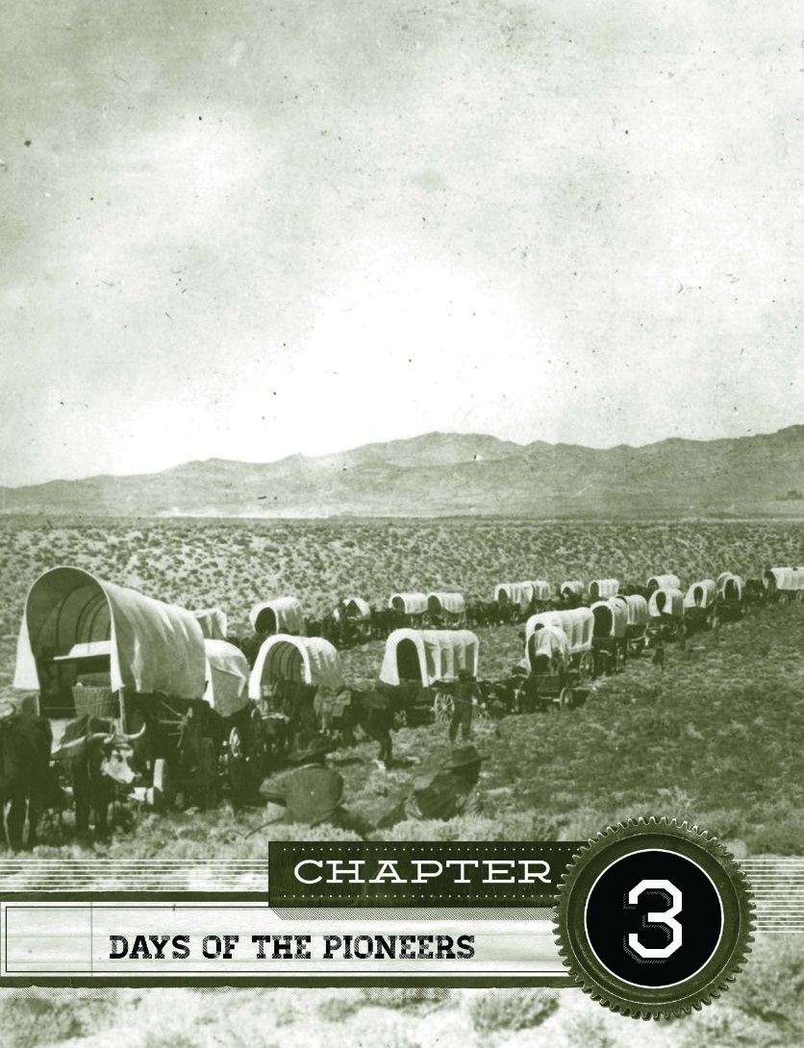
Why teach agriculture?
Teach students about:
Where their food/fiber comes from
Jobs/Careers
Hands-On Learning is fun!
Oregon history and geography

Slide 47
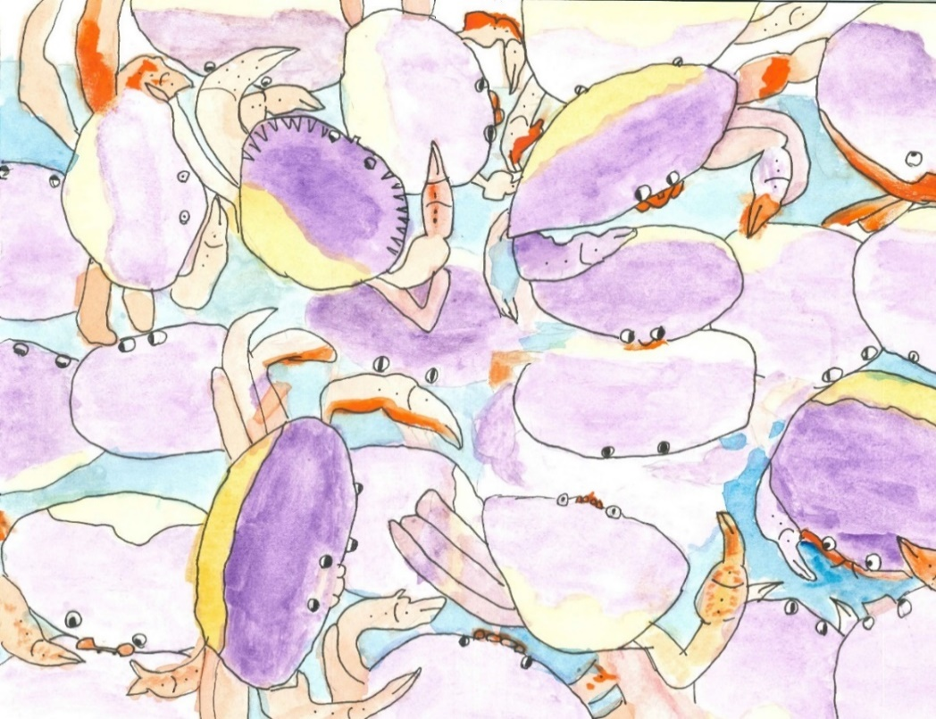
Why teach agriculture?
Teach students about:
Where their food/fiber comes from
Jobs/Careers
Hands-On Learning is fun!
Oregon history and geography
Writing, poetry, art

Slide 48
Why teach agriculture?
Teach students about:
Where their food/fiber comes from
Jobs/Careers
Hands-On Learning is fun!
Oregon history and geography
Writing, poetry, art
Real life application of core subjects

Slide 49
Earth as an Apple

Slide 50
Oregon Agriculture in the Classroom
Mission:
To help students grow in their knowledge of agriculture, the environment, and natural resources for the benefit of Oregonians today and in the future.
Notes:
Oregon AITC is a state branch of a National Ag in the Classroom nonprofit. It was founded in 1981. It was all-volunteer until 1999 when the first staff person was hired. and it’s mission is [read slide].

Slide 51
Oregon Agriculture in the Classroom
100,000+ students annually for the past 8 years; 2016-17 SY 190,931 students
Cross-curricular hands on materials and lessons
K-12, public, private, homeschool, afterschool, extracurricular, in all 36 counties of Oregon.
Supported by agriculture
Aligned to NGSS and CCSS
Notes:
We have updated all of our lessons to NGSS and CCSS and are about to get them online!

Slide 52
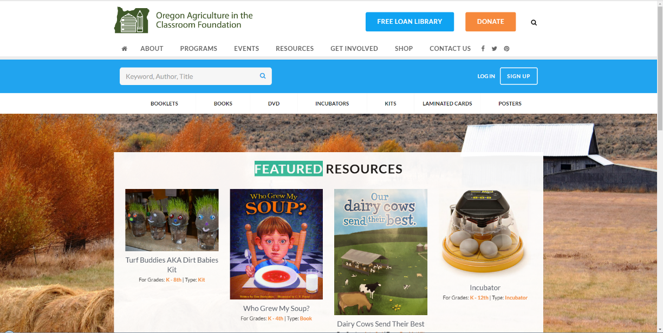
Oregon AITC Programs
Free Loan Library
*These items need returned!
Notes:
This is a unique attribute to Oregon AITC: the Free Loan Library. We have 420+ books, videos, resources for educators to borrow for free in the state. You may create an account, check out resources, and pay for return mailing. 3 weeks is the borrowing time, but you can request longer time.

Slide 53
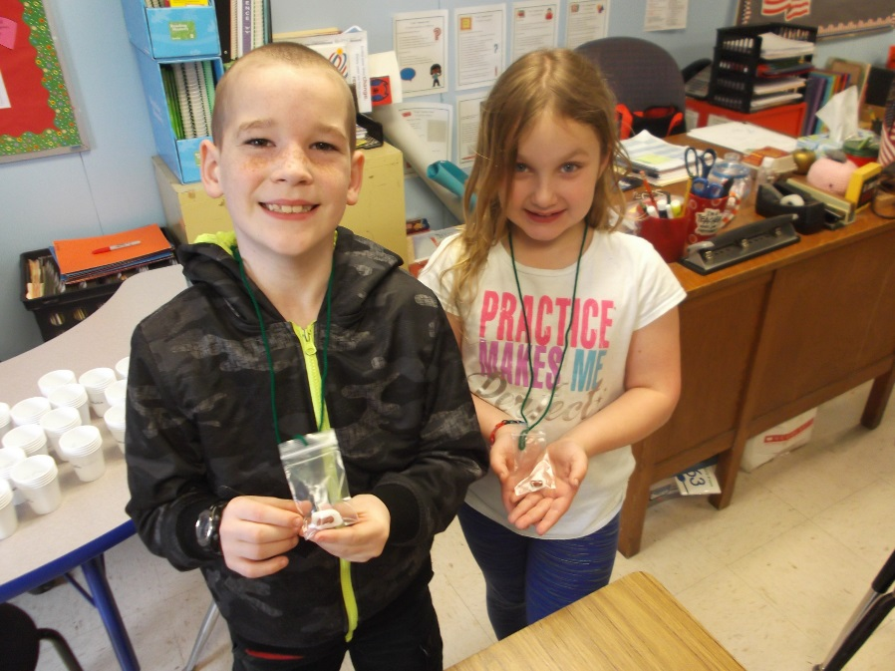
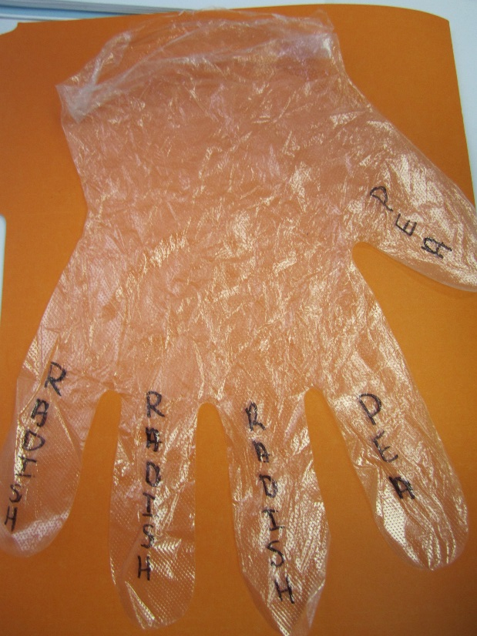
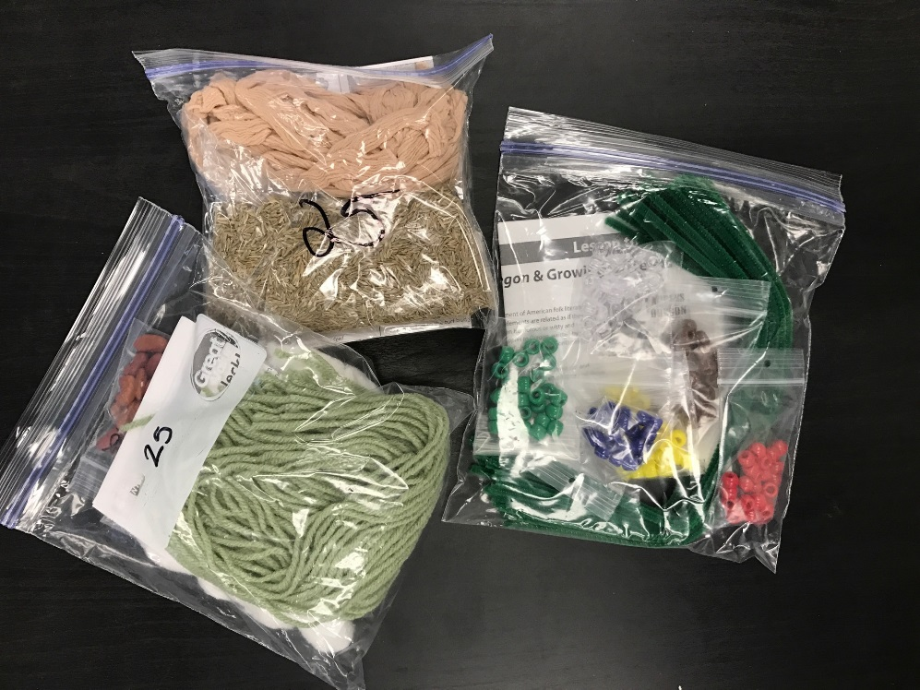
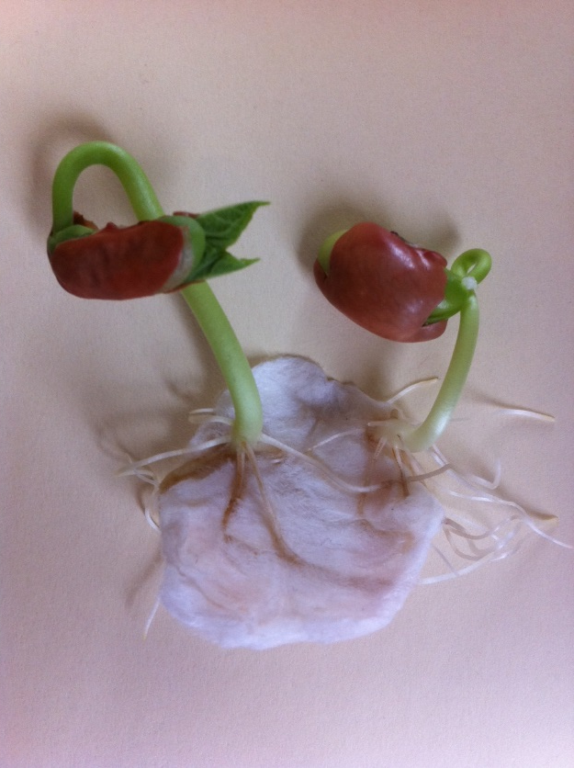
Oregon AITC Programs
Kits
*These items do NOT need returned!
Notes:
Kits are free, helpful materials for lessons. They would not be possible without our volunteers from OSU that help us put them together with their service hours. Living necklaces, cups for Seed Soil Sun, Busy Bees pollinator kit with chalk, etc.

Slide 54
Oregon AITC Programs
Lesson Plans
Downloadable PDF files!
Notes:
For all teachers that are registered on our website, our lessons are easily downloadable and provide grade level, time, materials, and NGSS and CCSS, math, social sciences standards alignment.

Slide 55
Oregon AITC Programs
Agricultural Literacy Project
Notes:
Our Annual Agricultural Literacy Project has been going on for about 10 years. The goals are both to increase awareness of where food comes from, and also improving reading skills. Each year a book is chosen to highlight one aspect of the 6 F’s of Oregon agriculture, and we develop a lesson around it. This years’ is about dairy. Volunteers with some connection to agriculture go into classrooms, read the book, and go through the lesson with students and talk about their role in farming or forestry, etc.
We are always looking for good childrens’ books, so let us know if you have a favorite!

Slide 56
Oregon AITC Programs
Art and Agriculture
Notes:
We want Oregon students to take pride in our state’s agricultural industry. We showcase the beauty and diversity of Oregon Ag with our annual Calendar contest. K-6th graders can submit their colorful art for a chance to win $50 and a place in our statewide calendar. Last year we received 1,754 entries so it is popular.
This year we started a Young Artist contest for 7th – 12th graders for any media including poetry, writing. The deadline is April 14th, but f you know an artist there may still be time to submit!

Slide 57
Oregon AITC Programs
Get Oregonized
Notes:
Get Oregonized is an Oregon history textbook that we have published since 1985 and it is revised every few years. It is now a beautiful book with historical images of our state and incorporates hands-on lessons. There is a teacher and student edition. They are $20 a book but we have a scholarship program – let us know if you are interested in applying.

Slide 58
Try it out!
Step 1: Breakout into small groups
Step 2: Work through the lesson and activity
Step 3: Answer the following questions as a group:
Would you keep the lesson as presented?
Would you change the lesson? If so, how?
Are there any extension activities or related lessons that could branch out from the current activity?
Step 4: Be ready to share with the rest of the group!

Slide 59
Website Tour
www.oregonaitc.org

Slide 60
Social Media
Oregon Agriculture in the Classroom Foundation
@OregonAITC
OregonAITC

Slide 61
Want More?
Summer Agriculture Institute
National Agriculture in the Classroom Conference

Slide 62
Jessica Jansen
Jessica.Jansen@oregonstate.edu
541-737-8629

