Slide 1
Taking Temperatures of Ancient Oceans

Slide 2
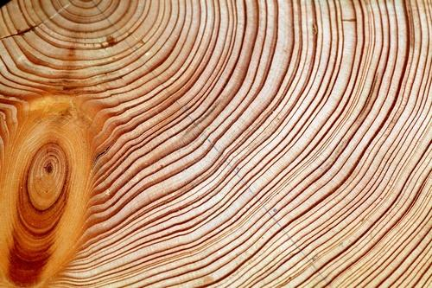
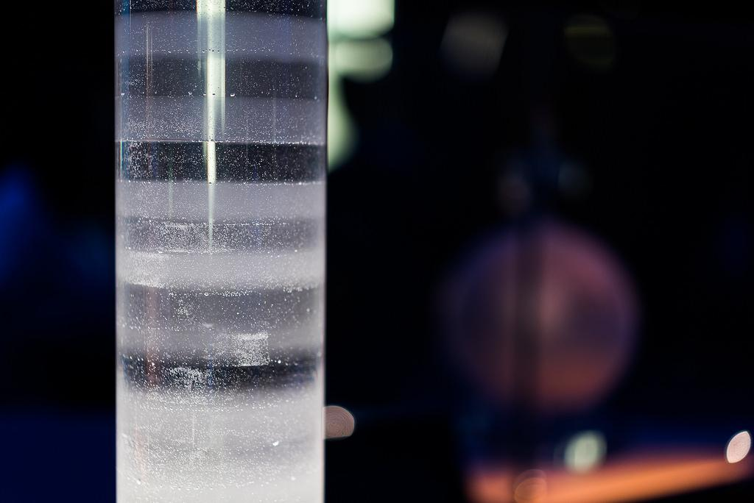
How do we use science to know ancient climates?
Tree Rings (Video Link)
Ice Cores (Video Link)

Slide 3
What about foraminifera (aka. Beasties Video Link)?
Time Scale: Infer ocean tempature from 70 to 100 million years ago to now!

Slide 4
Taking Temperatures of Ancient Oceans
Jennifer Fehrenbacher (Video Link) College of Earth, Ocean, and Atmospheric Sciences

Slide 5
Introduction
Essential and Guiding Questions:
How do scientists use foraminifera to reconstruct ancient ocean temperatures?
What are foraminifera (e.g. forams or beasties)?
How do researchers obtain fossil foraminifera?
Learning Objectives
Use foraminifera to reconstruct Earth’s temperatures over time
Graph foraminifera shell composition over time
Make predictions of temperature based on elements found in forams shells

Slide 6
What are Foraminifera?
“Forams” are single-celled plankton that build sand-grain-sized calcite shells. There are ~ 40 species that live in the open ocean.
Orbulina universa | Globigerinella calida | Neogloboquadrina dutertrei
Habitat: Tropics to sutropics | Habitat: Tropics to sutropics | Habitat: Tropics to sub-polar
Depth range: 0-90 meters (0-200 feet) | Depth range: 40-90 meters (~ 130-200 feet) | Depth range: 30-150 meters (~65-500 feet).

Slide 7
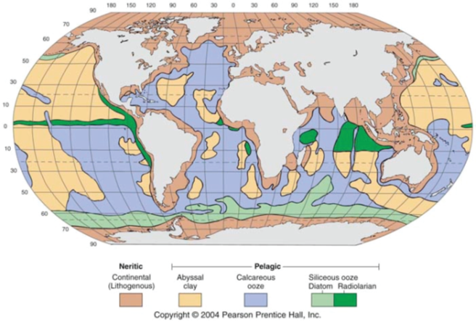
Where do Foraminifera Live?
Planktic forams live in the shallow depths of the oceans, from the surface to ~500 m, though some species can be found much deeper.
When they die, their calcite shells fall to the ocean floor and accumulate in sediments.
Forams are best preserved in the calcareous (calcite rich) regions (purple area on the map)

Slide 8
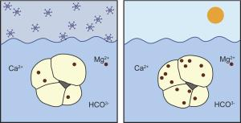
How do Foraminifera Record Temperature?
Their calcite shells are composed primarily of the elements calcium (Ca), carbon (C), and oxygen (O).
Trace amounts of other elements are incorporated into the calcite when they grow.
The amount of the trace element incorporated depends on environmental conditions (e.g. temperature or pH) of the water.
foramsetal.wordpress.com/research/mgca-paleothermometry/

Slide 9
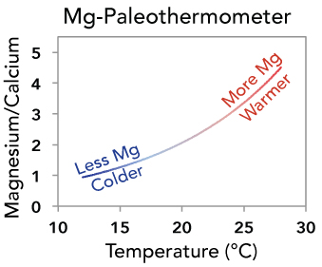
Reconstructing past Temperatures on
Earth is called Paleothermometry
Temperature is recorded in their shells by the amount of the magnesium (Mg) present.
The amount of Mg incorporated into their calcite shell depends on the temperature of the ocean when they grow.
When ocean temperatures are warm, the shells contain more Mg. When ocean temperatures are cold, the shells contain less Mg.
Scientist measure the amount of Mg relative to calcium in fossil foraminifera shells and can estimate the temperature at which they grew.

Slide 10
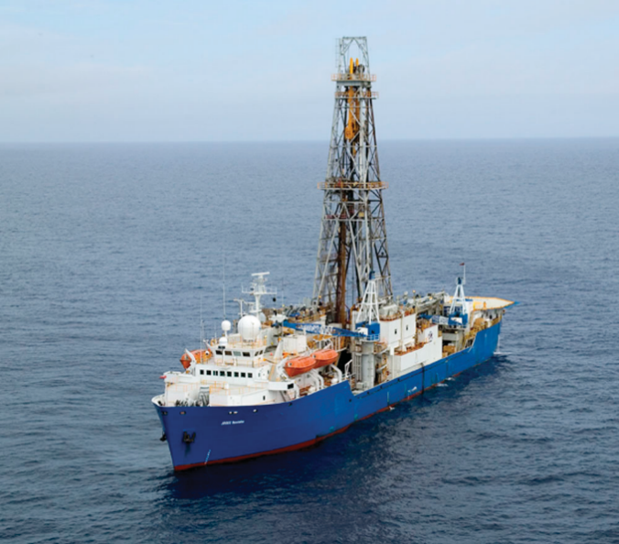
How do Researchers Obtain Fossil Foraminifera?
Seafloor sediments are obtained using scientific drilling ships like the JOIDES Resolution. Several thousand sediment cores have been collected from the ocean floors. The sediment cores range in length from under 1 meter to 10’s of meters.
What is a the core story here? (Video Link)
The JODIES Resolution is a scientific drilling ship operated by the International Ocean Discovery Program

Slide 11
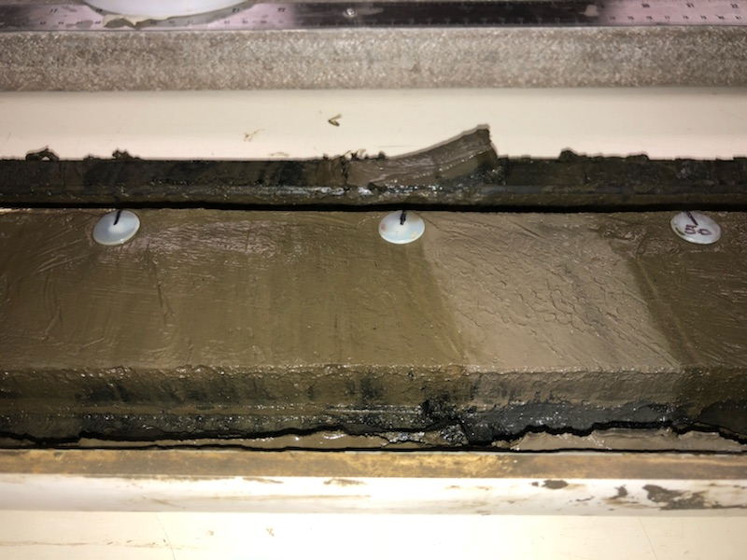
How do Researchers Obtain Fossil Foraminifera?
Sediments including foraminifera, accumulate on the seafloor. Depending on the location, sediment accumulates slowly at rate of ~0.1 to 5 cm every 1000 years.
The corer is attached to the ship using a steel cable. The corer is driven into the sea floor by heavy weights or a hydraulic piston. A hollow steel tube is pushed into the seafloor and fills with sediment. The sediment layers remain intact.
Corer attached to research ships that brings
sediment cores (including Foraminifera) to the surface

Slide 12
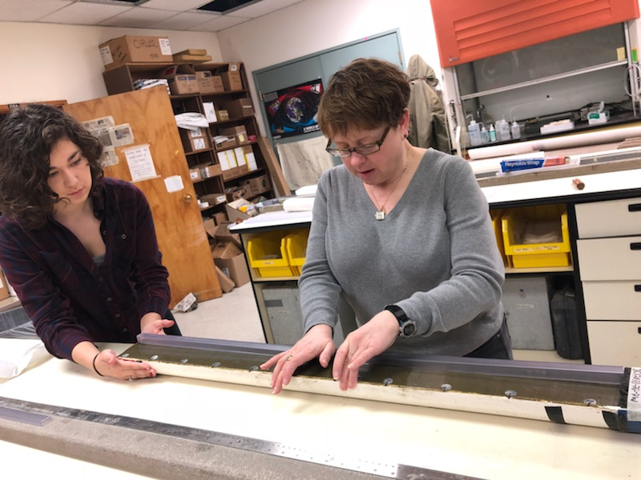
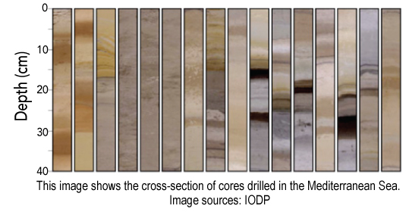
How do Researchers Obtain Fossil Foraminifera?
Sediment cores are processed on the ship and small sediment samples are taken by scientists for later processing and analysis. Forams are obtained after sediment is processed. They are handpicked from the sediment using a thin paint brush.
OSU Scientist Jennifer McKay and undergraduate Grace Meyer sampling a core from the California Coast

Slide 13
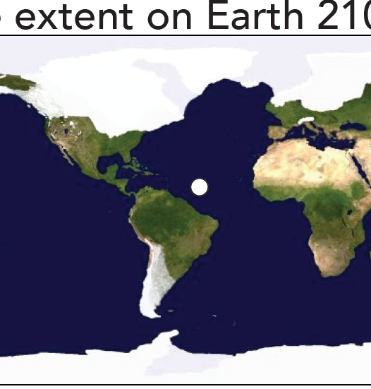
Reconstruction Site: Ice Extent on Earth
Now
21,000 Years Ago

Slide 14
Taking the Temperature of Ancient Oceans

Slide 15
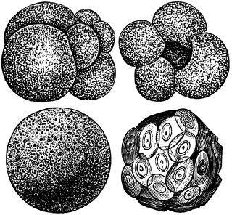
Questions?

Slide 16
Extension/ scaffolding
Instead of representing temperature, the color of the marbles represents the amount of Mg/Ca.
Students can convert the Mg/Ca ratio to temperature using a paleothermometer equation:
Mg/Ca = 0.25 exp (0.10*T°C)
(Note: the exponent value (0.10) shows the students that for every 1 degree °C (1.8 degree F) increase in temperature, the Mg/Ca ratio increases by approximately ~10%

