Slide 1
Food Science lessons
Glen Li
OSU Food Science and Technology

Slide 2
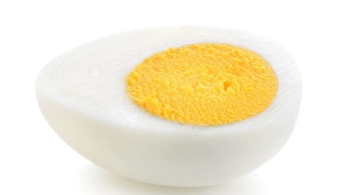
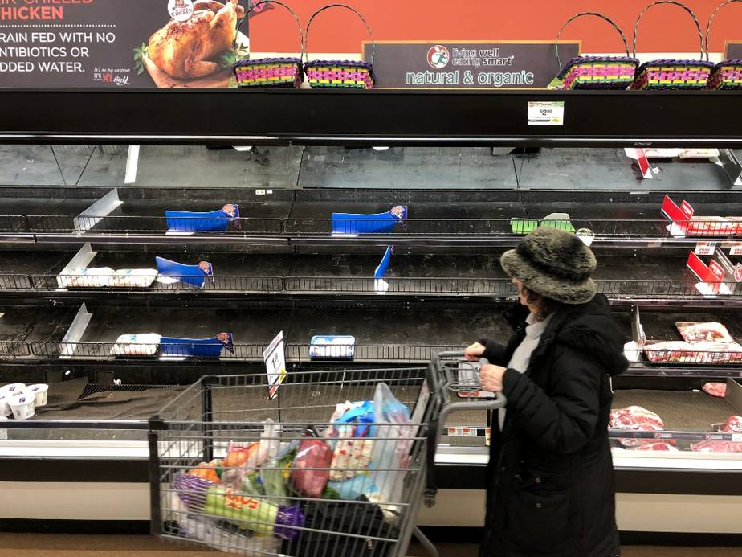
Learning Food Science before college - Unique opportunities
See samonella?
Food safety
Outbreaks, recalls
Nutrition
Healthy diet, healthy eating habits
Malnutrition epidemic
Environment protection
Marketing claims in consumer foods
Formation of regulations and policies
Engaging and fun!

Slide 3
Why teach food science?
Contextualizing science via food science
Chemistry
Biology (and microbiology)
Engineering
Inspiring students to become food scientists and technologists
Those with culinary interest
Foodies
Research in chemistry, human health, etc.

Slide 4
Three food-science themed lessons suitable for remote delivery
1 - Sweet Jell-O's
Examine the sensory properties of sugar substitutes
2 – Quick bread
Experiment with different recipes, and analyze how different recipes affect yeast
3 – Moldy bread
Identify the connection between storage condition and food spoilage

Slide 5
Food Science Schemes and NGSS
Sensory Science
Scale, proportion, and quantity (CCC)
Fermentation and Food Processing
Chemical Reactions
Food Safety and Sanitation
Cause and effect

Slide 6
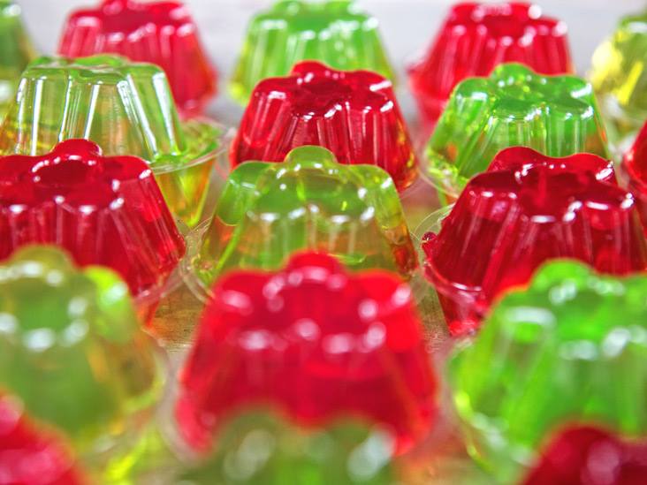
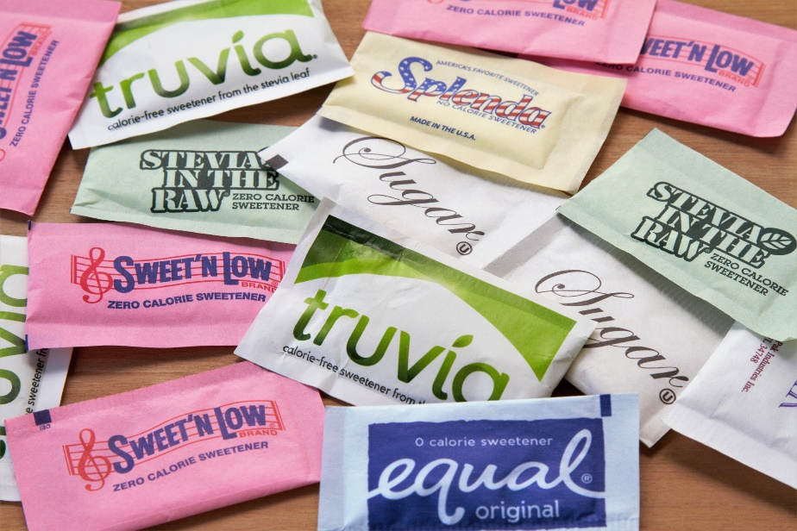
ACTIVITY 1: The SWEETEST JELLO

Slide 7
Sugar substitutes: How Sweet are they?
Sweeter | Sweetness compared to table sugar
Coconut sugar | Same
Fructose | > 1.5
Maple syrup | 0.5
Sweet’n’Low (saccharin) | 300-400
Truvia (erythritol) | 0.6-0.7
Sucralose | 320-1000
Neotame | ~8000

Slide 8
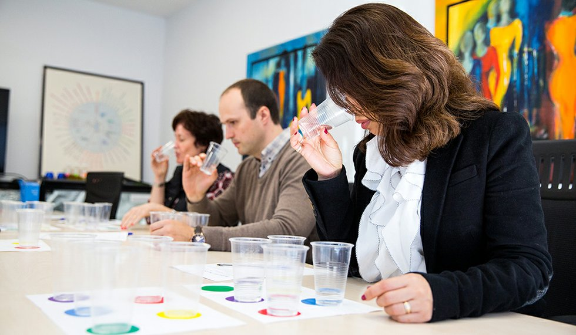
Dimensions of sensory properties
Texture
Mouthfeel
Sweetness
Aftertaste

Slide 9
Possible questions from Your class
More sweetness = less healthy?
Not necessarily
Do sugar substitutes contain sugar?
Dextrose (a.k.a. glucose), dextrin, and maltooligosaccharides are common ingredients

Slide 10
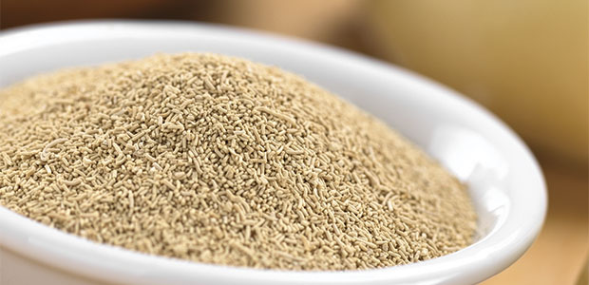
Activity 2: No knead bread, in 10 minutes?
Control group
Cooked yeast
Microwave yeast granule high, 1 min
Hydrated yeast
100 °F water, 5 minutes
Adding table sugar
sucrose
Adding soda beverage (e.g. Sprite)
fructose

Slide 11
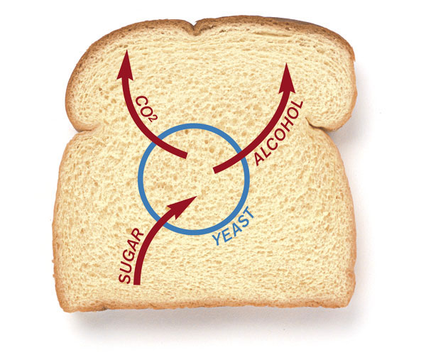
Effect of yeast metabolism on baking
Hydration in warm water
helps yeast adapt to changes in osmotic pressure
Microwave (this would kill the yeast)
Addition of nutrients (fructose, sucrose)
Sugars can be metabolized by yeast as carbon source
Boosts CO₂ generation and leavening

Slide 12
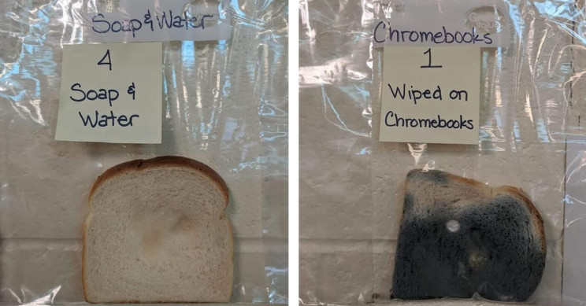
Activity 3: Moldy bread
You may use the leftover bread from Activity 2

Slide 13
Questions to expect from students
Where does the mold come from?
Mold spores are common in our living environment
They grow into mold under favorable conditions
Can I still eat it?
Allergen
Toxins
How can we suppress mold growth?
Antifungal food additives
Food sanitation practices

