Slide 1
Blind Drawing
INSTRUCTIONS
Get into pairs.
One member of the pair has a paper and pencil. This person is the “artist”.
Give the other member of the pair the photo or picture. This person is the “describer”.
Have the two sit back to back. The describer must not let the artist see the photo.
The describer must tell the artist what to draw in order to replicate the picture. But they cannot name objects in the picture. They can only say shapes or descriptive details.
After 3 minutes, have each pair sees the original photo shows the group the drawing.
Notes:
This activity is great for promoting communication skills. While it sounds like an easy task, the one-way communication from the team to their “artist” needs to be precise in order for the “artist” get the drawing right.

Slide 2
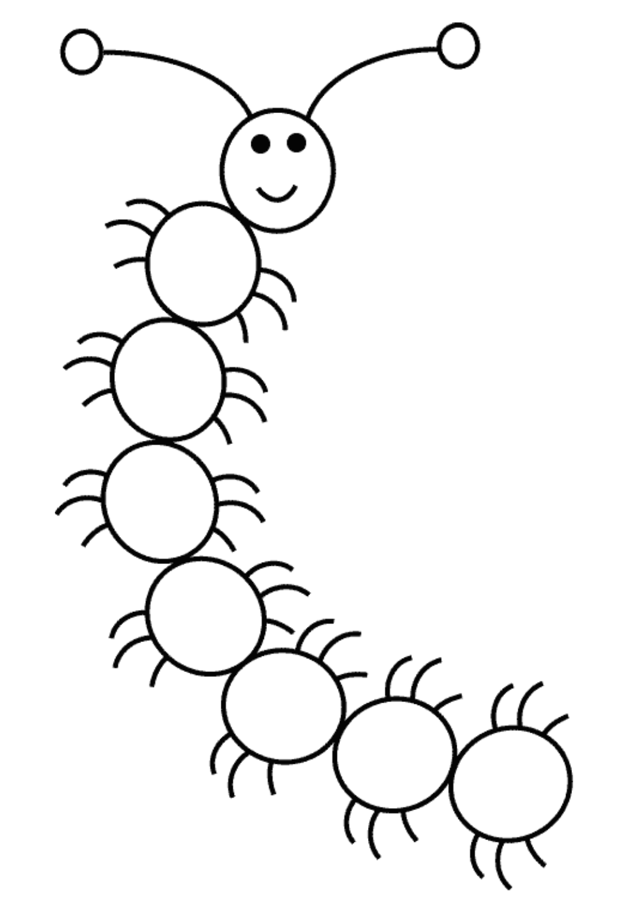

Slide 3
Debrief Questions
How well did the team describe the item to their “artist”?
How well did the “artist” understand the instructions and how close were they to duplicating the actual item?
What problems did you encounter during the challenge?
How well did you communicate during the challenge?
Notes:
It may be useful to run this activity in two rounds; after the first round, the team will realize how important it is to be detailed in their instructions. Challenge the teams to do better in the second round.

