Slide 1
Case Study: Should Dinosaurs be “Cloned” from Ancient DNA?
Adapted from Constance M. Soja and Deborah Huerta’s “Should Dinosaurs be ‘Cloned’ from Ancient DNA?”

Slide 2
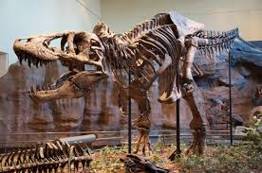
What we know so far...
Dinosaurs were large, lizard-like creatures that lived millions of years ago
They were the dominant life form on Earth for over 100 million years
In the time since dinosaurs lived, many large animals have lived on the Earth in the environments that humans have not inhabited
Any decision about reintroducing dinosaurs onto the Earth will be a landmark decision

Slide 3
Today’s Goal
Research scientific arguments from opposing viewpoints on whether or not to recreate dinosaurs
Engage in a thoughtful debate over those arguments
Come to a final decision about the reintroduction of dinosaurs into the world

Slide 4
What you will need to know
What ethical considerations will need to be made in order to properly clone dinosaurs?
Why is making this type of decision important?
What are the potential dangers and/or benefits of using cloning for this type of animal?

Slide 5
Case Study: Cloning Dinosaurs
You will be engaging in a debate over whether or not to reintroduce dinosaurs into the environment
Role Assignments:
High Court Judges: Responsible for making final decision after hearing from two teams of specialists
Two Teams: One for and one against Cloning
Each team is responsible for presenting specialists who do or not recommend dinosaur cloning
Specialists: Investors, Ethicists, Paleontologists, Geneticists, Veterinarians, and Citizens
“Team Leader”: Head of each team and helps guide discussion and questioning during the debate

Slide 6
Individual Specialist and Team Responsibilities
Each person represents a specialist in a field related to the potential reintroduction of dinosaurs
Use the presented research and any other information found in textbooks or other sources to create an argument
Prepare a one-page, handwritten report in your own words representing your position
“Team Leader”: Create 1 or 2 questions to ask the other team’s leader

Slide 7
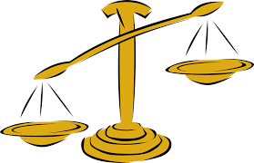
Judges’ Responsibilities
Highly-educated, moral decision makers
Research together both sides of the issue to learn everything possible about the case
Prepare a half-page, handwritten report with your position (for or against) before hearing the debate in class
Have a “Chief Judge” who decides the order of the speakers for each team

Slide 8
Class Responsibilities
Have a lively and educated debate over cloning dinosaurs
Create a final project summarizing the result of the judges’ decision
Examples: courtroom video, music video, poster highlighting key points, etc.

