Slide 1
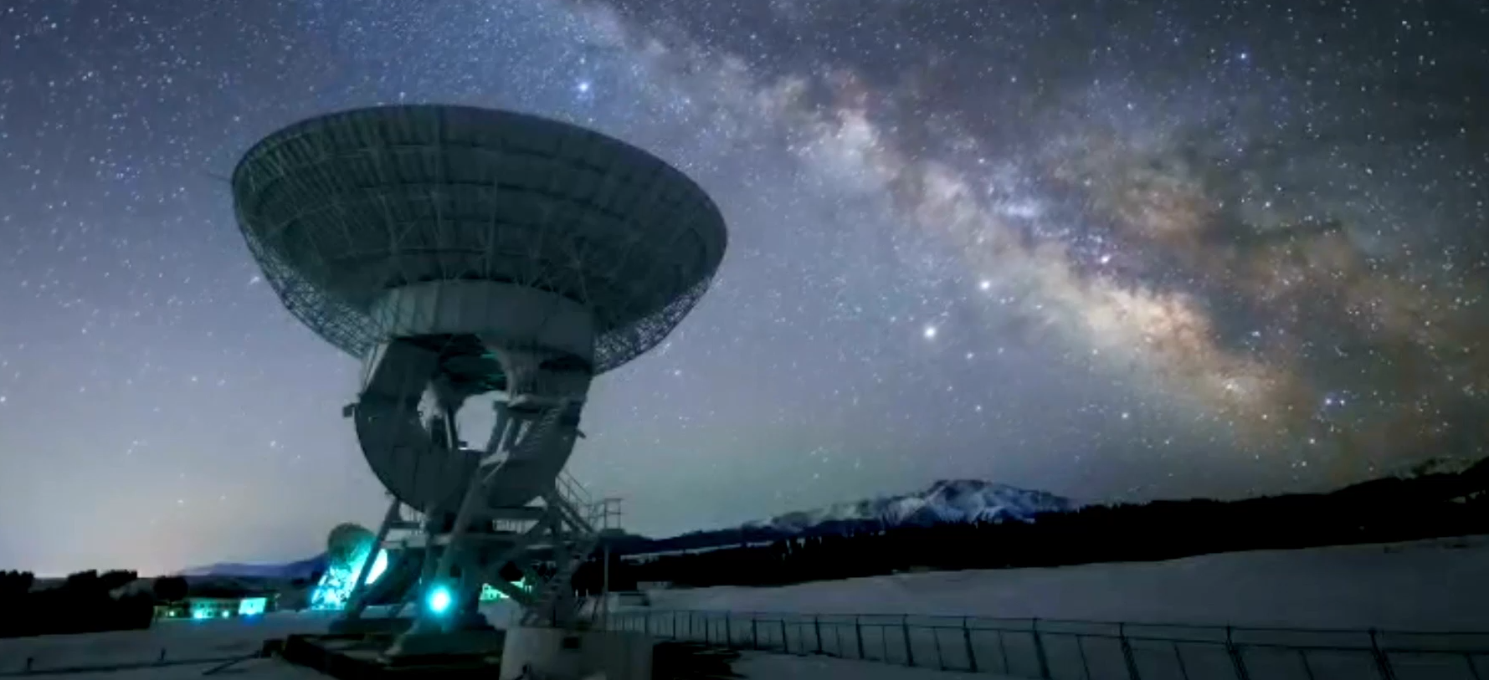
Working with CEOAS Scientists
College of Earth, Ocean, and Atmospheric Sciences

Slide 2
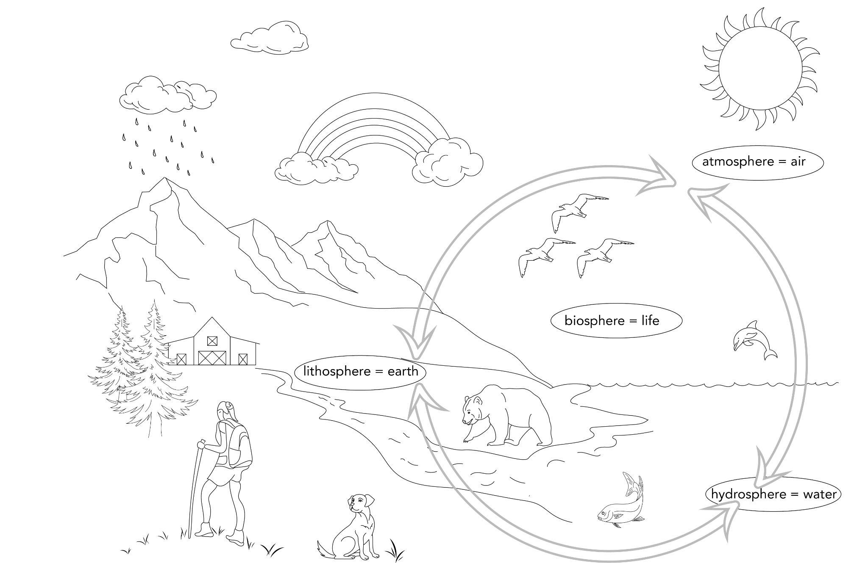

Slide 3
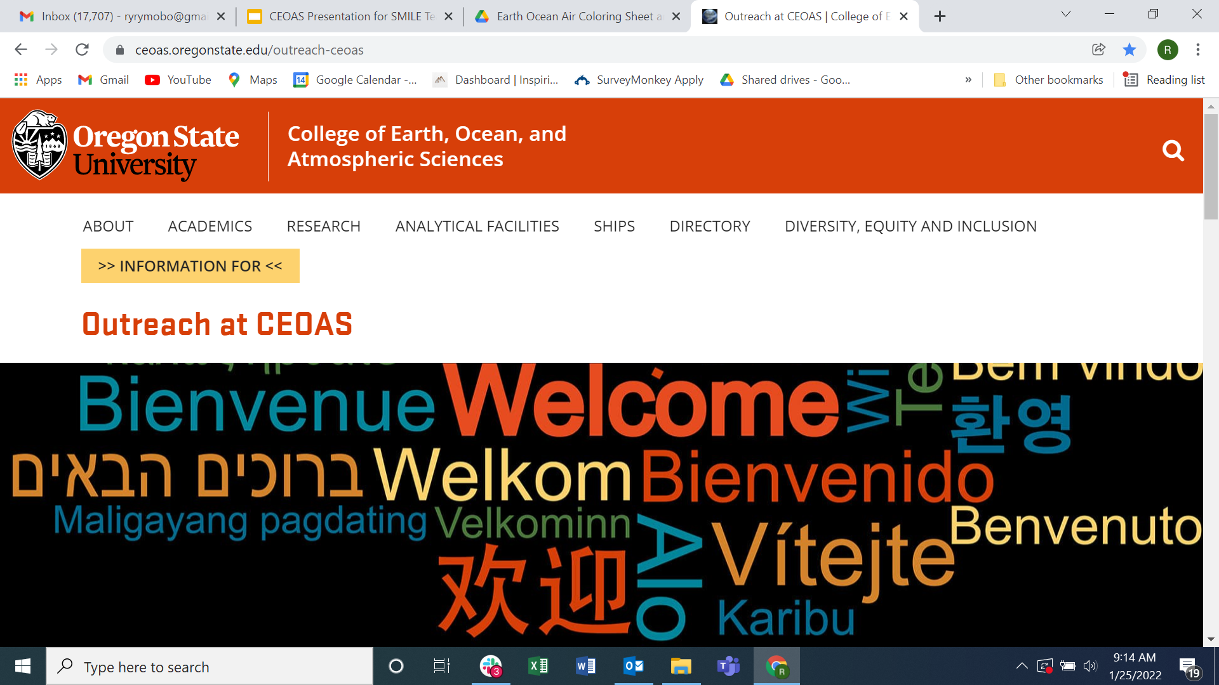
CEOAS Outreach Website

Slide 4
CEOAS & Beaver Hangouts
Partnership with OSU Precollege Programs
Six-week virtual curriculum
Weeks 1-3: College readiness
Weeks 4-5: Paleoclimate investigation of Missoula Floods
Week 6: Student panel
Sessions led by CEOAS students
Spring 2022 (or beyond!)

Slide 5
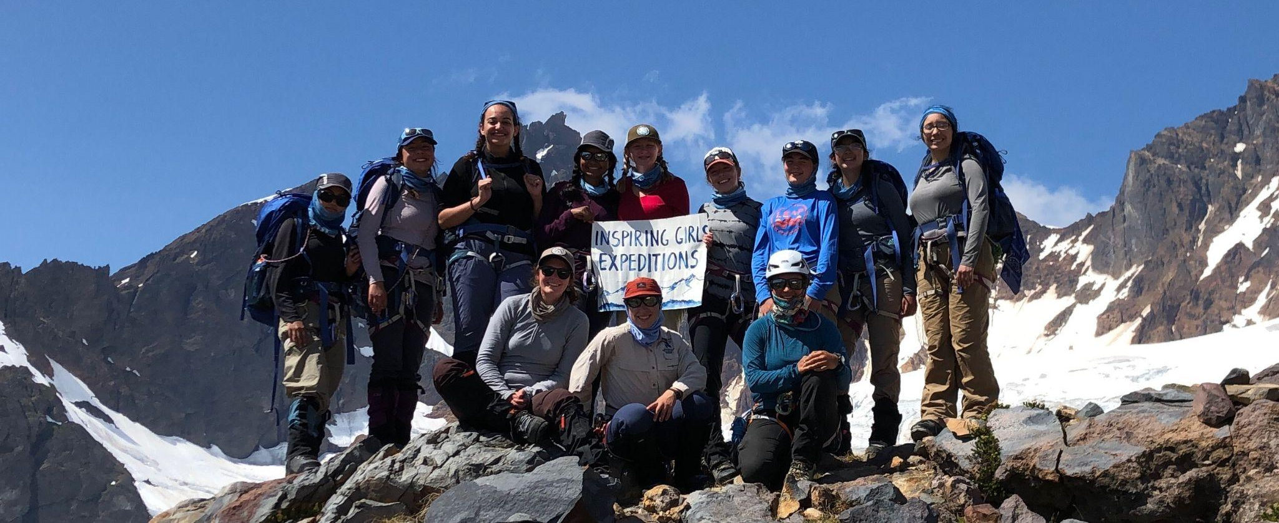
Inspiring Girls Expeditions

Slide 6
More Information!
CEOAS Beaver Hangouts:
email: beaverhangouts@oregonstate.edu
Inspiring Girls Expeditions:
https://www.inspiringgirls.org/
Start applications by Jan 31st!
CEOAS Outreach
https://ceoas.oregonstate.edu/outreach-ceoas
email: ryan.brown@oregonstate.edu

