Slide 1
What forces move water around the globe?
Notes:
Ask students this question.
Write a list of their ideas on a chalkboard or whiteboard. Students will say all kinds of things: wind, storms, currents… perhaps even temperature and salinity.
Return to their ideas, circling or underlining the words on the board, as you discuss those ideas throughout the class.

Slide 2
Wind
Notes:
Probably the students will have mentioned wind. Say that the first force that we’ll talk about today is wind.

Slide 3
Wind
Wind blows across the surface of the ocean
How far down in the water does the wind have an effect?
LET’S SEE….
Notes:
Tell students you’re going to do a demo on how wind affects the movement of water. You’ll answer the first question. Switch to the Wind Demo

Slide 4
Wind?
What forces move the water below the surface?
Notes:
By now you have done the Wind Demo and seen that wind does not move objects that are below the surface of the ocean. Ask students: what forces move water below the surface? Hopefully someone will say “currents.”

Slide 5
Currents
What are currents?
What drives the currents?
Let’s see with the fish tank demo.
Notes:
Ask the students these questions, and listen to their answers. Do not say whether their answers are right or wrong.
Switch to the Temperature Demo.

Slide 6
Currents – Temperature
Cold water – ?
Notes:
Ask students what happened to the cold water in the tank of room-temperature water. Did it sink or float?

Slide 7
Currents – Temperature
Cold water – sinks

Slide 8
Currents – Temperature
Cold water – sinks
Warm water – ?
Notes:
Ask students what happened to the hot/warm water in the tank of room-temperature water. Did it sink or rise?
Once they give an answer, click to the next slide.

Slide 9
Currents – Temperature
Cold water – sinks
Warm water – rises
Notes:
Warm water rose in the tank.

Slide 10
Currents – Temperature
Cold water – sinks
Warm water – rises
WHY?
Notes:
Why did the cold water sink and the warm water rise? Ask the class to do a “Think, Pair, Share” for a minute. They should think about the answer, then turn to their neighbor and and discuss for a minute or two. Then ask for someone to share with the rest of the class what they discussed.

Slide 11
Currents – Temperature
Cold water – sinks
Warm water – rises
DENSITY
Notes:
Someone may respond that the waters of different temperature behave differently because they have different densities.

Slide 12
Density d=m/v
Cold water is dense: the molecules move slowly, and are packed close together. So a set number of molecules take up less space.
→ Cold water sinks.
Warm water is less dense: the molecules move around more and a set number of molecules take up more space.
→ Warm water rises.
Notes:
Density explains the movement of the water. Ask if a student can explain it to the class. The answer is on the slide. Ask if this is something students have learned in their chemistry classes – most students should be aware of how temperature affects the density of water.

Slide 13
Currents
What drives the currents?
TEMPERATURE
Notes:
Temperature is one thing that drives ocean currents.

Slide 14
Currents
What else drives the currents?
Let’s try another demo.
TEMPERATURE
Notes:
What else drives the currents? Ask for some ideas. Someone may say salinity. Click to next slide.

Slide 15
Currents
What drives the currents?
TEMPERATURE
salinity
Notes:
Salinity also drives the currents. Now we’re going to do a demo on salinity.

Slide 16
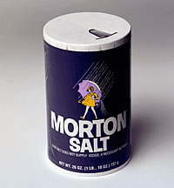
Currents – Salinity
Saltier water – sinks
Fresher water – rises
Notes:
What explains what we observed with the Salinity Demo?

Slide 17
Currents – Salinity
Saltier water – sinks
Fresher water – rises
DENSITY
Notes:
Saltier water sinks, and fresher water rises, because salty water is denser than fresh water. The salt in the water makes it heavier.

Slide 18
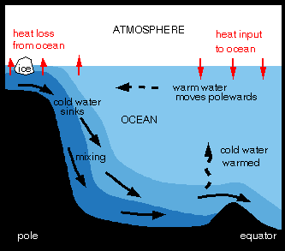
Can ice drive currents?
Notes:
In the ocean, temperature and salinity are very important in driving ocean currents.
At the poles, it is very cold, and ice forms at the surface of the water. The ice is fresh water; the salt is left in the liquid water. This makes the water around the ice really salty, and really cold. It is very dense, so it sinks.
The sinking of salty, cold, dense water at the poles drives ocean circulation. As the water moves throughout the ocean, it gets warmer and rises towards the surface. It moves back towards the poles (for a variety of reasons – currents and wind), where it again gets cold and salty, and it sinks.

Slide 19
Thermohaline Circulation
Notes:
Knowing what we now know about how cold water forms at the poles and sinks, how do you think water moves around the ocean?

Slide 20
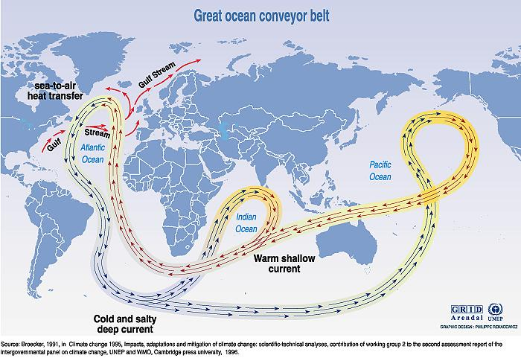
Thermohaline Circulation
Notes:
This is the general pattern of what thermohaline circulation looks like.

Slide 21
Reflection
What did you think about this as a content learning experience?
Notes:
Is this different from how content is presented in your other classes?
What did you think about this as a content learning experience? (pros and cons)
How would you present this kind of content on the museum floor? (how would you give context to the demonstrations?)

