Slide 1

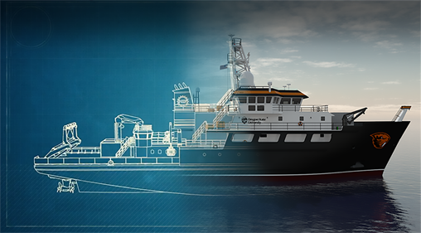
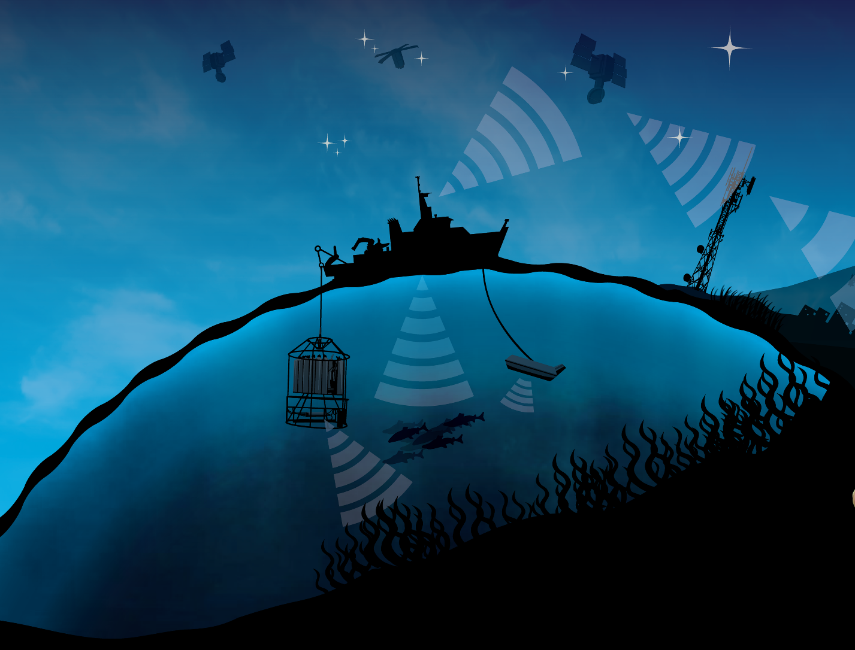

Visualizing Ocean Data
Jane the Glider
RCRV & SMILE
Notes:
Must be in Slide Master mode to swap out photos.

Slide 2
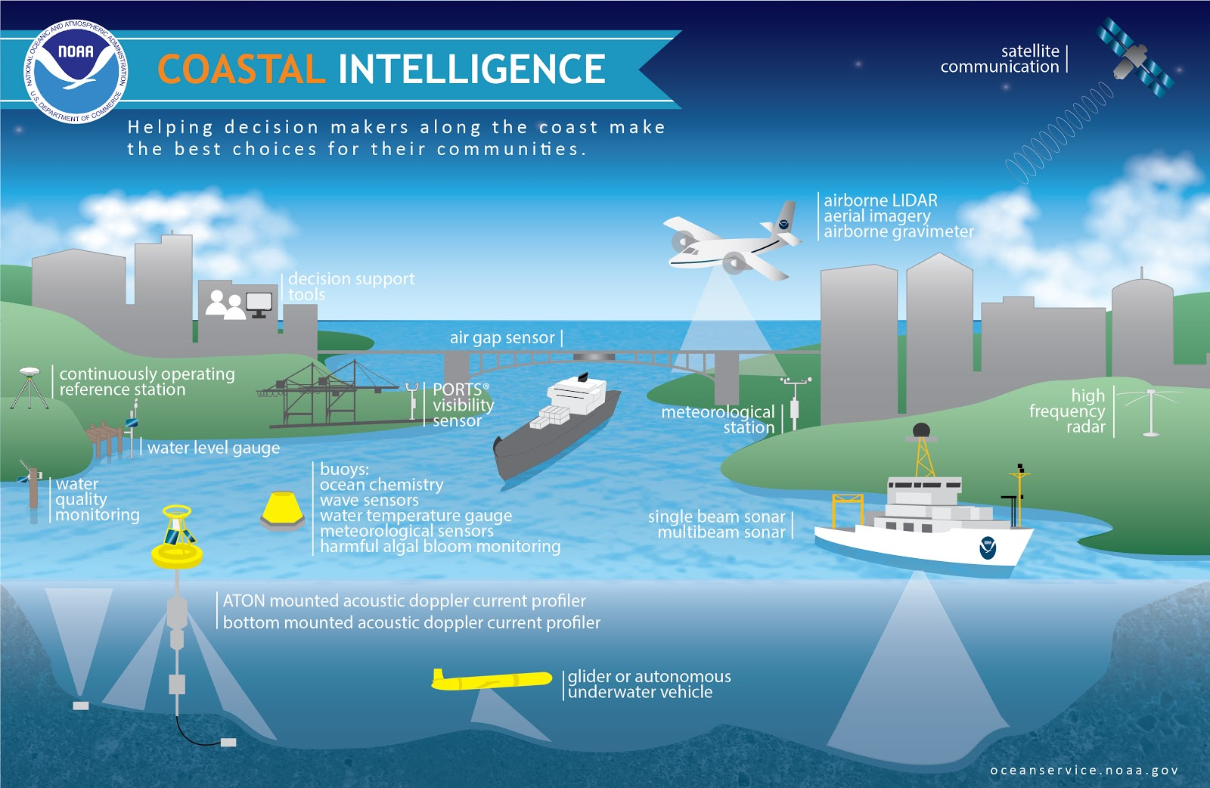
Scientists use a variety of tools to study the ocean and climate

Slide 3
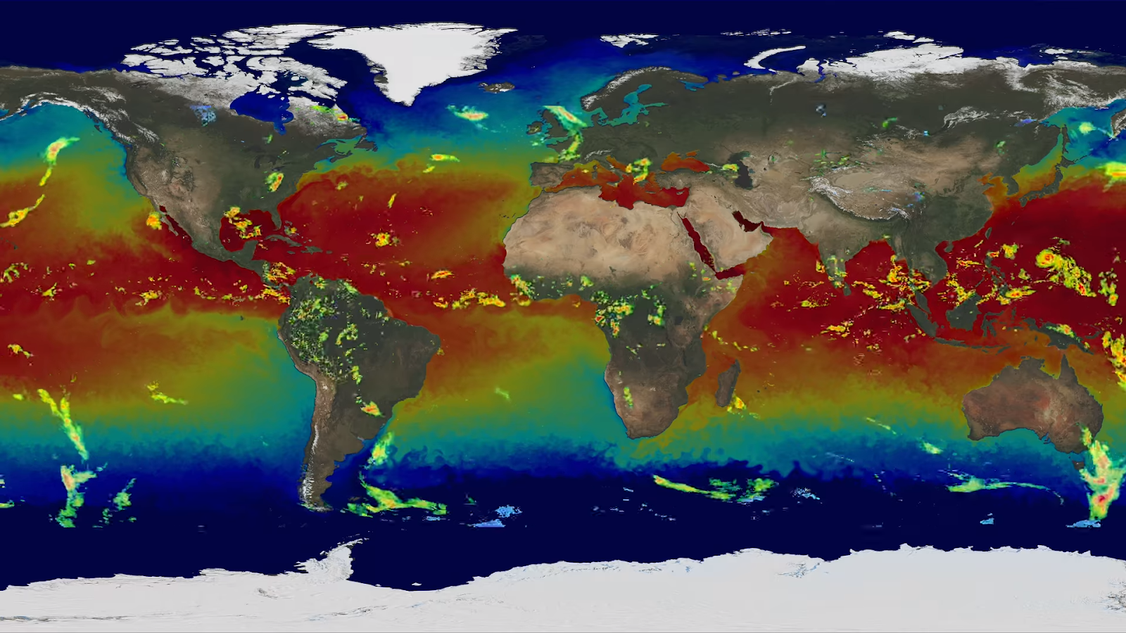
Scientists use the collected data to create models that help us understand the interconnections between land, air, and sea.

Slide 4
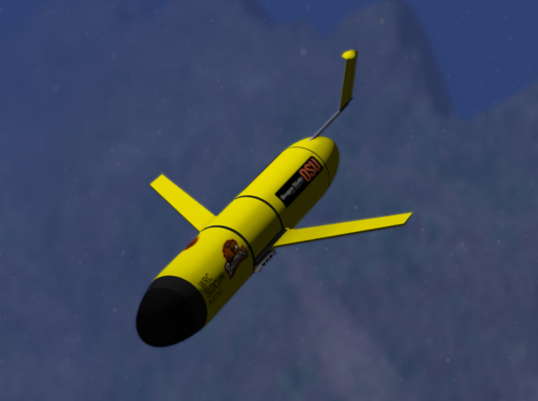
OSU Glider Jane (video)
  Active from 2006-2013
  842.5 days at sea
  60 deployments
  313 trips
  1,200 miles traveled
  Specs
  ½ knots (.6 mph)
  3-4 weeks run time
  7ft long, +100lbs
  Sensors, computers, batteries, communication equipmentz

Slide 5
Saw Tooth Pattern for Data Collection and Data Transmission

Slide 6
Tasks
Using Your Teams Worksheet and Computer
Map the path of OSU Glider Jane
Analyze Changes in Depth over Time
Look at Specific Changes in a Variable as the Glider gets Deeper
  Salinity
  Pressure
  Temperature
  Density
Explore the relationships between dead ocean matter, O2, and Phytoplankton

