Slide 1
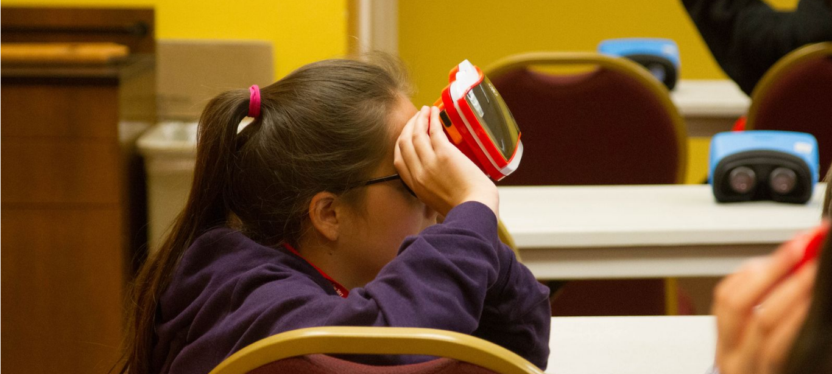
DIVE4Agriculture
Distance, Immersive,Virtual Education
Susan Rowe, OSU Precollege Programs & Maureen Hosty, OSU 4-H Program
Notes:
Add note to this slide

Slide 2
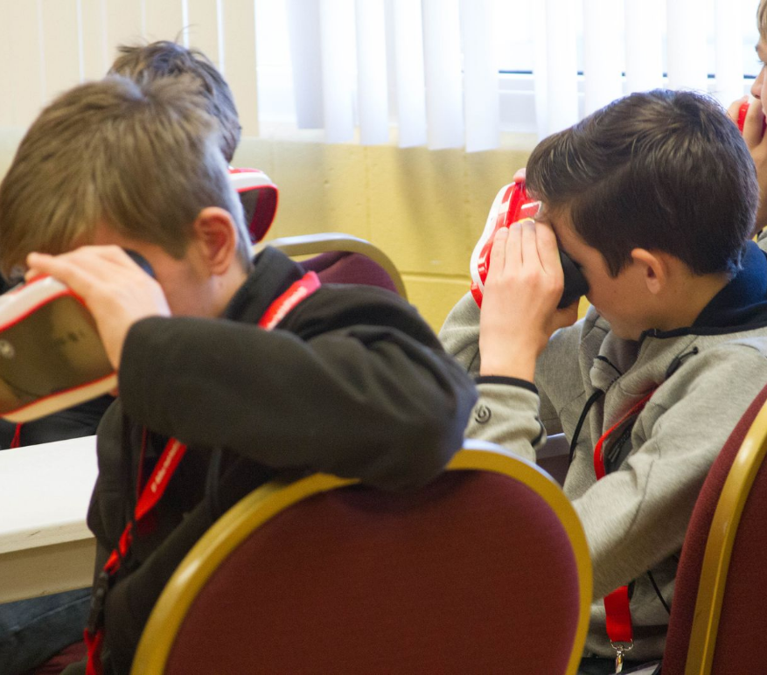
What is Dive4Ag?
1
Notes:
Add note to this slide

Slide 3
In the age of COVID-19, middle- and high-school students in Oregon and Washington will be able to explore agriculture through immersive experiences, including virtual reality, and online activities that they will help create.
Notes:
Add note to this slide

Slide 4
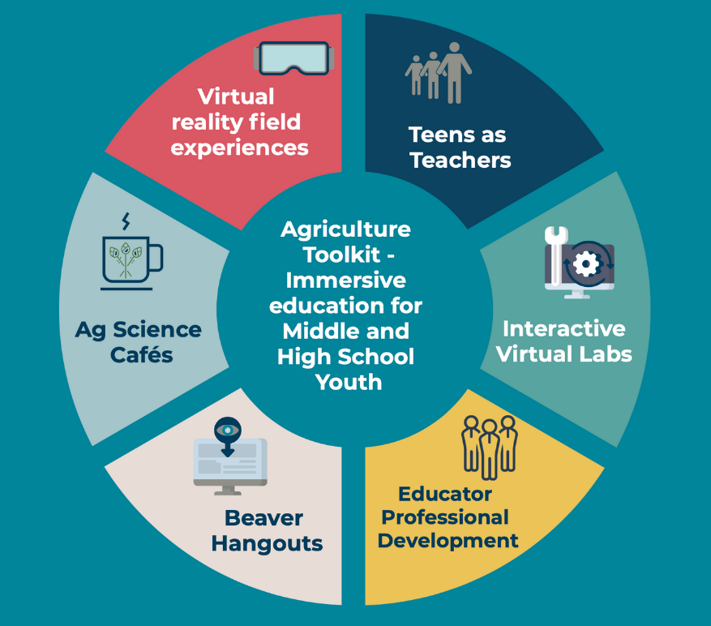
DIVE4Ag Toolkit
2
Notes:
Add note to this slide

Slide 5
Welcome to DIVE4Ag PD Series
This Project is funded by:
Project's core partners:
Notes:
Add note to this slide

Slide 6
Sign up and Commit!
Get a stipend ($1,000)
Participate in PD sessions (Total of 10 sessions)
Help us recruit youth and facilitate their participation
Lead a youth group on a virtual agriculture challenge event (May/June)
Offer feedback for evaluation
Notes:
Add note to this slide

Slide 7
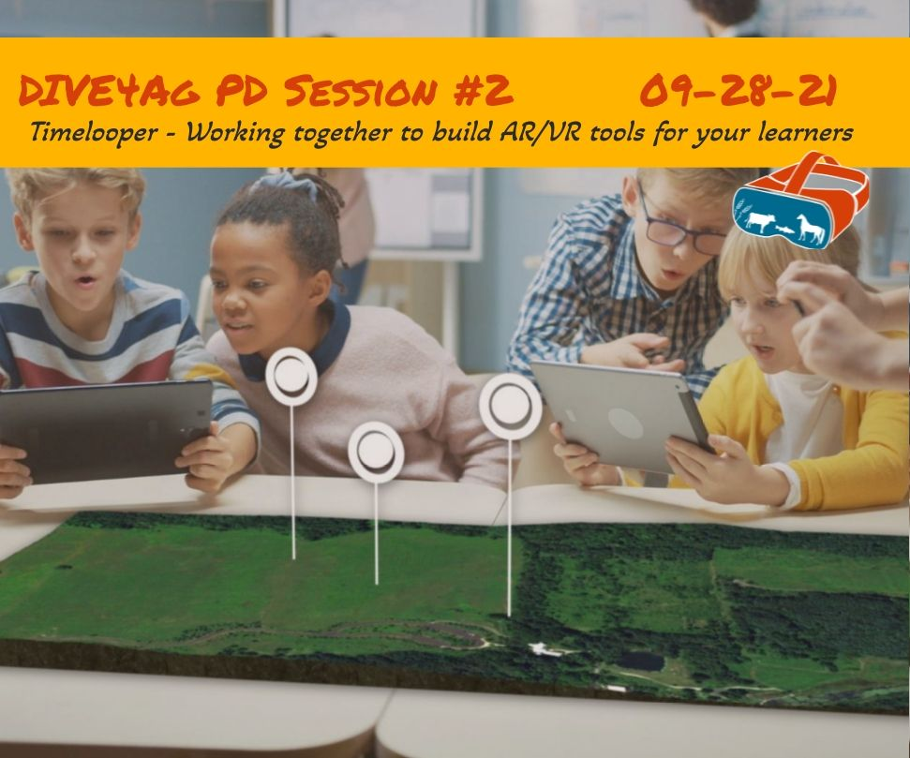
Notes:
Add note to this slide

Slide 8
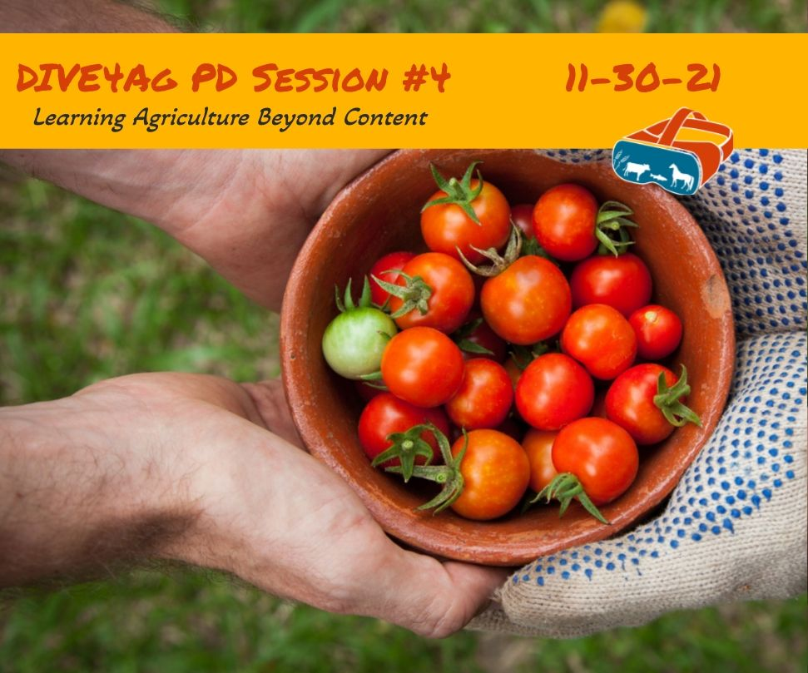
Notes:
Add note to this slide

Slide 9
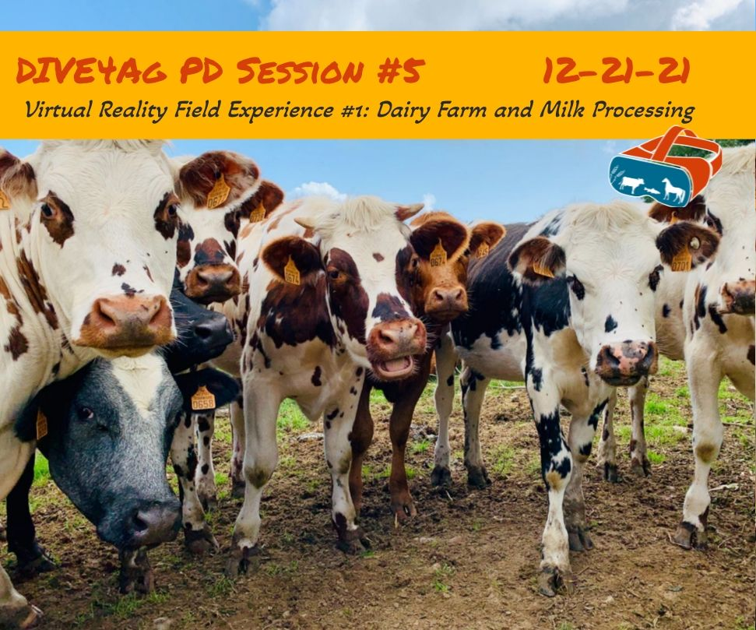
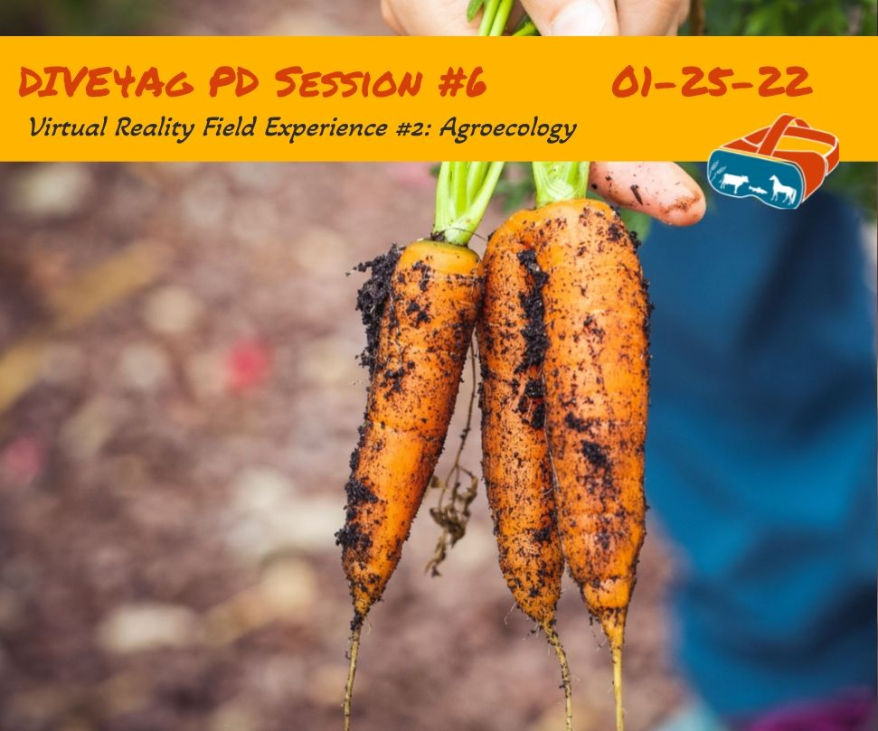
Notes:
Add note to this slide

Slide 10
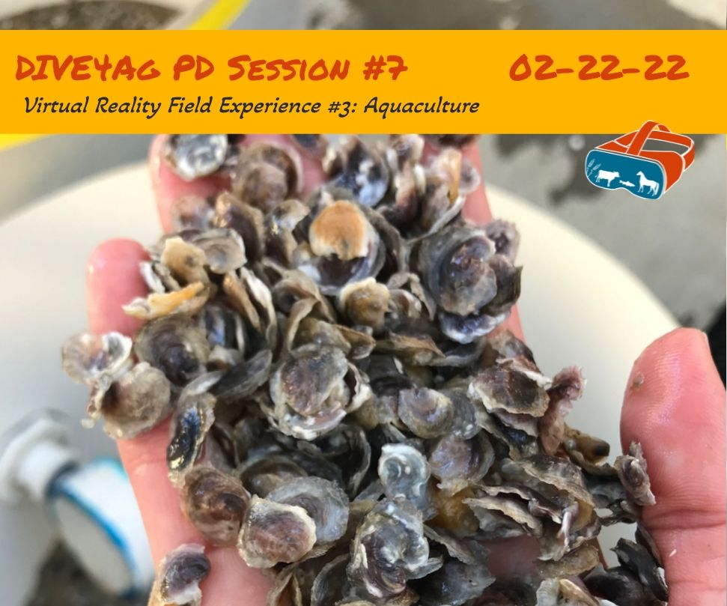
Notes:
Add note to this slide

Slide 11
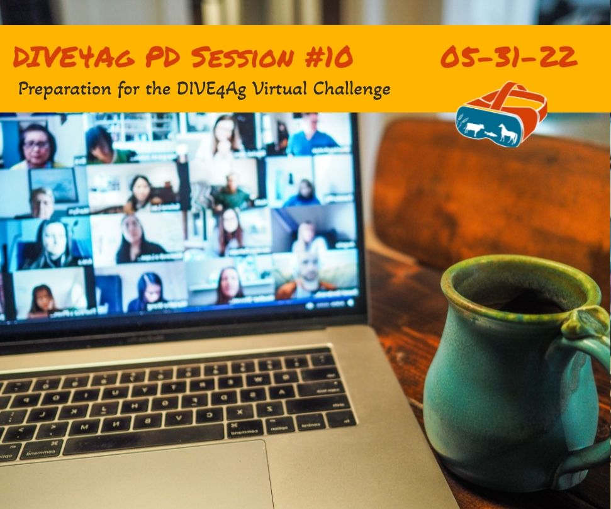
Notes:
Add note to this slide

Slide 12
Notes:
Add note to this slide

Slide 13
Next Steps to Sign Up
Notes:
Add note to this slide

Slide 14
Notes:
Add note to this slide

Slide 15
Notes:
Add note to this slide

Slide 16
Notes:
Add note to this slide

Slide 17
Stay Tuned to our calendar.
Join PD opportunities.
join virtual activities with the youth you teach.
DIVE4Ag.oregonstate.edu
Notes:
Add note to this slide

Slide 18
DIVE4Agriculture
Distance, Immersive,Virtual Education
THANK YOU FOR JOINING US TODAY!
Susan Rowe, Director
Maureen Hosty, Co-Director
Project Coordinators:
Kristen Moore, 4-H
Emily Nicholson, Precollege Programs
DIVE4Ag.oregonstate.edu
DIVE4Ag@oregonstate.edu
https://oregonstate.qualtrics.com/jfe/form/SV_9Y2govDa2zEtZ1s
Notes:
Add note to this slide

