Slide 1
Engineering a Solution to Marine Debris
Oregon State Science Math Investigative Learning Experiences

Slide 2
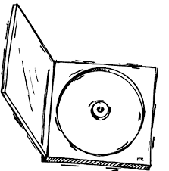
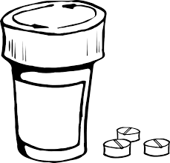
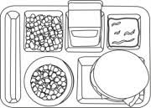
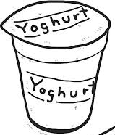
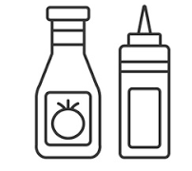
What is Marine Debris?
Marine debris is any man-made, solid material that enters waterways directly through littering od indirectly via rivers, streams, and storm drains.
Marine debris can be simple items such as discarded soda cans, cigarette butts, or a plastic bags that end up in the ocean potentially harming marine life.

Slide 3
The Great Pacific Garbage Patch
Did you know there’s a large patch of garbage floating in the Pacific Ocean?

Slide 4
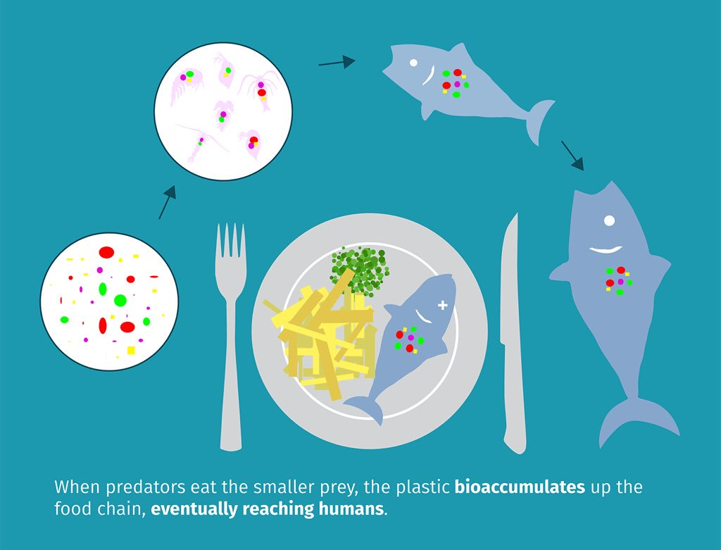
Plastics
There are many types of marine debris, plastic being the worst. There is an estimated 150 million metric tons currently circulating our oceans
Although plastic is a useful product, many plastic items are created for single use- with an estimated 50% of plastic used once thrown away
Currently only 9% of the world’s plastic is recycled
Most plastics are not biodegradable and typically take more than 400 years to degrade
Not only is it harmful to the environment and the oceans, but it is also harmful to wildlife
Ingesting plastic has life threatening effects on wildlife- and eventually ends up being digested by humans

Slide 5
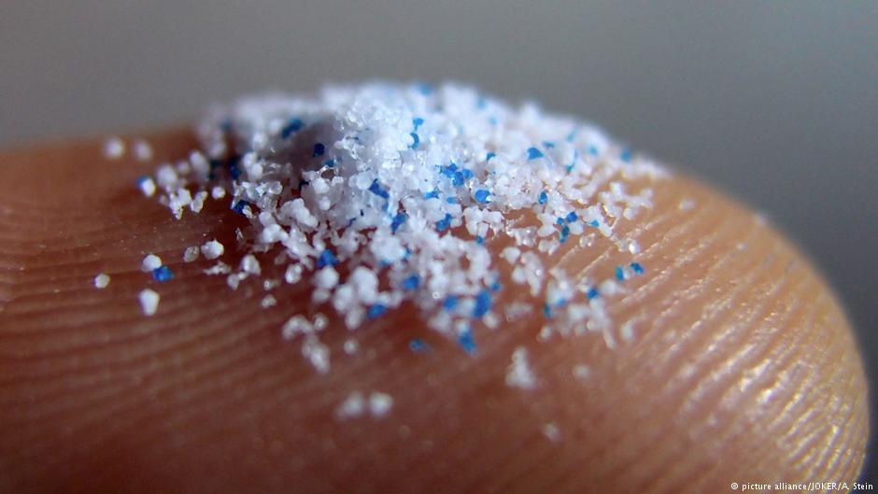
Microplastics
Plastic debris can come in all shapes and sized, but those that are less than five millimeters in length (about the size of a sesame seed) are called microplastics.
Microplastics, are the result of a variety of sources including the degradation of larger plastic already in the oceans, the disposal and breakdown of consumer products, and industrial waste.
Microplastics are even more difficult to filter out of the because of their small size.

Slide 6
Microplastics
Even plankton, an essential creature of the marine food chain, have been found to eat microplastic contaminants
https://youtu.be/2oQeXhURTgY

Slide 7
What is being Done to Clean Up Marine Debris that is Already Present in Our Oceans?
https://youtu.be/nBVL3lp9fGo

Slide 8
What is being Done to Clean Up Marine Debris that is Already Present in Our Oceans?
https://youtu.be/QCozwkSQ7g0

Slide 9
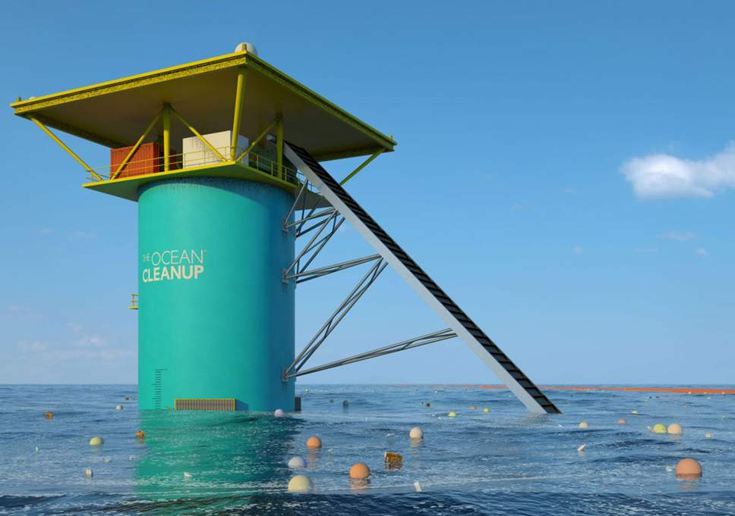
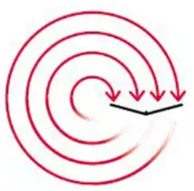
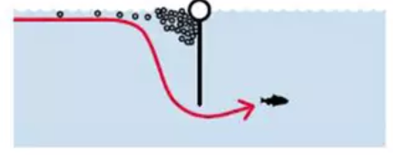
Other Ideas for Engineering a Solution to Marine Debris
An artist’s impression of the Ocean Cleanup project, which aims to remove tons of toxic plastic from the world’s oceans
A v-shaped array of floating barriers, attached to the seabed, will catch plastic deposited there by the natural ocean currents
Underneath the booms, a screen will help gather plastic suspended under the surface. Most of the current will pass under these screens

Slide 10
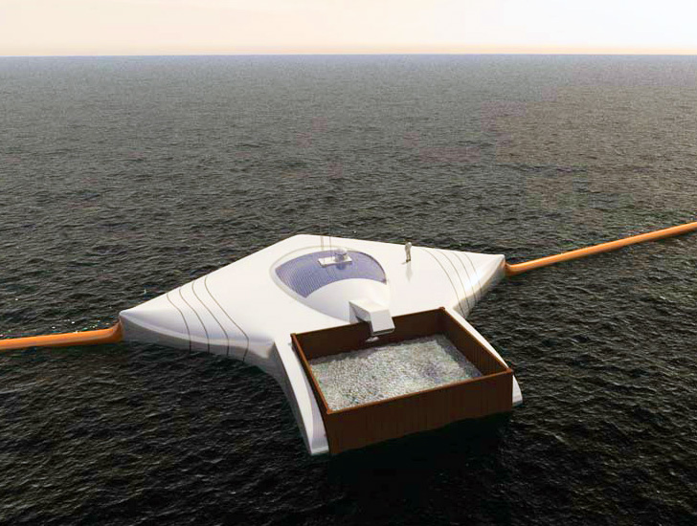
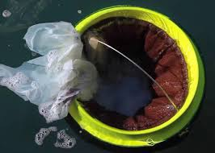
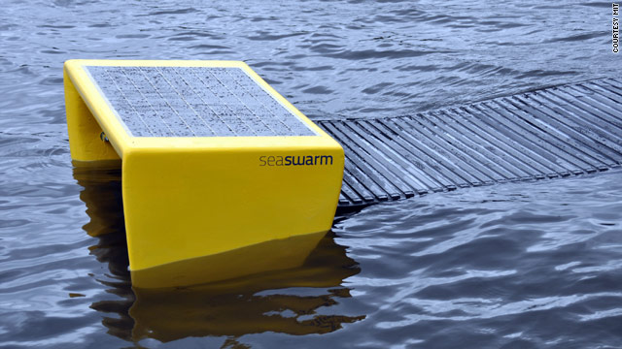
Engineer a Solution
Design your own pollution collector to remove marine debris from the oceans, and beaches, or prevent it from entering the water ways
Devices should not harm or interfere with wildlife
Sketch your ideas and write 2-3 sentences about your design
If you want a challenge, design a device that cleans both plastics AND microplastics!

