Slide 1
From Fossils to Phylogenies
Dane Besser and Baylee Goodwin
In the laboratory of Stephen Ramsey
Notes:
B: Hello all, welcome to our presentation for our project “From Fossils to Phylogenetics”
D

Slide 2
Who are we?
Professor Stephen Ramsey
Ph.D. from University of Maryland, faculty in Biomedical Sciences.
Baylee Goodwin
Undergraduate at OSU studying Zoology; career goal is to work in wildlife conservation.
Dane Besser
Undergraduate at OSU studying Biology with a focus in Genetics; career goal is to become a genetic counselor.
Notes:
B: Our professor who oversees all the work we have done on this project is Professor Stephen Ramsey. He has a PHD from University of Maryland and his focus is in Bioinformatics. My name is Baylee Goodwin, I am about to start my senior year here at OSU and I am a Zoology major. Once I finish my education, I plan to dedicate my life to wildlife conservation work. I actually came from a very tiny high school in Lake Tahoe, California where science wasn’t a big focus. We didn’t have many AP classes, definitely no science clubs, and no interesting science electives. Nonetheless, I still fell in love with the subject and I am extremely glad to have the opportunity to create these interesting activities for students who do have the ability to join science clubs.
D: My name is Dane Besser, I am going into my junior year at OSU. I am a genetics major and my career goal is to be a Genetic Counselor.

Slide 3
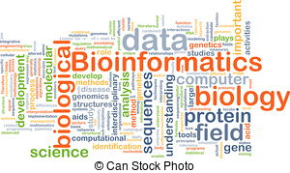
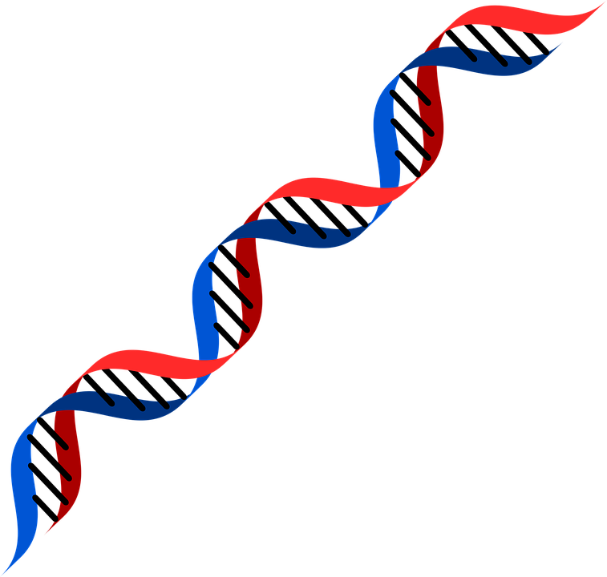
What is Bioinformatics? Why is it important?
Bioinformatics is a field of science that blends biology, computer science, statistics, and mathematics in the systematic analysis of biological data and information. Two example tools:
BLAST- Basic Local Alignment Search Tool
MAB (Methods and Algorithms in Bioinformatics) Phylogenetic Analysis
Notes:
B: *Read definition on slide of bioinformatics* Using bioinformatics tools, entire genomes can be quickly compared to detect genetic similarities and differences.
D: An extremely powerful and versatile bioinformatics tool is the Basic Local Alignment Search Tool (BLAST). Using BLAST, you can input a DNA or amino acid sequence and search entire genomic libraries for identical or similar known sequences. BLAST is the focus of the third activity, the students will use it to search an amino acid sequence in an online genomic library in order to learn how computers can take their biological data and compare it to all other protein sequences in the library.
B: MAB- Methods and Algorithms in Bioinformatics, is a bioinformatic program used specifically to align DNA/Amino acid sequences. Once it aligns them it uses algorithms to determine where species diverged and evolved from one another, which is how it can then generate phylogenetic trees.

Slide 4
Our Project: From Fossils to Phylogenies
Unifying Theme: Dinosaurs
Case Study Activity- A case study on the ethics of cloning dinosaurs. This gives the students the ability to discuss and debate the ethics of scientific endeavors.
Mass Spectrometry Activity- Using analytical chemistry methods to analyze protein fragments from the fossil of a T-rex.
BLAST Activity- Using BLAST to determine which extant animal the T-rex is most closely related to.
Phylogenetic Tree Activity- Using MAB Phylogeny Analysis to generate a phylogenetic tree placing extinct animals, like the T-rex and Mastodon, among extant animals.
Notes:
B: Our project includes four separate activities that follow a central theme: Dinosaurs. The students are paleontologists being called into Jurassic Park to extract genetic material from the fossil of a T-rex. They will then use bioinformatics tools to analyze the genetic material in order to determine evolutionary relationships between extinct and extant taxa. Below are the topics each activity focuses on:
The actual order of our project is Ethics Case Study, Mass Spectrometry, BLAST, and MAB. However, for this presentation we thought it would be best to present Mass Spec, BLAST, MAB and then the case study. This way allows you to see how the three activities are related, and then you will get general overview of the case study that is meant to get the students discussing applications of science with each other.
D: Can we have you all get into groups of four? We are going to run through our activities and have you try them out. Each group will need at least one laptop.

Slide 5
What we will provide
With each activity, you will have:
A student edition
A teacher edition
A powerpoint to explain how to complete the activity
Supplementary materials with further research and citations
Notes:
B:
D: For each activity there will be one powerpoint for both the teachers and students, a PDF for the students that walks them through the background materials, a video screen capture/PDF for the teachers to give them the answers to any questions the students might have, a document with supplementary materials if the students want to learn more, and a bibliography.

Slide 6
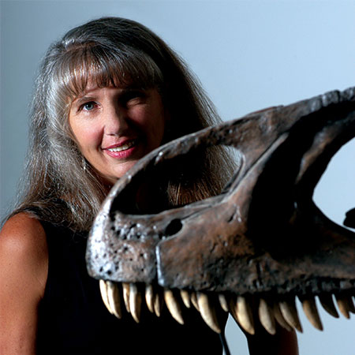
Our Inspiration: Dr. Mary Schweitzer
Our team used her articles to examine the science behind dinosaurs, bioinformatics, and phylogenetics:
“Protein Sequences from Mastodon and Tyrannosaurus Rex Revealed by Mass Spectrometry”
“Molecular Phylogenetics of Mastodon and Tyrannosaurus Rex”
“Biomolecular Characterization and Protein Sequences of the Campanian Hadrosaur B. Canadensis”
Dr. Schweitzer’s research is the basis for our curriculum; however, we have slightly modified the material in order to fit the age group for these activities.
Notes:
B: What makes these activities unique are that the methods and results the students will work with come directly from a real scientific study conducted by paleontologist Mary Schweitzer in 2007. During the activities, the students will be “working alongside” Mary in Jurassic Park in order to extract, identify, and analyze the biological material of an animal who has been extinct for roughly 65 million years.
D

Slide 7
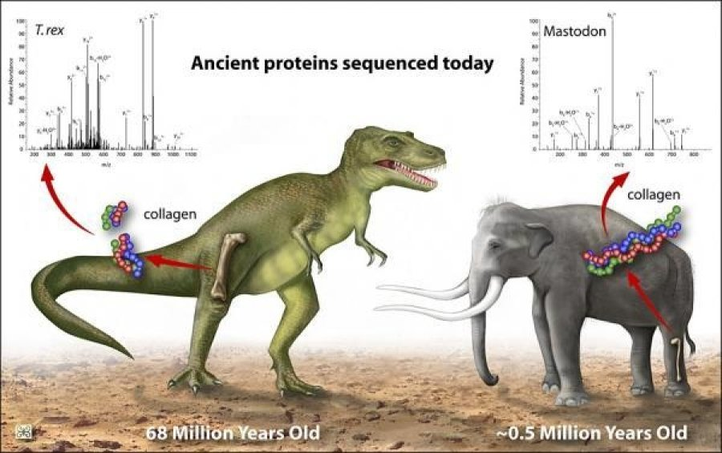
Notes:
D:Mary Schweitzer and her fellow colleagues are the research team who extracted and identified a collagen peptide from the femur bone of a T-rex fossil found in Montana. This picture shows the bone of a T. rex, the collagen protein they identified, and the spectra of the collagen protein (the results of the sample going through a Mass Spectrometer) which you will learn more about next.
B:

Slide 8
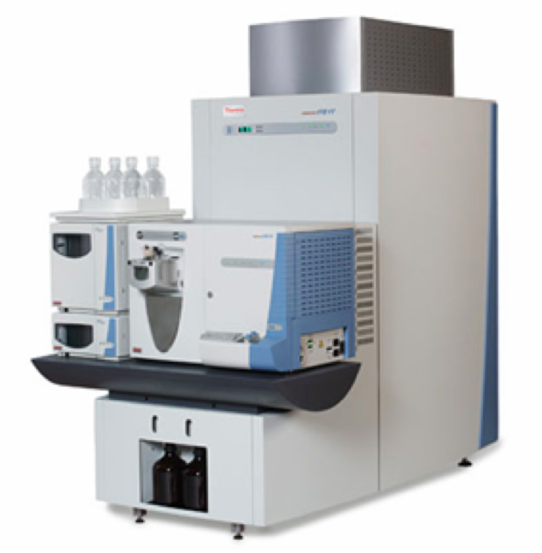
Mass Spectrometry Activity
In this activity, students will learn how to use analytical chemistry tools (Mass Spectrometry) to extract biological material from a fossil, and how to interpret the results. They will also learn the basics of cellular biology in order to understand how and why bioinformatic tools are necessary in science.
Describe what protein mass spectrometry is
Read and analyze protein mass spectra
Describe a biological application of identifying and sequencing proteins from sample of unknown composition
On your laptops, please open the document titled “Mass Spectrometry Activity- Student Edition” and we will go through the activity with you.
Notes:
(we made the learning objectives broad, that way you can find where to fit them into existing curriculum)
B: In the Mass Spectrometry activity, the students are Paleontologists being called into Jurassic Park to assist Dr. Schweitzer in extracting biological material from the fossil of a T. rex. The main activity focuses on interpreting the results from the mass spectrometer. First, the students will be provided with information to help them learn how chemistry and biology overlap, as well as how evolutionary relationships among animals can be determined using chemistry tools to analyze biomolecules (DNA or Amino acids). The chemistry tool they will “use” is the Mass Spectrometer. It can take very small samples of substances, in this case the substance is a small section of the T. rex femur bone, and it will tell you what the molecular composition of your sample is on a spectra. The students will be responsible for creating that spectra using Legos, and then match it to an already known protein.
The purpose of this activity is to introduce the application side of chemistry. In their classrooms, they will be taught what molecules are, how they react, how to balance chemical equations, and so on. However, this activity focuses on a very important application of how chemistry can be utilized in the real world. I specifically did not focus on how the machine itself ionizes molecules or how it changes the structure of an atom, because I did not want to teach them more tedious chemistry. I want the students to understand how chemistry was applied and used in scientific studies. They will learn how chemistry is used to identify important aspects of biology. Which can be used in research, medicine, and many more fields as time goes on and it continues to grow.
*switch over to activity 2’s powerpoint, go over the basics of the purpose of the PP and what they can find in it(don’t go through every slide in detail, they can do that on their own time).*
I have created a powerpoint for you as teachers to present to your students in order to introduce the main topics they will be learning during the activity. The powerpoints are meant to provide visual aids on each subject for those students who learn better visually rather than auditory. The material from the powerpoints will be repeated in the PDF’s in order to help the students learn the material.
* Then switch over to activity 2’s PDF for the students, walk the teachers through the activity using Legos. (Let them read the PDF background on their own time, have them start at the procedure)*
If you could all open “PDF for students- Activity 2” and we will walk you through the activity.
This is what the students will be provided with. As far as the teacher's material goes, we have a version of the students PDF that has footnotes from us on areas that could be confusing, as well as the answers to any questions asked during the activity. *Show them the teachers PDF, go down the comments, and show that the answers are provided* You don’t have to answer now, but we want your feedback on what would be best for you. Would you rather have a PDF this style to go along with each activity, or would you rather have a screen capture video where we go through the whole activity and talk about it?
D

Slide 9
Mass Spectrometry Activity- Supplementary Material
For this activity, a few examples of supplementary materials that will be provided to you are:
Spectrometry in a suitcase- This is a link to a website that contains a PDF discussing more background information on Mass Spectrometry, as well as how the machine itself works.
More facts about the T-rex- This is a Youtube video providing additional facts about the T-rex.
Mary Schweitzer's paper on Mass Spectrometry- This is a link to one of the papers by Mary Schweitzer, the basis of this activity.
Are there any areas you saw while doing the activity that could use further clarification?
Notes:
B: As you saw in my comments in the teacher’s PDF, I mention multiple times that you can find more information in the supplementary materials. For every activity we will provide a document containing links to a variety of supplementary materials. This is a useful tool for the students if they have any questions on the material that was not addressed in the activity itself, or if the students want to further their knowledge in these fields. The three I have up here are just examples of what you can expect to find in this document.
Are there any areas you saw while doing the activity that could use further clarification?
D:

Slide 10
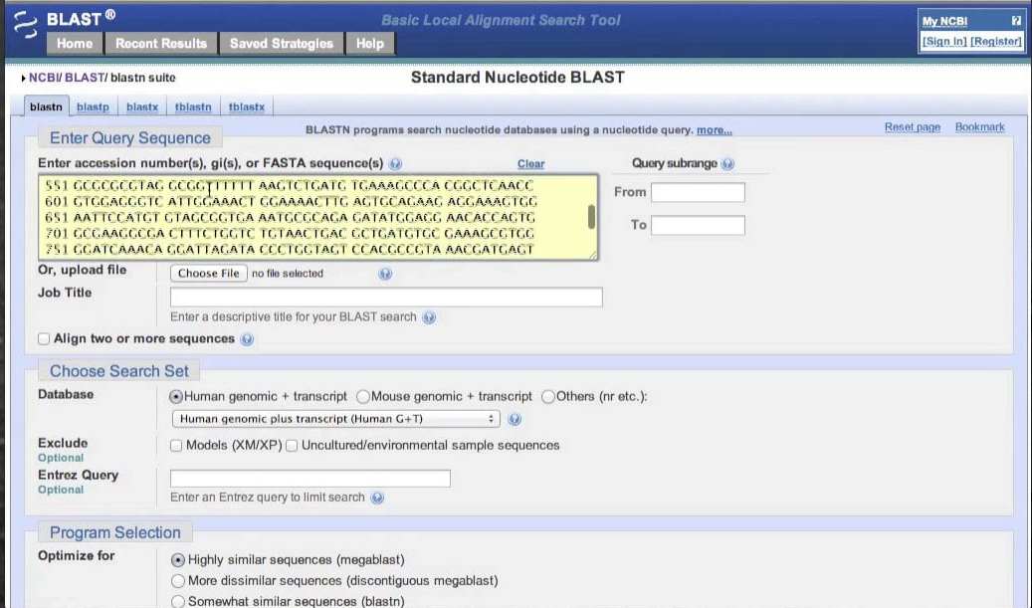
BLAST Activity
Students will use BLAST to identify proteins that are evolutionarily related across species. BLAST is an important bioinformatics tool connecting databases that contain partial and full gene sequences for both extinct and modern species.
Understand how phylogenetic trees depict evolutionary relationships
Understand how the bioinformatics tool BLAST enables the identification of evolutionarily related proteins in different species (orthologs)
Analyze the results from a BLAST analysis to assess consistency with a current phylogenetic tree for various animal species groups.
On your laptops, please open the document titled “BLAST Activity- Student Edition” and we will go through the activity with you.
Notes:
B
D: ADD WHAT THE POINT OF DOING THIS IS AND WHY IT IS IMPORTANT, SELL THIS ACTIVITY AND Talk about the learning objectives and the activity itself
*switch over to activity 3’s powerpoint, go over the basics of the purpose of the PP and what they can find in it(don’t go through every slide in detail, they can do that on their own time).*
* Then switch over to activity 3’s PDF for the students, walk the teachers through the activity using BLAST. (Let them read the PDF background on their own time, have them start at the procedure)*

Slide 11
BLAST Activity- Supplementary Material
For this activity, a few examples of supplementary materials that will be provided are:
Comparing DNA Sequences to Understand Evolutionary Relationships with BLAST- This is a College Board activity that has been adapted to form the basis of the BLAST search. If teachers want to see the original document, go to page 130 of the link
How the Beak was Born- An example of the evolution of dinosaurs turning into chickens
Are Birds Really Dinosaurs?- An article debating whether or not birds are considered dinosaurs and if dinosaurs are considered birds
After completing this activity, how confident are you in your students’ ability to complete this activity?

Slide 12
Phylogenetic Tree Activity
In this activity, students will be creating a phylogenetic tree depicting the evolutionary relationships among a specific set of animals. They will do this using an online program called MAB (Methods and Algorithms in Bioinformatics) Phylogeny Analysis. The learning objectives in this activity are:
Understand how amino acid sequences can be compared using a computer program in order to construct a phylogenetic tree
Learn how to obtain protein or peptide sequence data in the correct formatting
Understand how to interpret a phylogenetic tree
On your laptops, please open the document titled “Phylogenetic Tree Activity- Student Edition” and we will go through the activity with you.
Notes:
In Activity 4- MAB Phylogeny Analysis, the students will be using the same sequences from the BLAST activity in order to generate their own phylogenetic tree. I have provided them with a document containing sequence data from a variety of animals. This will allow them to see how Bioinformatics programs can take molecular data and use it to compare things we interact with everyday, animals. The program MAB Phylogeny Analysis uses algorithms to align the sequences and find which animals are more closely related based on mutual changes in the sequences. The students just have to follow the steps provided in order to acquire one additional sequence, and to use MAB to create their tree.
The point of this activity is to show the students how biology can be applied and utilized by anyone. When they search for the T. rex sequence they will be using a database that is free for the public to access, this database has an endless supply of biological data they can use, see, and learn about. This activity shows that it isn’t just scientists in white lab coats with fancy gadgets that can use bioinformatic tools to learn more about life; but that anyone from anywhere can do these kinds of science activities at home with wifi and a computer.
*switch over to activity 4’s powerpoint, go over the basics of the purpose of the PP and what they can find in it(don’t go through every slide in detail, they can do that on their own time).*
* Then switch over to activity 4’s PDF for the students, walk the teachers through the activity using MAB. (Let them read the PDF background on their own time, have them start at the procedure)*
D

Slide 13
Phylogenetic Tree Activity- Supplementary Material
For this activity a few examples of supplementary materials that will be provided are:
Was the T-rex warm blooded or cold blooded?- This is a link to a LA Times articles discussing how the T-rex maintained its body temperature. This is helpful when comparing the T-rex to birds and reptiles.
Skin of the T-rex- This is a link to another articles discussing the similarities between the T-rex, reptiles, and birds.
Understanding Phylogenies- This is a link to help students who are struggling to understand how phylogenetic trees work.
How do you plan on explaining the inaccuracies in the final phylogenetic tree to your students?
Notes:
B: These are again more examples of the supplementary materials that will be provided to you and the students. The few I have here focus on features of the T. rex that lead scientist to hypothesize whether it is more closely related to lizards or birds. I also have a few links for students who still do not fully understand how to read a phylogenetic tree.
D

Slide 14
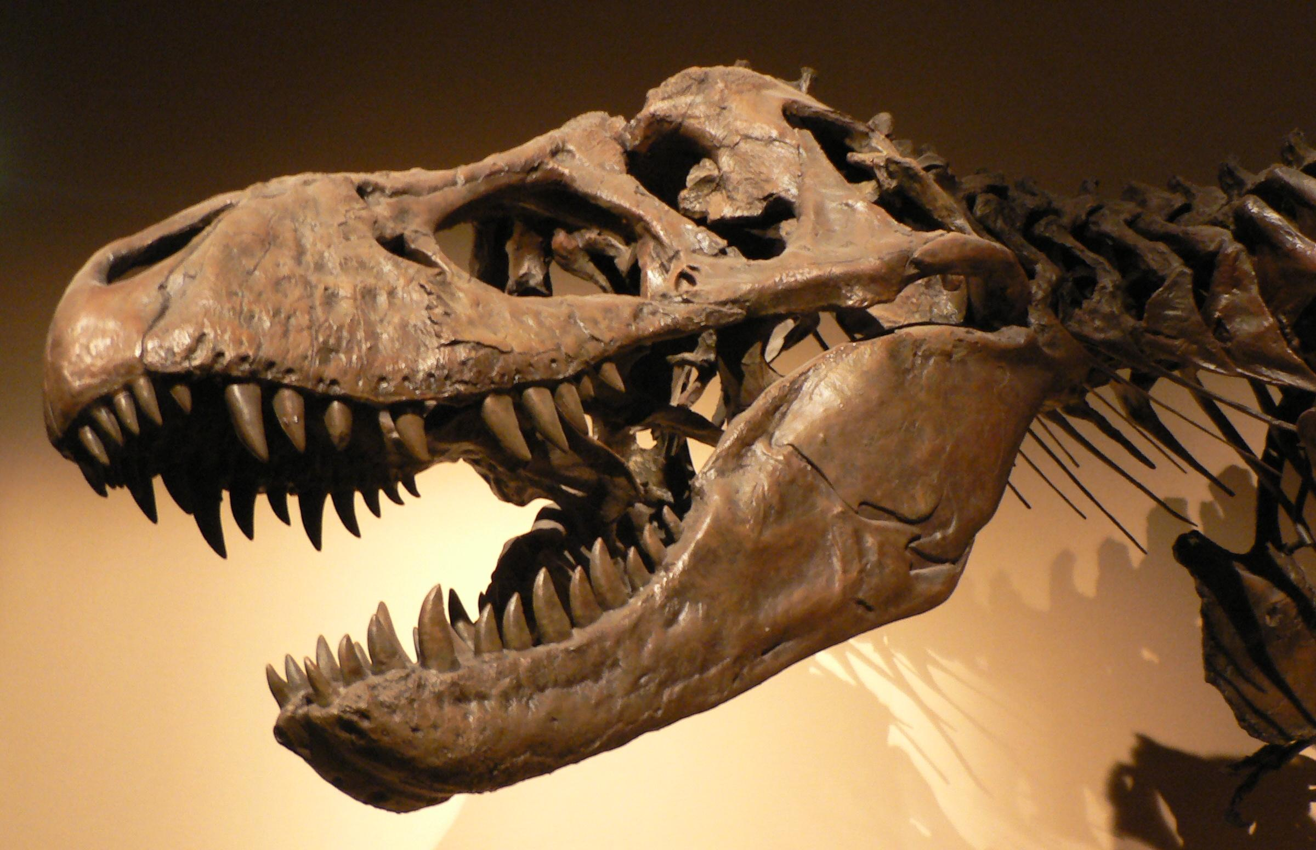
Case Study Activity: The Ethics of Cloning
This activity is a case study examining the ethics of potentially cloning and reintroducing dinosaurs into the world. The purpose of this activity is to engage students in a debate about scientific breakthroughs that have a lasting effect on the environment. The learning outcomes of this activity are:
To ethically argue for or against the reintroduction of dinosaurs into today’s ecosystem
Employ scientific facts and knowledge in support of an argument
Debate the merits of a significant environmental disturbance from different stakeholders' perspectives

Slide 15
Case Study Activity- Supplementary Material
For this activity a few examples of supplementary materials that will be provided are:
Should Dinosaurs be “Cloned”?- This is a National Education Association activity that we adapted for the theme of our curriculum
Dinosaur into a Chicken- This is an article describing a potential application of cloning dinosaurs from the famed paleontologist Jack Horner
Given that you know your students better than us, do you believe that students should be “Judges” in this case study, or should there be a “Jury” to make this decision?

Slide 16
Questions or Suggestions?
If you have any questions or suggestions on the material, activities, documents, or powerpoints please feel free to ask now.
Notes:
B:Are there any questions on material, the project, or suggestions?
D:

Slide 17
Please take our survey
We still have over a month to work on our curriculum, since it is not finalized and we can still make changes. Our team would love to hear back from you on what you think will work well or not. After all, you know the students and timeframe better than us! You can take our survey right away or wait until later if you want time to think it over.
Dinosaur Bioinformatics Curriculum Survey
https://www.surveymonkey.com/r/GGMVLW3
Notes:
B: We have created a short 3 questions survey for you to give your opinions on our work. We still have lots of time to continue editing and making changes to our project. If you think there are some parts that could be adjusted to better suit the students learning please let us know! You can fill out our survey now, or later if you want some time to think on it.
D:

