Slide 1
Genetic Engineering in Agriculture
A review of resources and thoughts on implementation

Slide 2
Adgenda
Leah McGrath - Dietitian
@InglesDietitian·13h
Dear food company. Please don't complain about not having money for ____(research, equipment, staff etc) & then brag about how you have the #NonGMO project label (on a product that has no #gmo alternative) ...I know that label costs 10's of thousands of dollars.
Project Goals
Lessons we have produced
Condensed unit
Closing the loop
Current and ongoing research
Beyond GM
@Beyond_GM·13h
1/ Michelin star chef @TomKitchin
cited for multiple health/safety infringements at his Edinburgh restaurant, including use of #GMO ingredients. We’ve spent a couple years now talking to chefs about GM ingredients & their obligations to own up on the menu
GMWatch
@GMWatch·Oct 20, 2019
Secrecy, threats and ethics violations as the Pentagon tests Gene Drives in West Africa https://biohackinfo.com/news-secrecy-threats-ethical-violations-pentagon-tests-gene-drives-burkina-faso/… Even biohackers have concerns about this project. #gmo

Slide 3
Understanding how students think about GE in agriculture
Skill not content focused
Increasing students scientific and digital literacy
Moving away from heuristic views of GE Agriculture
Connect to a wide range of existing MS and HS content
Notes:
What is ironic about this picture?

Slide 4
A diverse group of lessons were developed
Fact Checking in the Digital Age
Methods of Food Modification
GMOs and the Nature of Science
Eras of Crop Improvement
Investigating the GMO Controversy
Why Genetically Modify?
Better Bananas
GMO Labeling

Slide 5
Condensed Unit
Designed for approximately 120 minutes of club/class time
Made up of elements from the existing lessons
Can be used as insertion unit for a genetics unit at the MS and HS level

Slide 6
Condensed Unit
Concept Map-establish students understanding of GE Agriculture
Fact Checking and Digital Literacy skill development
Investigation of GE case studies (tomato, papaya, salmon)
Understand perspectives of GE case studies (environmental, social, scientific, economic)
Develop policy recommendations from their roleplay perspective (small group)
Compare and contrast the different GM case studies
Concept Map-revisit initial concept map to see how students thought process on GE Agriculture has evolved

Slide 7
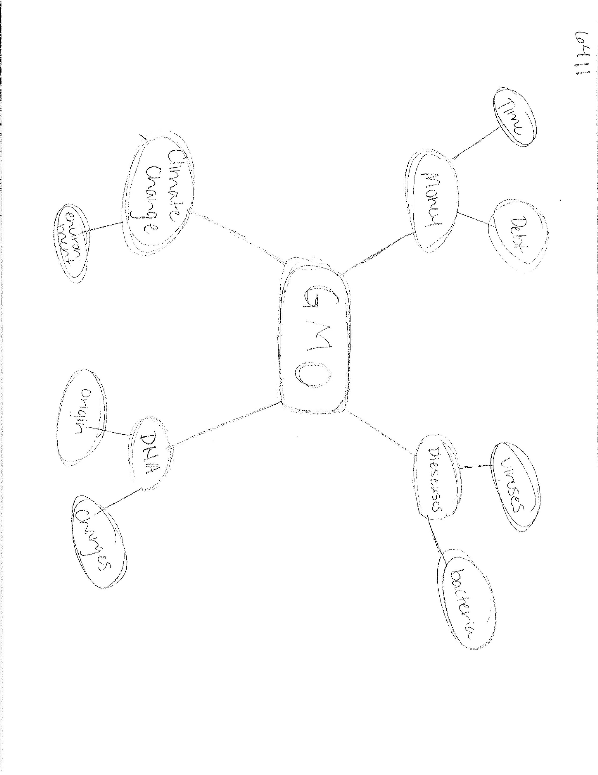
Closing the Loop
What knowledge, beliefs, and attitudes do science club students in rural Oregon have about genetic modification (GM) and genetically modified foods?
Students assess their knowledge of GM as low
As knowledge increases, they exhibit more support
Students do not have strong beliefs about GM
Concept maps show most students are ambivalent (pros/cons)
Connect GM to “chemicals” frequently

Slide 8
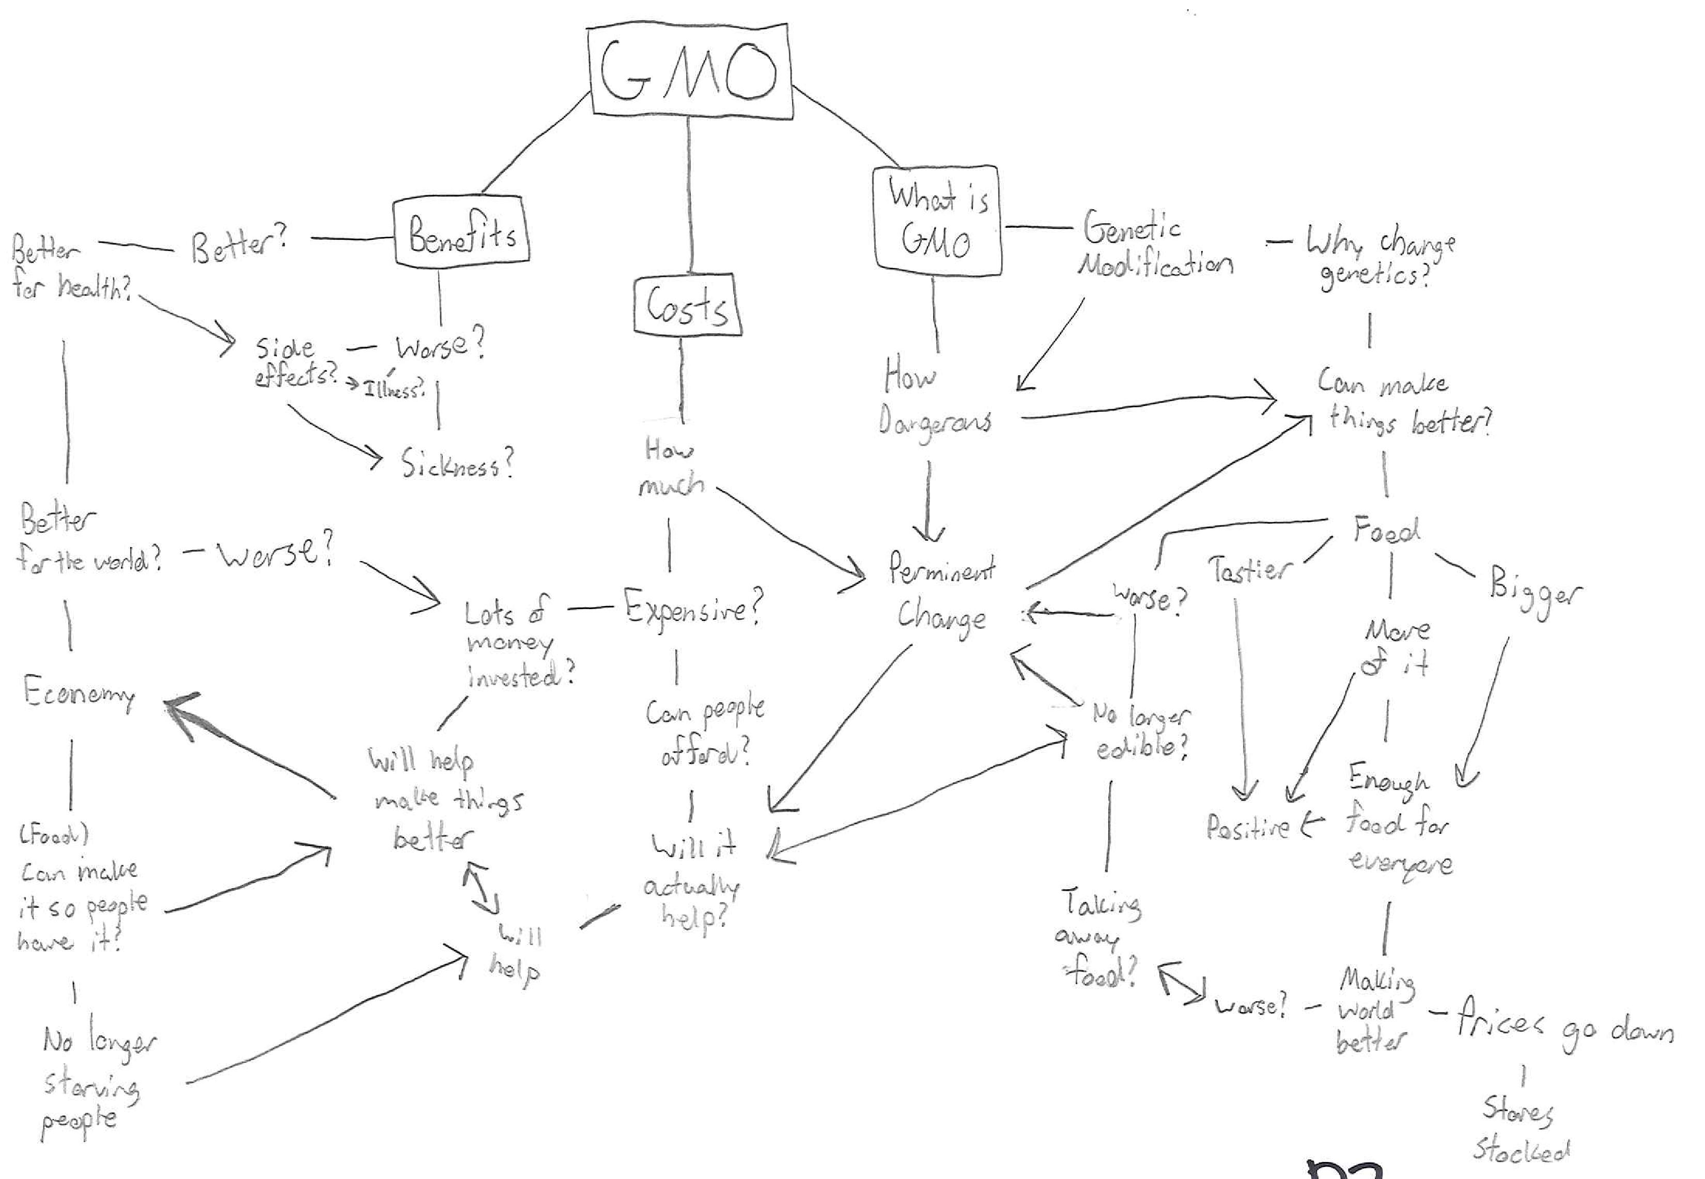
Current and Ongoing Research
Goal: how does our curriculum affect complexity of student thinking about GM?
Moving from our descriptive pilot to an experiment design
Partnering with pre-service teachers at OSU to implement lessons and data collection

