Slide 1
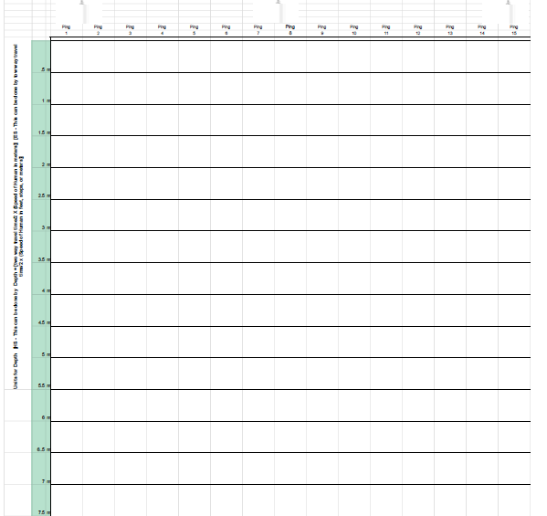
Round 1.
Arrange a room with objects that can to act as the sea floor.
Create plots on depth and ping from right to left.
Create a line plot.
Example:
Here is an example of Gray’s Bank

Slide 2
Round 2.
Arrange a room with High and Low return ammplitude cards arranged in any order Ping from right to left
The order represents the hard/softness of the seafloor below each ping
Add Color to your plot of seafloor
Example:
Here is an example of a soft seafloor changing to a hard see floor
H - Hard (Orange), Low - Soft (Yellow)
High Return
Low Return

Slide 3
Round 3.
Arrange a room with Ping Return Carts. The return cards map
The order corresponds to the pings.
Add Color to your plot of seafloor
Example:
38kHz is for Fish (Blue Diamond), 120kHz is for Air (Red Circle)
2 38kHz Bottom
4 120kHz Middle
3 120kHz Bottom
4
5
5
3
2
5 38kHz Bottom
5 120kHz Bottom

