Slide 1
Genetics intro
Stephen Ramsey and Dominique Brooks

Slide 2
A trait is something that we can observe about an individual
attached/detached earlobe
tongue rolling vs. cannot roll
dimples vs. no dimples
height
handedness
freckles vs. no freckles
curly hair vs. straight hair
can taste phenylthiocarbamide (PTC) vs. cannot taste PTC
A possible observation for a trait (like "detached earlobe") is called a phenotype

Slide 3
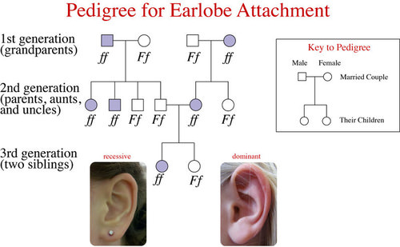
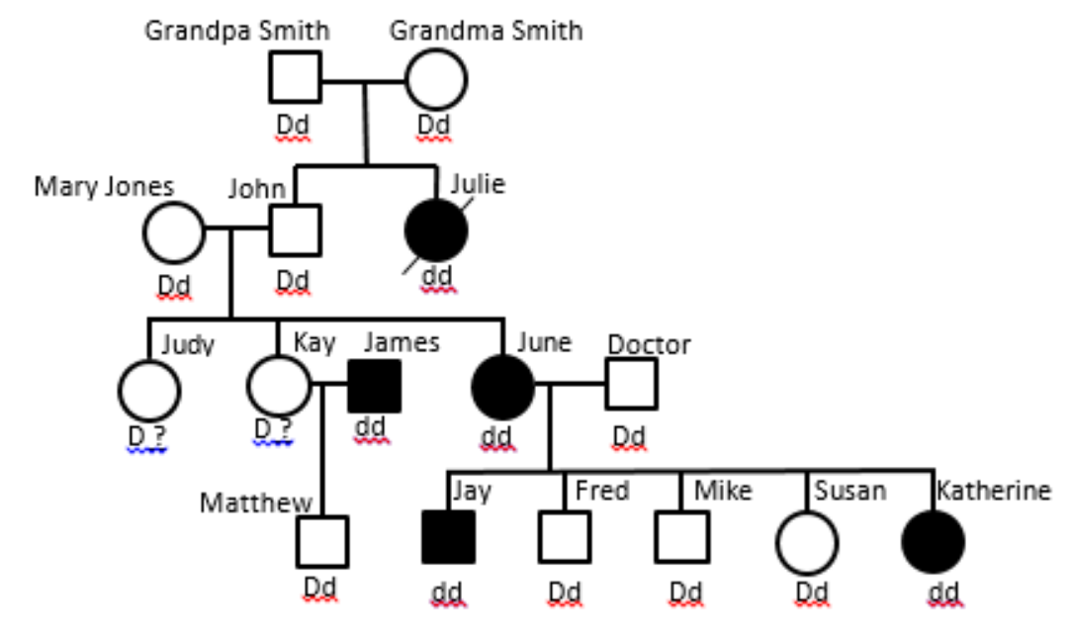
Many traits are heritable
Dimples
Image credit: www.ck12.org
Image credit: www.kyrene.org

Slide 4
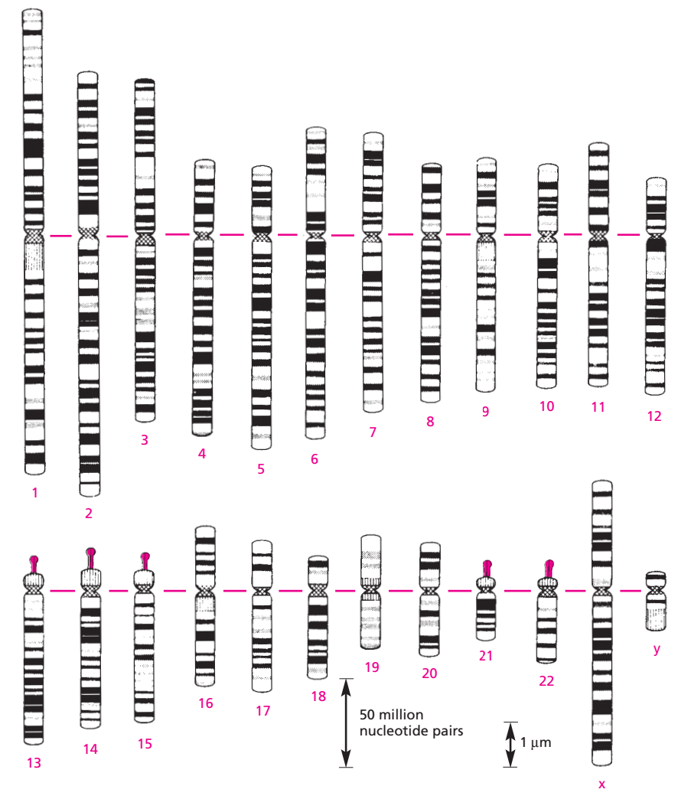
Human heredity is based on
46 nuclear chromosomes
Image credit: Molecular Biology of the Cell

Slide 5
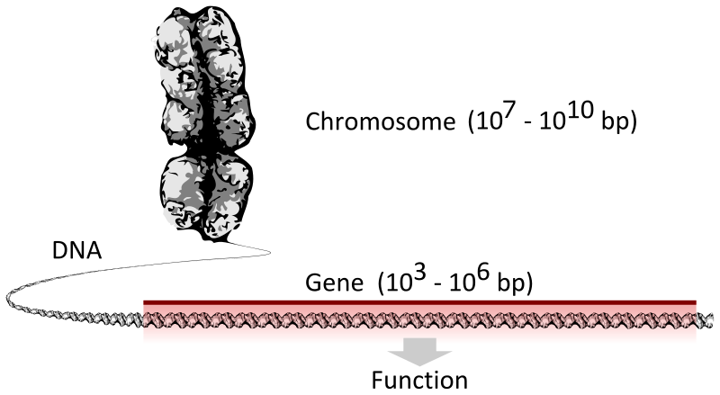
A gene encodes a functional protein or RNA
Image credit: Thomas Shafee

Slide 6
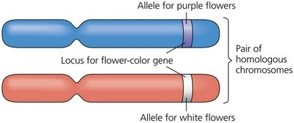
A particular variant (form) of a gene is called an allele
"D" allele
Human
chromosome
16
pair
cheek dimples gene
"d" allele
This gene (cheek dimples) is on Chromosome 16, which is an autosome (i.e., not a sex-determining chromosome)
Image credit: slideshare.net

Slide 7
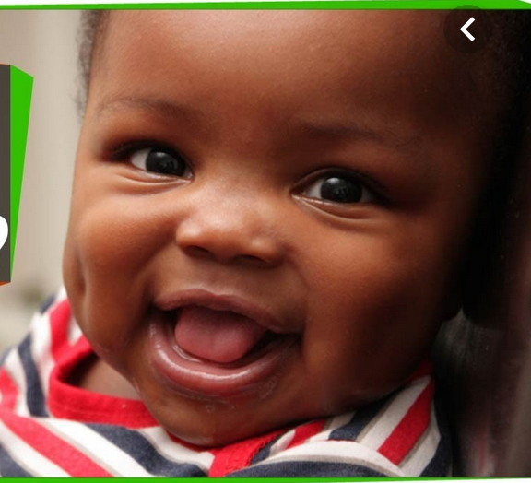
A "Mendelian" trait is one that is determined by the combination of the two alleles of a single gene
"D" allele
phenotype =
"dimples"
Gene for "dimples vs. no dimples"
"d" allele
We call the combination of the two alleles, the person's genotype: Dd
Image credit: slideshare.net

Slide 8
A "Mendelian" trait is one that is determined by the combination of two alleles of a single gene
"D" allele
Gene for "dimples vs. no dimples"
"d" allele
We call the combination of the two alleles, the person's genotype: Dd
Image credit: slideshare.net

Slide 9
For a Mendelian trait, one allele is dominant; the other is recessive
Dimples example:
"D" allele: dominant
"d" allele: recessive
Genotype symbols | Genotype, in plain English | Phenotype
DD | homozygous dominant | dimples
Dd | heterozygous | dimples
dd | homozygous rcessive | no dimples
in this situation we would say that the dominant allele is the "dimples" allele

Slide 10
A Punnett Square enables us to calculate the probability of each phenotype in a given offspring if parents' genotypes are known
Suppose the parents' cheek dimples genotypes are as follows:
• mom: Dd
• dad: Dd
if dad contributes:
 | D | d
D | DD | Dd
d | Dd | dd
if mom contributes:
Probability of baby having dimples
is 3/4

Slide 11
What if mom and dad have different genotypes?
Suppose the parents' cheek dimples genotypes are as follows:
• mom: DD (has dimples)
• dad: Dd (has dimples)
if dad contributes:
 | D | d
D | DD | Dd
D | DD | Dd
if mom contributes:
Probability of baby having dimples
is 1

Slide 12
What if mom and dad have different genotypes?
Suppose the parents' cheek dimples genotypes are as follows:
• mom: dd (does not have dimples)
• dad: Dd (has dimples)
if dad contributes:
 | D | d
d | Dd | dd
d | Dd | dd
if mom contributes:
Probability of baby having dimples
is 1/2

Slide 13
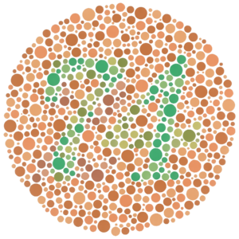
Sex-linked traits are carried on the X chromosome
trait: red-green colorblindness
gene: OPN1LW, on chromosome X
alleles:
c (recessive; colorblindness)
C (dominant)
Y (no allele on Y chromosome)
"test plate" for colorblindness
dad: CY
 | C | Y
C | CC girl | Cy boy
c | Cc girl | cY boy
Image credit: Wikipedia
mom: Cc
a son will have 50% chance of being colorblind

Slide 14
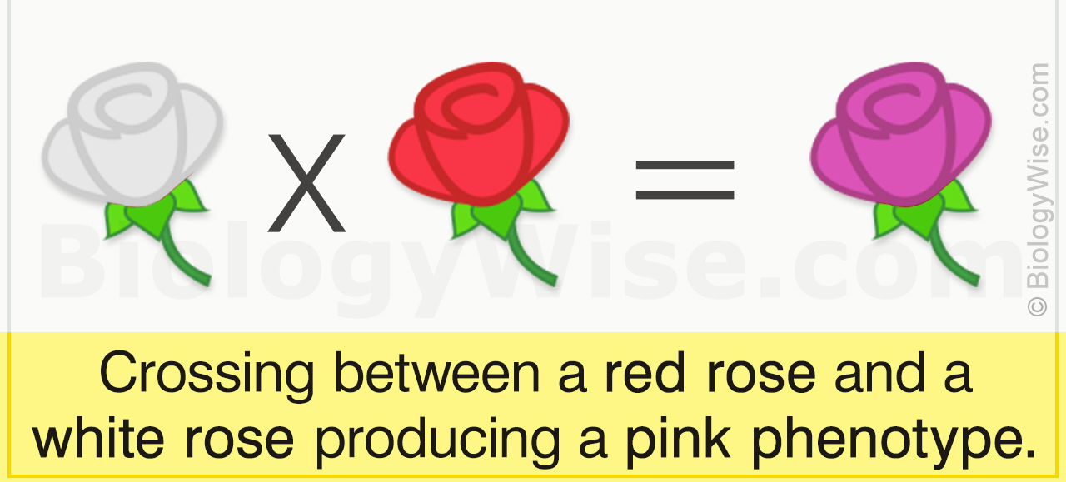
For some single-gene traits, a heterozygous genotype has an intermediate phenotype ("incomplete dominance")
Example: Tay-Sachs Disease
Gene: HEXA (chrom 15)
recessive allele (t) causes Tay-Sachs
the normal allele (T) has "incomplete dominance"
 | T | t
T | TT (no neurological disease) | Tt (intermediate phenotype)
t | Tt (intermediate phenotype) | tt (Tay-Sachs disease)
Botany example of incomplete dominance:
Image credit: biologywise.com

Slide 15
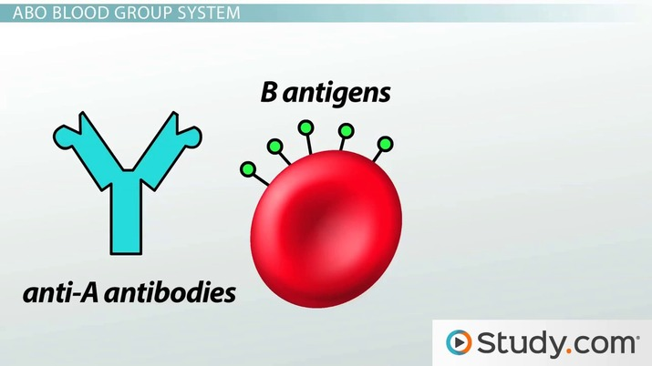
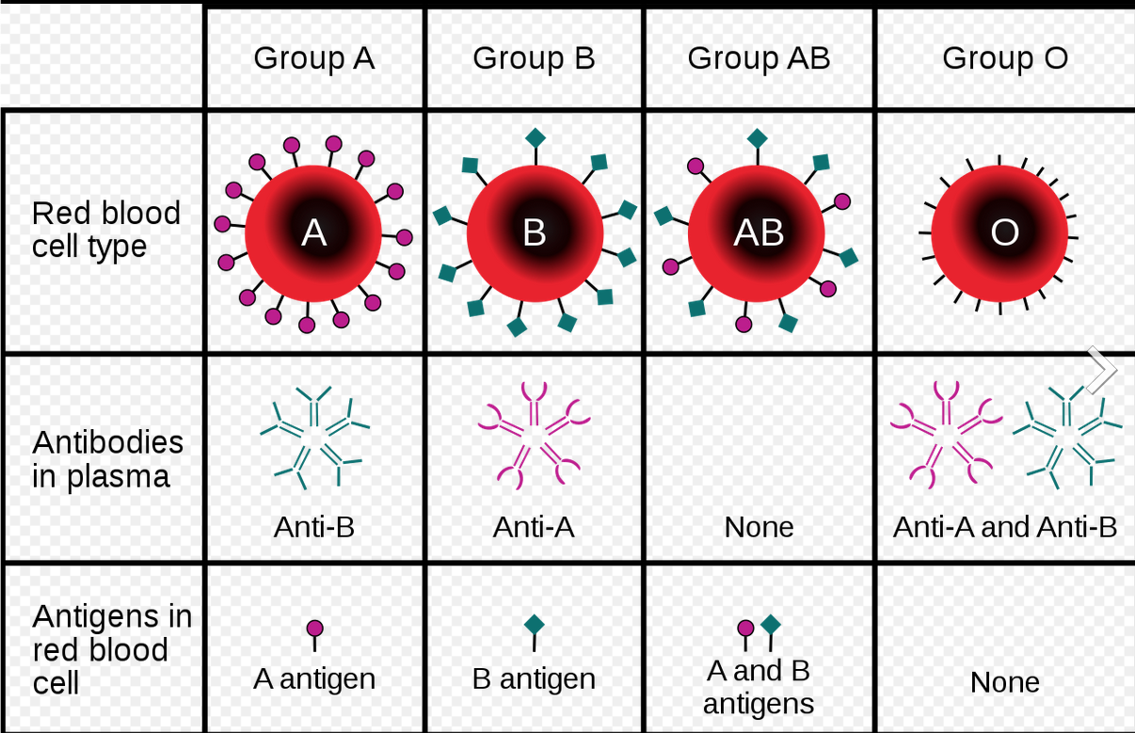
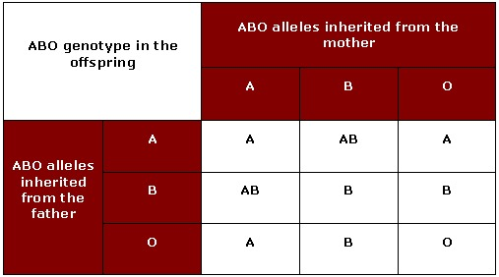
Some traits can have more than one phenotype with dominant inheritance: this is called co-dominance
Example: human blood groups
Gene: ABO (chromosome 9)
A allele is dominant for A antigen
B allele is dominant for B antigen
O allele is recessive (produces no antigen)
Image credit: InvictaHOG
Image credit: Laura Dean

Slide 16
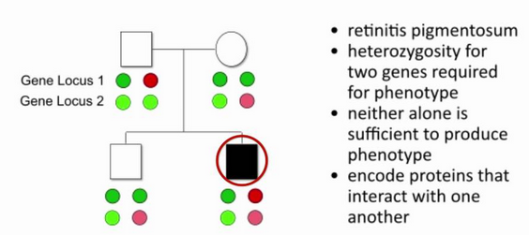
phenotype for a digenic trait depends on genotypes of two genes
Image credit: OPENPediatrics

Slide 17
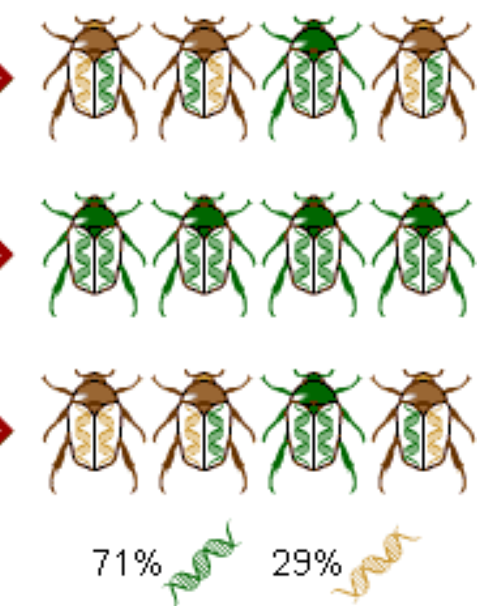
How to calculate the allele frequency from the recessive phenotype frequency
Allele frequency is the frequency at which an allele occurs in the population, combining each person's two alleles as random samples.
For a Mendelian trait (with two phenotypes and two alleles, T and t), let's suppose the frequency of the recessive phenotype is Ft.
Assuming (1) random mating in a fixed large population; (2) no mutations are occurring, and (3) the phenotype has no effect on fitness, we can calculate the frequency q of allele t using the Hardy-Weinberg equation:

Slide 18
Genetics has many real-world applications
Medicine:
  thousands of diseases have genetic origins
  Personal genome sequencing is becoming much more common
Computer science: ”genetic algorithms”
Bioengineering: engineering new life forms that
  Mass-produce difficult-to-synthesize compounds or biofuels
  Degrade environmental contaminants
  Improve crop yields, etc.
Biomedical research:
  Genetic tools in model organisms (fruit fly, mouse, worm, etc.)
  Genetic studies in humans and other species to map the genes underlying polygenic traits
  Genetics is becoming critical in development of new pharmaceuticals

Slide 19
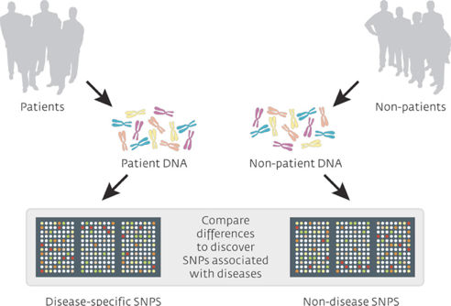
Genome-wide association study (GWAS)

Slide 20
An interesting locus from a GWAS
Wang et al., Nature, 459(7246), 2009
Notes:
A nice illustration of the problem comes from a recent genetic study of autism, in which the strongest susceptibility locus is <NEXT> in an intergenic region. Which of these variants are the strongest candidates to be causal for trait variation?

Slide 21
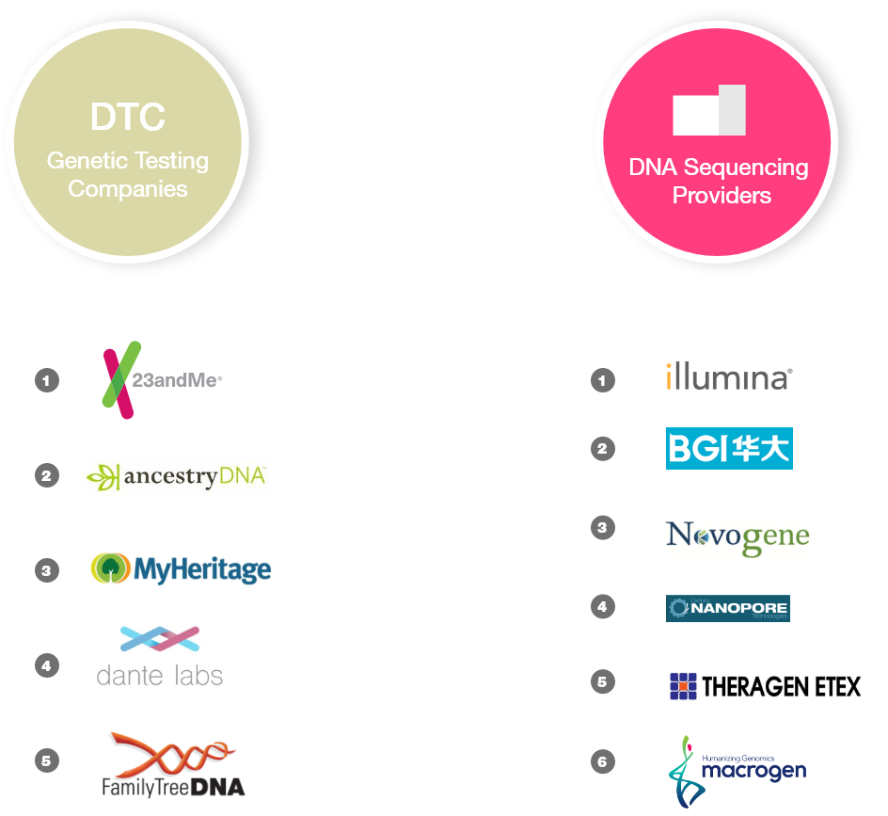
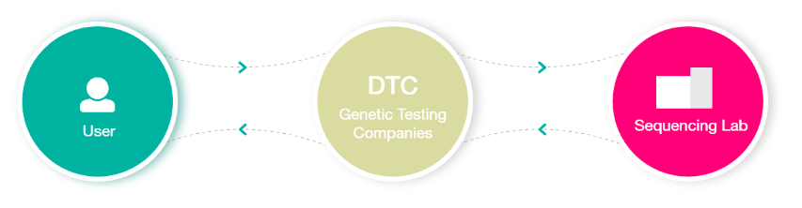
Direct-to-consumer genetic testing has become big business
Notes:
14 million people have taken a DTC genetic test
(should be 100 million by 2021)

Slide 22
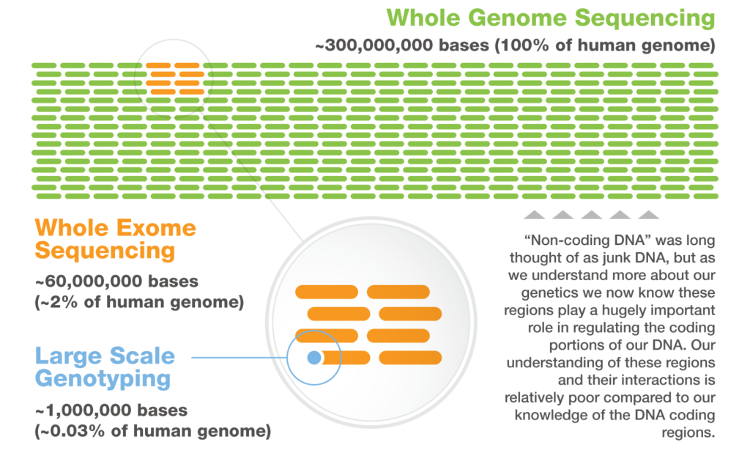
Different types of genetic analysis that are currently used

Slide 23
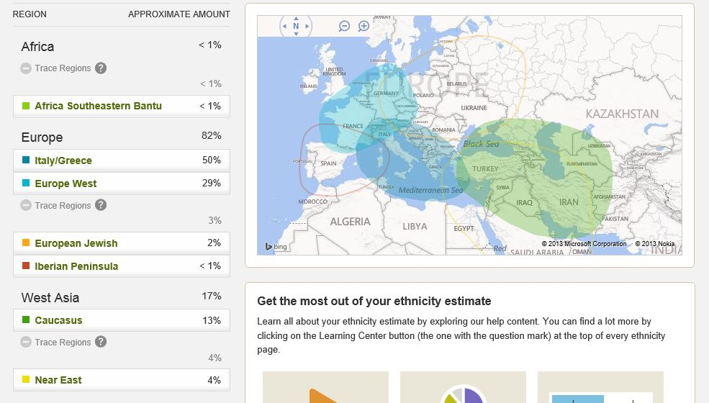
Example ancestry report from ancestry.com

Slide 24
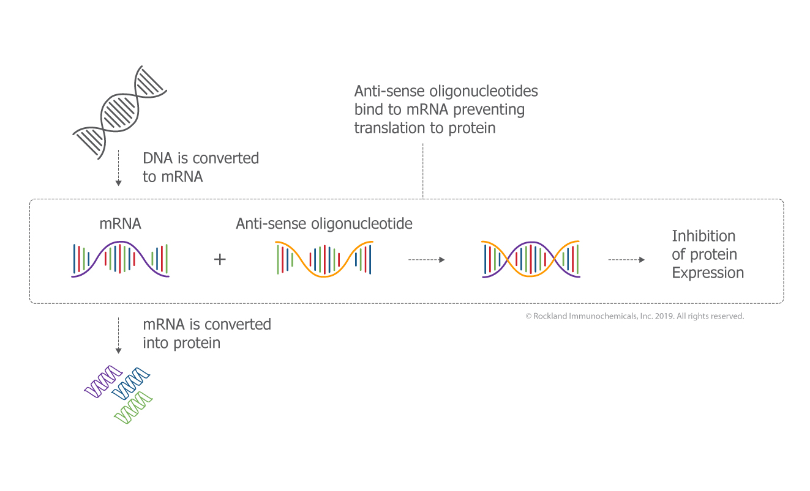
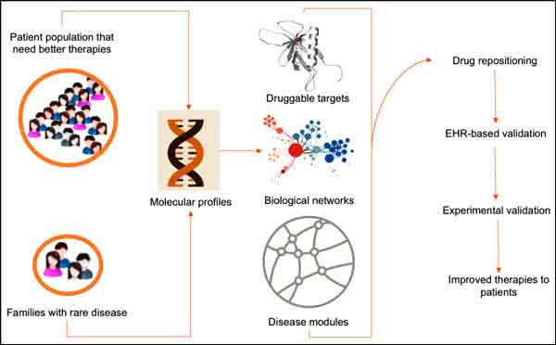
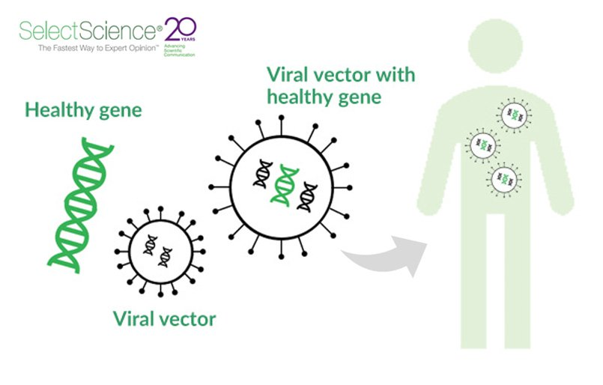
Rare diseases
By definition: affects fewer than 1 in 200,000 citizens (in the EU, definition is 1 in 2,000)
How many different rare diseases are there? Perhaps as many as 7,000.
How many Americans have a rare disease? Possibly 25-30 million!
What causes rare diseases? The majority are genetic and can be pinpointed to a location in the genome.
What help is there for someone with a rare disease?
  Rare Diseases Clinical Research Network: rarediseasesnetwork.org
  Undiagnosed Diseases Network: rarediseases.org
How can DNA sequencing help someone with a rare disease?

