Slide 1
Exploring Data & Storytelling
Dani Miller, Hannah Nolan, Adam Talamantes

Slide 2
Outline
Footprints
Data Exploration
Isle Royale, Not Battle Royale

Slide 3
Think-Pair-Share:
How do you want students to use data?
How can you get students interested in ‘data’ so they ‘engage’ in making claims, using evidence, and clarifying their reasoning? (NGSS)

Slide 4
Footprints

Slide 5
“Field Geology” 201
Your geology class is on a field trip to a fossil bed in Alberta, Canada. While exploring the site, you discover a slab of rock covered with interesting impressions. Your instructor invites the class to make observations and inferences about the imprints…

Slide 9
Complete Task 1:
Exploring to Explore: Serious Fun
(groups of 3)

Slide 10
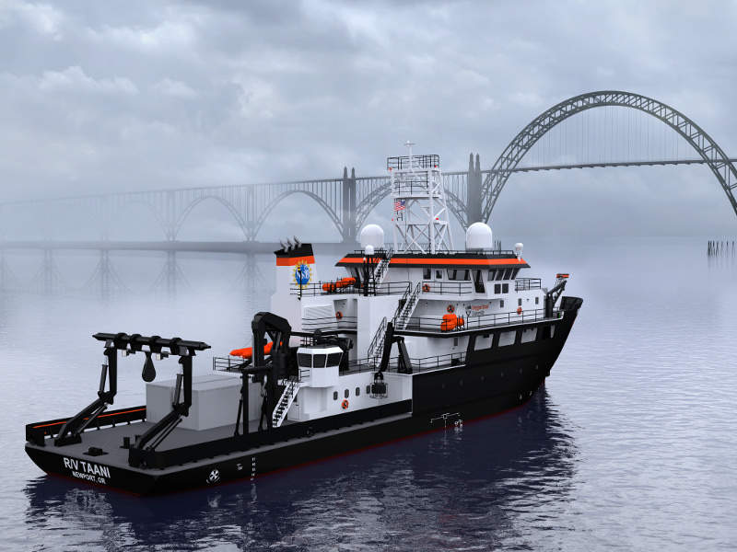
RCRV’s:
A new fleet of academic regional class research vessels to supply the public with real time data

Slide 11
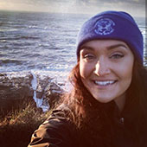
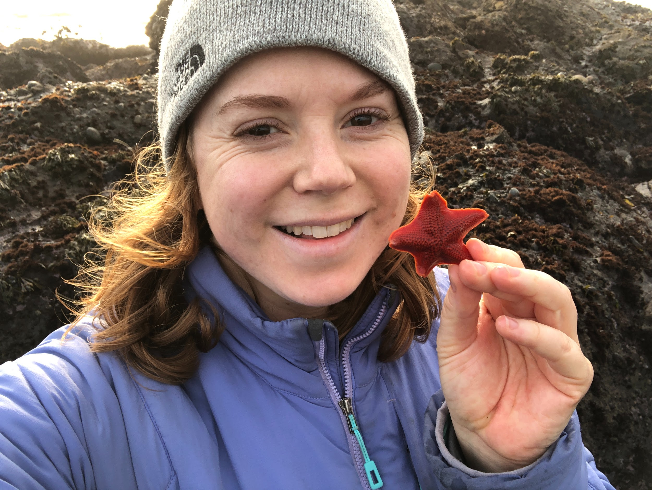
Who are we?
Graduate students in the Marine Resource Management program at OSU. Working on the RCRV project to effectively streamline the flow of data from researcher to educator to student.

Slide 12
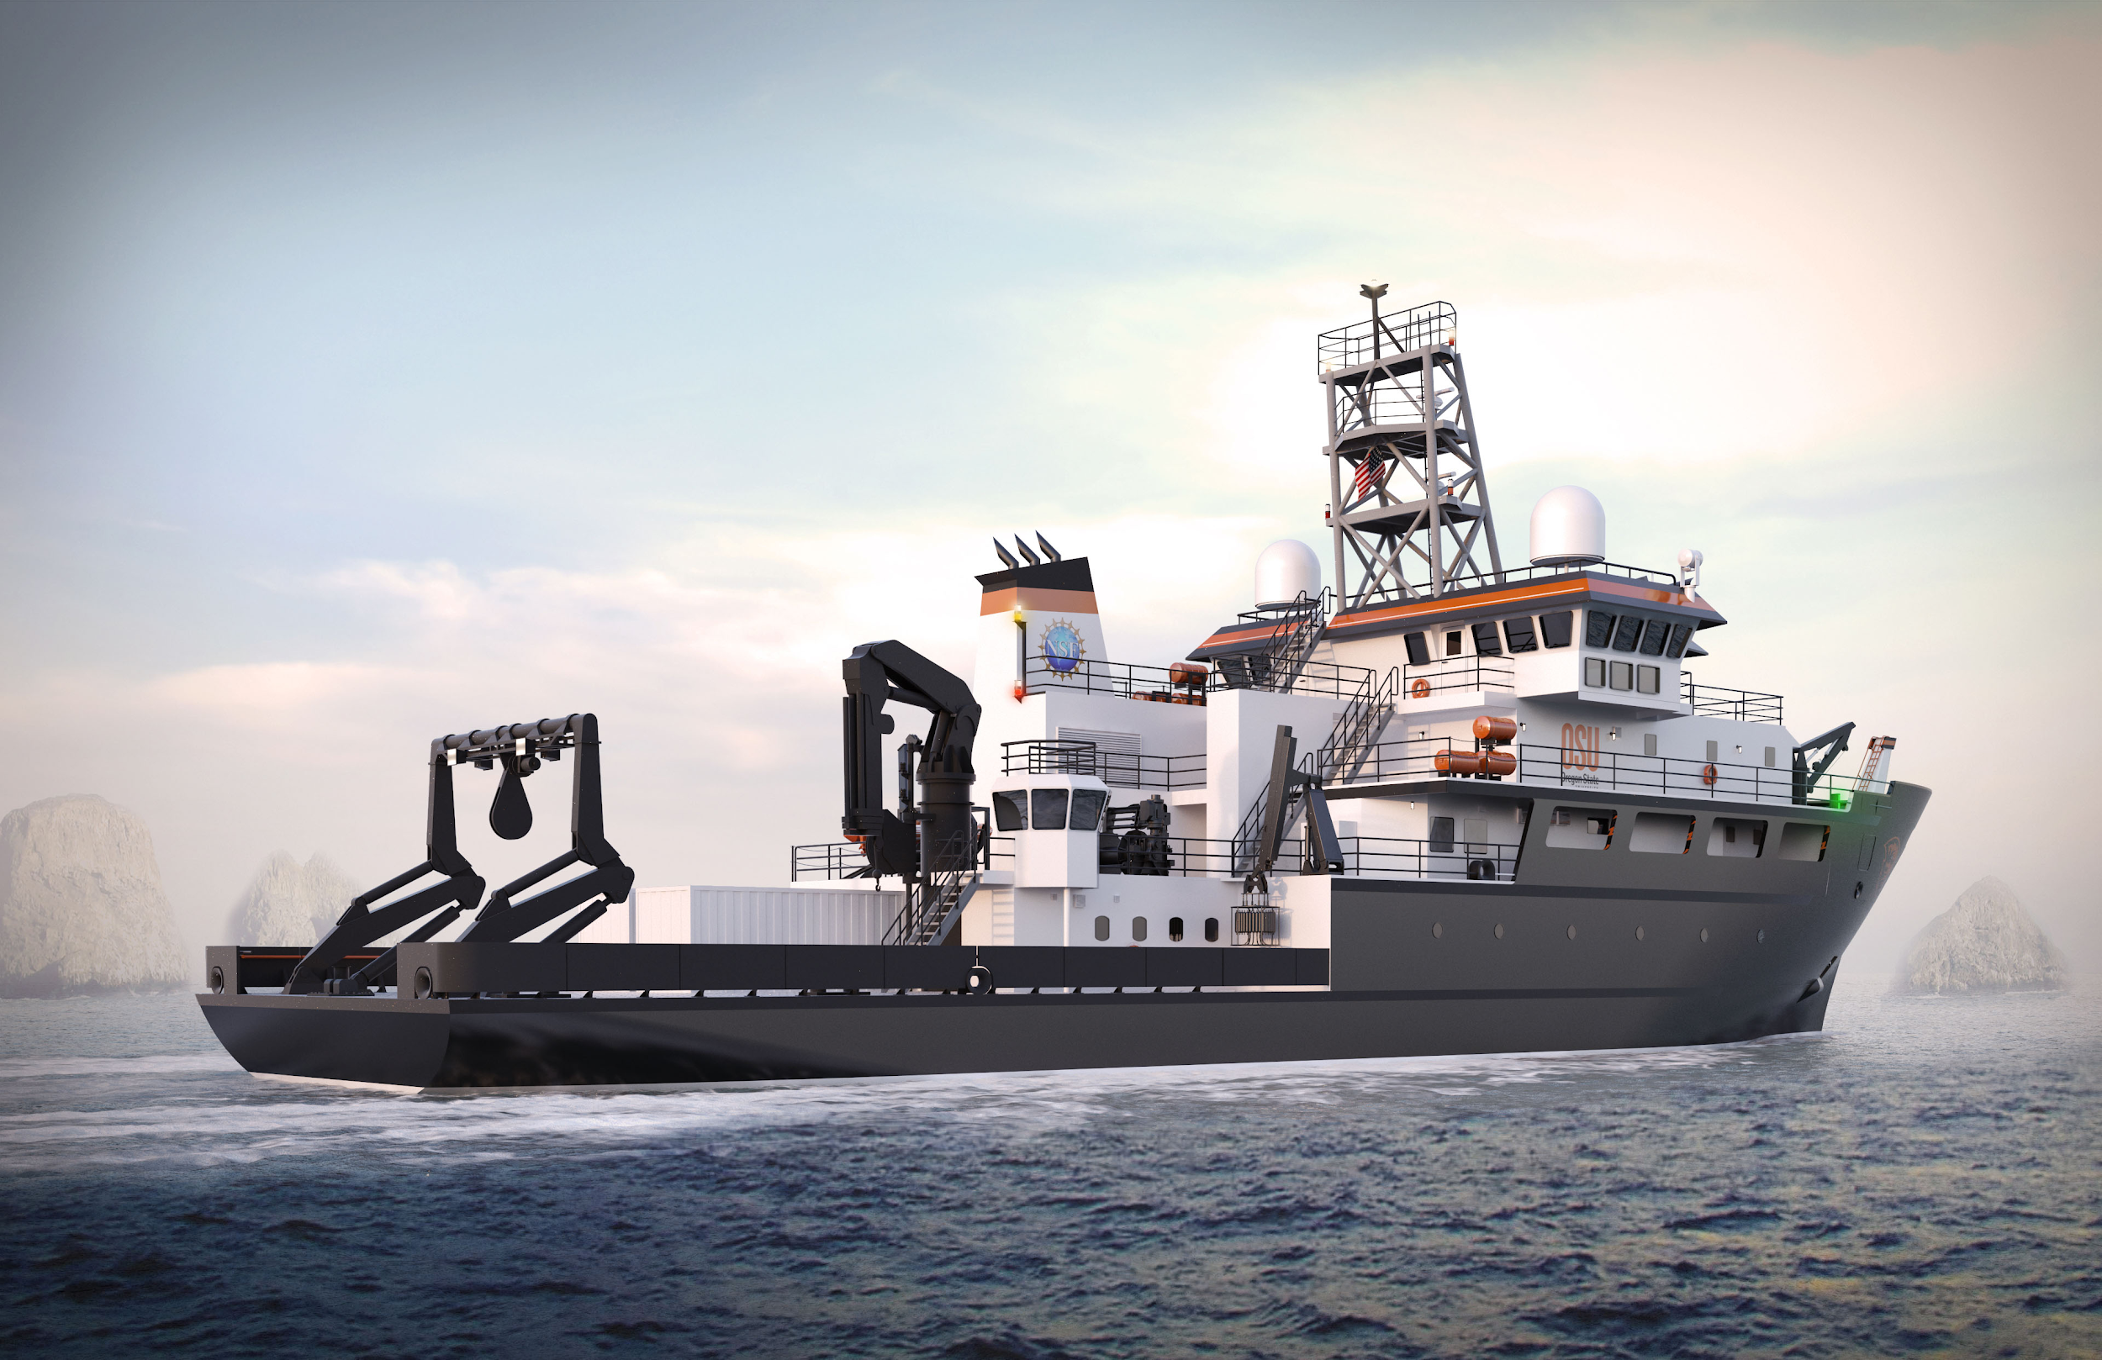
What is RCRV?
Regional Class Research Vessel
A vessel used for ocean research
Stays to a specific geographic location
Will range the atlantic, gulf, and pacific coasts

Slide 13
What is the RCRV project at OSU?
“Leading the design and construction of the next class of ocean-going research vessels for the National Science Foundation”

Slide 14
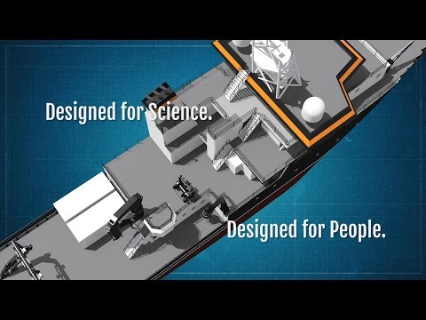
What will they look like?

Slide 15
Construction of R/V Taani begins.
Potential delivery of RCRV #3. UNOLS designation of R/V Taani & potentially RCRV #2.
Launch of R/V Taani
2023
2018
2019
2020
2021
2022
Construction of RCRV #2 begins. Construction of RCRV #3 potentially begins.
Potential designation of RCRV #3. .
Launch & Delivery of RCRV #2. Potential Launch of RCRV #3. Delivery of R/V Taani.

Slide 16
What is data - presence?
Vessels will have the ability to collect and beam back ocean data in near-real time.
This means that researchers, educators and students on shore will have access to real, marine science data virtually as it is collected.

Slide 17
What are we doing today?
Website Review
Help the RCRV team better understand what “works” and “doesn’t work” for teachers when using a data portal.
Each person will be given a web-portal to explore for the next ten minutes.

Slide 18
Resources for Teachers & Researchers
The RCRV main webpage:
http://ceoas.oregonstate.edu/ships/rcrv/
The RCRV Education & Outreach webpage:
http://ceoas.oregonstate.edu/ships/rcrv/outreach/
*Available through the SMILE OSU Teacher Workshop materials*

Slide 19
Complete Task 2:
Exploring to Explore: Serious Fun
(groups of 3)

Slide 20
Using Data to Tell a Story:
Isle Royale,
Not Battle Royale

Slide 21
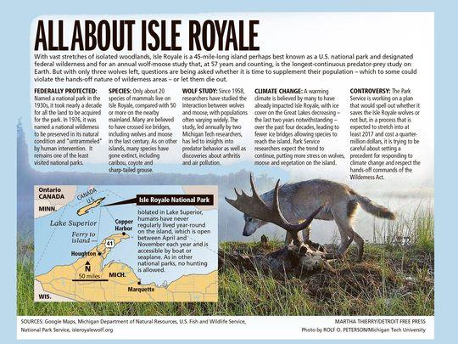
Background of the Isle Royale
Fast Facts Isle Royale National Park is 571,790 acres The number of people visiting in 2017 was 28,196 Isle Royale was made a national park on March 3, 1931 The lowest is 601 feet at Lake Superior The highest is 1,394 feet on Mount Desor Entrance fee is $7 per person per day In the Eastern time zone Random Facts Isle Royale National Park is the only national park in the United States that completely closes in the offseason. The park is typically closed November through mid April.
The most common large mammals are moose and gray wolves. The interaction of these two species in the park has been extensively studied. On rare occasions Lake Superior completely freezes over in winter, allowing animals from the mainland to access the island.

Slide 22
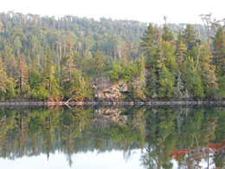
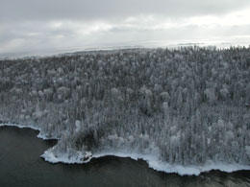
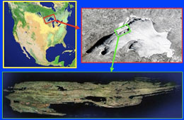
Background on Isle Royale
The Ecosystem on Isle Royale (Lake Superior)
One of the longest population ecology studies (closed system)
Images by www.isleroyalewolf.org

Slide 23
Island Royale, Not Battle Royale
Description
Graphs
Population-Prey (one goes up, the other goes down)
Science and Society
Using historical data to make decisions about the future
*Oregon Relevant?

Slide 24
Did we do this?
Concepts:
Ecosystem interactions between predators and prey.
Use a model to make predictions of that effect predator-prey population dynamics overtime.
Learn about an ongoing wolf study that resonates with Oregon residents.
Which Performance Expectation?
HS.Interdependent Relationships in Ecosystems
MS.Interdependent Relationships in Ecosystems
5-LS2-1
5-ESS3-1

Slide 25
Extensions/Scaffolding
Website Resource
http://www.isleroyalewolf.org/
OMS
https://wiki.islandwood.org/index.php?title=Owls,_Mice_and_Seeds
wolf quest
https://www.wolfquest.org/about_overview.php
Deer Me
https://www.wolfquest.org/pdfs/Deer%20Me%20Lesson.pdf
High School
https://www.hhmi.org/biointeractive/wolves-isle-royale
Radio collar data
https://www.dfw.state.or.us/Wolves/notification.asp

Slide 26
Questions?

