Slide 1
Demystifying the NGSS
By Amity and Adam

Slide 2
By the end of this session you will..
Outline
Dropper Poppers
NGSS
Disciplinary Core Ideas (DCI)
8 Science and Engineering Practices (SEP)
Crosscutting Concepts (CCC)
Dropper Poppers (Revisit)
Your Lessons
Strengthen a lesson by tying it to NGSS
Become familiar with PE, SEP, DCI, and CCC
Learn how to read NGSS
Gain experience searching NGSS
Use NGSS to revise a lesson you or your peer is already doing

Slide 3
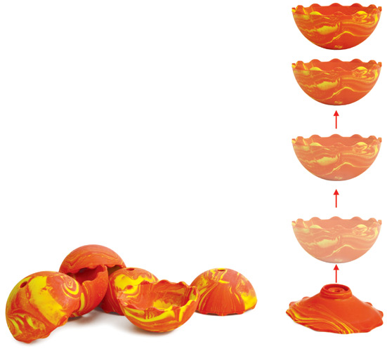
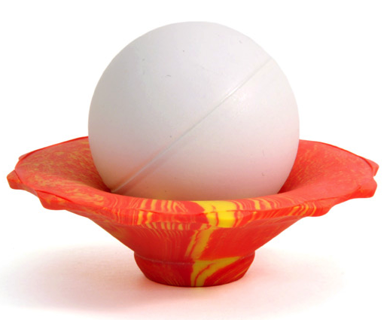
Classic Science Activity: Dropper Poppers
Guiding question: How is this a “science activity”?
Things you are doing, saying, thinking, etc.
You will be asked to “strengthen” this activity later on
Dropper poppers are a fun and exciting tool to model the transformation of energy from potential/mechanical to kinetic
Number off 1-5 (groups of 3-4)
Supplies needed
Meter Stick
Ping pong ball
Worksheet
EI Handout
Notes:
- Play video to prime the activity

Slide 4
Overview
The NGSS Framework
Why are the standards changing?
What do they look like?
How can these strengthen the dropper popper activity?
Notes:
Link to video

Slide 5
Facts, facts, facts
Problems with teaching science this way...
Students don’t build the skills needed for real science
Notes:
o If students experience science as something to memorize rather than as a process, they won’t develop the skills to succeed in science careers or even in college science courses.
o What if we taught soccer the way science is often taught? Students would read about famous soccer matches, memorize rules and statistics, and learn about famous players. Then when they get to college, they would finally be handed a ball for the first time and be expected to play. It’s easy to predict that they would not be successful.
o Science is the same; if we expect students to be able to DO science in college or career, they need many opportunities to practice before then.

Slide 6
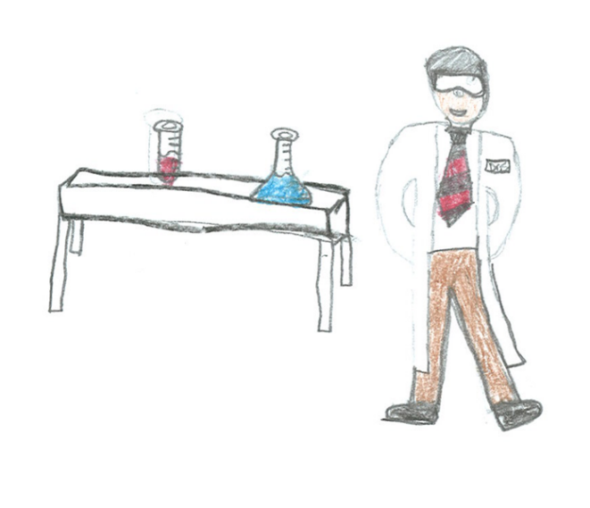
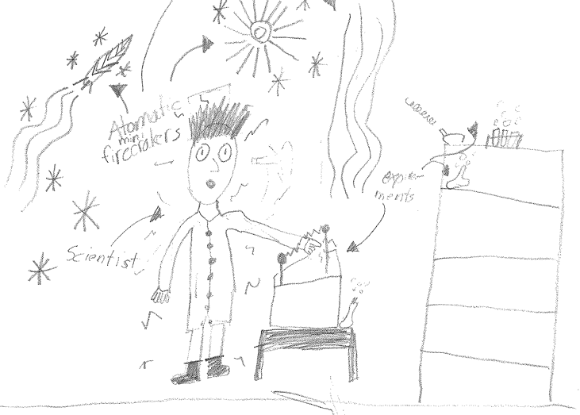
Facts, facts, facts
Problems with teaching science this way...
Students don’t relate to science or scientists
Notes:
o These pictures are by 4th graders when asked to draw a scientist. What do you notice about these pictures?
o These pictures show white male chemists. Some scientists definitely look like this; however, many more do not.
o Most students drew something similar, which for most of them meant drawing someone very different from themselves.
o If students get to DO science, they are more likely to be able to see themselves as someone who could be a scientist.

Slide 7
Science Standards in Oregon
Facts about science
Doing science

Slide 8
Next Generation Science Standards (NGSS)
Science and Engineering Practices
(doing science)
Disciplinary Core Ideas
(facts)
Crosscutting Concepts
(connecting science)
*
*
is a registered trademark of Achieve. Neither Achieve nor the lead states and partners that developed the Next Generation Science Standards was involved in the production of, and does not endorse, this product.
Notes:
o The NGSS fundamentally changes this balance. o The facts about science are still there (knowledge is important, after all), but it’s now on equal footing with doing science, as well as with connecting ideas across science.
o These three components are called the three dimensions of the NGSS.

Slide 9
The 3 Dimensions of the NGSS
*
Disciplinary
Core Ideas
(facts)
Crosscutting Concepts
(connecting science)
Science & Engineering Practices
(doing science)
This symbol actually
means something!
Student Performance Expectation (PE)
Adapted from NSTA
*
is a registered trademark of Achieve. Neither Achieve nor the lead states and partners that developed the Next Generation Science Standards was involved in the production of, and does not endorse, this product.
Notes:
o Did you know the NGSS logo actually means something? The three colored
bands on represent the three dimensions and their equal balance in the NGSS.
o These components weave together to form Performance Expectations, which are statements of what students should be able to do.

Slide 10
Math
Science
M4. Models with mathematics
S2: Develop & use models
S5: Use mathematics & computational thinking
M1: Make sense of problems and persevere in solving them
M2: Reason abstractly & quantitatively
M6: Attend to precision
M7: Look for & make use of structure
M8: Look for & make use of regularity in repeated reasoning
S1: Ask questions and define problems
S3: Plan & carry out investigations
S4: Analyze & interpret data
S6: Construct explanations & design solutions
E2: Build a strong base of knowledge through content rich texts
E5: Read, write, and speak grounded in evidence
M3 & E4: Construct viable arguments and critique reasoning of others
S7: Engage in argument from evidence
E6: Use technology & digital media strategically & capably
M5: Use appropriate tools strategically
S8: Obtain, evaluate, & communicate information
E3: Obtain, synthesize, and report findings clearly and effectively in response to task and purpose
E1: Demonstrate independence in reading complex texts, and writing and speaking about them
E7: Come to understand other perspectives and cultures through reading, listening, and collaborations
Cheuk, T. (2013). Relationships and convergences among the mathematics, science, and ELA practices. Stanford University. http://ell.stanford.edu/sites/default/files/VennDiagram_practices_v11%208-30-13%20color.pdf
ELA
Notes:
o There is intentional overlap and synergy between the NGSS practices and practices students are already learning in Common Core Math and ELA.
o This creates opportunities for integration across subject areas, and shows that ways of thinking are not isolated to one discipline.

Slide 11
Disciplinary Core Ideas (DCIs) No more “mile wide, inch deep”
“…our effort to identify a small number of core ideas may disappoint some scientists and educators who find little or nothing of their favorite science topics included in the framework.
…students will leave school better grounded in scientific knowledge and practices than when instruction ‘covers’ multiple disconnected pieces of information that are memorized and soon forgotten once the test is over.”
“…the framework focuses on a limited number of core ideas... Reduction of the sheer sum of details to be mastered is intended to give time for students to engage in scientific investigations and argumentation and to achieve depth of understanding of the core ideas presented.”
NGSS Lead States. 2013. Next Generation Science Standards: For States, By States. Appendix E: Progressions within the Next Generation Science Standards. Washington, DC: The National Academies Press.
Notes:
- The structure moves away from the ‘‘mile wide, inch deep’’ approach to science education.
- To make room for deeper understanding and incorporate two other dimensions with equal standing (SEPs and CCCs), some things have to be removed.
We all may have that one favorite activity or subject that we just love to teach.
- However, in order for this shift to be successful, educators have to be willing to let go.
- Remind participants: while this may seem frustrating, keep in mind that the potential benefits are powerful and very much worthwhile.

Slide 12
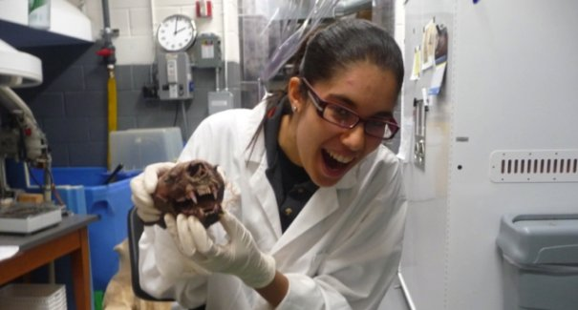
Learning as a progression
“[The framework] is built on the notion of learning as a developmental progression. It is designed to help children continually build on and revise their knowledge and abilities.”
NGSS Lead States. 2013. Next Generation Science Standards: For States, By States. Appendix E: Progressions within the Next Generation Science Standards. Washington, DC: The National Academies Press.
Notes:
- Structure is intended to create a clear and solid progression of ideas from K through 12, building and deepening student knowledge in developmentally appropriate ways

Slide 13
SCIENCE!
Physical Sciences
PS1
PS2
Engineering, Technology, and Applications of Science
ETS1
Life Sciences
Earth and Space Sciences
PS3
PS4
LS1
LS2
LS3
LS4
ESS1
ESS2
ESS3
ETS2
PS1.A
PS1.B
PS1.C
PS2.A
PS2.B
PS2.C
PS3.A
PS3.B
PS3.C
PS3.D
PS4.A
PS4.B
PS4.C
LS1.A
LS1.B
LS1.C
LS1.D
LS2.A
LS2.B
LS2.C
LS2.D
LS3.A
LS3.B
LS4.A
LS4.B
LS4.C
LS4.D
ESS1.A
ESS1.B
ESS1.C
ESS2.A
ESS2.B
ESS2.C
ESS2.D
ESS2.E
ESS3.A
ESS3.B
ESS3.C
ESS3.D
ETS1.A
ETS1.B
ETS1.C
ETS2.A
ETS2.B
Disciplines
Notes:
Now that we’ve touched on the philosophical underpinnings of the DCIs, let’s explore how they are structured. It looks complex at first glance, but they do have a clear hierarchical structure. Let’s explore it one layer at a time…
- Science is divided into four broad areas called Disciplines.
o Physical Sciences
o Life Sciences
o Earth and Space Sciences
o Engineering, Technology, and the Applications of Science

Slide 14
SCIENCE!
PS
PS1
PS2
ETS
ETS1
LS
ESS
PS3
PS4
LS1
LS2
LS3
LS4
ESS1
ESS2
ESS3
ETS2
PS1.A
PS1.B
PS1.C
PS2.A
PS2.B
PS2.C
PS3.A
PS3.B
PS3.C
PS3.D
PS4.A
PS4.B
PS4.C
LS1.A
LS1.B
LS1.C
LS1.D
LS2.A
LS2.B
LS2.C
LS2.D
LS3.A
LS3.B
LS4.A
LS4.B
LS4.C
LS4.D
ESS1.A
ESS1.B
ESS1.C
ESS2.A
ESS2.B
ESS2.C
ESS2.D
ESS2.E
ESS3.A
ESS3.B
ESS3.C
ESS3.D
ETS1.A
ETS1.B
ETS1.C
ETS2.A
ETS2.B
Disciplinary Core Ideas
DCIs
Notes:
- Each Discipline is divided into a handful of Disciplinary Core Ideas, or DCIs
- These are the big ideas of each field
- They appear consistently from K --- 12
- They are identified using discipline abbreviations and numbers
o e.g.: PS1, PS2, PS3, etc.

Slide 15
Disciplinary Core Ideas (DCIs)
Core ideas should:
Have broad importance across multiple sciences or engineering disciplines or be a key organizing principle of a single discipline
Provide a key tool for understanding or investigating more complex ideas and solving problems.
Relate to the interests and life experiences of students or be connected to societal or personal concerns
Be teachable and learnable over multiple grades at increasing levels of depth and sophistication
National Research Council (2012). A framework for K-12 science education: Practices, crosscutting concepts, and core ideas. Washington DC: The National Academies Press
Notes:
Why these DCIs?
- Four criteria were used in deciding on and crafting the DCIs.
- Read out the criteria, or ask for volunteers to read them.
- In order to be chosen as a DCI, an idea had to meet at least two of these criteria.
- Ask participants: What do you think about these criteria?

Slide 16
Disciplinary Core Ideas (DCIs)
Physical Sciences (PS) | Life Sciences (LS)
PS1: Matter and Its Interactions PS2: Motion and Stability: Forces and Interactions PS3: Energy PS4: Waves and Their Applications in Technologies for Information Transfer | LS1: From Molecules to Organisms: Structures and Processes LS2: Ecosystems: Interactions, Energy, and Dynamics LS3: Heredity: Inheritance and Variation of Traits LS4: Biological Evolution: Unity and Diversity
Earth & Space Sciences (ESS) | Engineering & Technology (ETS)
ESS1: Earth’s Place in the Universe ESS2: Earth’s Systems ESS3: Earth and Human Activity | ETS1: Engineering Design ETS2: Links Among Engineering, Technology, Science, and Society
National Research Council (2012). A framework for K-12 science education: Practices, crosscutting concepts, and core ideas. Washington DC: The National Academies Press
Notes:
2. Tell participants to discuss the DCIs in small groups. Their task is to look at each DCI and decide whether they think it meets the criteria outlined on slide 12, as well as sharing any other observations about the DCIs. Acknowledge that there is only so much you can tell based on these titles, but just base this discussion on first impressions.
3. Give participants 5 --- 10 minutes to discuss this in small groups.
4. Lead a discussion with the whole group, asking them to share their first impressions of and observations about these DCIs. • We don’t find it to be worth the

Slide 17
SCIENCE!
PS
PS1
PS2
ETS
ETS1
LS
ESS
PS3
PS4
LS1
LS2
LS3
LS4
ESS1
ESS2
ESS3
ETS2
PS1.A
PS1.B
PS1.C
PS2.A
PS2.B
PS2.C
PS3.A
PS3.B
PS3.C
PS3.D
PS4.A
PS4.B
PS4.C
LS1.A
LS1.B
LS1.C
LS1.D
LS2.A
LS2.B
LS2.C
LS2.D
LS3.A
LS3.B
LS4.A
LS4.B
LS4.C
LS4.D
ESS1.A
ESS1.B
ESS1.C
ESS2.A
ESS2.B
ESS2.C
ESS2.D
ESS2.E
ESS3.A
ESS3.B
ESS3.C
ESS3.D
ETS1.A
ETS1.B
ETS1.C
ETS2.A
ETS2.B
Component Ideas
Notes:
- Each DCI is further subdivided into component ideas
- Number of component ideas ranges anywhere from two (LS3) to five (ESS2)
- Component ideas are more specific concepts within those broader DCIs
- They also build from K --- 12.
- They are identified using DCI codes and letters
o e.g.: PS1.A, PS1.B, PS1.C, etc.
1. Acknowledge that there is no way we can look at each of these component ideas in the time that we have together. Instead, we will zoom in and focus on one component idea as an example.

Slide 18
Science and Engineering Practices (SEPs)
Asking questions (for science) and defining problems (for engineering)
Developing and using models
Planning and carrying out investigations
Analyzing and interpreting data
Using mathematics and computational thinking
Constructing explanations (for science) and designing solutions (for engineering)
Engaging in argument from evidence
Obtaining, evaluating, and communicating information
Notes:
We will talk about these in greater detail, but your students are most likely doing these already in your classroom.

Slide 19
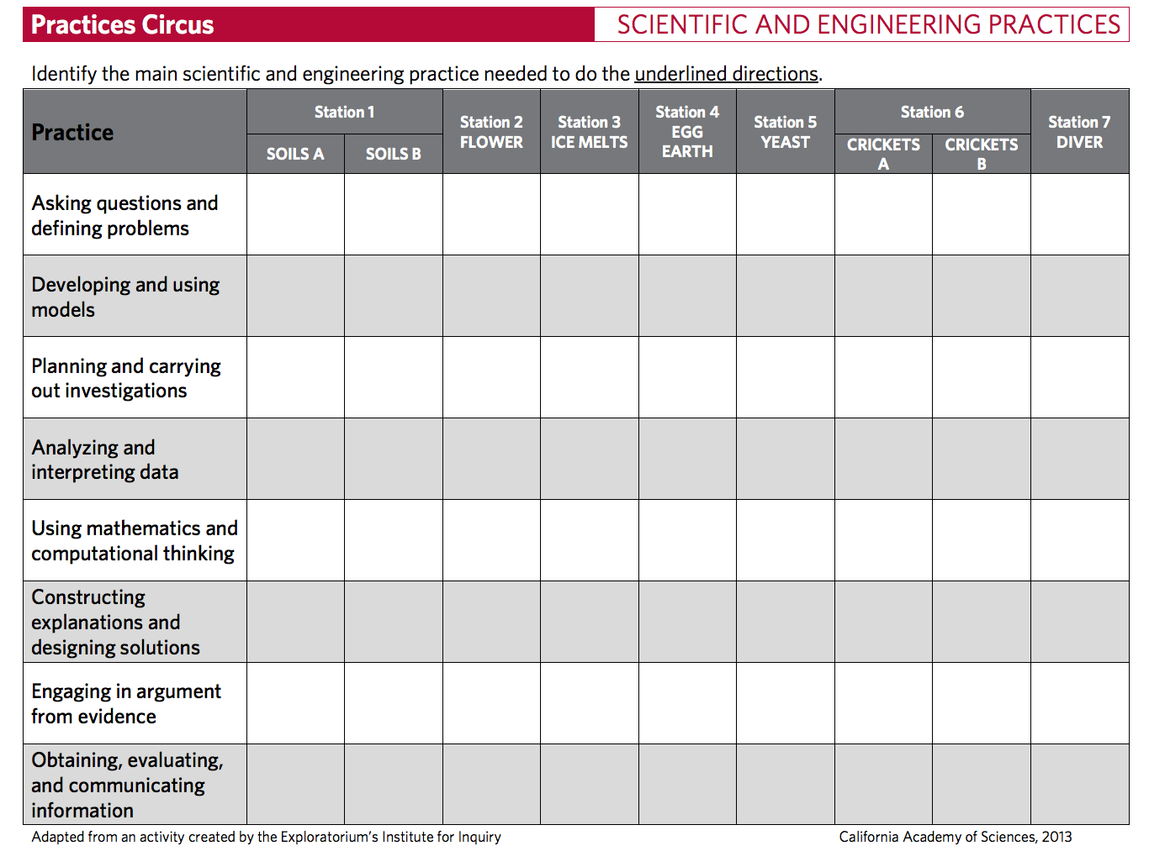
NGSS Lead States. 2013. Next Generation Science Standards: For States, By States. Appendix E: Progressions within the Next Generation Science Standards. Washington, DC: The National Academies Press.

Slide 20
There are 7 Crosscutting Concepts (CCCs)
Patterns
Cause and effect
Scale, proportion, and quantity
Systems and system models
Energy and matter
Structure and function
Stability and change
NGSS Lead States. 2013. Next Generation Science Standards: For States, By States. Appendix G: Crosscutting Concepts in the NGSS. Washington, DC: The National Academies Press.
Notes:
We are going to do an activity to get to know these

Slide 21
“Speed Dating” Definitions
Patterns | The CCC of ____ highlights that structures or events are often consistent and repeated.
Cause and effect | The CCC of ____ investigates how things are connected by identifying the reasons behind an occurrence, and what that occurrence results in.
Scale, proportion, and quantity | Different measures of size and time affect a system’s structure, performance, and our ability to observe phenomena.
Systems and system models | The CCC of _____ helps us understand the world by describing how things connect and interact. We can use simple representations to explore these interactions.
Energy and matter | These things are neither created nor destroyed, but may flow into and out of a system and influence its functioning.
Structure and function | The way something is built and the parts that it has determine how it works.
Stability and change | Over time, a system might stay the same or become different, depending on a variety of factors.
Notes:
o Experts in physics, biology, computer programing, history, teaching, and chess
o Experts use a conceptual framework of big ideas or broad categories to organize their ideas
o Novices use surface features, such as isolated facts and memorized formulas, to organize their ideas
o It’s not that experts are just “smarter”…they think differently than novices

Slide 24
Looking for Evidence of 3D Learning

Slide 25
Revisiting Dropper Poppers
Task: How can the dropper popper activity be better aligned with NGSS?
Look at the 8 practices
Cross-Cutting Concepts
Disciplinary Core Idea
Each group should be able to provide 2-3 suggestions
Hint: Go to ngss.nsta.org > The Standards and review handouts
Notes:
May want to have partner up or stay at tables

Slide 26
Looking for Evidence of 3D Learning
Dropper Poppers
& NGSS
Suggestions :
My suggestions:
PE: MS – PS3 – 5, 4-PS3-1, 4-PS3-4
DCI – PS3. A, PS3. B., PS3.D
SEP - Engaging in Argument from Evidence and Constructing Explanations (using evidence)
CCC – Energy and Matter
Record, share, and discuss data.
Construct small group and large group Claims, Evidence, Reasoning
Links to types of energy, and energy flows in and out of systems

Slide 27
Building on Lessons you Have!
Readings and Using the NGSS
Notes:
Go to https://www.nextgenscience.org/resources/how-read-next-generation-science-standards to watch the video form 2:55 to the end

Slide 28
4-PS3 in NGSS
Topic: 4th Grade, PS3 Energy
PE: 4th Grade, PS3 Energy, has 4 sub sections, clarifications, and assessment boundaries
3 Dimensions:
SEP, DCI, CCC

Slide 29
4-PS3 in NGSS
3 Dimensions
SEP, DCI, CCC, tied to each PE by code
Connections to other DCI, and Common Core (ELA/Literacy, Math)

Slide 30
Tips for USING NGSS
When searching the NGSS here are some quick tips
If you know the code (PE or DCI)
Search it on google by adding NGSS to it
Try it! Search 4-PS4 and see what you get!
If you want a better user experience
Go to ngss.nsta.org then click on “The Standards”
Here the standards are arranged by topic
Y ou can drill down to specific grades
You can drill down to the progressions
Link to NGSS Hub via NSTA
If you want to know what you need to assess
Check the NGSS evidence statements
Link to NGSS site
There is an app for that!
NGSS app is available through NSTAS on IOS, Android, and Windows

Slide 31
Strengthening your Lessons
Creating a Poster
Get in groups of 2-3
Choose a standard related to something you are already doing in your class or club
Create a poster with a sample activity that you are already doing that could be used to teach the PE, SEP, DCI, and CCC related to the topic you chose
On Poster Draw out:
The PE code (e.g. 5-PS1-1)
SE Practices
DCI
Crosscutting Concepts
Relation to activity you are already doing
USE: NGSS or ngss.nsta.org to find the standard you’d like to use

Slide 32
Poster Share out
What is your PE, DCI, CCC, and SEPs
How are they related to your activity?
How do you think these changes could complement what you are already doing in your club or classroom?
How might you use NGSS in the future?
Notes:
Connection to other DCIs
Articulation of DCIs across grade levels
Connections to the Common Core

Slide 33
What did we do?
Thank you and we hope you enjoyed the session!
Best,
Adam and Amity
Strengthen a lesson by tying it to NGSS
Become familiar with PE, SEP, DCI, and CCC
Learn how to read NGSS
Gain experience searching NGSS
Use NGSS to revise a lesson you or your peer is already doing

