Slide 1
Using Data to Tell a Story:
Isle Royale,
Not Battle Royale

Slide 2
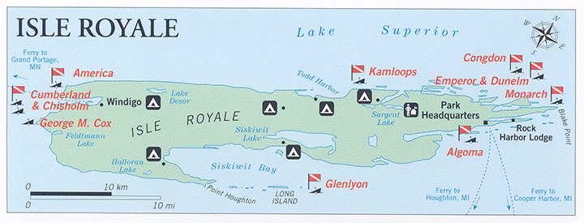
Background of the Isle Royale
Fast Facts Isle Royale National Park is 571,790 acres The number of people visiting in 2017
was 28,196 Isle Royale was made a national park on
March 3, 1931 The lowest is 601 feet at Lake Superior The highest is 1,394 feet on Mount Desor Entrance fee is $7 per person per day In the Eastern time zone Random Facts Isle Royale National Park is the only national park in the United States that completely closes in the offseason. The park is typically closed November through mid April.
The most common large mammals are moose and gray wolves. The interaction of these two species in the park has been extensively studied. On rare occasions Lake Superior completely freezes over in winter, allowing animals from the mainland to access the island.

Slide 3
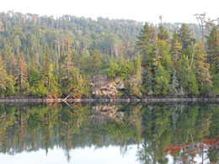
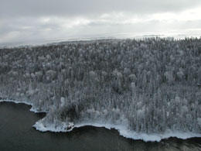
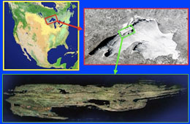
Background on Isle Royale
The Ecosystem on Isle Royale (Lake Superior)
One of the longest population ecology studies (closed system)
Images by www.isleroyalewolf.org

Slide 4
Part 1 – THEN to NOW Video Link
Images by www.isleroyalewolf.org
Notes:
Watch the video from 0-2:36 and then have students complete part 1, then after part 1 finish this video

Slide 5
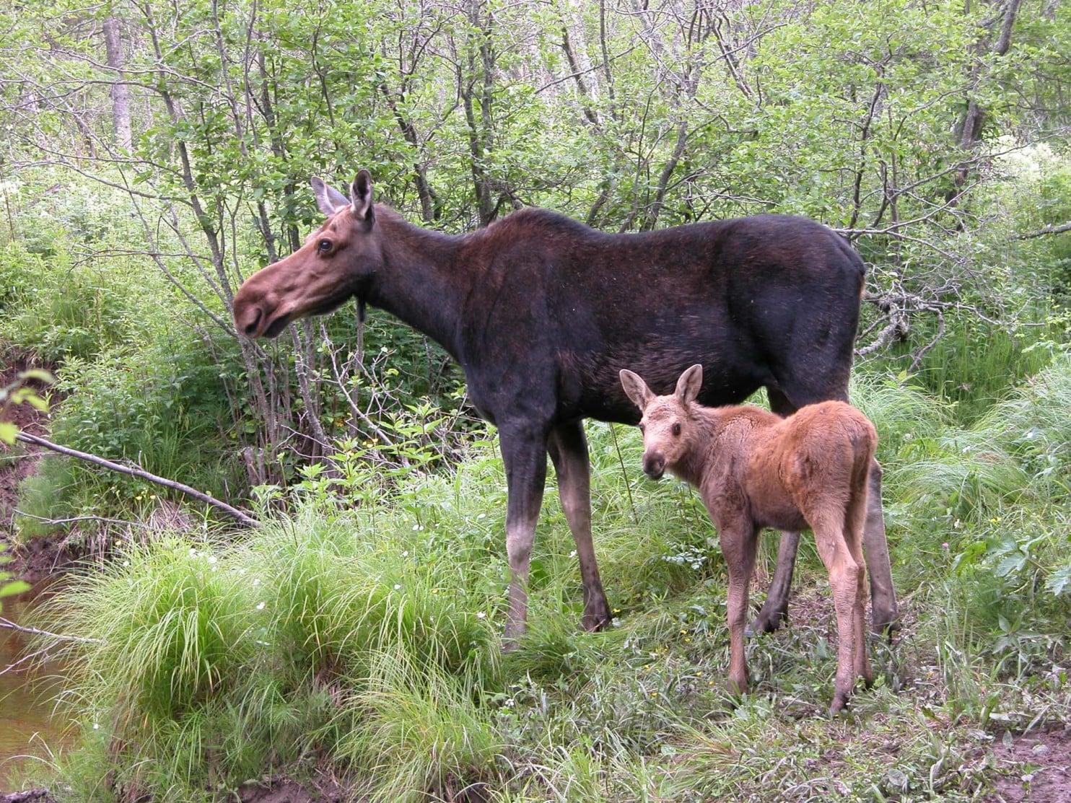
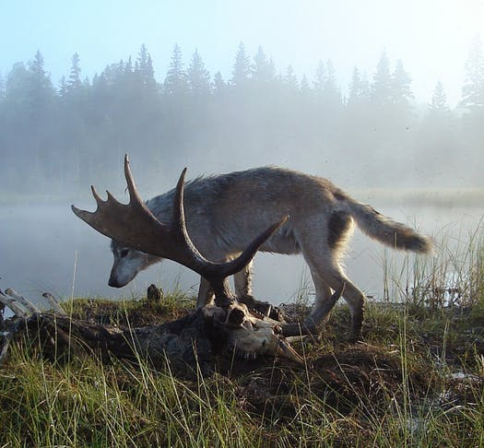
Exploring the Data (online graph)

Slide 6
Exploring the Data (online graph)

Slide 7
Exploring the Data (online graph)

Slide 8
Exploring the Data (online graph)

Slide 9
Part 1 – THEN to NOW Video Link
Images by www.isleroyalewolf.org
Notes:
Watch the video from 0-2:36 and then have students complete part 1, then after part 1 finish this video

Slide 10
Part 2 – NOW to the FUTURE Video Link
Images by www.isleroyalewolf.org

Slide 11
Q: Would you introduce wolves?
Science give us insight, but our values tell us what to do!
Images by www.isleroyalewolf.org

Slide 12
Questions?

Slide 13
Extensions/Scaffolding
Website Resource
http://www.isleroyalewolf.org/
OMS
https://wiki.islandwood.org/index.php?title=Owls,_Mice_and_Seeds
Deer Me
https://www.wolfquest.org/pdfs/Deer%20Me%20Lesson.pdf
High School
https://www.hhmi.org/biointeractive/wolves-isle-royale
Radio collar data
https://www.dfw.state.or.us/Wolves/notification.asp

