Slide 1
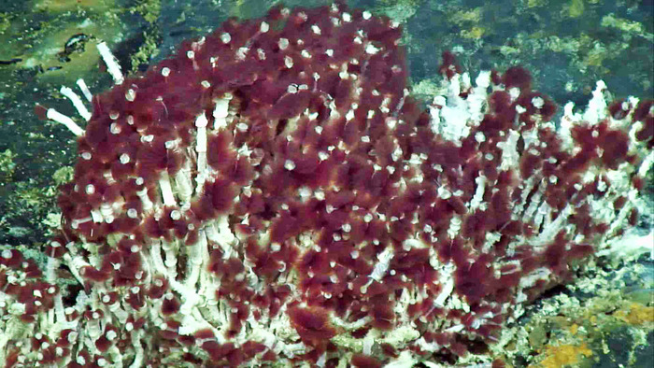
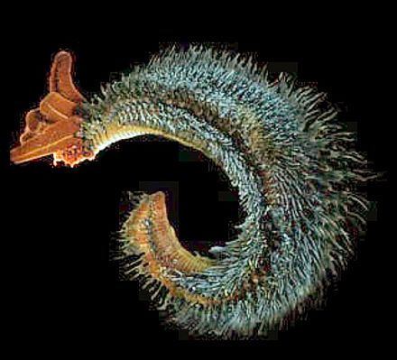
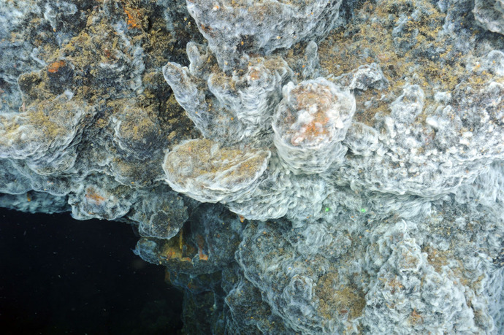
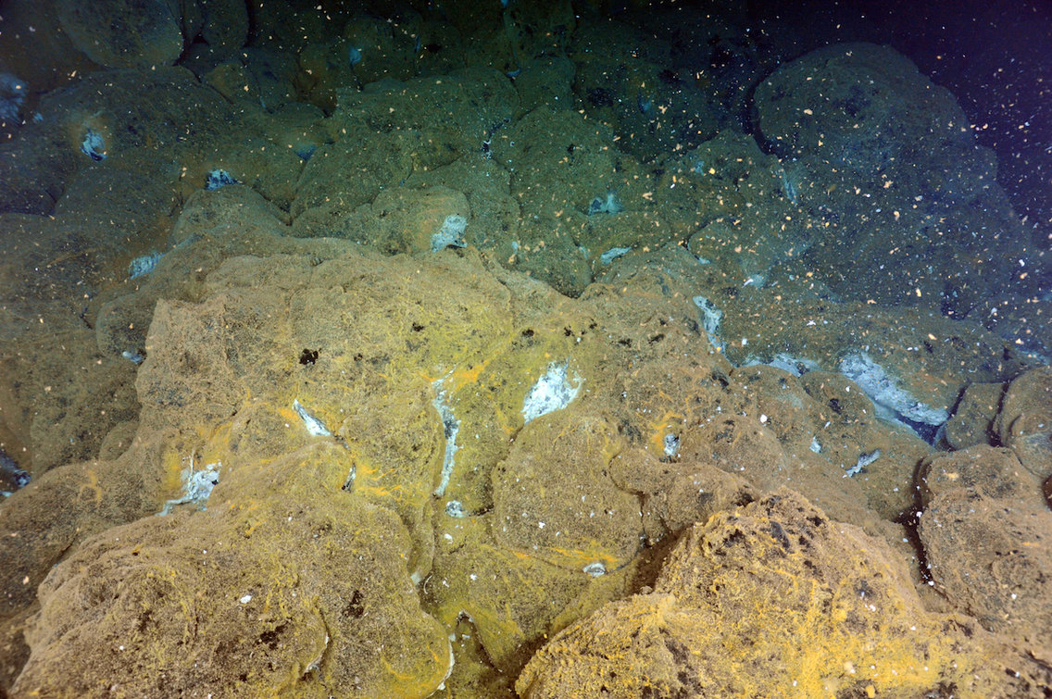
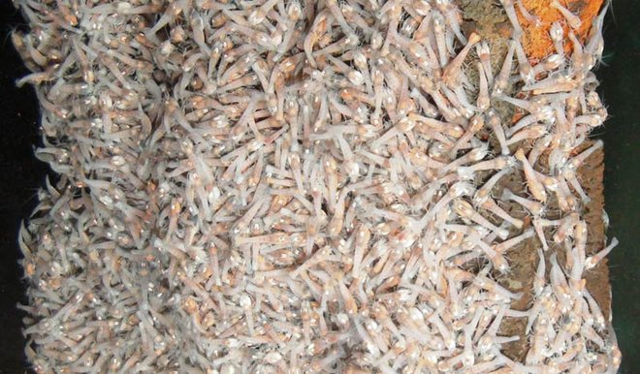
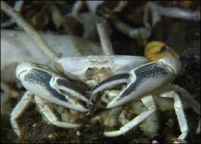
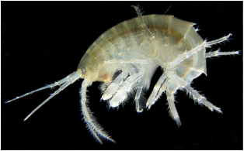
Vent Tubeworm
Pompeii worm
Tubeworms have no mouth, eyes, or stomach! Their survival depends on a symbiotic relationship with the billions of bacteria that live inside of them to produce food. They have few predators, that include crabs, shrimp, mussels, and clams. They spend most of their lives attached to hydrothermal vents, as they live in high water temperatures and sulfide concentration. “Black smoker” chimneys are often colonized by giant tubeworms. As more hydrothermal vents are explored, more and more species of tube worms are being discovered too.
The most heat-tolerant animal on Earth, able to withstand a bath as hot as 176°F. The gray “fleece” on its back is actually bacteria which the worm feeds upon. How the Pompeii worm survives the nearly boiling water emanating from the vents is a mystery!
Image Source: Interactive Oceans
Image Source: Wikipedia
Vent Bacteria
Blind Vent Shrimp
These bacteria use a process called chemosynthesis to produce sugar from the chemicals spewed out by hydrothermal vents. These bacteria, like plants or algae in most other ecosystems, form the base of the food web in vents.
Blind Vent Shrimp swarm the black smoker chimneys, feeding on the bacteria that live there. They survive in the mineral-laden water gushing from cracks in the deep-sea floor that is 350°-400°C.
Image Source: Interactive Oceans
Image Source: Live Science
Blind Brachyuran Crab
Vent Amphipod
These crabs live around vent sites in the Pacific
Ocean. These round white crabs are fierce
predators. They eat bacteria, shrimp, mussels,
clams, tubeworms, and even each other. They only fear other top carnivores.
A small crustacean, related to crabs and
lobsters, found embedded in bacterial mats
around the vents. They feed directly on bacterial mats.
Image Source: Discovery Zone Blue Planet
Image Source: Weebly

Slide 2
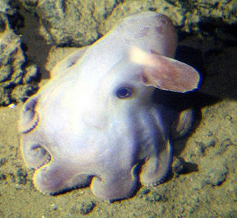
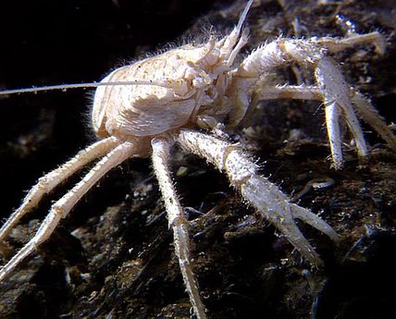
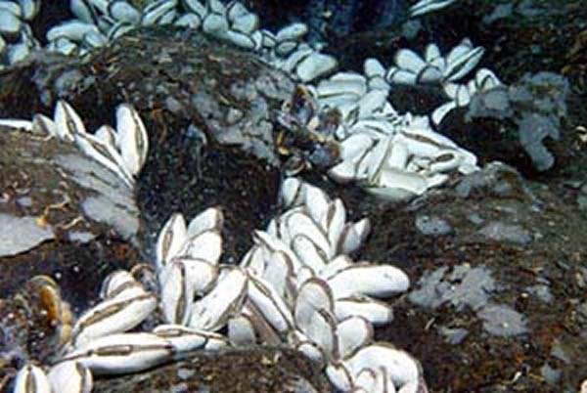
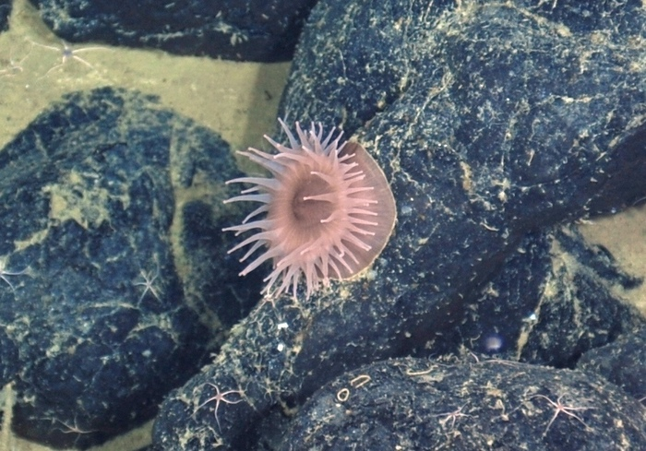
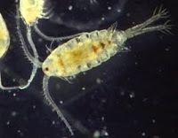
Dumbo Octopus
Squat Lobster
Dumbo octopus are named for the large, ear-like fins on the sides of their heads, which are used for swimming through the water column. Not having the ability to chew their food, the octopuses are forced to hunt small prey, which can include crustaceans, bivalves, and worms, but sit at the top trophic level.
Squat lobsters are small crustaceans that
roam about the vent ecosystem feeding
on small animals and debris. They get predated upon by large fish, octopi, blind crabs and squids.
Image Source: NOVAE
Image Source: Mother Nature Network
Vent Clams
Vent Octopus
The largest octopus observed at Axial Seamount, Graneledone pacifica, is fairly common on the lava rocks and at vent fields. At Axial, these octopods seem to be attracted to the abundant crabs, shrimp, and muscles on which they prey. The octopus may also use the hard lava rock substrate found at Axial for laying their eggs. They may not have any predators at vent sites.
Vent clams have a big muscular foot that they wedge into cracks that form in the lava. These clams use their foot to move around. They thrive on the bacteria which live inside their tissues.
Image Source: NOAA Ocean Explorer
Image Source: Interactive Oceans
Vent Anemones
Vent Zooplankton
Tube anemones attach themselves to the sea floor and use poisonous tentacles to capture prey. Most are found in shallow waters, but this vent species thrives 1.5 miles below the surface. They are first order predators and scavengers, feeding on shrimp and debris that comes within its reach. Although not a top order carnivore, they do not seem to have common predators at vent sites.
The vent zooplankton is one of the most important animals in the food chain. These drifting animals in the water column find
plenty of food in the form of the
chemosynthetic bacteria which thrive
in the hot sulfide water. They are predated upon by many creatures in vent communities, such as crabs, dandelions, and zoarcid fish.
Image Source: Insteractive Oceans
Image Source: Britannica

Slide 3
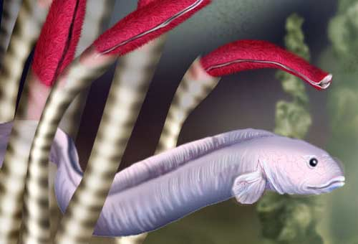
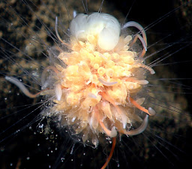
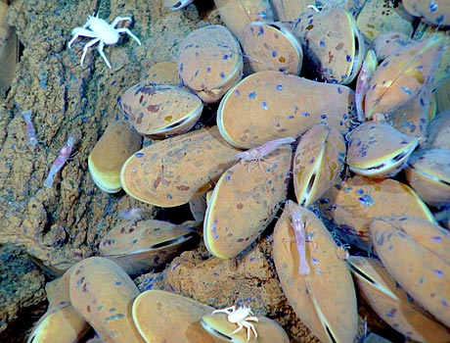
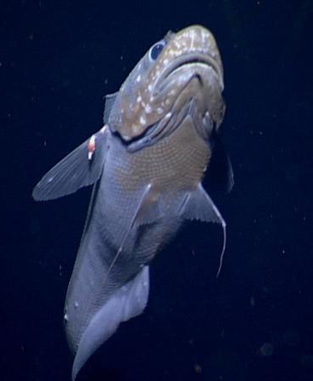
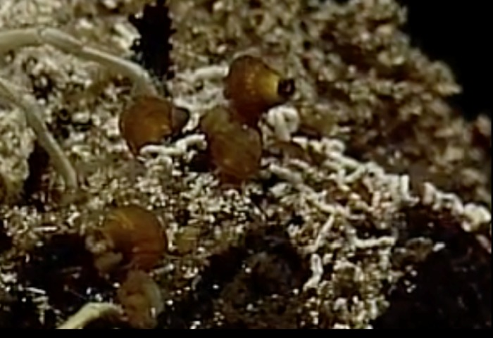
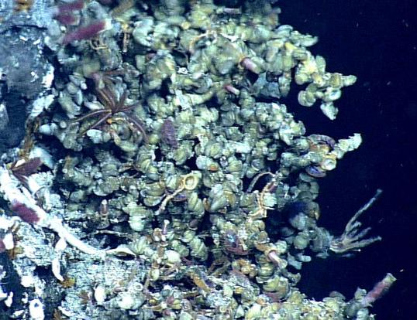
Zoarcid fish
Dandelion Siphonophores
These two-foot long white fish are top predators around vents. They eat everything from tubeworms to shrimp. Despite their huge
appetites, these fish are slow and lethargic.
They spend a lot of time floating around clumps of tube worms and mussels, while avoiding the vent octopi who eat them.
The animals in these colonies are related to jellyfish. They use long whisker-like tentacles to anchor themselves on rocks and to move around. They sting and eat shrimp and other animals and it may also be that the dandelions are scavengers. They are known to be eaten by blind crabs.
Image Source: National Science Foundation
Image Source: NOAA Okeanos Explorer
Vent Mussel
Vent Rattail fish
Mussels are very late to colonize vent sites. They clump together in the cracks in lava rock. Symbiotic bacteria live in the mussels’ gills. These bacteria use energy from chemicals in the vent fluids to produce sugars that provide nourishment for both the mussels and the bacteria. Mussels can also filter food from the water.
Rattail fish are common at Axial Seamount, and can be seen near the vents and in the surrounding areas. The vent rattail is a carnivore and feeds on a variety of animals smaller than itself. It eats crabs, shrimps, smaller fish and mussels, while not having to fear other predators at vent sites.
Image Source: NOAA
Image Source: NOVAE
Glob Snail
Vent Limpets
Limpets are a group of marine snails and are the most abundant macrofaunal organism found on Axial's hydrothermal vents. They are most abundant on sulfide chimneys, and are often attached to the abundant tube worms. They are also found occasionally on basalt lava surfaces. Like other snails at Axial, limpets feed directly off of the bacteria.
The second most dominant species of Gastropod at Axial Seamount is the Glob Snail. It is tiny with a brown high-spiral shell. It is found living among the limpets and tube worms on hydrothermal vents.
Image Source: NOVAE
Image Source: NOVAE

Slide 4
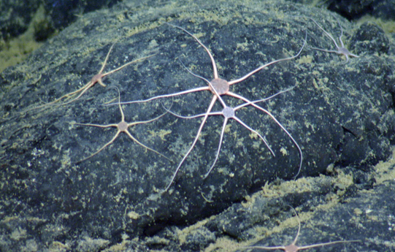
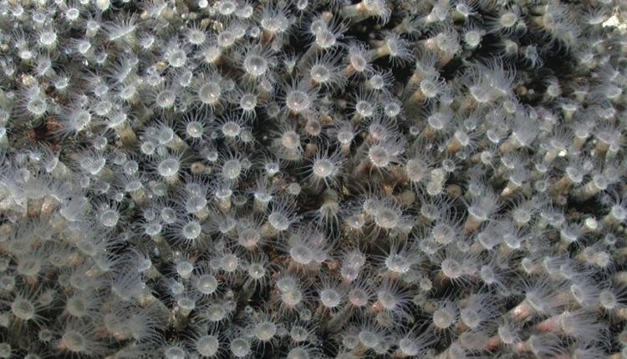
Vent Sea Urchins
Sea Cucumbers
A number of deep sea cucumbers can be found at Axial Seamount. Sea cucumbers can be found In the hottest habitat around the black smokers. These first order carnivores feed on plankton, and scavenge for detritus. They are predated upon by large fish, crabs, and possibly others.
There are a couple of unidentified sea urchins found at Axial Seamount. Above is the most common sea urchin found on Axial. Sea Urchins have been known to be herbivorous in other environments, but here it is a decomposer feeding on the detritus of the sea floor – or maybe something more? Currently, there is still much to learn about these Sea Urchins. Their main predators are top order carnivores, like crabs and large fish.
Image Source: NOVAE
Image Source: NOVAE
Brittle Star
Sea Spider
The lava rocks at Axial Seamount are covered with many species of brittle stars. They move rapidly, as brittle stars use their arms to quickly propel themselves along the lava rock. They feed on small primary consumers like crustaceans and plankton, but will also scavenge on detritus. They are predated upon by many species, such as crabs, fish, and even sea stars.
This species of sea spider is very common on hydrothermal vents at Axial. They use a tubular proboscis to prey on food, such as zoanthids, sea cucumbers, sea anemones, small crustaceans, clams, worms, sea urchins and also scavenge for food. They are generally left alone by other first and top order carnivores.
Image Source: Interactive Oceans
Image Source: NOVAE
Cockatoo Squid
Zoanthids
The Cockatoo Squid is found in the waters above Axial Seamount. These squid have sac-like bodies filled with ammonia to aid in their buoyancy. They also have a mass of tentacles above their heads that resemble a cocatiel's crest. The Cockatoo Squid has large eyes that are capable of moving from a forward looking direction to either side of its head. As a top carnivore, they feed on fish, crabs, lobsters, and even other squid.
These are flower-like zoanthids, relatives of coral, and they form a “carpet” on the hydrothermal vent sites. As a first order carnivore, they mainly feed on plankton and detritus, but are capable of eating worms and small crustaceans.
Image Source: NOVAE
Image Source: Smithsonian

Slide 5
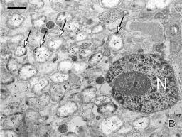
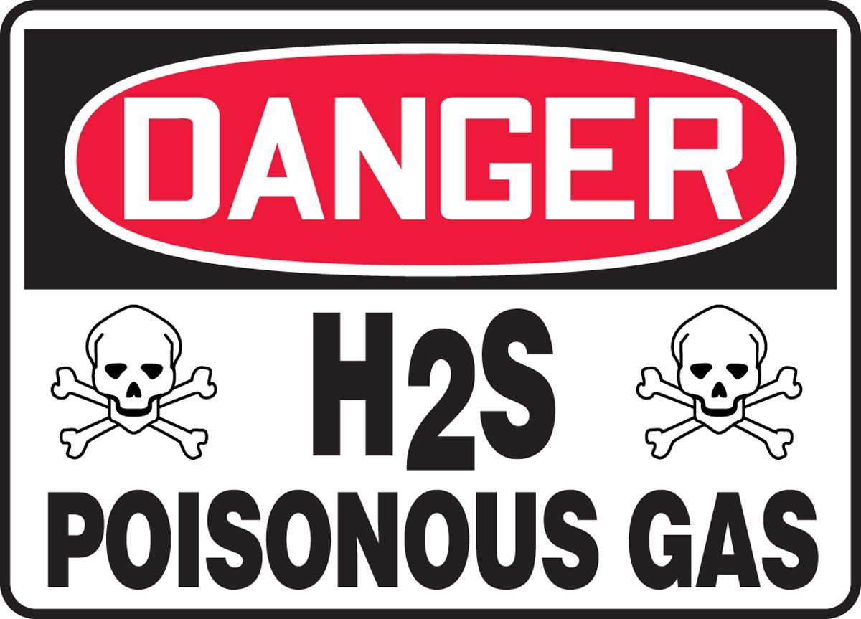
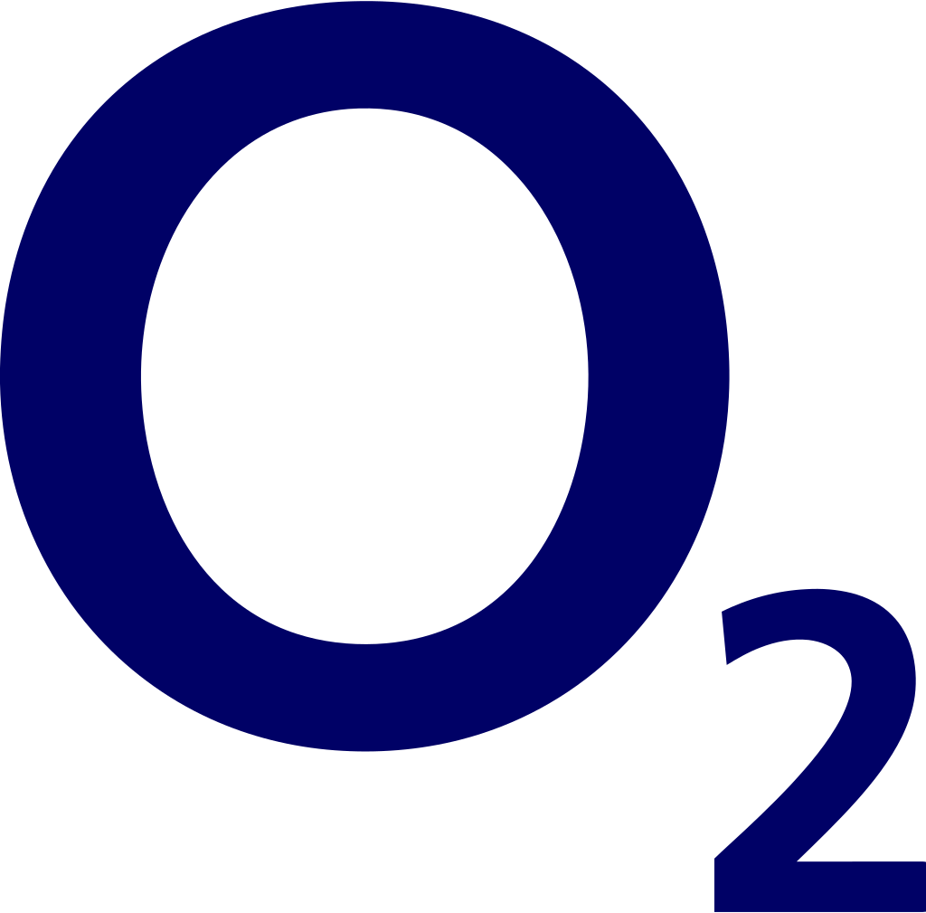
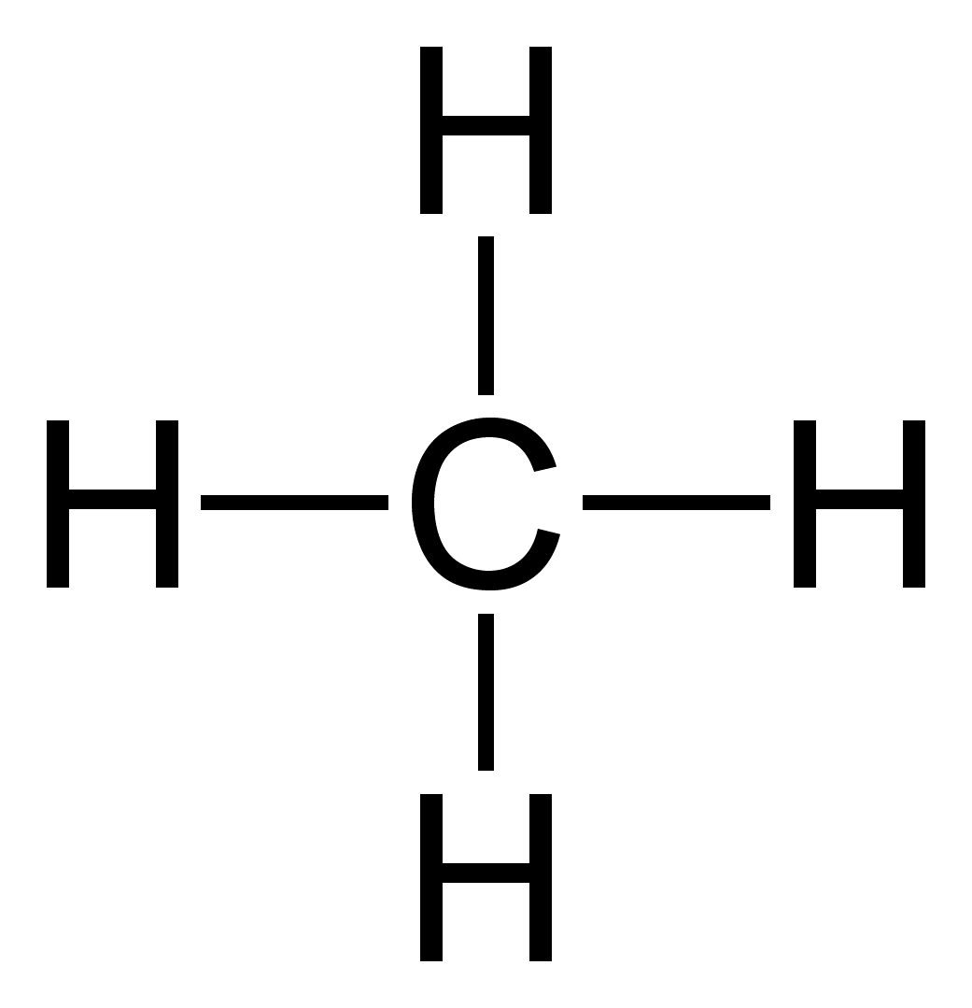
Symbiotic Chemosynthetic Bacteria
Hydrogen Sulfide
Endosymbionts of vent bivalves. A. Methanotrophic (large arrows) and sulfide oxidizing (small arrows) bacteria in mussel gills. B. Sulfide-oxidizing bacteria (arrows) in clam gill cells. N = nucleus; scale bars = 1mm.
Hydrogen sulfide is a poisonous to most living things, but in a hydrothermal vent it can be used to sustain life. This compound is a combination of the elements Hydrogen and Sulfur.
Image Source: NOAA
Carbon Dioxide
Oxygen
Carbon dioxide is a colorless gas that occurs naturally in Earth’s atmosphere. It is naturally found in volcanos, hot springs, geysers, and hydrothermal vents.
By mass, oxygen is the third most abundant element in the universe and makes up 20.8% of the Earth’s atmosphere. It is important in all forms of life. Oxygen also readily forms oxides with other chemicals by binding to them, and oxide compounds make up almost half of the Earth’s crust.
Methane (CH₄)
Decomposing Microbes
There are most likely many types of decomposing microbes to be discovered at hydrothermal vents. Also, there are many types of microbes that have been discovered that are most likely decomposers, but their exact role in the hydrothermal vent ecosystem are still being studied. These microbes include types of Archaea, that break down chemicals bonded to sulfur and need to live in environments rich in sulfur, and Bacteria, that produce Hydrogen gas.
Natural methane is found below ground and under the seafloor, when it reaches the surface it is called atmospheric methane. Hydrothermal vents seep out methane on the ocean floor, which are a major factor in shaping ocean ecosystems and global climate

Slide 6
SIMPLE CHEMICALS
(Used for Chemosynthesis)
PRIMARY PRODUCERS
(Create their own food using simple chemicals found at the hydrothermal vent, and some have symbiotic relationships with other organisms)
PRIMARY CONSUMERS
(Feed directly on primary producers – chemosynthetic bacteria - or have symbiotic relationships with them, but get predated upon by First Order and Top Order Carnivores)

Slide 7
First Order Carnivores
(Feed directly on primary consumers, but get predated upon by other First Order and Top Order Carnivores)
Top Order Carnivores
(Feeds upon Primary Consumers and First Order Carnivores, and is only predated by other Top Order Carnivores.)
DECOMPOSERS
(Interact with every trophic level to break down dead and decaying matter that has been deposited on the seafloor and that is falling down from the sea above, such as carcasses, feces, or debris. Decomposers feed on the smaller particles left behind from carnivores, scavengers and detritus feeders, as they break down nutrients to simpler forms that can be taken up by primary producers. At deep sea vents, decomposers are mainly bacteria, archaea and, possibly, sea urchins.)

