Slide 1
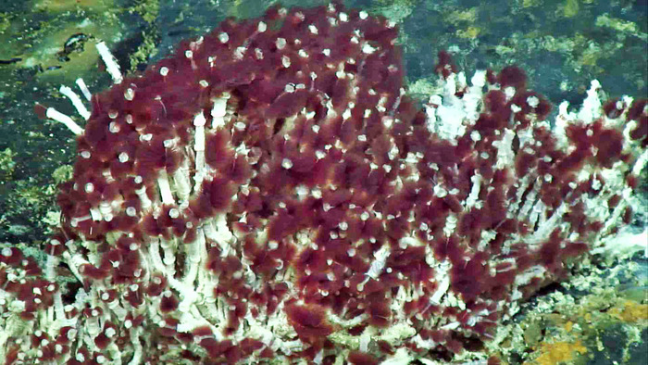
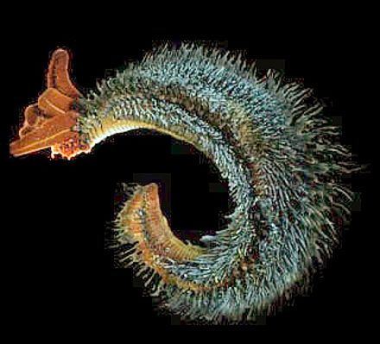
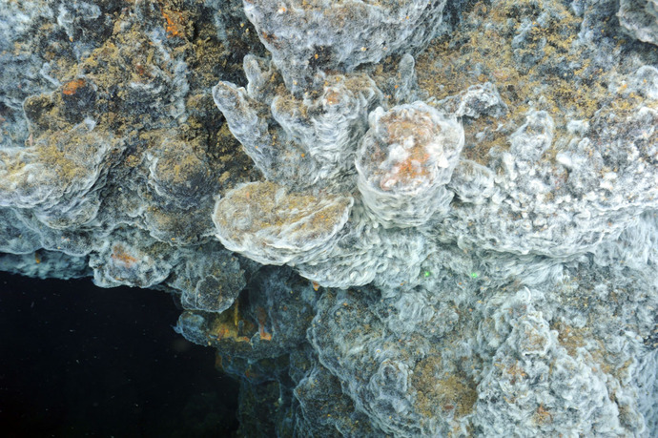
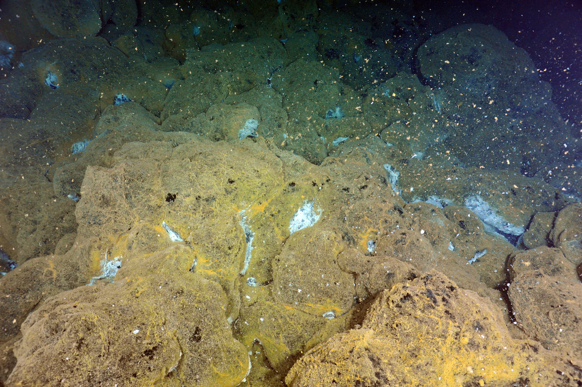
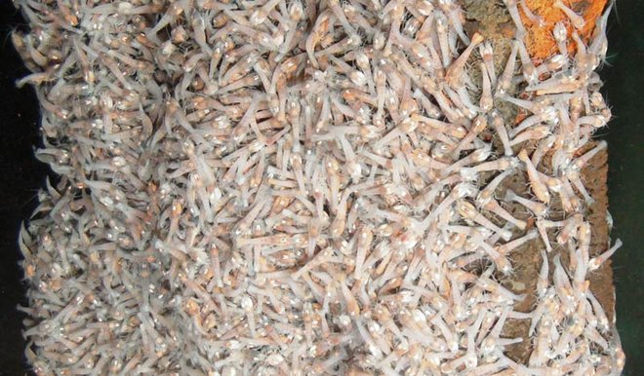
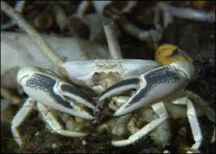
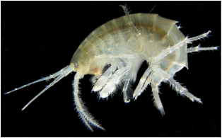
Vent Tubeworm
Pompeii worm
Predators: Crabs, shrimp, mussels, and clams
Key Information: Has a symbiotic relationships with the billions of bacteria that live inside of them
Predators: Many species found at hydrothermal vents can feed on worms
Key Information: Feeds on the bacteria living on its back
Image Source: Interactive Oceans
Image Source: Wikipedia
Vent Bacteria
Blind Vent Shrimp
These bacteria use a process called chemosynthesis to produce sugar from the chemicals spewed out by hydrothermal vents.
Predators: Many of the crabs, lobsters, and other creatures can feed on the Blind Shrimp.
Key Information: Feeds on the bacteria that living on deep sea vents
Image Source: Interactive Oceans
Image Source: Live Science
Blind Brachyuran Crab
Vent Amphipod
Predators: Squids, octopus, crabs, lobsters, large fish
Key Information: They eat bacteria, shrimp, mussels, clams, tubeworms, and even each other
Predators: Many upper level carnivores will feed on Amphipods
Key Information: Feed directly on bacterial mats
Image Source: Discovery Zone Blue Planet
Image Source: Weebly

Slide 2
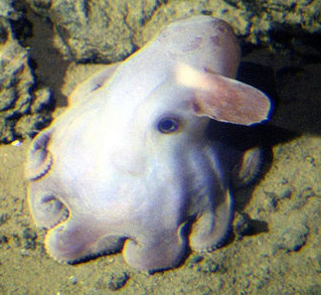
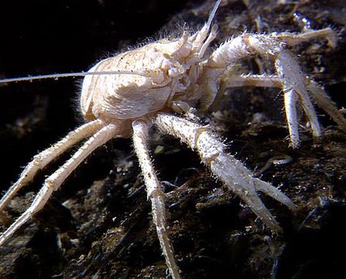
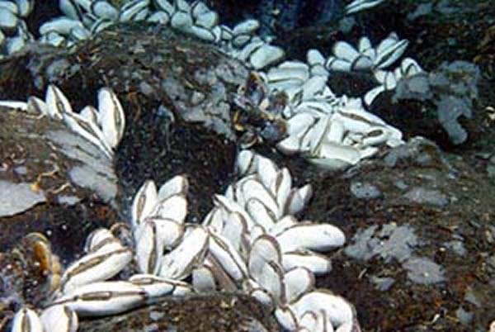
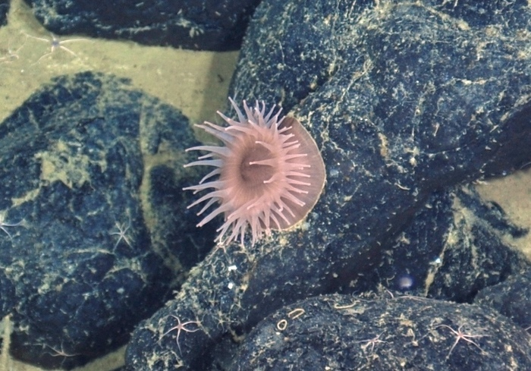
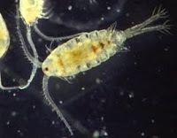
Dumbo Octopus
Squat Lobster
Predators: They do not have any natural predators commonly found at hydrothermal vents
Key Information: They hunt small prey, like crustaceans, clams, muscles, snails, and worms
Predators: Large fish, octopus, blind crabs and squids.
Key information: Feeds on a variety of smaller creatures, and will feed on dead and decaying matter
Image Source: NOVAE
Image Source: Mother Nature Network
Vent Clams
Vent Octopus
Predators: Octopus, anemones, and other creatures that can chew through their shell
Key Information: Uses symbiotic bacteria to get nutrients and feeds on plankton
Predators: This octopus does not have any common predators at hydrothermal vents
Key Information: Feeds on crabs, shrimp, and muscles
Image Source: NOAA Ocean Explorer
Image Source: Interactive Oceans
Vent Anemones
Vent Zooplankton
Predators: This creature does not have any common predators at hydrothermal vents
Key Information: Feeds on shrimp, clams, and dead and decaying debris
Predators: Predated by many creatures in vent communities, such as crabs, dandelions, and zoarcid fish
Key Information: Feed on chemosynthetic bacteria
Image Source: Insteractive Oceans
Image Source: Britannica

Slide 3
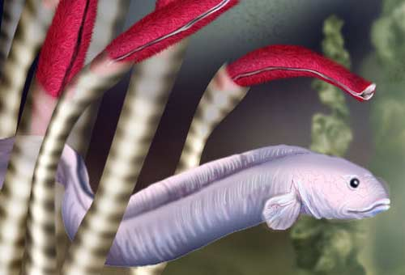
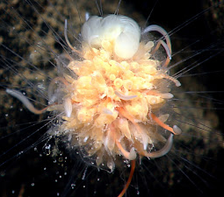
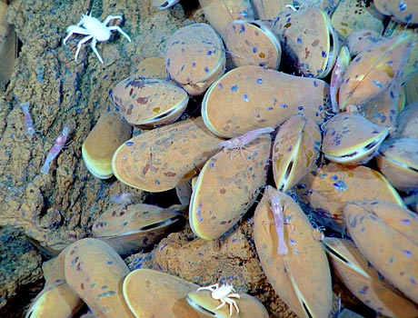
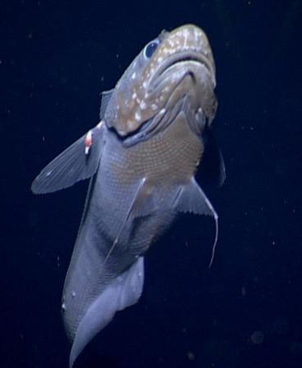
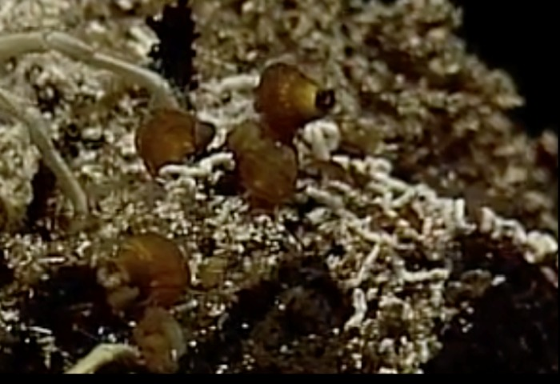
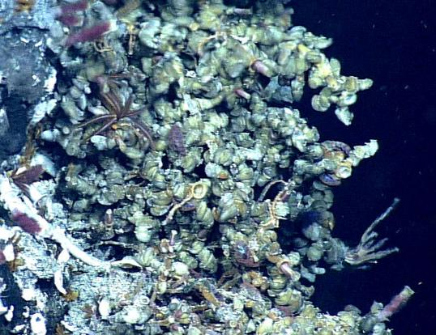
Zoarcid fish
Dandelion Siphonophores
Predators: Octopus, squids, and larger fish
Key Information: These lazy fish feed on everything, tubeworms, shrimp, crustaceans, mussels, clams, and more
Key Information: They sting and eat shrimp, blind crabs, other animals, and scavenge for food
Image Source: National Science Foundation
Image Source: NOAA Okeanos Explorer
Vent Mussel
Vent Rattail fish
Key Information: They have chemosynthetic symbiotic bacteria that helps them produce sugars that provide nourishment. They also filter food from the water around them, eating small plankton and worms
Predators: No common predators at vent sites
Key Information: It eats crabs, shrimps, smaller fish and mussels
Image Source: NOAA
Image Source: NOVAE
Glob Snail
Vent Limpets
Predators: Many creatures that can crush hard shells will feed on this creature. If it eats crustaceans or mollusks, it can eat a snail.
Key Information: Lives among limpets and tube worms on hydrothermal vents, while feeding on bacteria
Predators: Many creatures that can crush hard shells will feed on this creature. If it eats crustaceans or mollusks, it can eat a snail.
Key Information: Lives among Glob snails and tube worms on hydrothermal vents, while feeding on bacteria
Image Source: NOVAE
Image Source: NOVAE

Slide 4
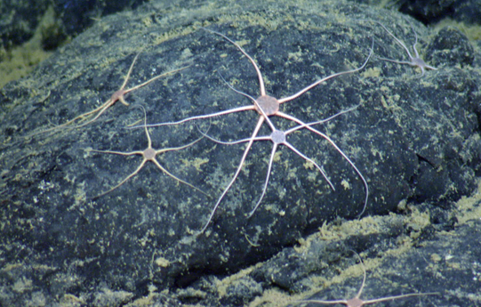
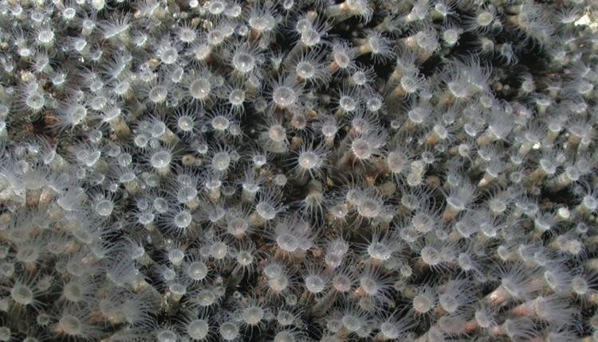
Vent Sea Urchins
Sea Cucumbers
Predators: large fish and crabs
Key Information: Feeds on plankton,
and scavenge for detritus
Key Information: Sea Urchins have been known to feed on algae in other environments, but here it is a decomposer feeding on the detritus of the sea floor
Image Source: NOVAE
Image Source: NOVAE
Brittle Star
Sea Spider
Predators: Crabs, fish, and sea stars
Key Information: Feeds crustaceans and plankton. But will also scavenge on dead and decaying matter
Key Information: Feeds on may creatures, like zoanthids, sea cucumbers, sea anemones, small crustaceans, clams, worms, sea urchins and dead decaying matter
Image Source: Interactive Oceans
Image Source: NOVAE
Cockatoo Squid
Zoanthids
Predators: Does not have any natural predators at the Axial Seamount Vent sites
Key Information: feed on fish, crabs, lobsters, and even other squid
Key Information: mainly feed on plankton and detritus, but can eat worms and small crustaceans
Image Source: NOVAE
Image Source: Smithsonian

Slide 5
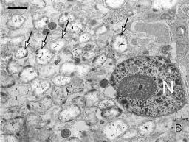
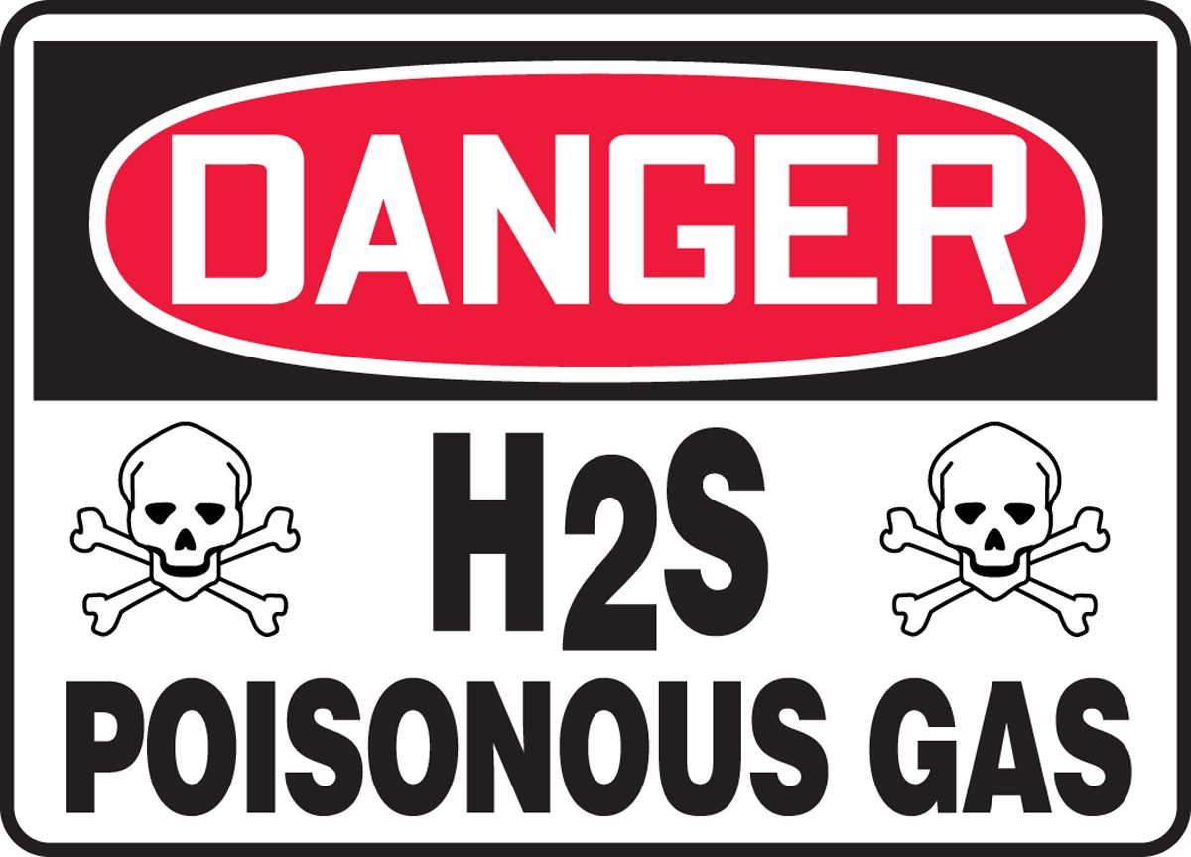
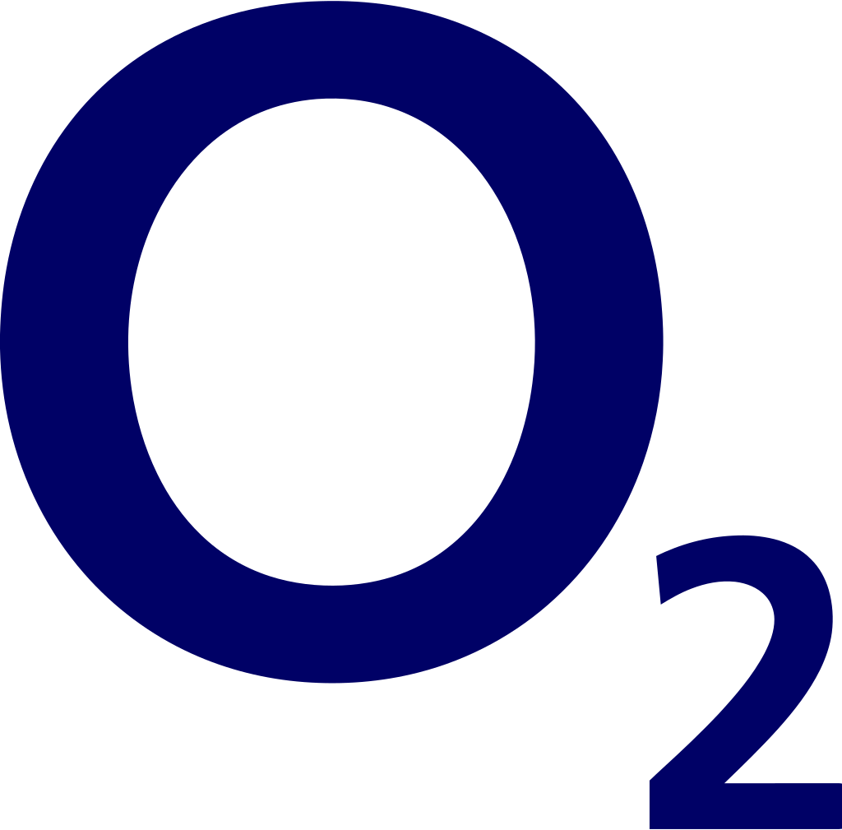
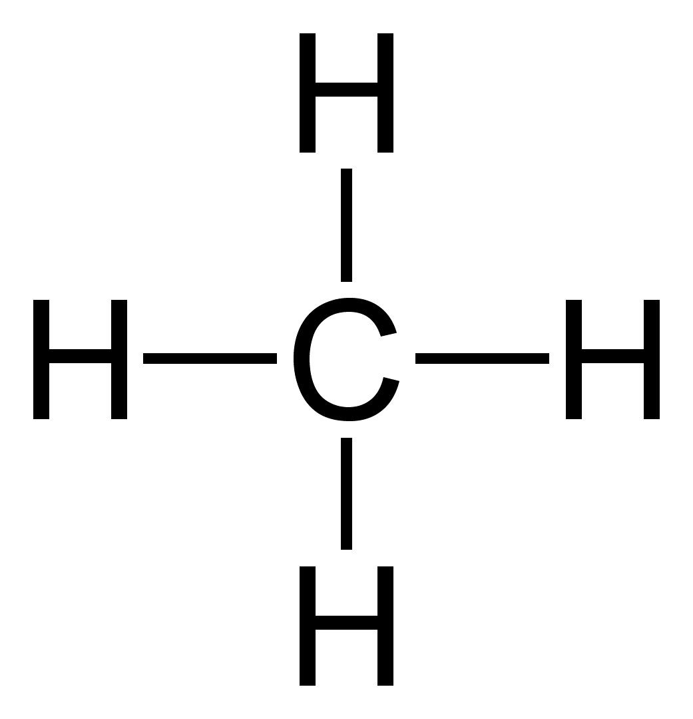
Symbiotic Chemosynthetic Bacteria
Hydrogen Sulfide
Key Information: Usually lives inside another organism to get shelter and food, but also helps the other organism create food or additional nutrients.
Hydrogen sulfide is a poisonous to most living things, but in a hydrothermal vent it can be used to sustain life.
Image Source: NOAA
Carbon Dioxide
Oxygen
It is naturally found in volcanos, hot springs, geysers, and hydrothermal vents.
Oxygen is important in all forms of life.
Methane (CH₄)
Decomposing Microbes
Predators: Anything that feeds on bacteria or microbes.
Key Information: There are many types of decomposing microbes to be discovered at hydrothermal vents. They break down all the dead and decaying mater falling from the seafloor.
Hydrothermal vents seep out methane on the ocean floor, which is a major factor in shaping ocean ecosystems

Slide 6
SIMPLE CHEMICALS
(Used for Chemosynthesis)
PRIMARY PRODUCERS
(Create their own food using simple chemicals found at the hydrothermal vent, and some have symbiotic relationships with other organisms)
PRIMARY CONSUMERS
(Feed directly on primary producers – chemosynthetic bacteria - or have symbiotic relationships with them, but get predated upon by First Order and Top Order Carnivores)

Slide 7
First Order Carnivores
(Feed directly on primary consumers, but get predated upon by other First Order and Top Order Carnivores)
Top Order Carnivores
(Feeds upon Primary Consumers and First Order Carnivores, and is only predated by other Top Order Carnivores.)
DECOMPOSERS
(Interact with every trophic level to break down dead and decaying matter that has been deposited on the seafloor and that is falling down from the sea above, such as carcasses, feces, or debris.)

