Slide 1
Mission:

Slide 2
Mission:
SUBMERSIBLE

Slide 3
Mission:
SUBMERSIBLE
Renee O’Neill, SMILE
Don B. Hilliard, RCRV

Slide 4
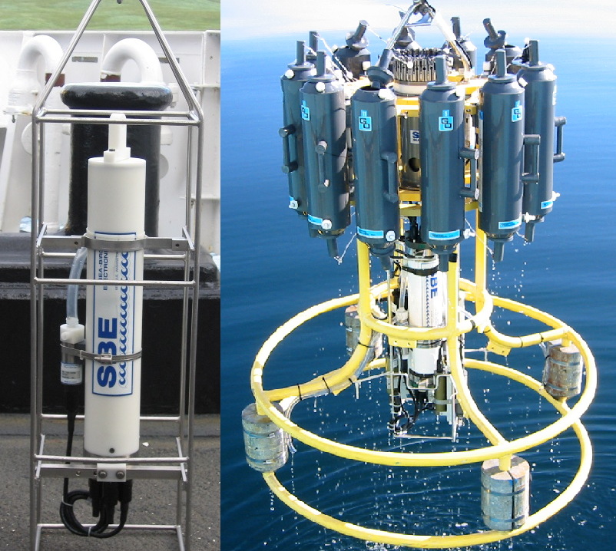
CTD (Conductivity, Temperature, Depth)
Measures conductivity, temperature, and pressure of seawater
Some can measure:
salinity of water
phytoplankton in water
Sampling takes place one location at a time

Slide 5
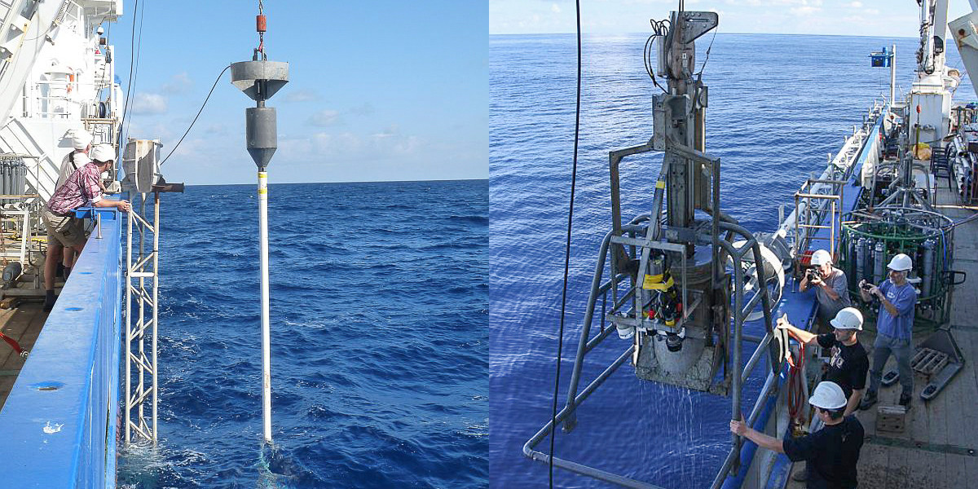
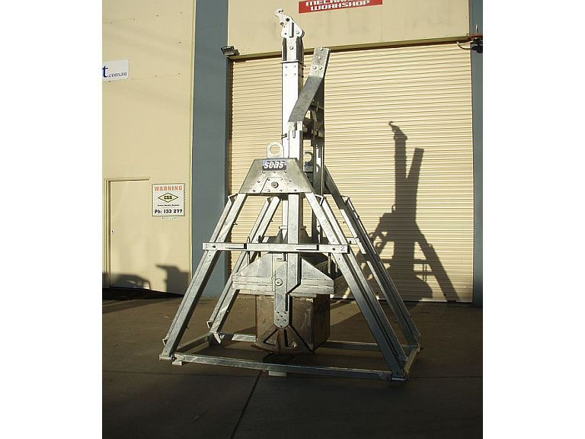
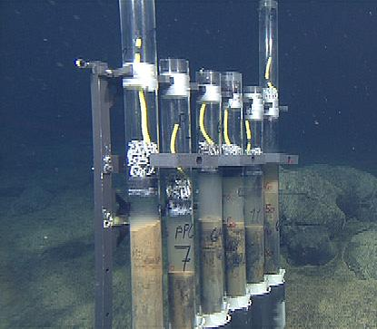
Coring Devices (Piston or Box)
Collect ocean sediment and mud samples (some including phytoplankton)
Used to study ocean circulation, climate, formation of ore deposits, movements of oceanic plates, stability for oil drilling and exploration
Many types of corers for different depths
Box
Piston

Slide 6
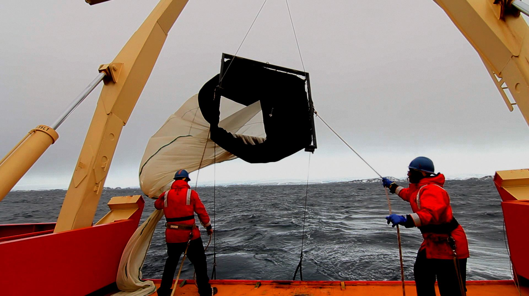
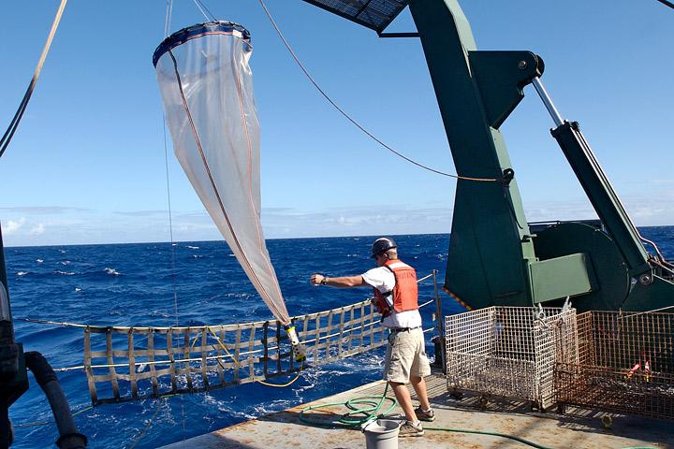
Nets
Used in the collection of phytoplankton, microplastics, and fish

Slide 7
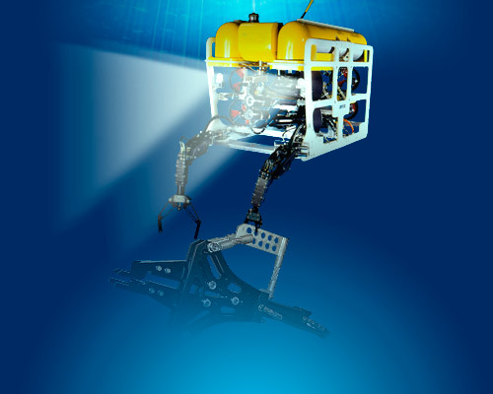
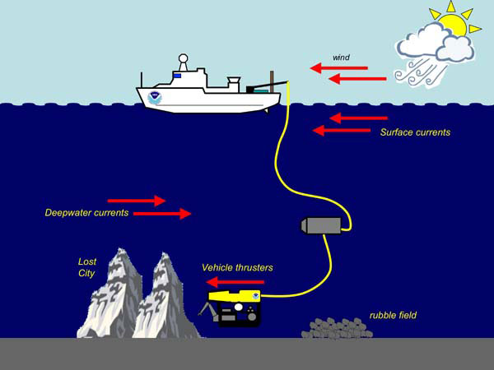
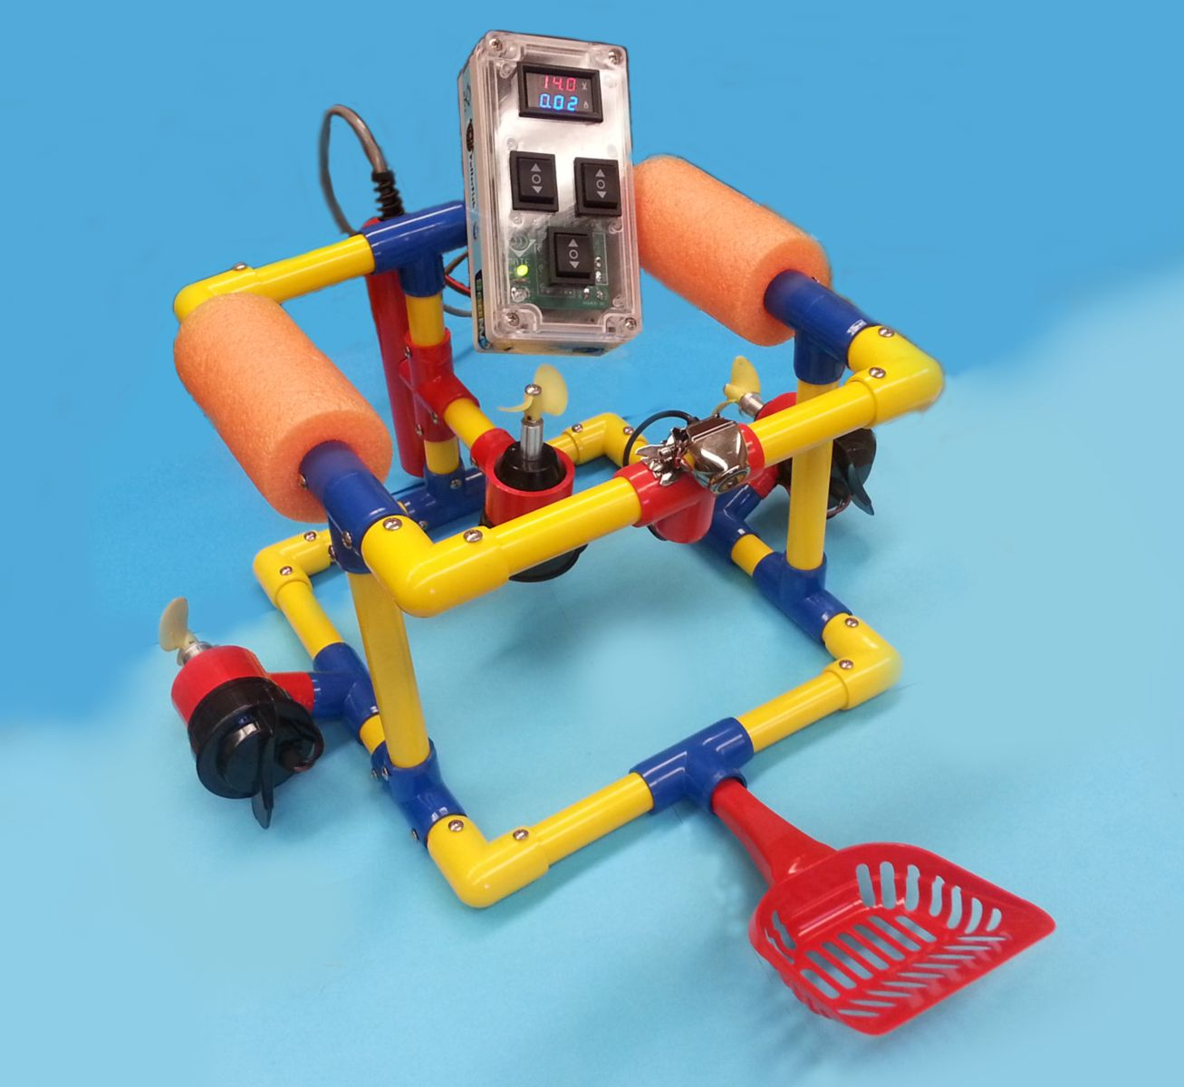
ROVs (Remotely Operated Vehicles)
An underwater robot
Pilot is not in the vehicle, it is controlled by a human on the vessel
Come in all shapes and sizes
Notes:
http://www.instructables.com/id/Underwater-ROV/

Slide 8
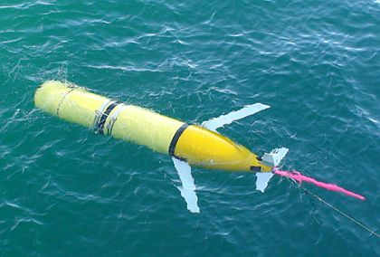
Other types of underwater robots
Autonomous underwater vehicle (no cables)
Seagliders
Buoys
Wave gliders
Drifters

Slide 9
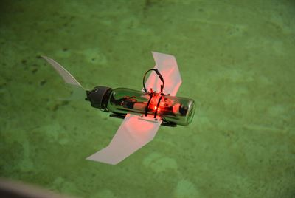
What are Underwater Robots used for?
Scientific research
Collecting real time video and physical samples of the marine environment
Seafloor mapping
Underwater archaeology
Oil and gas drilling support
Reconnaissance
Telecommunications
Ship maintenance
Student competitions

Slide 10
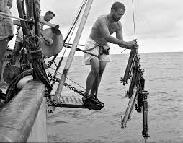
Launch and recovery methods:
All by hand
Mechanically operated bottles

Slide 11
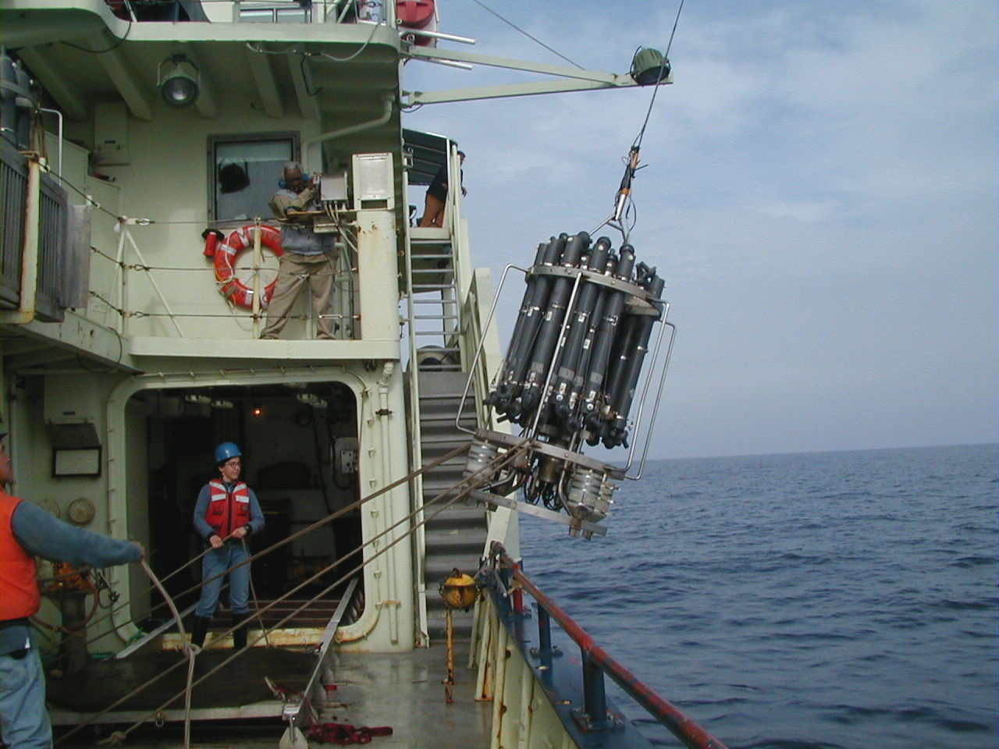
Launch and recovery methods: boom
Simple & easy to build & maintain
NOT so easy to control the package!

Slide 12
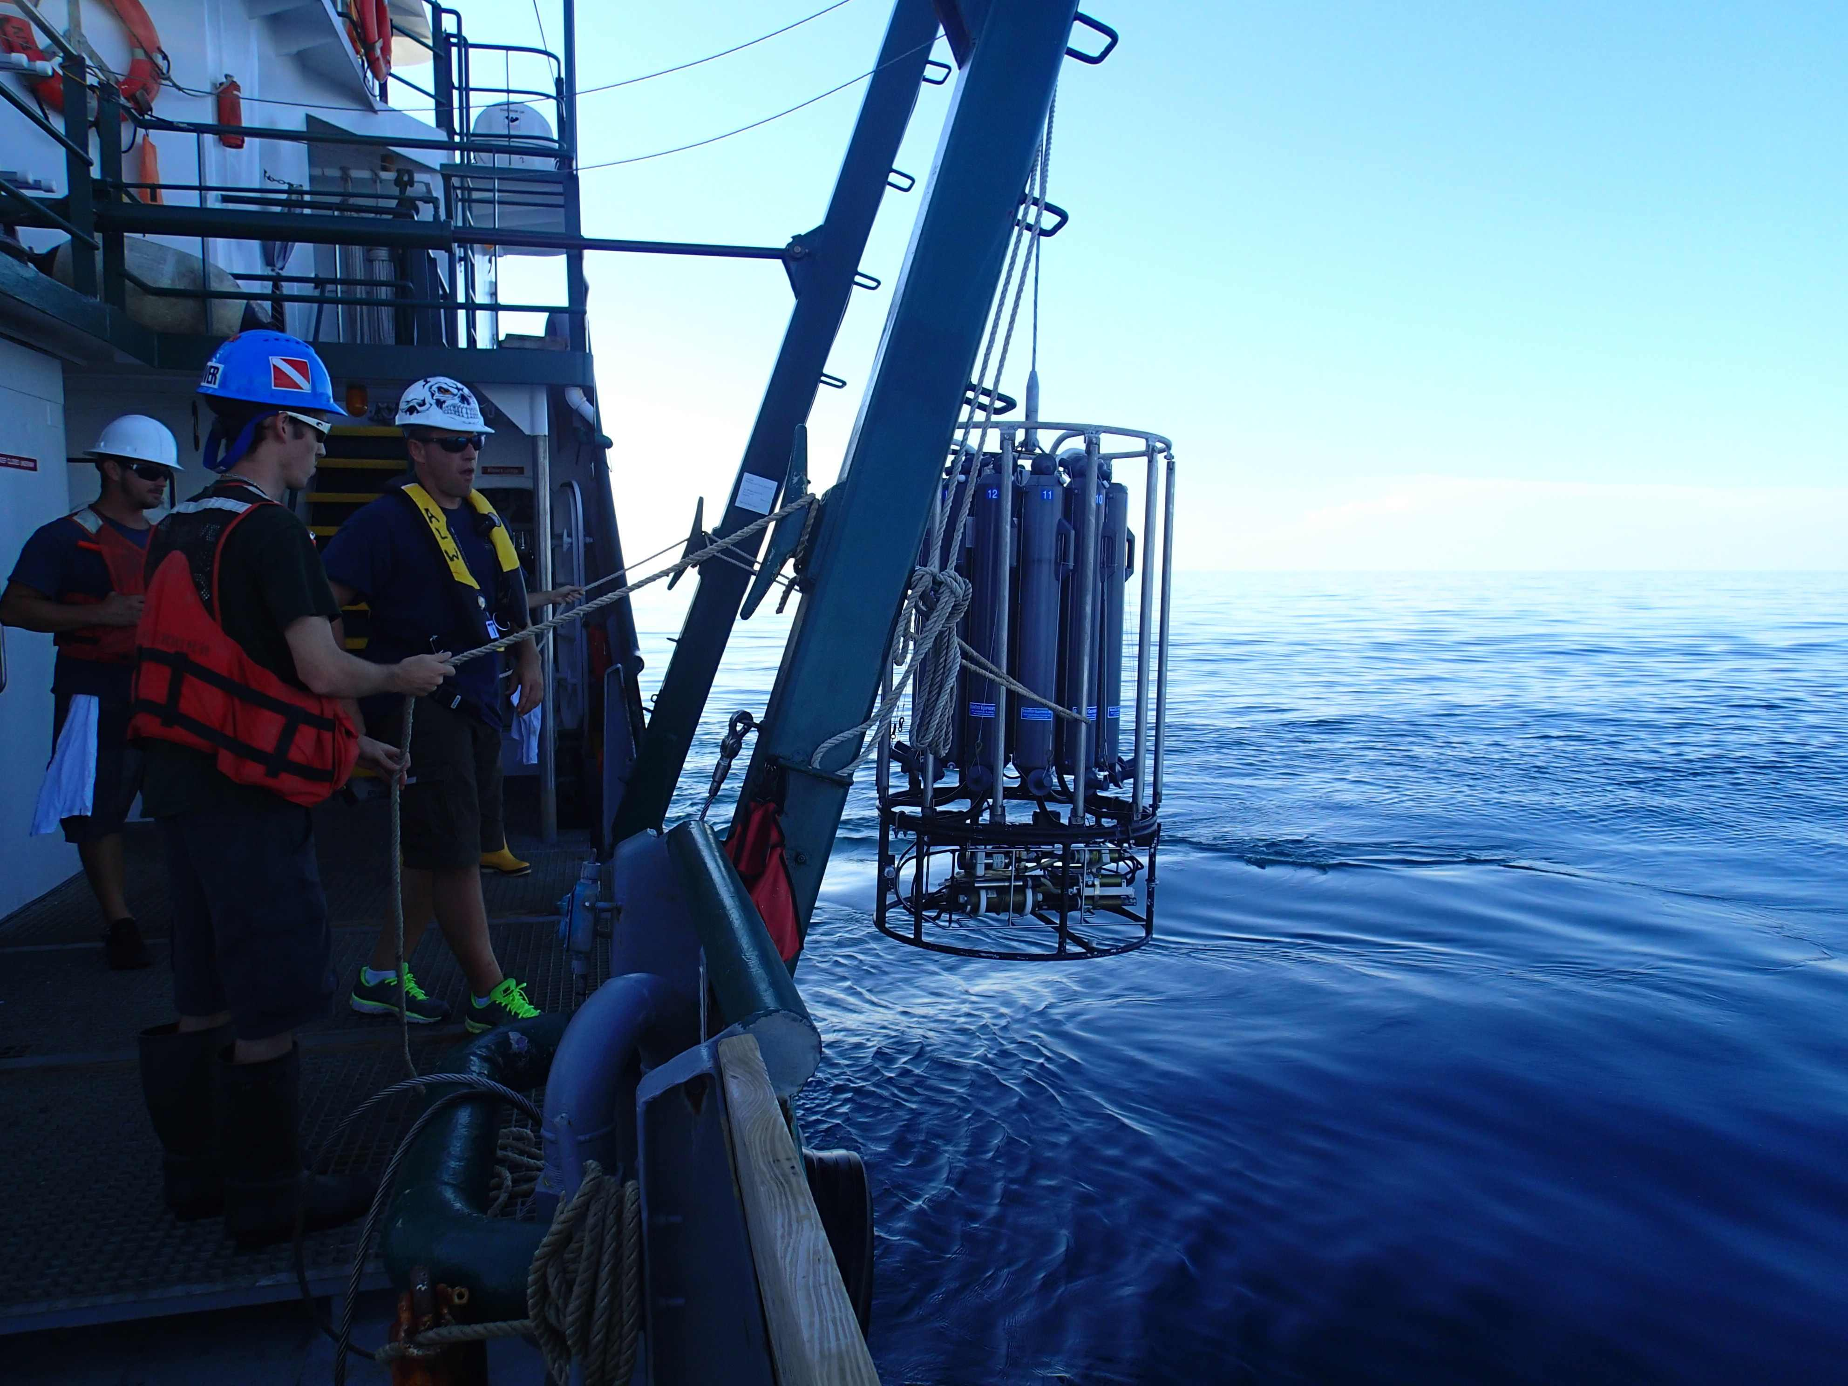
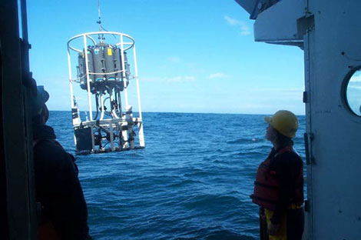
LAUNCH AND RECOVERY METHODS: FRAME
Reduces but doesn’t eliminate swing
Requires very skilled operator or
longer process
Most can’t get close to the water

Slide 13
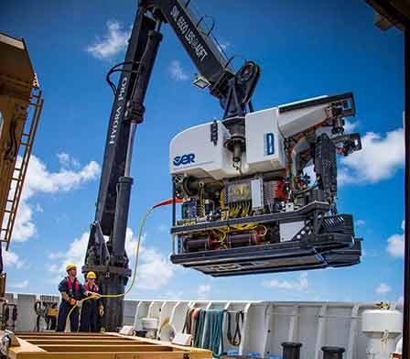
Launch and recovery methods: Crane arm
Much tighter control
Still requires a skilled operator
Often can’t get close to the water

Slide 14
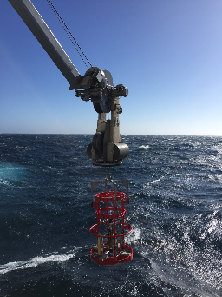
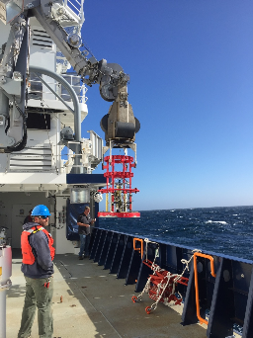
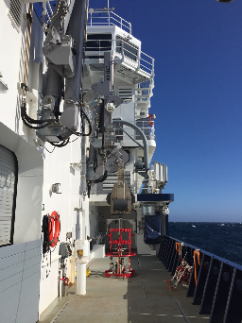
Launch and recovery methods: l.a.r.s
Fully automated
Package fully controlled until
within a few feet of the surface
“Heave” compensated

Slide 15
Mission:
SUBMERSIBLE

Slide 16
Mission:

