Slide 1
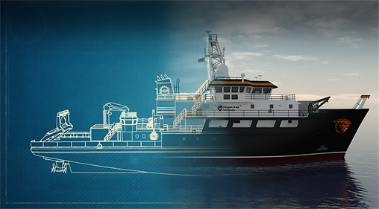
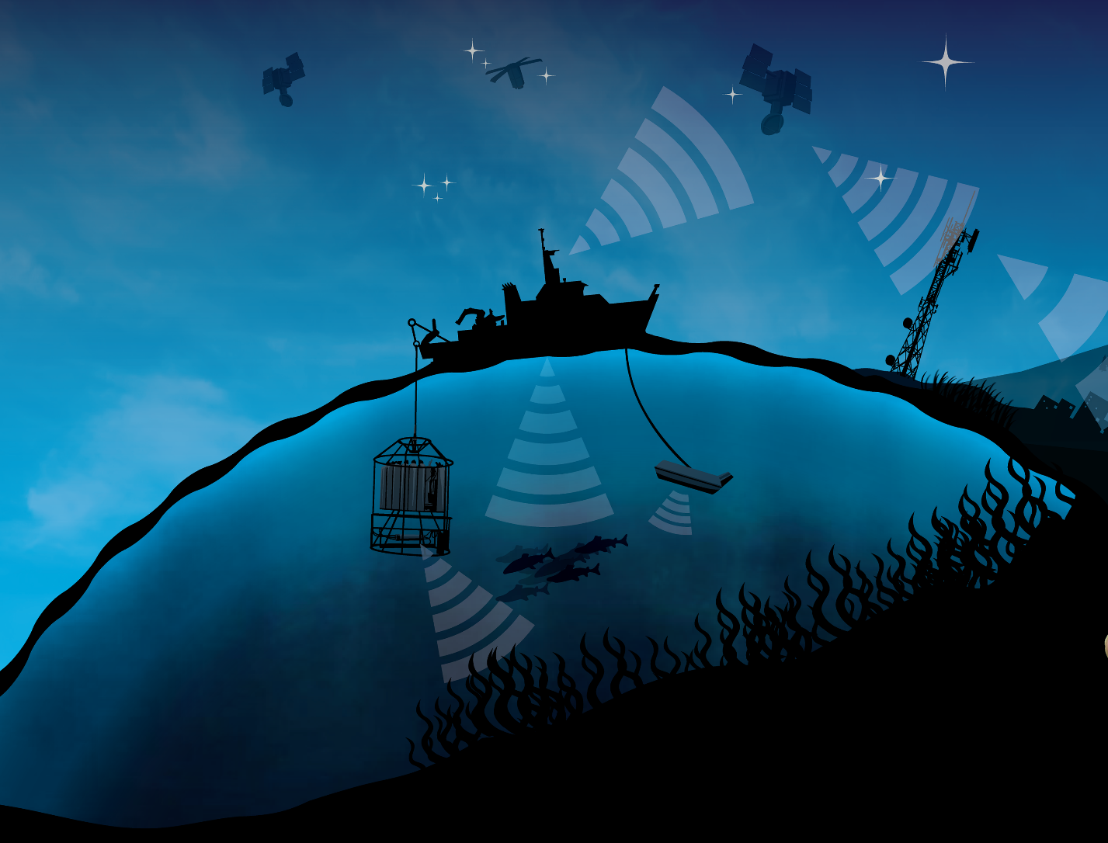
DATA DRIVEN ACTIVITES FOR OCEAN SCIENCE
Adam Talamantes & Kate Kouba

Slide 2
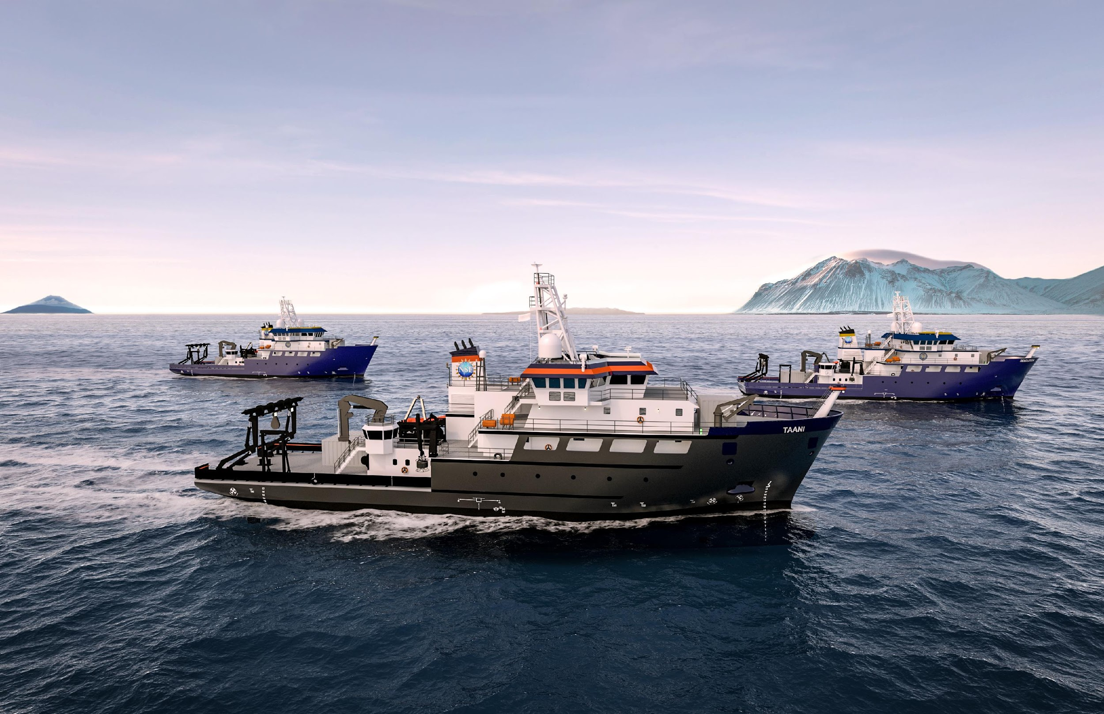
OSU, URI, Gulf of Mexico University Research Consortium

Slide 3
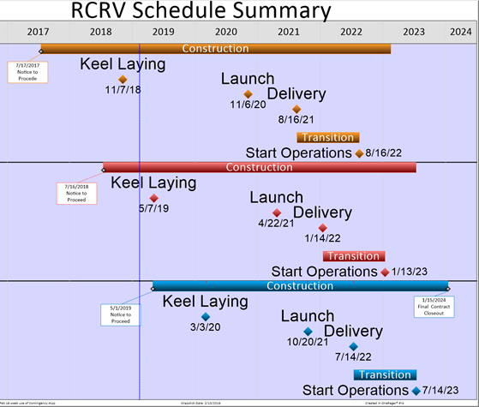
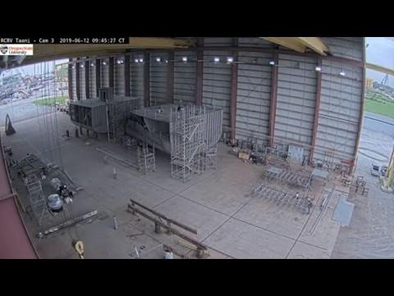
RCRV Program Update from Louisiana’s Gulf Coast Shipyards!
https://ceoas.oregonstate.edu/ships/rcrv/
OSU - 8/2021, 8/2022

Slide 4
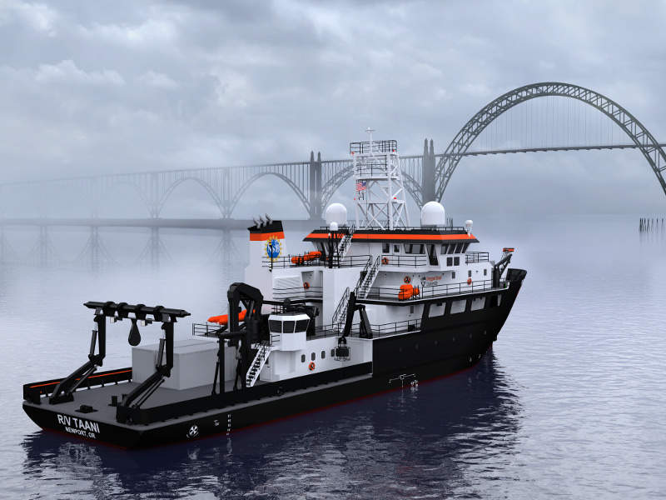
Outline
Data Tips
NGSS
Data Story

Slide 5
Framing the Data Story
Who, how, why, when?
Active
Researchers
Tools / Research Vessels
Jobs / Careers
Local / Community Members
Sorting/Analyzing
Generating
Discussion
Interpretation
Technology

Slide 6
Accessible Data Reduces “Math” Phobia
Youth and Data
Canned Data
Cell Phones
Google Maps
Facebook Analytics
Weather Forecasts
Sabermetrics
Other?
Limited Errors
Historical
Sub set
Phenomena Oriented
*Easy to Analyze*

Slide 7
Tips for Engaging Youth in
Data Driven Lessons
Accessible
“Math Phobia”
Remind youth they already use data
Tell the Story Behind the Data
Who collected it?
Why did they collect it?
When and how did they collect it?
What could it be used for?
Make it Active
Tangible
Technology

Slide 8
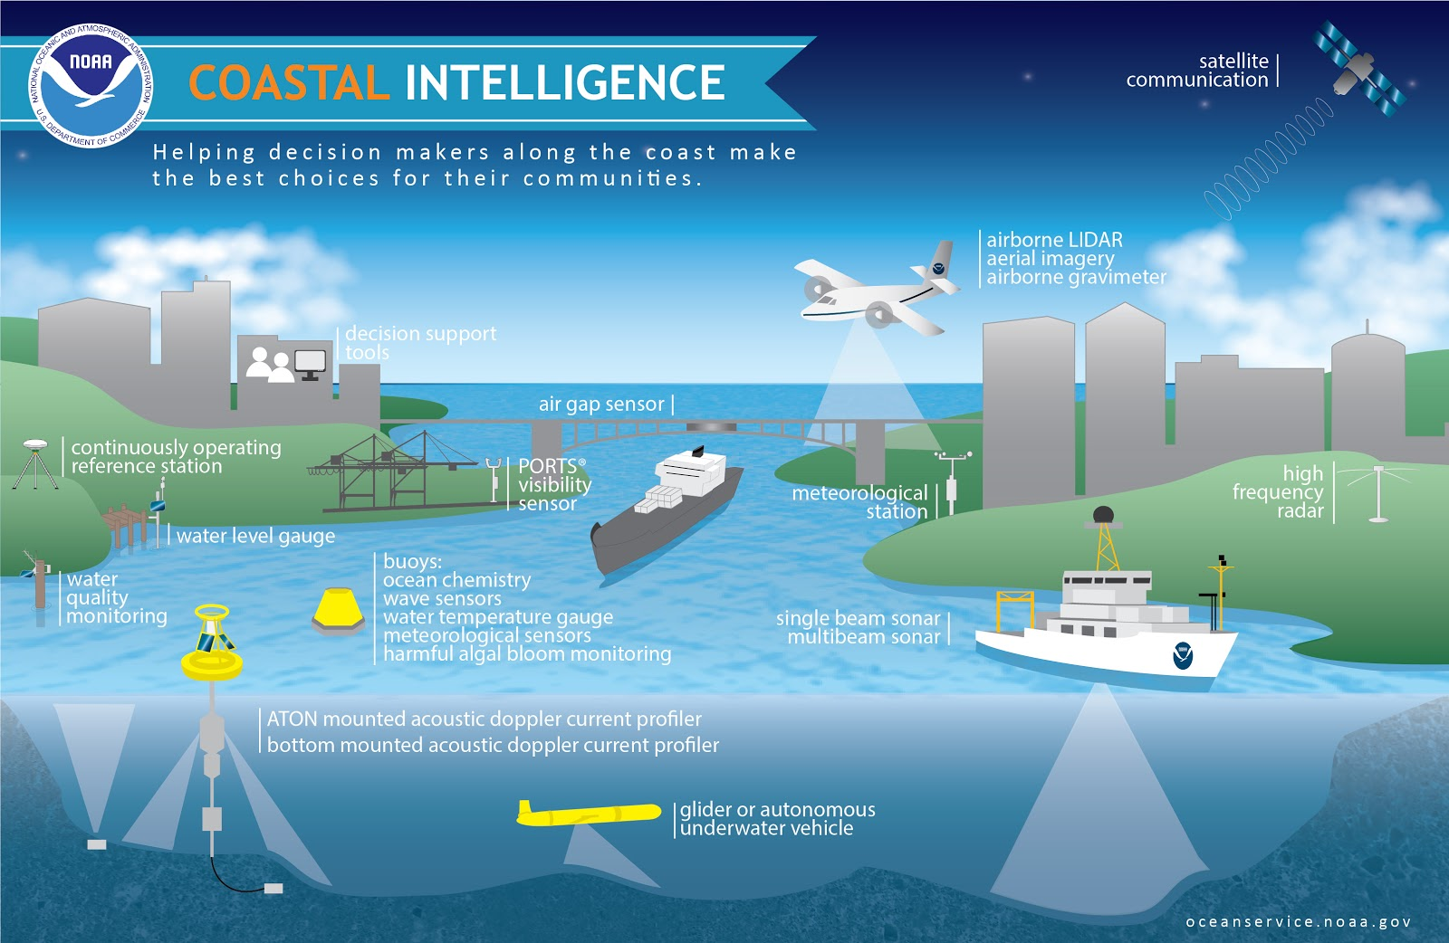
NGSS: Scientists use a variety of tools

Slide 9
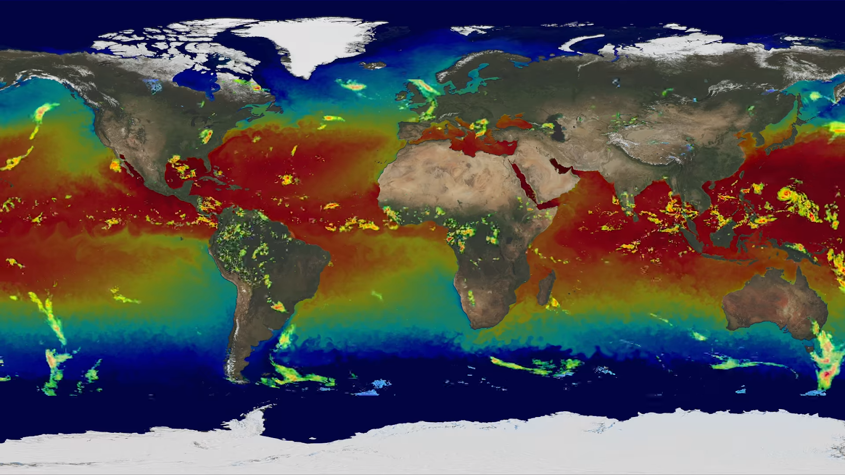
NGSS: Systems and System Models

Slide 10
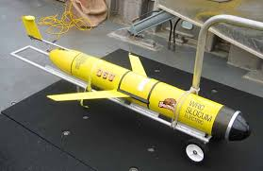
OSU Glider Jane
Active from 2006-2013
842.5 days at sea
60 deployments
313 trips
1,200 miles traveled
Specs
½ knots (.6 mph)
3-4 weeks run time
7ft long, +100lbs
Sensors, computers, batteries, communication equipmentz
Glider Video
Notes:
Jennifer Video
Glider Video

Slide 11
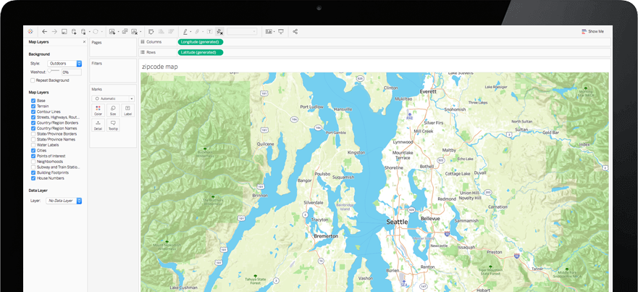
Data to IPads
Tableau Public
Create class account
Load up blank data books from Excel
Login and edit online
*Students can make Excel files in later exercises*
Creating an Activity Account
Talamana@
Oregonstate.edu
SMILE1234!

Slide 12
Holland Games and Ocean Science Careers
Kids and Careers

Slide 13
Science is Down by People for People

Slide 14
Losing STEM Professionals
4/5th grade decide on STEM as an option
4th grade Math scores matter
Access to caring adults in a STEM context maters
Developing a STEM identity matters
“Recruit Resources” to learn cool “STEM”
College – URM most likely to transfer out from STEM major
“Develop a Resilient STEM Identify”

Slide 15
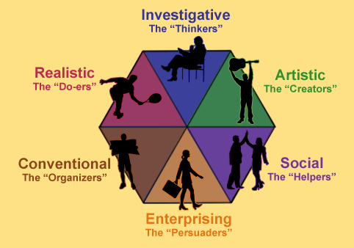
HOLLAND
GAMES
Notes:
Holland was a psychologist who categorized careers related to what people like to do, so by learning about yourself you can learn about careers that may interest YOU! Every career has a Holland Code that can be used to help you identify careers your are interested in.
We are going to do that today while we learn about ocean science careers. After we talk about each category, we will do a game, and then at the end of the lesson we will each record which

Slide 16
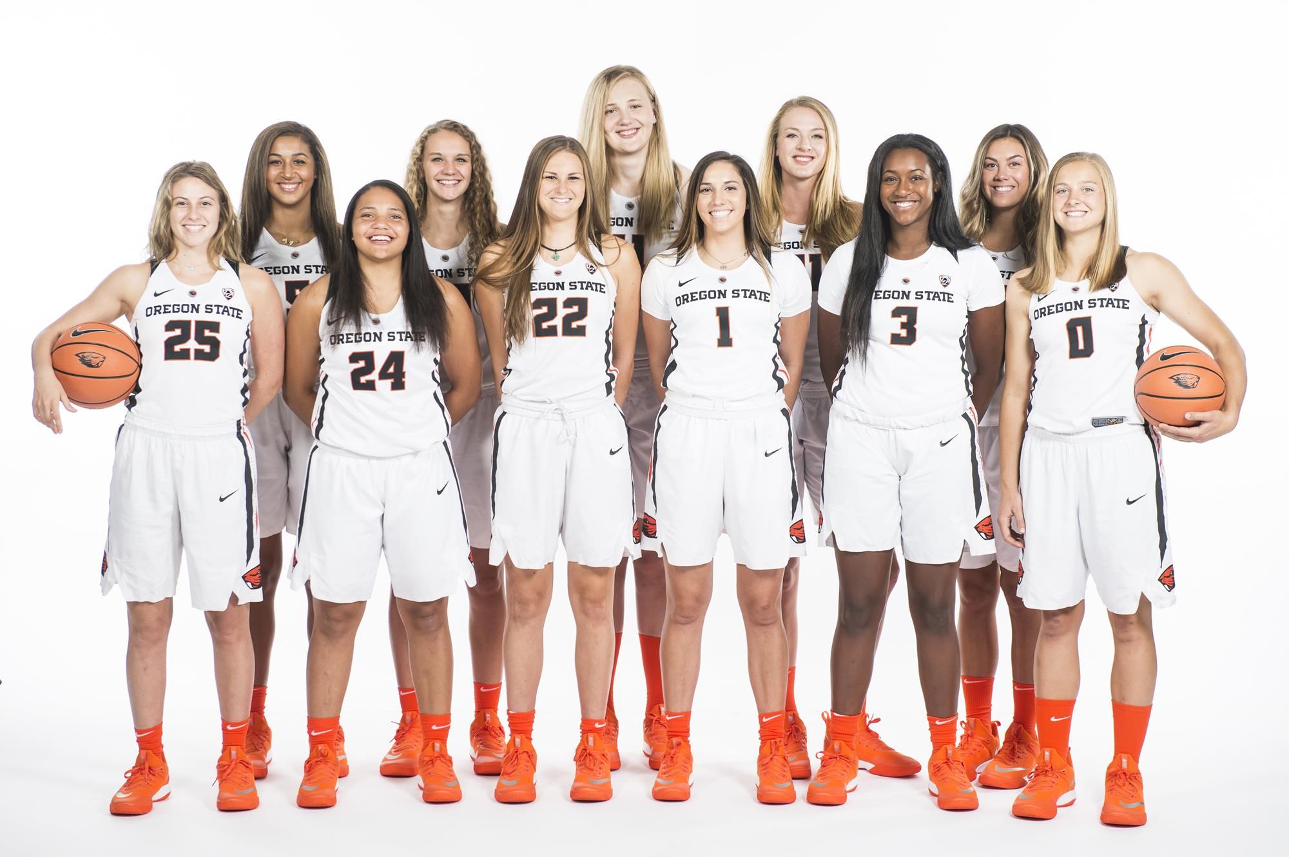
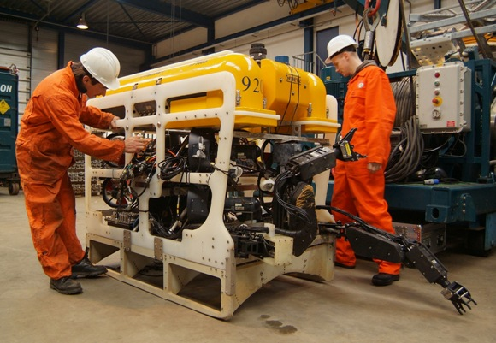
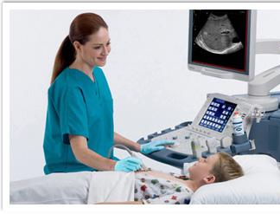
REALISTIC
Make it FAST!
Notes:
Realistic is the DO-ers. Work with their hands. Think of engineerings, athletes, health science technicians. In an ocean science career they may work on a ship repairing remotely operated vehicles, sensors, and or lab equipment used to support science goals.
Game - Make it FAST (Tower power) (you could also make shapes with Tangrams)

Slide 17
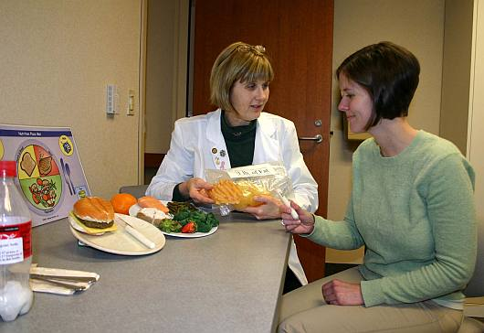
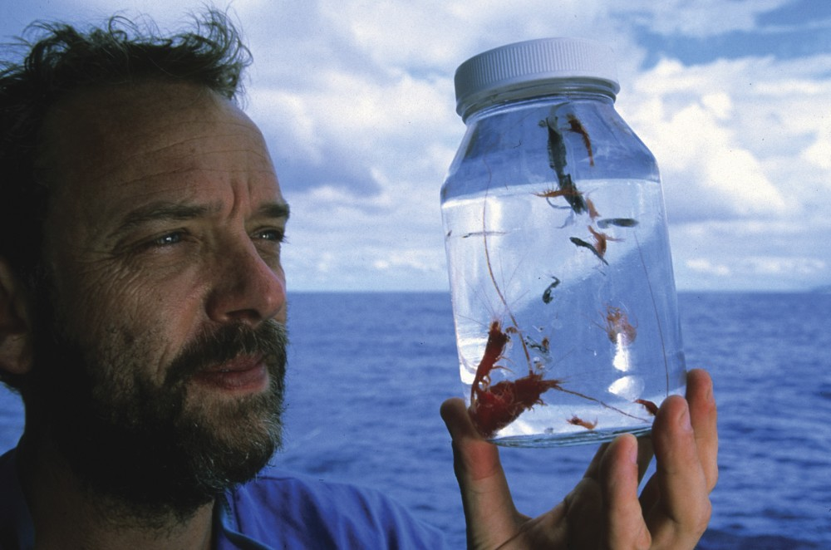
INVESTIGATIVE
20 QUESTIONS!
Notes:
Investigative is if you enjoying asking question, learning new information, and conducting investigations. This quality is used in science as they develop questions about the natural world. A scientist or researcher would use this skill.

Slide 18
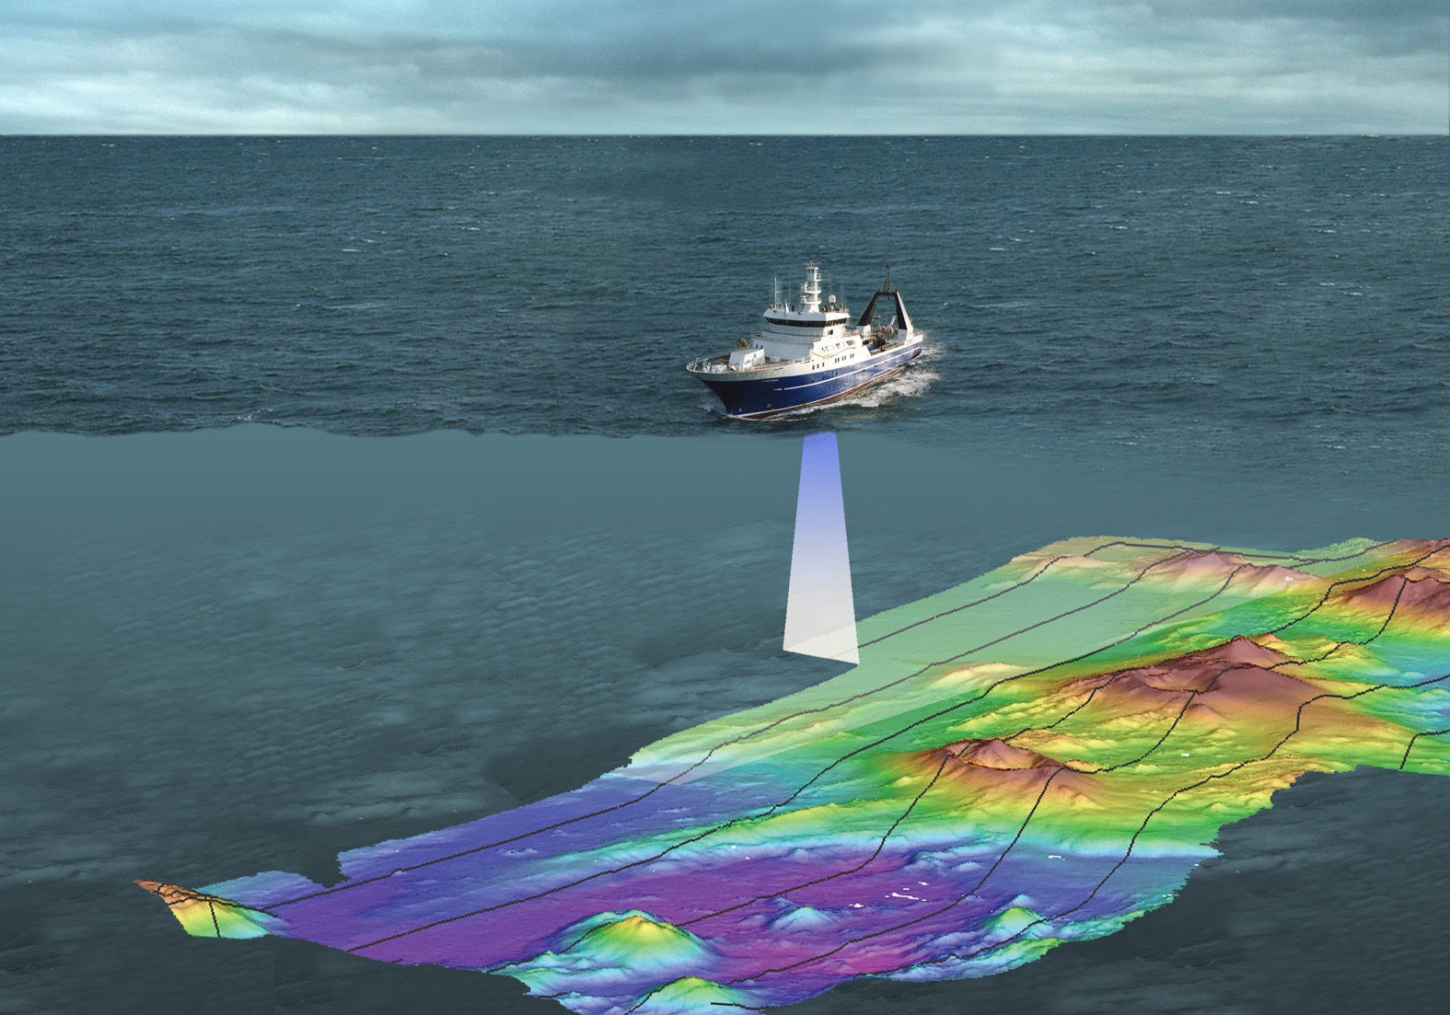
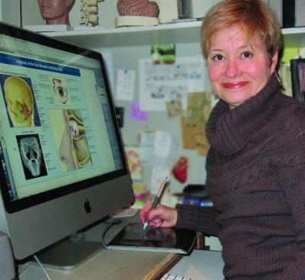
ARTISTIC
PICTIONARY!
Notes:
Artistic is a category for creativity. This could be used in creating social media posts about research done at sea or this could be done in making maps or visualizing data to tell a story!

Slide 19
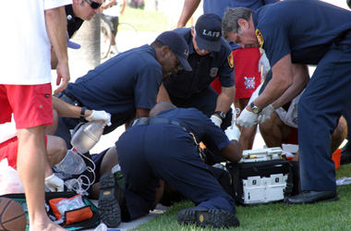
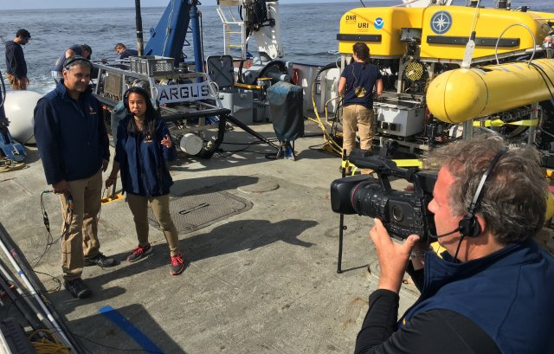
SOCIAL
TABOO!
Notes:
Social is the category for people who like working with others and helping the to solve their problems, like emergency medical professionals, teachers, and videographers. On research vessels, there are people who help researchers, scientists, and the general public understand the science goals at sea. These folks do outreach education, create videos, and interact with folks from all backgrounds.

Slide 20
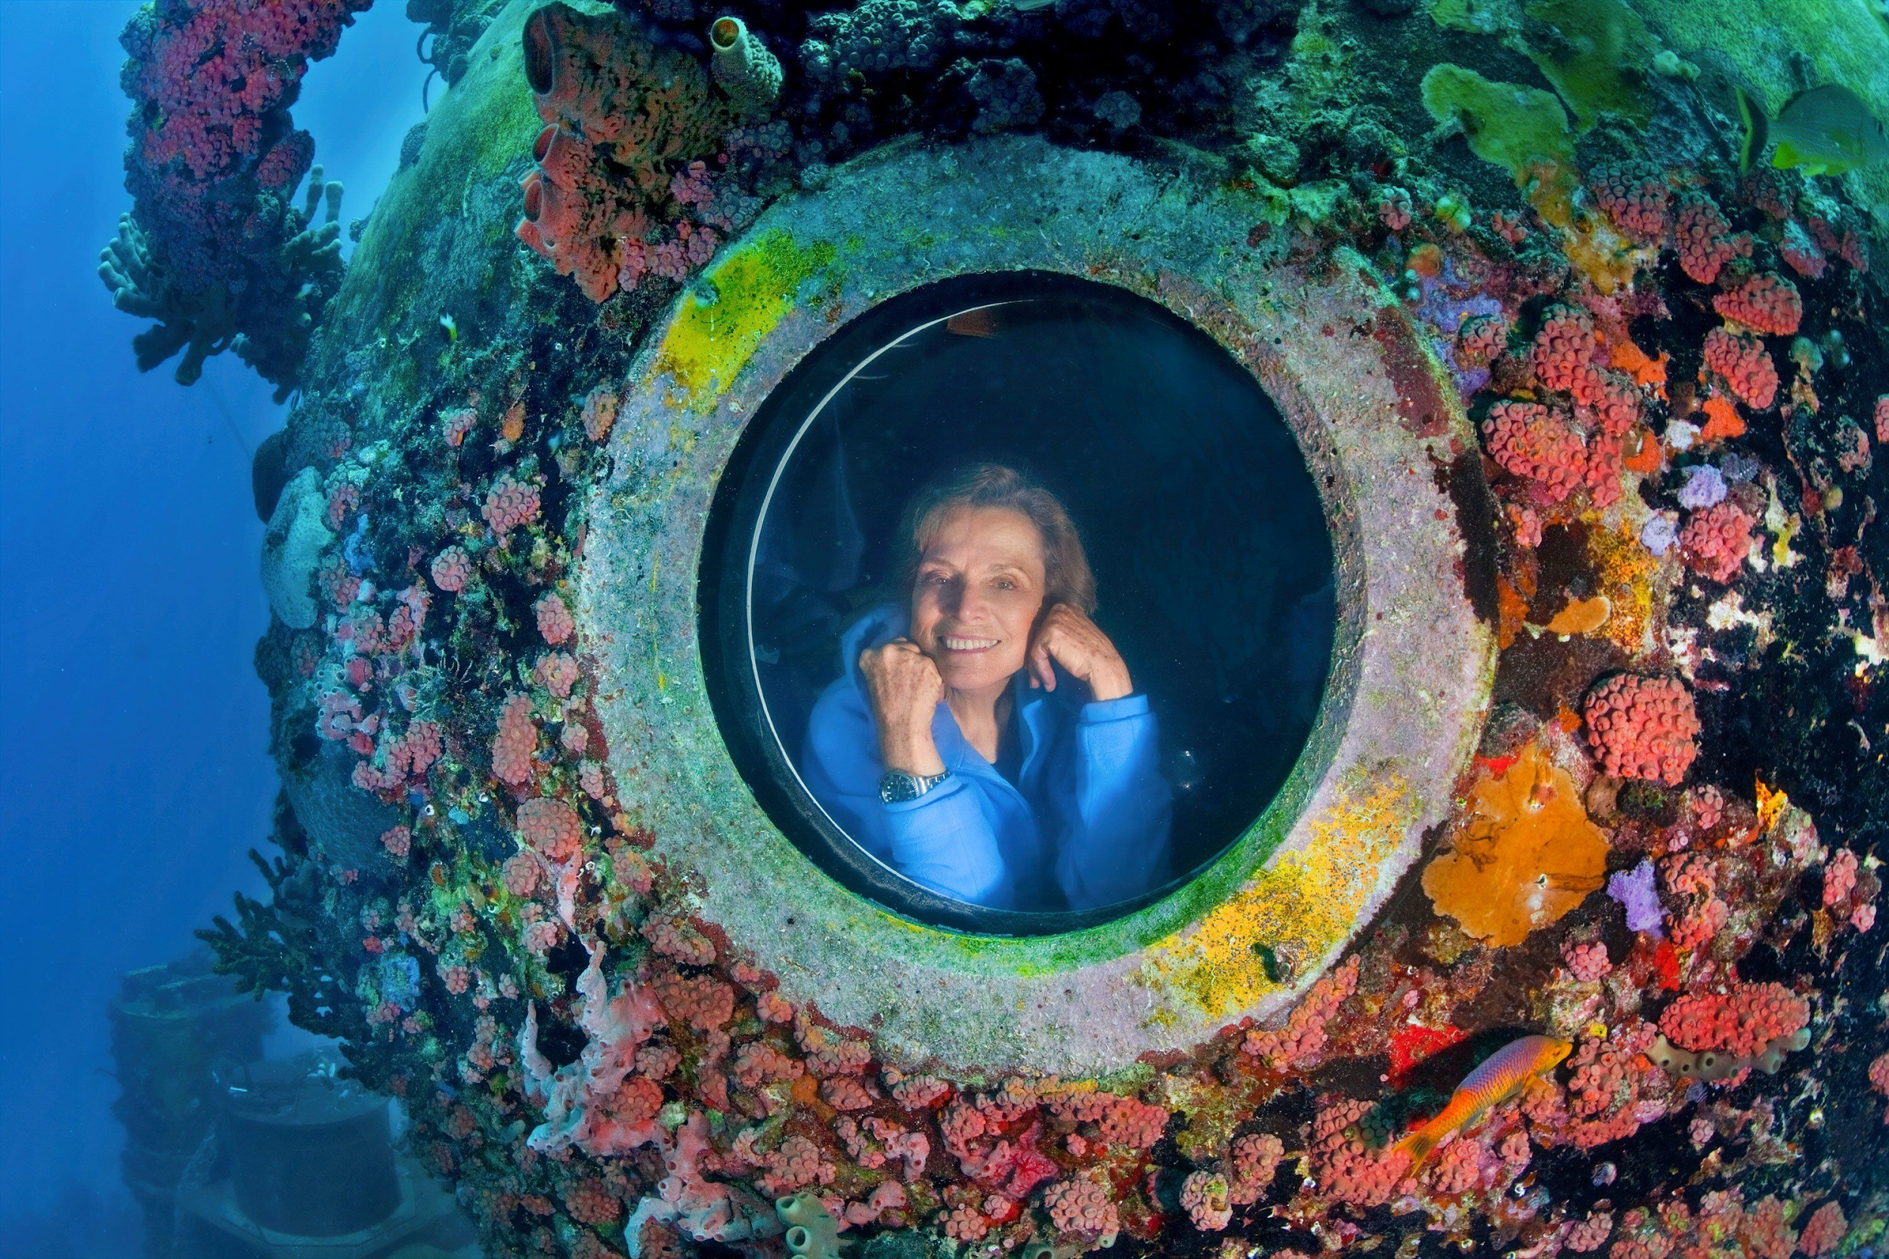
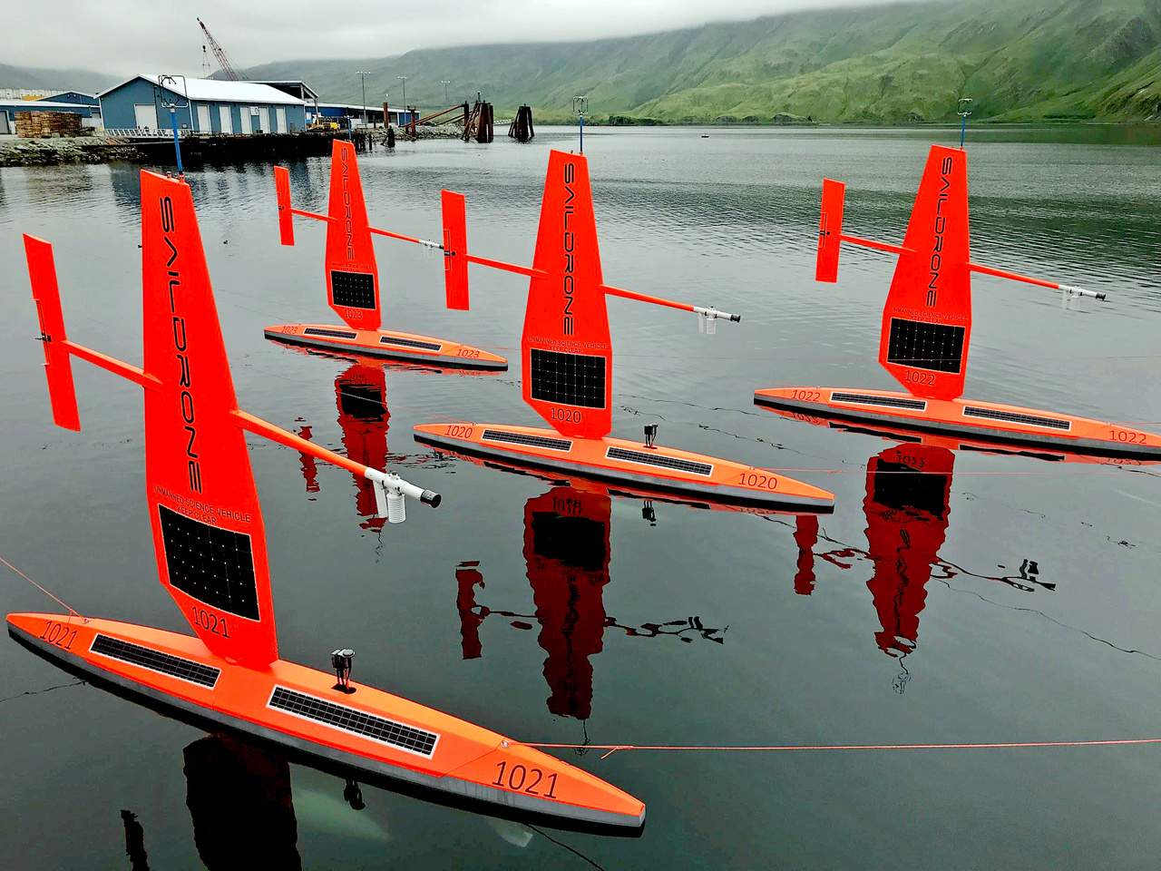
ENTERPRISING
SELL IT!
Notes:
Enterprising is the category for sellers, innovators, and, in the case of ocean science careers, funders and advocates. National Science Foundation funds ocean science expeditions and researchers have to “sell their expedition to them” also engineers often develop new technology to use at sea so they have to “sell their tool” to scientists and National Science Foundation to fund the production of the new tool. Lastly, Ocean Advocates, like Sylvia Earle (https://news.yahoo.com/meet-sylvia-earle-jane-goodall-120000457.html).
For a tech example you can look up – sail drone - https://www.saildrone.com/
Imagine if you came up with a new tool to clean up the ocean, what would it be and how would you sell it?
5-7-5 Haiku about yourself – SELL IT!

Slide 21
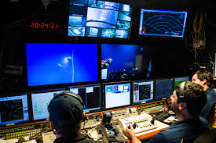
CONVENTIONAL
LINE IT UP!
Notes:
Conventional is the category for organizers. People that like clear order and procedures generally like professional like these, such as a pharmacist or on a ship - a Navigator who reads maps, GPS, and directs ROVs under water.

Slide 22
TOP 3?
WHY?
Notes:
Holland was a psychologist who categorized careers related to what people like to do, so by learning about yourself you can learn about careers that may interest YOU! Every career has a Holland Code that can be used to help you identify careers your are interested in.
We are going to do that today while we learn about ocean science careers. After we talk about each category, we will do a game, and then at the end of the lesson we will each record which

Slide 23
Exploring Ocean Science Careers
How is the career you looked out related to your Holland Code?
Would you be interested in a career like that or any other one your saw? Why?
Record your code
Pick a Card
Look up the profession
Answer the worksheet
Website:
https://nautiluslive.org/people

Slide 24
Additional Resources
Holland Codes background and job list
http://www.wiu.edu/advising/docs/Holland_Code.pdf
Middle School interest and job profiler
https://www.mynextmove.org/explore/ip
High School interest and college majors
http://www.roguecc.edu/counseling/hollandcodes/test.asp
K-12 Resources by grade
http://www.californiacareers.info/#?Lesson%20Plans

Slide 25
Technology & Patenting
Changing pace!

Slide 26
NGSS Connection
Engineering – providing, comparing, evaluating solutions
Human relationship with the natural environment
Technology Impacts on natural systems
Human impacts on natural systems

Slide 27
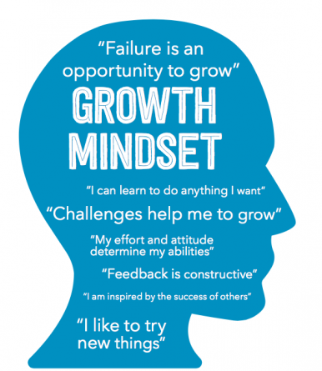
Innovating at the Boundaries
Advancements in Technology and the Patenting Process

Slide 28
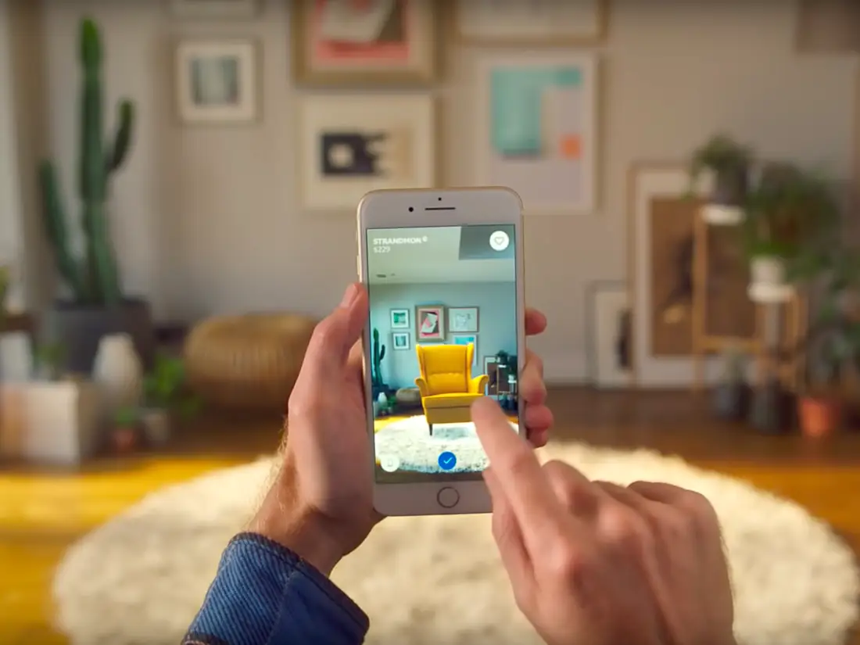
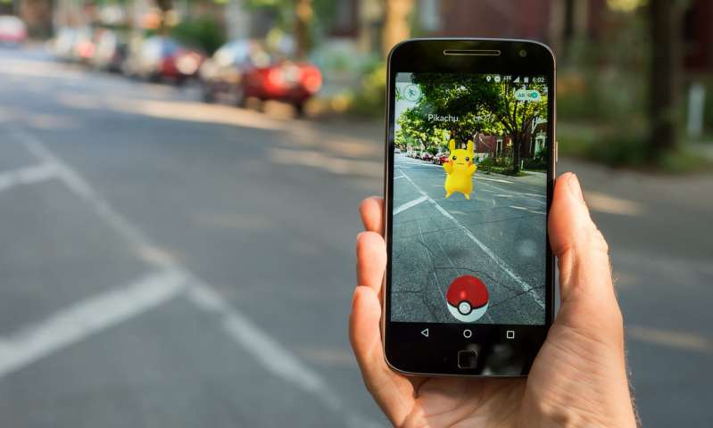
What is next?

Slide 29
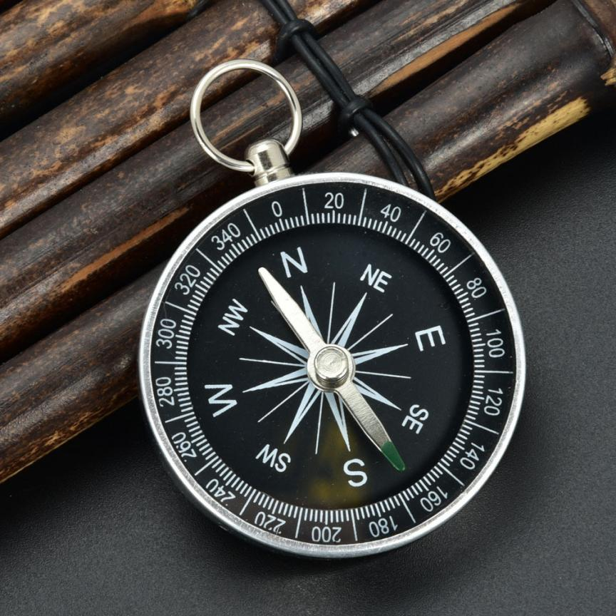
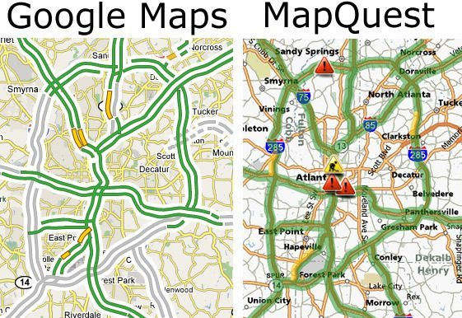
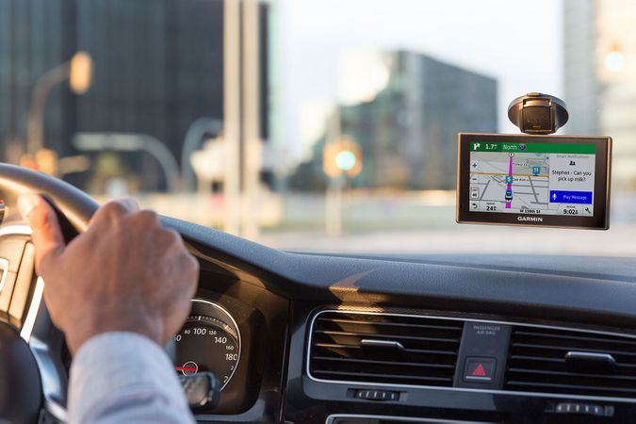
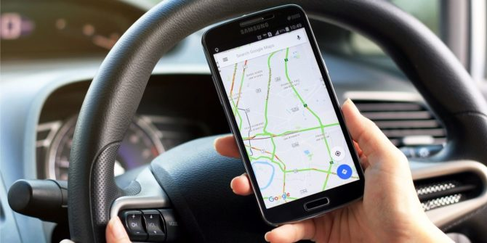
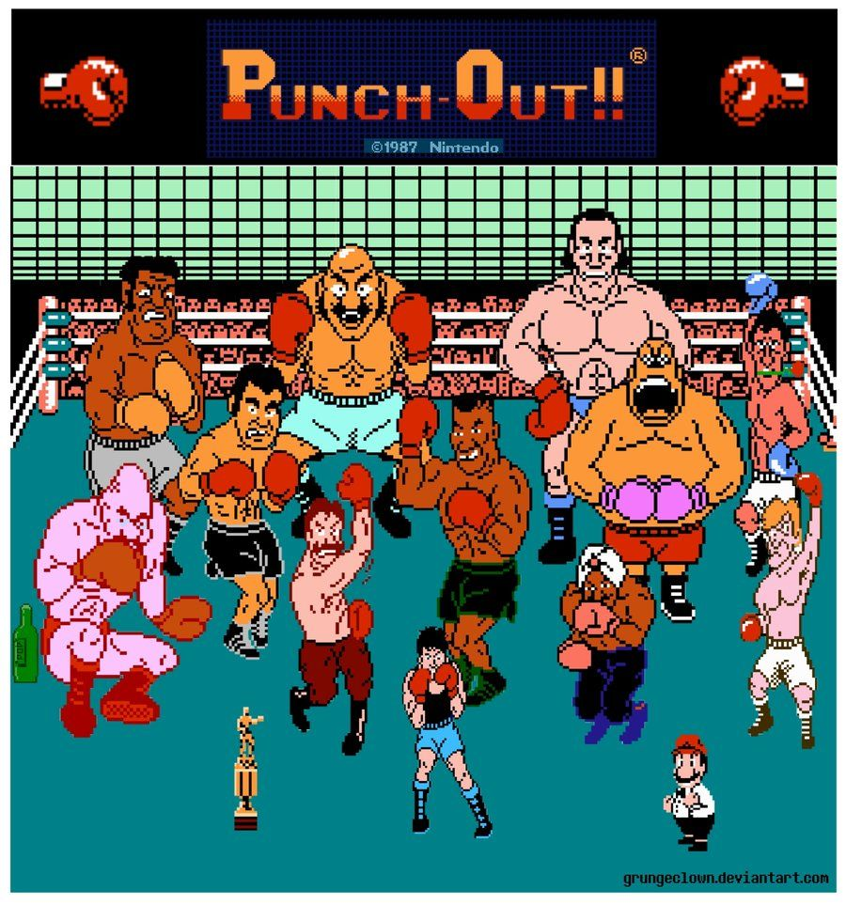
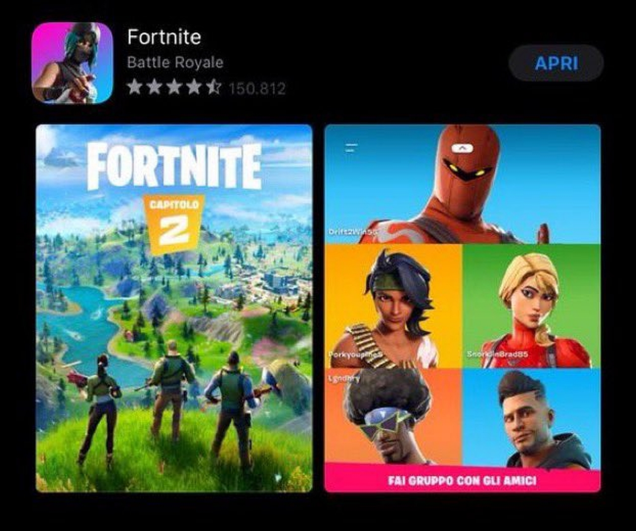
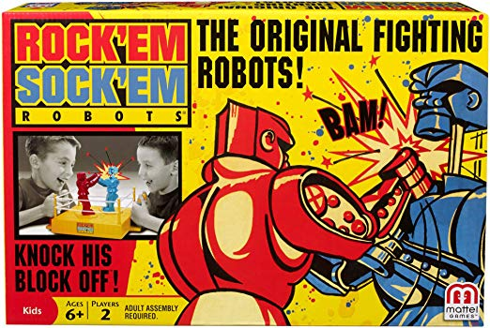
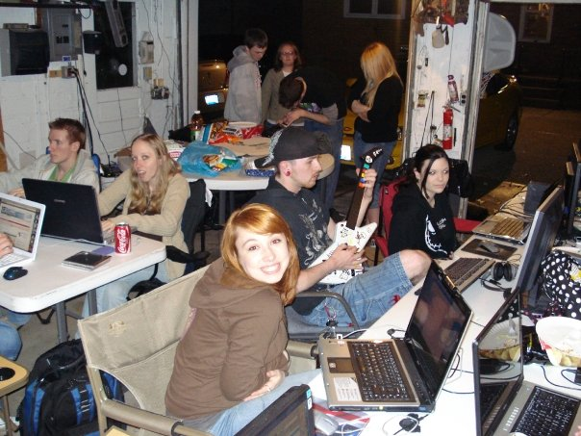
Innovation occurs by enhancing existing technology to meet “emerging” needs/wants

Slide 30
Many times professionals need to innovate to solve problems related to their work
Who are these “professionals” ?
Athletes AND…
Notes:
https://www.youtube.com/watch?v=x6VWOMRHm48&feature=emb_title

Slide 31
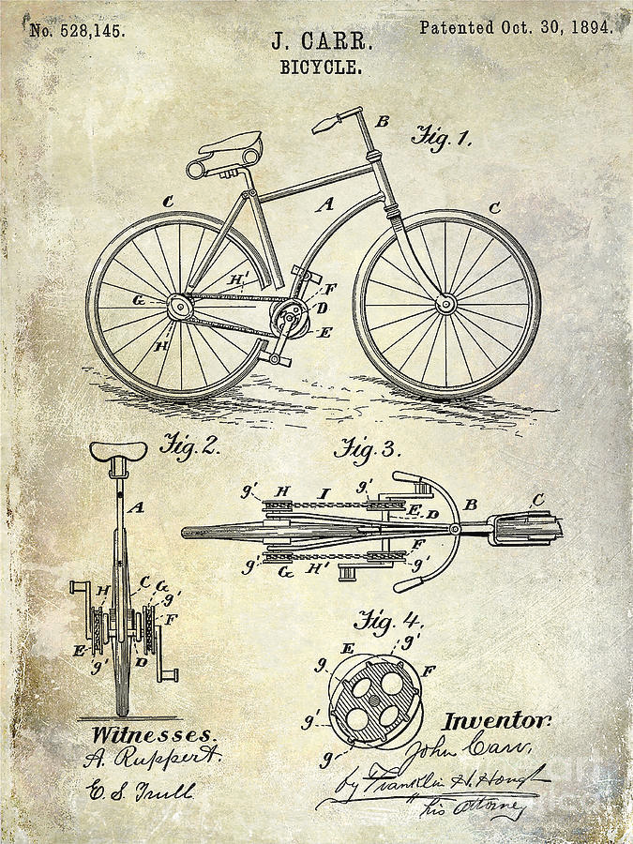
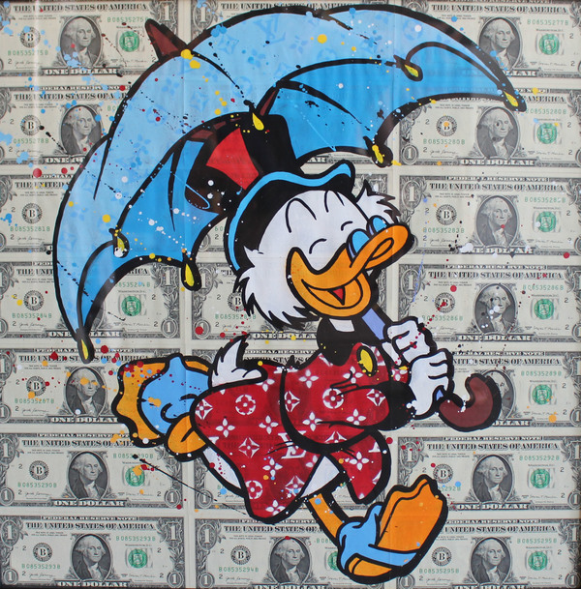
Patents document innovation
Why?

Slide 32
What is a patent?
A patent has…
Details
Numbers
Pictures
Language
Diagrams
Dates
Name(s)
Claims
Legally binding document of ownership for
“Intellectual property”
Science of Innovation
Notes:
https://www.uspto.gov/kids/videos.html – science of innovation video

Slide 33
Spot the Invention
A (1-12)
B (13-25)
C (1-8)
D (9-21)
Notes:
https://www.uspto.gov/kids/spot.html

Slide 34
Share Out
Name of the product/process
Name of the inventor(s)
Number and Date of acceptance
Pages
1 interesting thing you learned
Have you seen the invention before?

Slide 35
A Companion for GeaRS, The Robot Cat

Slide 36
I claim:
1. A toy for a pet comprising:
An elongated mobile device having a front and back end;
A head attached to said front end and legs attached to said back end;
A tail attached to said back end;
A means for pulling said toy.
2. The toy as claimed in claim 1, wherein said device has a means for pulling and
moving said toy.
3. The toy as claimed in claim 1, wherein eyes and ears are attached to said head.
4. The toy as claimed in claim 1, wherein said tails is any color such as pink, red, green, excluding white, yellow or blue.
5. They toy as claimed in claim 1, wherein said means of moving the toy attaches to the legs.
6. The toy as claimed in claim 1, wherein said means of pulling must be attached to the front end and must be at least 4 inches long.

Slide 37
THANK YOU & QUESTIONS
http://ceoas.oregonstate.edu/ships/rcrv/outreach/
https://smile.oregonstate.edu/view-lessons
Notes:
Must be in Slide Master mode to swap out photos.

