Slide 1
The SMILE Program
Science and Math Investigative Learning Experience
Envision, Believe, Succeed
email smileprogram@orgonstate.edu
phone 541-737-0534

Slide 2
The SMILE Program
Science and Math Investigative Learning Experience
Founded 1987
“There is no rational reason why we should be able to identify someone’s ethnicity by whether they attend and succeed in college.” Mimi Orzech, founder
Motivation--Help students and their families overcome intrinsic and extrinsic barriers for these students to a vivid academic future.
Assure “equal” access to higher education so as to increase the number of underrepresented youth who aspire to and attend higher education

Slide 3
The SMILE Program
Science and Math Investigative Learning Experience
Our mission is to increase underrepresented students’ success in STEM degree programs and careers, and to deliver high-quality teacher professional development.
Historically underrepresented and other educationally under-served students:
“Minority students” underrepresented in STEM by race, ethnicity or gender.
Low Income, qualify for Free and Reduced Lunch
“First generation to college”: neither parent attained a Bachelor’s Degree

Slide 4
SMILE Program Design
1) Teacher Professional Development
  Over 400 SMILE teachers since 1987
  45 teachers in 2020
2) Afterschool club pipeline from 4th-12th grades
  39 clubs, 18 communities, 500 students in 2020
3) College Connection Events
  522 students visited OSU for STEM challenge capstone
4) Community Engagement
  Family Math and Science Nights

Slide 5
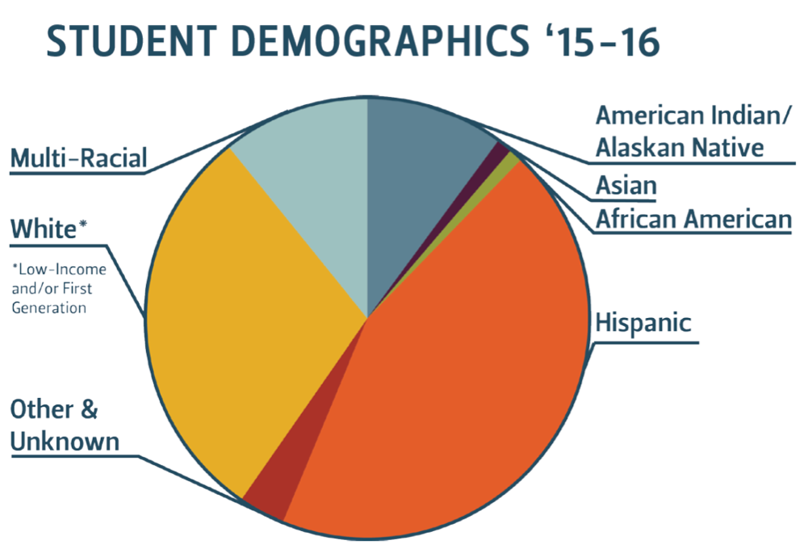
SMILE Clubs
11%
10%
32%
44%
3%

Slide 6
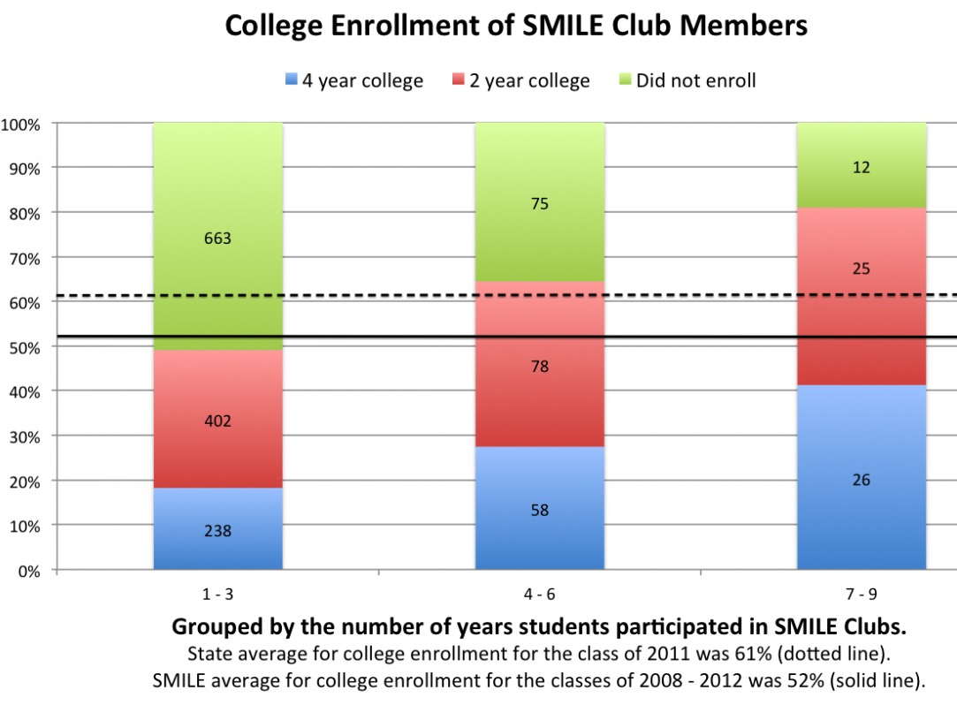
SMILE Student Impact
Increased High School graduation
100% of SMILE seniors graduated last year
Increased college-going rates:
The longer a student is in SMILE the more likely they will go to college

Slide 7
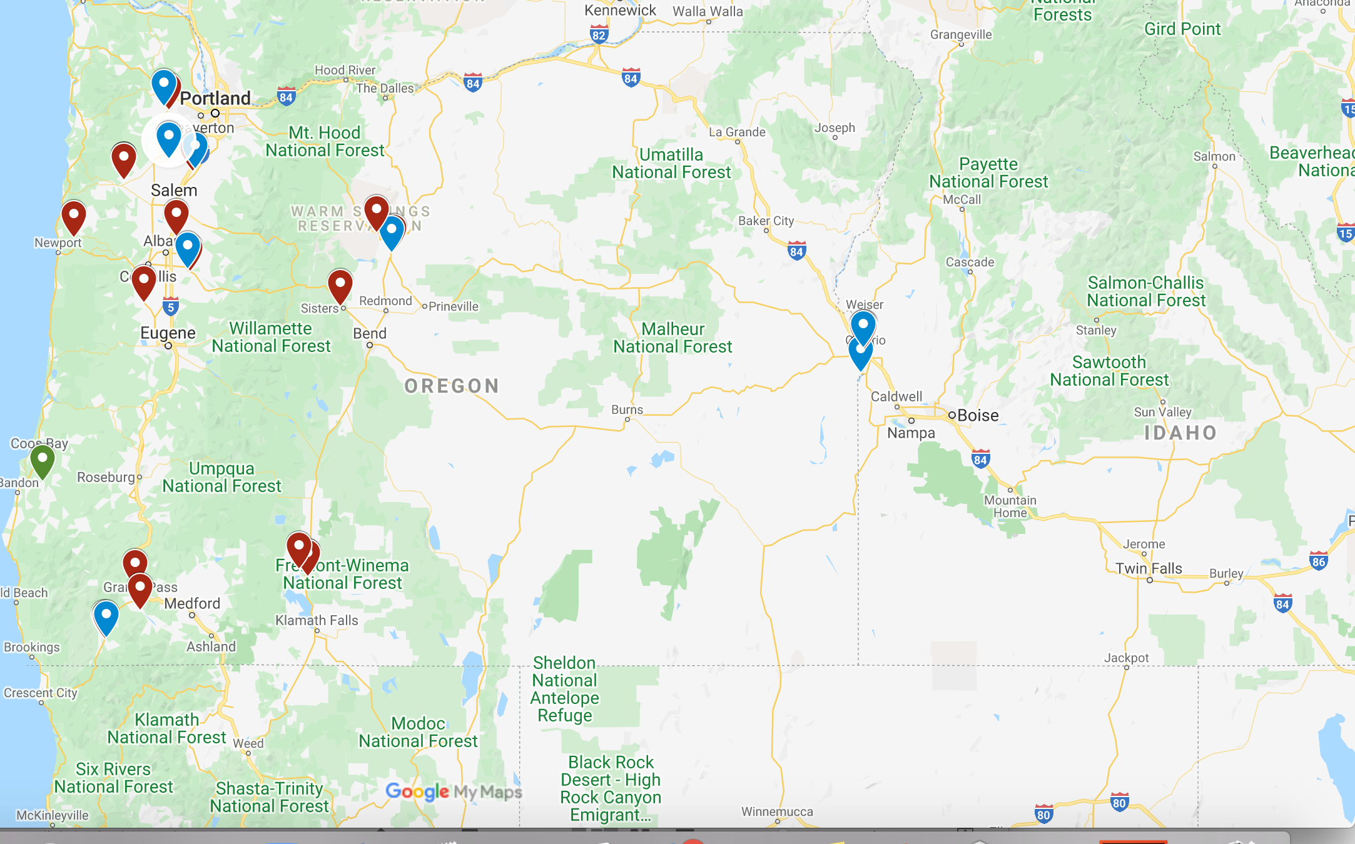
SMILE Communities (15)
39 clubs, 18 communities

Slide 8
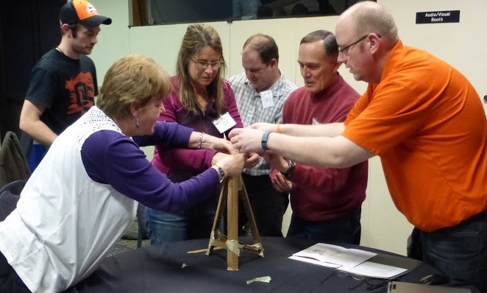
SMILE Teachers
41 teachers total
Elementary: 10 Clubs, 18 Teachers
Middle: 10 Clubs, 17 Teachers
High: 11 Clubs, 15 Teachers
Longest serving teacher: 30 years
Average teacher tenure in SMILE: 5 years
Notes:
The National Commission on Teaching and America's Future proffers starker numbers, estimating that one-third of all new teachers leave after three years, and 46 percent are gone within five years.

Slide 9
Teacher Professional Development
Two annual workshops (August, January)
50+ hours of STEM PD
Focus on cutting-edge scientific research from OSU faculty and students
Provided hands-on STEM activity kits and curriculum aligned with NGSS
Teachers use SMILE clubs to test new activities and practice instruction skills.
Teachers are part of an active learning community that reaches across Oregon

Slide 10
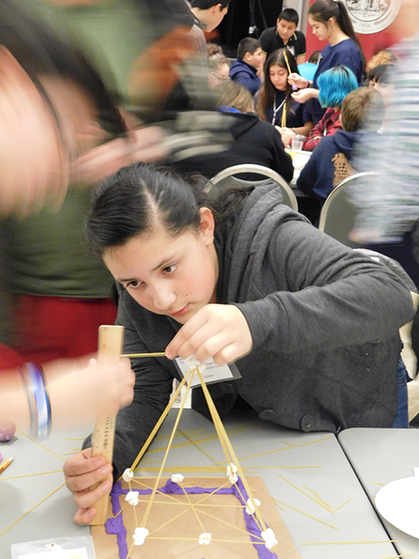
Elements of SMILE
SMILE Teachers
SMILE Clubs
Contextual STEM Activities
Family and Community Involvement
College Connection Events
Bridge-to-College

Slide 11
Teacher PD Impacts
Workshop Survey Feedback
“This is the only STEM PD I receive all year and can’t wait to come to the workshops!”
“My favorite part is meeting the other teachers and sharing activities and teaching strategies.”
“Because of SMILE workshops and the activities I receive, I am a resource for the other teachers in my department.”

Slide 12
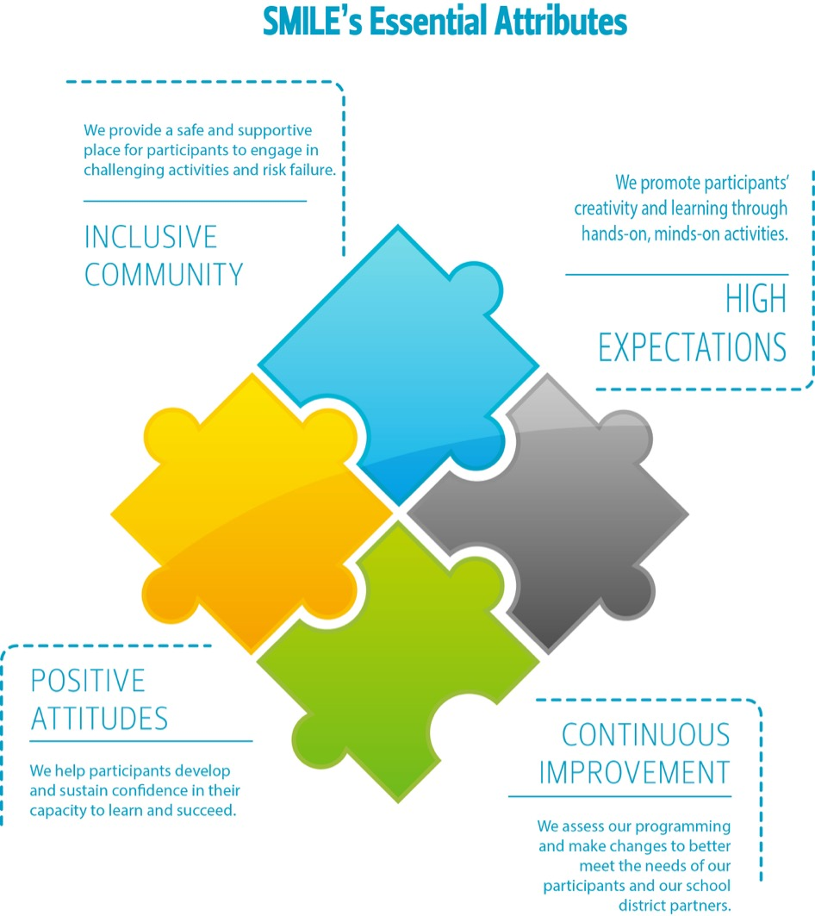

Slide 13
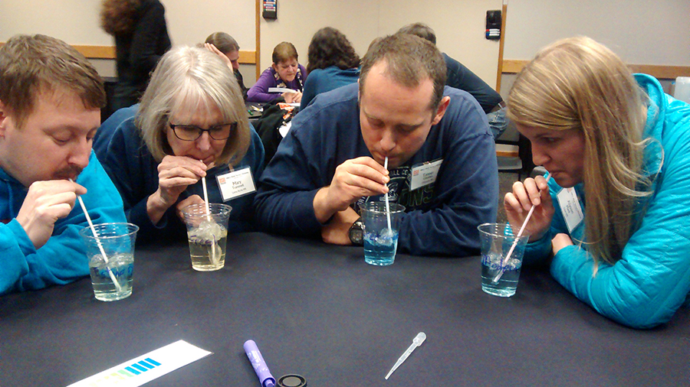
SMILE Teachers
The Heart and Soul of the SMILE Program

Slide 14
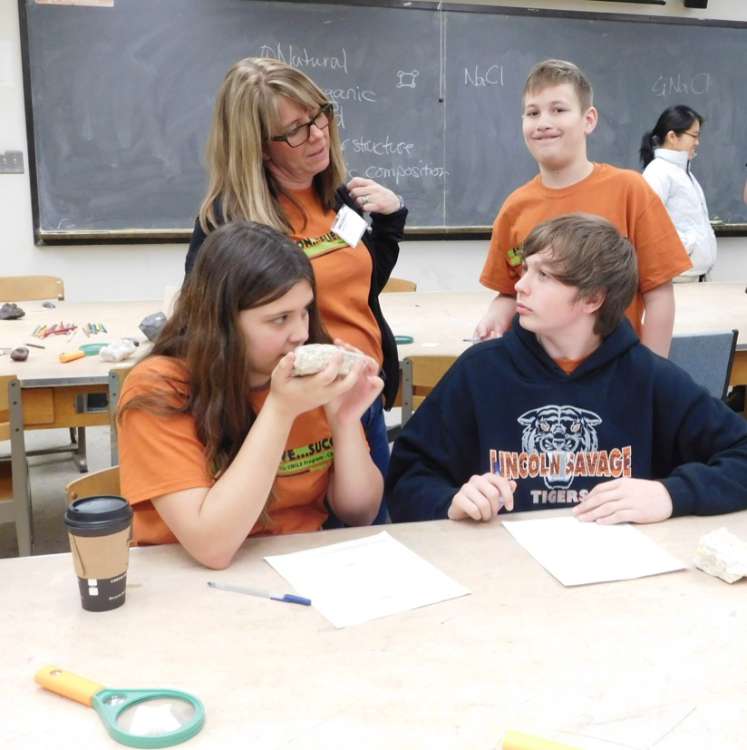
SMILE Clubs
Elementary “Becoming Scientists”
Middle School “Growing Into Problem Solvers”
High School “Serving As Informed Community Voices”

Slide 15
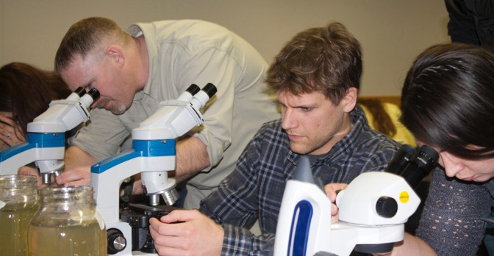
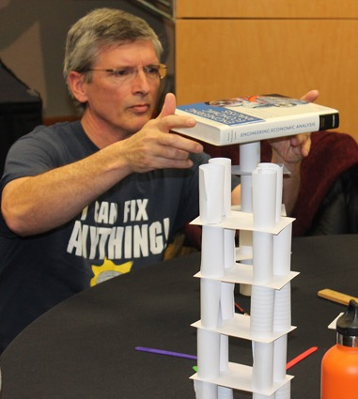
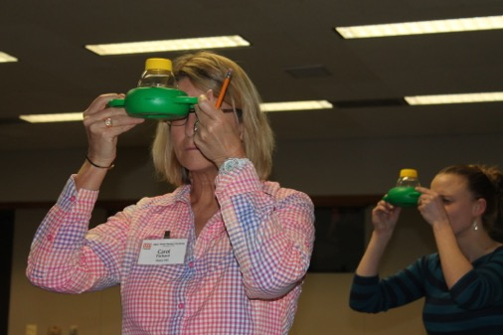
Contextual STEM Activities
Teacher Workshops
SMILE Website
SMILE Blog
SMILE Webinars

Slide 16
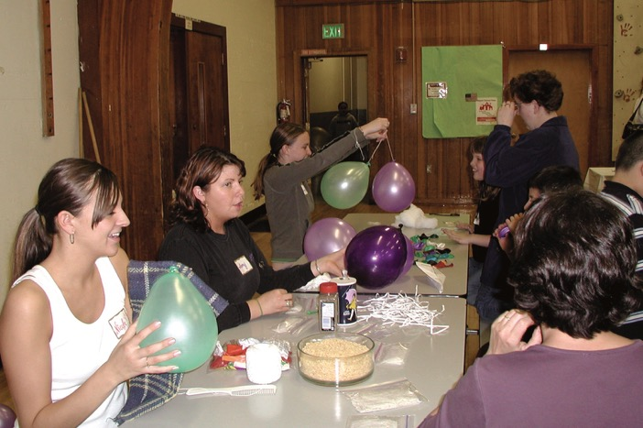
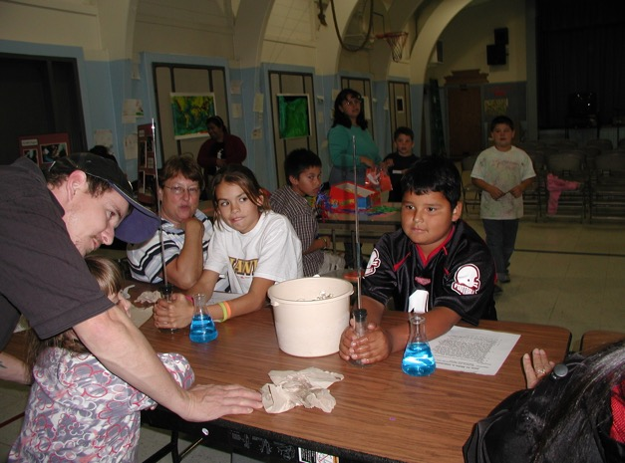
Family and Community Involvement
Family Math and Science Nights (FMSN)

Slide 17
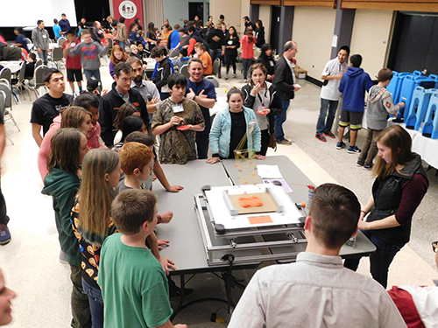
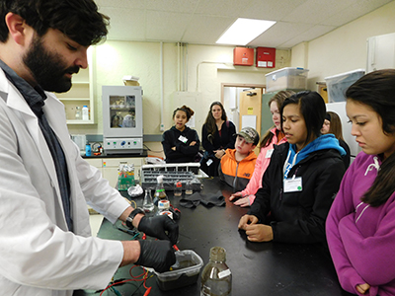
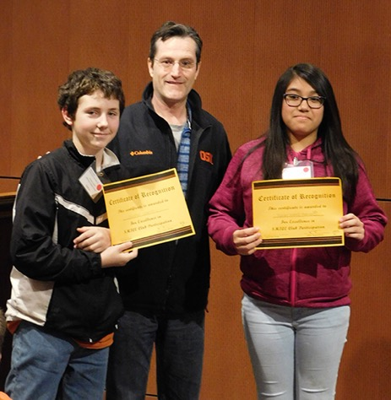
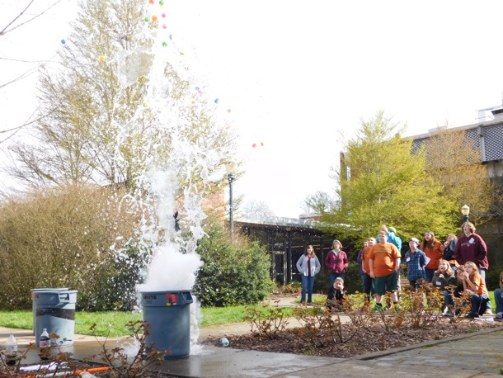
College Connection Events

Slide 18
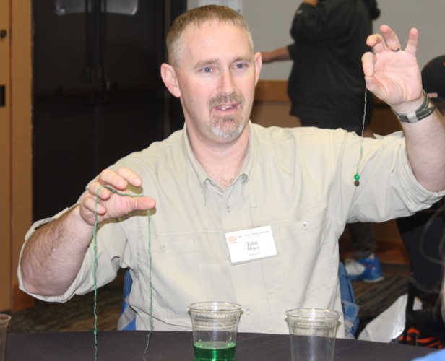
Teacher Expectations
Attend all workshops
Recruit eligible students
Hold weekly club meetings
Complete weekly club logs
Attend annual college connection events
Stay in regular communication with the SMILE office
Notes:
Attend all SMILE Teacher Workshops.
Identify and recruit eligible students from the appropriate grades to be members of the SMILE Club. Membership at any one time should be approximately 20. Clubs to begin meeting before October 1.
Plan and direct weekly integrated math and science activities for the SMILE Club. About 30 meetings should be held during the school year. Meetings that are canceled or postponed should be rescheduled. Dependability and continuity are important to the success of SMILE students. Select meeting times that are convenient for the most students. Negotiate solutions to conflicts with other activities in the school.
Prepare students for, and participate with students in, the SMILE special events arrange for and coordinate transportation to and from these events.
Keep records of the following and report to the SMILE Office:
Student membership (see Section 3 - Membership in the SMILE Handbook for a sample of the application form and instructions for completing it).
Club activity logs.
Expenditures from SMILE Club funds (if applicable - report only if there are issues).
Keep SMILE equipment and materials in good working order. Share materials and expertise with colleagues.
Maintain contact with and encourage participation of parents of SMILE students.
Facilitate transportation of students to and from SMILE meetings and field trips.

Slide 19
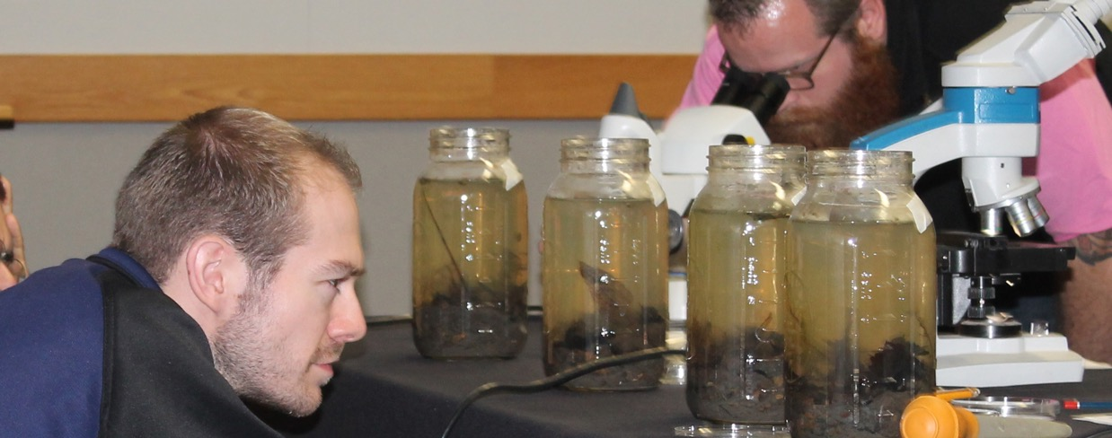
Questions

