Slide 1
Science and Knowing: Ancient Oceans, and Isle Royale

Slide 2
Outline:
Science as a way of Knowing
Taking the Temperatures of Ancient Oceans
Isle Royale, Not Battle Royale

Slide 3
Science as a way of Knowing

Slide 4
How do we know the world we live in?
(Think-Pair-Share)

Slide 5
How does Math, Science, Religion, Art, and History help us know “the world we live in”?

Slide 6
What do these “fields of study” have in common?
Art
Mathematics
History
Science
Religion
**Small groups of 3, look through handout**

Slide 7
What does this formula helps us know?
m – M = 5 log₁₀ (r/10)

Slide 8
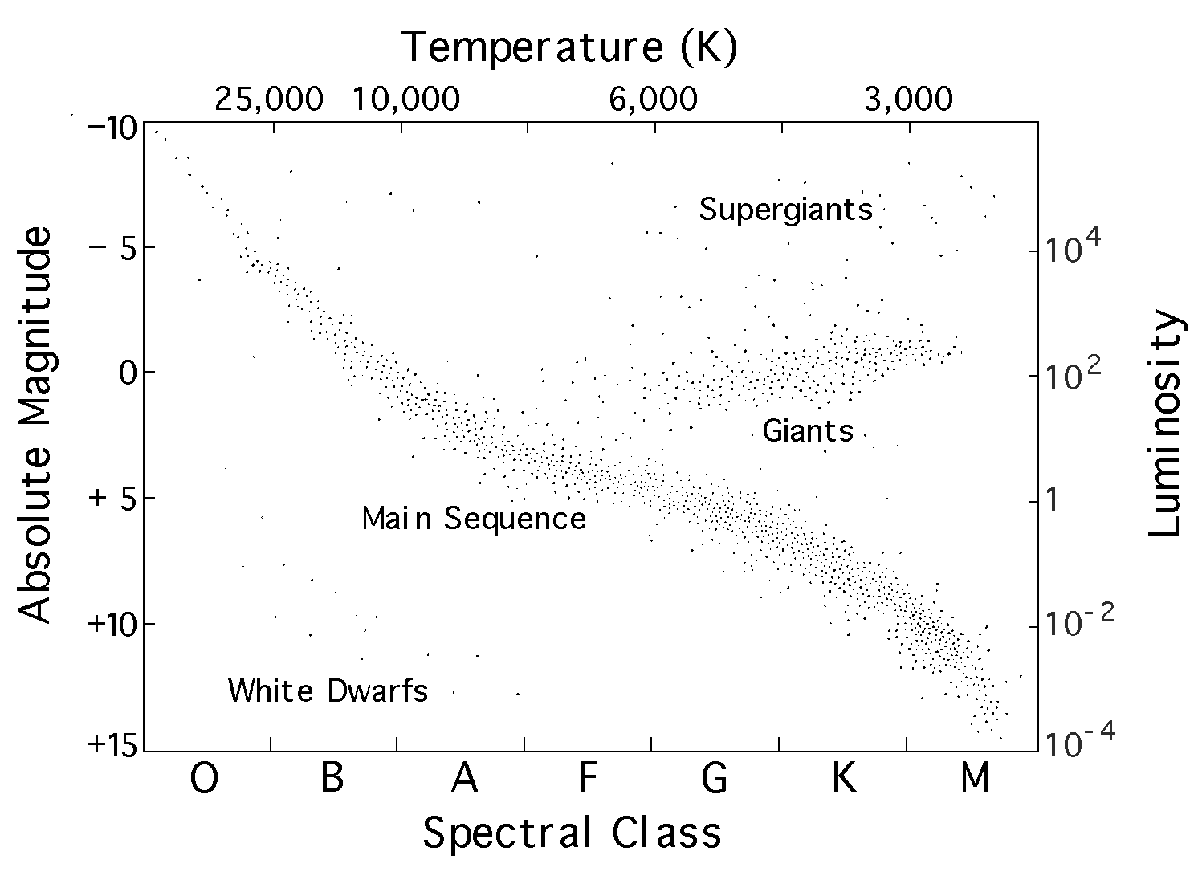
What counted as the “data” here?

Slide 9
Psalm 8:3-4 (The Bible)
What are we getting to know here? What is this a human expression of?
3 When I consider your heavens,
the work of your fingers,
the moon and the stars,
which you have set in place,
4 What is man that you are mindful of him,
the son of man that you care for him?
Sura 10, Verse 5 (The Quran)
God is the One Who made the sun a shining glory, and the moon a light…

Slide 10
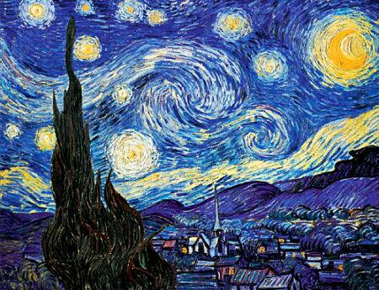
What are we getting to know here? What is this a human expression of?

Slide 11
Taking Temperatures of Ancient Oceans

Slide 12
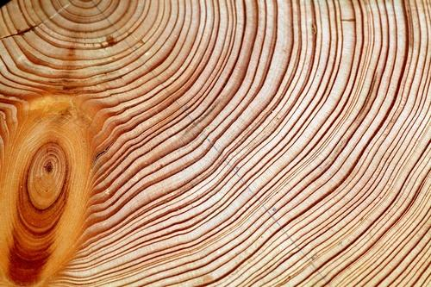
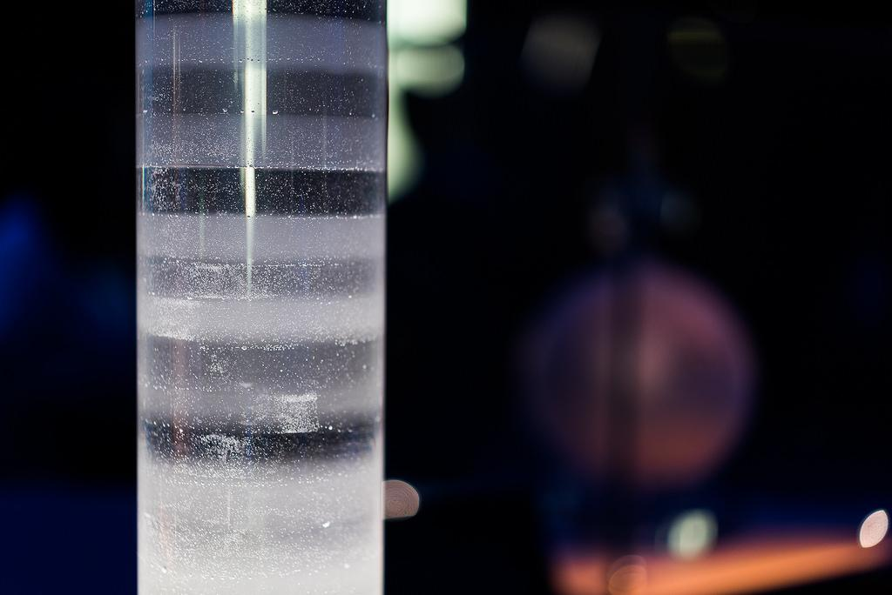
How do we use science to know ancient climates?
Tree Rings
Ice Cores

Slide 13
What about foraminifera (aka. Little Beasties)?
Time Scale: 70 to 100 million year ago to now!

Slide 14
Taking Temperatures of Ancient Oceans
Jennifer Fehrenbacher College of Earth, Ocean, and Atmospheric Sciences
SMILE Program January Teacher Workshop

Slide 15
Introduction
Essential and Guiding Questions:
How do scientists use foraminifera to reconstruct ancient ocean temperatures?
What are foraminifera (e.g. forams or beasties)?
How do researchers obtain fossil foraminifera?
Learning Objectives
Students will:
Use foraminifera to reconstruct Earth’s temperatures over time
Graph foraminifera shell composition over time
Make predictions of temperature based on elements found in forams shells

Slide 16
What are Foraminifera?
“Forams” are single-celled plankton that build sand-grain-sized calcite shells. There are ~ 40 species that live in the open ocean.
Orbulina universa | Globigerinella calida | Neogloboquadrina dutertrei
Habitat: Tropics to sutropics | Habitat: Tropics to sutropics | Habitat: Tropics to sub-polar
Depth range: 0-90 meters (0-200 feet) | Depth range: 40-90 meters (~ 130-200 feet) | Depth range: 30-150 meters (~65-500 feet).

Slide 17
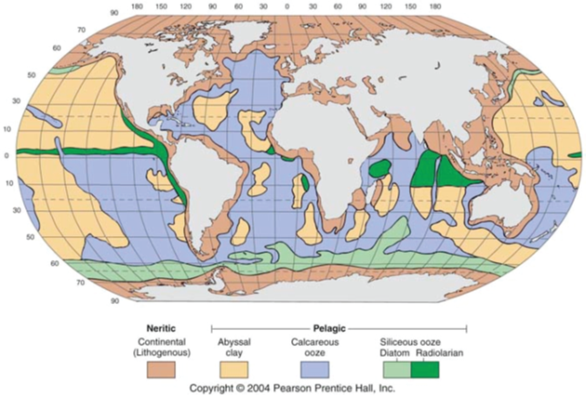
Where do Foraminifera Live?
Planktic forams live in the shallow depths of the oceans, from the surface to ~500 m, though some species can be found much deeper.
When they die, their calcite shells fall to the ocean floor and accumulate in sediments.
Forams are best preserved in the calcareous (calcite rich) regions (purple area on the map)

Slide 18
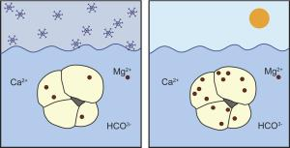
How do Foraminifera Record Temperature?
Their calcite shells are composed primarily of the elements calcium (Ca), carbon (C), and oxygen (O).
Trace amounts of other elements are incorporated into the calcite when they grow.
The amount of the trace element incorporated depends on environmental conditions (e.g. temperature or pH) of the water.
foramsetal.wordpress.com/research/mgca-paleothermometry/

Slide 19
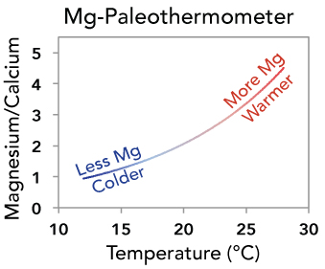
Reconstructing past Temperatures on
Earth is called Paleothermometry
Temperature is recorded in their shells by the amount of the magnesium (Mg) present.
The amount of Mg incorporated into their calcite shell depends on the temperature of the ocean when they grow.
When ocean temperatures are warm, the shells contain more Mg. When ocean temperatures are cold, the shells contain less Mg.
Scientist measure the amount of Mg relative to calcium in fossil foraminifera shells and can estimate the temperature at which they grew.

Slide 20
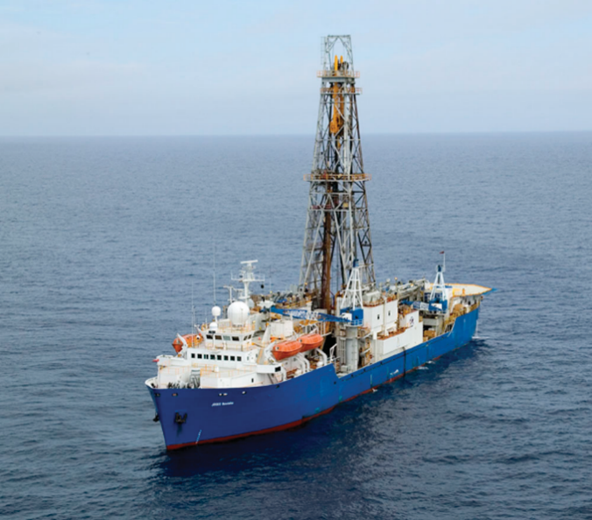
How do Researchers Obtain Fossil Foraminifera?
Seafloor sediments are obtained using scientific drilling ships like the JOIDES Resolution. Several thousand sediment cores have been collected from the ocean floors. The sediment cores range in length from under 1 meter to 10’s of meters.
What is a the core story here?
The JODIES Resolution is a scientific drilling ship operated by the International Ocean Discovery Program

Slide 21
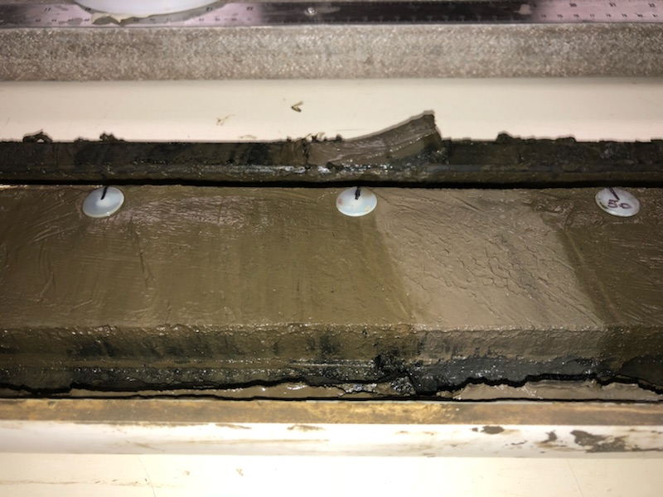
How do Researchers Obtain Fossil Foraminifera?
Sediments including foraminifera, accumulate on the seafloor. Depending on the location, sediment accumulates slowly at rate of ~0.1 to 5 cm every 1000 years.
The corer is attached to the ship using a steel cable. The corer is driven into the sea floor by heavy weights or a hydraulic piston. A hollow steel tube is pushed into the seafloor and fills with sediment. The sediment layers remain intact.
Corer attached to research ships that brings
sediment cores (including Foraminifera) to the surface

Slide 22
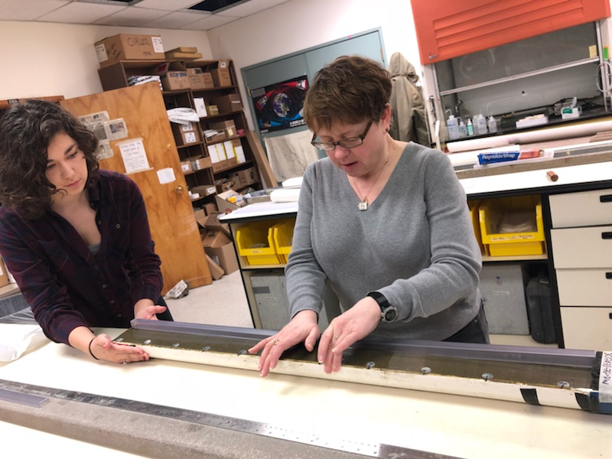
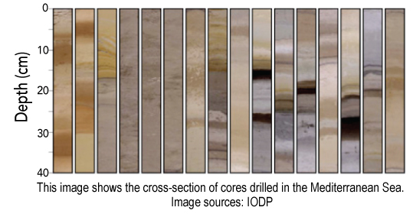
How do Researchers Obtain Fossil Foraminifera?
Sediment cores are processed on the ship and small sediment samples are taken by scientists for later processing and analysis. Forams are obtained after sediment is processed. They are handpicked from the sediment using a thin paint brush.
OSU Scientist Jennifer McKay and undergraduate Grace Meyer sampling a core from the California Coast

Slide 23
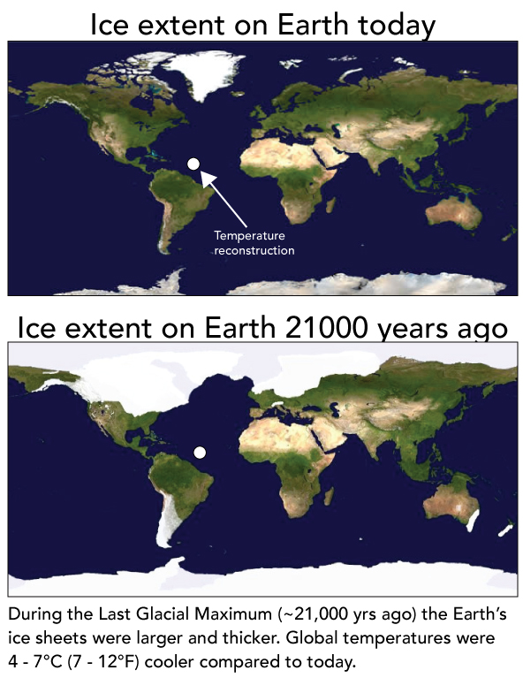
Foraminifera Activity
Students will then partake in a graphing activity where they take different colored marbles meant to represent foraminifera during a specific time period and place them on a graph of temperature and time.
The end result is a graph that shows how the ocean’s temperature has changed over the last ~20,000 years (since the Last Glacial Maximum, when the earth was in a glacial period).

Slide 24
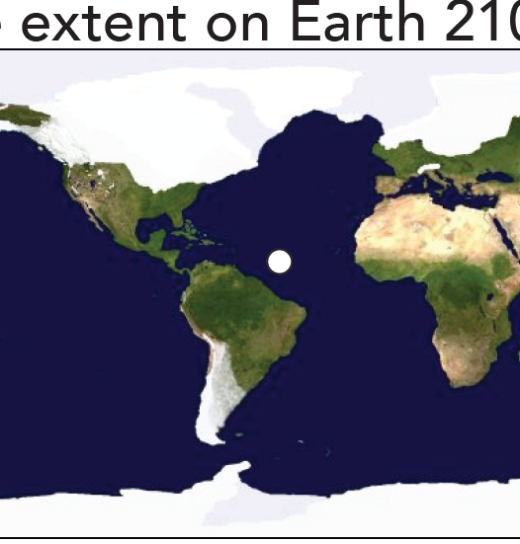
Reconstruction Site: Ice Extent on Earth
Now
21,000 Years Ago

Slide 25
Taking the Temperature of Ancient Oceans

Slide 26
Extension/ scaffolding
Instead of representing temperature, the color of the marbles represents the amount of Mg/Ca.
Students can convert the Mg/Ca ratio to temperature using a paleothermometer equation:
Mg/Ca = 0.25 exp (0.10*T°C)
(Note: the exponent value (0.10) shows the students that for every 1 degree °C (1.8 degree F) increase in temperature, the Mg/Ca ratio increases by approximately ~10%

Slide 27
NGSS Connections to an Existing Activity?
Concepts:
Ocean temperature changes effect the composition of the shells and which forams can survive there
Ocean temperature (pH) Influences what those shells are made of based on where they live(d)
Scientist use this information to reconstruct a model of ancient climates
Which Performance Expectation?
3-LS4-1
3-LS4-4
5-ESS3-1

Slide 28
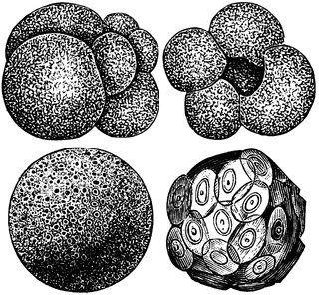
Questions?

Slide 29
Isle Royale, Not Battle Royale

Slide 30
Using NGSS to Make an Activity:
Concepts:
Ecosystem interactions between predators and prey.
Use a model to make predictions of that effect predator-prey population dynamics overtime.
Learn about an ongoing wolf study that resonates with Oregon residents.
Which Performance Expectation?
3-LS4-4*
5-LS2-1
5-ESS3-1

Slide 31
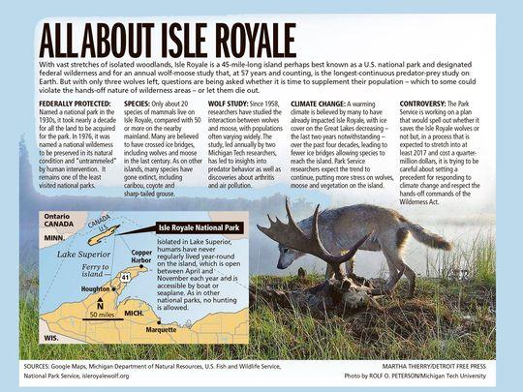
Background of the Isle Royale
Fast Facts Isle Royale National Park is 571,790 acres The number of people visiting in 2017 was 28,196 Isle Royale was made a national park on March 3, 1931 The lowest is 601 feet at Lake Superior The highest is 1,394 feet on Mount Desor Entrance fee is $7 per person per day In the Eastern time zone Random Facts Isle Royale National Park is the only national park in the United States that completely closes in the offseason. The park is typically closed November through mid April.
The most common large mammals are moose and gray wolves. The interaction of these two species in the park has been extensively studied. On rare occasions Lake Superior completely freezes over in winter, allowing animals from the mainland to access the island.

Slide 32
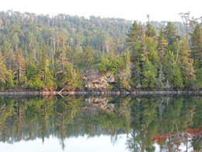
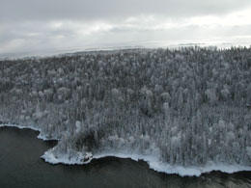
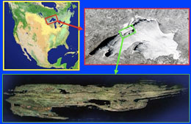
Background on Isle Royale
The Ecosystem on Isle Royale (Lake Superior)
One of the longest population ecology studies (closed system)
Images by www.isleroyalewolf.org

Slide 33
Island Royale, Not Battle Royale
Description
Graphs
Population-Prey (one goes up, the other goes down)
Science and Society
Using historical data to make decisions about the future
*Oregon Relevant?

Slide 34
Did we do this?
Concepts:
Ecosystem interactions between predators and prey.
Use a model to make predictions of that effect predator-prey population dynamics overtime.
Learn about an ongoing wolf study that resonates with Oregon residents.
Which Performance Expectation?
3-LS4-4*
5-LS2-1
5-ESS3-1

Slide 35
Extensions/Scaffolding
Website Resource
http://www.isleroyalewolf.org/
wolf quest
https://www.wolfquest.org/about_overview.php
Deer Me
https://www.wolfquest.org/pdfs/Deer%20Me%20Lesson.pdf
High School
https://www.hhmi.org/biointeractive/wolves-isle-royale

Slide 36
Questions?

Slide 37
Owls mice and seeds
Link
https://wiki.islandwood.org/index.php?title=Owls,_Mice_and_Seeds

Slide 38
Extensions/Scaffolding
Website Resource
http://www.isleroyalewolf.org/
OMS
https://wiki.islandwood.org/index.php?title=Owls,_Mice_and_Seeds
wolf quest
https://www.wolfquest.org/about_overview.php
Deer Me
https://www.wolfquest.org/pdfs/Deer%20Me%20Lesson.pdf
High School
https://www.hhmi.org/biointeractive/wolves-isle-royale
Radio collar data
https://www.dfw.state.or.us/Wolves/notification.asp

