Slide 1
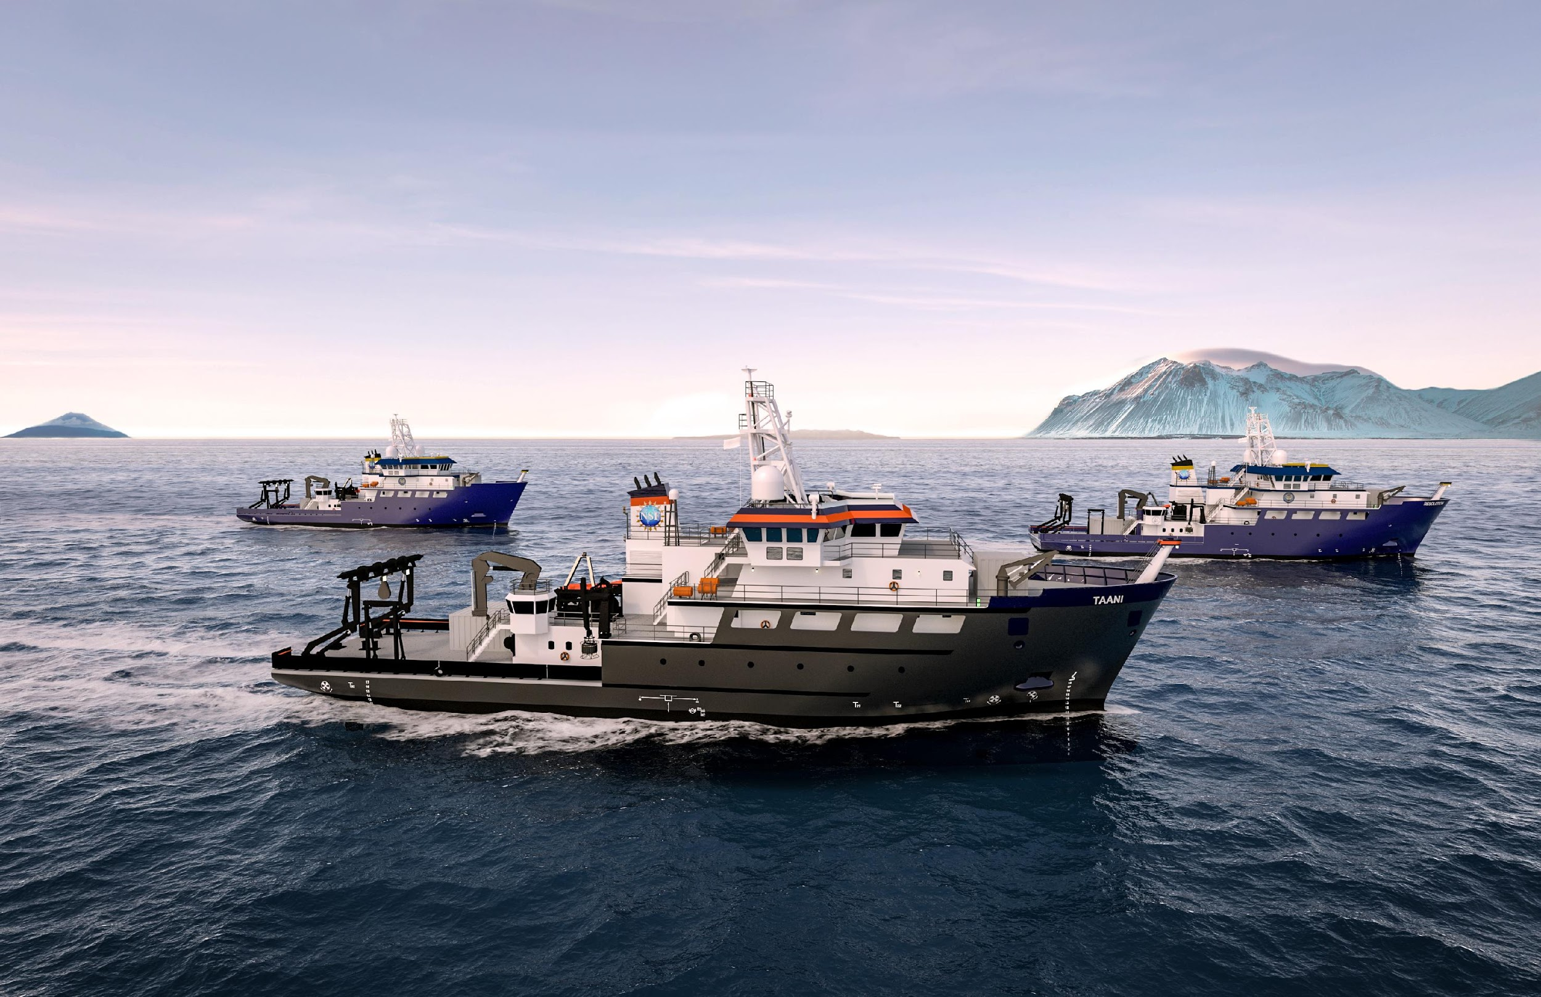
OSU, URI, Gulf of Mexico University Research Consortium

Slide 2
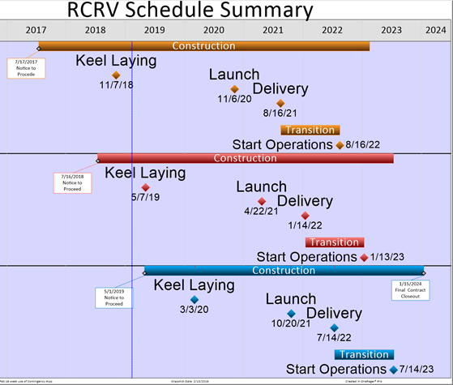
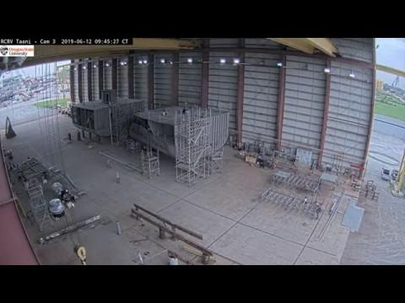
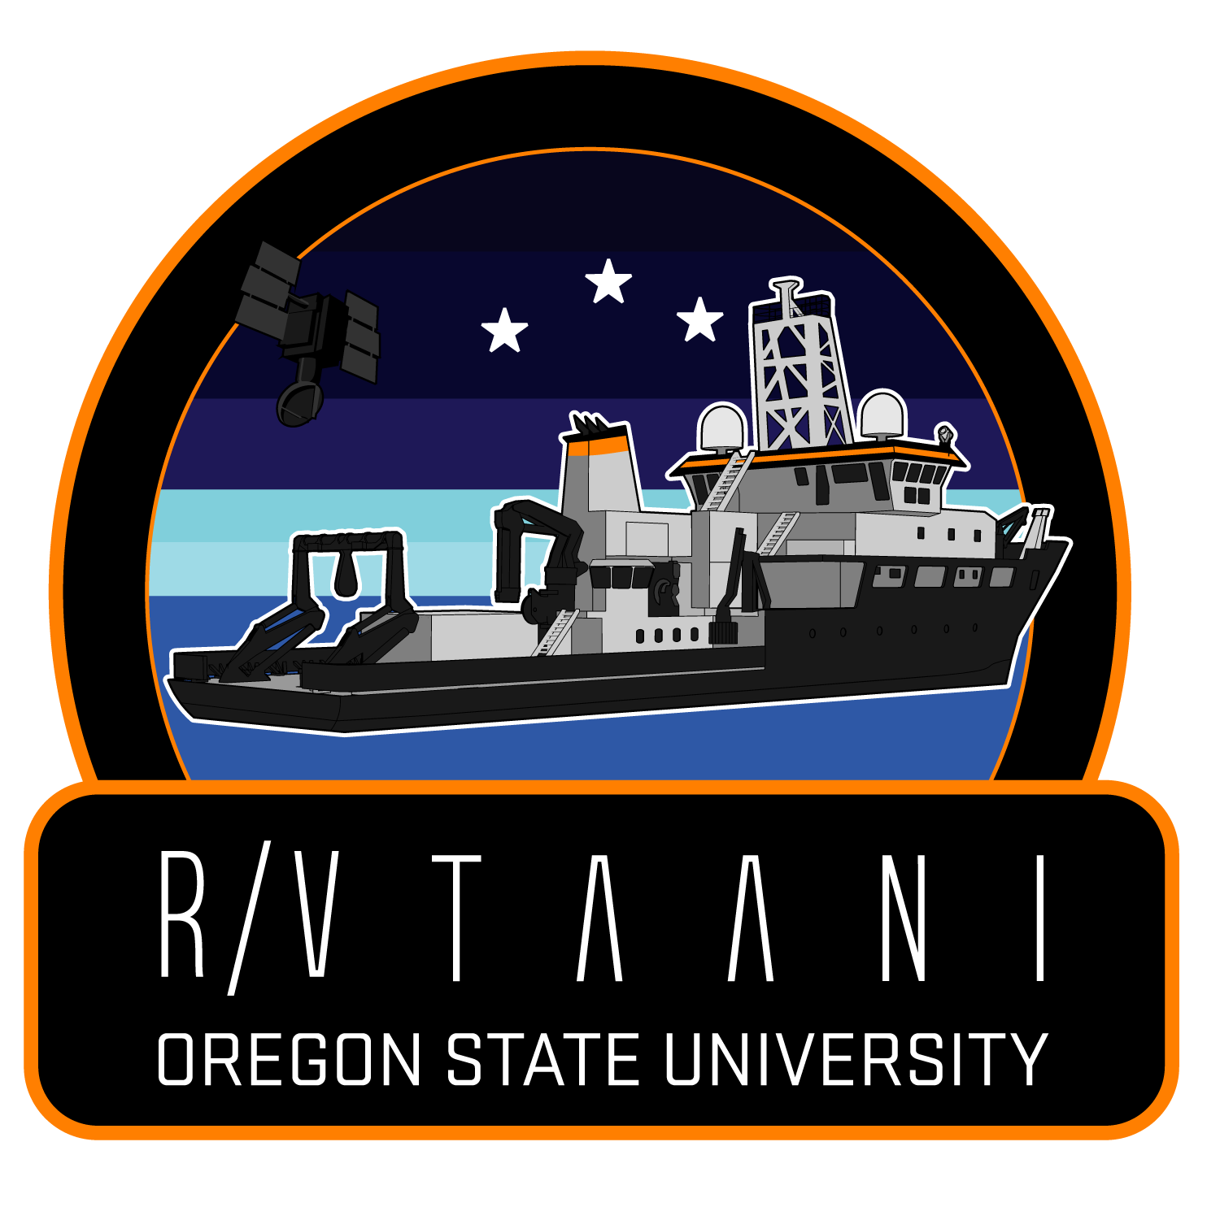
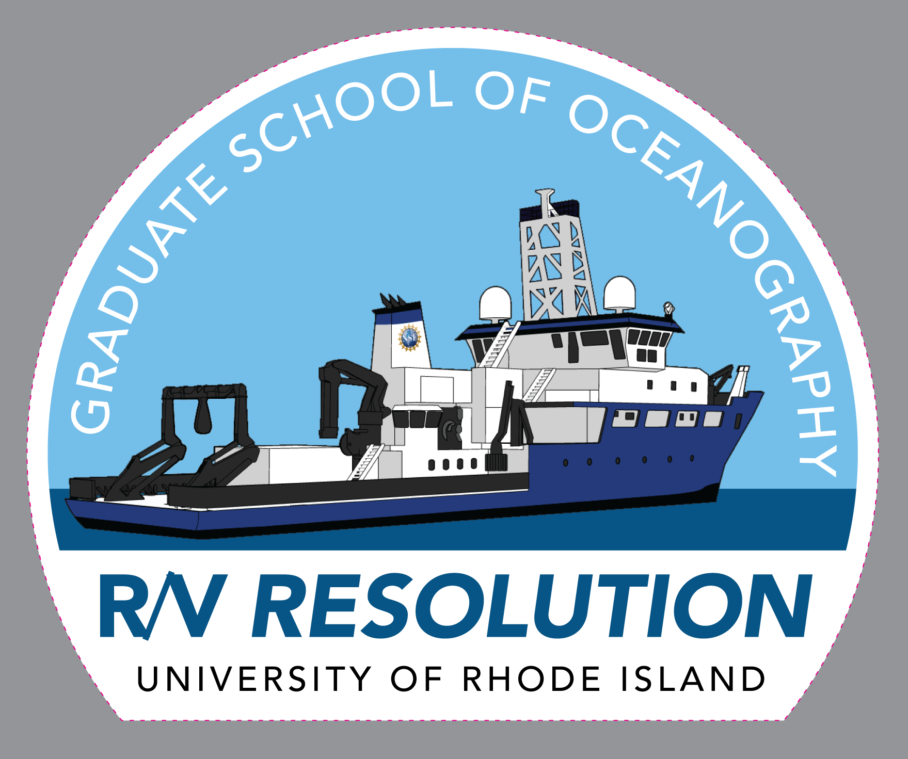
RCRV Program Update from Louisiana’s Gulf Coast Shipyards!
https://ceoas.oregonstate.edu/ships/rcrv/
OSU - 8/2021, 8/2022

Slide 3
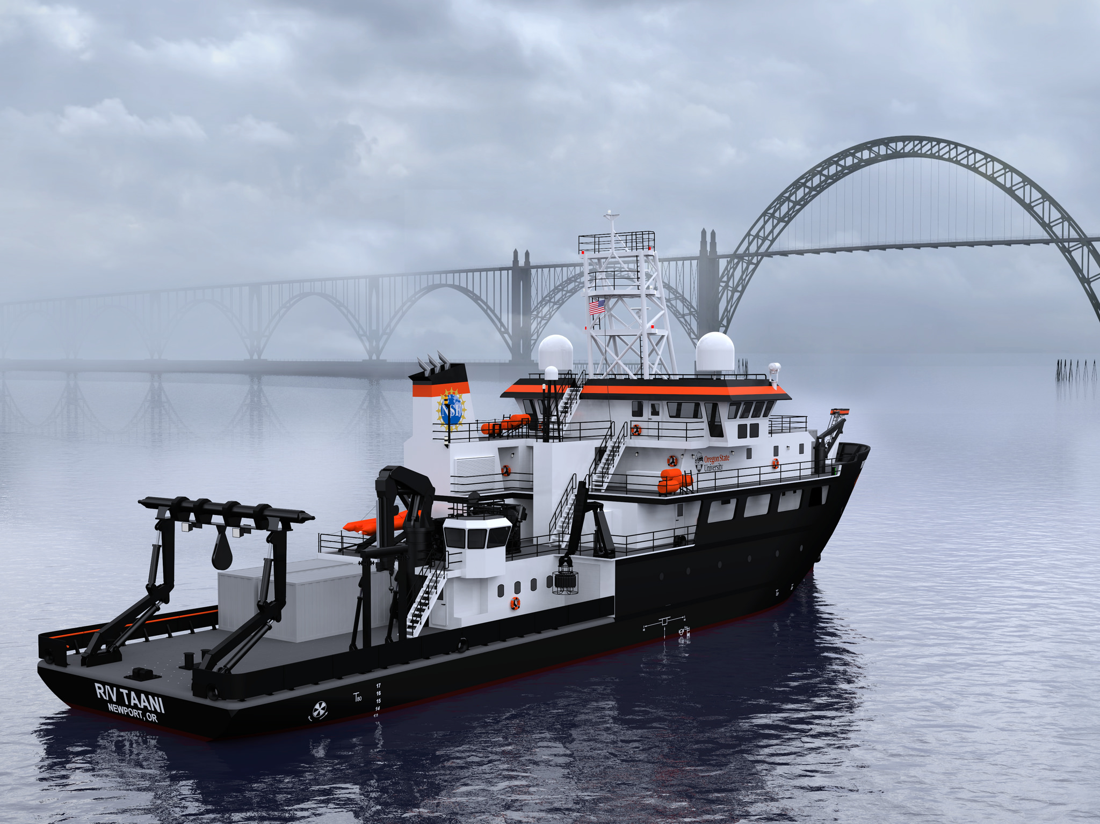
Challenge events
RCRV 2020

Slide 4
RV Taani
Your team is applying to come aboard the R/V Taani's (Oregon State operates it) or R/V Resolution (University of Rhode Island operates it) as part of their Youth in Ocean Science Initiative sponsored by the National Science Foundation. To complete your application process to be considered for “Youth Marine Technicians”. A majority of a Marine Tech’s voyage is spent organizing and supporting diverse science needs, such as supporting deployment of submersibles, analysis of data, and communicating the ship’s voyage to the general public, research institutions, and funders via social media. To show that your team could handle a youth Marine Technician position on R/V Tanni you must engineering and test an Remotely Operated Vehicle (ROV), analyze and visually represent data about that phenomena, and communicate how the each relates to a broader ocean science issue via social media.

Slide 5
4 Breakout sessions
Application
ROV
Engineering
Organism ID
Data Visualization/
Research profile
Telling the Story

Slide 6
Locations, Dates, Bussing
Eastern Oregon University (Eastern) (ES/MS)
April 4th
Oregon State Challenge (ES/MS)
May 9th
Western Oregon University/Oregon State (HS)
April 16th – 17th
Oregon Tech (Southern) (ES/MS)
April 25th

Slide 7
Relevant ROV Activities
SMILE Lessons
Life on a Vent
Helping Hand / Save the Soup
Mission Submersible
Ocean Careers
Volcanoes
ROV Mate Simulator - http://mate.gearsinc.org/
ROV Examples - https://nautiluslive.org/tech
MATE ROV Competition Website - http://www.materovcompetition.org/

Slide 8
Go Pro
Real Time Data/Tangible
Collection of Lessons
“Applied”
Visual Display

