Slide 1
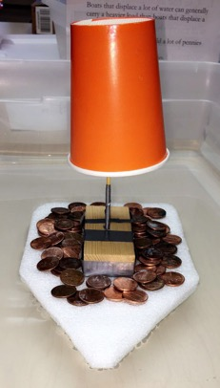
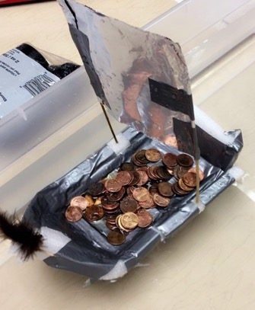
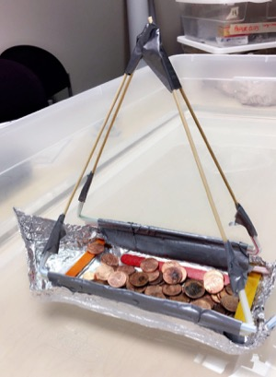
Build a boat for scientific research

Slide 2
REGIONAL CLASS RESEARCH VESSELS Coming to an Ocean Near You
http://ceoas.oregonstate.edu/ships/rcrv/
OSU is leading a project to construction 3 new research vessels to bolster the marine science capabilities of the United States.
OSU will operate the first vessel built. The vessels will serve research needs on the West, Gulf, and East Coasts.
Notes:
The need was identified so we began the RCRV
OSU is leading the project to construction 3 new research vessels to bolster the marine science capabilities of the United States.
OSU’s current research vessels are outdated for the type of research.
OSU researchers want to put new equipment on the boats for gathering data.
First boat is being built in Louisiana, Built for doing the science of today.

Slide 3
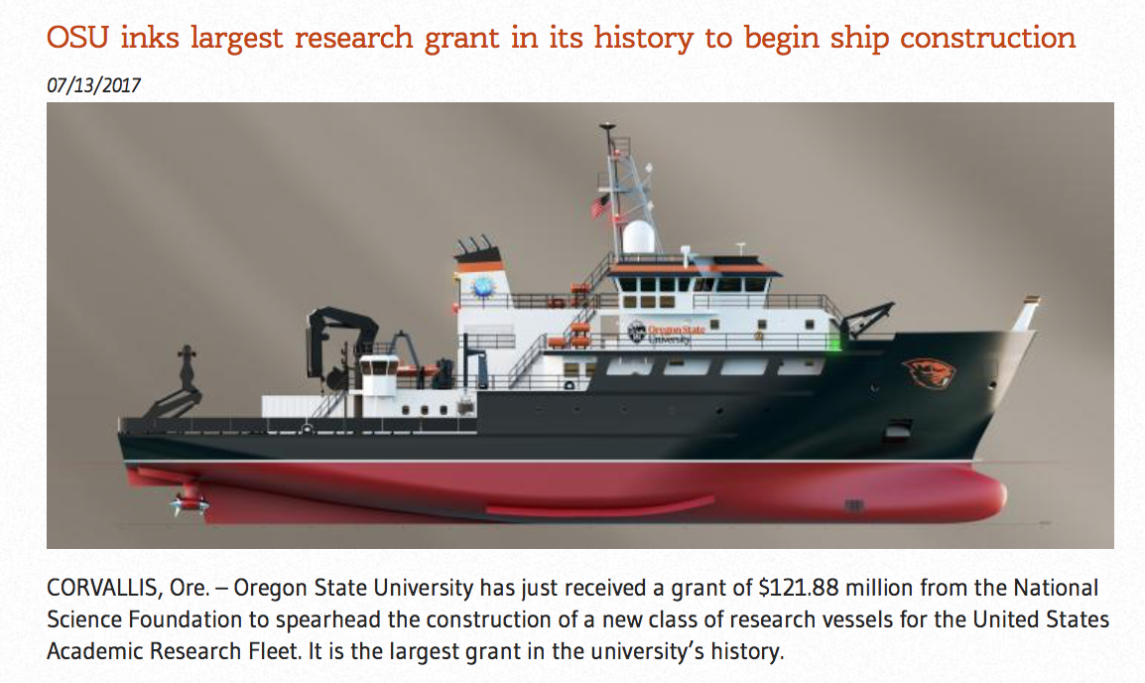
https://youtu.be/qz1NIwz_coQ
Notes:
OSU is leading the construction of three NEW ships to replace the current ships that are getting old.

Slide 4
DATAPRESENCE: Instant communication , like a high speed internet of the sea!
Promoting land –based expertise in participating in sea-going operations
Enabling scientists onboard to participate in outreach activities, with local communities and the general public
Notes:
It’s like high speed internet on the ocean.
The future is to be able to interact with teachers and students in real time.
An interdisciplinary approach to ocean science research enhancing observational, experimental, and analytical capabilities

Slide 5
Long-term GOALS: RCRV Education Outreach: Bringing Ocean Research to the Classroom and Community
Bringing Datapresence to the Classroom
Develop lesson plans designed for teachers to obtain data, visualize it, and discuss important trends and themes.
Virtual Fieldtrips: A Day in the Life of a Scientist at Sea
Provide streaming capabilities from ship to shore for “ask a scientist” sessions.
Datapresence for the Community
Develop a website so teachers and students can investigate what oceanographers do, how they do it, where the ship is now, and where it has been.
Bridging Science, Technology, and the Community
Notes:
Future opportunities: ” Educators at Sea” program will be possibility for summer 2019 . Contact Renee O'Neill.
Amanda is this too much?
(Today we would really like to focus on the use of data presence in the classroom. Our goal is to not only use data presence in the classroom and develop lesson plans around it but also have it available to the community, including teachers as an open data source to utilize. These are the 3 main ideas focused on data presence that we are developing outreach with the overall goal of bridging science, technology, and the community. )

Slide 6
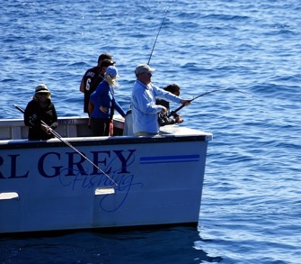
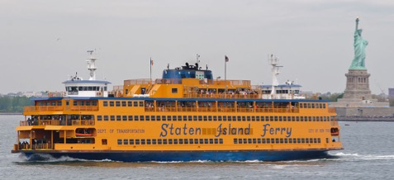
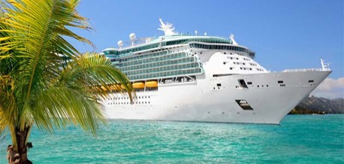
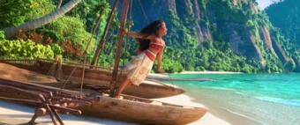
We use boats for many things
Transportation
Fishing
Research
Exploration
Cruises/Leisure

Slide 7
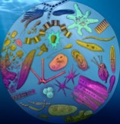
Why study the ocean on a boat?
What percentage of the Earth’s surface is covered by ocean?
Largest ecosystem on earth!
Plankton make 50% of the oxygen that we breathe!
Billions of people get their food from the ocean!
71%
Notes:
Who can tell me how much of the Earth is covered by the ocean? It is about 70% of the earth’s surface.
Our oceans are the largest ecosystem on Earth.
In every breath you take you can thank the photosynthesizers of the ocean as they generate roughly 50% of the oxygen we breath!
97% of the worlds water resides in oceans and it is this water that absorbs a large amount of carbon dioxide from the atmosphere to mitigate the impacts of climate change, it is estimated that between 2002 and 2011 there was a average annual release of 9.3 billon tons of carbon per year and roughly 2.5 billion tons went into the oceans (Scripps, Rob Monroe, The Keeling Curve).
The Marine stewardship council found that in 2013, fish provided 3.1 billon people with almost 20% of their intake of animal protein and the demand for seafood in increasing at a rate of 3.2% annually.

Slide 8
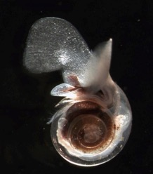
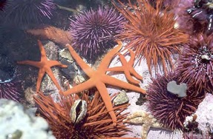
The ocean supports a great diversity of life – from the smallest microbes to the largest animal that ever lived on Earth
Less than 5% of the ocean has been explored and even less researched!
Notes:
We as humans have explored less than 5% of the Earth’s oceans, and better understanding the diversity and productivity of the oceans should be of great interest to humans as our existence, survival and ability to prosper depends on health oceans. With exploration in less than 5% of the Earth’s oceans we as oceanographers have a lot of work to do and to do that work we need research vessels.

Slide 9
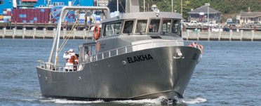
Ships operated by Oregon state university
Notes:
Three ships at OSU

Slide 10
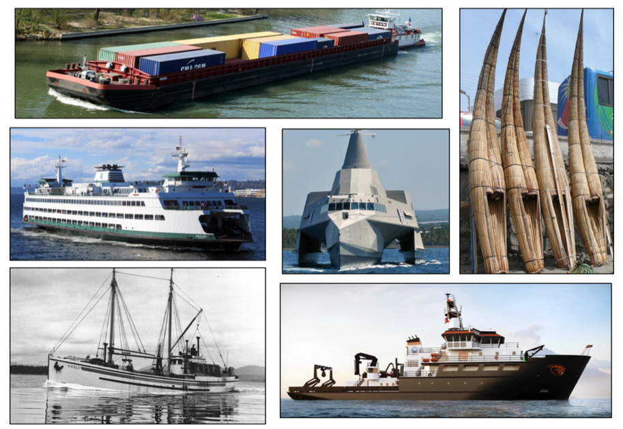
Why do boats have different shapes?
Notes:
Discuss
-Why do boats have different shapes?
-Which of these boats would be the most stable? Support
the most weight? Travel the furthest without going back
to land? Be the fastest? Slowest?
Shaped depend on what your goals are! In the case of research vessels, the vessels must also be equipped with special tools and technology that allow scientists to explore ocean environments. Research vessels are highly advanced traveling research stations. They must be able to offer scientists stable platforms from which they can deploy equipment, divers, and submersibles. In addition, these vessels carry electronics, computers, and navigational and communications systems.

Slide 11
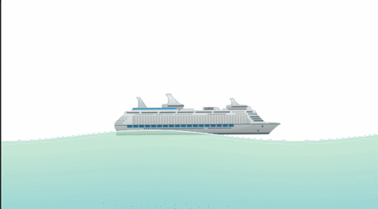
How can heavy ships float?
Archimedes Principle or buoyancy
If the density is greater than that of water, the object will sink. If the density is less than, or the same as, that of water, the object will float.
Even if boats are made of materials that sink they can float IF THEY ARE SHAPED RIGHT
Notes:
An object will float if it displaces as much water as it weighs. A ship made out of metal is able to remain lighter than the amount of water it
displaces, because it is not a complete solid.
Demonstrate buoyancy to students by showing them a ball of clay.
Ask: What do you predict will happen if I put this clay into the
water? (It will sink)
Now make the same piece of clay into the shape of a boat. Have them predict what will
happen when it is put in water. (It should float)
If the density is greater than that of water, the object will sink. If the density is less than (or the same as) that of water, the object will float. Even if boats are made of things that sink they can float IF THEY ARE SHAPED RIGHT (which was the case for the clay boat).

Slide 12
Lets build a boat!
Separate into groups of 2
Come up with a name for your boat
Brainstorm a design for your boat
What shape do you want to make?
What materials do you need?
How will your boat float?
Draw a design for your boat before you start building!
Build and test your design!
GOAL:
Your boat design must show the following:
Deck Space: sufficient deck space for carrying materials
Indoor Space: sufficient wheelhouse space for labs, sleeping accommodations, and food
Stability: is able to carry the most amount of weight and be stable in rough water
Notes:
There are limited resources available for students to use to build their boat. Handout:
- Sheet metal (6x6in piece aluminum foil)
- Welding material (1 foot of tape)
- Wood (4 popsicle sticks)
- Reinforcements (1 straw)
- Cable (2 pipe cleaners)
- Fiberglass (½ in clay cube)
- Wheelhouse (1 small cup)
In the case of research vessels, the vessels must also be equipped
with special tools and technology that allow scientists to explore
ocean environments. Research vessels are highly advanced
traveling research stations. They must be able to offer scientists
stable platforms from which they can deploy equipment, divers,
and submersibles. In addition, these vessels carry electronics,
computers, and navigational and communications systems.

Slide 13
Research vessels need space to deploy equipment, divers, and submersibles.
Notes:
CTD-conductivity, temperature and depth
Give students a bag of assorted materials that represent people, equipment, and supplies that their boat must carry.

Slide 14
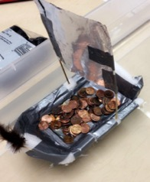
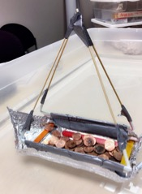
Testing your boat
To test your boat you will load as many pennies as you can onto the deck of your boat.
The most successful designs will hold the most pennies without sinking.

Slide 15
Debrief
Which boat designs were most successful and why?
What did you find difficult about designing and building your vessel?
What would you change about your boat design and why?

Slide 16
Inform the Research Team
What ocean topics are you interested in studying with students?
What standards (DCIs) would you like ocean curriculum connected to?
What tools and resources would support you using data with your students?

