Slide 1
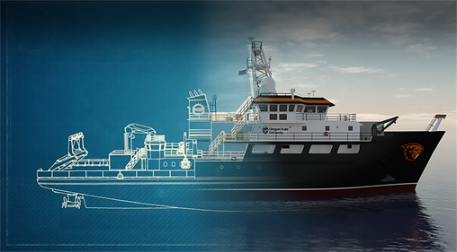
RCRVs, Volcanos, & Hydrothermal
Vents
Adam Talamantes
& Kimberley Preston

Slide 2
Outline for Today
Introduction to RCRVs, Volcanoes, and Hydrothermal Vents
Axial Seamount
Regional Class Research Vessels, ROVs
Activities
Volcano Profiles
(BREAK - 10-15min)
Axial Seamount: Life on a Vent
Making Connections to Other Activities
RCRVs
Volcanos
Ocean Sciences
What do you link Earth and Ocean Sciences too?

Slide 3
Goals for Today
Reflect on how you are teaching earth sciences and food webs
Reflect on the affordances and constraints of “Framing” / “Structure” of an activity
Learn more about the RCRV project
Learn about volcanoes and hydrothermal vents
Learn 2 new activities!
Make connections to other in class and afterschool activities!

Slide 4
NGSS:
Volcanos
4-ESS2-2
MS-ESS2-2
MS-ESS2-3
Hydrothermal Vent Ecosystems
5-LS2-1 MS-LS2-3
Questions:
How are you already teaching earth sciences in your classroom?
How are you already teaching it in your club?
Do you use a story to teach science in your classrooms and/or club?
For those that attended the challenge..
Have you done any follow up Axial Seamount activities? (Build a Boat? Mission Submersible? Plankton? Living on the Edge?)

Slide 5
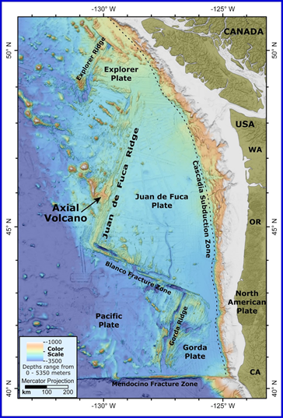
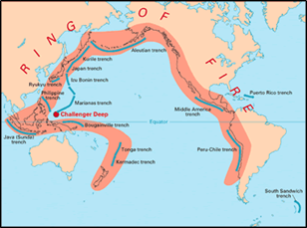
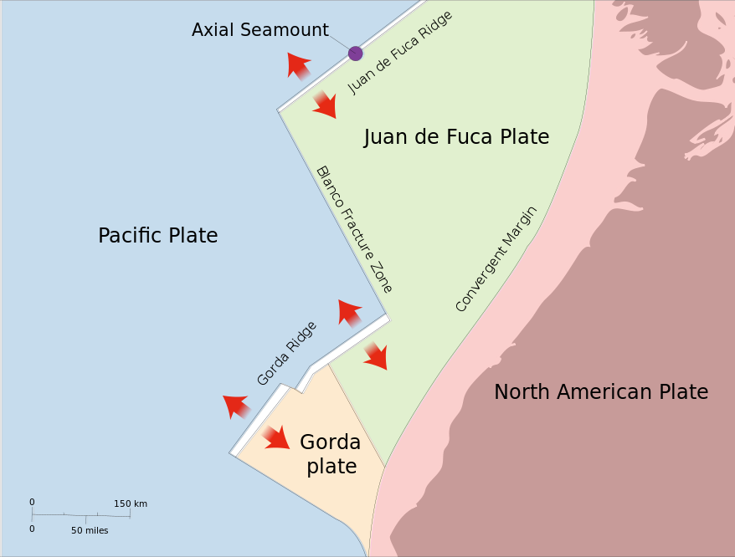
The Axial Seamount is Ripe for Volcanic Activity and Hydrothermal Life
300 miles off the coast of Oregon - erupted in 1998, 2011, 2015
Is part of the Ring of Fire (Video)
Most Active Volcano in a string of volcanoes that straddle the Juan de Fuca Ridge
At the Axis of a divergent plate boundary and a Hot Spot (video)

Slide 6
Axial Seamount is a Rich Context for Research
Researchers have been monitoring the seamount for the past 35 years.
200+ scientists, as part of Pacific Marine Environmental Laboratory (PMEL, NeMO) at HMSC (and elsewhere, and with other research groups)
Two Main Areas
Earth-Ocean Interactions
Acoustics
Key Research Areas:
Ocean acidification
Geological processes (Volcanoes)
Tsunami detection and forecasting
Hydrothermal vent systems
Fisheries oceanography
Long term climate monitoring and analysis
What does this look like? (Video)

Slide 7
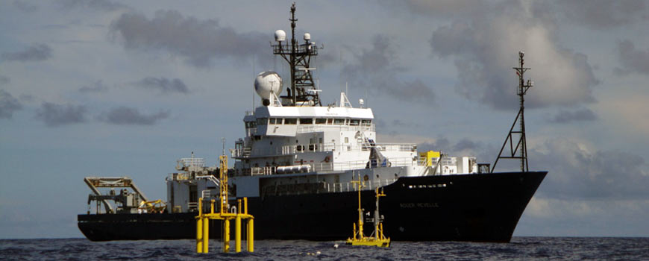
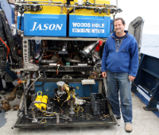
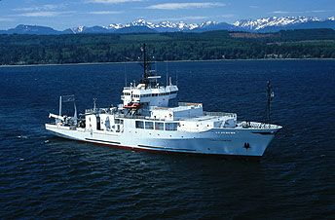
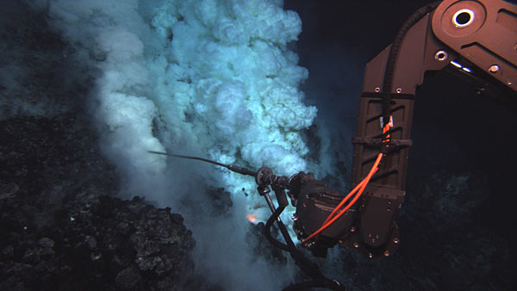
Conducting Observations at the Seafloor using Research Vessels and ROVs (OSU is making 3!)
Research Vessels (Video)*
Remote Operated Vehicles
It Takes a Crew! (Video)
2017 Expedition
Geologists & Geophysicists | 5
Data Management | 2
Teacher at Sea (Teresa Atwill) | 1
Techs | 4
Chemists | 4
Microbiologists | 1
ROV/AUV Crew | 15
Crew | 21
Roger Revelle, Scripps, 2017
ROV Jason (Video)*
Thomas Thompson, UW, 2011

Slide 8
Volcano Profiles
Kimberley Preston

Slide 9
Volcano Profiles
NGSS Performance Exp
4-ESS2-2
MS-ESS2-2
MS-ESS2-3
DCI: Earth Systems
ESS2.B: Plate tectonics and large scale system interactions
Science and Eng Practices
Analyzing & Interpreting data
Cross-cutting Concepts
Patterns
In this activity students will…
learn about geological process that form volcanoes on land and underwater.
synthesize and communicate scientific information about specific volcanoes to fellow students.
explore the different methods researchers employ to study volcanoes and related geological activity.
Practice public speaking, presentation, and reading comprehension skills.

Slide 10
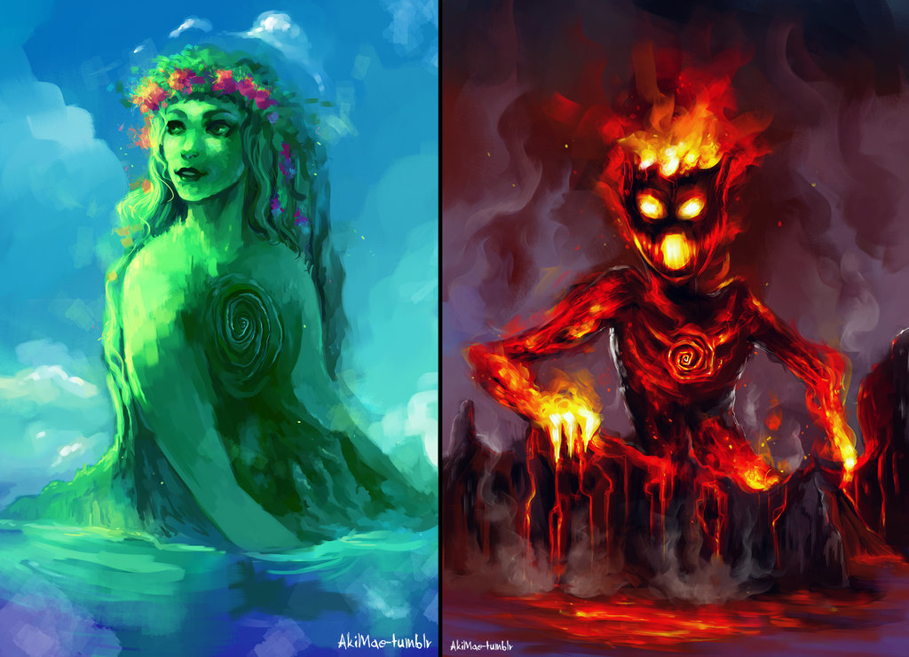
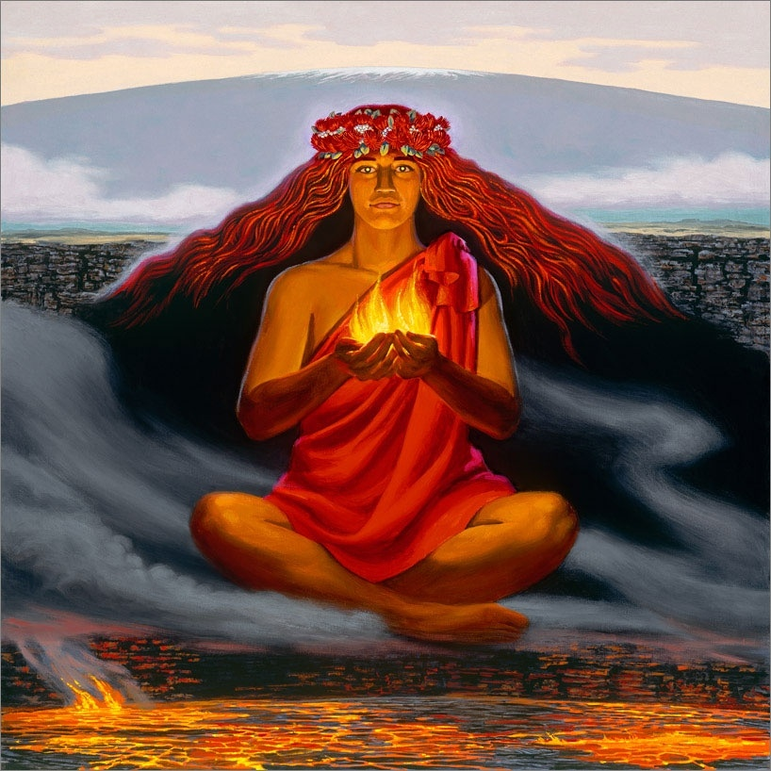
Framing the Activity Matters to Students!
Moana, Tafiki, and Pele
Pele was Te Fiti/Te Ka in Disney’s movie Moana, and lives in Kilauea!
Hawaiian Goddess of Lava Flows
Pele is also known as:
“Pele of the Sacred Land”
“The Earth-eating Woman”
“She who Shapes the
Sacred Land”
Discussion Questions:
Would you use this and, if so, how would you use this? (Video)
What about this one? (Video)

Slide 11
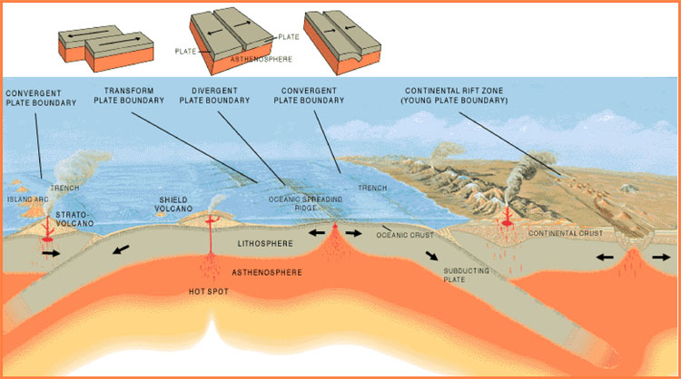
A volcano is a vent in the Earth’s crust through which lava, ash, rock and gases erupt.
Tectonic plates sit on the Earth’s crust in the lithosphere (part of the “Geosystem” in NGS).
Formation: volcanoes generally occur near tectonic plate boundaries, as plate move (Divergent, Convergent, Transform). Or volcanoes can form via Hot-spots (video).
Classification: based on shape and type of eruption that created the volcano (Cinder cone, Shield, Stratovolcano).

Slide 12
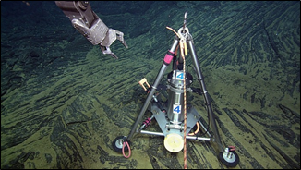
We study volcanoes to better understand how they form in order to predict/prepare for future eruptions.
Many people study volcanoes:
On land, tilt (slope) and strainmeters (shape) measure small changes in the shape of the volcano as it inflates with magma.
Under the ocean (video), scientist use remote operated vehicles to position tilt (slope) and pressure meters (rise or fall of the seafloor) to measure the slope and shape of the volcano.
Monitoring: US Geological Survey’s Volcanoes Hazards Program gives current activity alerts

Slide 13
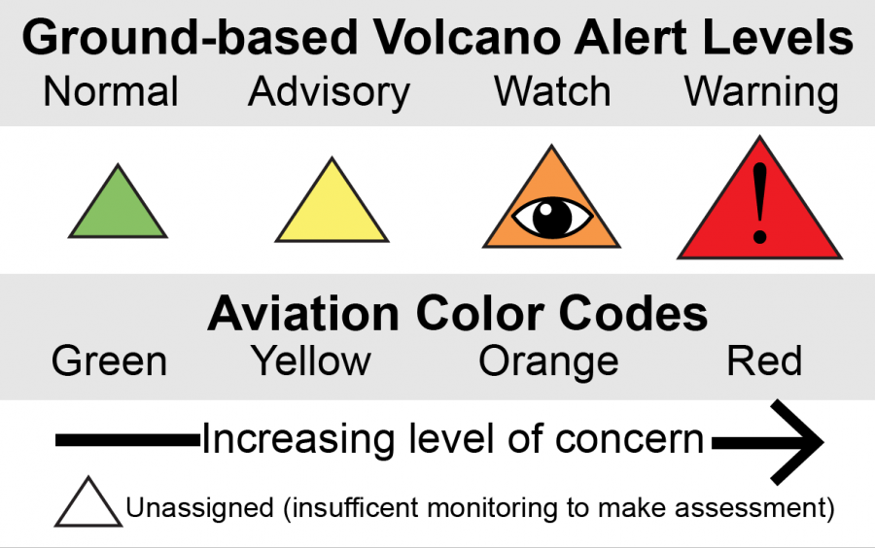
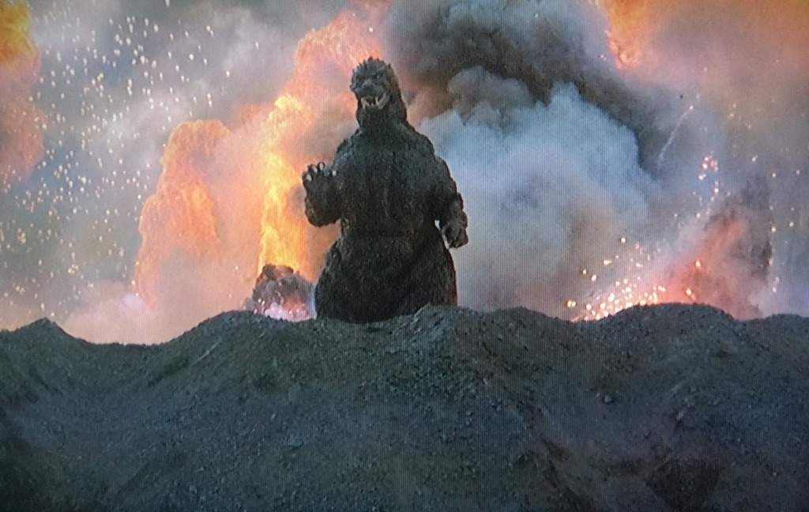
Volcano Webquest!
Go to: volcanoes.usgs.gov
Pairs of 2
Tasks
Find where you live on the map!
What are the 3 closest volcanoes to you?
Find a volcano with an “eye” or a “!” icon on it.
What volcano did you find? Why is it being monitored?
Can you find the “Ring of Fire”?

Slide 14
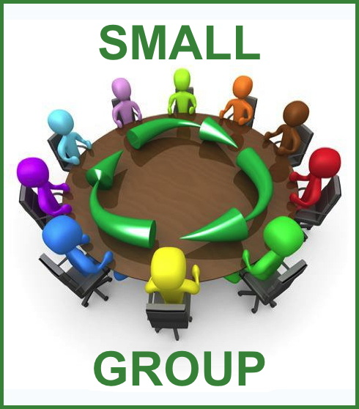
Volcano Activity: Each One Teach One
Pairs will be rotated through different stations to learn about volcanoes and hear the presenter’s haiku, as other pairs teach about their volcano and present their haiku to the rotating pairs (60 sec). This structure allows small pieces of information to be shared across a group.
Divide into pairs, and co-construct a 5-7-5 Haiku based on your card (this will be shared, so write it down!)
We will take groups out one at time and then start the rotations.
How did this structure work for you?

Slide 15
Volcano Activity Debrief
Activity Participation:
What were some similarities or differences between the volcanoes?
What stood out to you as interesting or challenging?
What did you learn about the volcanoes in the PNW?
Activity Facilitation:
What are some other ways we can frame (Moana, NatGeo, RCRVs)/structure (E1T1) this activity?
Where do you see this fitting in with your existing curriculum?
Any suggested changes/additions?
Examples:
K-W-L Chart, Create your own volcano profile, Ready to Erupt! activity, Living on the Edge activity

Slide 16
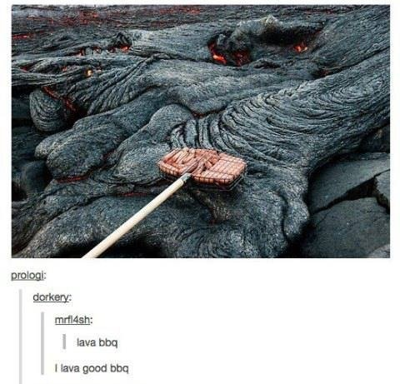
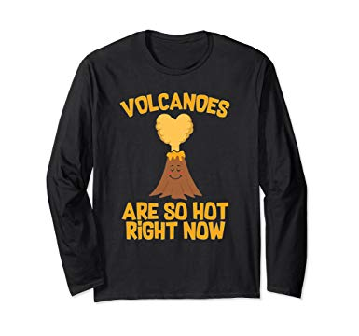
BREAK!
Question:
Just how deep is the ocean?
Answer
(Hydrothermal vents are in the Abyssal Zone; bottom of the Midnight Zone)
Visit: https://divediscover.whoi.edu/
Vent Life
Lava Flow Video

Slide 17
Axial Seamount: Life on a Vent
Adam Talamantes

Slide 18
Axial Seamount: Life on a Vent
NGSS Performance Exp
5-LS2-1 MS-LS2-3
DCI: Earth Systems
LS2: Ecosystems: Interactions, Energy, and Dynamics
Science and Eng Practices
Developing & Using Models
Cross-cutting Concepts
Systems, Energy & Matter
In this activity students will…
Construct individual and class models of ecosystem food web.
track nutrients and energy through a food web.
learn about deep sea hydrothermal vent ecosystems and how they differ from ecosystems on land.
synthesize and communicate scientific information about hydrothermal vent creatures

Slide 19
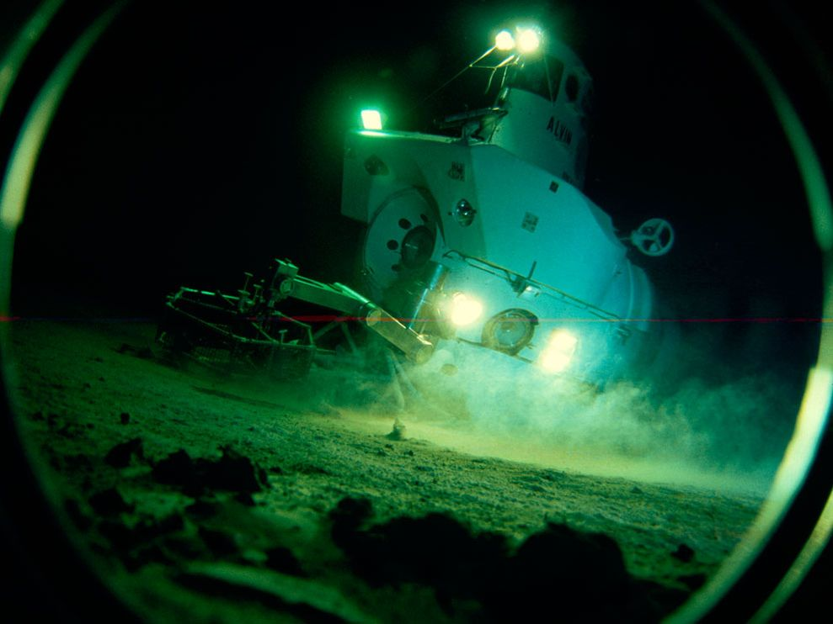
Framing the Activity: The Story of the Alvin!
Hydrothermal Vents
First Discovered in 1977
Near the Galapagos Islands (Hot Spot Islands)
The Alvin 1964
Human Occupied Vehicle (HOV)
Two Scientists
+4,500 meters, during dives lasting up to ten hours.
Still in use today! (Video)
What are hydrothermal Vents? (Video)

Slide 20
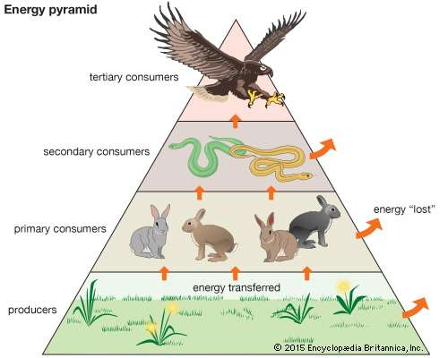
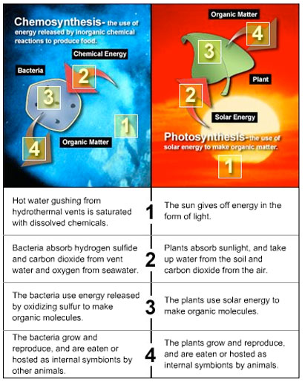
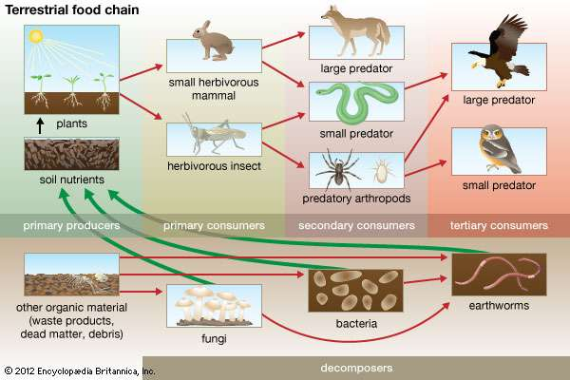
Food Webs, Ecosystems, & Deep Sea Vents
Food webs (Video)
Same Trophic levels exist
Producer, Consumer, First Order Carnivore, Top Order Carnivore
Detritivores (Decomposer?)
Ecosystems are Relative
Photosynthesis
Chemosynthesis
Extremophiles (Extreme)
Thermophiles (Hot Loving)

Slide 21
Doing the Activity: 3 Teams Building a Food Web
Divide into 3 Teams of 5
Construct a Food Web based on
Primary Producers
Primary Consumers
First Order Carnivores
Top Order Carnivores
Decomposers
1 Round of Giving Feedback
Revisions, Adds, Questions
Must suggest at least 3 per team using sticky note
Can point out “possible food chains”
Identify 3 food chains using tape
Share Out/Discussion

Slide 22
Life on a Vent Debrief
Discussion Questions:
Can you describe the flow of energy and nutrients in this hydrothermal vent ecosystem?
If a creature or creatures are removed from the foodweb, do other creatures change places?
Detritivores feed on dead and decaying matter falling from the sea above. Are they decomposers or are they other things that just happen to feed on dead and decaying matter?
Activity Facilitation:
What are some other ways we can frame (Alvin)/structure (Modeling) this activity?
Where do you see this fitting in with your existing curriculum?
Any suggested changes/additions?
Examples:
K-W-L Chart, Create your own Ecosystem Food Web, Ready to Erupt! activity, Living on the Edge activity, Volcano Profiles

Slide 23
Revisiting the Goals for Today
Reflect on how you are teaching earth sciences and food webs
Reflect on the affordances and constraints of “Framing” / “Structure” of an activity
Learn more about the RCRV project
Learn about volcanoes and hydrothermal vents
Learn 2 new activities!
Make connections to other in class and afterschool activities!
(Cards in your Club Bins and Lessons Online Soon!)

Slide 24
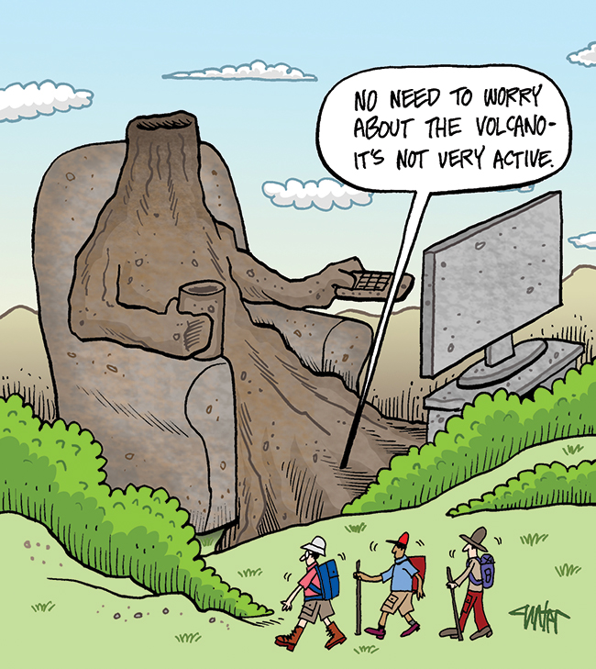
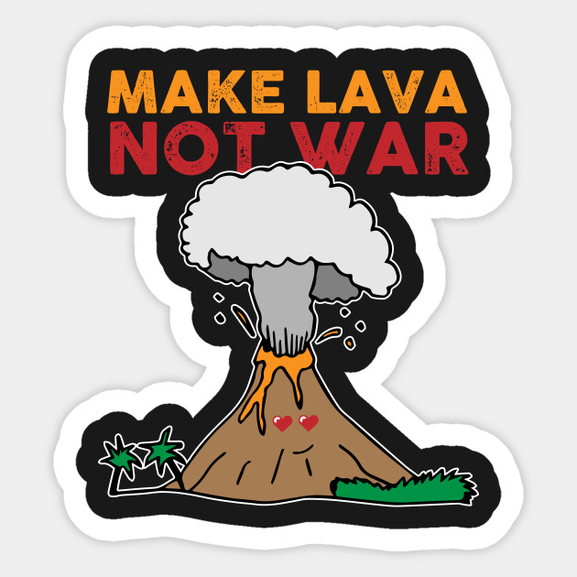
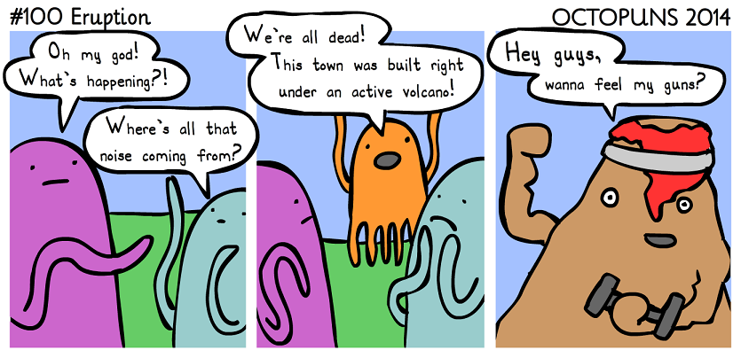
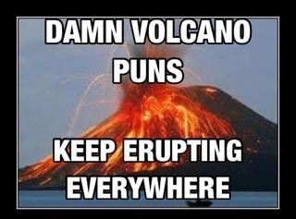
Thank You
&
Questions

Slide 25
BREAK!
Question:
Just how deep is the ocean?
Answer
(Hydrothermal vents are in the Abyssal Zone; bottom of the Midnight Zone)
Visit: https://divediscover.whoi.edu/
Vent Life
Lava Flow Video

