Slide 1
Mill Creek Project
SMILE Summer Teacher Workshop 2019

Slide 2
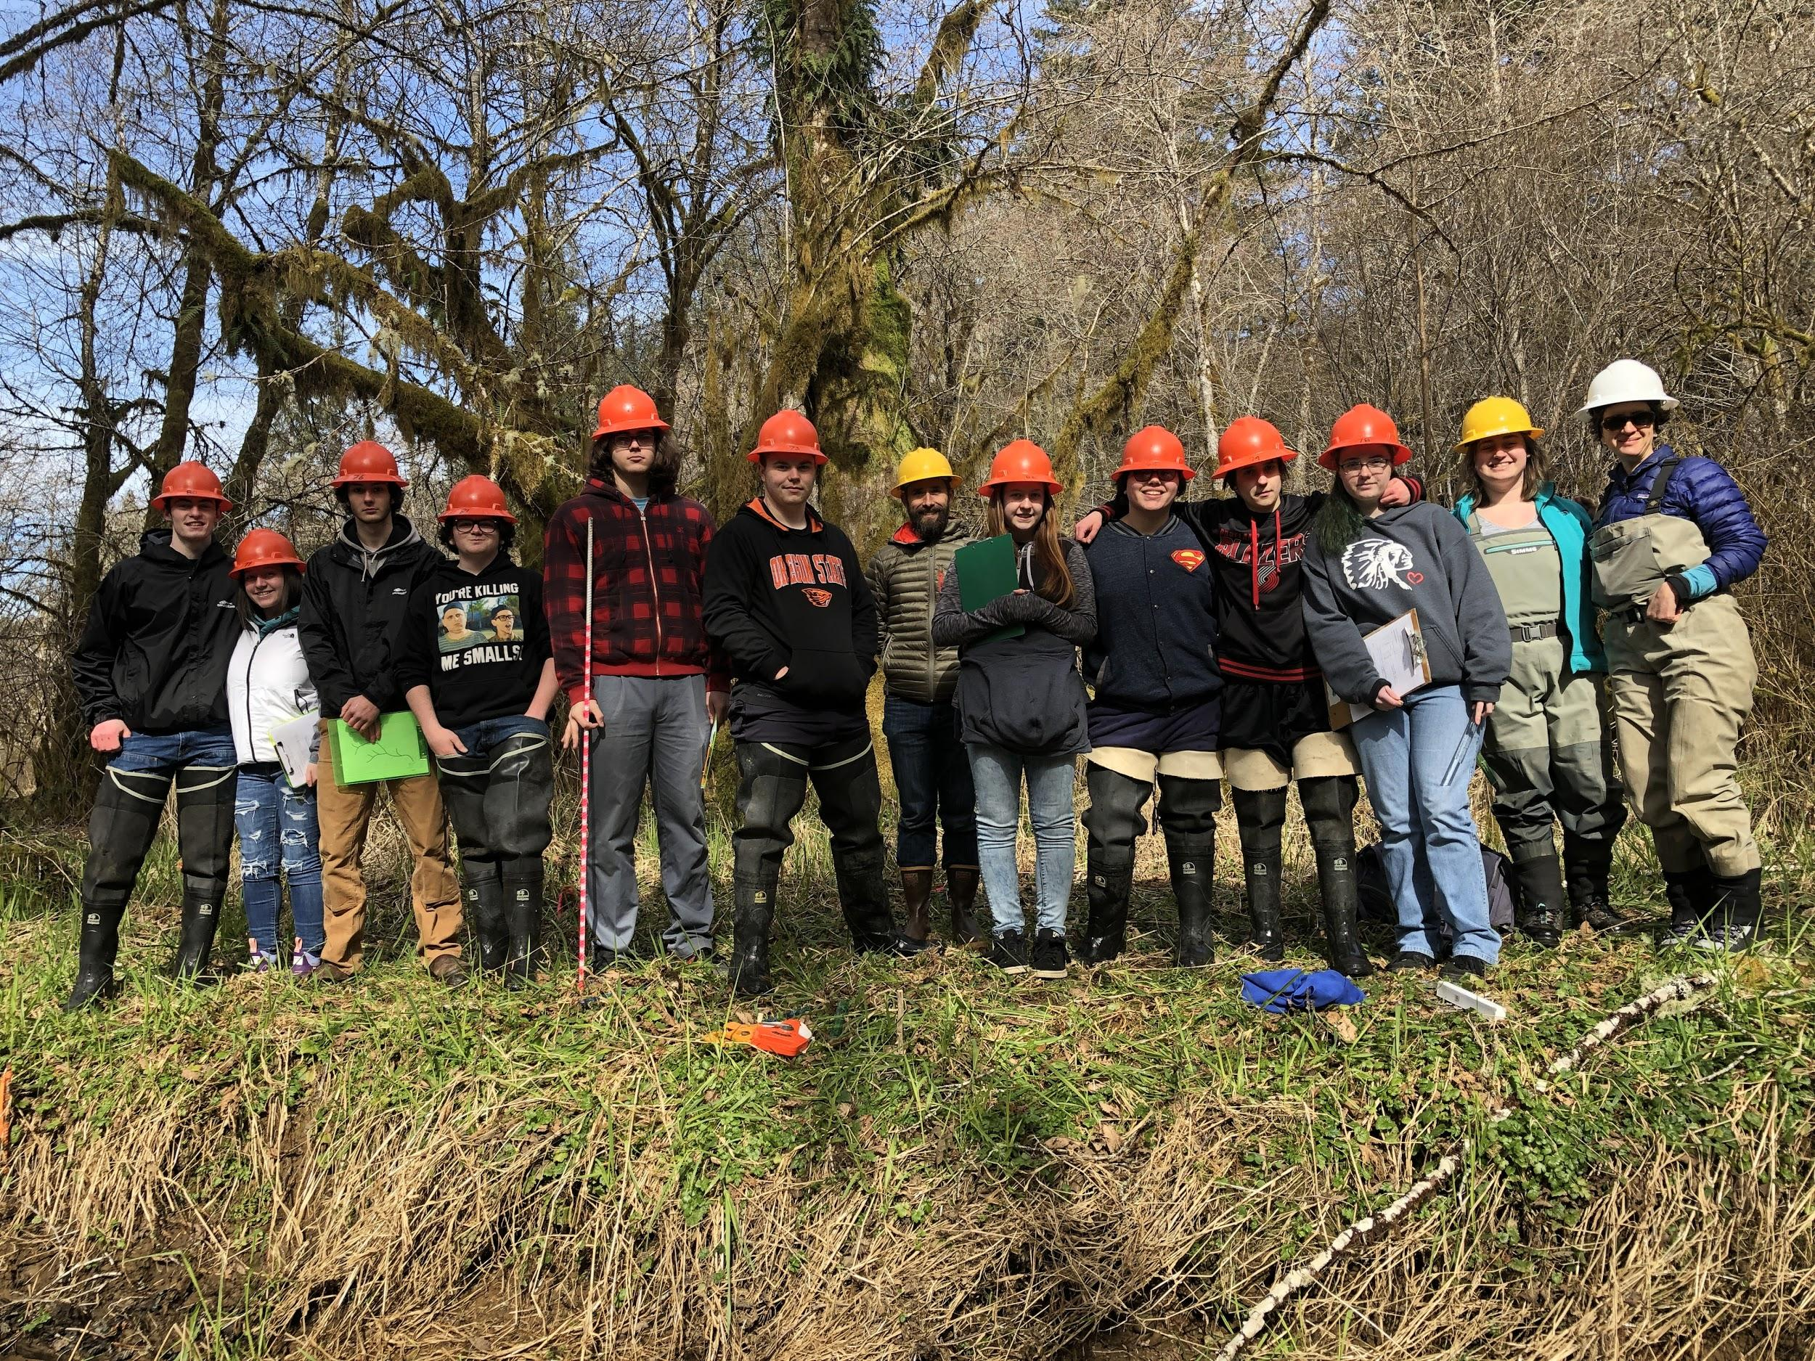
Overview
Background
Project
Inspiration
Logistics
Takeaways

Slide 3
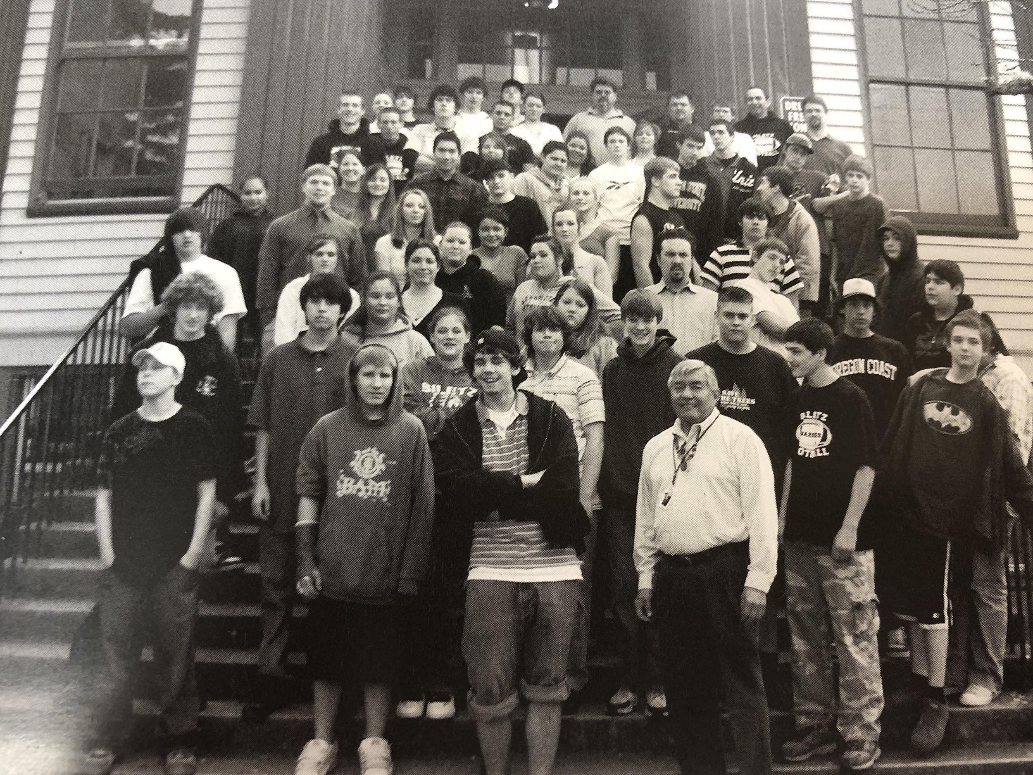
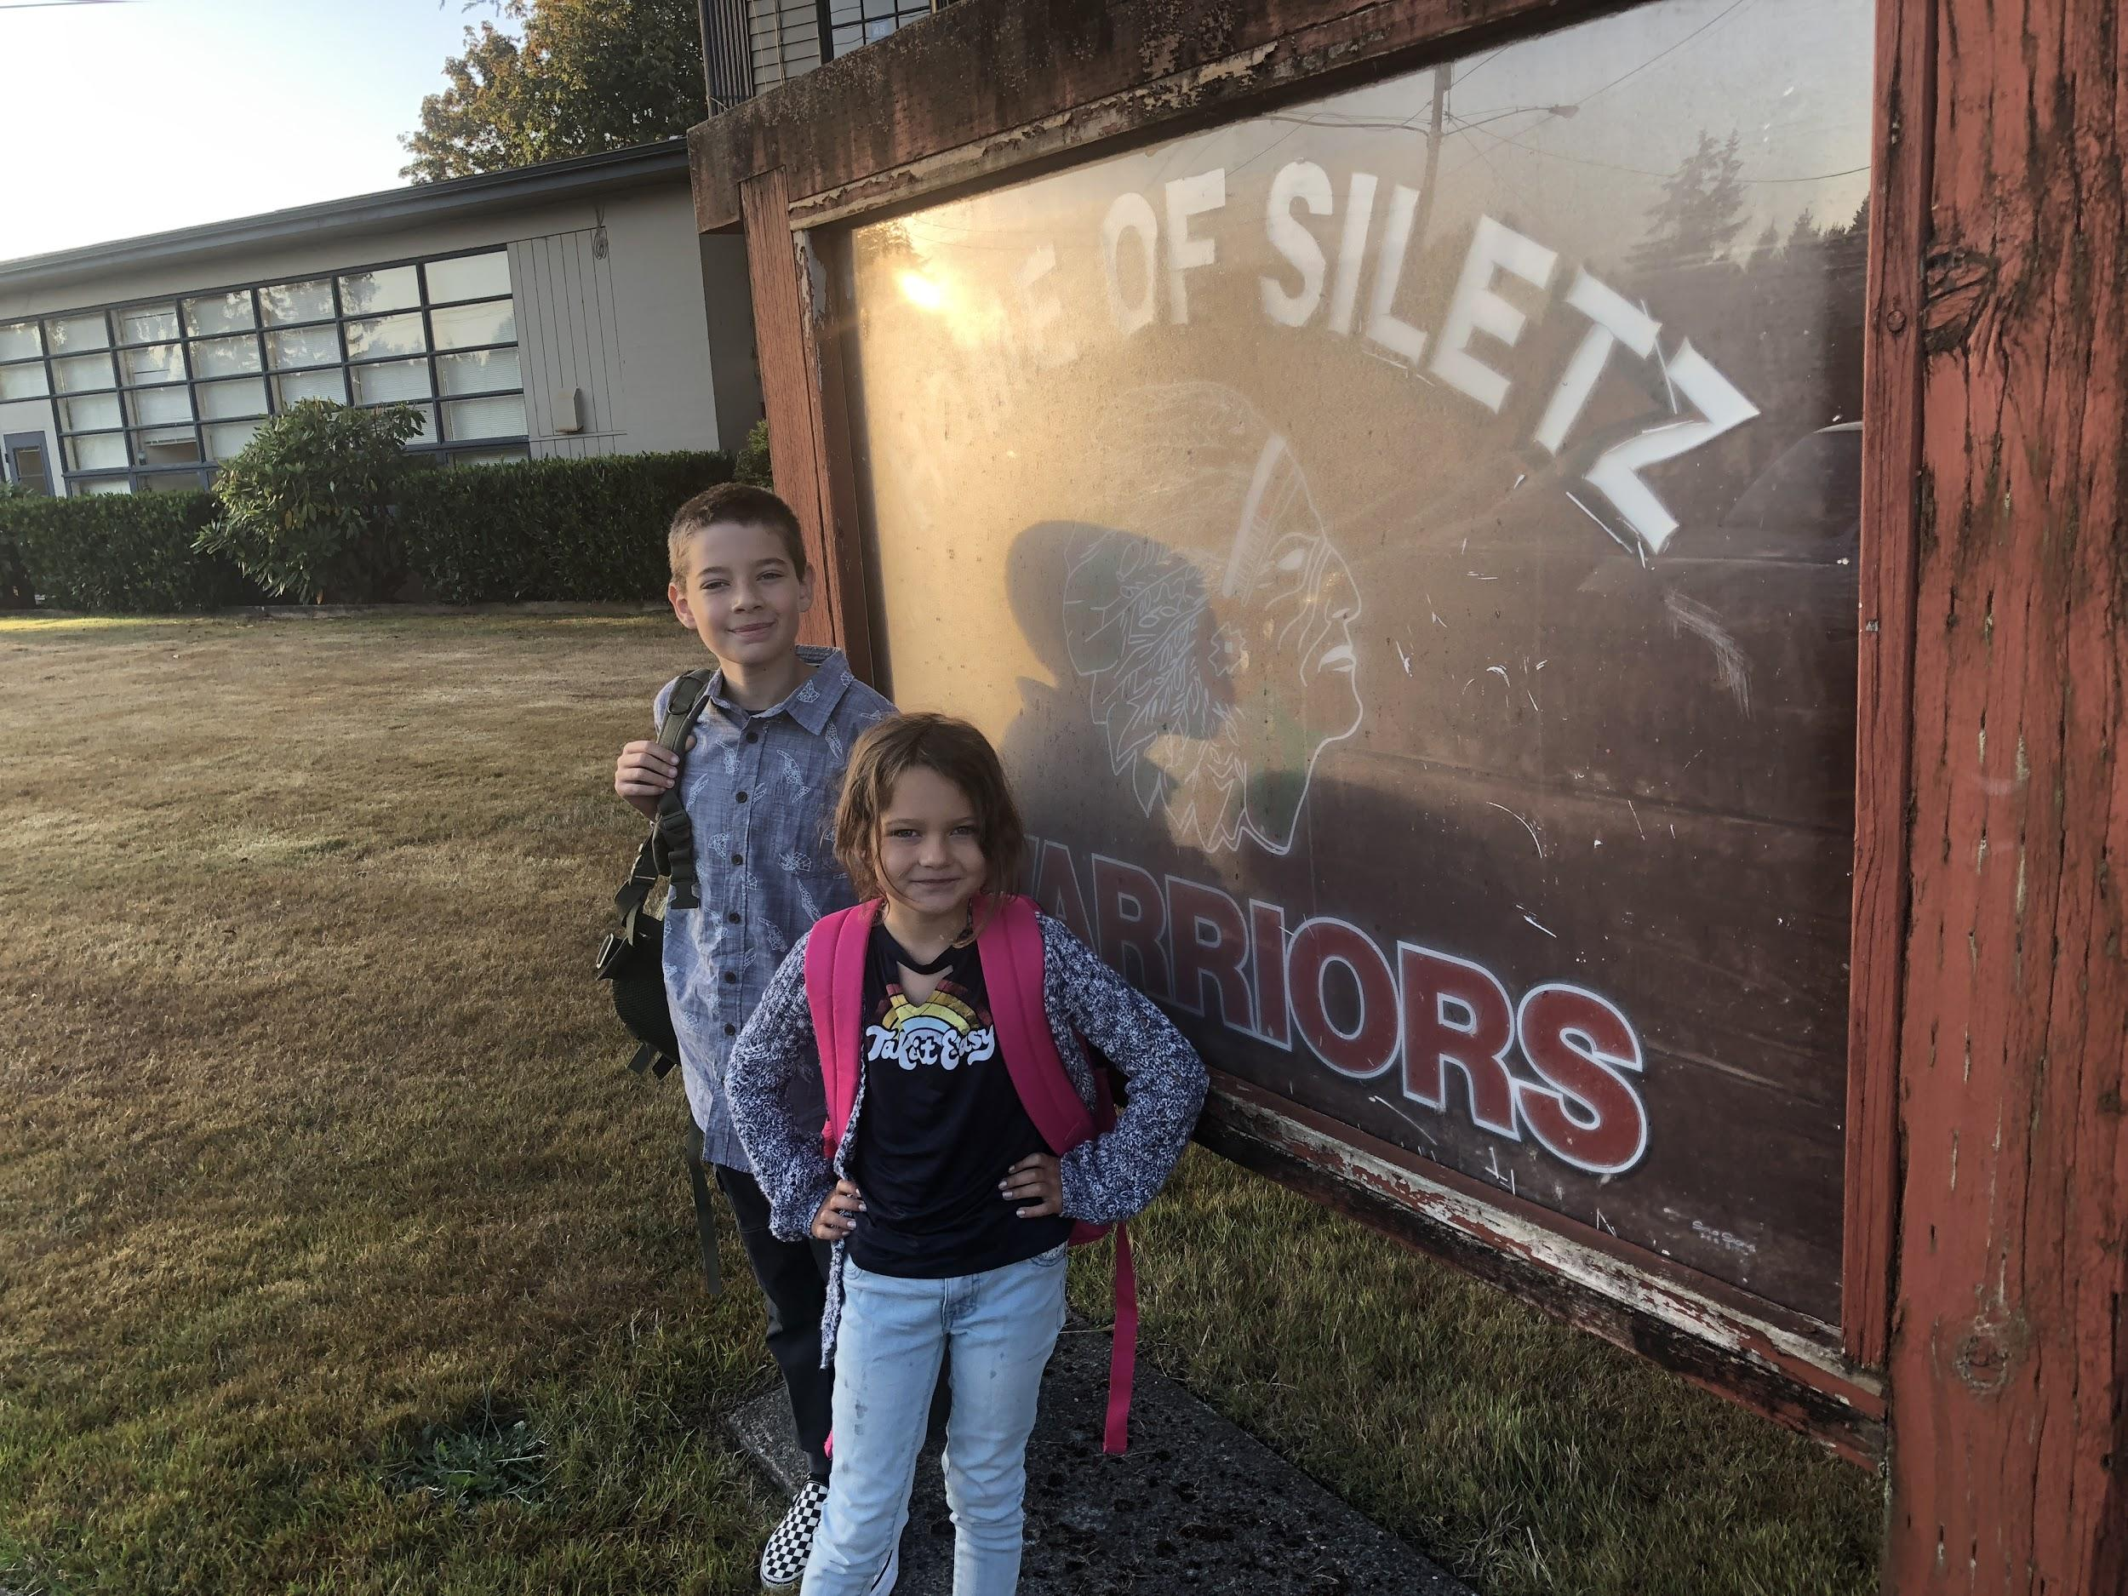
Background

Slide 4
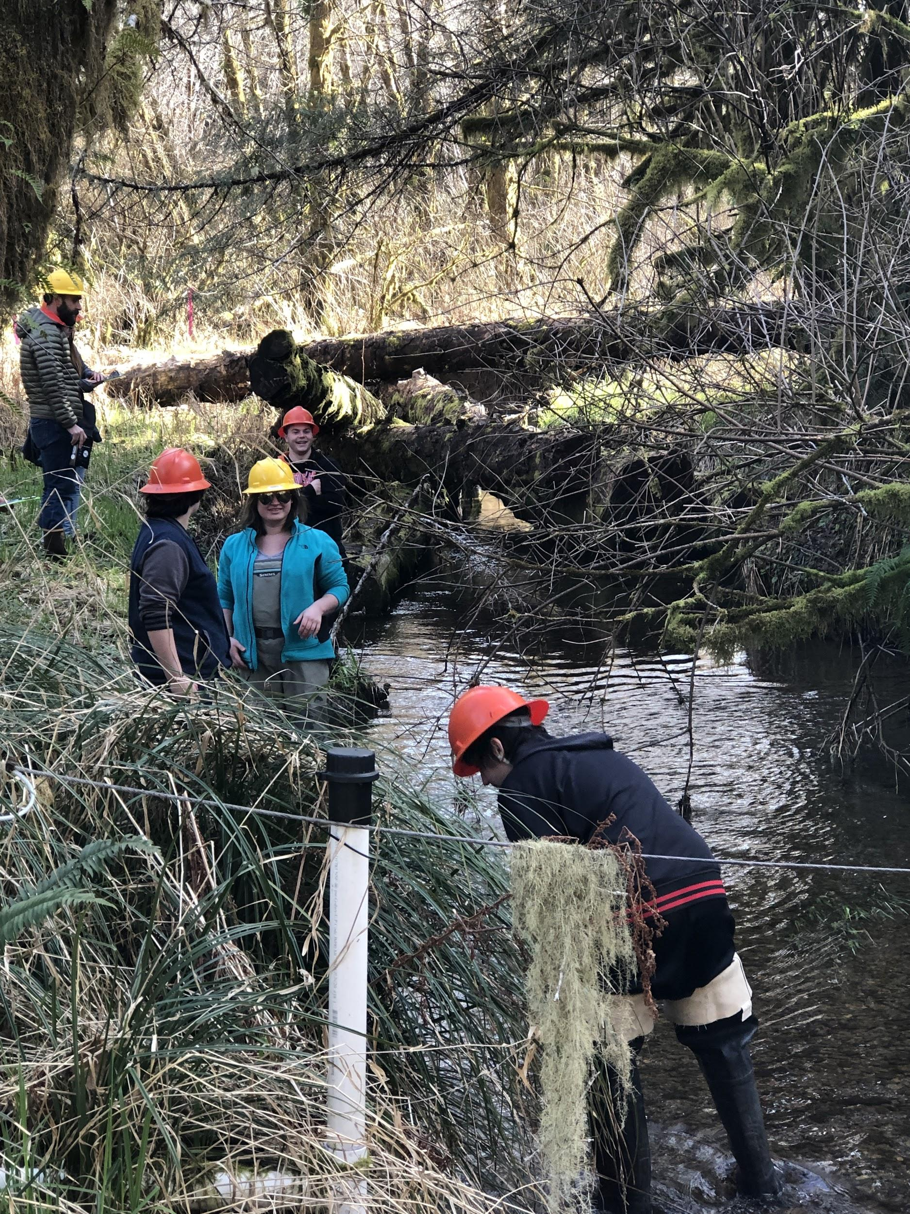
Project
Partner with OSU
Goals
Get students into the field
Real world experience
Collect data
Develop curriculum
Share with others

Slide 5
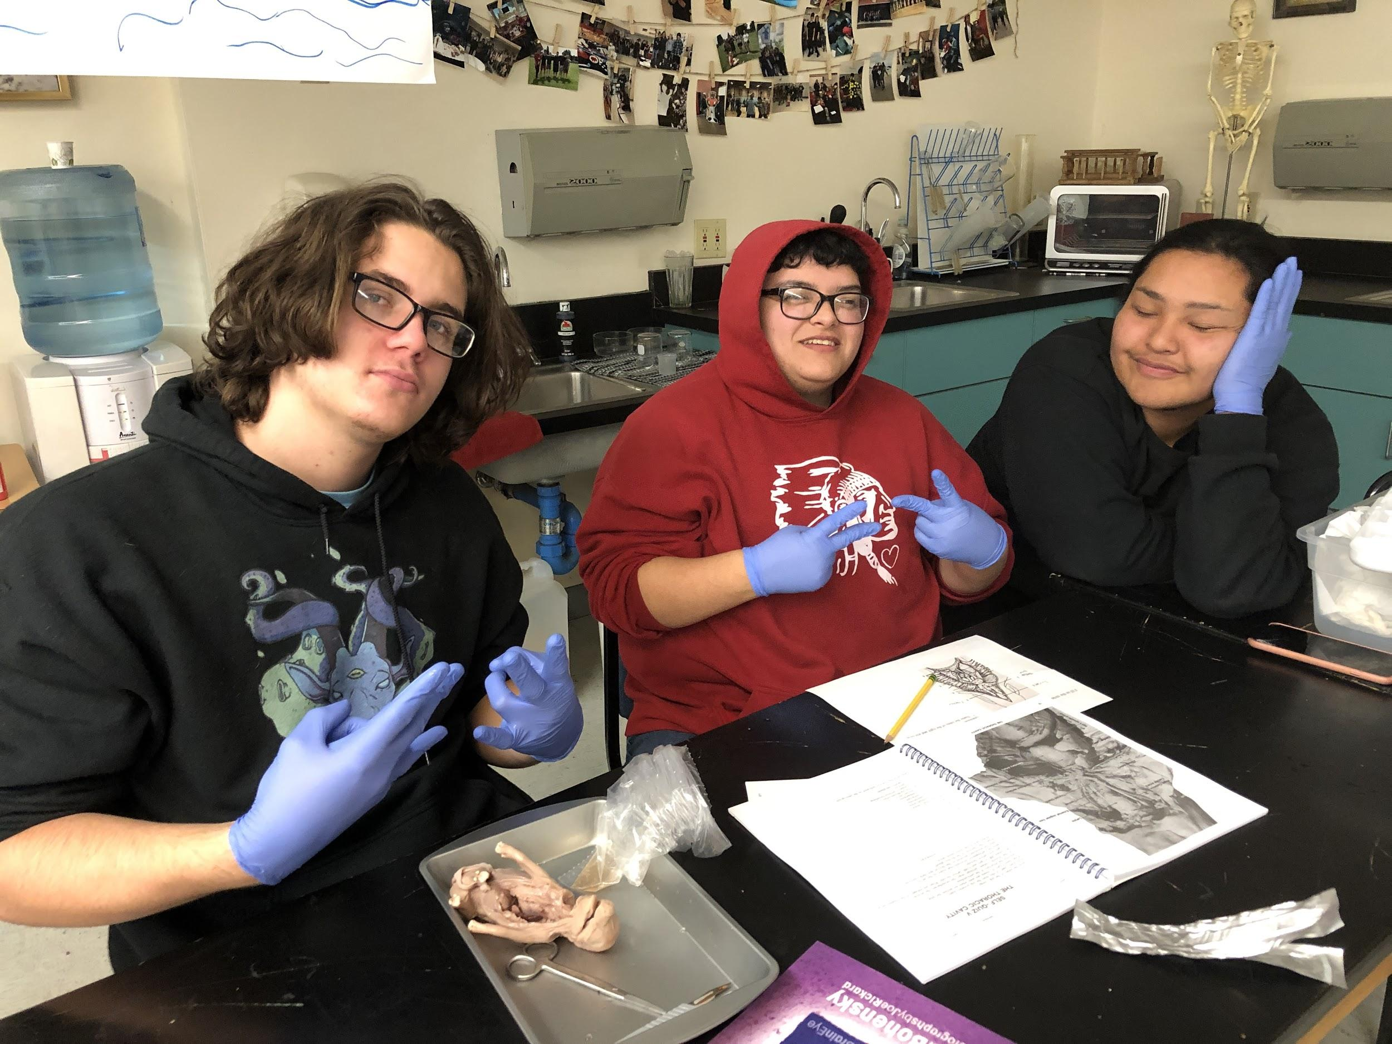
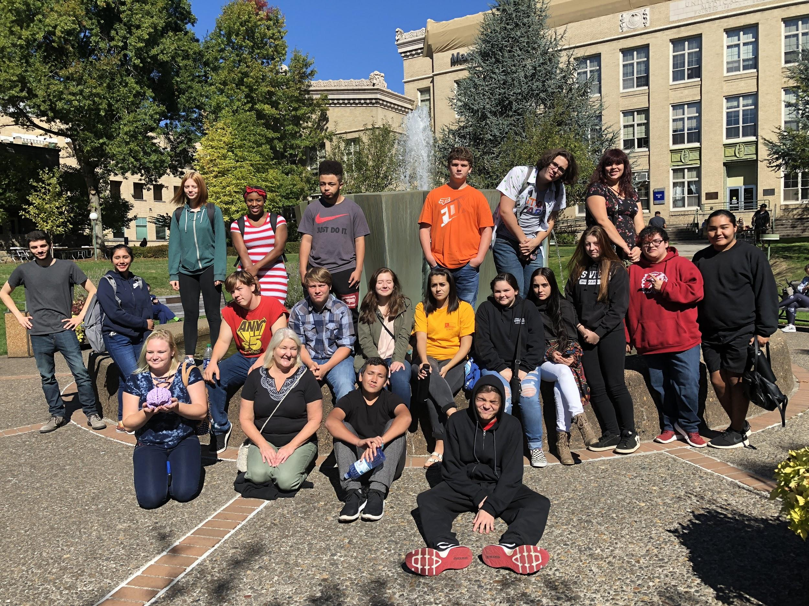
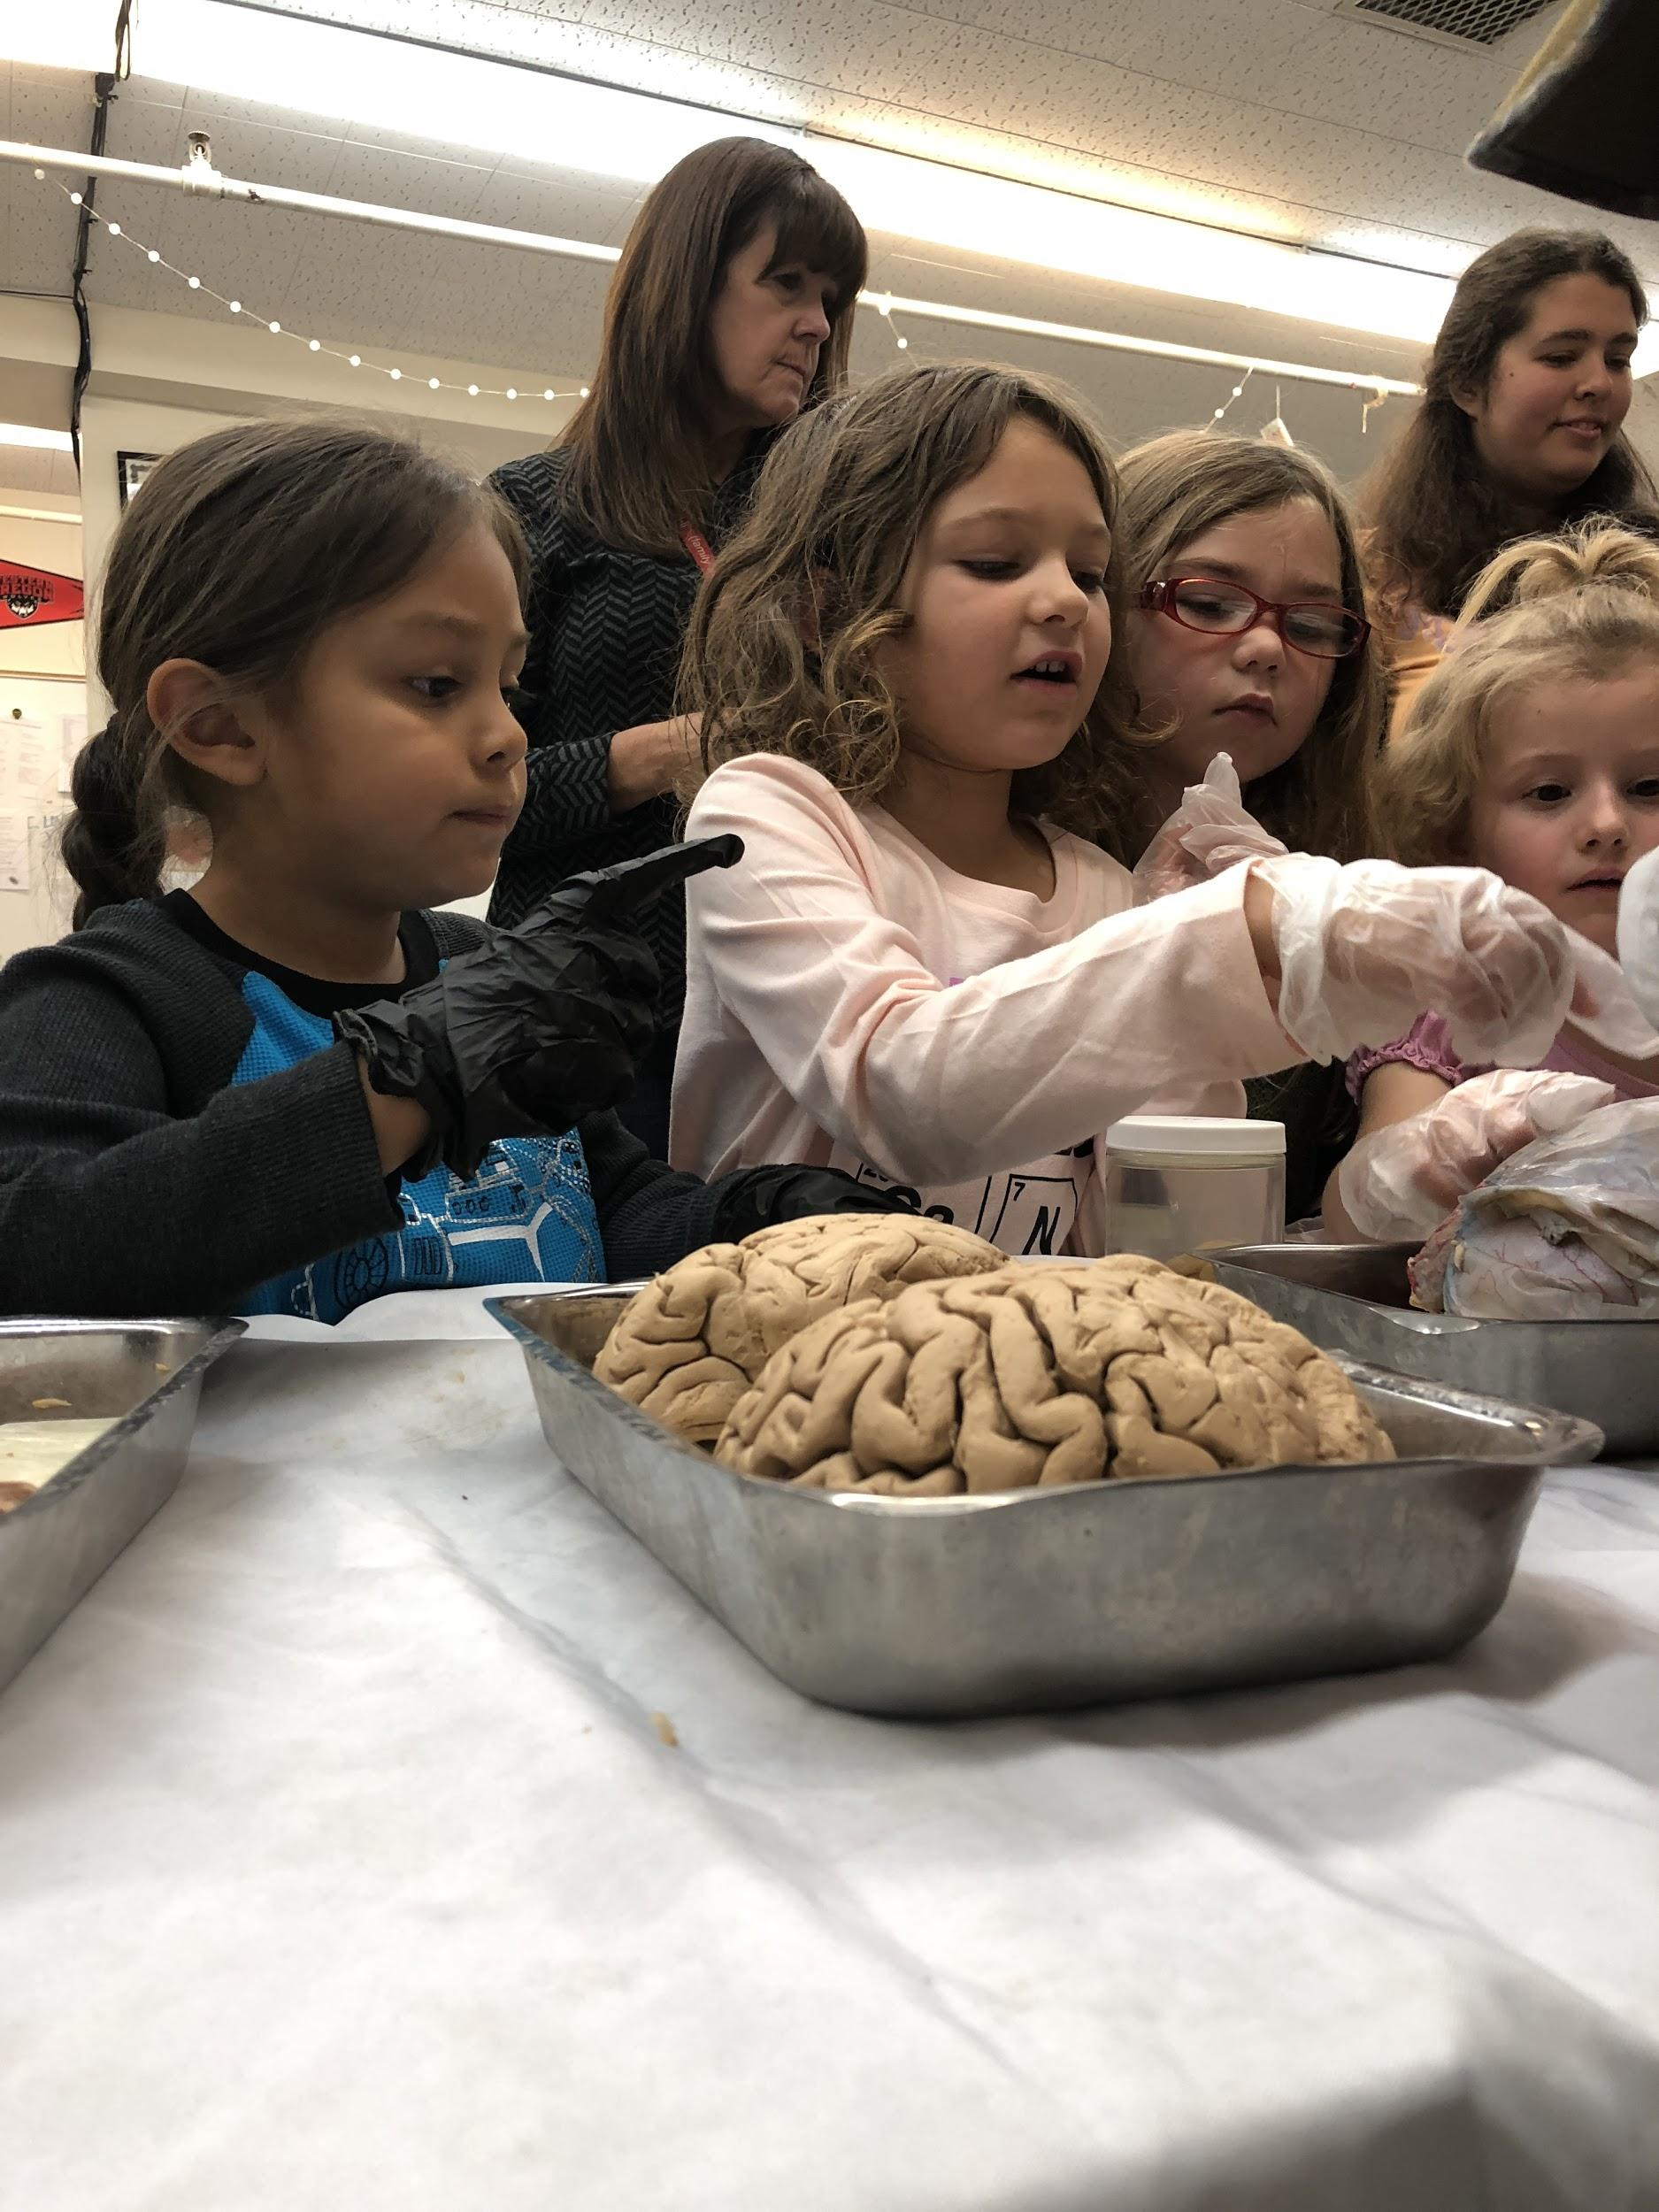
Inspiration

Slide 6
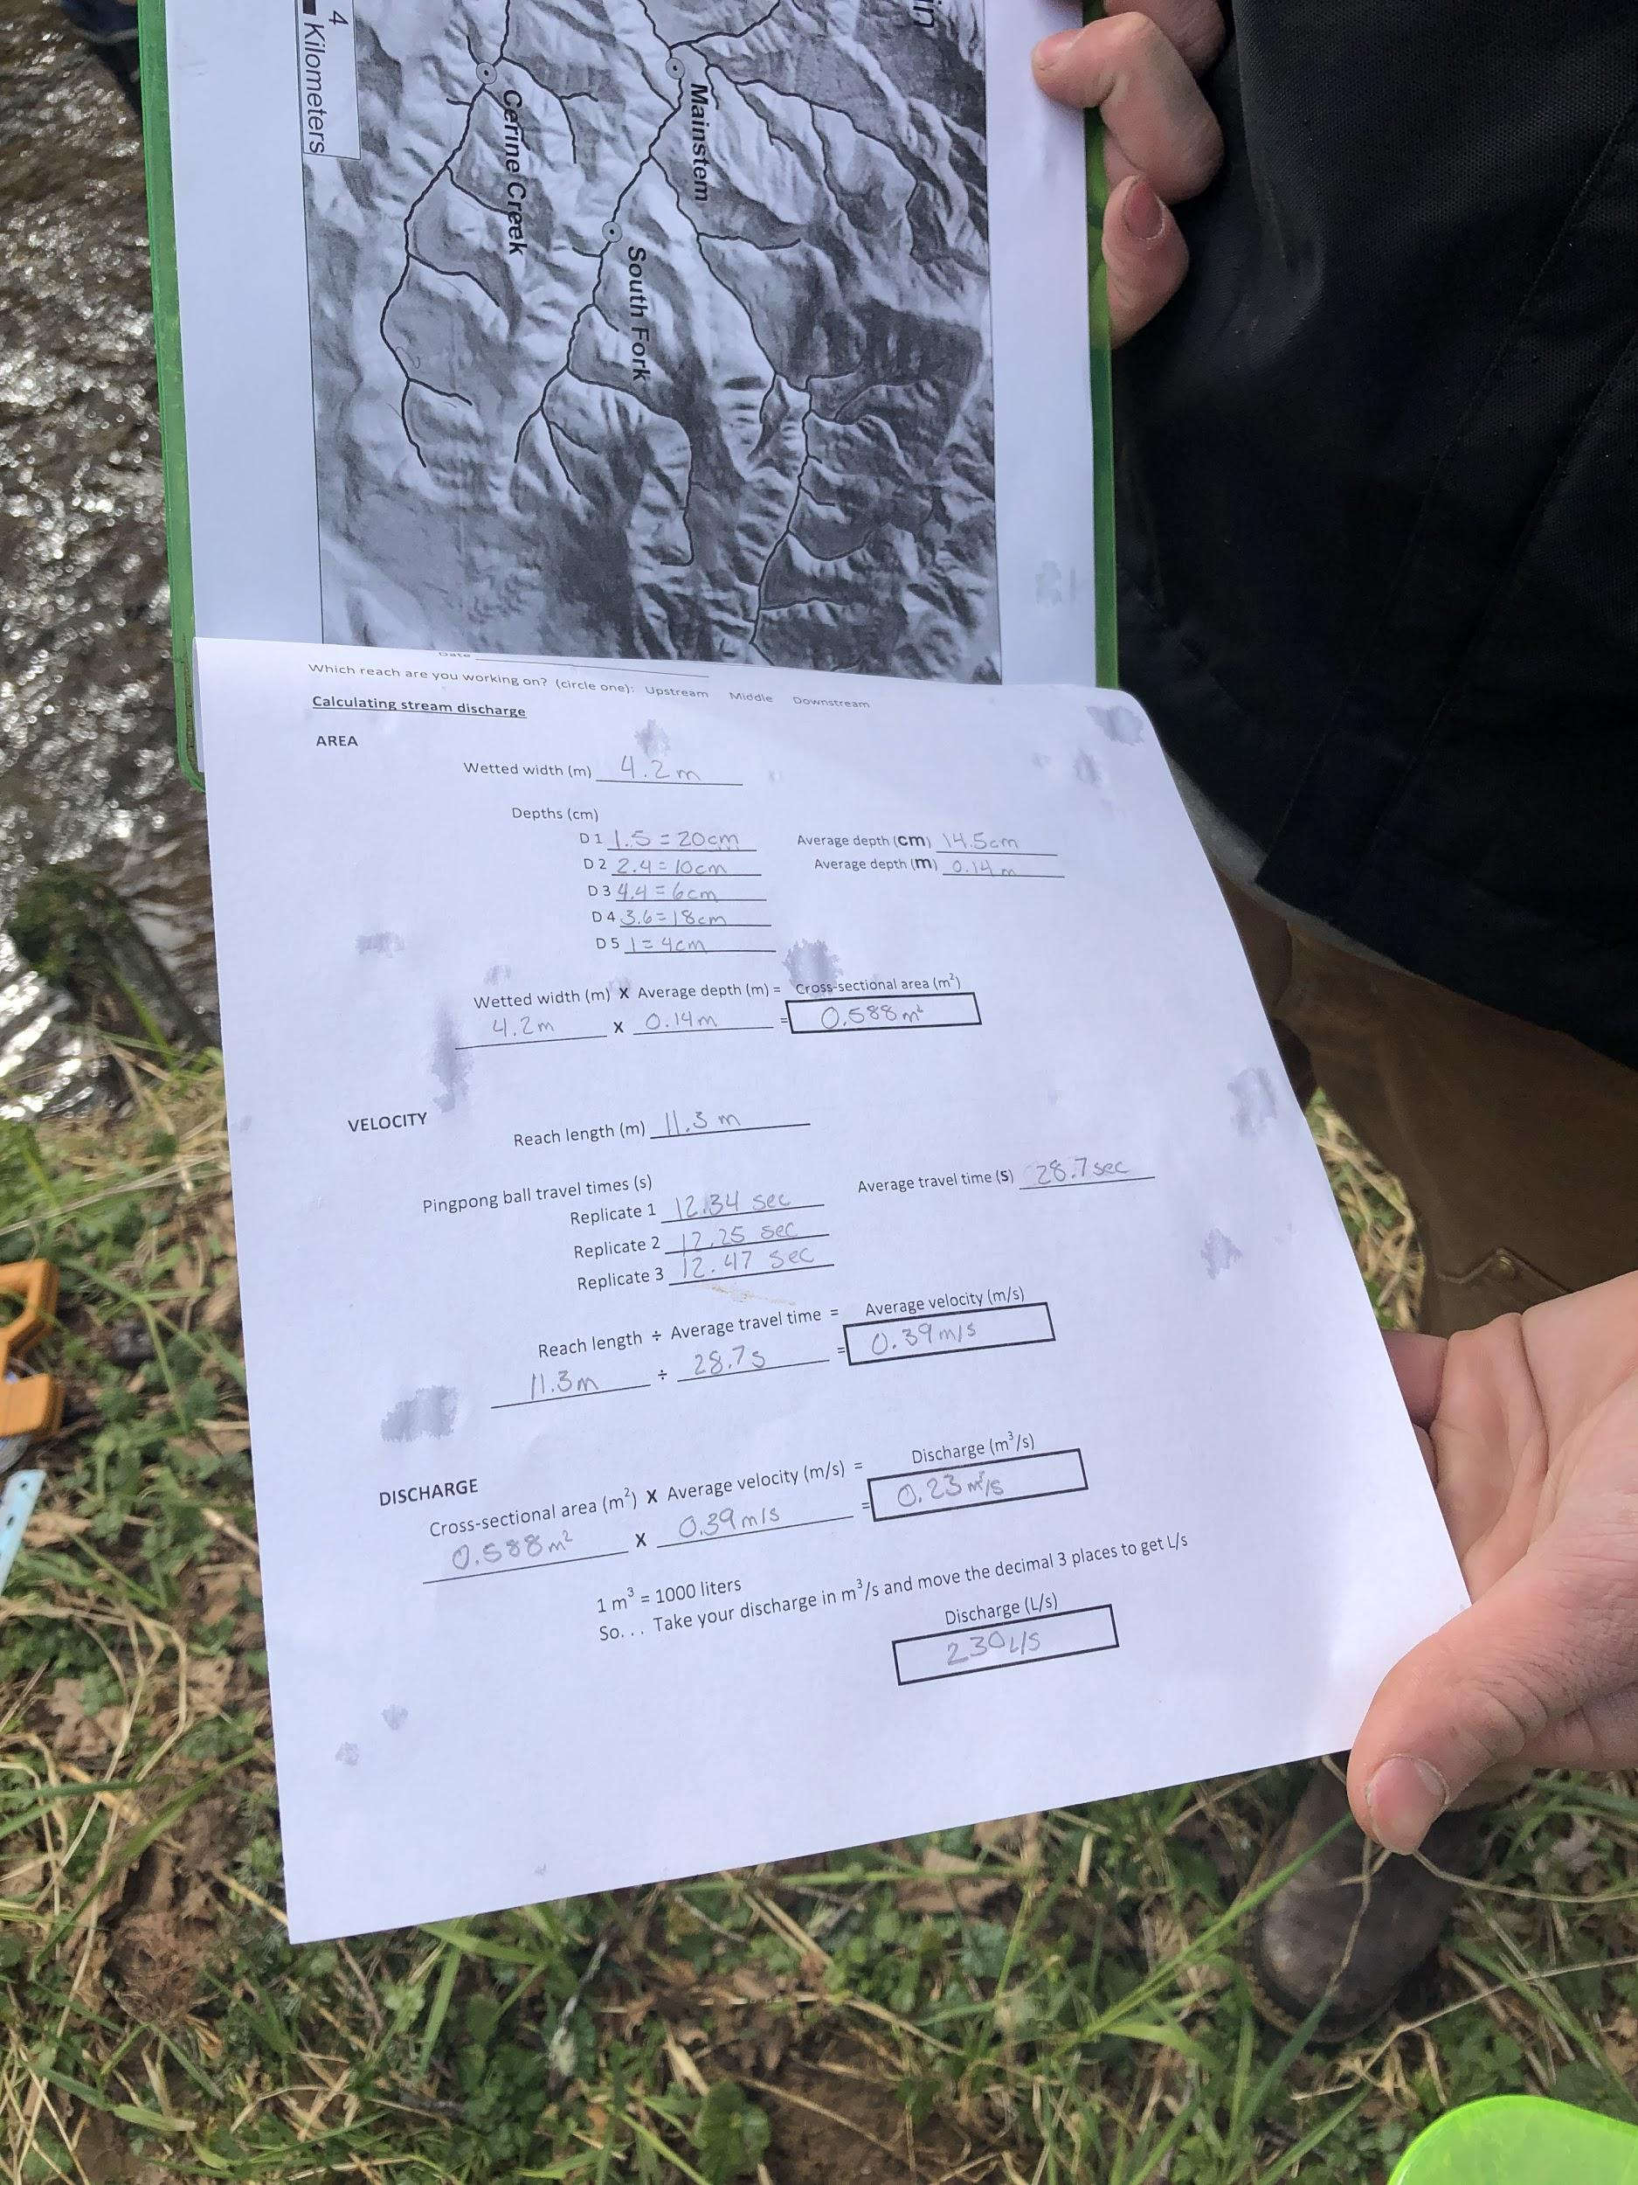
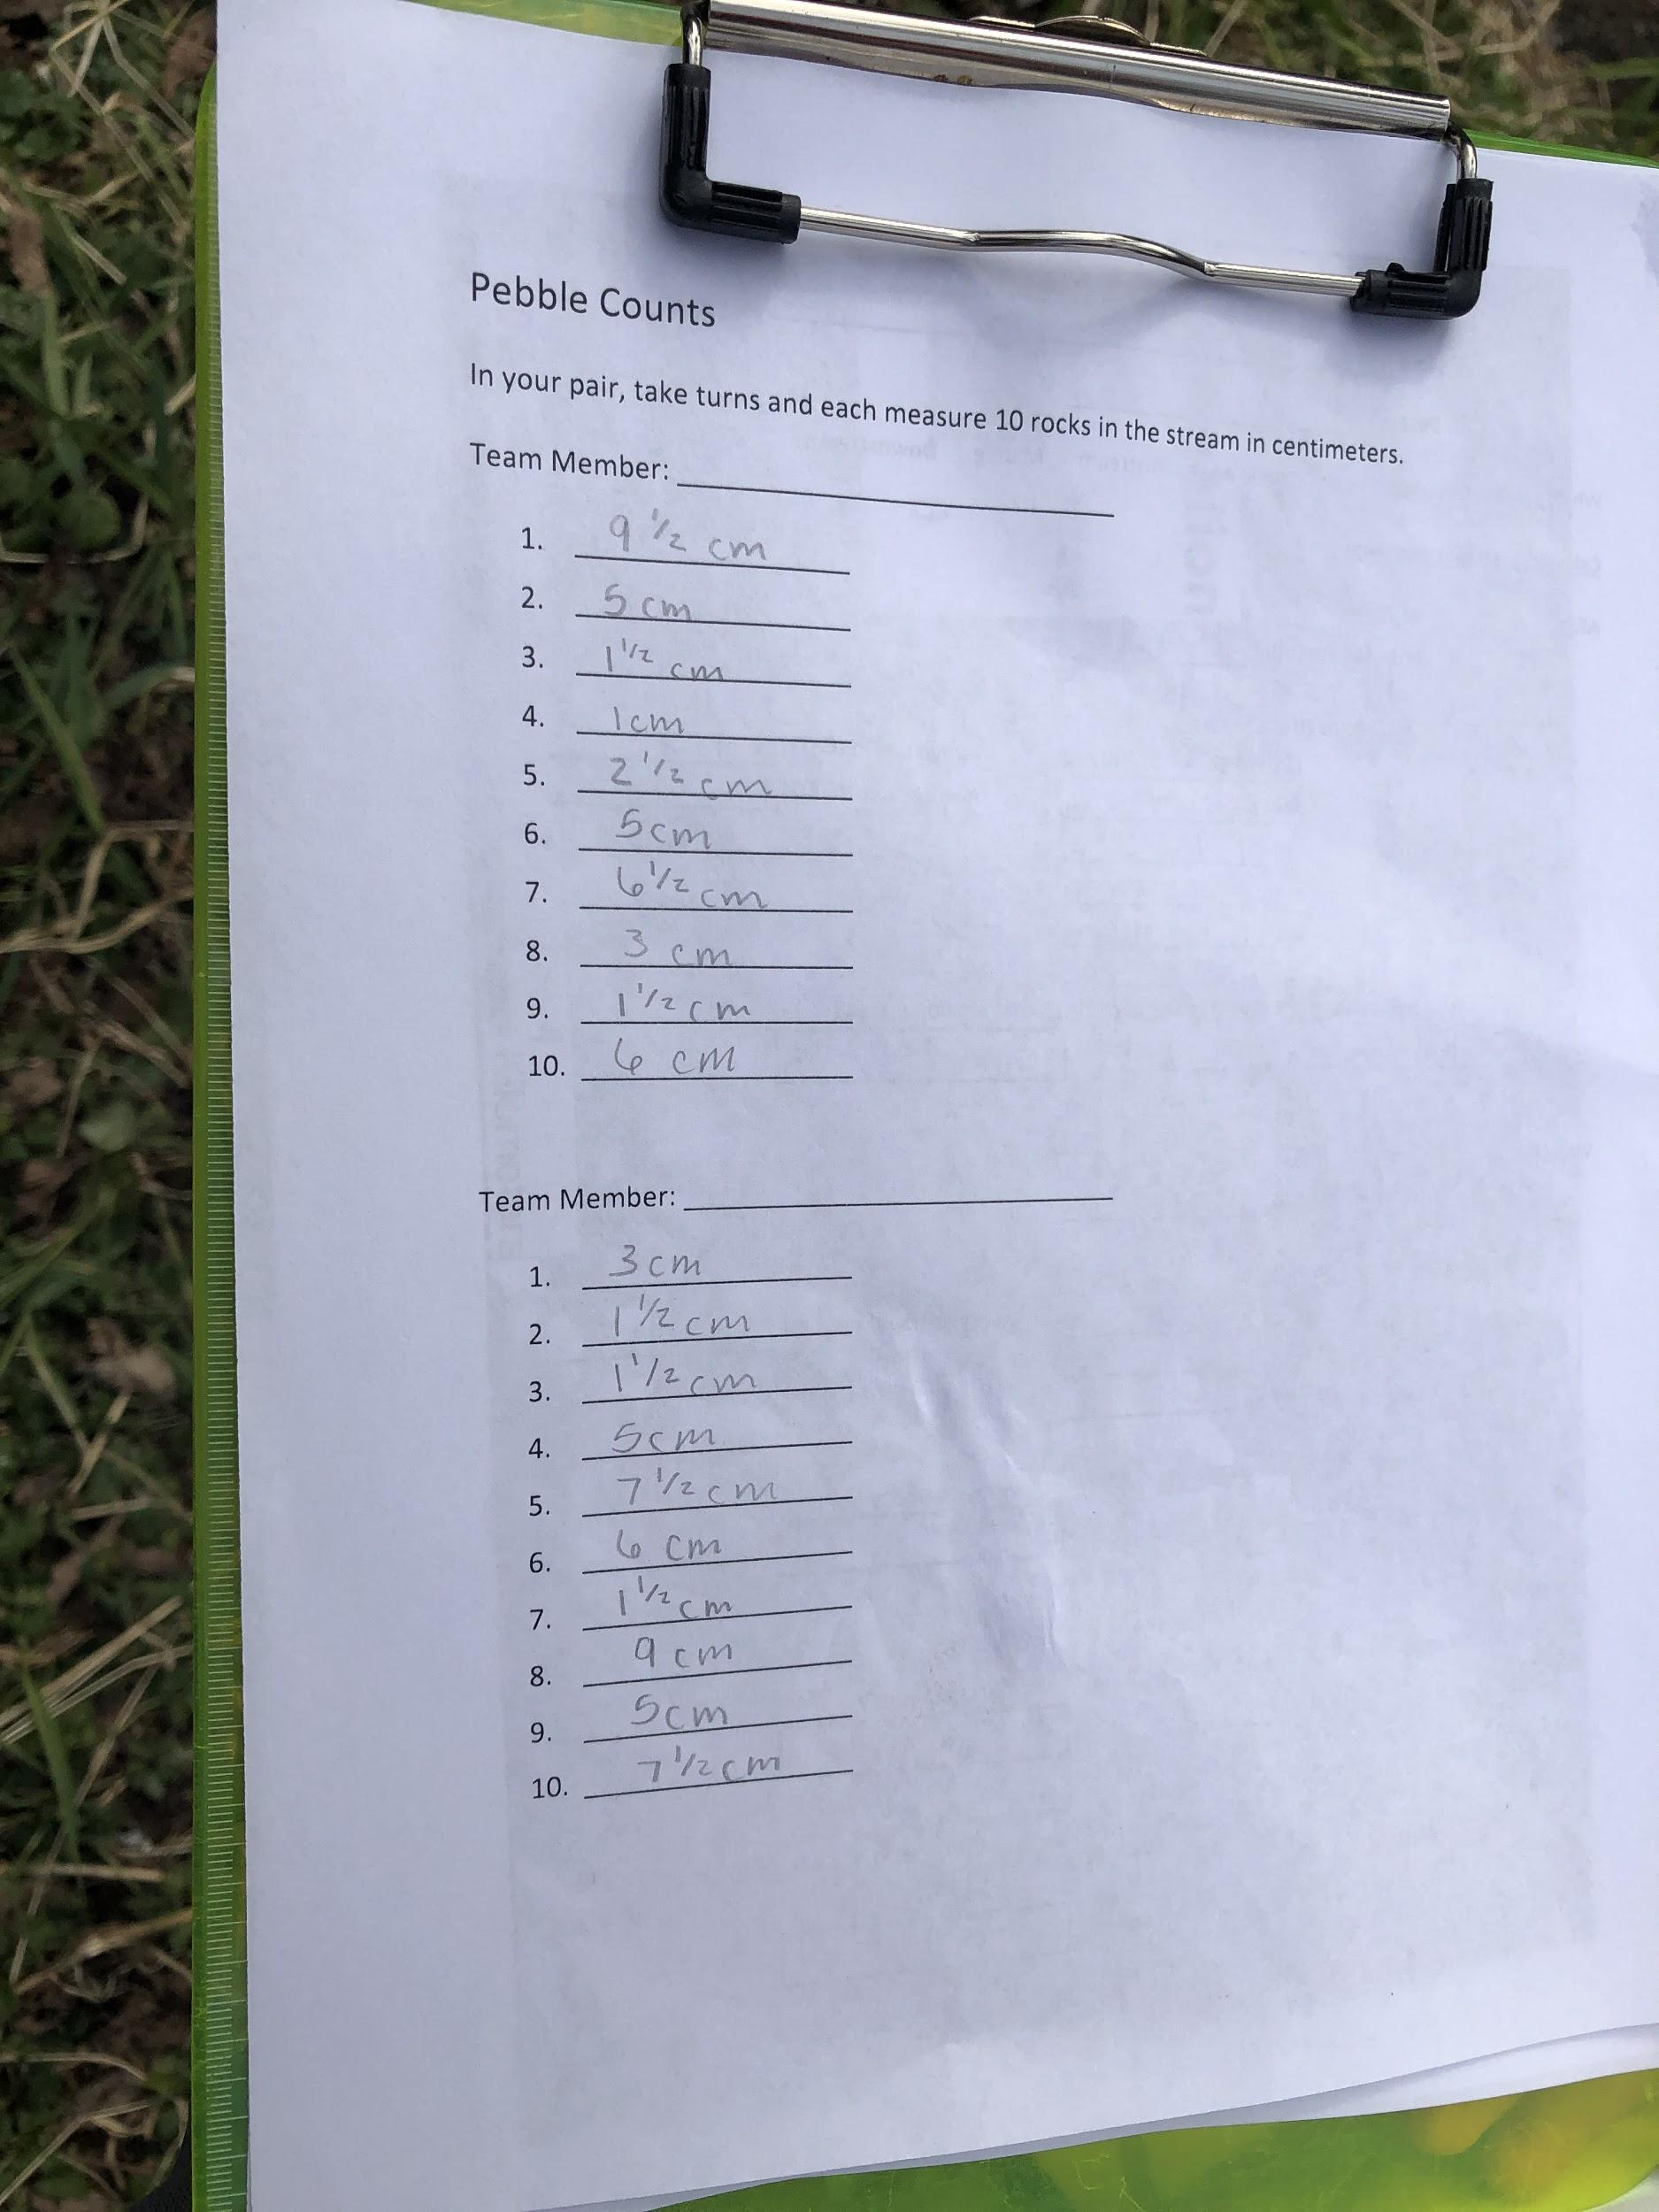
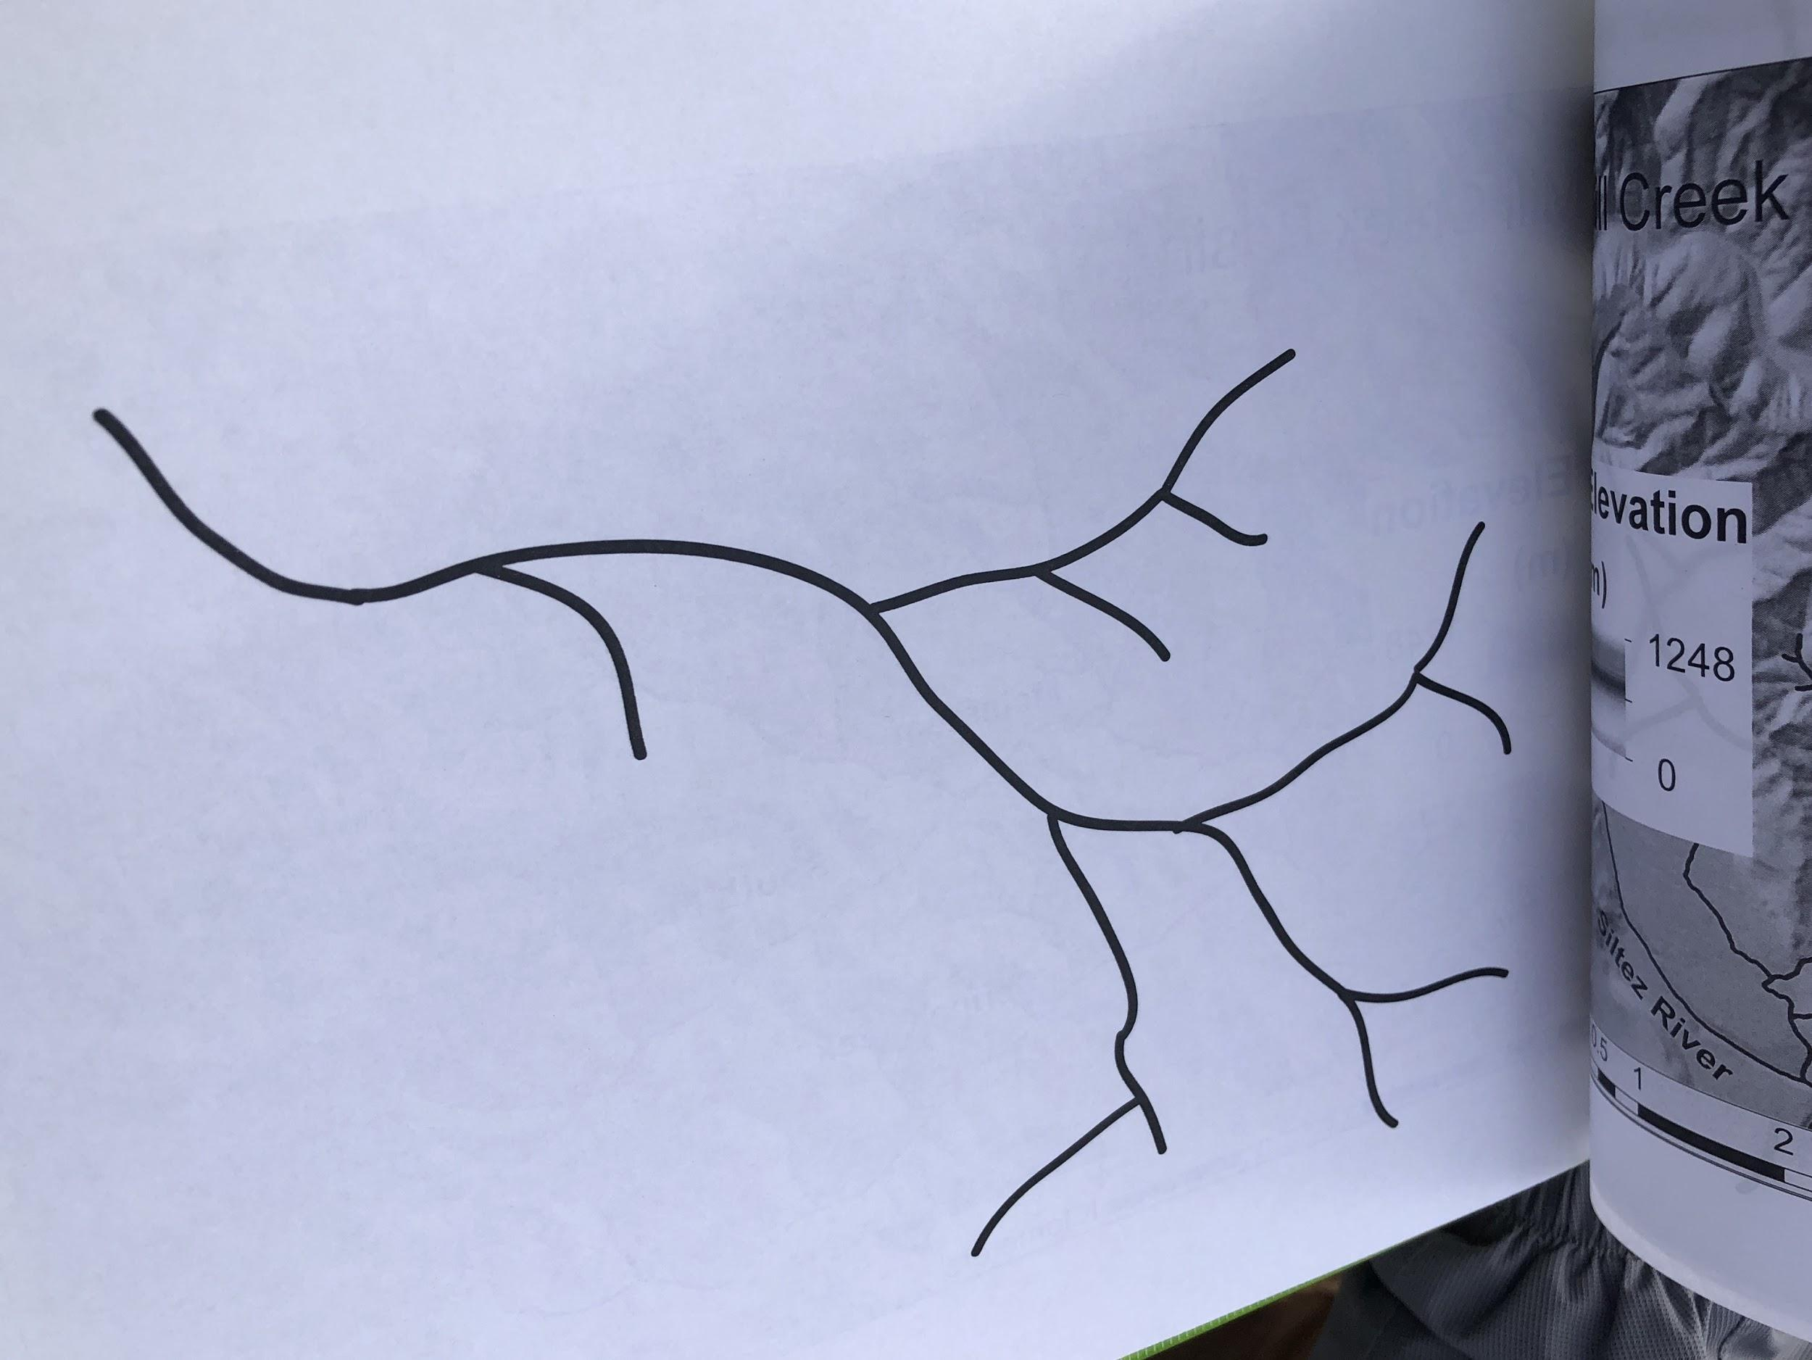
Logistics-the plan
Experts meet with students at school, lead activities
Students pulled from class during my prep period
Activities support field work
Field trips to creek site throughout the year
Collect data
Repeat

Slide 7
Logistics-what we did in class
Adults
Brainstormed ideas/concepts
Scoped out field site
With students
Mapped our watershed-intro activity and team building
Calculated stream volume

Slide 8
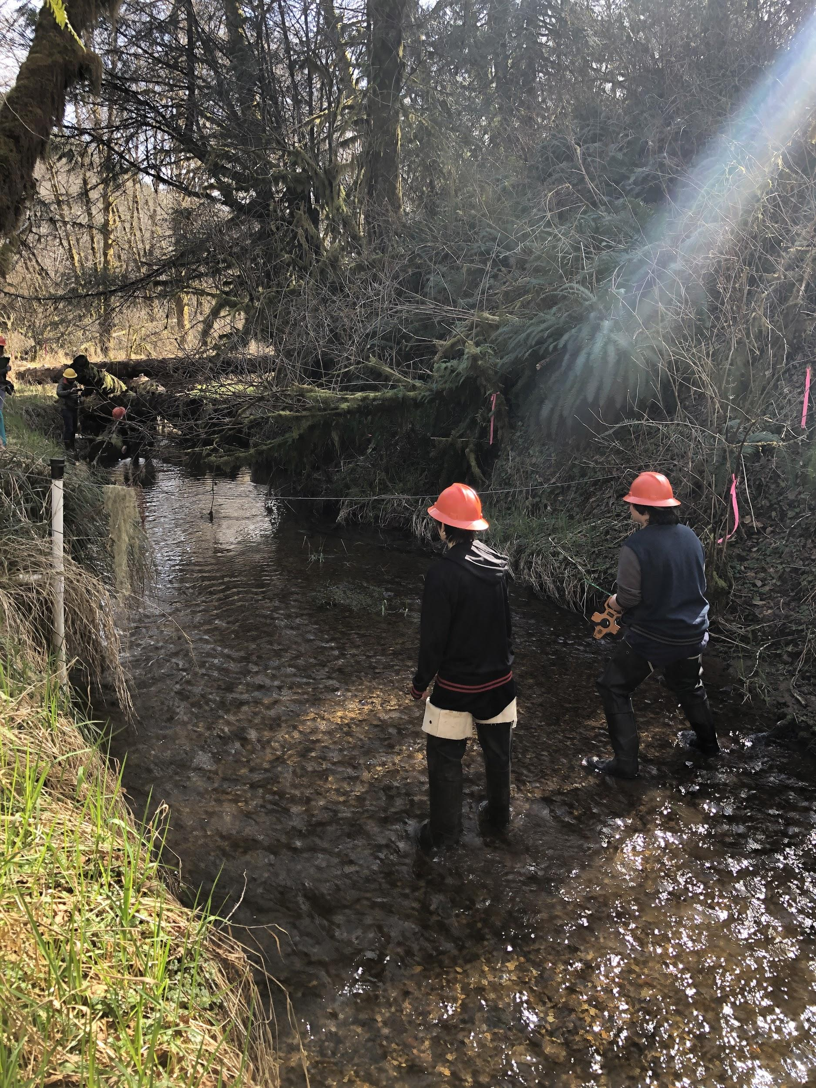
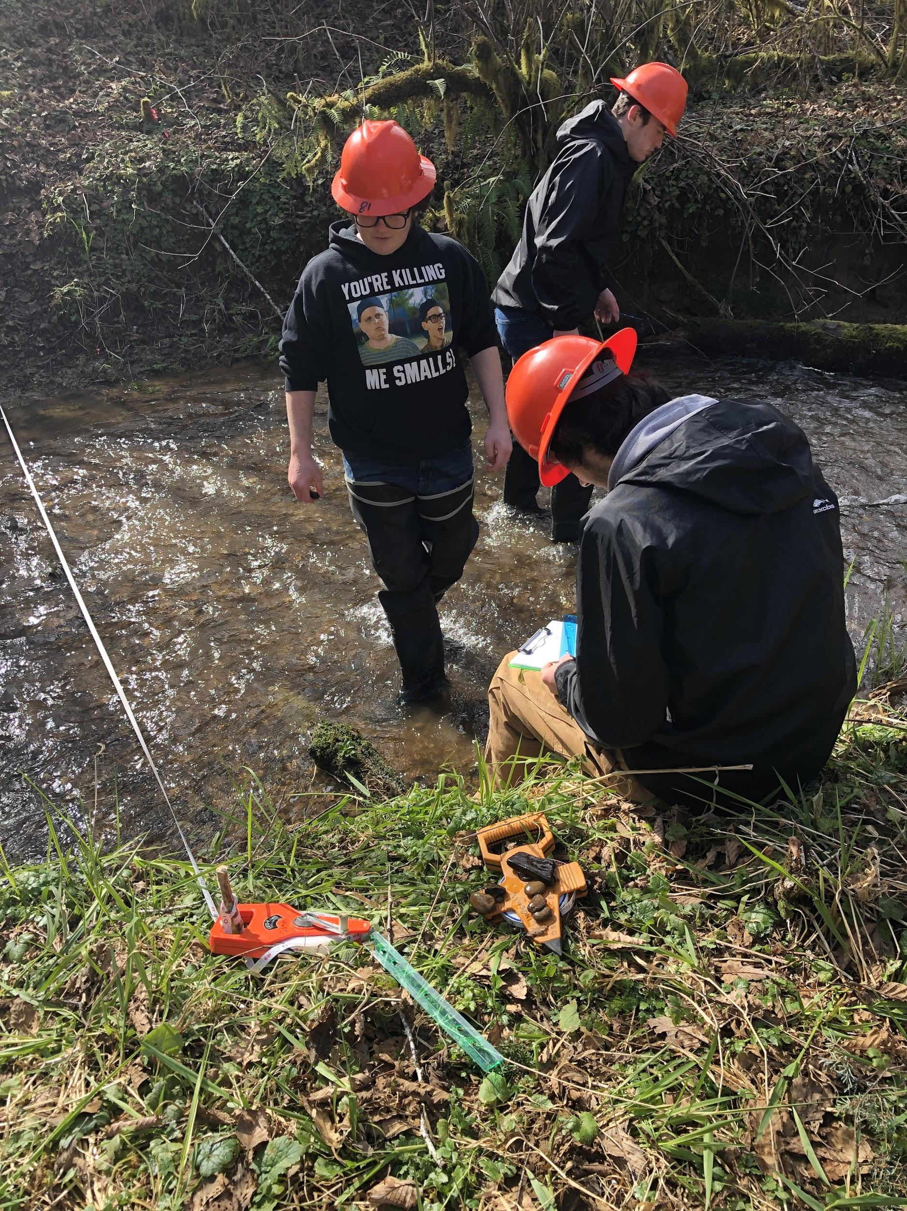
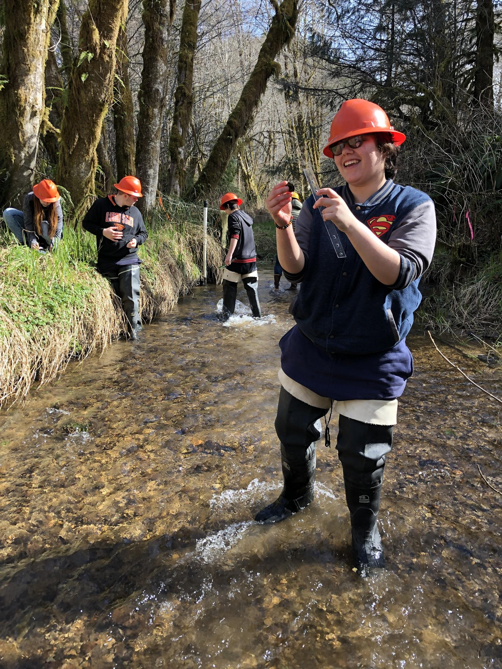
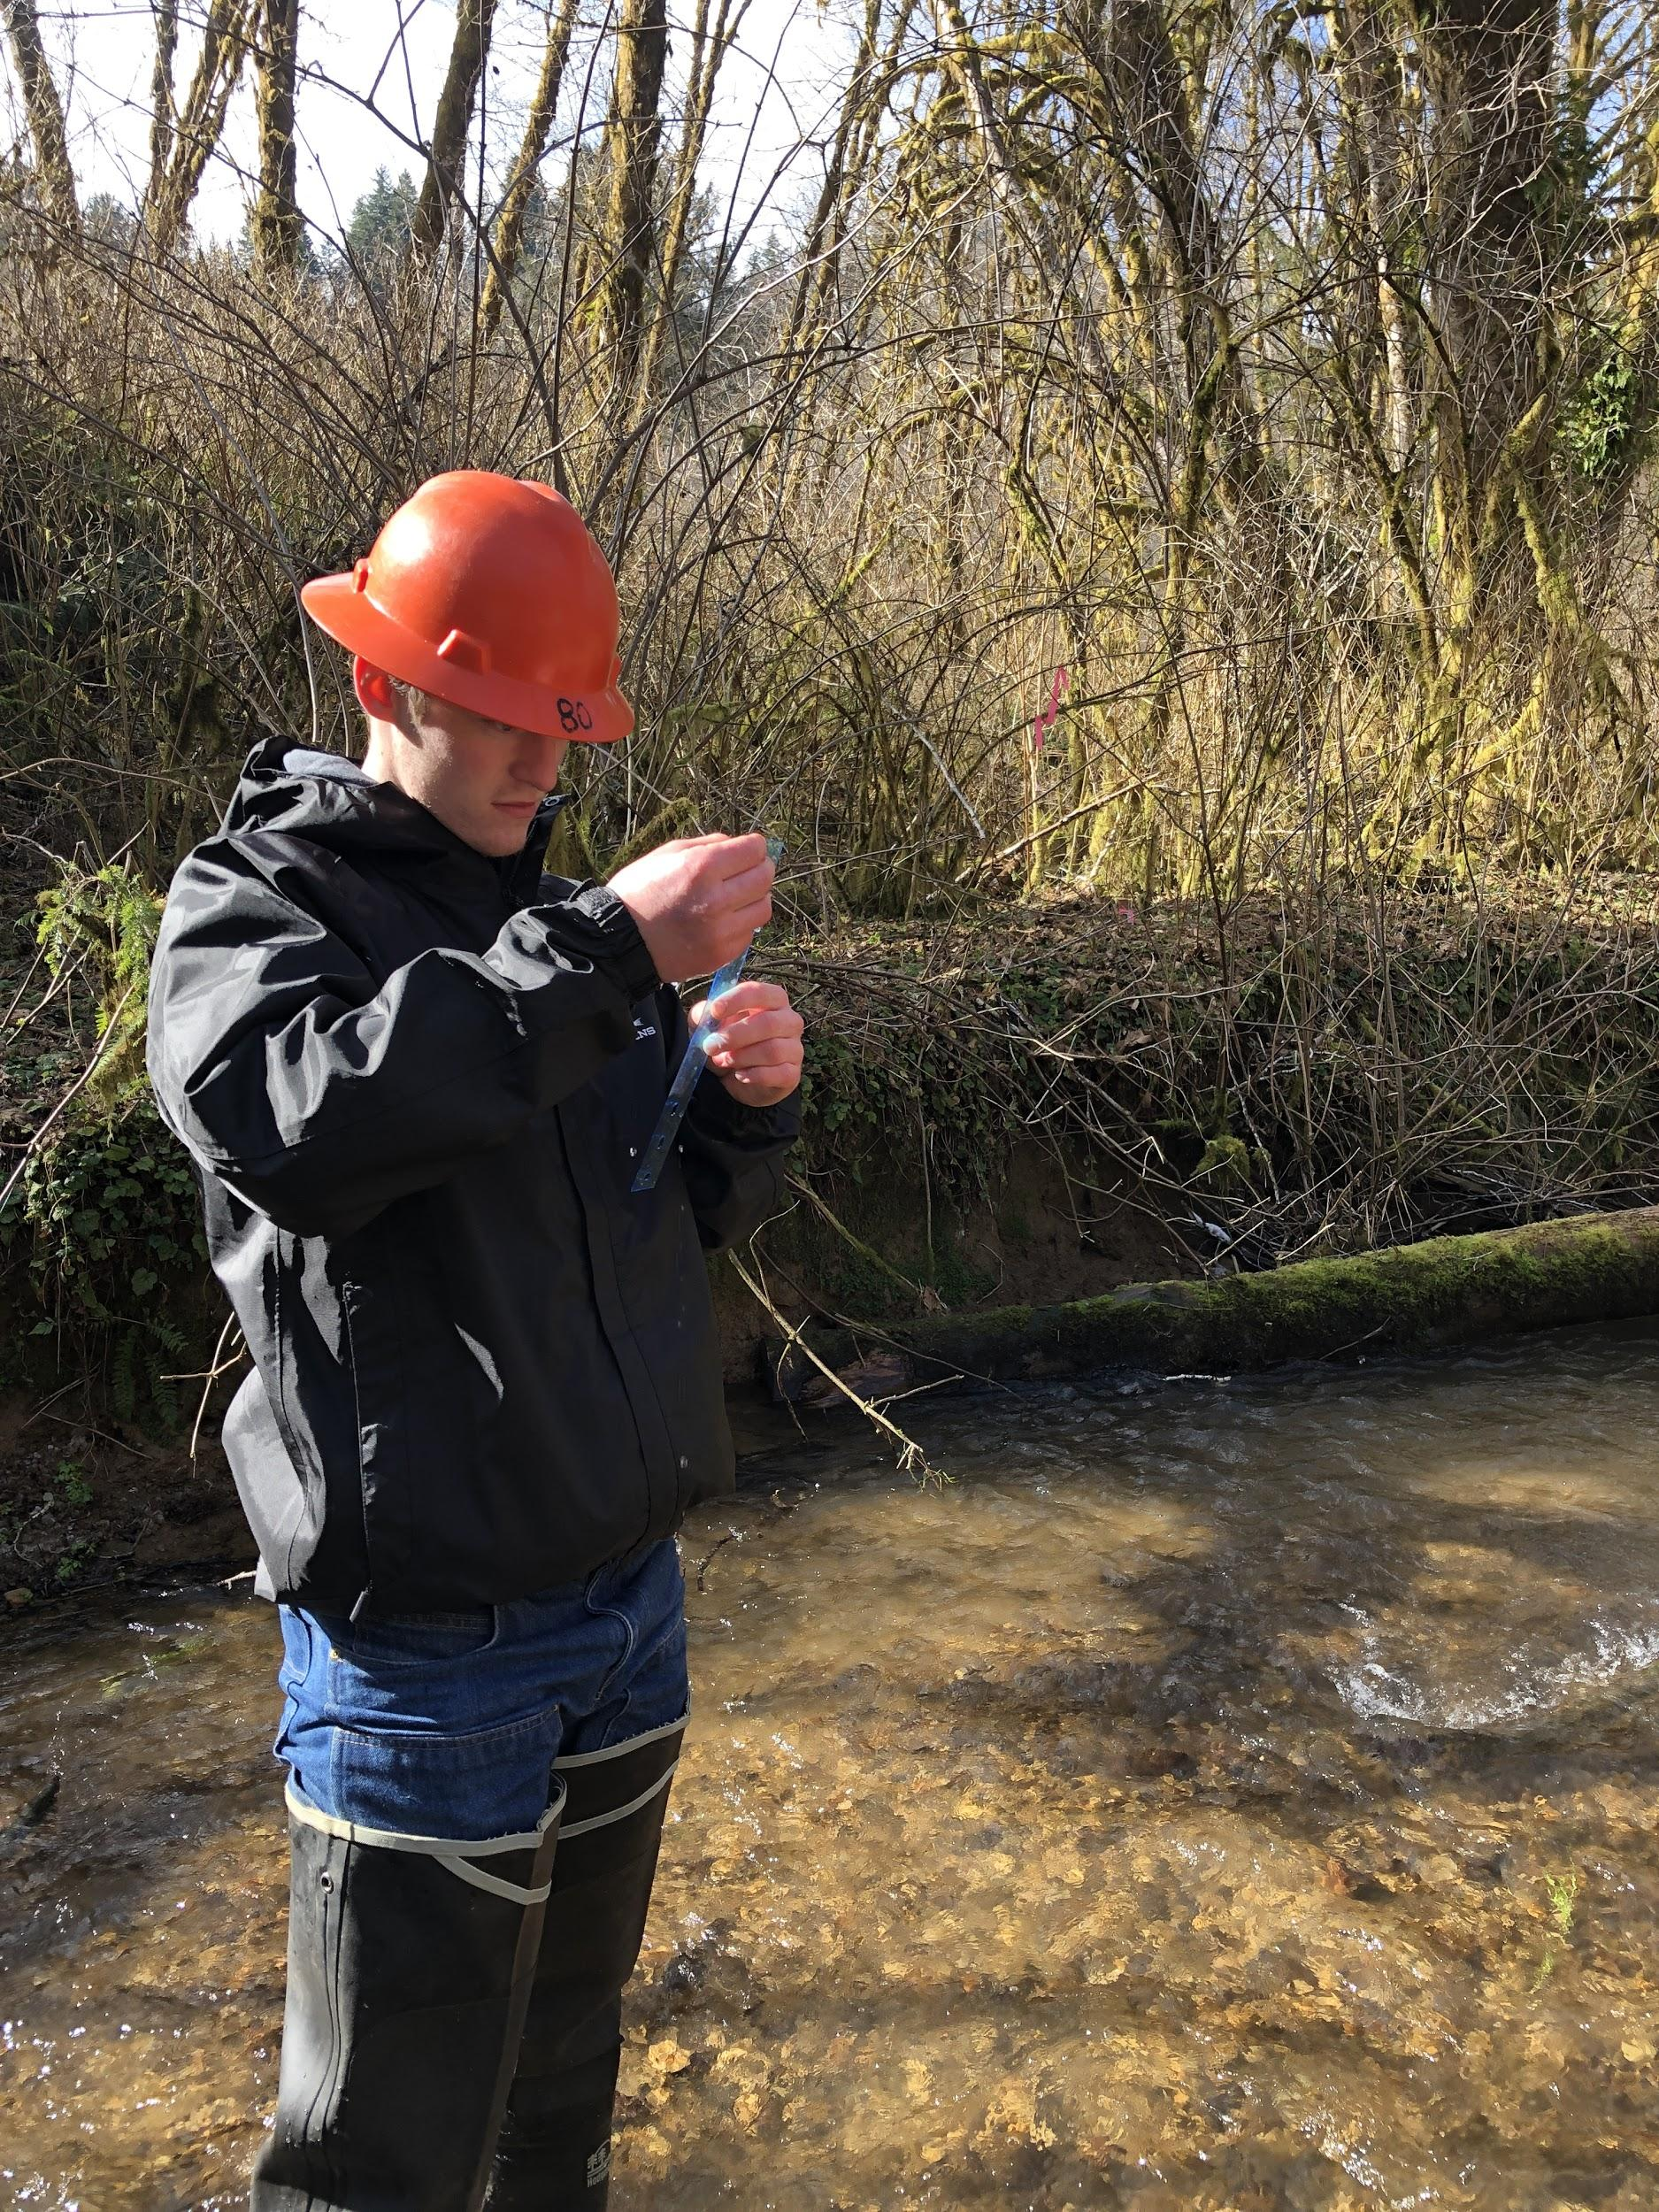
Logistics-what we did in the field

Slide 9
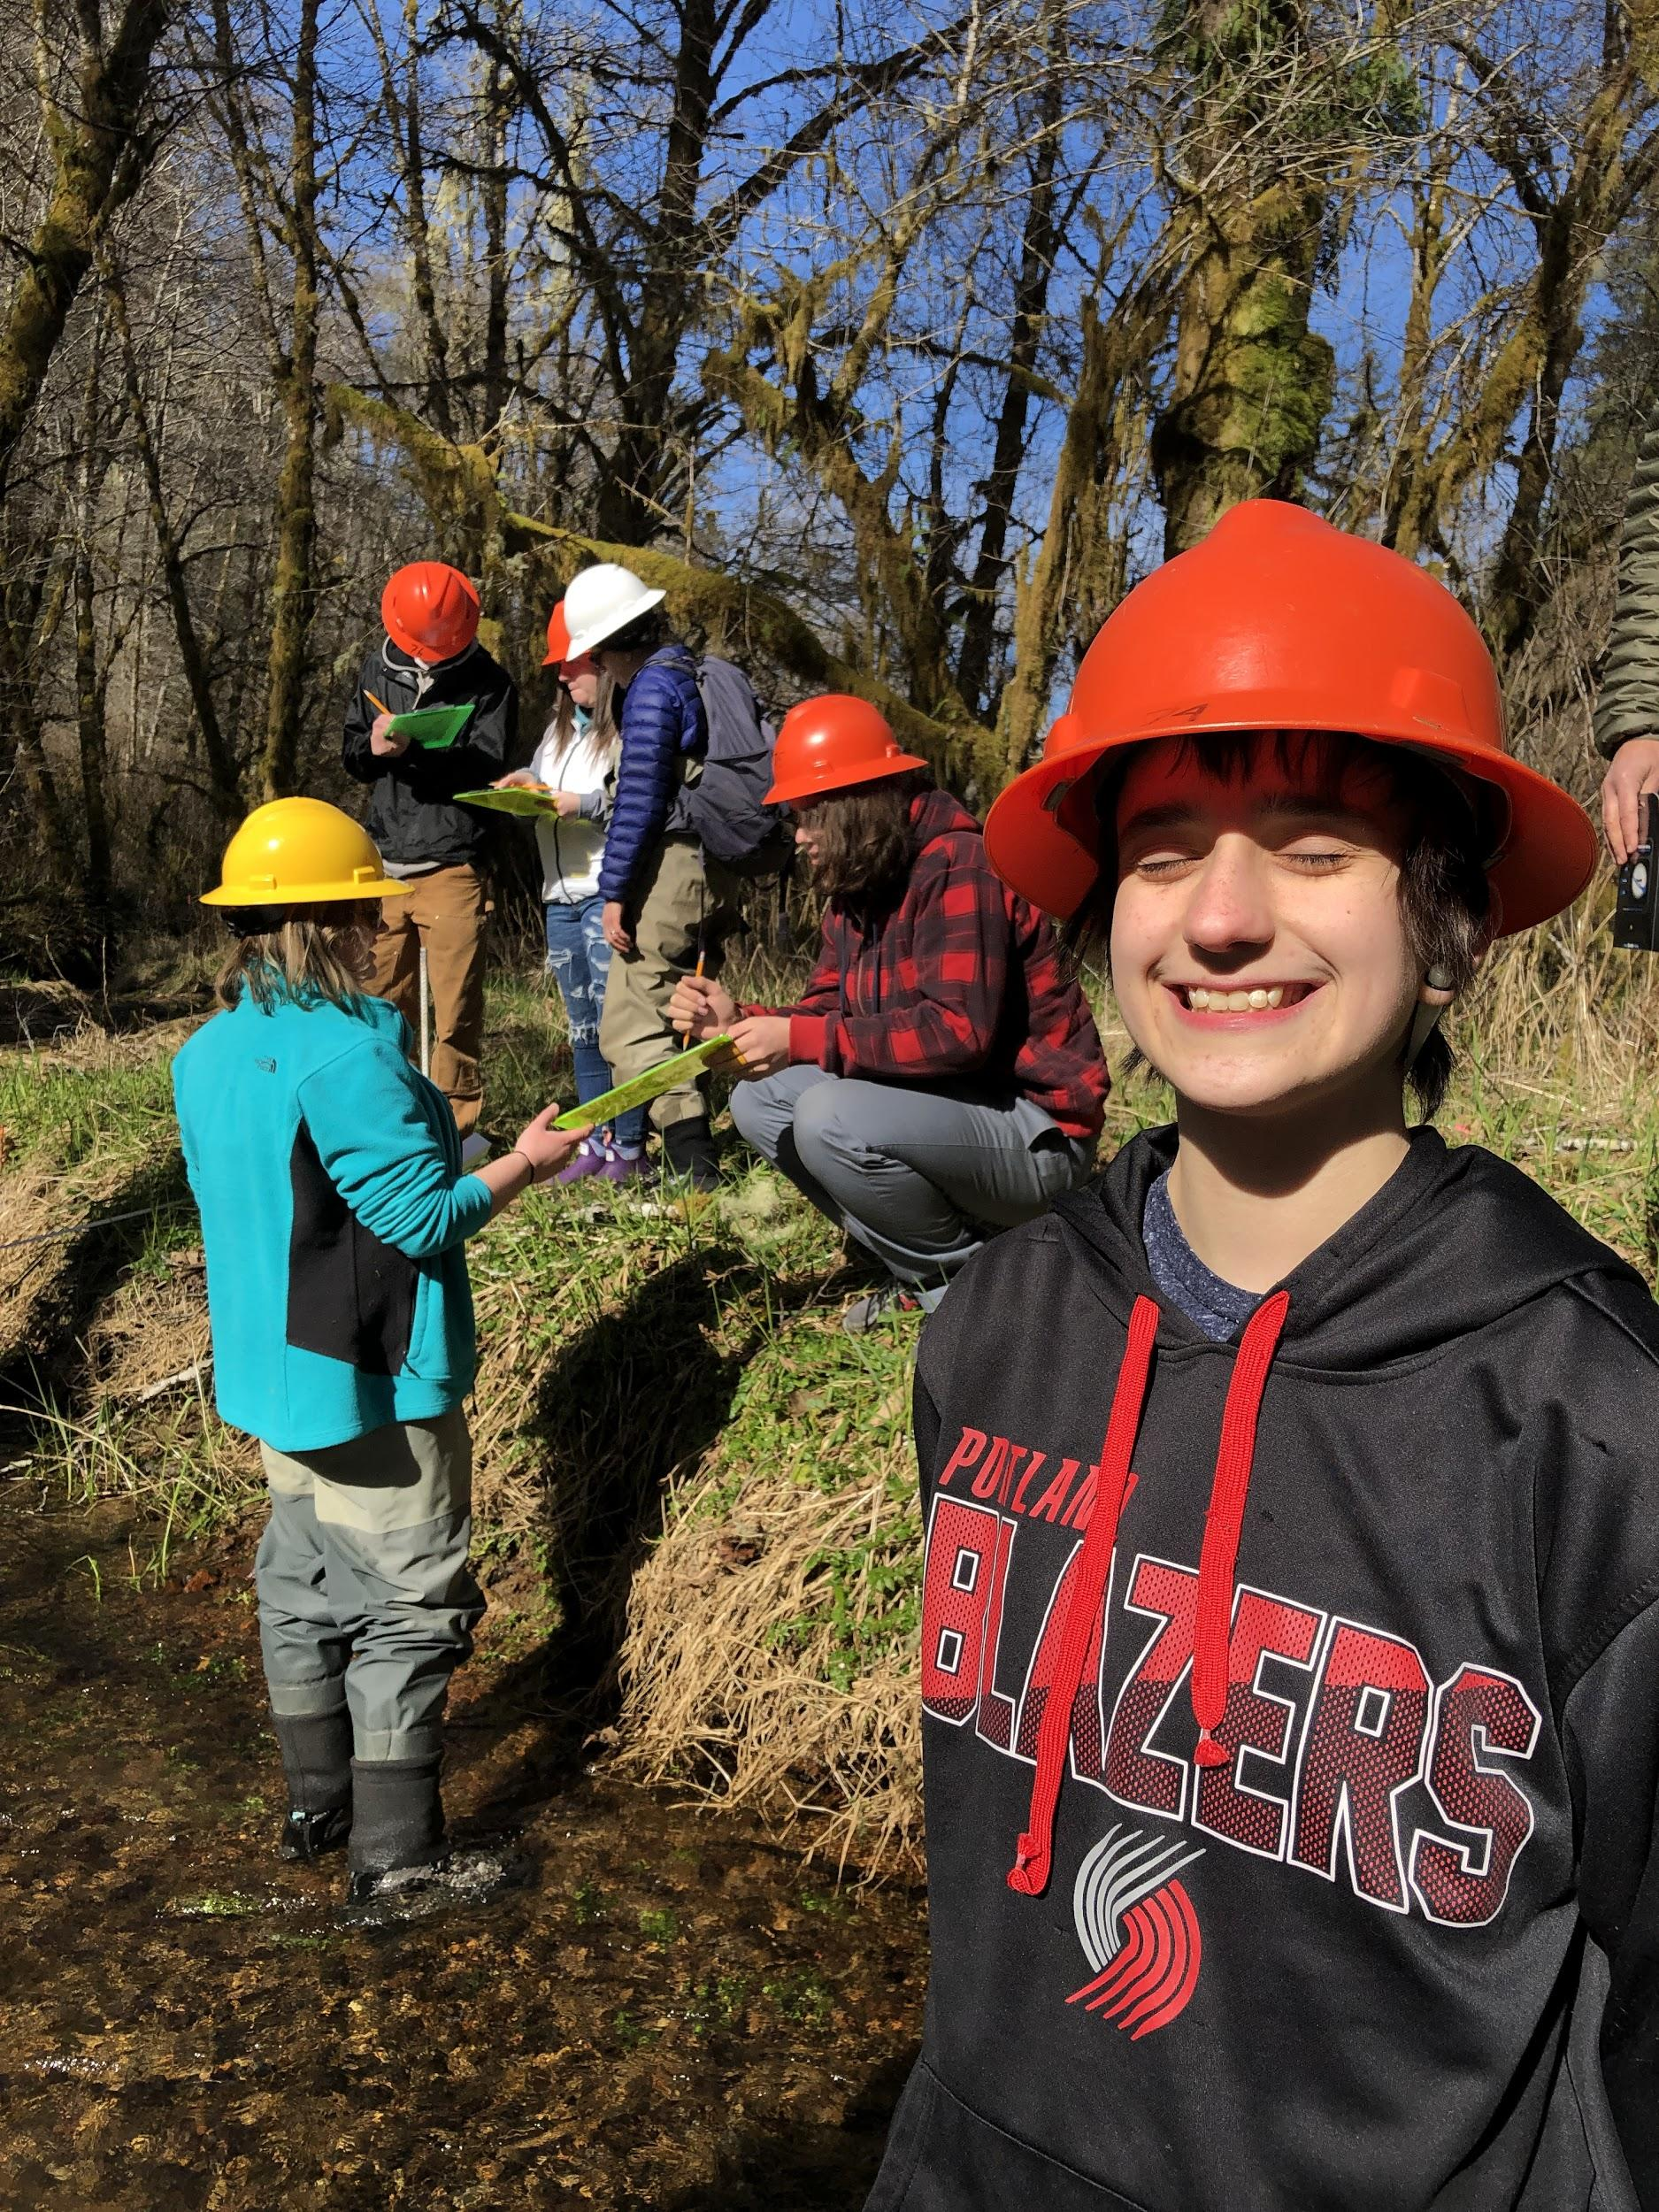
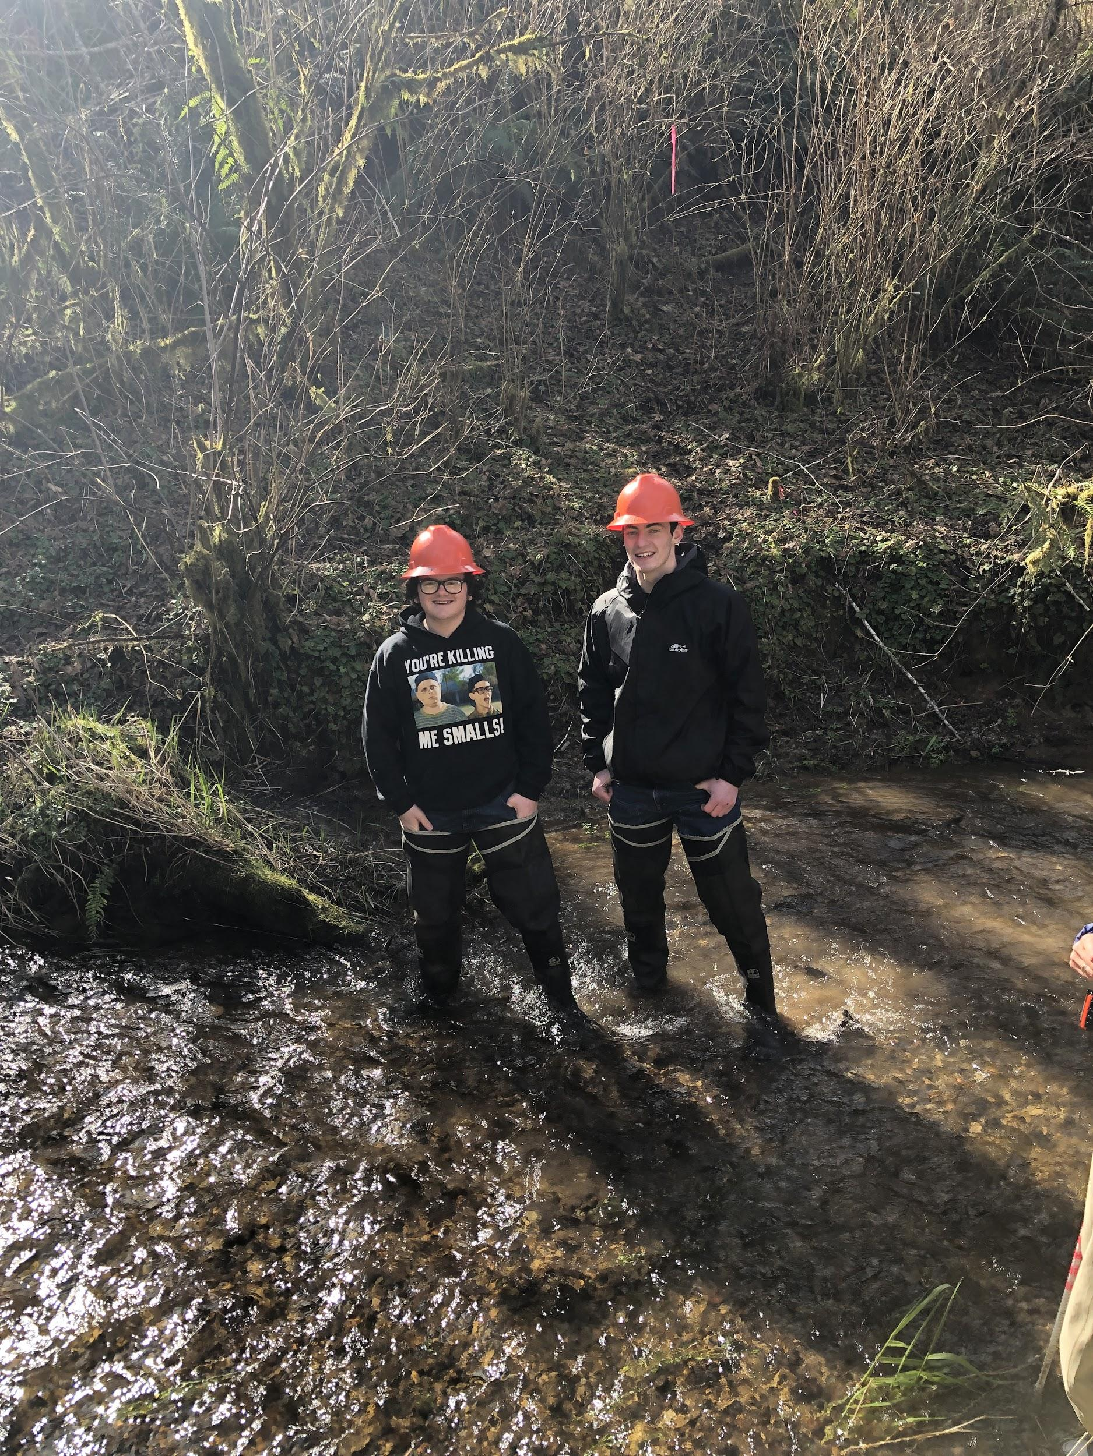
Takeaways
Challenges
Scheduling
Organization
Communication
The good stuff
Student pride
Always good to get outside

Slide 10
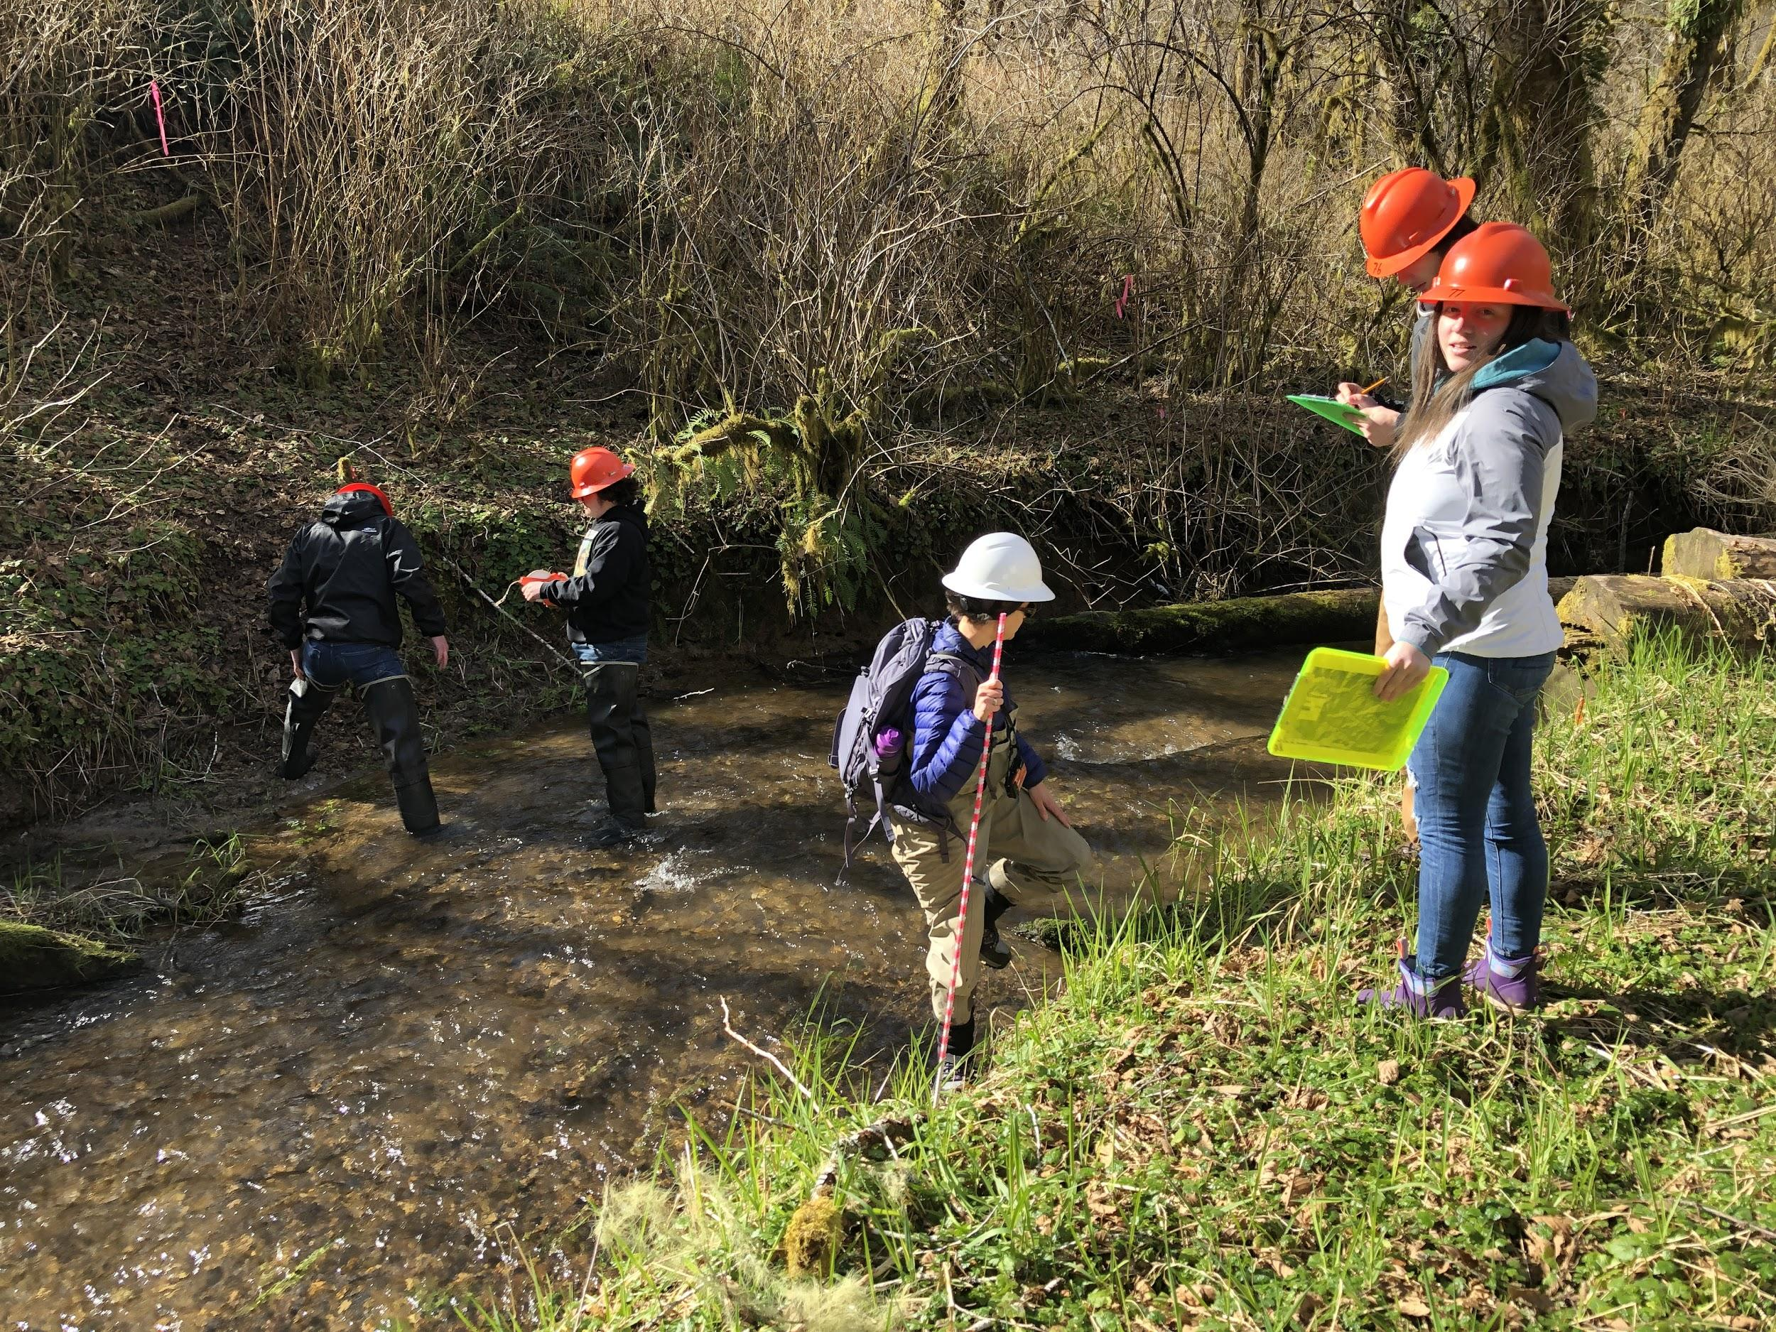
What’s next
For us
Lessons learned
Back into the field
For you
Inspiration
Curriculum

