Slide 1
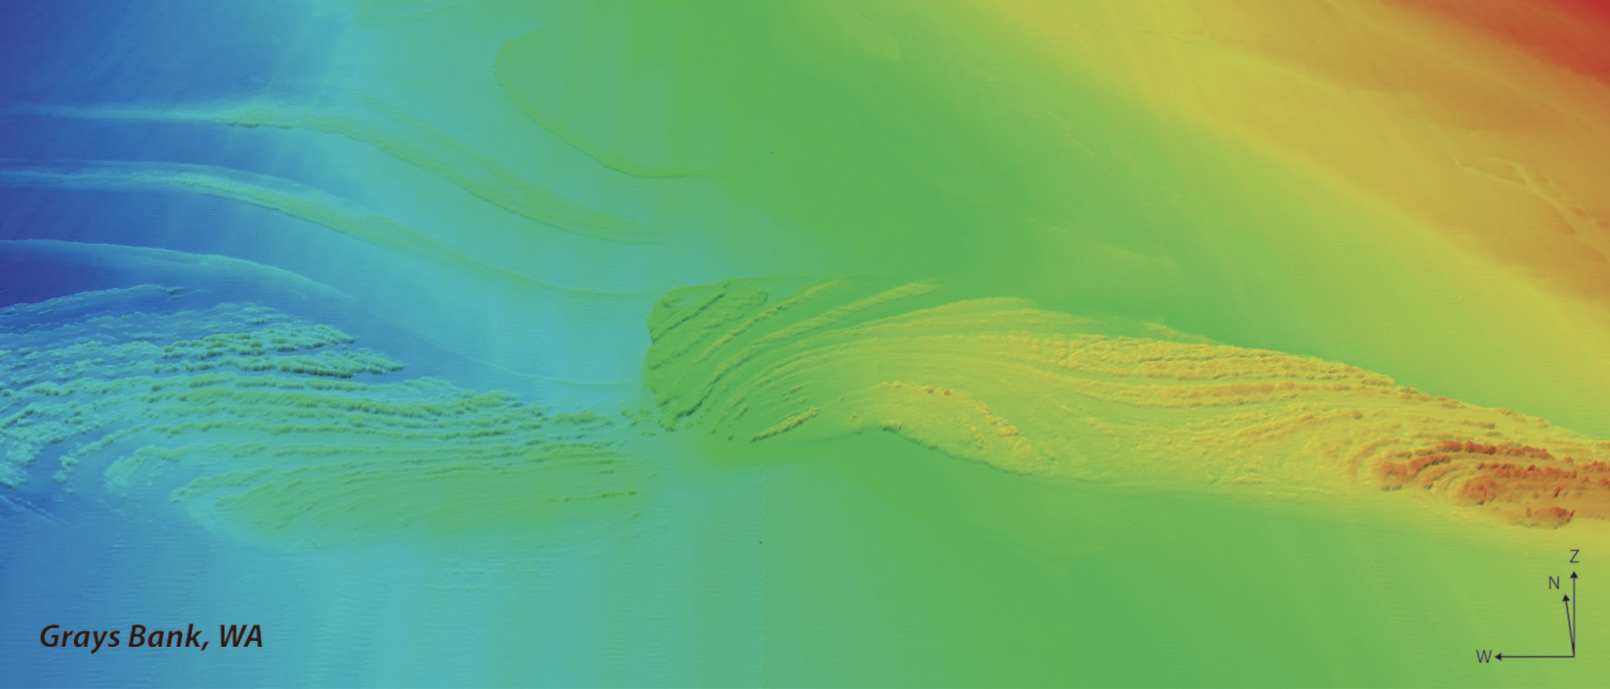
Exploring Ocean
Acoustics
The Human Sonar Simulation
2021 Summer Teacher Workshop

Slide 2
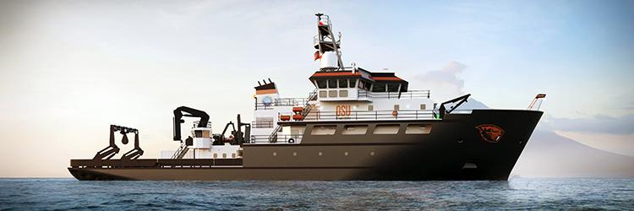
What have you done in your classroom or club that relates to sound and waves?
Table Share and
Sticky Notes

Slide 3
The Properties of Sound
Amplitude (strength)
Frequency (Hz)
Wavelength (inversely proportional to frequency)
Velocity (speed)
Duration (time length of sound)

Slide 4
Sound and its Application in Technology and Science
NGSS and Waves
First Grade
High School
PS-4 Waves and their Application in Technologies and Information Transfer
Notes:
NGSS is the Next Generation Science Standars. Waves and their application to technologies is covered under the Phisical Science 4 standard. It is introduced in 1st and goes until High School.

Slide 5
4-PS4-1 Waves and Their Applications in Technologies for Information Transfer
Develop a model of waves to describe patterns in terms of amplitude and wavelength and that waves can cause objects to move.
Using Models
Scientific Knowledge is based on Recognising Patterns
Wave
Properties
Similarities and differences in patterns can be used to sort, classify, and analyze simple rates of change for natural phenomena.
Practice
DCI
CC

Slide 6
MS-PS4-2 Waves and Their Applications in Technologies for Information Transfer
Develop and use a model to describe that waves are reflected, absorbed, or transmitted through various materials
Modeling in 6–8 builds on K–5 and progresses to developing, using, and revising models to describe, test, and predict more abstract phenomena and design systems.
A sound wave needs a medium through which it is transmitted.
Structures can be designed to serve particular functions by taking into account properties of different materials, and how materials can be shaped and used.

Slide 7
HS-PS4-1 Waves and Their Applications in Technologies for Information Transfer
Use mathematical representations to support a claim regarding relationships among the frequency, wavelength, and speed of waves traveling in various media.
Use mathematical representations of phenomena or design solutions to describe and/or support claims and/or explanations.
The wavelength and frequency of a wave are related to one another by the speed of travel of the wave, which depends on the type of wave and the medium through which it is passing.
Empirical evidence is required to differentiate between cause and correlation and make claims about specific causes and effects
Notes:
Not covered but easily ties into

Slide 8
HS-PS4-5 Waves and Their Applications in Technologies for Information Transfer
Communicate technical information about how some technological devices use the principles of wave behavior and wave interactions with matter to transmit and capture information and energy.
Communicate technical information or ideas in multiple formats (including orally, graphically, textually, and mathematically)
Multiple technologies based on the understanding of waves and their interactions with matter. They are essential tools for producing, transmitting, and capturing signals and for storing and interpreting information.
Science and engineering complement each other in the cycle known as research and development (R&D)
Modern civilization depends on major technological systems

Slide 9
The Study of Sound
in Earth’s oceans is called
Ocean Acoustics
(e.g. Acoustical Engineer, Acoustic Oceanographer, Acoustician)
Based on applying the properties of sound to identify and analyze patterns to classify information
SONAR
Passive (collects)
Active (sends out and collects)
New Research Vessel Technology
Seabed 2030

Slide 10
SONAR
Three main uses for sonar:
Detection and mapping of objects
2) Mapping of the seafloor
3) Imaging below the seafloor:
Notes:
NGSS is the Next Generation Science Standars. Waves and their application to technologies is covered under the Phisical Science 4 standard. It is introduced in 1st and goes until High School.

Slide 11
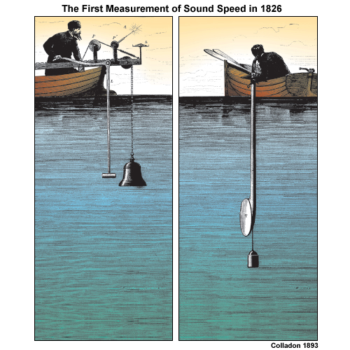
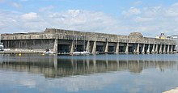
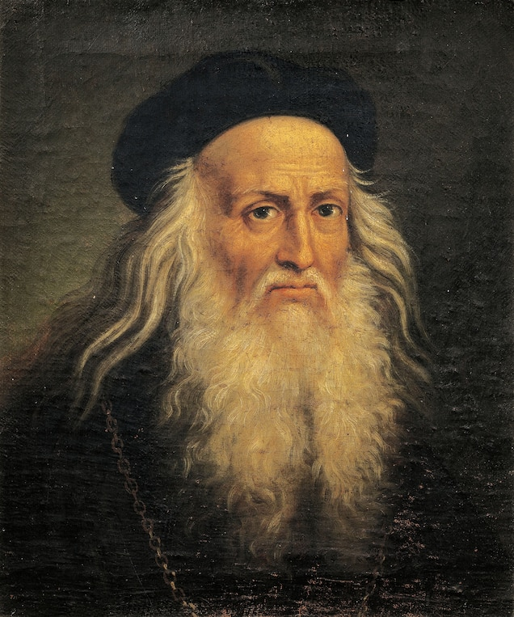
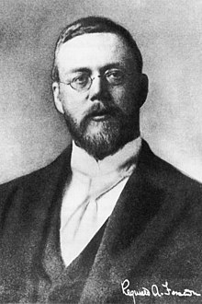
History of
SONAR
Lake Geneva, Switzerland, 1826
World War II, 1939
Leonardo da Vinci, 1490
Reginald Fessenden, 1912
RV Taani, in progress
Notes:
Leonardo da Vinci - 1490 - Credited with first use of sonar. Used a tube ( connected on one end to his ear, and the other end inserted underwater ) to detect approaching ships.
1822, Daniel Colloden used an underwater bell in an attempt to calculate the speed of sound underwater in Lake Geneva, Switzerland as shown in the sketch above. In spite of the crude instruments, their work resulted in figures remarkably close to today's accepted values.
Reginald Fessenden - Built an experimental system beginning in 1912, a system later tested in Boston Harbor, and finally in 1914 from the U.S. Revenue Cutter Miami on the Grand Banks off Newfoundland.^{[7][9]} In that test, Fessenden demonstrated depth sounding, underwater communications (Morse code) and echo ranging (detecting an iceberg at a 2-mile (3.2 km) range)
Unfortunately, armed conflicts and defending our merchant and naval vessels from submarine attack has been a major driver of sonar development.
There are many applications of sonar technologies for industrial (Oil and Gas exploration, Commercial Fishing) as well as Scientific uses. The RCRV Taani will be equipped with:
2 Depth sounders (single beam sonars)
2 Multibeam sonars (one high frequency for shallow water and one lower frequency for deep water) for swath mapping
1 Fisheries (Midwater) sonar with 5 unique frequencies
1 Acoustic Doppler Current Profiler (to measure ocean currents below th ship)
1 SubBottom Profiling Sonar (very low frequency to image beneath the surface of the sediment)
1 Doppler speedlog (to measure the speed of the boat through the water, which may be different from over land due to currents)

Slide 12
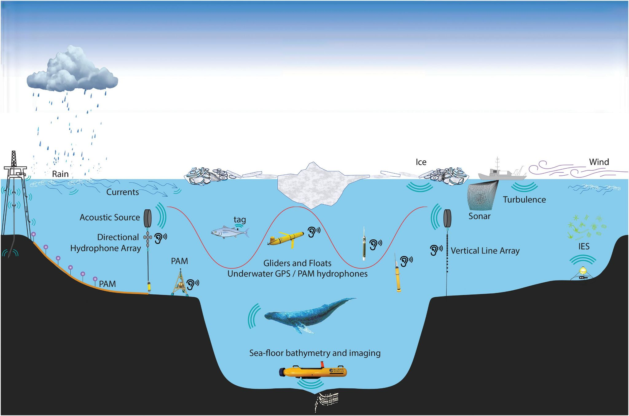
Acoustical observation tools and modes
Image From:
Howe, Miskis-Olds, Rehm, Sagen, Worcester, and Haralabus, 2019, Observing the Oceans Acoustically, Frontiers in Marine Science V6, DOI=10.3389/fmars.2019.00426
Notes:
From Eric Rham - Need to get permission to use.

Slide 13
What is SONAR?
https://oceanservice.noaa.gov/facts/sonar.html

Slide 14
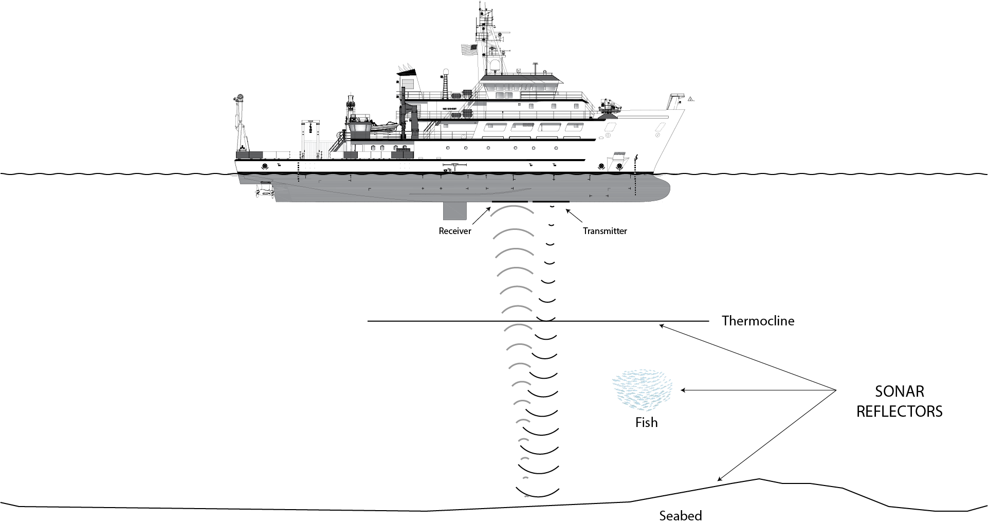
Properties and Application of Sound in SONAR
Transmitter
Reciever
Ping
Transmission Medium (water)
Pressure Wave
Amplitude (db)
Frequency (kHz)
Absorbed (by water, by seabed)
Vibrates (pressure waves)
Refracts (thermocline)
Reflects (bottom)
Notes:
Use the NOAA ship graphic video, photo to show these properties.
HS Standard - the student must communicate and do with math.
Must be able to explain it.
Make one problem where they solve for something
If you change it explain what you expect to happen.

Slide 15
Human Sonar Simulation
Lets go!
How can we apply the properties of sound to make inferences about the seafloor and the marine life?

Slide 16
Team Roles and Locations
RV Taani (Shipside)
Underwater (Depth, Water Column, Seafloor)
Hydrographer:
Recording output (Helps convert Speed of Human, needs calculator)
Receiver/Timer:
Walks to other room and passes information (time, steps)
Water Surface
Transmitter and Sound wave:
Counts steps or time as they act like a wave traveling to the seafloor and back from transmitter to the receiver
(Can make 2 roles)*
Seafloor
Seafloor Mapper:
Fills out map, cannot see the other room
RV Taani
SONAR Ping is constant (Hz, db, Amp, f)

Slide 17
Where are we sampling each round to create our seafloor map?
2xkHz
3
1
2
RV Taani
Seafloor
Water Surface
Cards
Solve
Cards
Underwater (Depth, Water Column, Seafloor)

Slide 18
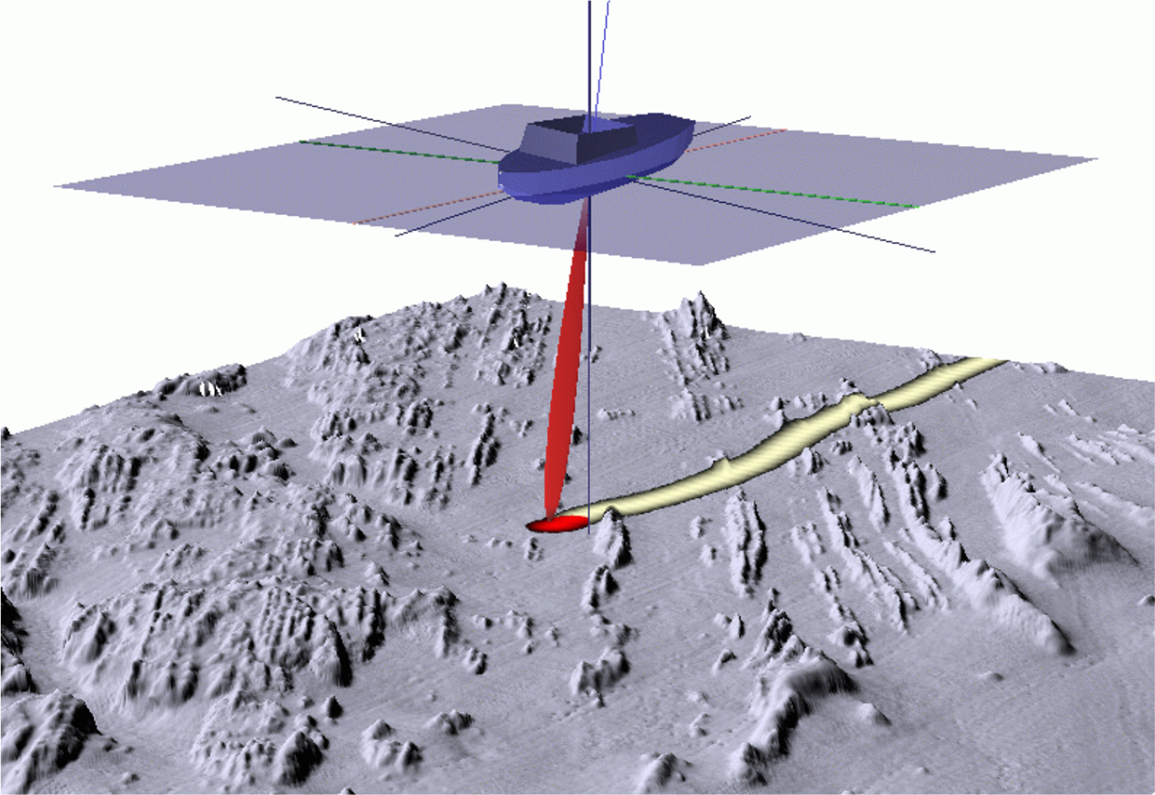
Round 1: Measuring for Depth (19 Pings)
Water Depth =
Speed of Sound x [(Two Way Travel Time)/2]
Speed of Human x [(Two Way Travel Time)/2]
Time students walking a known distance. And record that as the “Speed of Human” you will use for this simulation
*only measurement you get is two way because cannot stop the clock when sound hits the bottom
Notes:
Identify Volunteers for each of the 3 roles.
Brief each volunteer on their job.

Slide 19
Round 1: Measuring for Depth (Range)
Receiver
Transmitter
Ping
Reflect (seafloor)

Slide 20
Round 1 - Roles and Rules (15 Pings)
Walk each “Ping”, say ping to start.
Pass off information to reciever
Interpret information
Depth = Speed of Human x [(Two Way Travel Time)/2]
RV Taani
Underwater (Depth)
Hydrographer:
Help Analyze
Receiver/Timer:
Time the sound wave. Starts each time the wave says “ping” stops when they get back to the front - two way time
RV Taani
Seafloor Mapper
Plot depth
Transmitter and Sound wave:
act like a wave traveling to the seafloor and back. You ping each time you turn to walk towards the seafloor
Each Ping - Start walking and time, run to other room with time, repeat
Notes:
Identify Volunteers for each of the 3 roles.
Brief each volunteer on their job.

Slide 21
Debrief
What shapes can be seen in the 2D profile plot?
(Distance Traveled and Depth)
What are some possible explanations for these shapes?
What are some sources of error or other problems that you can think of?

Slide 22
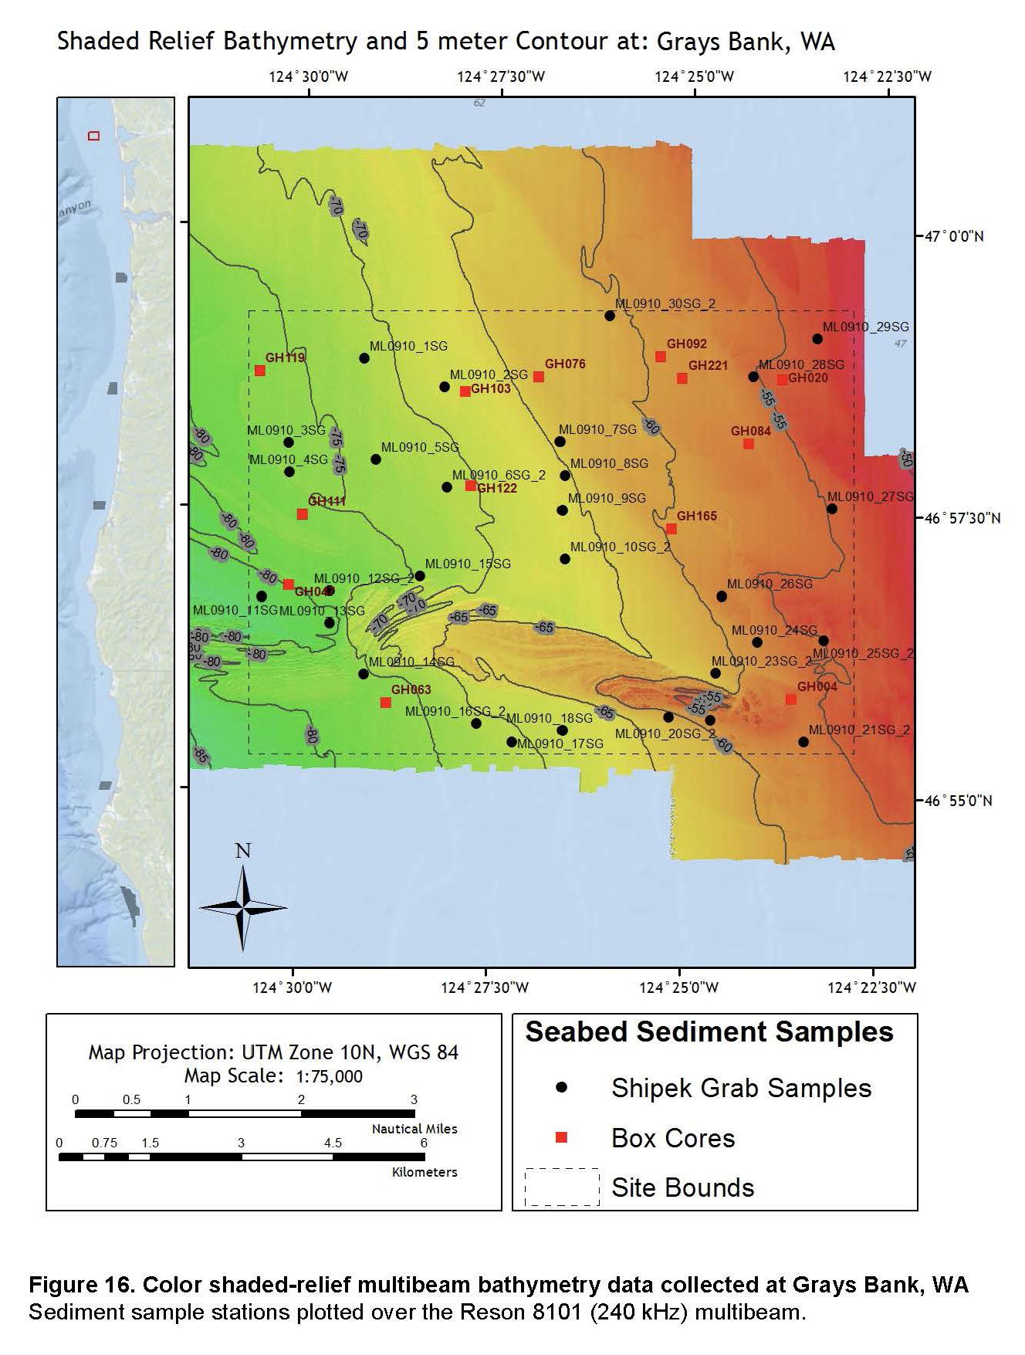
Your Seabed Profile At Grays Bank!
Warm - Shallow
Cool - Deep
Deeper as you go West (away from the coast)

Slide 23
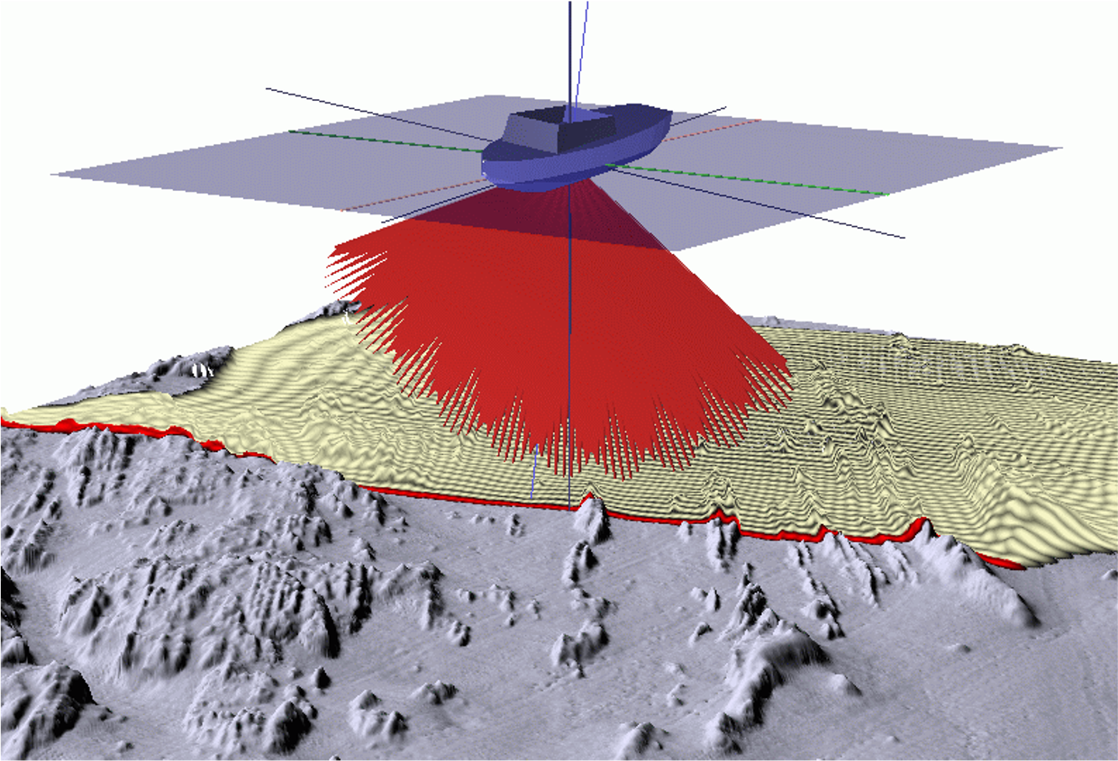
Multibeam Sonar for Ocean Floor
Our previous example provided a nice 2D profile of a simulated seabed.
In order to create a more informative 3D view of the seabed, we’re going to need to collect some more data. A 3D view of the seabed may be created by aggregating multiple 2D profiles.
On a ship we can do this by sending out not one but many narrowly focused “pings” in a fan pattern beneath the vessel.

Slide 24
Round 2: Imaging the Seafloor Composition (BackScatter)
db
Receiver
Transmitter
Ping
Absorption (water)
Absorption (water)
Reflection+Absorbtion (seafloor)

Slide 25
Round 2 - Back Scatter at Grays bank
(15 Pings)
High amplitude means hard surface (rocks, boulders)
Middle amplitude (sand, gravel)
Low amplitude mean softer (mud, plants)
RV Taani
Underwater (Depth)
Hydrographer:
Help Analyze
Receiver/Timer:
Pass off card
RV Taani
Seafloor Mapper
Plot seafloor
Transmitter and Sound wave:
act like a wave traveling to the seafloor and back. Pick up a card .
Each Ping - Start walking, run to other side of room. Pick up card and pass off the card.
Notes:
Identify Volunteers for each of the 3 roles.
Brief each volunteer on their job.

Slide 26
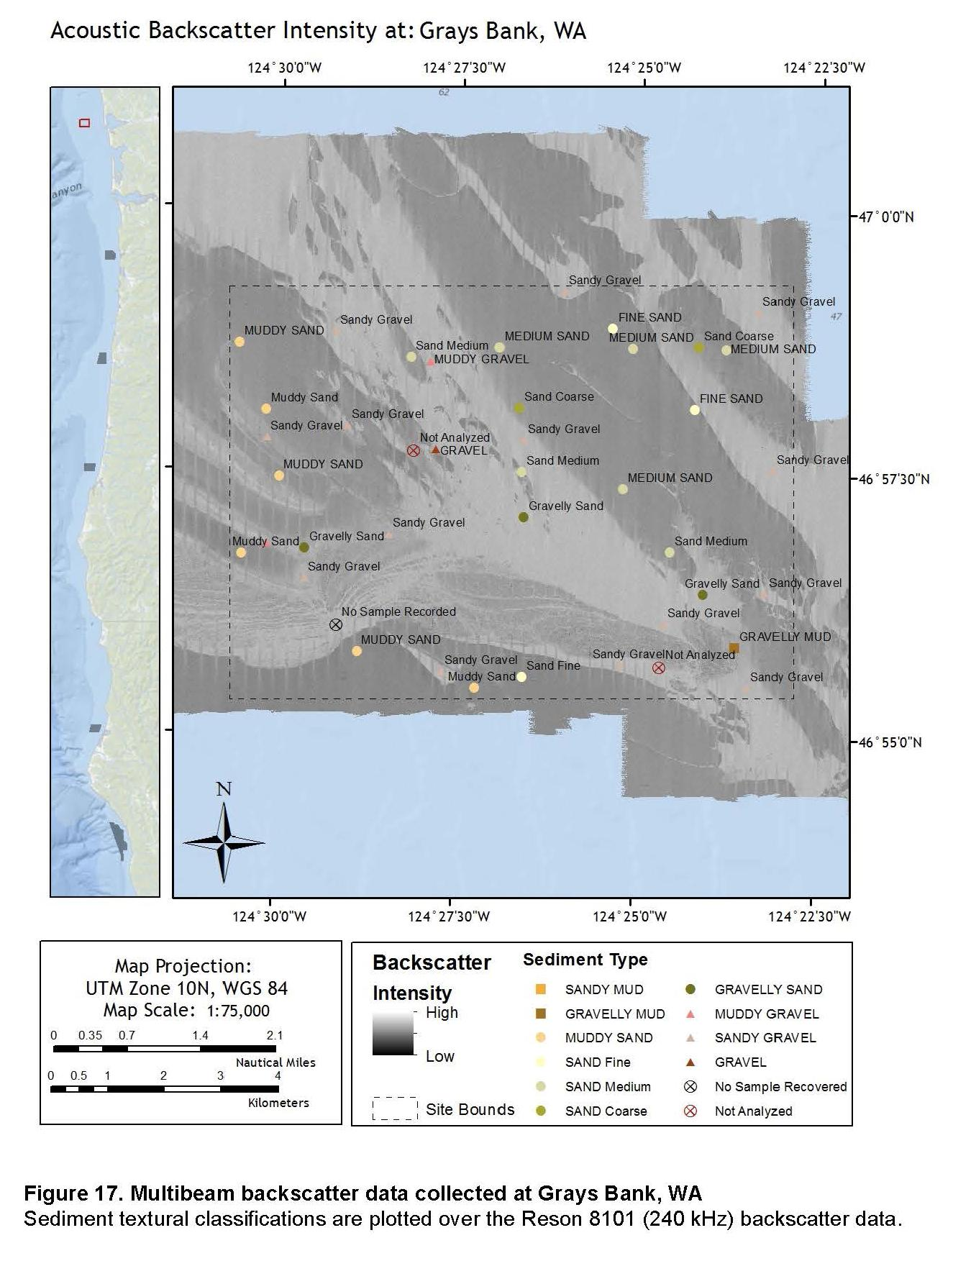
Debrief
Black and white gradient
Black is soft (low reflection, high absorption, low amplitude return)
White is hard (high reflection, low absorption, high amplitude return)

Slide 27
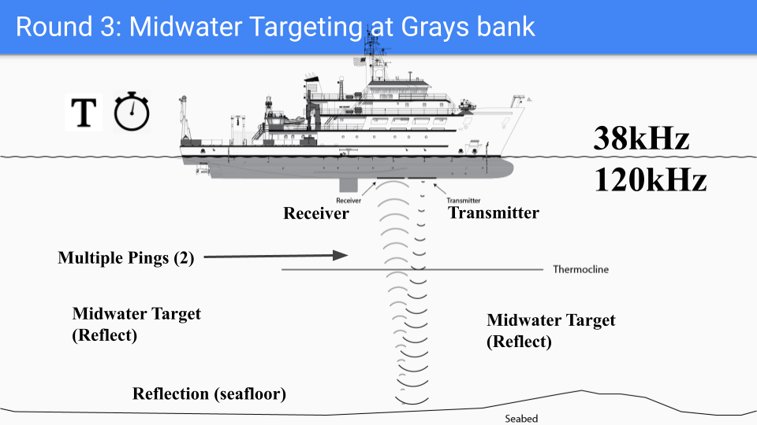

Slide 28
Round 3 - Midwater Targeting at Grays bank
(15 Pings
120kHz, 38 kHz
38kHz - Fish
120 kHz - Bubbles
RV Taani
Underwater (Depth)
Hydrographer:
Help Analyze
Receiver/Timer:
This person will act like the second sound wave because depth is known
RV Taani
Seafloor Mapper
Plot seafloor
Transmitter and Sound wave:
Act like a wave traveling to the seafloor and back. Pick up a card .
2 Pings - Start walking, run to other side of room. Pick up card and pass off the card.
Notes:
Identify Volunteers for each of the 3 roles.
Brief each volunteer on their job.

Slide 29
Debrief
What if the midwater was more heterogeneous, more fish and bubbles everywhere, what would happen to the return of each ping? (38Hz, 120Hz)
What are we not showing in this model?
Ex: Fish above and below bubbles.
Notes:
Some things are invisible to specific pings. You can math frequencies to a specific animal, or you can use multiple frequencies. RV Taani has 5 transmitters, for 5 separate frequenicies.

Slide 30
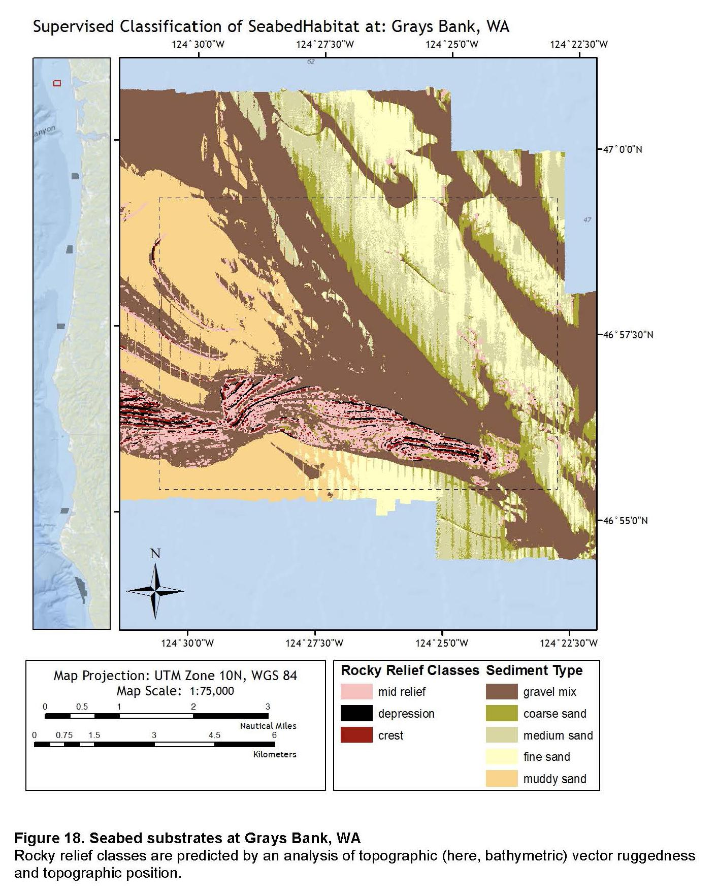
RV Pacific Storm Profile at Grays Bank made by Chris Rosmos
Geology Map
Very Detailed

Slide 31
Labeling and Explaining the parts of a SONAR system

Slide 32
Properties and Application of Sound in SONAR
Transmitter
Reciever
Ping
Transmission Medium (water)
Pressure Wave
Amplitude (db)
Frequency (30 kHz)
Absorbed (by water, by seabed)
Vibrates (pressure waves)
Refracts (thermocline)
Reflects (bottom)

Slide 33
Labeling the Model as a Debrief

