Slide 1
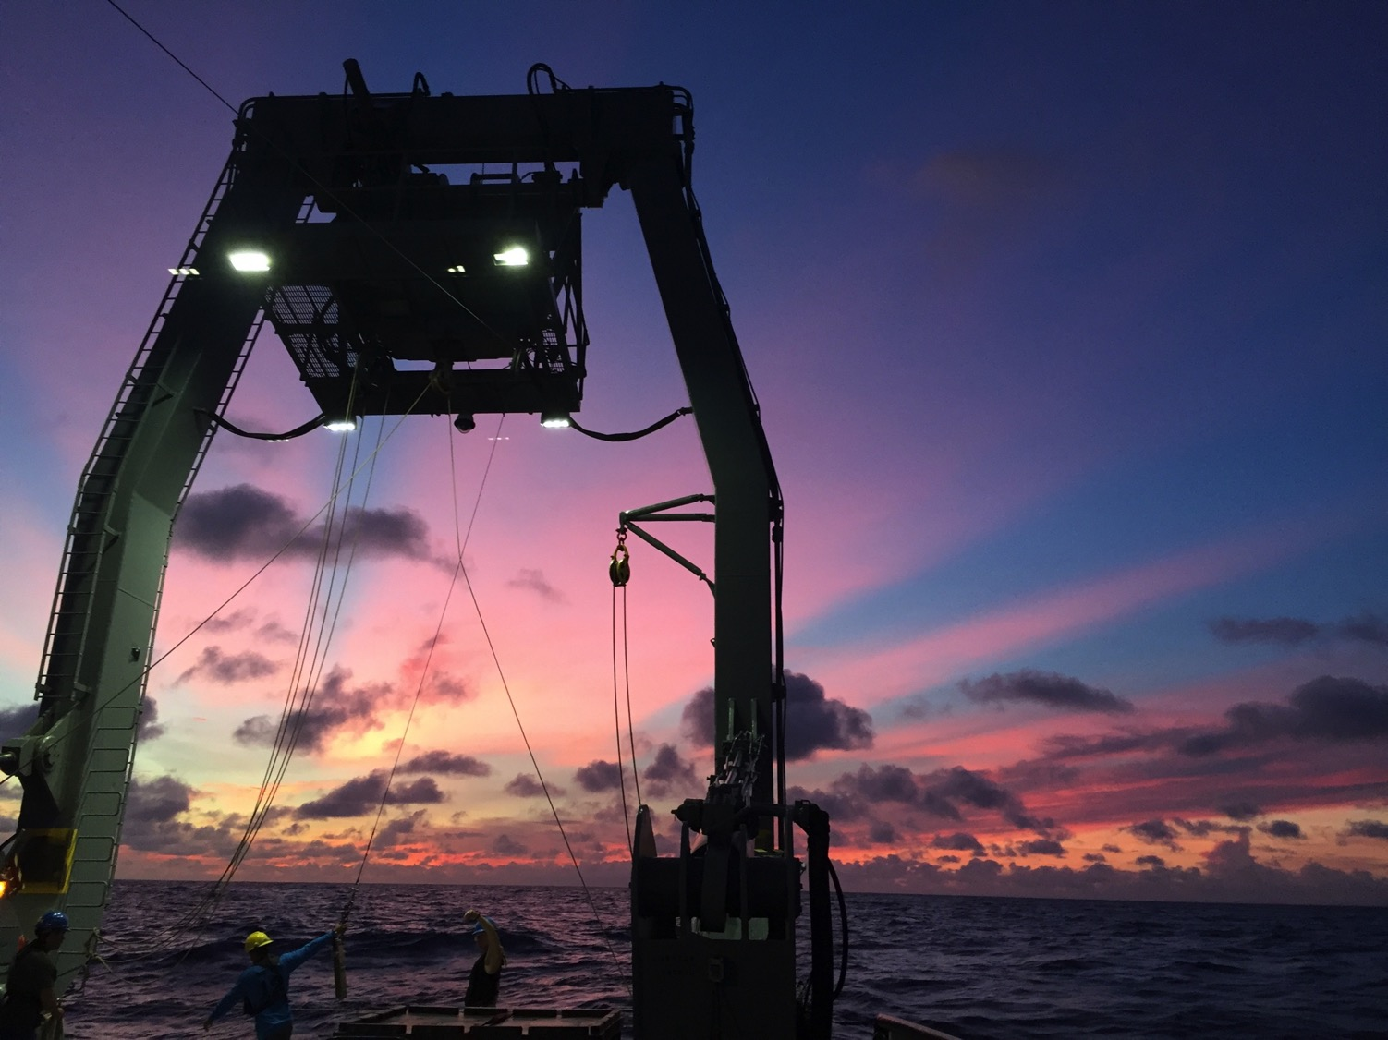

Marine Microbiology
Bloom in a Bottle
“Oligotrophic” Game
Giovannoni Lab
January 25th, 2019

Slide 2
Expected Learning Outcomes
The ocean is the largest biome on Earth
The ocean is full of life
Microorganisms are the most abundant and important inhabitants of the ocean
Microbes are diverse (size, shape, function)
Microbes form ecosystems where their interactions impact global processes

Slide 3
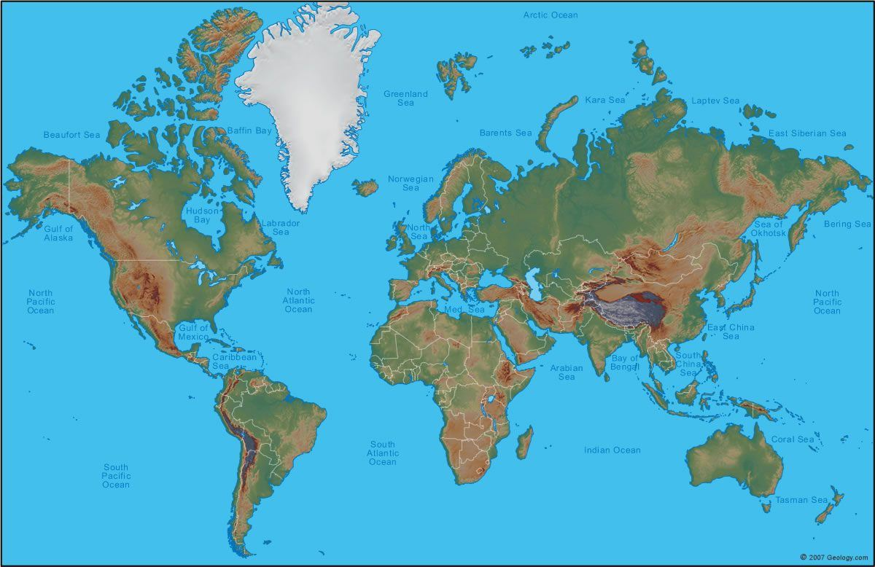
Notes:
Classic map projection of Earth that makes presents a land-centric view of the planet. Its obvious why this is so common: people make maps, people live on land. However, this type of map leads to major misconceptions about our planet!

Slide 4
Is the Earth BLUE or GREEN?
Notes:
STOP. Have students discuss if there is more land or ocean on Earth.

Slide 5
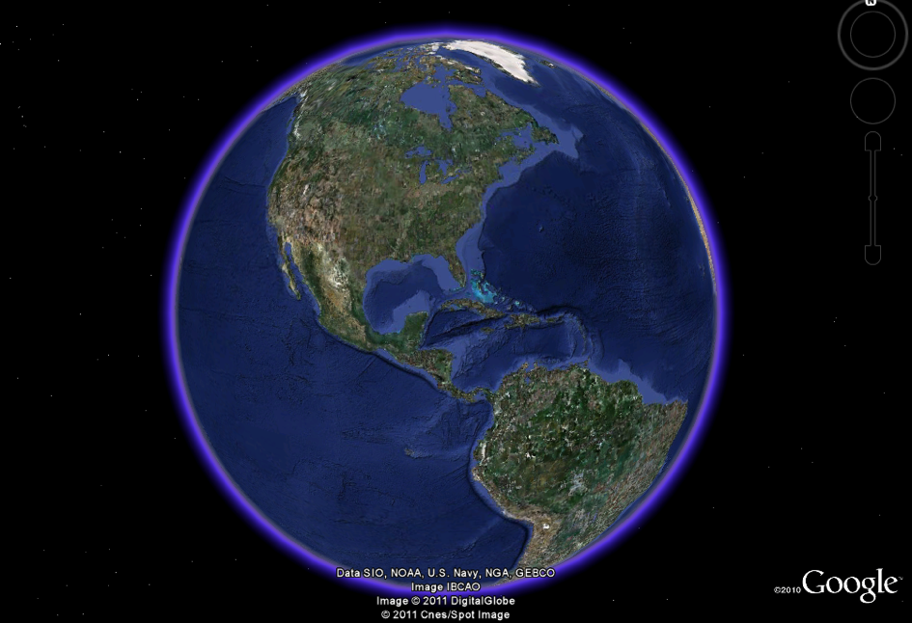
Notes:
Realistic. No distortion. Still an continent centered view.

Slide 6
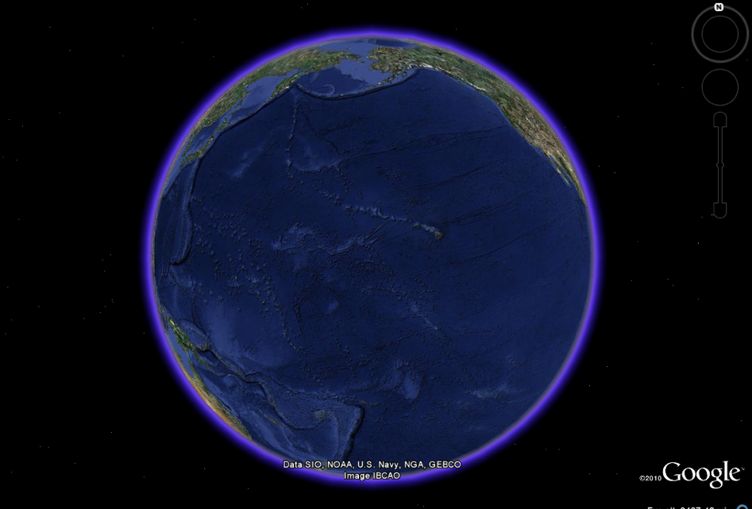
Notes:
Where did the continents go? This is the part of the globe that I’m interested in. This is the Globe’s largest biome. 70% of the Earth is covered in ocean, it is a 3D environment and is the home of an abundance of life

Slide 7
70% of the Earth’s surface is ocean
The ocean is on average 4000m deep
The majority of the ocean is oligotrophic
Every drop of the ocean contains life!
Notes:
Where did the continents go? This is the part of the globe that I’m interested in. This is the Globe’s largest biome. 70% of the Earth is covered in ocean, it is a 3D environment and is the home of an abundance of life. Oligotrophic mean nutrient deplete.

Slide 8
What types of organisms live in the ocean?
Which types are most important
to our planet?
Notes:
STOP. Have the students discuss this.

Slide 9
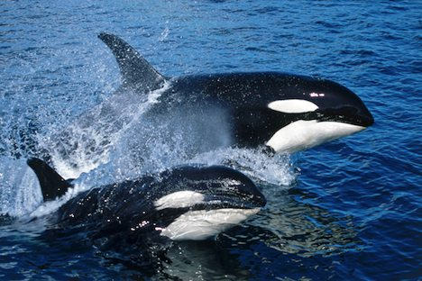
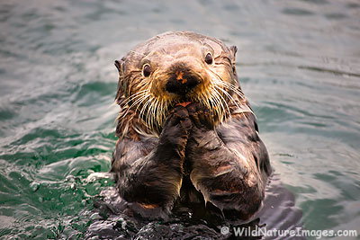
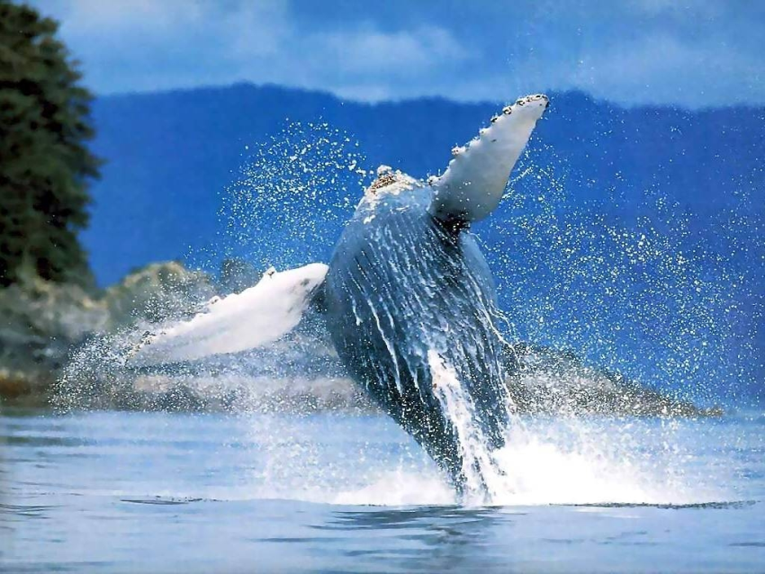
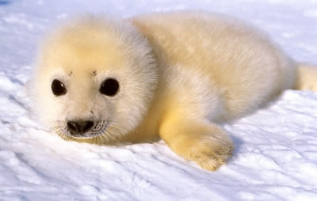
Notes:
While these are probably what most students responded with, these charismatic mega-fauna are outnumbered and under-important compared to MICROBES!
Lets zoom in!

Slide 10
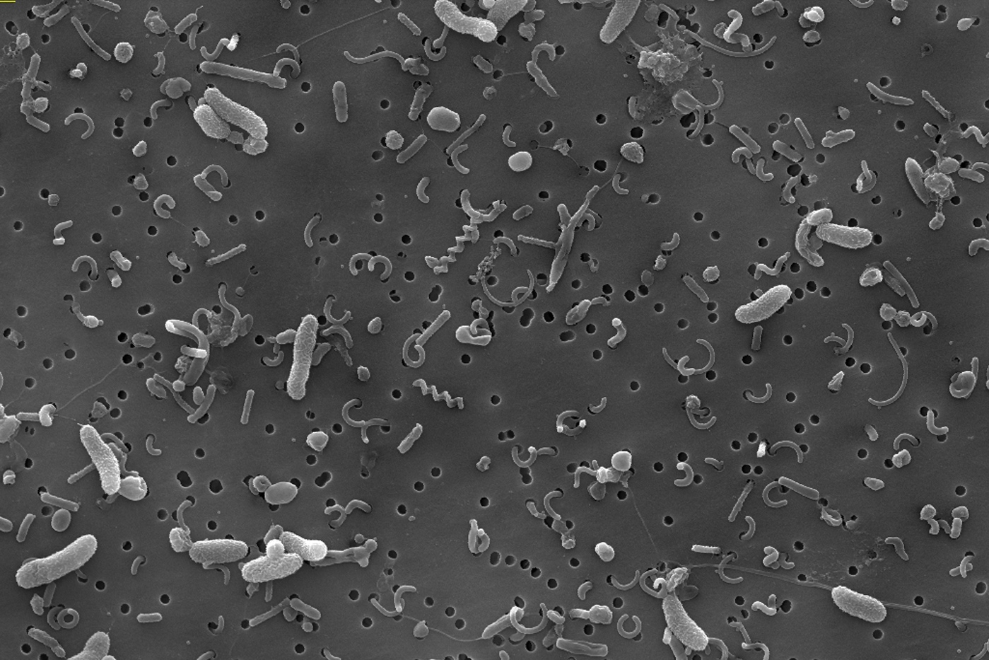
Marine Bacteria
Image from Yanlin Zhao and Stephen Giovannoni
electron-microscopy image.
Seawater filtered on 0.1µm filter
Notes:
Scientists use a microscopes to see the most abundant marine organisms, bacteria! This is an image from an electron microscope. The small comma-shaped cells are SAR11. The holes in the filter are 0.1microns in diameter

Slide 11
Fun Fact:
In 1 drop of seawater there are
1 million bacteria!
Notes:
Incredibly abundant! 10^6/ml in seawater!

Slide 12

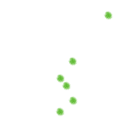

Marine Microbial Vocab!
Oligotrophic: an area of the ocean with low nutrient concentrations
Phytoplankton:
-Create biomass from the sun
(like plants)
-example: Prochlorococcus
Bacterioplankton:
-Use biomass produced by
phytoplankton to survive
-example: SAR11
Zooplankton:
-Consume both phytoplankton and
bacterioplankton
-example: copepod
Notes:
Vocab!

Slide 13
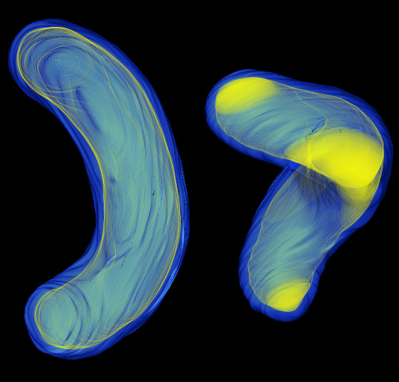
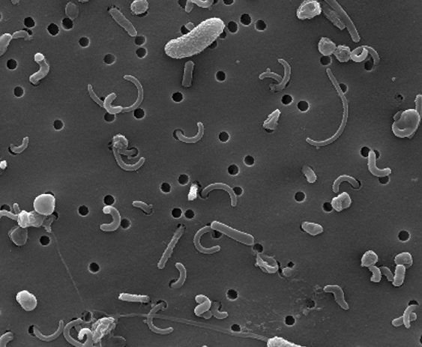
SAR11 is the most abundant bacterioplankton
Discovered in the Giovannoni Lab at OSU
Notes:
Look like Cheetos. 30% of all bacterial cells in the ocean are SAR11. The most abundant organism you’ve never heard of! Oligotrophic specialists. As much as 37% of ocean gross primary production is oxidized by this cell type. Very small cells

Slide 14
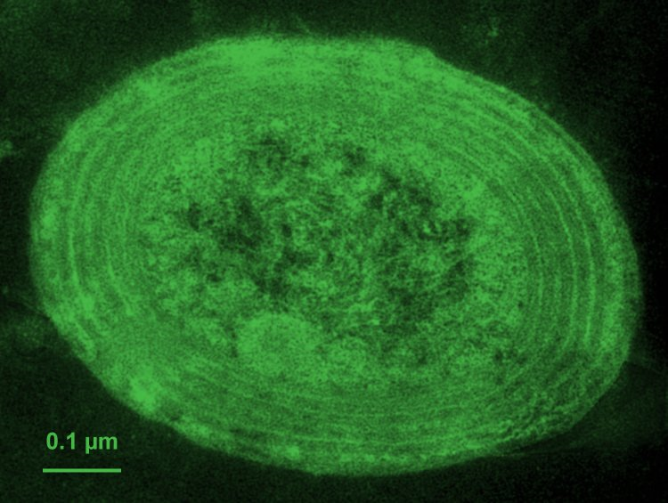
Prochlorococcus is an important phytoplankton
0.5µm
200 in a row = 1 human hair!
Notes:
Responsible for a substantial portion of oceanic primary production. About 100,000cells/ml in the sunlight upper ocean.

Slide 15
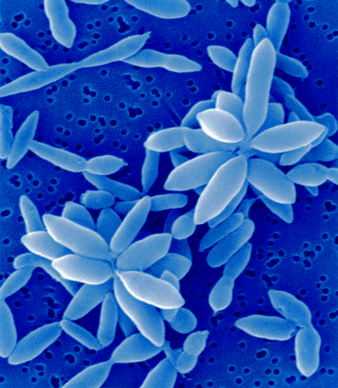
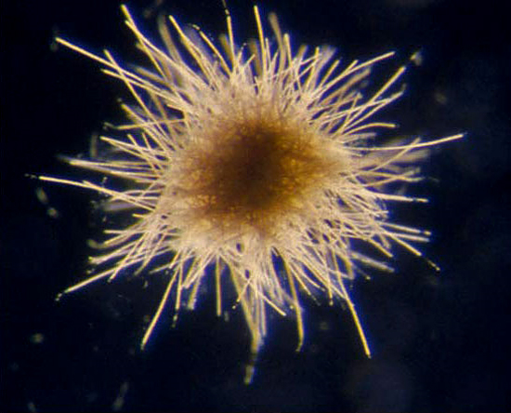
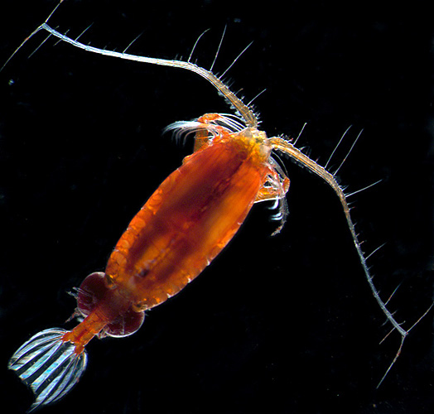
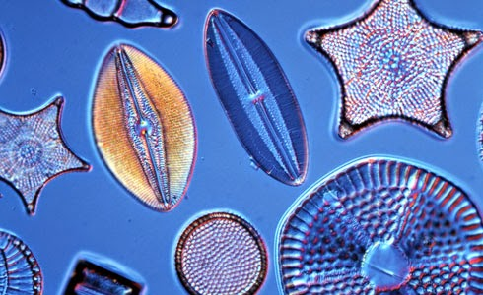
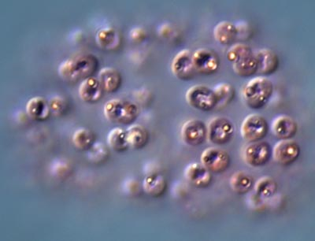
Notes:
Marine bacterioplankton and phytoplankton are very diverse in structure and function! Roseobacter (heterotroph), Trichodesmium (autotroph, nitrogen fixers), diatoms (autotrophic eukaryotes. Silica (glass shells), form massive blooms), copepod (metazoan: multicellular eukaryote. Heterotroph. Zooplankton. Feeds on all others in the slide).

Slide 16
Marine microbes are small and diverse
Notes:
Large size range

Slide 17
What are these marine microbes doing?
Why should we care about them?
Notes:
STOP. Have the students hypothesize.

Slide 18
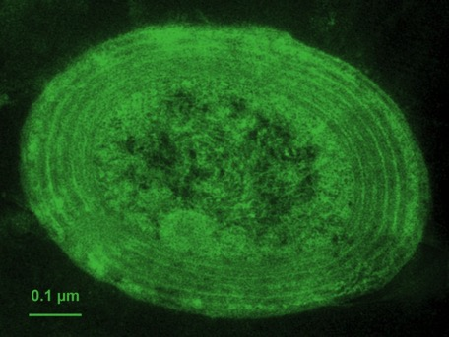
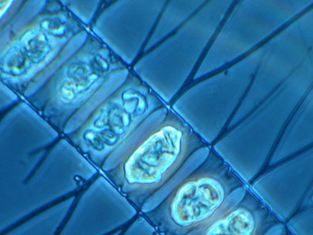
50% of all oxygen we breathe is produced by microbes in the ocean!!
Notes:
How is the O2 produced? Bring in photosynthesis. CO2 absorbed converted to biomass, O2 produced.

Slide 19

Photosynthesis removes CO₂ from the atmosphere, and forms biomass that is the base of the food chain
CO₂
O₂
Bacterioplankton
Phytoplankton
Zooplankton
Nutrients

Slide 20
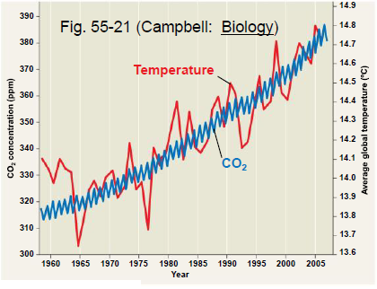
Atmospheric CO₂ Concentration
is Increasing

Slide 21

Microbial interactions will help regulate climate change
CO₂
O₂
Phytoplankton
Carbon
Pump

Slide 22
Can we observe marine microbes in the classroom?
Activity:
BLOOM IN A BOTTLE

Slide 23
Bloom in a Bottle
Observation: Scientists say there are abundant microbes in the ocean, but we can’t see them! How can we see microbes in the class room?
Hypothesis: By adding nutrients and sunlight to seemingly lifeless seawater, microbes will grow.
Setup:
  Collect seawater in a plastic water bottle
  Add nutrients to bottle (Miraclegro)
  Loosely cap bottle
  Place bottle near a window where it will receive sunlight
  Wait….

Slide 24
Phytoplankton
Bloom
1 week - 1 month

Slide 25
Thank You
Questions?
Feel free to email your questions to
Chris Suffridge suffridc@oregonstate.edu

Slide 26
How are the diverse marine microbes interacting in the environment?
Oligotrophic Game

Slide 27
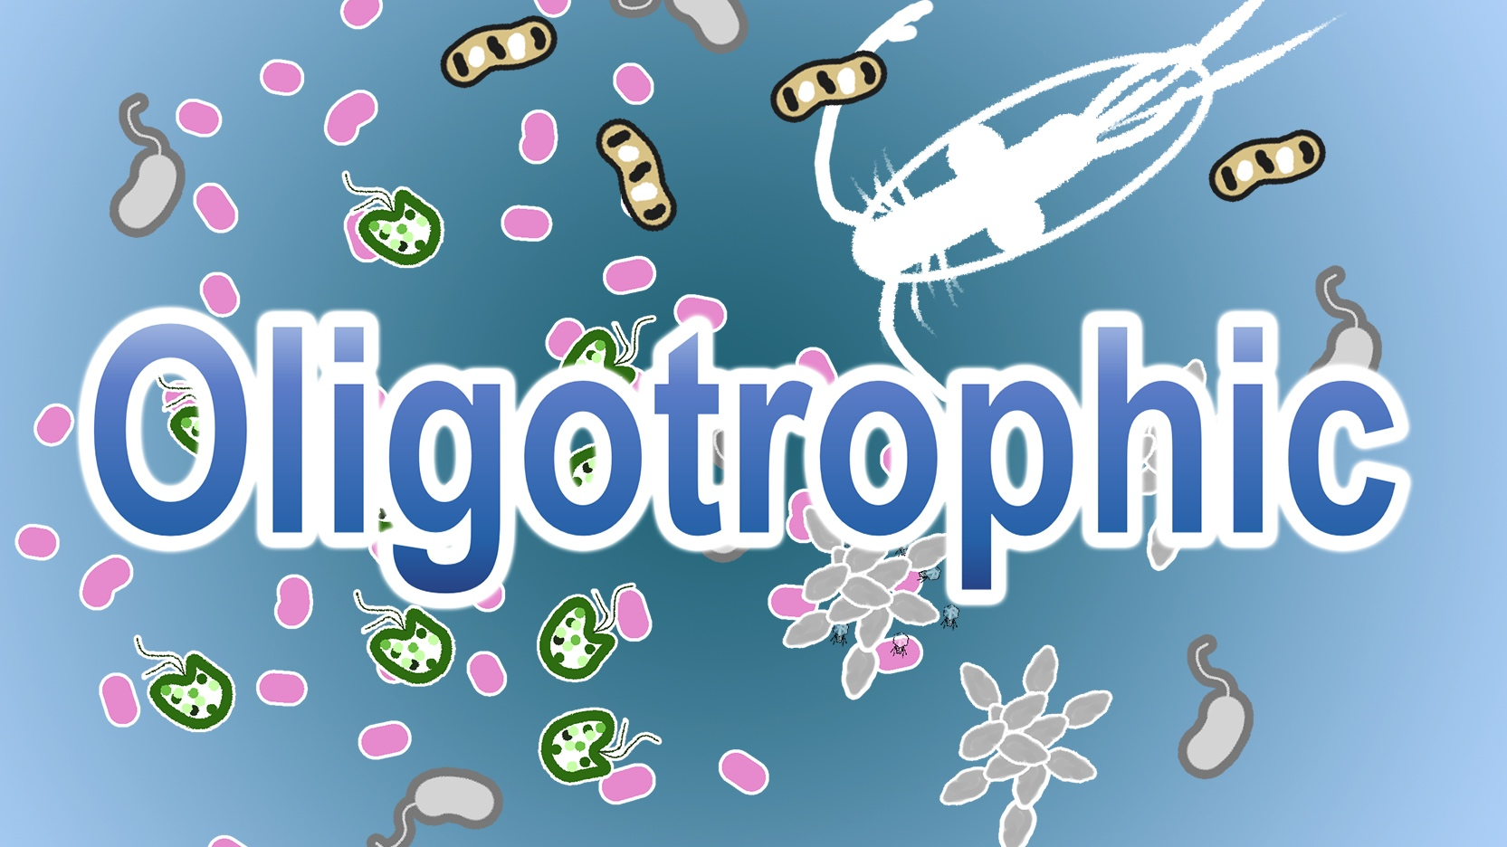
How to play:

Slide 28
To win, start your turn with 5 or less biomass (cubes).

Slide 29
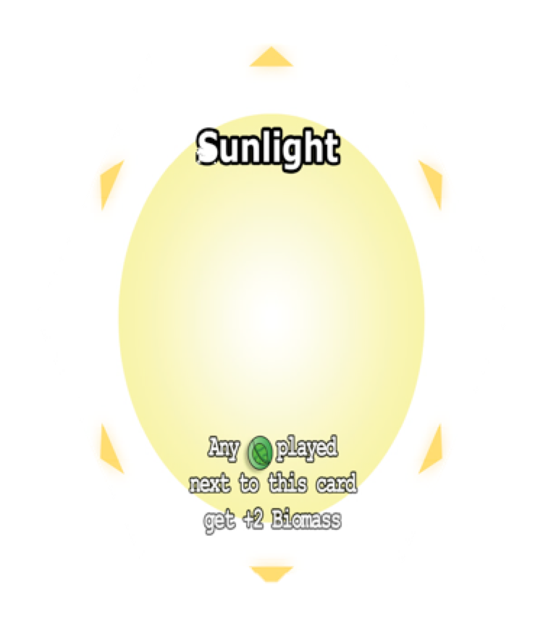

Set up
Give 20 cubes to each player of a single color
Pull out the sunlight card
Shuffle all of the other cards together

Slide 30
Set up
Give each player 3 cards

Slide 31
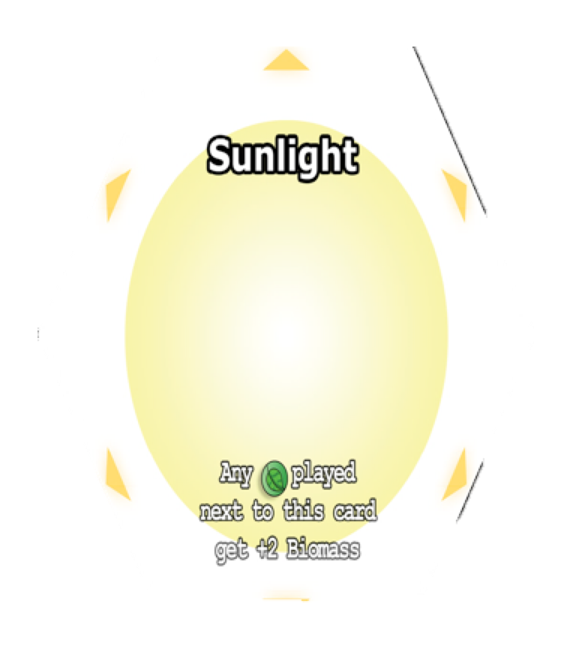
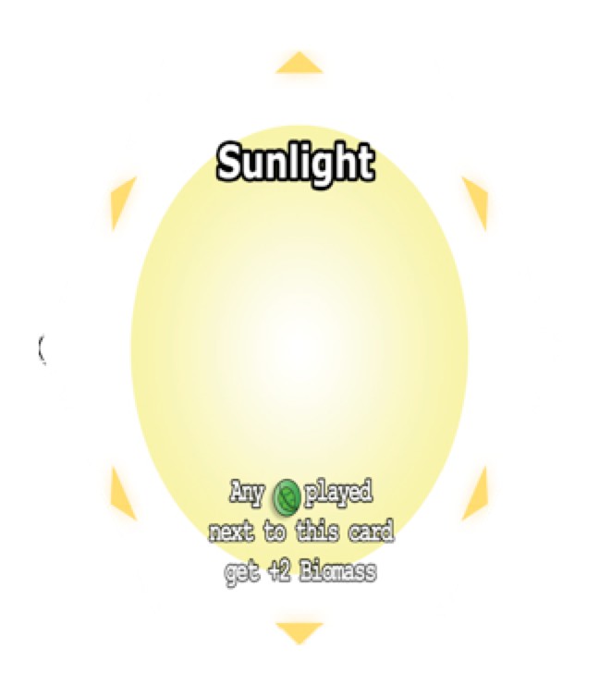
Set up
Put the sunlight card in the center of the play area
You are now ready to play!

Slide 32
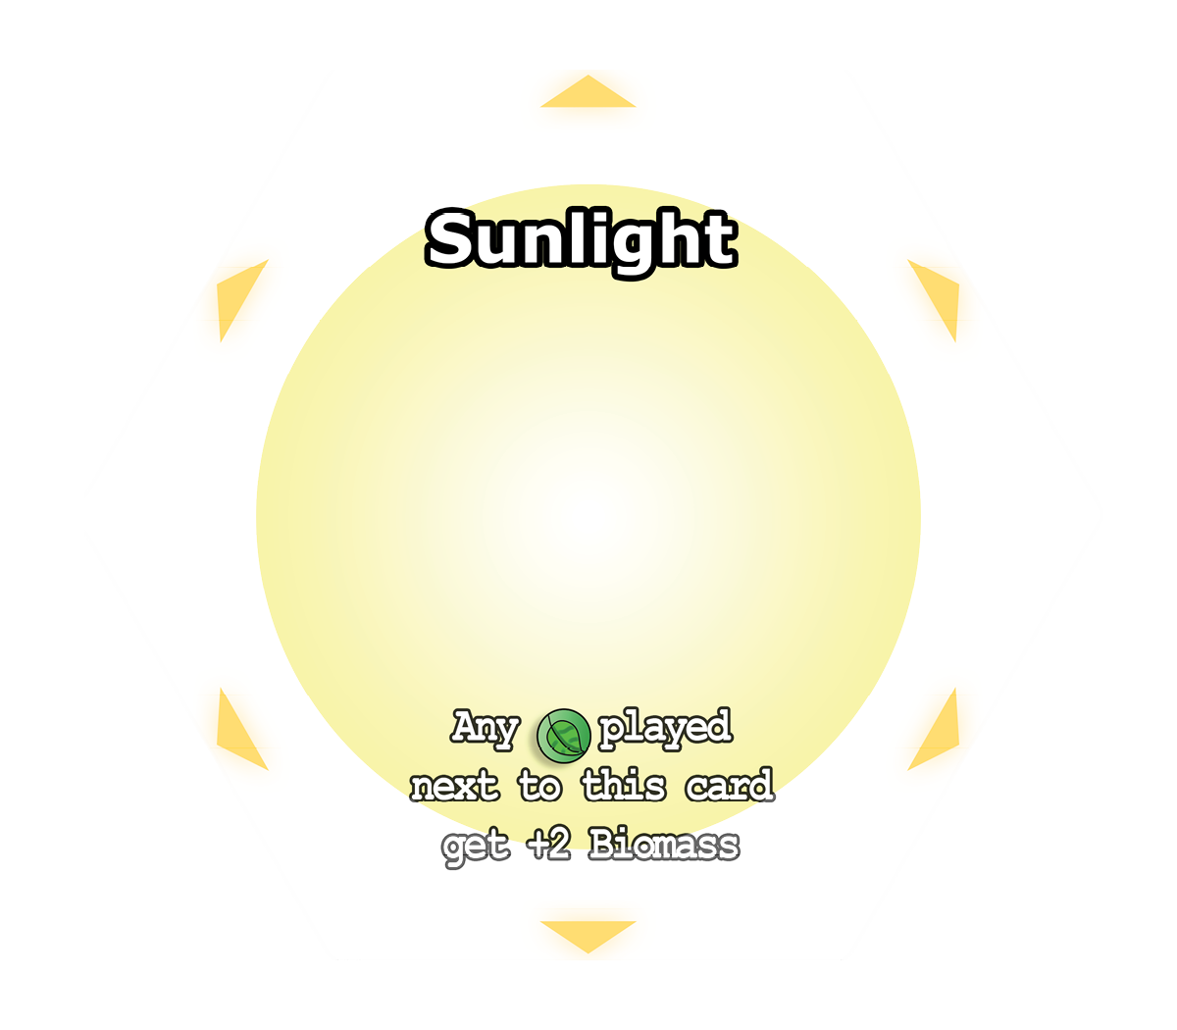
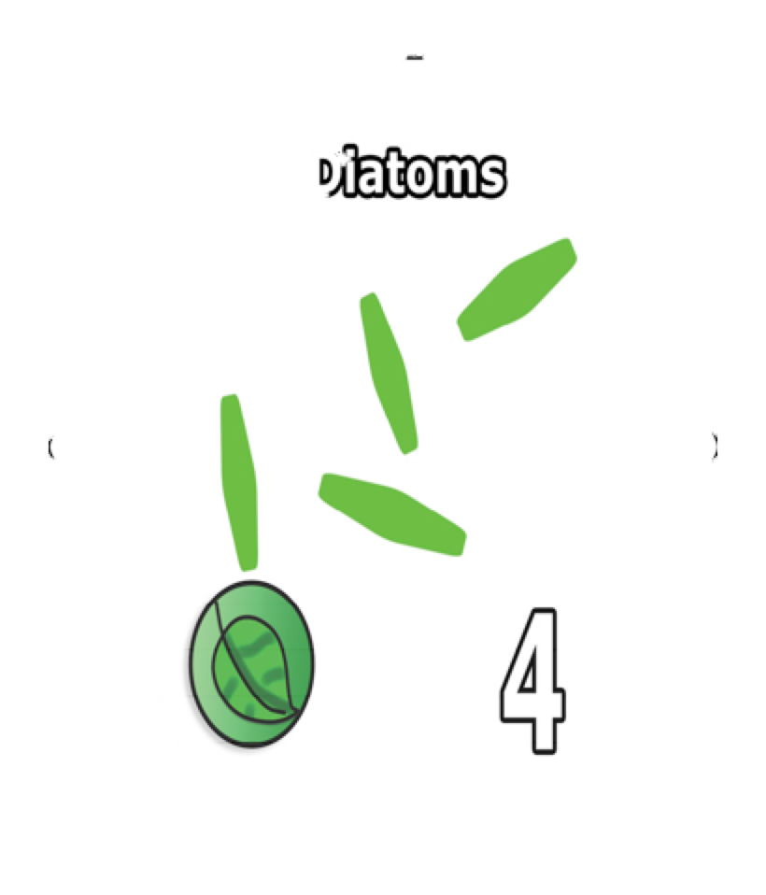

How to play:
Each turn, play 1 card from you hand so it connects to at least one other card.
Put cubes of your color equal to the number on the card
If you play a Phototroph by the sun, add 2 more cubes

Slide 33
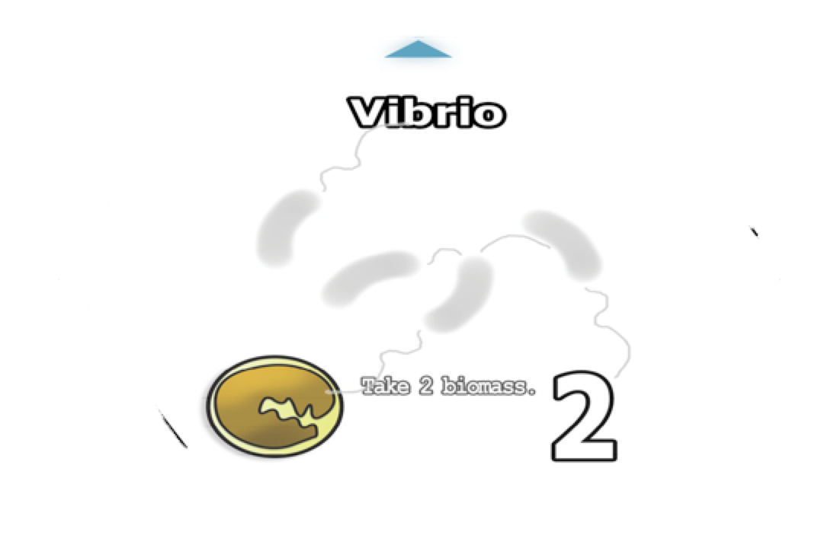
When you play a card:
The arrow points to the cards that it effects.
Take: Switch the cubes to you color and move it to you card.
(Remember some can only take from certain others!)
Return: Give the cubes on the indicated card back to their player.
Return to player.

Slide 34
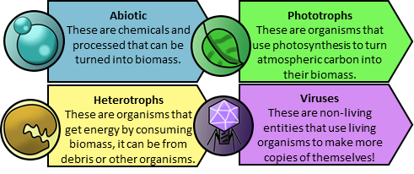

Slide 35
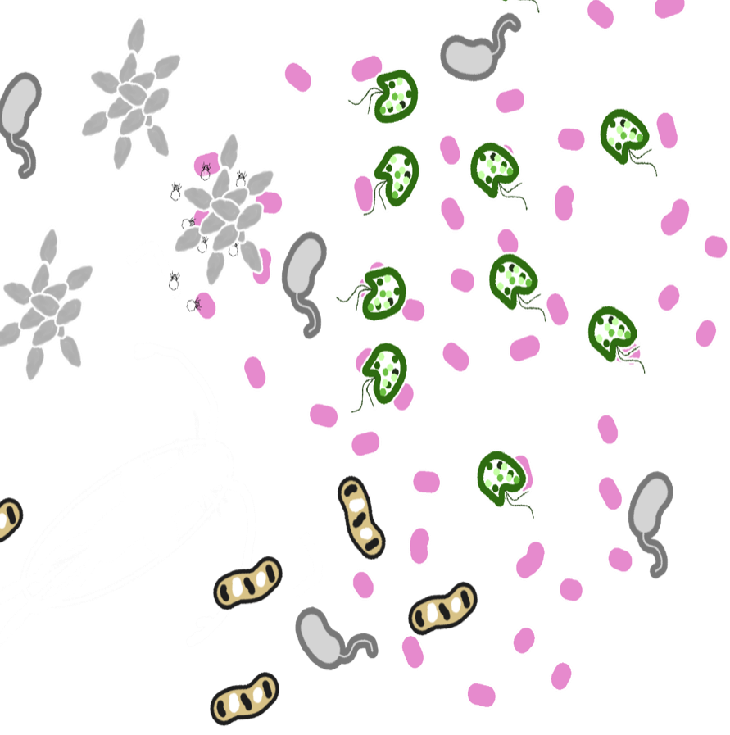
Oligotrophic
Available now!
Oligotrophic is a fast-to-learn, strategic tile placement game where players compete to place biomass the fastest. In the game players will select and play hexagonal cards based on actual microorganisms to accumulate biomass, often getting bonuses, hurting, or taking biomass from the other organisms they encounter.
Use it as a fun way to teach about the ecology of globally significant marine microorganism!
Free to download at:
https://boardgamegeek.com/boardgame/269171/oligotrophic
Coming to the Game Crafter soon! https://www.thegamecrafter.com/

