Slide 1
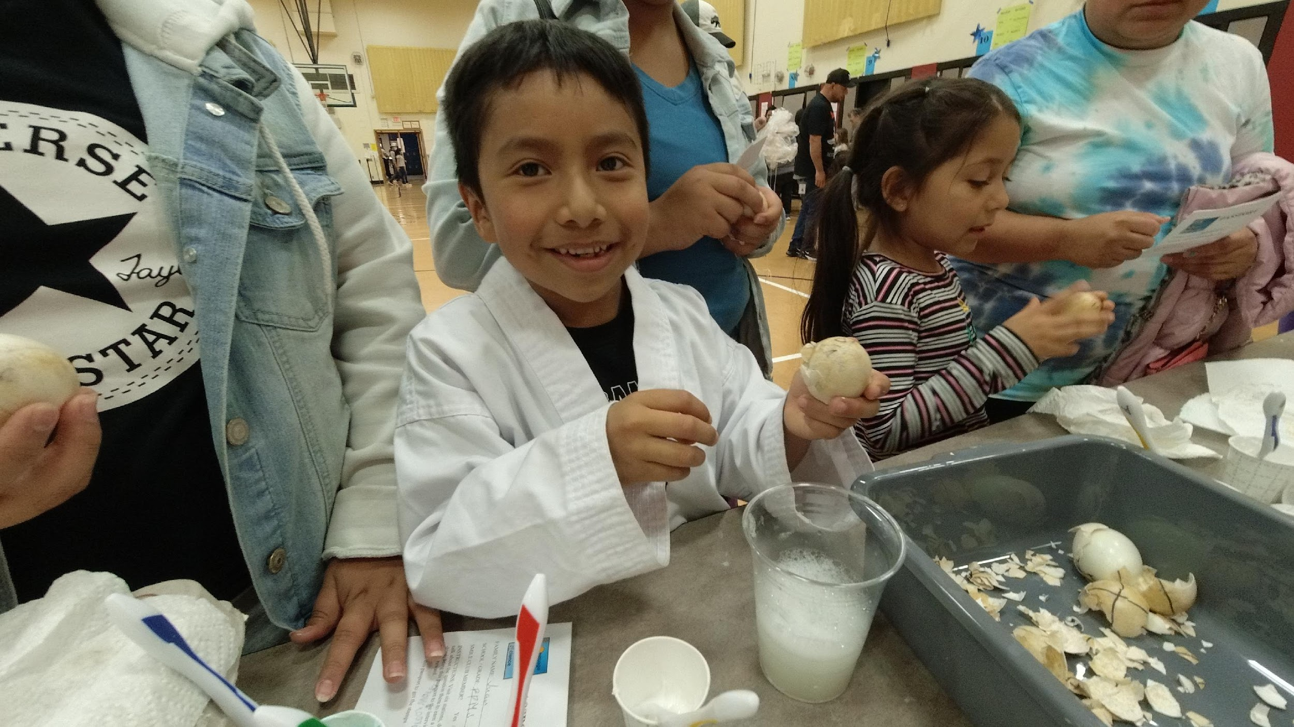
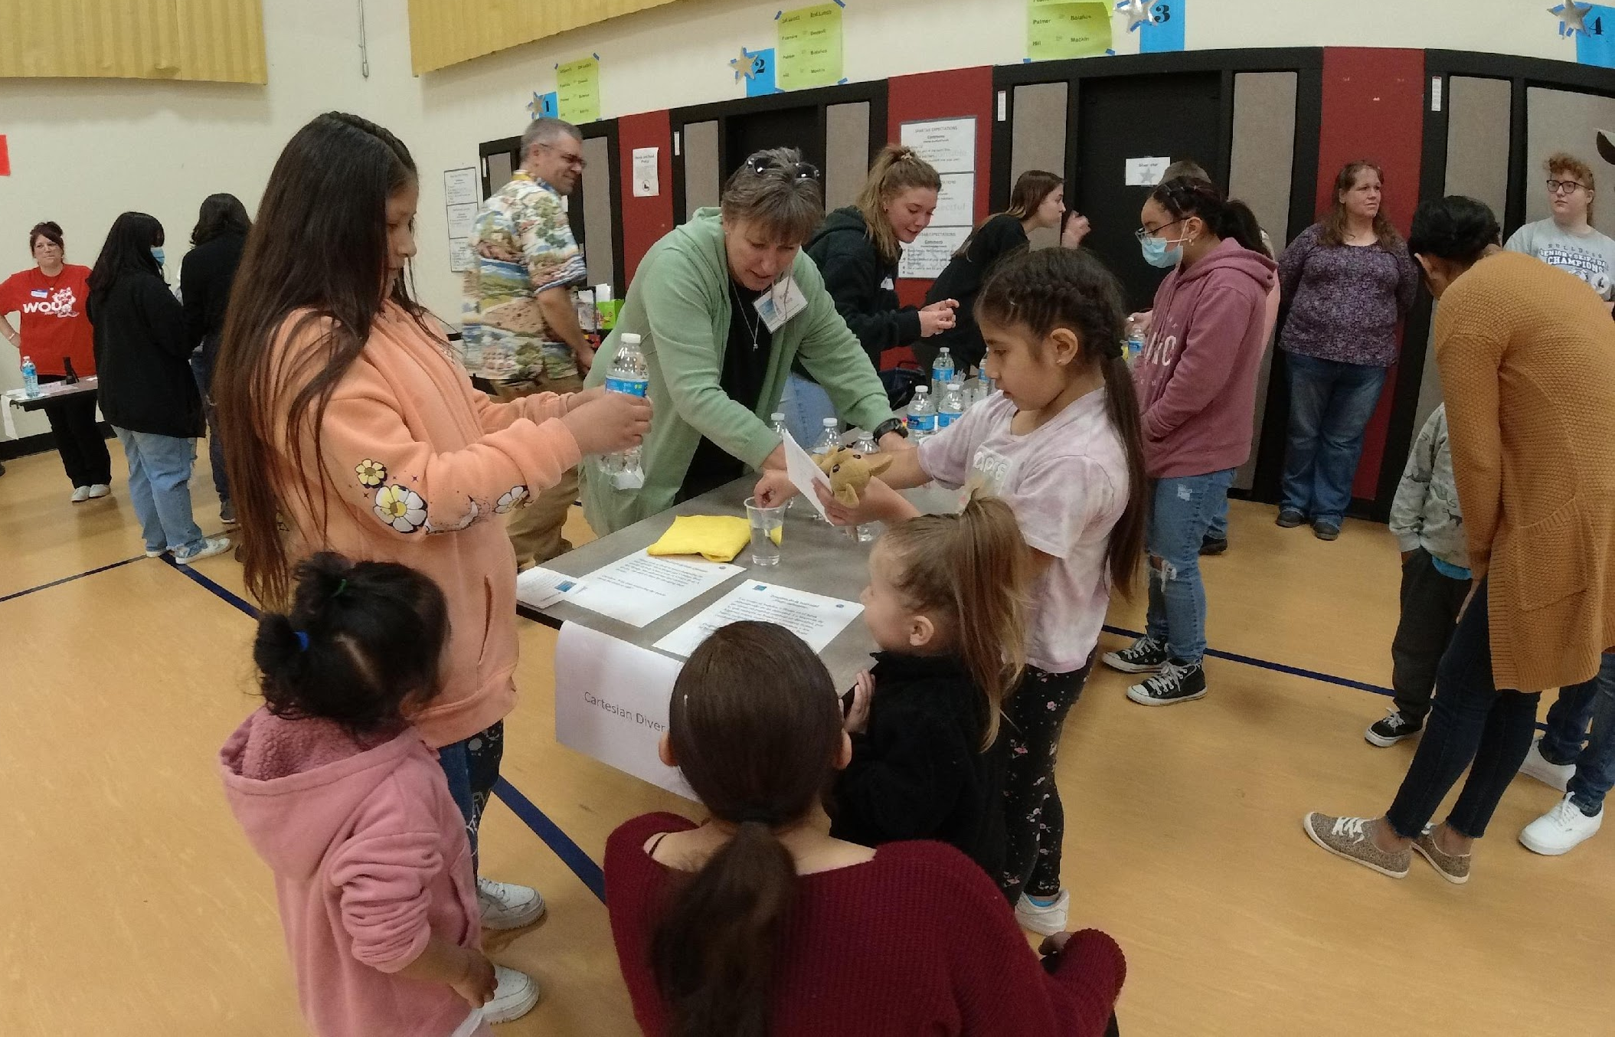
<< School Name SMILE Club >>
Proudly Presents
FAMILY MATH AND SCIENCE NIGHT
Bring Your Family and Enjoy -
Hands-on science activities
Spectacular demonstrations
Tasty food
Where: <<School name and address, room location >>
When: <<Date and Time>>
For more information: Email <<Teacher’s email address>>

