Slide 1
SMILE Project: ME Team
John Tijerina, Elsa Harder, Anton Aleksiev

Slide 2
Meet the Team

Slide 3
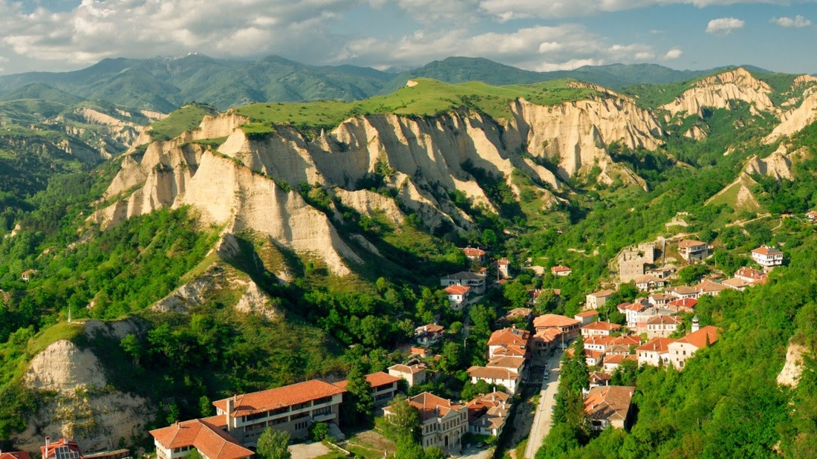
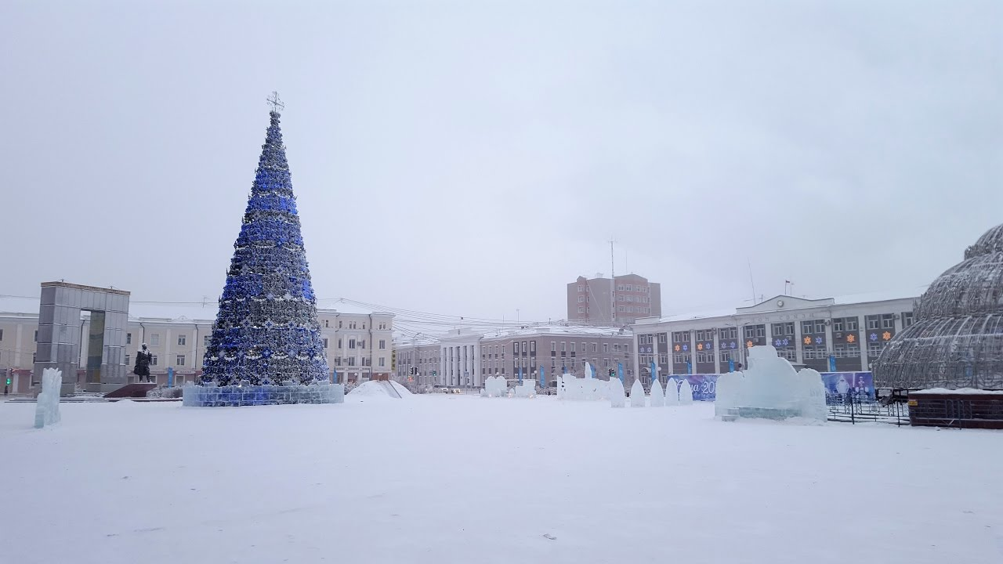
Anton Aleksiev
Studying Mechanical Engineering with Minor in Business

Slide 4
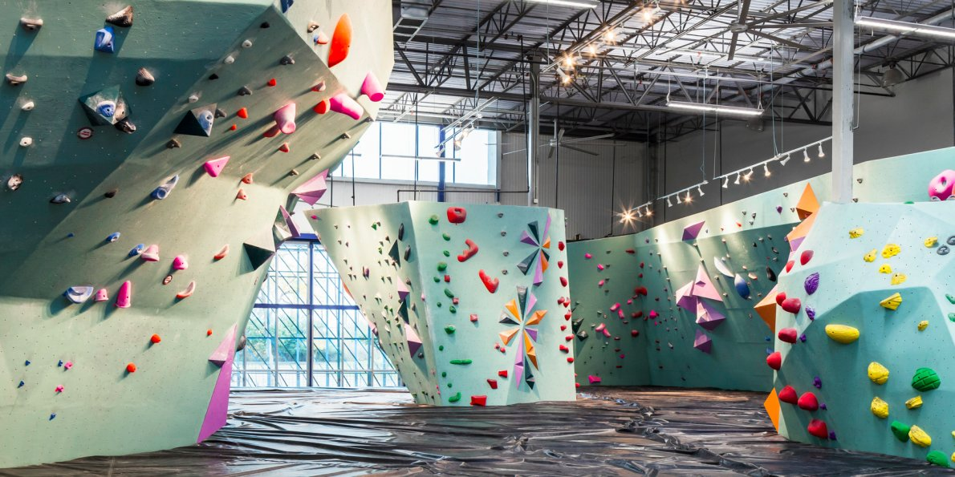
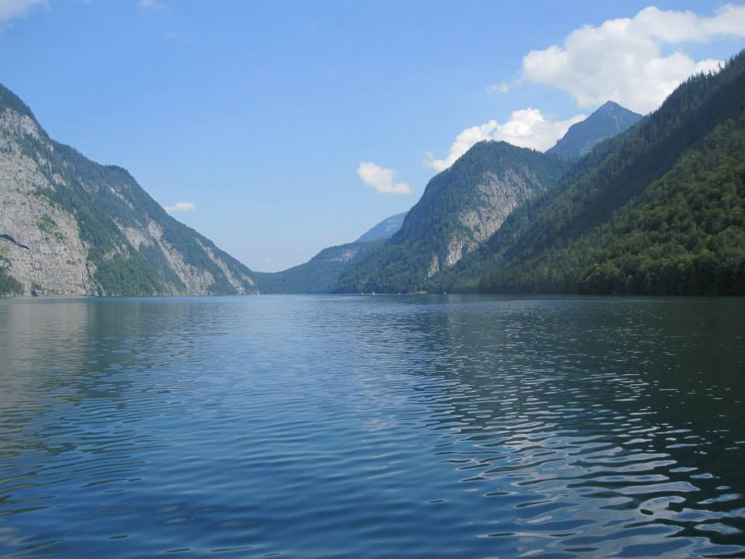
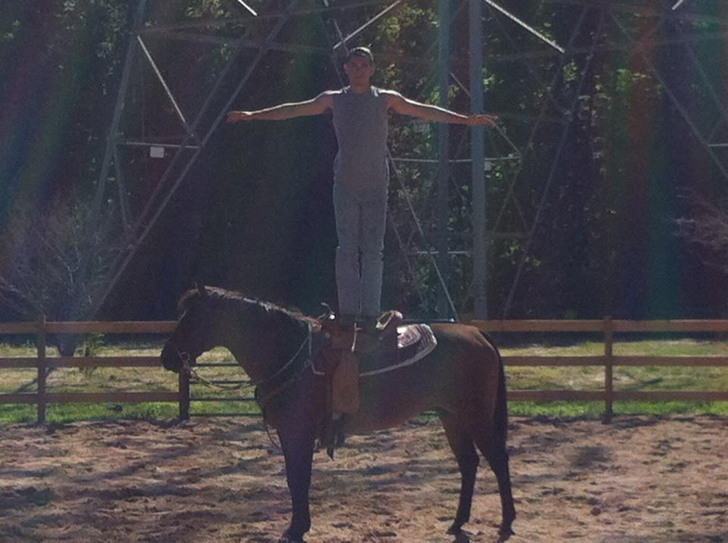
John Tijerina
Studying Mechanical Engineering with Minor in Business

Slide 5
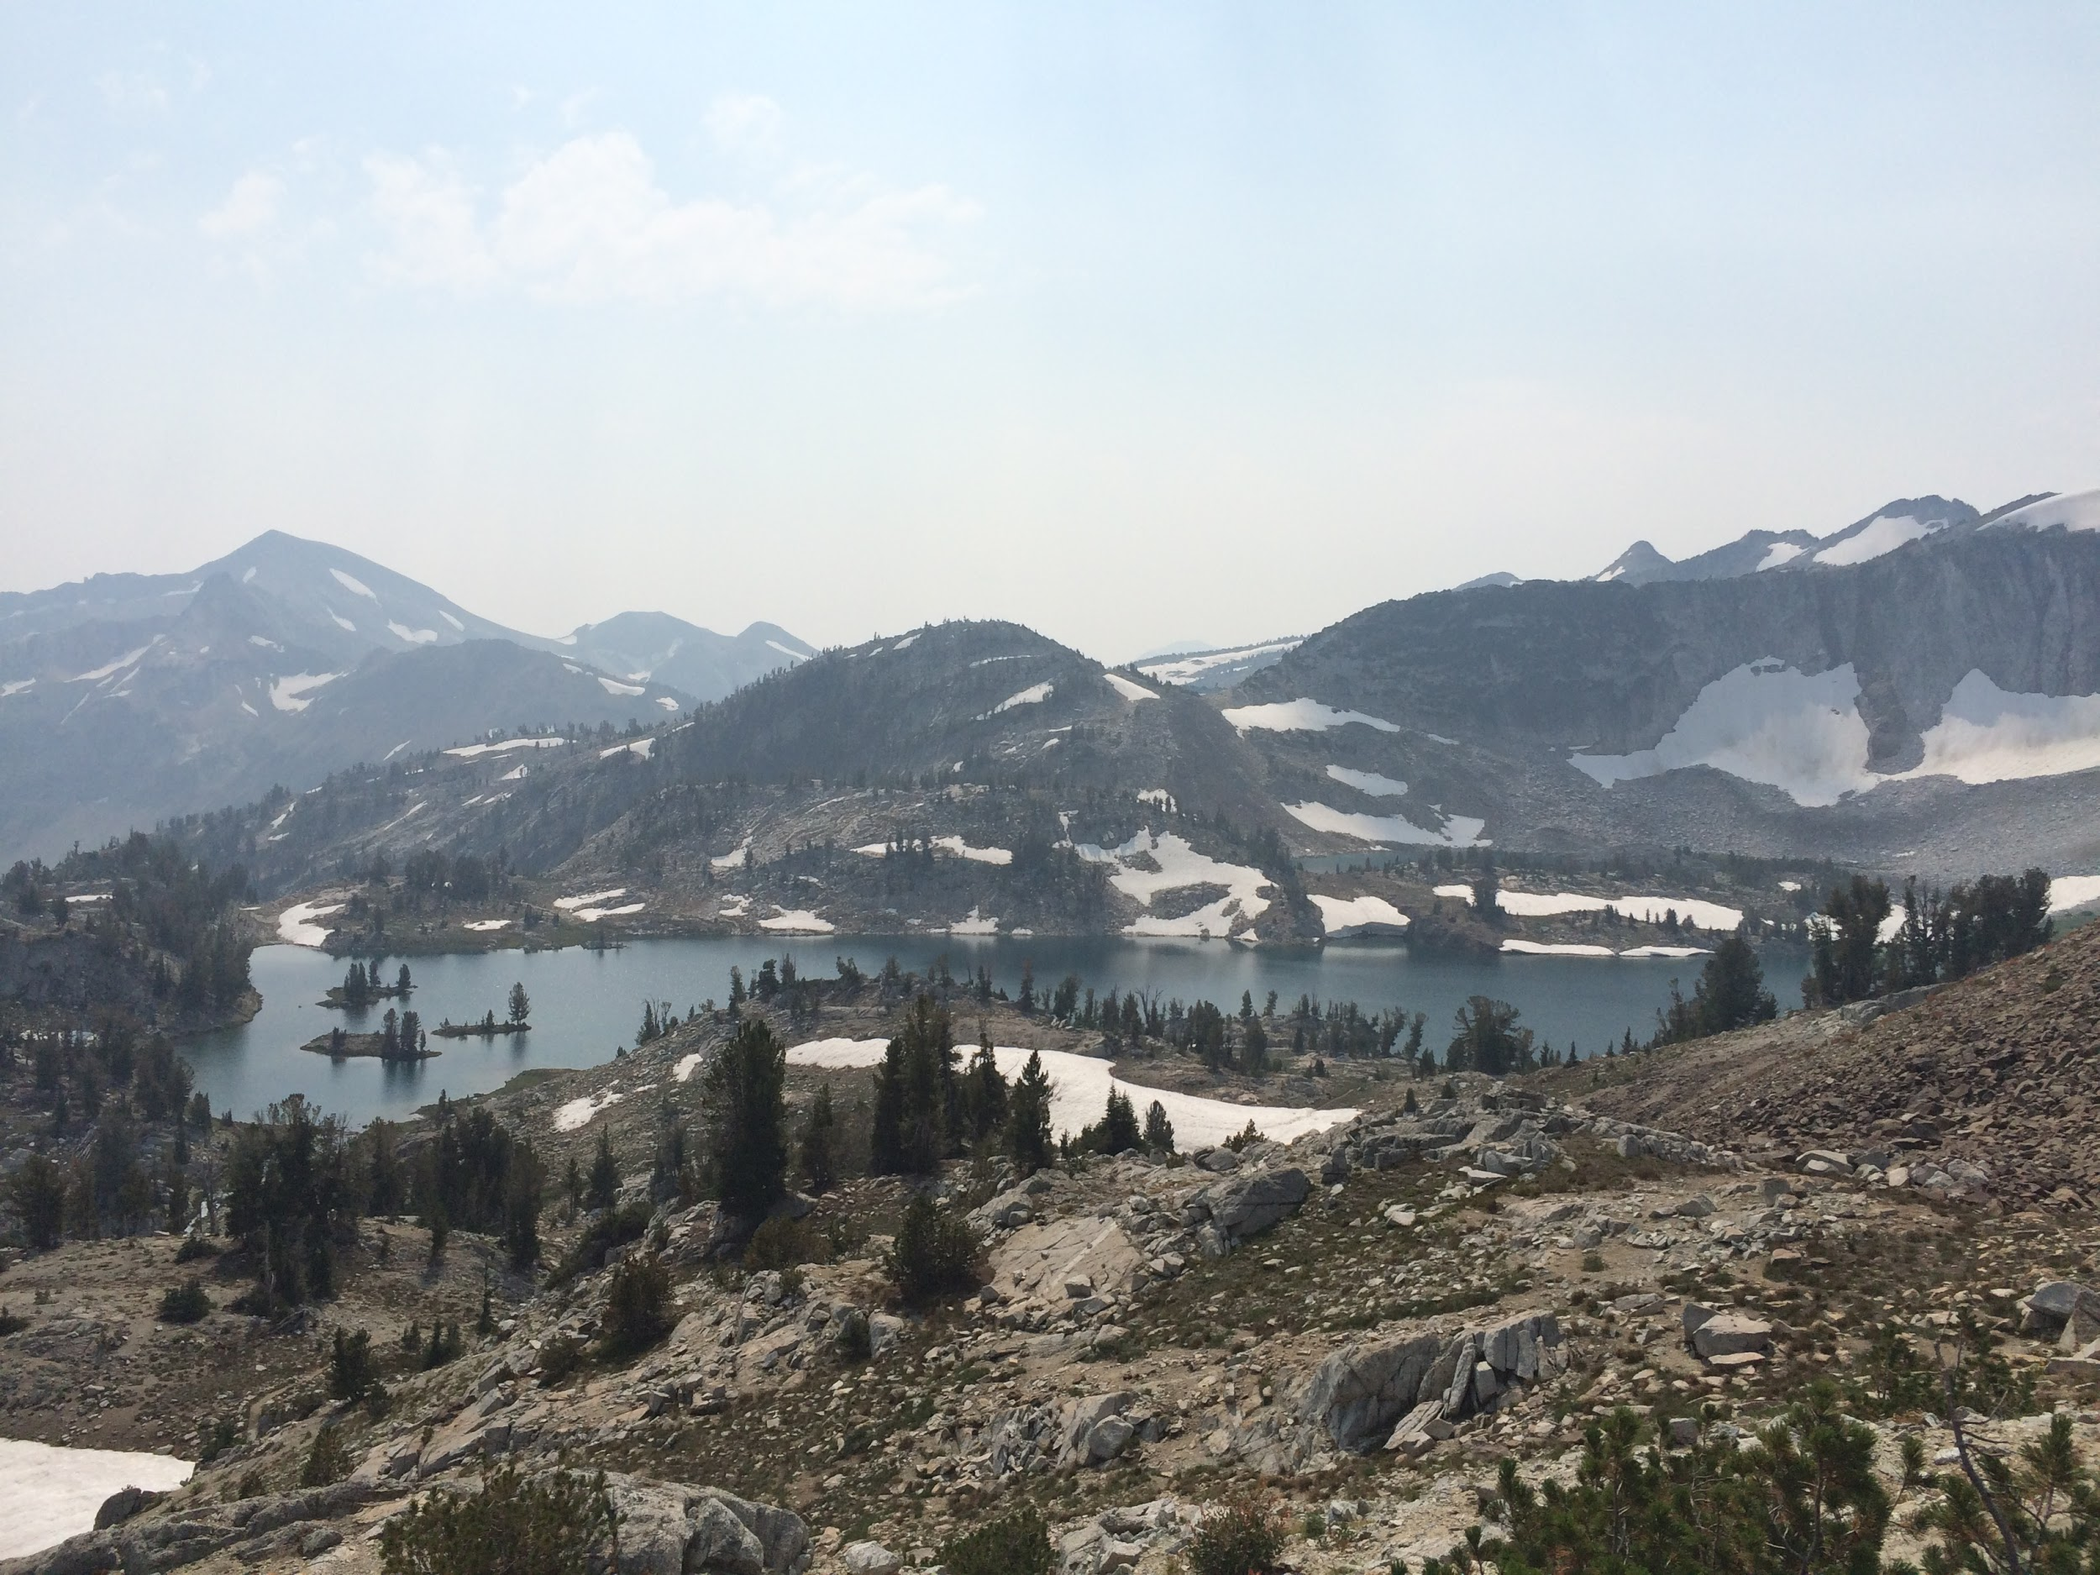
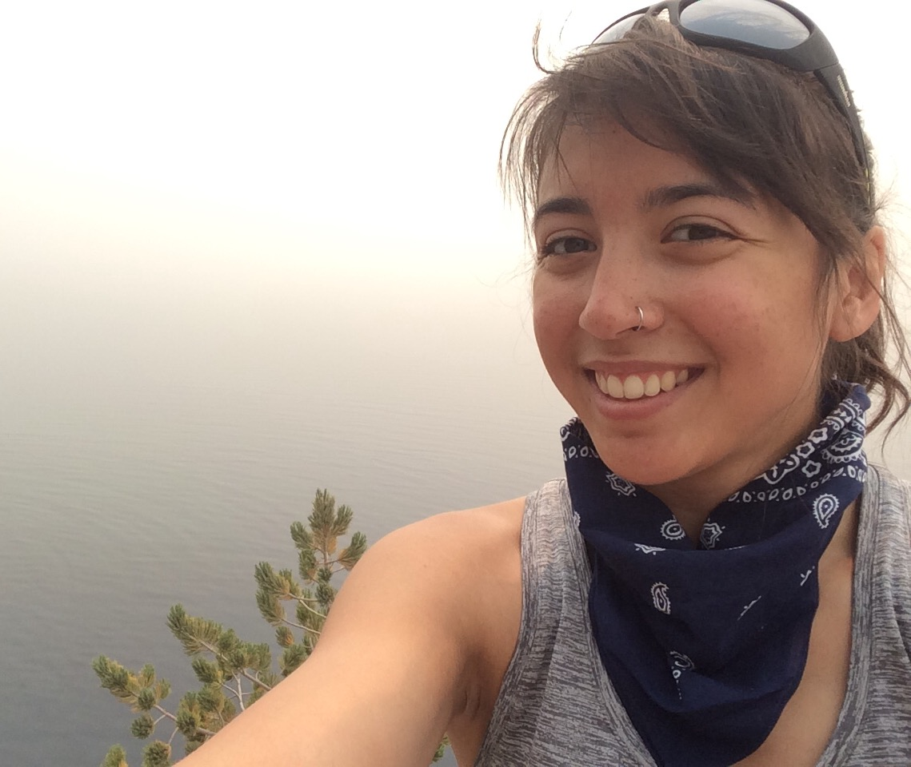
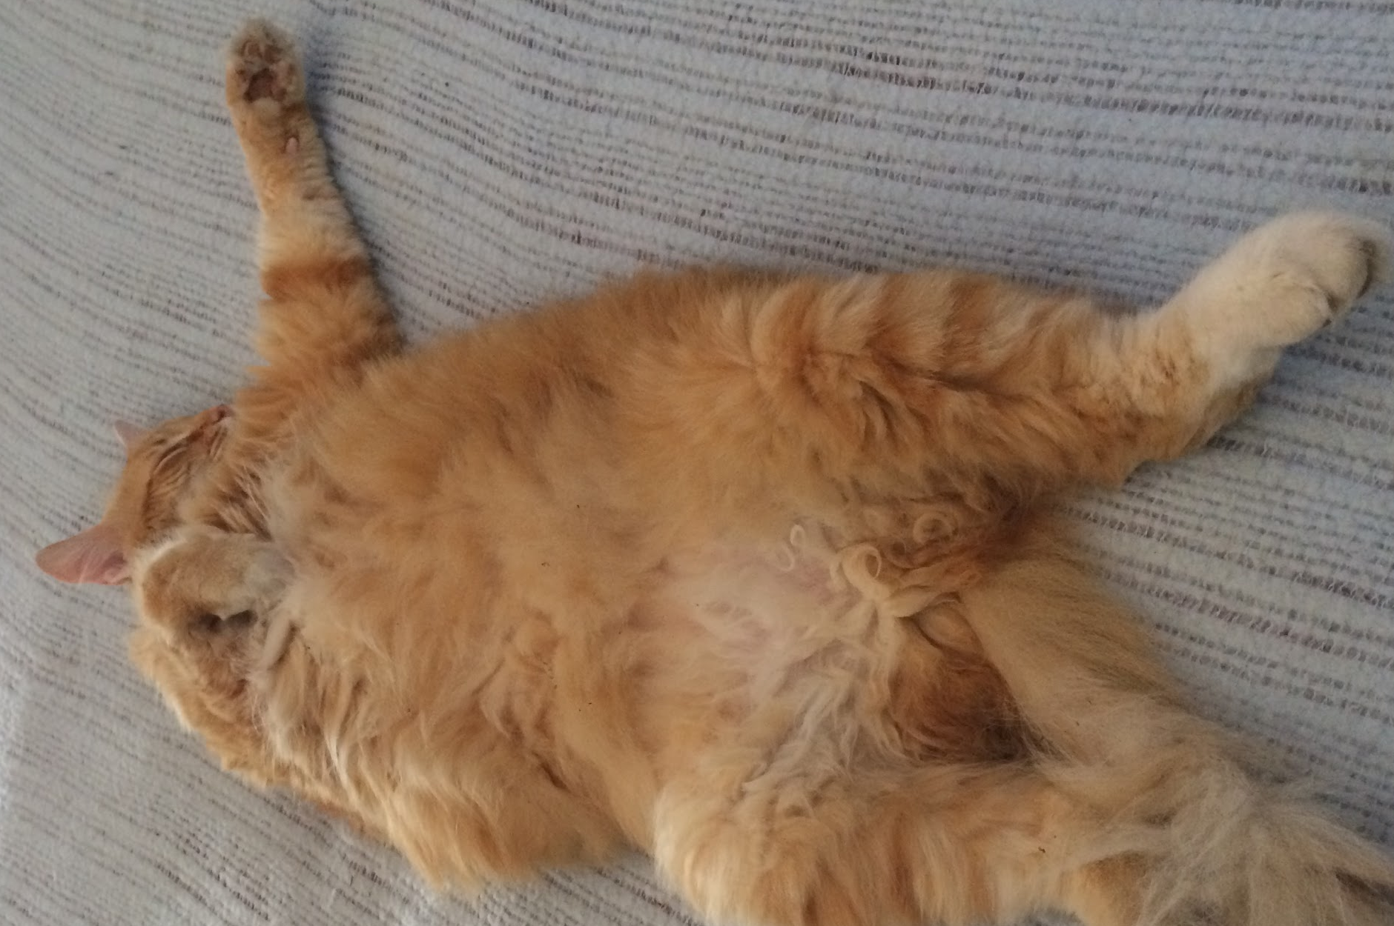
Elsa Harder
Studying Mechanical Engineering with a Minor in Economics

Slide 6
Background

Slide 7
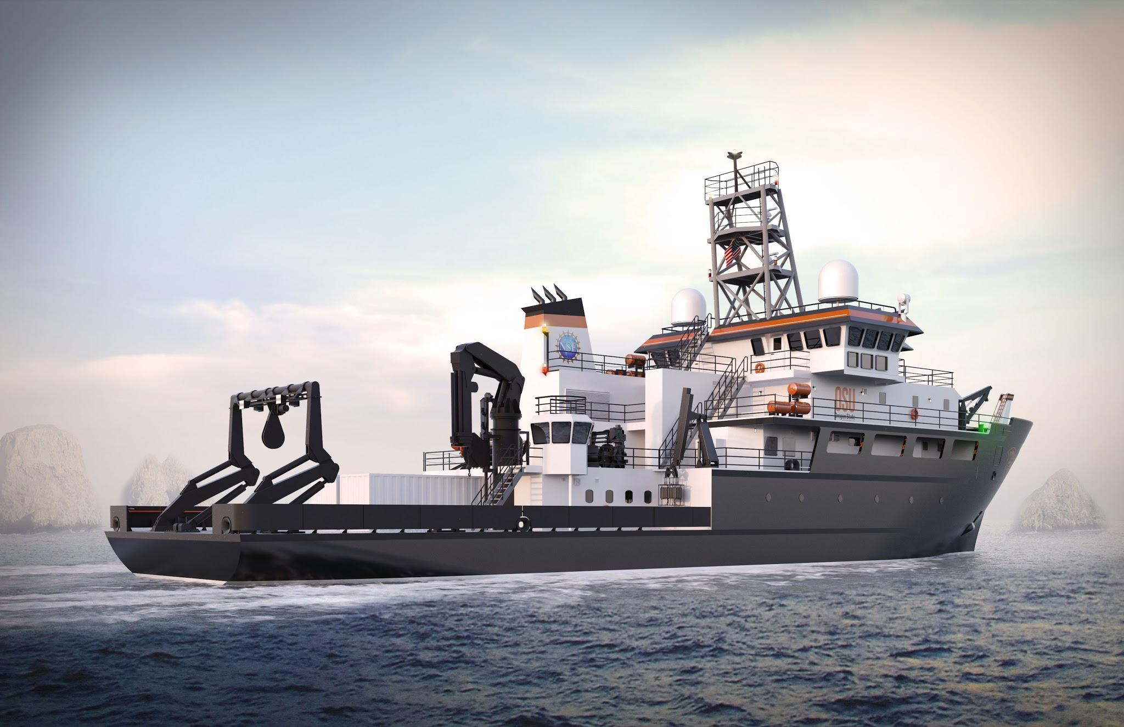

Slide 8
Project
Old LARS

Slide 9
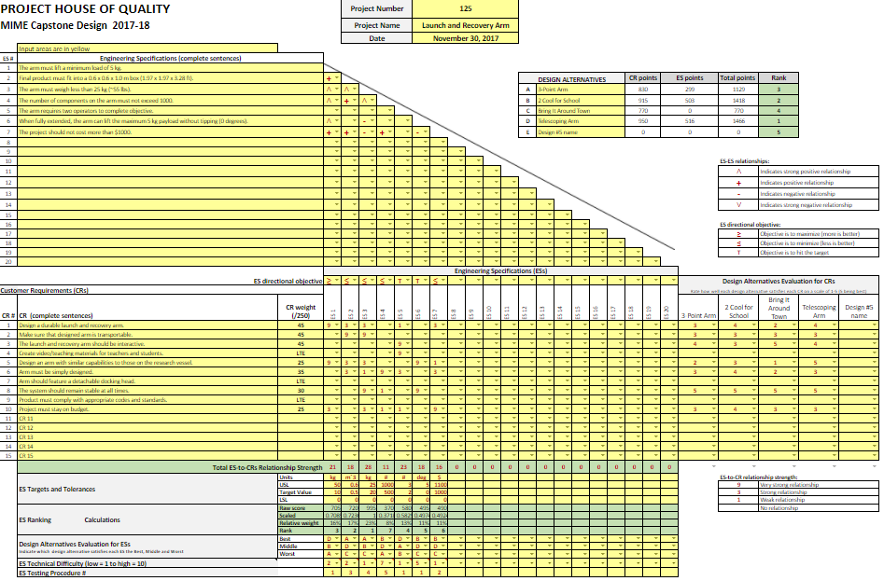

Slide 10
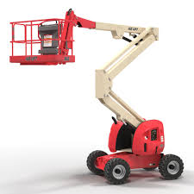
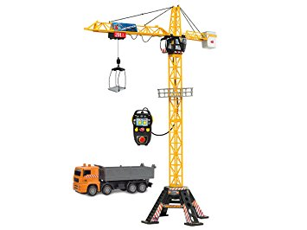
Inspiration

Slide 11
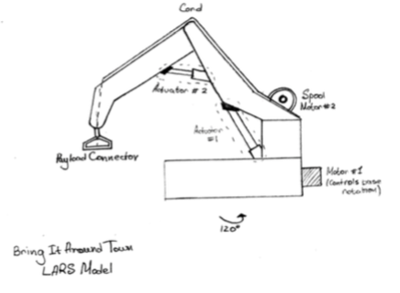
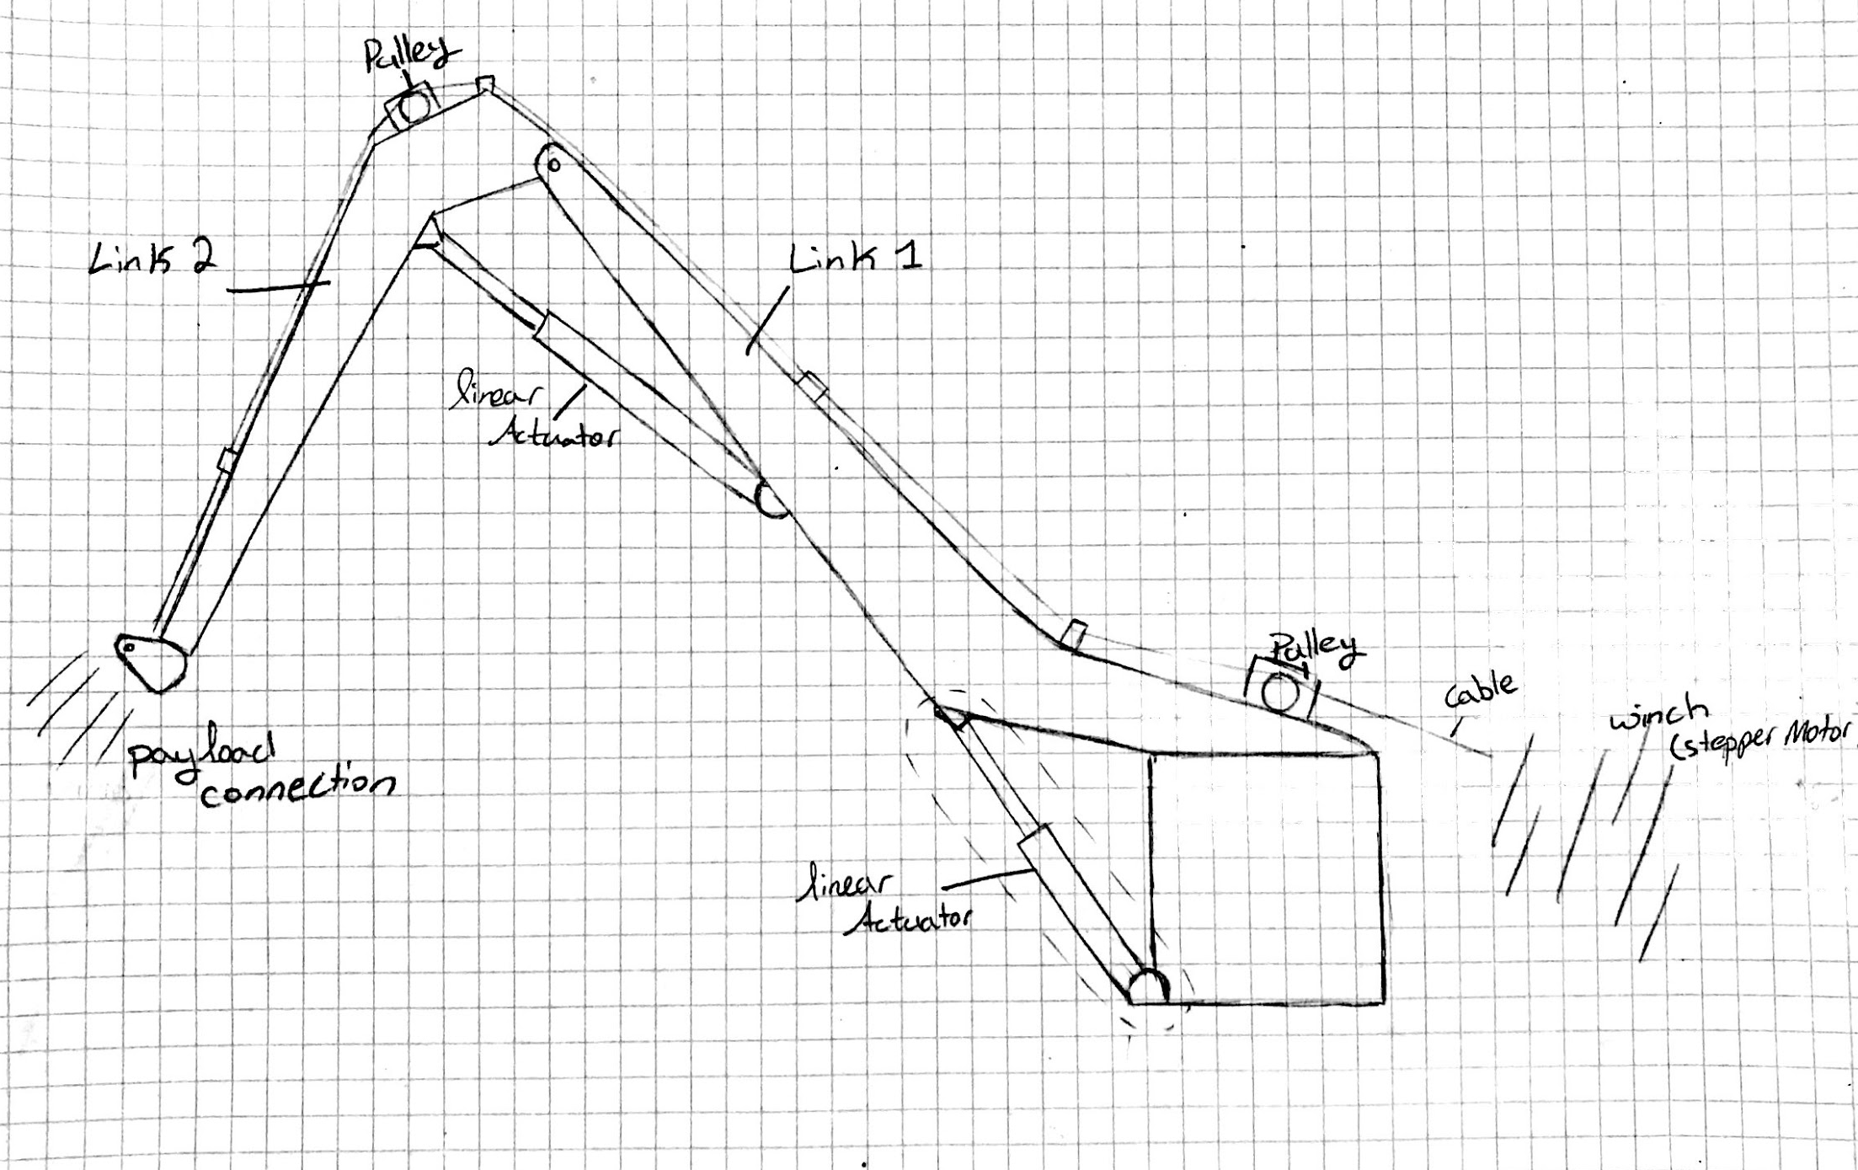
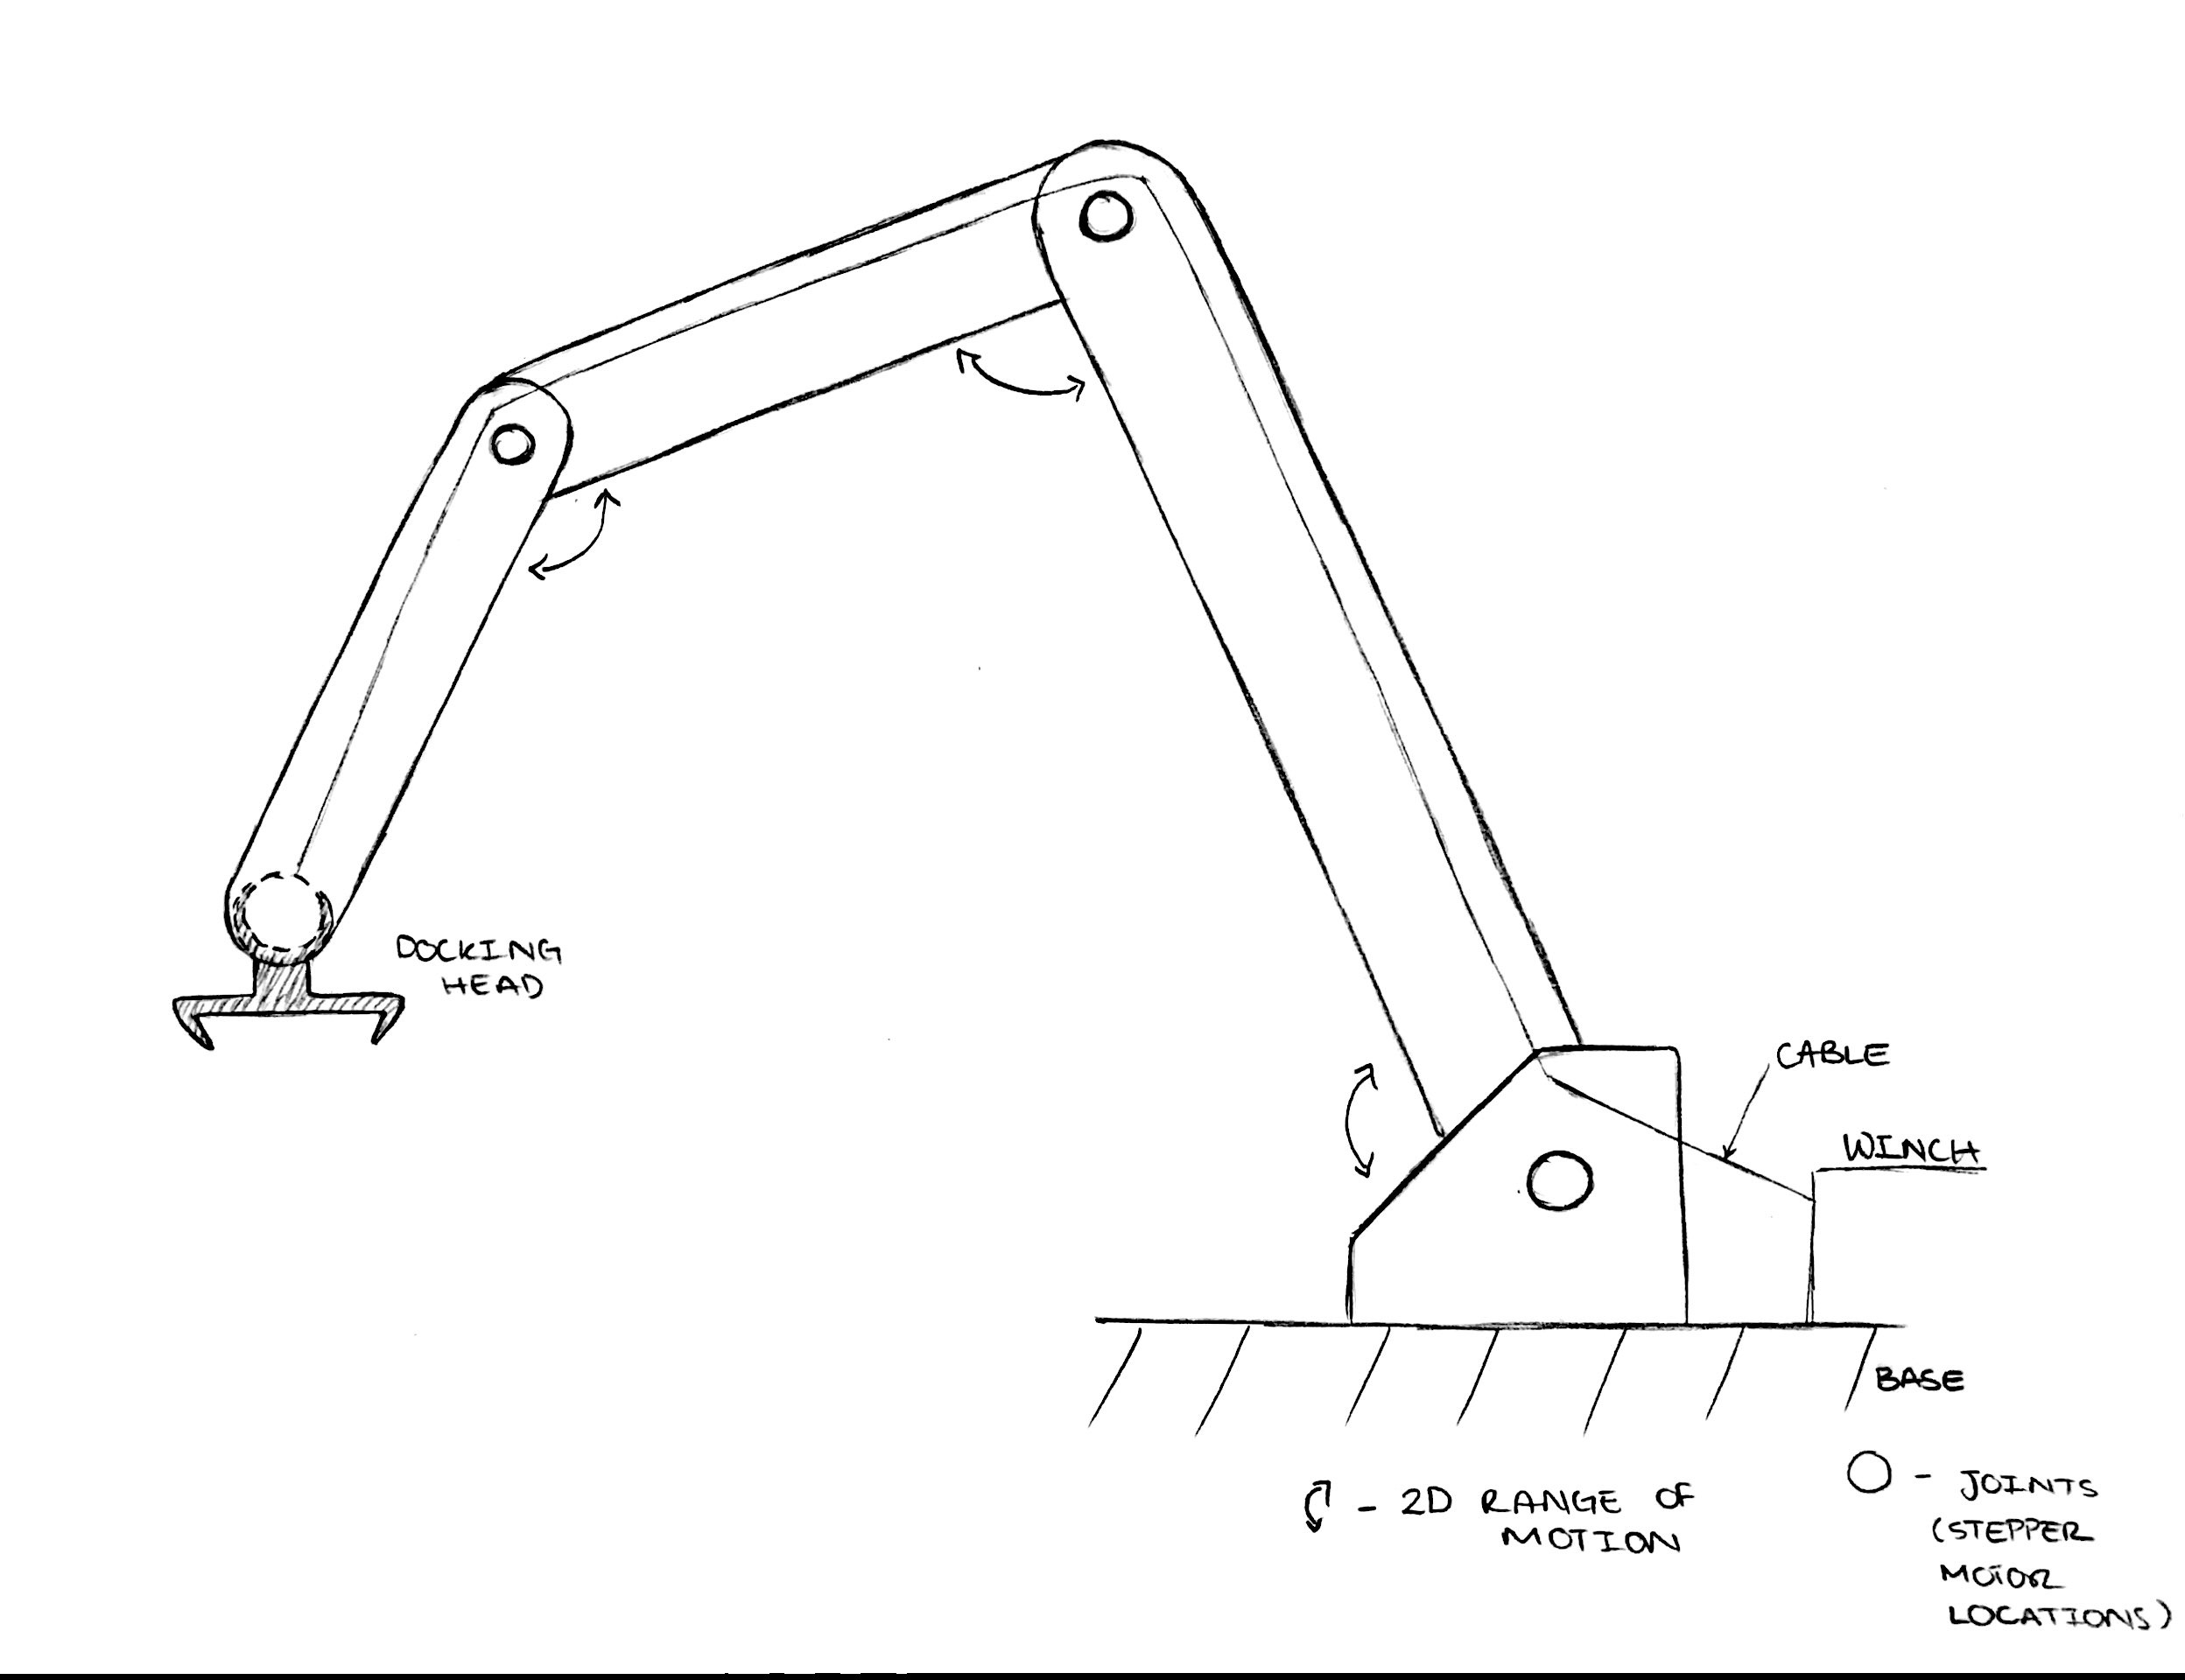
Design Alternatives
1
Bring it Around Town: Rotating Base
3-Point Arm: Three Independent Links
2 Cool for School: Two Independent Links
Telescoping Arm
2
3

Slide 13
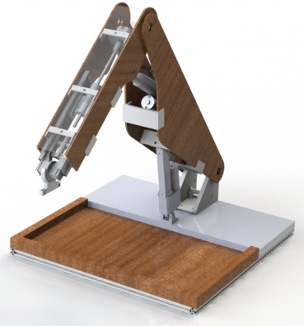
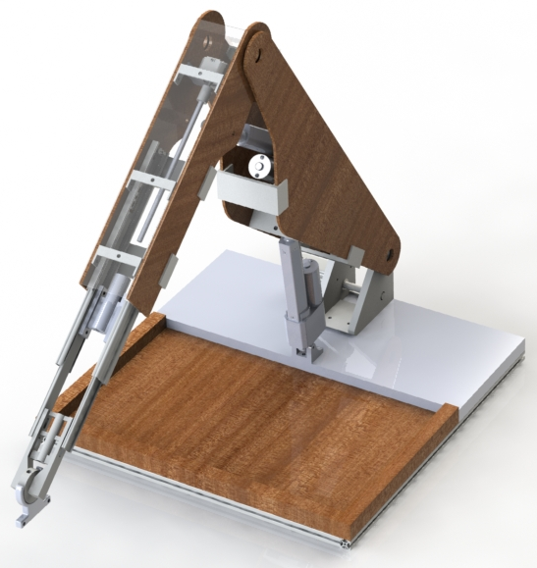

Slide 14
Questions?

