Slide 1
Sea Ice
Tracking sea ice drift
Navigating

Slide 2
Navigating ocean currents and ice drift
In the past many people did not know that there was ice in the Arctic Ocean or that the ice moved.
We first learned this from finding objects that had drifted across the Arctic.
If we are on the ice, we can use navigation tools to track where we drift.
We now can track these drifters by satellite to study ice motion.

Slide 3
How do we navigate?
When we navigate we are finding our way. For example you might navigate from home to a friends house.
How do you navigate?

Slide 4
How do we navigate?
Notes:
GPS is a modern system that gives you your position at any place on the planet. I expect some children will say they navigate by phone, or GPS.

Slide 5
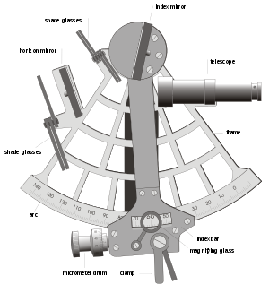
How do we navigate?
A sextant
Phone
GPS
Maps
Compass
Recognizing land marks
Positioning by dead reckoning (knowing your speed and direction of travel) and sextant (using height of the sun in the sky to identify your latitude).
Notes:
GPS is a modern system that gives you your position at any place on the planet.
We also use maps that we can read to identify our location, we might find landmarks on these maps and we probably know how to find places by remembering the landmarks. We use a compass to identify direction.
Sailors use dead reckoning and a sextant to navigate. Dead reckoning requires that you know your speed (which can be calculated by how long a rope – with knots on it – pays out from a ship deck into the ocean as the ship travels – hence ship speed is measured in knots) and direction of travel. You can locate your latitude with a sextant.

Slide 6
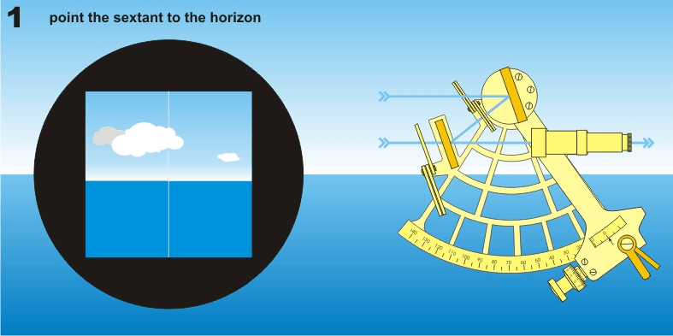
Using a sextant
Notes:
From wikipedia
If you have access to a sextant, this would be a hands on experience for the children to feel how people navigated at sea 50 years ago.
You can make a simple sextant with materials you may have in the class room.
https://solarscience.msfc.nasa.gov/suntime/sxtnt_tchr.pdf
https://solarscience.msfc.nasa.gov/suntime/expt.htm
Use the sextant to measure the angle between the horizon and the north star (which marks the north pole). This angle is related to your latitude. If you have a globe with a latitude scale on it you can see how this works. When you stand on the globe at the equator the star is low in the sky. It is higher in the sky as you go north, until you are at the pole when it is directly over head.
You can make a dead reckoning exercise in the class room. Place a marker on the ceiling (Above the north pole). Measure the angle to this as you move closer to it. At the same time record time and distance travelled. How far did you travel to get to the north pole in meters? How long did it take? How fast did you travel (this is the distance travelled divided by the time to travel that distance). What happened to the angle to the north star as you move to the north pole?

Slide 7
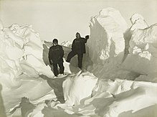
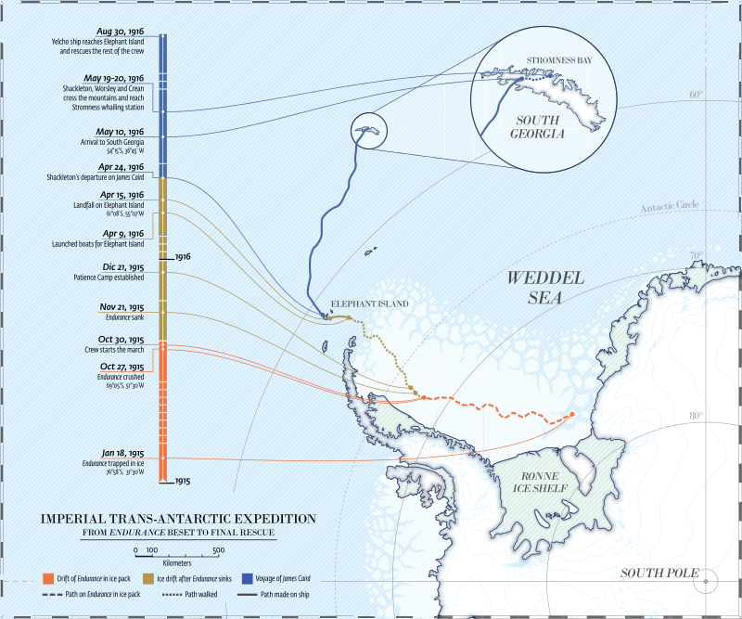
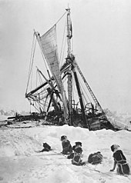
Drift of the Endurance
Notes:
This is a story of exceptional navigation skills.
The Endurance became beset and sank in the Weddell Sea near Antarctica on route to an expedition to cross the Antarctic continent. The expedition then drifted with the sea ice and navigated to Elephant island. They used maps (they knew where the land was), clocks, sextant and compass to keep track of their position.

Slide 8
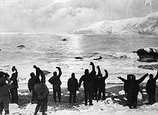
Drift of the Endurance
Notes:
At Elephant island, most of them camped while a small group navigated 800 miles across the open ocean to South Georgia in a life boat to find help. They navigated by dead reckoning, using a compass to track direction and a sextent to find their latitude.
Photographs by Frank Hurley.
Additional resources: The book “Shackleton’s Journey” by William Grill

Slide 9
How did they do this?
No GPS
They had maps, compass, sextant and clocks.
They were very skillful in being able to track their drift as they moved north on the ice, and their navigational skills in crossing the open ocean saved their lives.

Slide 10
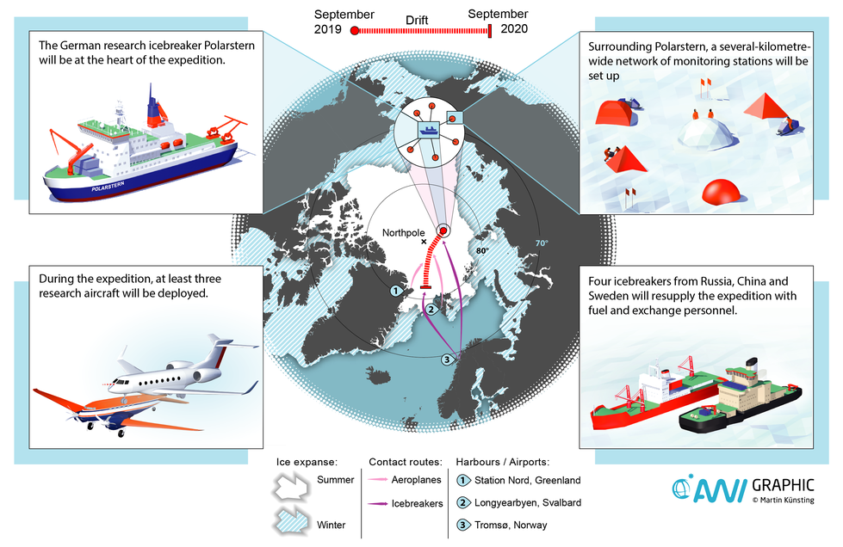
A Modern Ice Drift Experiment
Notes:
We now have GPS, which uses signals received from satellite to identify locations of GPS receivers. As the satellite positions are really well known the position of receivers can be found very accurately (to within meters) from the time the signal travels between satellite and receiver.
The MOSAiC Ice Drift Experiment is a large international effort to study the Arctic Ocean. A ship will be locked in the ice pack, just like the Fram, and will spend a year drifting with the ice. Hundreds of scientists are involved in this experiment. We want to track the ice drift around the ship. You can help us.

Slide 11
We now navigate using GPS.
But I always carry a compass for backup, and track landmarks.
Notes:
We now have GPS that provide accurate to 20m positions. Letting us track ice drift at many locations without the need for a person on the ice measuring the height of stars and tracking time.

Slide 12
You can participate in an ice drift experiment.
Design a drifter to be placed on the ice next to a GPS station, that you can track while it is on the ice. This drifter might one day wash ashore and tell a story of the ocean currents that brought it there.
Notes:
We now have GPS that provide accurate to 20m positions. Letting us track ice drift at many locations without the need for a person on the ice measuring the height of stars and tracking time.

Slide 13
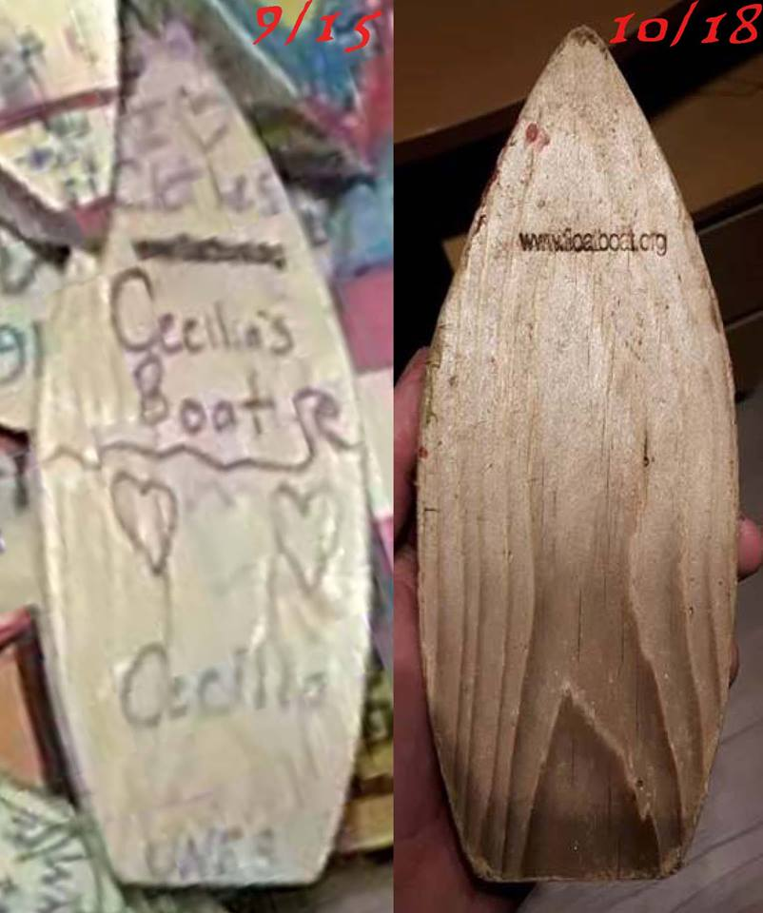
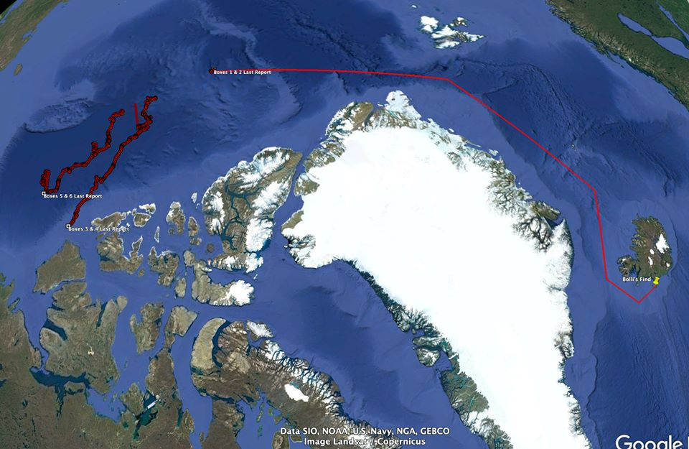
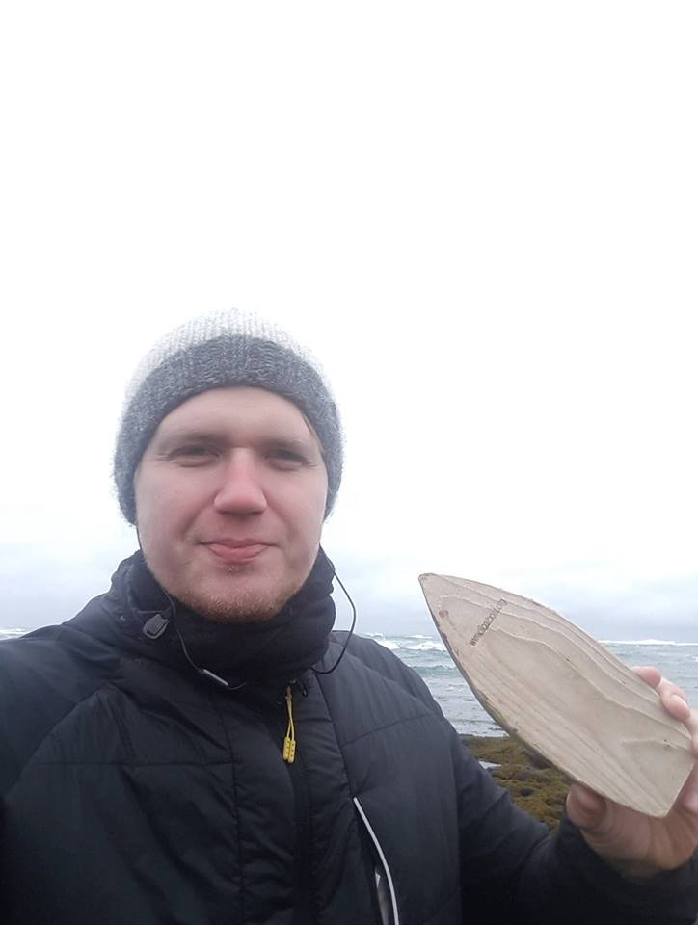
Drifter found on beach
Notes:
From the ‘Float your Boat’ program Facebook page:
Three year and 2,000 mile voyage ends on a beach in Iceland. Cecilia was a student at Upper Nyack Elementary when she decorated the Float your Boat and sent it into the Arctic on the USCGC Healy. As a High School Freshman she learned that her boat was found on a beach in Iceland by Bolli Thor while walking his dog Týra.

Slide 14
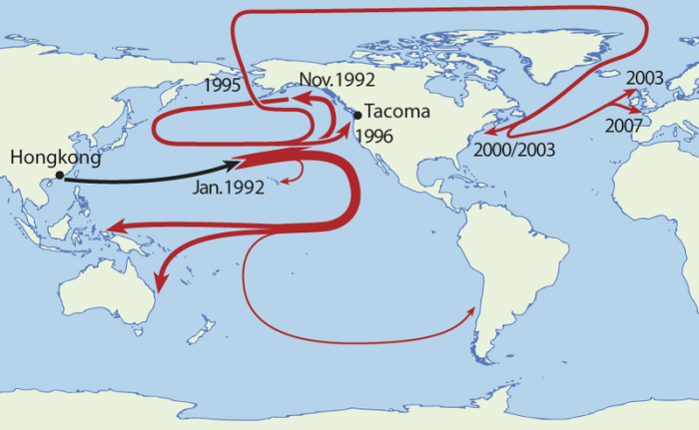
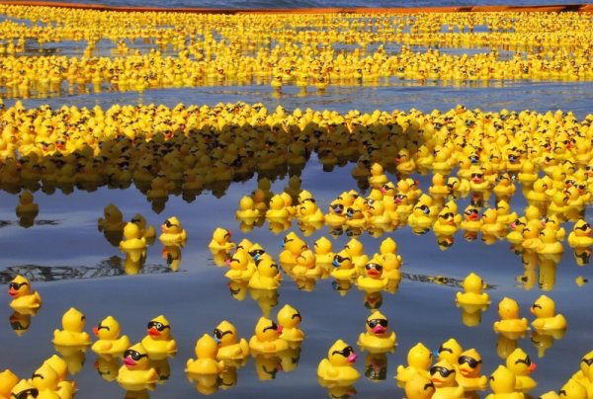
An example of Drifter Science
Notes:
28000 rubber ducks were accidentally lost in the pacific ocean when their shipping crate fell of a ship somewhere between Hongkong and Tacoma, WA. These ducks have been found on various beaches and even in Arctic sea ice. By tracking where the ducks were found and counting them we can learn about ocean currents. We learned that water in the north pacific takes 3 years to make a full circulation from Asia to North American and back to Asia.
https://www.porttechnology.org/news/how_rubber_ducks_reveal_the_ocean_currents

Slide 15
Let’s do some drifter science!
You can make a drifter that a scientist will place on sea ice for you.
You will be able to track where your drifter goes while it is on ice.
Maybe one day someone will find it and we can learn where the ocean currents flowed.

Slide 16
What is the chance your drifter will be found?
Of 28000 ducks that fell into the ocean on January 10 1992, 400 were found by August 1993.
The fraction found is 400 / 28000 = 0.014
We can convert this to a percentage, which is the number found per 100 ducks that fell in the ocean
The percentage found is 0.014 x 100 = 1.4%
Notes:
This means that we expect that for 100 drifters placed on the ice 1 or 2 drifters will be found in 20 months (January 1992 to August 1993).
You can work out a per year rate of finding = 1.4 x 12/20 = 0.6 ducks per year are found. So for 100 ducks falling in the ocean we expect to find a duck every year or two.
If you want, the students can calculate a chance their drifter will be found by giving them some numbers to work with. For example the Float your Boat program has placed 1800 drifters on the ice in 4 years. During which time one drifter was found. What is the chance of a drifter you deploy being found in a 4 year period? What is the chance of being found per year?
Or in 13 years Jenny Hutchings has placed 38 buoys in the Arctic. Of which 1 was found on a beach on the north slope of Alaska. What is the chance of one of Jenny’s drifters being found in 13 years? What is the chance of being found per year?

Slide 17
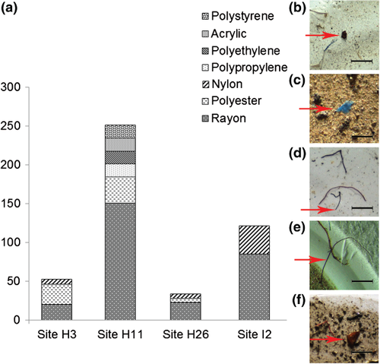
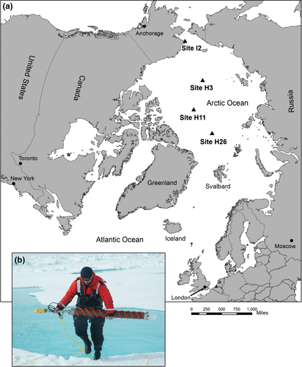
Are we littering the ocean and beaches?
Notes:
Racheal Obbard and her colleagues found plastic in sea ice. The map shows where they took cores from the ice in which they located plastic. The plastic is in the form of very small fibers or particles. The photographs on the right show the plastic pieces. The graph shows how many pieces were found in a liter of melted ice.
Some of the rubber ducks drifter from the Pacific Ocean across the Arctic to the Atlantic Ocean. They must have drifted with the ice when they did this. Are these ducks litter?
Plastic does not decompose, and is found throughout the oceans. It is man-made and endangers some wildlife.
Do we want to design a float that will not add to litter in the ocean?
Figures taken from Racheal’s paper published in Journal of Geophysical Research - Oceans.

Slide 18
Design Specifications for a Drifter
While on the ice, the drifter must not be blown far by the wind.
The drifter must float or sink when not on the ice.
The drifter must survive floating in the ocean.
It must be identifiable so that it might be found.
Someone finding it must be able to tell you they found it.
Notes:
Jenny likes to make buoys that sink, because she wants to only track ice. If the ice melts and the drifter floats she would be tracking ocean currents not the ice drift.
Drifters in the Antarctic might be designed to sink so that they do not wash ashore in places where the ecosystem is protected.
Think about whether you want to litter sea shores. You can talk about plastic not being biodegradable. What materials do not add to the problem of litter or waste in the ocean that endangers wildlife?
Let the children design on whether a drifter should sink or float. Ask them what materials they would like to use. You will be designing the drifter out of found materials. The children could participate in finding these materials.
Hints for a design:
A hole can be drilled in the ice to put an anchor in.
Some materials are heavy enough to stay in place. Ice and snow surface is rough, so your drifter might stay on the ice by friction.
Snow drifts on objects, and snow drifts protect the object from moving under wind.

Slide 19
Engineer a Drifter
What are your design specifications for your buoy?
There will be two tests you can apply to make sure the drifter meets the first two design specifications:
Does the drifter float/sink?
Will it stay in place on the ice?
Notes:
You can use any materials you can find to build the drifter.
What are the students personal design criteria? Get them to write these down. They will need to refer to them. They can then take some time to think about found materials that are suitable to build the drifter from. Ask them how they will test that their drifter meets the design criteria.
Perhaps add a criteria that the scientist needs to wear a big mitten to place the drifter on the ice. It is hard to hold delicate pieces with a big mitten on.
One could add an additional test, immersing the drifter in water to see if decoration washes off.
You could also see how long it takes a drifter to disintegrate if it is immersed in water.
You can put all the drifters together and use your hands to make waves in the water and see if the drifters survive being buffeted around against each other.

Slide 20
A drifter will be placed on the ice next to a GPS buoy. This will happen between August 2019 and March 2020. You will be given a number identifying this buoy. The number will let you track the buoy’s drift on the following website:
http://iabp.apl.washington.edu/maps_daily_table.html
Notes:
Contact Jenny Hutchings jhutchings@coas.oregonstate.edu for information on how to participate in the drift experiment.
At the website look for your buoy id number in the table. Click on this number. This will show you a map of where the buoy has been and where it is now. You might also see data the buoy is measuring, such as the air temperature and pressure.

Slide 21
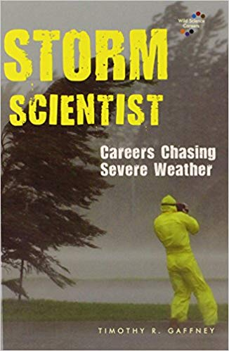
Extra Resources
IABP / Float my boat. A program which places drifters on the sea ice
https://www.facebook.com/explorethearctic/
There is a children’s book that features the author of this presentation.
Contact Jenny Hutchings at
jhutchings@coas.oregonstate.edu

