Slide 1
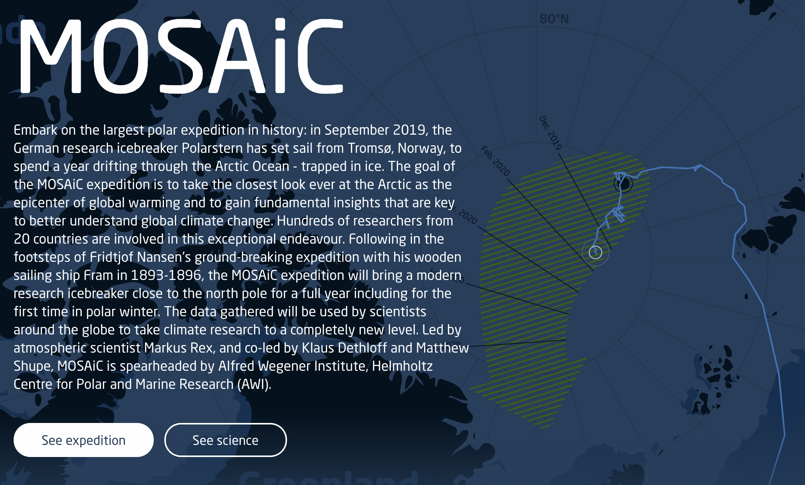
https://mosaic-expedition.org/
Notes:
Multidisciplinary drifting Observatory for the Study of Arctic Climate (MOSAiC) expedition is a modern sea ice drift experiment. Follow the link for more information (as well as addition outreach and curriculum resources).

Slide 2

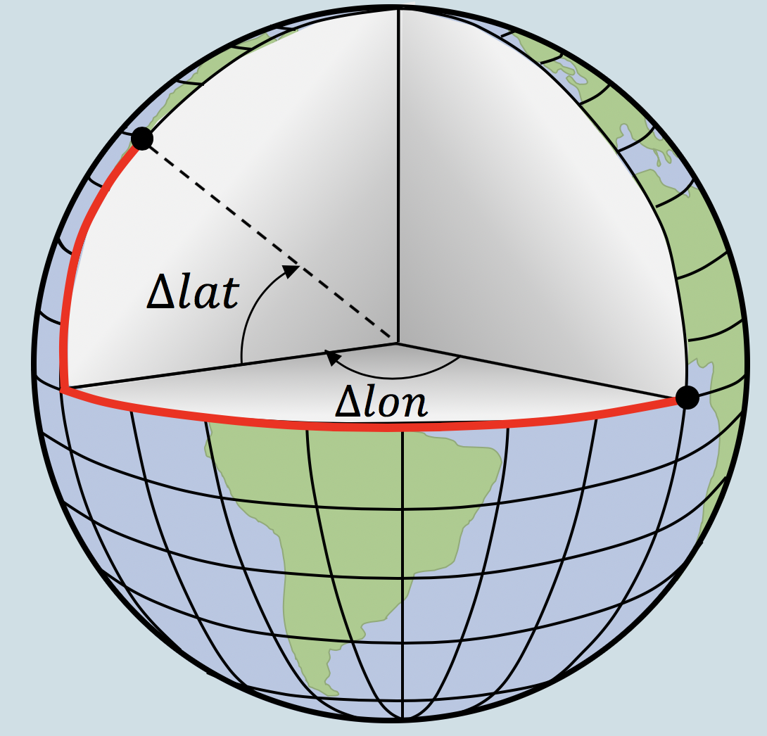
Module 1:
What is Sea Ice?
Module 2:
Building a Forecast Model
Module 3:
Assessing the Model
Sea Ice Drift Curriculum

Slide 3
Module 1
What is sea ice?

Slide 4
Module 2
Building a model

Slide 5
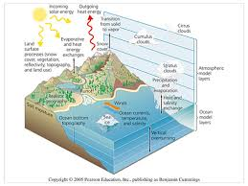
Module 2
Persistence
Climatology
Climate Model

Slide 6
Module 2: Building a model
Ensemble Mean Error
lead time (days)

Slide 7
Module 2: Building a model
Ensemble Mean Error
lead time (days)

Slide 8
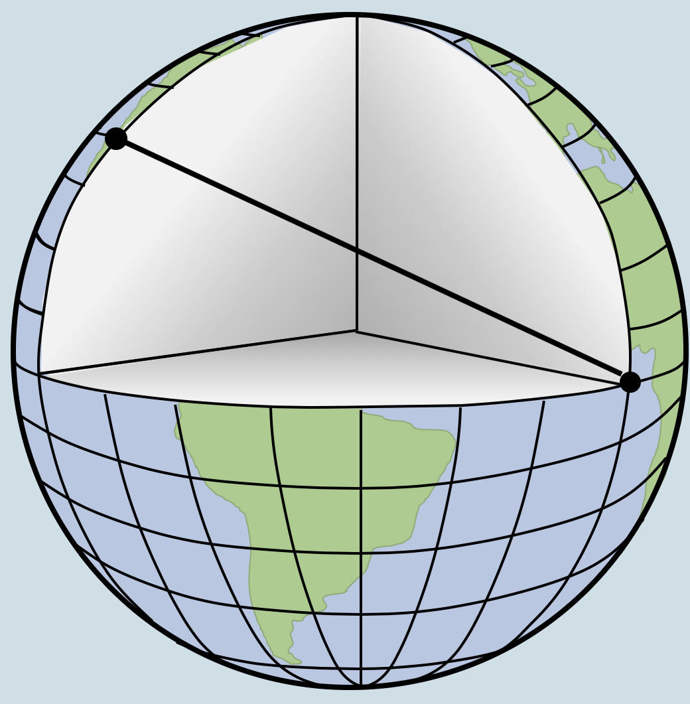
Module 2: Building a model

Slide 9
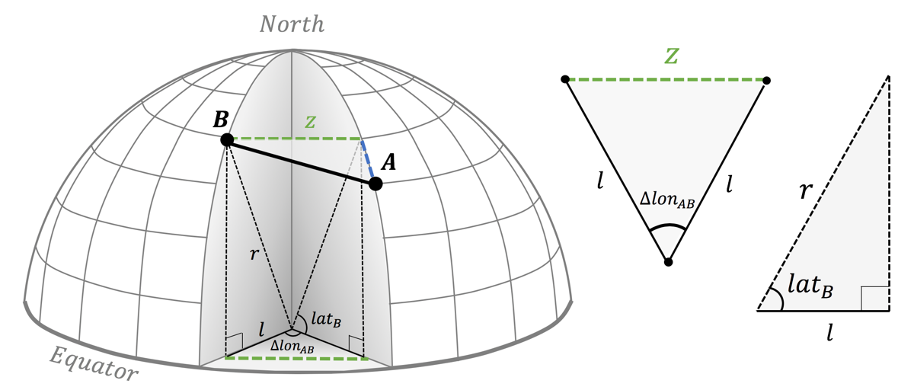
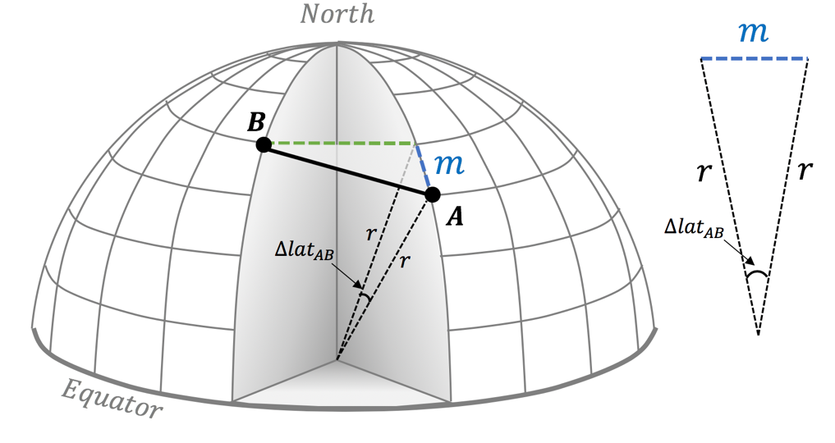
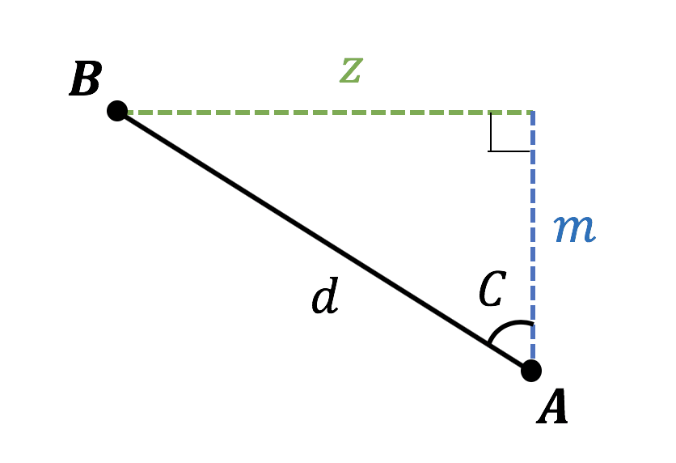
Module 2: Building a model

Slide 10
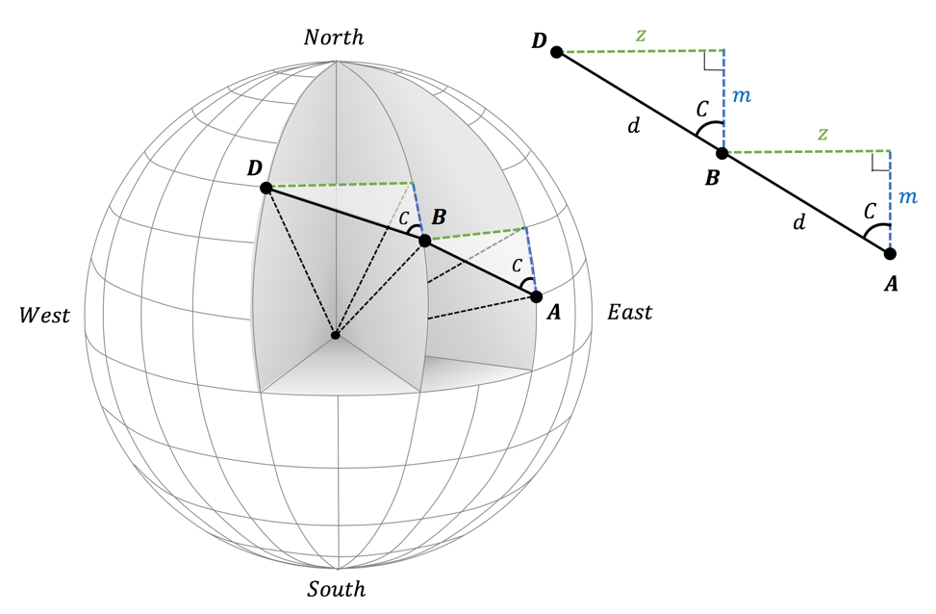
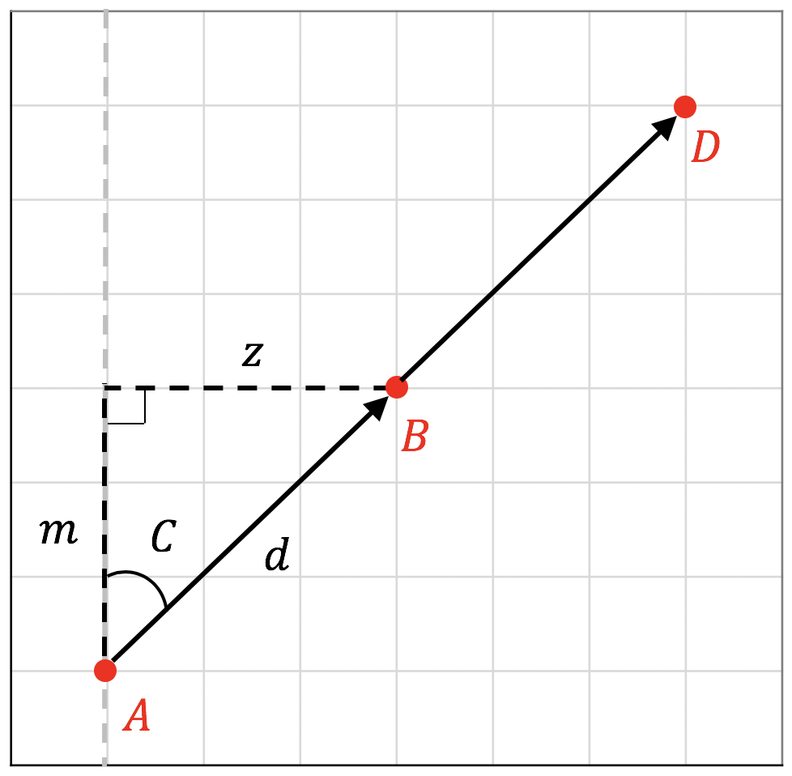
Module 2: Building a model

Slide 11
Module 3
Assessing the model

Slide 12
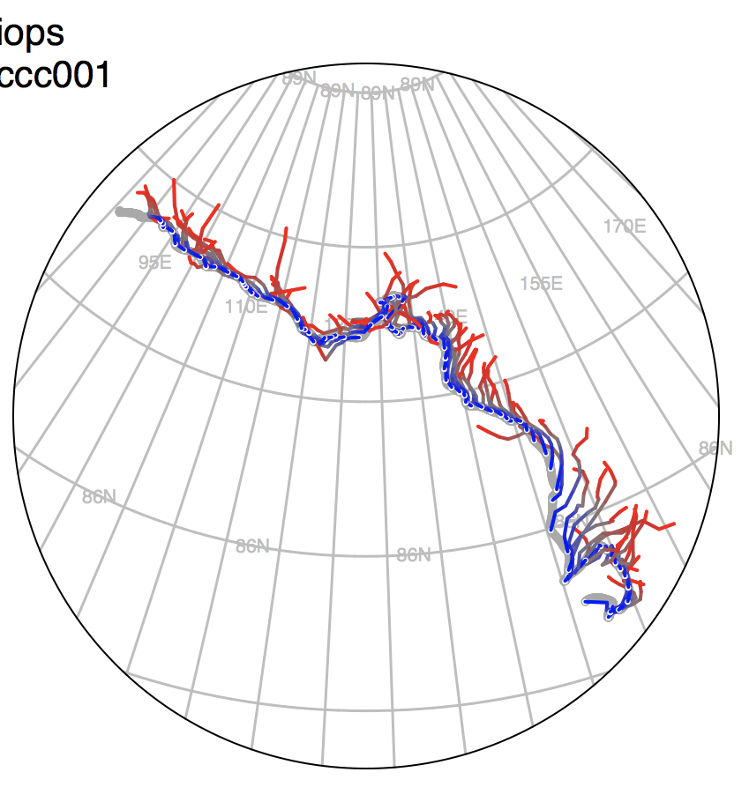
Module 3: Assessing the model
Credit: Sea Ice Drift Forecast Experiment (SIDFEx)

Slide 13
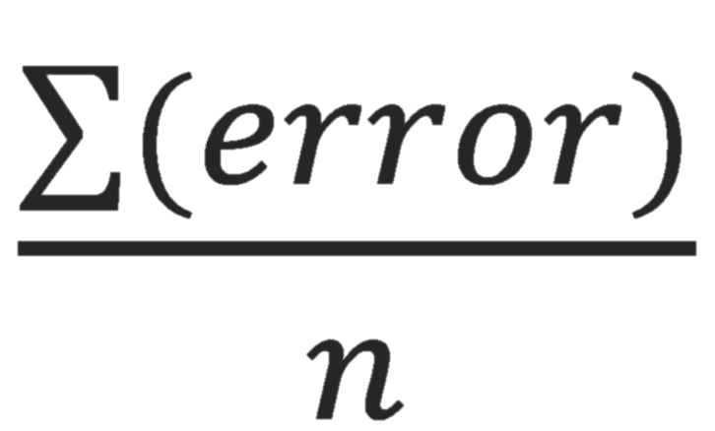
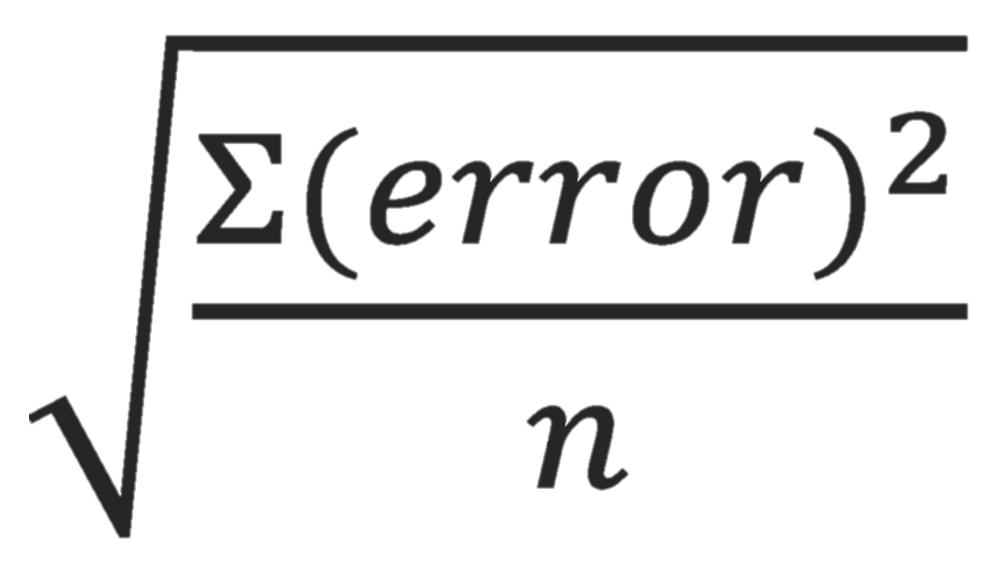
Module 3: Assessing the model
  Model Bias:
  Model Error:
  Sources of error discussed

Slide 14
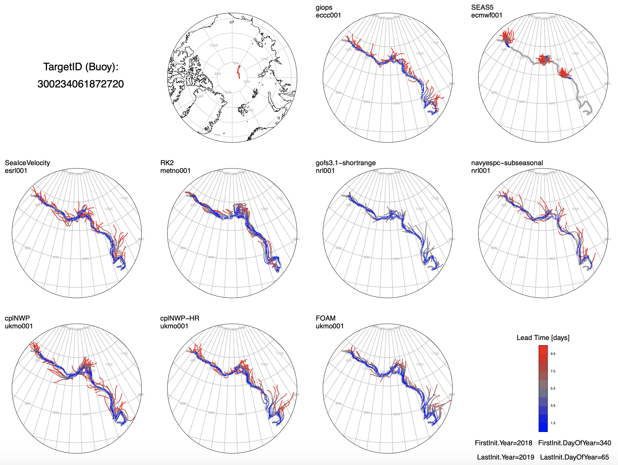
Module 3: Assessing the model

Slide 15
Module 3: Assessing the model
Ensemble Mean Error
lead time (days)
Credit: Helge Goessling, Sea Ice Drift Forecast Experiment (SIDFEx)

