Slide 1
Stream Physics
Integrating hydrology with traditional watershed investigation

Slide 2
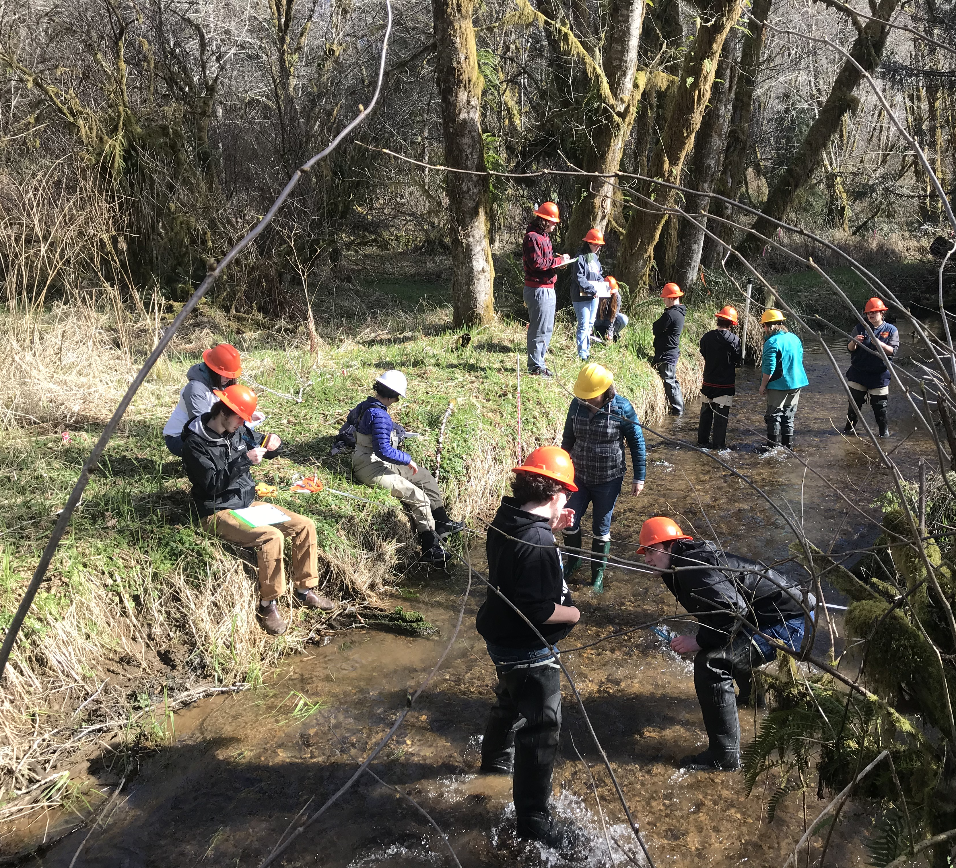
What watershed investigation activities have you engaged students in?

Slide 3
Quantifying the amount of water in streams is important for:
Water supply
Flood control
Water quality
Aquatic ecosystem
Water moves sediment in the streams

Slide 4
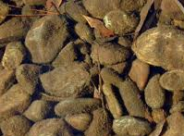
Primary producers in streams
Biomass Accrual
RESOURCES
DISTURBANCE
Nutrients
Substratum stability
Light
Velocity
Temperature
GRAZING
Macroinvertebrates
Fish
Biomass Loss

Slide 5
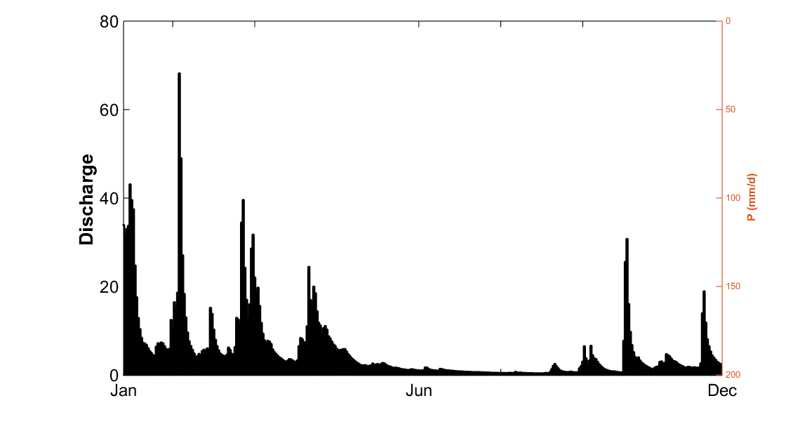
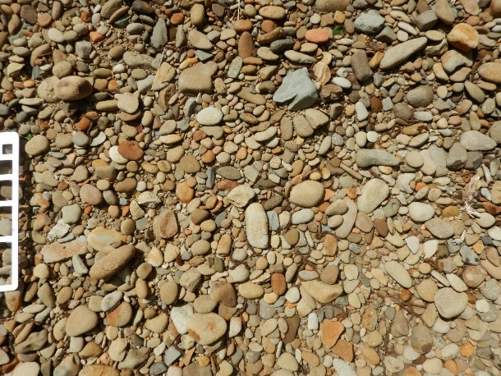
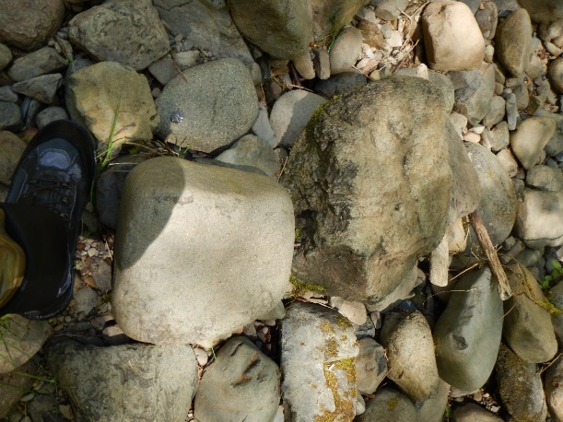
Rocks
(soft or hard)
Frequency of sediment transport events
Abundance of small particles in the channel bed (sand)
Flow regime
Disturbance
(movement of particles of different sizes)
1. Movement of large particles
2. Abrasion of algae from substrata
Notes:
The importance of each of these mechanisms depends on the hydrologic regime (temporal), the lithology (availability of sand particles), and the spatial variability of shear stress.

Slide 6
Watershed Investigation in your SMILE clubs:
Session #1: Discovering You Watershed—Overview of watersheds, methods, logistics, and goals for the watershed investigation.
Session #2: Visiting your watershed/collecting data: Macros, water quality, stream width, depth, flow, and pebble count.
Session #3: Making sense of data—determine discharge, determine D₅₀, compare macro and water quality results
Session #4: Revisit your watershed—Collect same data as before for compassion, and distribute D₅₀ rocks
Session#5: Present findings to stakeholder group

Slide 7
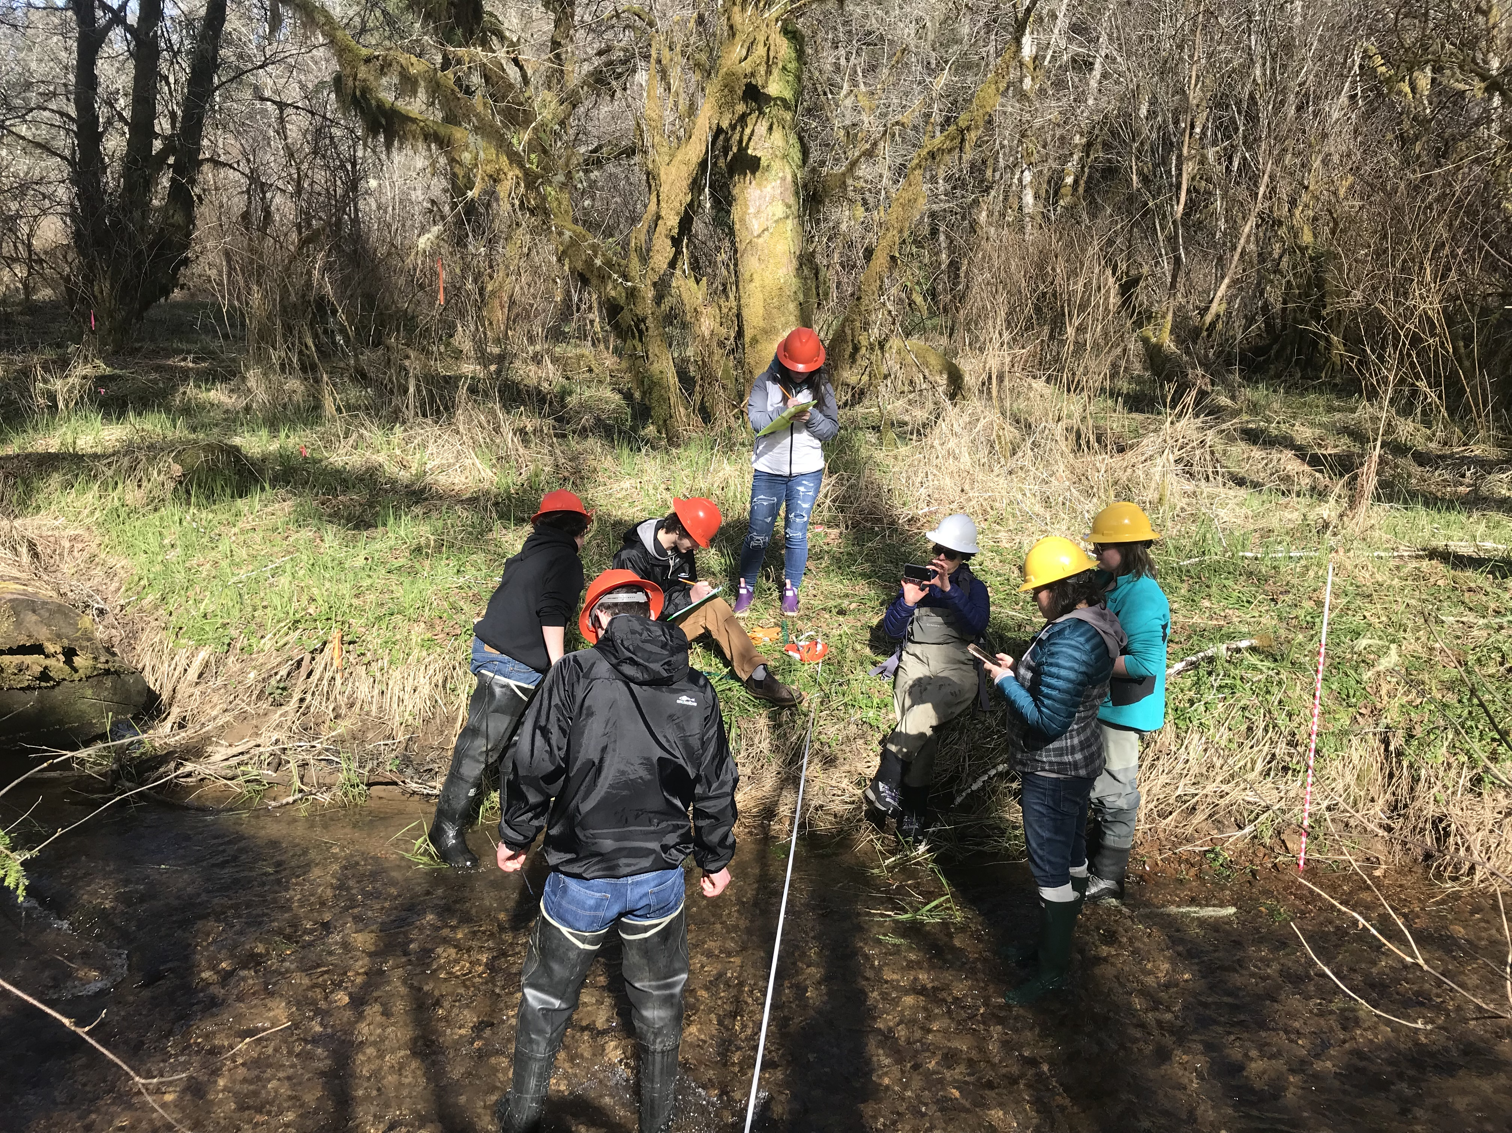
Resources to use:
Stream webs curriculum
Stream Physics lesson and worksheets
Local water and soil conservation district
Extension office
Federal and local agencies

