Slide 1
Innovating at the Boundaries
Advancements in Technology and the Patenting Process

Slide 2
What is next?

Slide 3
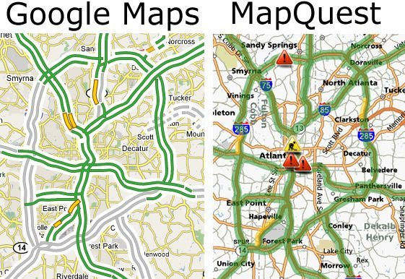
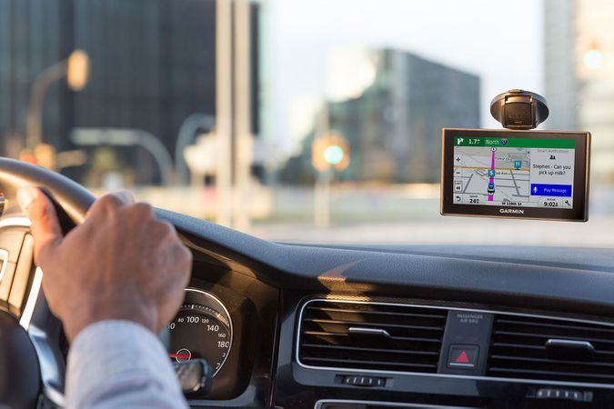
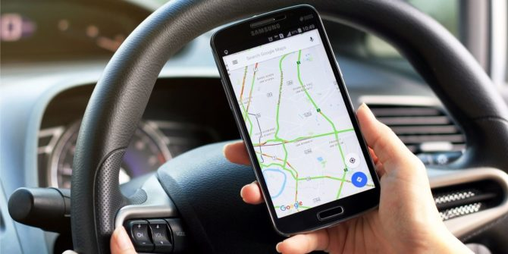
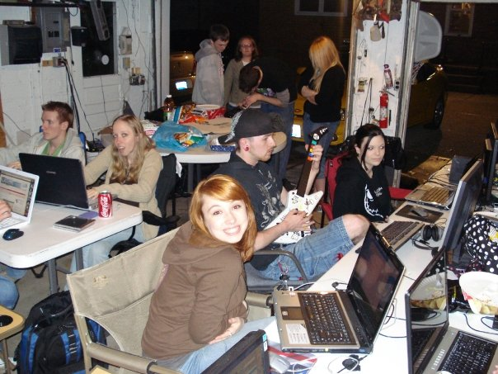
Innovation occurs by enhancing existing technology to meet “emerging” needs/wants

Slide 4
Many times professionals need to innovate to solve problems related to their work
Who are these “professionals” ?
Athletes AND…
Notes:
https://www.youtube.com/watch?v=x6VWOMRHm48&feature=emb_title

Slide 5
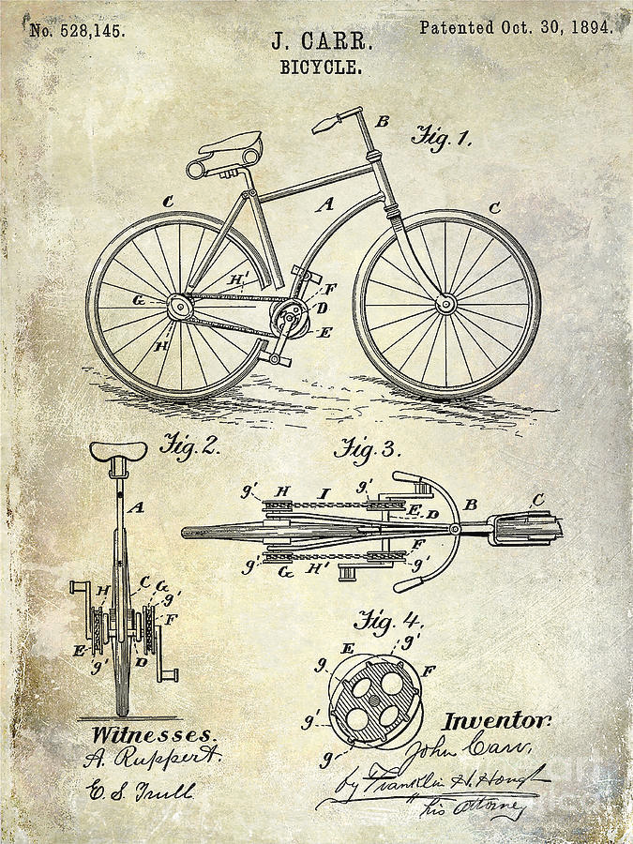
Patents document innovation
Why?

Slide 6
What is a patent?
A patent has…
Details
Numbers
Pictures
Language
Diagrams
Dates
Name(s)
Claims
Legally binding document of ownership for
“Intellectual property”
Science of Innovation
Notes:
https://www.uspto.gov/kids/videos.html – science of innovation video

Slide 7
Spot the Invention
A (1-12)
B (13-25)
C (1-8)
D (9-21)
Notes:
https://www.uspto.gov/kids/spot.html

Slide 8
Share Out
Name of the product/process
Name of the inventor(s)
Number and Date of acceptance
Pages
1 interesting thing you learned
Have you seen the invention before?

Slide 9
A Companion for GeaRS, The Robot Cat

Slide 10
I claim:
1. A toy for a pet comprising:
An elongated mobile device having a front and back end;
A head attached to said front end and legs attached to said back end;
A tail attached to said back end;
A means for pulling said toy.
2. They toy as claimed in claim 1, wherein said device has a means for pulling and
moving said toy.
3. They toy as claimed in claim 1, wherein eyes and ears are attached to said head.
4. They toy as claimed in claim 1, wherein said tails is any color such as pink, red, green, excluding white, yellow or blue.
5. They toy as claimed in claim 1, wherein said means of moving the toy attaches to the legs.
6. They toy as claimed in claim 1, wherein said means of pulling must be attached to the front end and must be at least 4 inches long.

