Slide 1
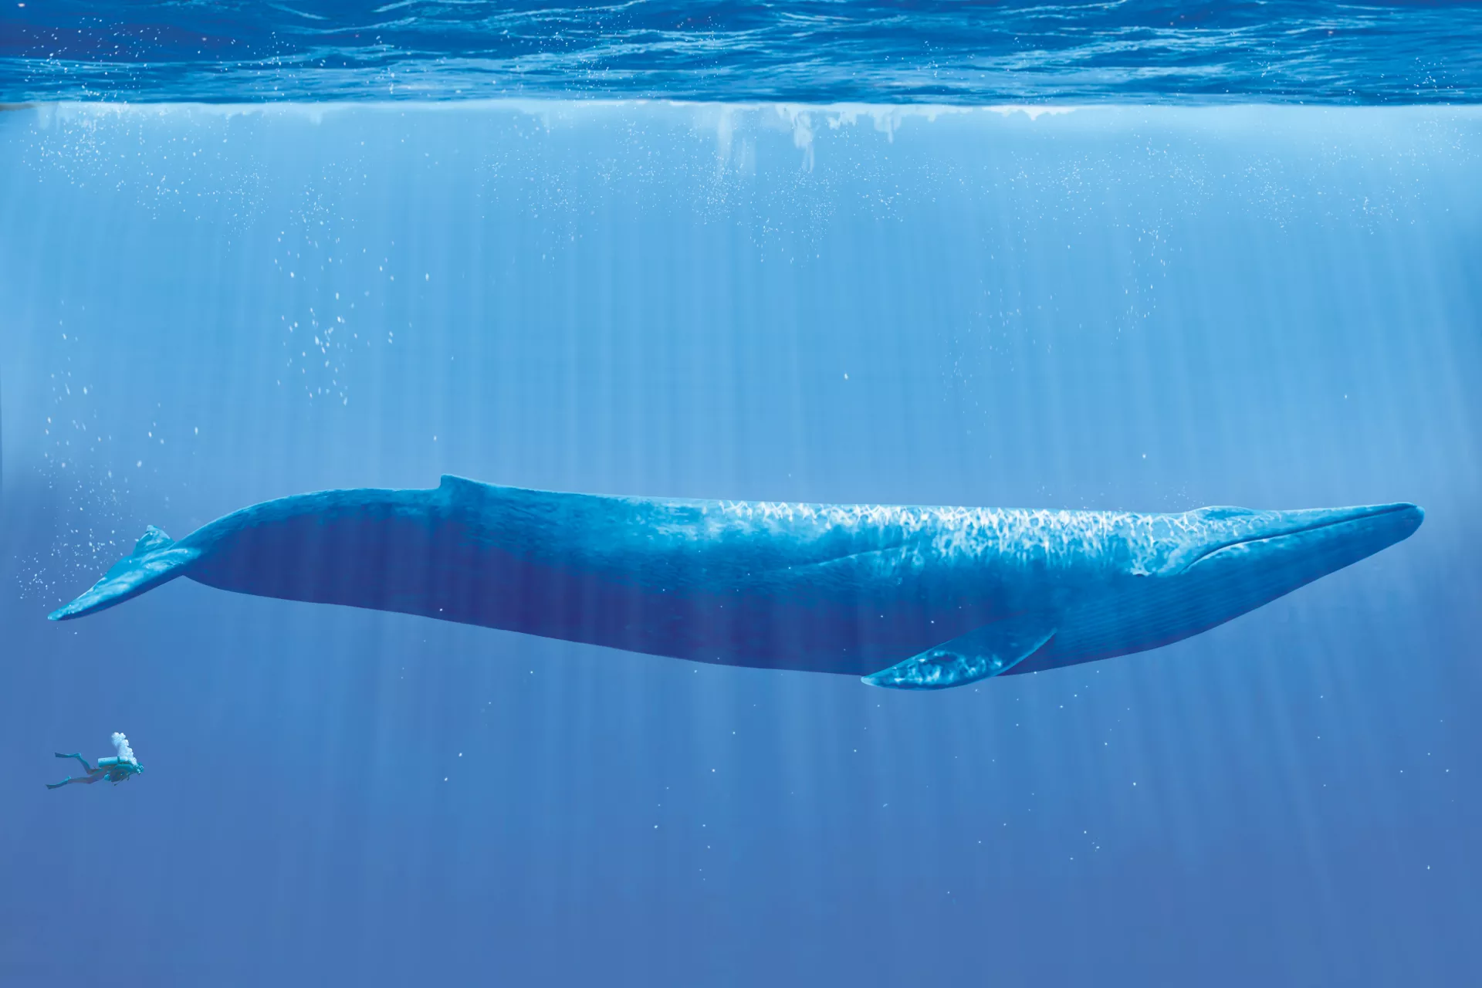
Voices from the deep

Slide 2
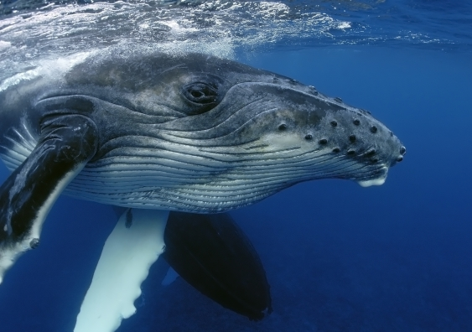
Why Do We Study Whales?
There is still a great deal of things we don’t know about them
They play important roles in the food chain of the ocean
Many species are threatened by human activity
The more we learn about them, the better we can protect them!

Slide 3
What are Cetaceans?
Whales are known as Cetaceans – which means they are classified in the order “Cetacea.” Cetacea also includes all dolphins and porpoises as well.
There are approximately 80 species of cetaceans currently identified.
We have 10 species that live off the coast of Oregon
There are two suborders of cetaceans – Odontoceti and Mysticeti

Slide 4
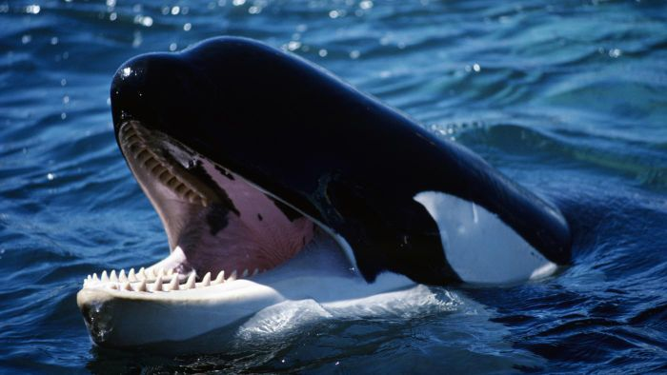
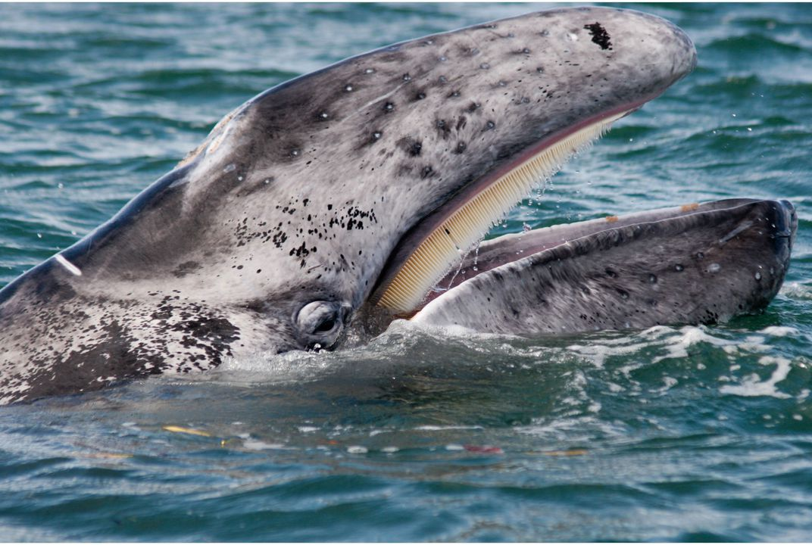
What is the difference?
Toothed Whales (Odontoceti) | Baleen Whales (Mysticeti)
Odontoceti means “tooth whale” | Mysticeti means “mustache whale”
Bodies are usually smaller, so they can save energy for hunting. (Smaller body = less food!) | Bodies are usually very large, because their food is everywhere. (Big body = lots of food!)
Use sound (whistles and clicks) | Use sound (songs, groans, grunts, squeals)
 | Don’t have the special brain structure OR vocal chords – scientists aren’t sure how they do it!
Make sound using a special structure in the brain

Slide 5
Cetacean vocalization
All whales make noise! But, just like humans have different voices and different languages, so do different whale species!
Take a listen to the examples below, comparing Odontoceti and Mysticeti noises

Slide 6
ACTIVITY
Why do you think whales vocalize?
To communicate with pod members
To warn others
To find a mate

Slide 7
How do we communicate?
Listen to each of the songs.
What type of music is it?
What is the message being communicated?
How do you know?

Slide 8
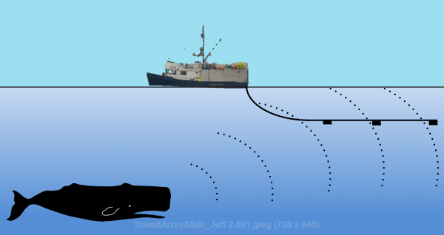
How do Scientists hear them?
You are going to have the chance to listen to three species of local whales. How do you think scientists heard them in the first place?
Scientists use “hydrophones,” large underwater microphones to pick up and record whale noise!
Hydrophones can be towed behind a ship or placed on the seafloor.
Marine Mammal Scientists from Oregon State University just placed two large hydrophones on the seafloor off the coast of Oregon!

Slide 9
Voices from the deep
Listen to the clips below of local baleen whales – what kind of sounds do you hear? What are they communicating?
BLUE HUMPBACK GRAY

Slide 10
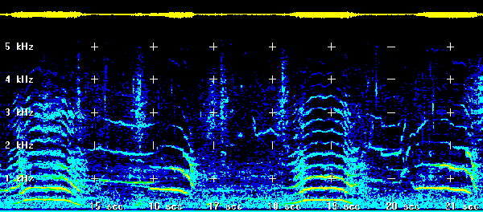
HOW CAN WE VISUALIZE SOUND?
Scientists make “spectrograms” to help them visualize changes in the sound they recorded. They organize sounds by frequency.

Slide 11
Make your own spectrogram
Listen to the sounds below again and practice making your own spectrogram

Slide 12
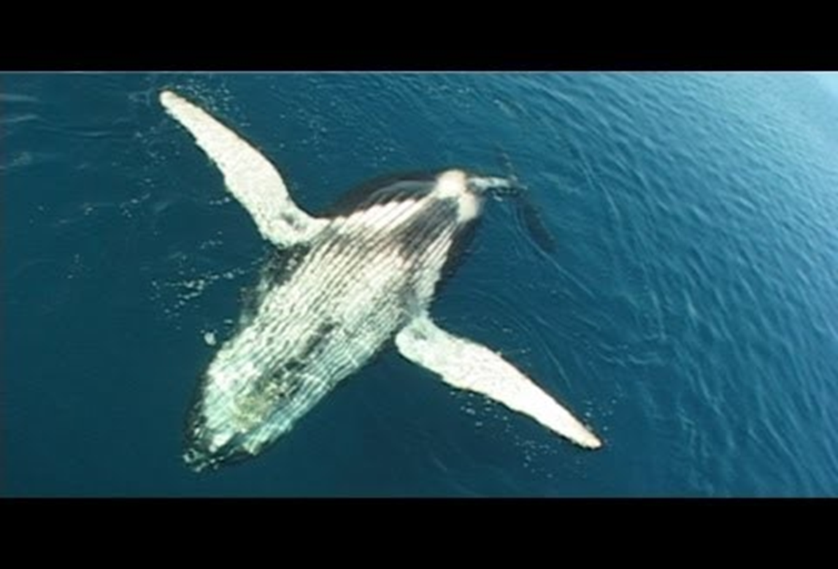
DECODE THE SONG
Listen to the song below again, this is a male humpback singing. The male Humpback is actually the only whale that sings!
Write your own lyrics for what you think he is singing
WHAT is this whale singing about?
WHERE is the singing taking place? (Describe the environment.)
WHO is the whale singing for?

Slide 13
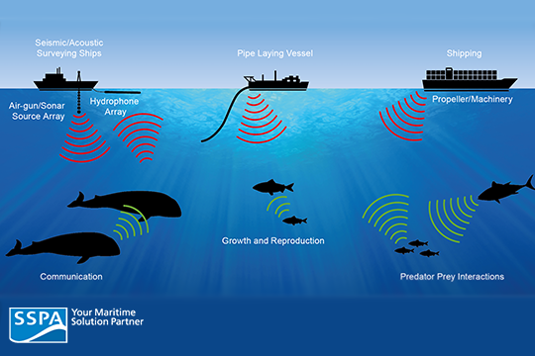
Discussion
Why is it important for scientists to study whale vocalizations?
How do you think human-caused noises in the ocean affect cetaceans?

Slide 14
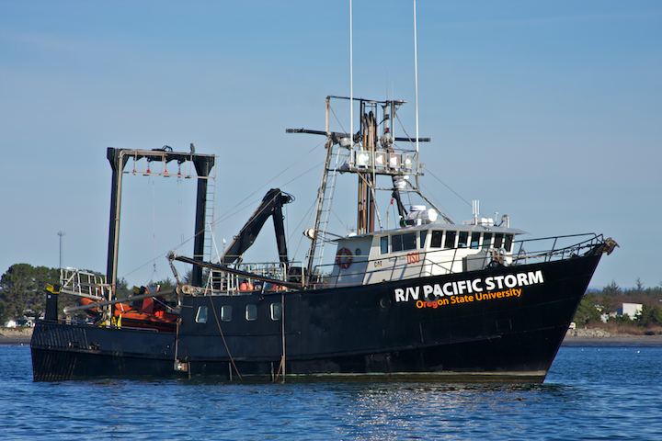
DISCUSSION
Oregon State University is conducting multiple research studies regarding sound and cetaceans.
Blue Whale ecology in New Zealand
How Cetaceans might use sound to find food
How noise levels might affect hormone levels and body condition of Gray Whales.
OSU recently dropped two hydrophones off of the Oregon Coast

Slide 15
Resources
https://www.google.com/search?q=humpback+whale&rlz=1C1CHBF_enUS722US722&source=lnms&tbm=isch&sa=X&ved=0ahUKEwi4zM6QmOPbAhWRHnwKHViFBtMQ_AUICigB&biw=650&bih=550#imgrc=G03hjGASDziU6M:
http://www.environment.gov.au/marine/marine-species/cetaceans/whale-dolphins-sound
http://us.whales.org/whales-and-dolphins/facts-about-whales
https://www.google.com/search?q=hydrophone&rlz=1C1CHBF_enUS722US722&source=lnms&tbm=isch&sa=X&ved=0ahUKEwj-hfGepePbAhVpjVQKHTiRCj0Q_AUICygC&biw=1242&bih=577#imgrc=zhGnC9KGCZ2zAM:
https://www.google.com/search?rlz=1C1CHBF_enUS722US722&tbm=isch&q=spectrogram+whale+song&chips=q:spectrogram+whale+song,online_chips:humpback+whale&sa=X&ved=0ahUKEwjb79mrp-PbAhWCHHwKHUaBDAUQ4lYIKygD&biw=1242&bih=577&dpr=1.1#imgrc=aD5SW75-9hFzCM:
https://www.google.com/search?q=vessel+noise+effects&rlz=1C1CHBF_enUS722US722&source=lnms&tbm=isch&sa=X&ved=0ahUKEwjQws_oqePbAhWKCnwKHaTaAWsQ_AUICygC&biw=1242&bih=577#imgrc=9Ih9aKzmmBq8HM:
https://www.google.com/search?rlz=1C1CHBF_enUS722US722&biw=1242&bih=577&tbm=isch&sa=1&ei=uxcsW8vVJ5G98APYipqYDQ&q=the+pacific+storm+vessel+osu&oq=the+pacific+storm+vessel+osu&gs_l=img.3...1374.3103.0.3273.11.11.0.0.0.0.62.512.11.11.0....0...1c.1.64.img..0.0.0....0.9cBMPgra_M0#imgrc=YwWUqBCwQDSmKM

