Slide 1
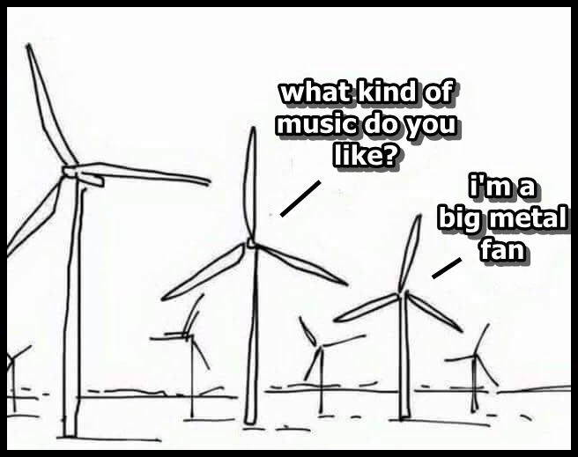
Outline
Introductions
Name, Club Level, Community, yrs with SMILE
Thumb Meters and Windmills
Windmills & NGSS (modeling)
Windmill info (mirrors student slides)
Making Windmills! (What team will produce the most power?)
Blades, math, revisions
Student Handout
Debrief

Slide 2
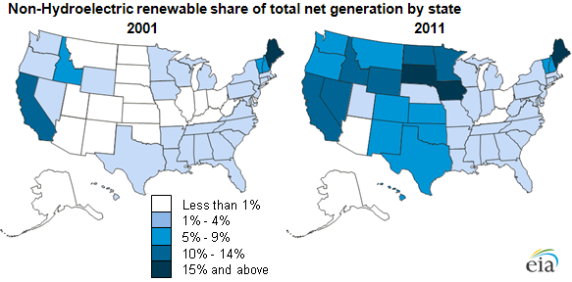
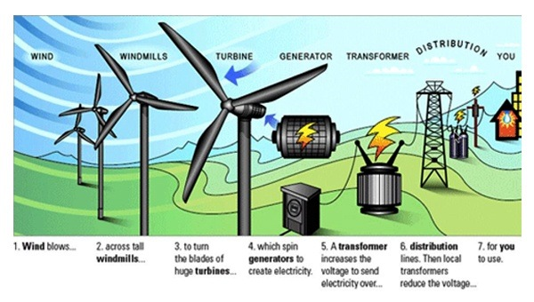
Windmills, ngss, & engineering
Energy: We don’t create it, we convert it
Wind Energy is the fastest growing renewable Energy in OR! Number 2 state in the U.S.!

Slide 3
How could you be using WINDMILLS in your class?
CAREER
CONTENT
CONNECTIONS
Windmills
Think
Pair
Share

Slide 4
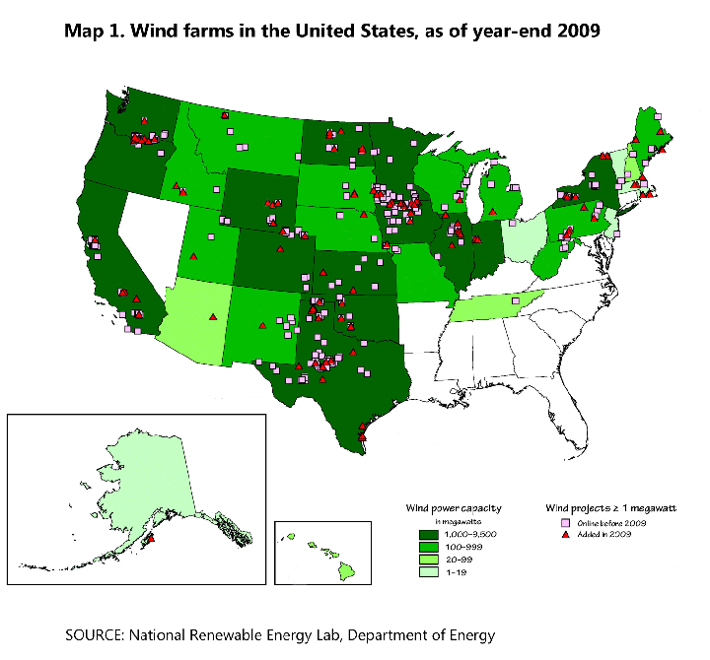
Why wind energy?
CAREER
CONTENT
CONNECTIONS
Windmills
Oregon supplies over 1,000 megawatts (1 megawatt =1,000 homes)
4,289 megawatts in 2012
12.6% Energy in OR is from Wind (2016)
Senate Bill 838 (25% renewable by 2025, 50% by 2040)
Wind Farms 400 jobs to build, 35 permanent jobs
Can’t be stored

Slide 5
Ngss Core ideas and Windmills
3-5
Moving objects contain energy.
6-8
Kinetic energy can be distinguished from the various forms of potential energy.
9-12
The total energy within a system is conserved.
Energy changes to and from each type can be tracked through physical or chemical interactions.
Systems move toward stable states
The faster the object moves, the more energy it has.
Energy can be moved from place to place by moving objects, or through sound, light, or electrical currents.
Energy can be converted from one form to another form
The relationship between the temperature and the total energy of a system depends on the types, states, and amounts of matter.
Energy transfer within and between systems can be described and predicted in terms of energy associated with the motion or configuration of particles (objects).
Core Idea PS3:
Energy
PS3.A:
Definitions of Energy
PS3.B:
Conservation of Energy
and Energy Transfer

Slide 6
K-2 Engineering
K-2-ETS1-1.Ask questions, make observations, and gather information about a situation people want to change to define a simple problem that can be solved through the development of a new or improved object or tool.
K-2-ETS1-2.Develop a simple sketch, drawing, or physical model to illustrate how the shape of an object helps it function as needed to solve a given problem.
K-2-ETS1-3.Analyze data from tests of two objects designed to solve the same problem to compare the strengths and weaknesses of how each performs.

Slide 7
3-5 Engineering
3-5-ETS1-1.Define a simple design problem reflecting a need or a want that includes specified criteria for success and constraints on materials, time, or cost.
3-5-ETS1-2.Generate and compare multiple possible solutions to a problem based on how well each is likely to meet the criteria and constraints of the problem.
3-5-ETS1-3.Plan and carry out fair tests in which variables are controlled and failure points are considered to identify aspects of a model or prototype that can be improved.

Slide 8
6-8 Engineering
MS-ETS1-1. Define the criteria and constraints of a design problem with sufficient precision to ensure a successful solution, taking into account relevant scientific principles and potential impacts on people and the natural environment that may limit possible solutions.
MS-ETS1-2. Evaluate competing design solutions using a systematic process to determine how well they meet the criteria and constraints of the problem.
MS-ETS1-3. Analyze data from tests to determine similarities and differences among several design solutions to identify the best characteristics of each that can be combined into a new solution to better meet the criteria for success.
MS-ETS1-4. Develop a model to generate data for iterative testing and modification of a proposed object, tool, or process such that an optimal design can be achieved.

Slide 9
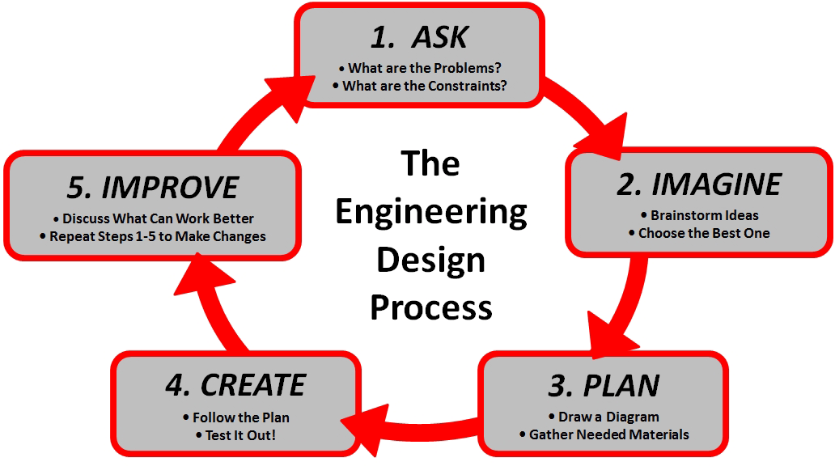
There is no single Engineering design process…. but this is helpful.

Slide 10
There is no single Engineering design process…. but this is helpful.
In some ways, children are natural engineers. They spontaneously build sand castles, dollhouses, and hamster enclosures, and they use a variety of tools and materials for their own playful purposes. ...Children’s capabilities to design structures can then be enhanced by having them pay attention to points of failure and asking them to create and test redesigns of the bridge so that it is stronger.
(NRC, 2012, p. 70).

Slide 11
Conclusions for Teaching
Set up design challenges with Criteria & Constraints. (e.g. A sailboat made from limited materials that can float for 10 minutes)
Use authentic problems when possible.
Emphasize the iterative process of engineering (the design cycle).
Tie closely to science content. Design and redesign based on data and scientific concepts.

Slide 12
Energy: ms-ps3-5 & Windmills
MS-ETS1-4: Develop a model to generate data for iterative testing and modification of a proposed object, tool, or process such that an optimal design can be achieved.

Slide 13
Strengths and weakness of our model
Strength
Weakness
Variables
NGSS Practices
Cost Efficient
Authentic Context
Scalable
Line loss
Gearing/Generator/Transformer
Speed/Weight
Variability of design
Energy must be used right away
Use DC motor, Not AC

Slide 14
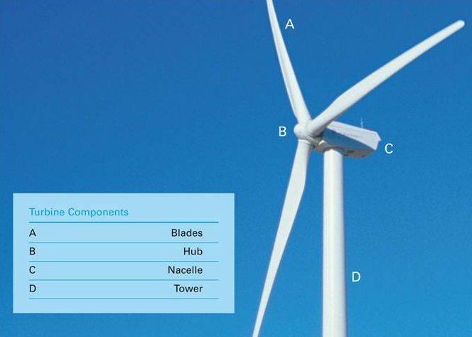
Parts of a Wind Turbine
Notes:
Later today we are going to build our own wind turbine. As we discuss this, it will be helpful for you to know the parts of a wind turbine.

Slide 15
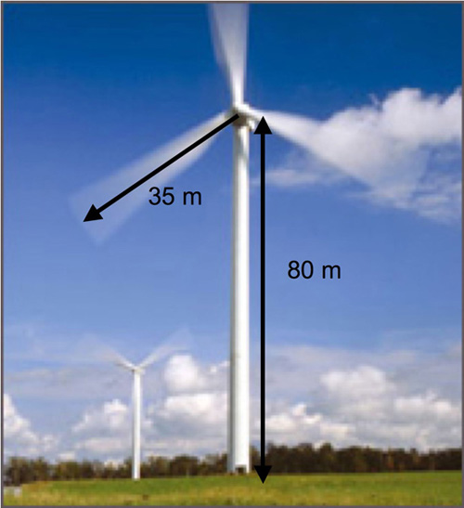
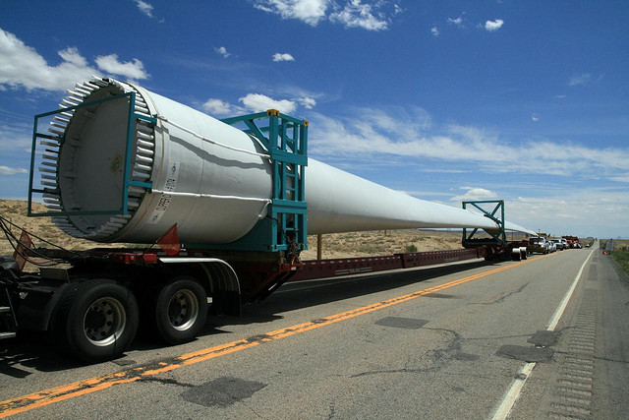
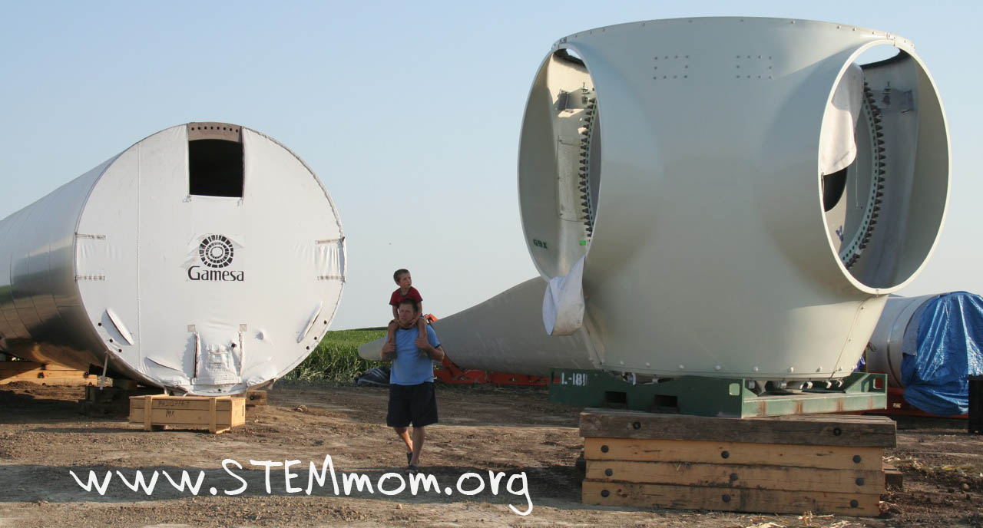
Large Wind Turbines
Notes:
So what do windmills actually look like? You can see here that they go up to 400 ft tall, and there blades are nearly 150 ft long!!
The blades can be half the length of a football field!

Slide 16
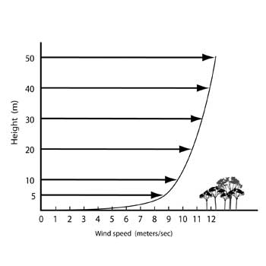
Why do windmills need to be high in the sky?
High above the ground, winds are faster and more consistent.
Notes:
Larger windmills will generate more electricity. What is stopping us from building them even taller than the way they are now?
-materials are the limiting factors: not strong enough, do not last long enough

Slide 17
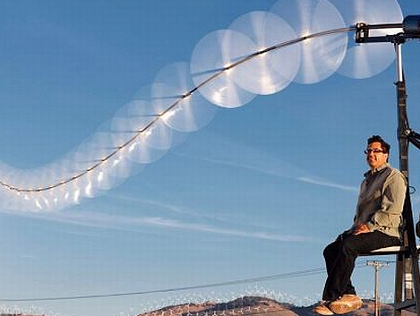
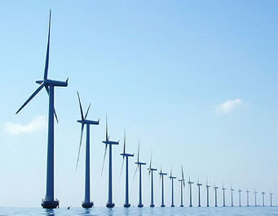
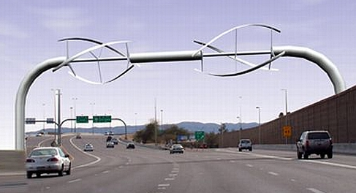
Different places, shapes, and sizes
Notes:
1. Wind is often stronger and more consistent out in the ocean.
2. Windmills can be all different shapes
3. Windmill over the highway
4. “Sky serpent”- Lots of little windmills. Why may this be a good idea as compared to the “generic” windmill?
-same amount of energy generated using fewer materials

Slide 18
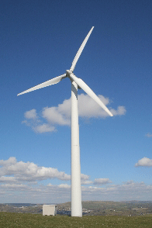
How can we generate electricity?
ENERGY
MECHANICAL ENERGY
ELECTRICITY
Notes:
Kinetic energy from wind is converted to mechanical energy (the blades spinning) which is then converted to electricity by the generator.
See if your students can brainstorm and suggest several forms of energy that is converted into mechanical energy and then into electrical energy. Two common suggestions are hydroelectric energy and wind energy.
When you have a magnet in the middle of a coil- when either of them move it creates a voltage, or an electrical current. You can have either a moving wire, or a moving magnet which causes minute pushes and pulls on the electrons in the wire, causing them to move on down the line… thus creating an electrical current.

Slide 19
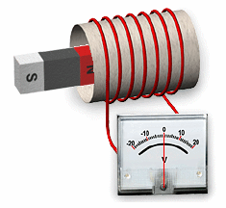
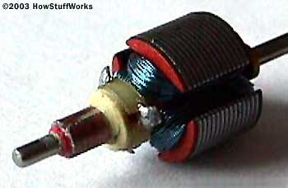
Electric Generator
G
MECHANICAL ENERGY
ELECTRICITY
A coil of wire is rotated in a magnetic field. When this happens, a voltage is produced in the coil!
This is called Induction.
Magnet
Coil of wire
Notes:
So we have what are called generators, which convert what’s called mechanical energy- into electrical energy by having a coil rotate around a magnet.

Slide 20
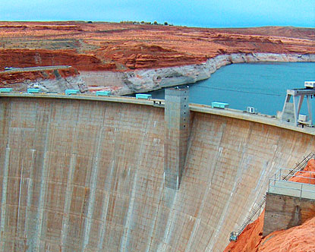
Are there other ways to get a coil to rotate to produce electricity?
Pressurized Steam Turbines
Burning fossil fuels to heat water into steam
Nuclear – high temperatures to make steam
Hydroelectric
Falling water has energy,
which spins turbines
Wind!
Moving air molecules have energy, too!
Which of these methods uses renewable sources? Which use non-renewable sources?
Notes:
But how do we get these coils to rotate and create electricity? Well there are many different ways. We have what are called steam turbines, where you either burn fuels or use nuclear plants that make heat to warm up water into steam and turn turbines. Then there is what’s called hydroelectric power, where you use turbines spinning from the weight of falling water. Who here has seen a dam? Well inside those dams are giant turbines that are designed to turn a coil and induce electricity. Lastly, there is wind power! Using large blades, windmills catch the wind and turn a coil inside the windmill- again inducing electricity!
RENEWABLE VS. NONRENEWABLE

Slide 21
How do we measure electrical energy?
Voltage
Stored energy
Volts
Current
Flowing energy
Amps
Power
Volts X Amps= Watts (unit of “Work”)
You will be recording these

Slide 22
Let’s get testing!
 | Group 1 | Group 2 | Group 3 | Group 4 | Group 5
Design 1
Design 2
Design 3
Best Design
Key Changes
Number of into groups
Retrieve 1 student handout per group
Name
Build, test, revise
Report Power (Voltage * I) for each design
Q: What can you take from this experience to help your students?

Slide 23
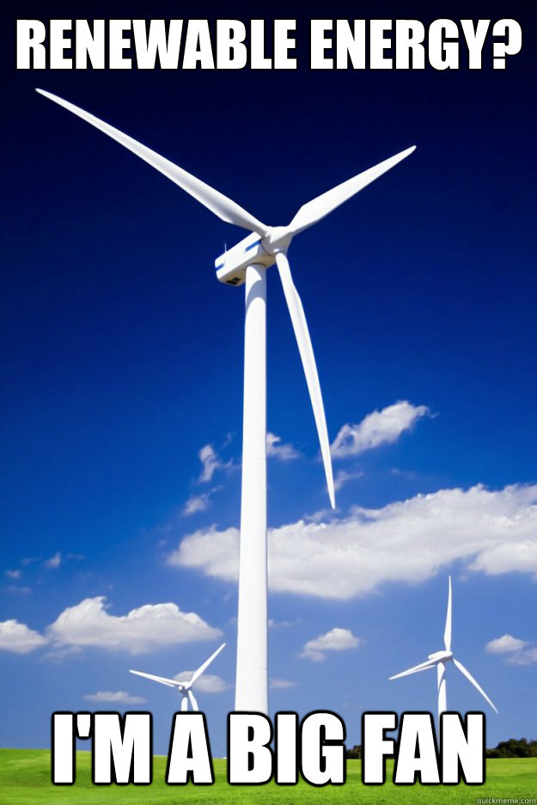
How would you adjust this to fit your students?
How would you modify this for your club and grade level?
How does this connect to what you have already done? (Renewables? Energy?)
How can this activity be improved on?
How do you think about groupings of students?

