Slide 1
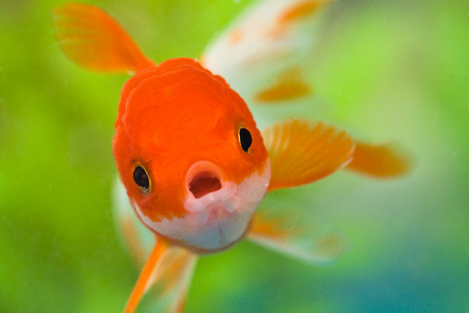
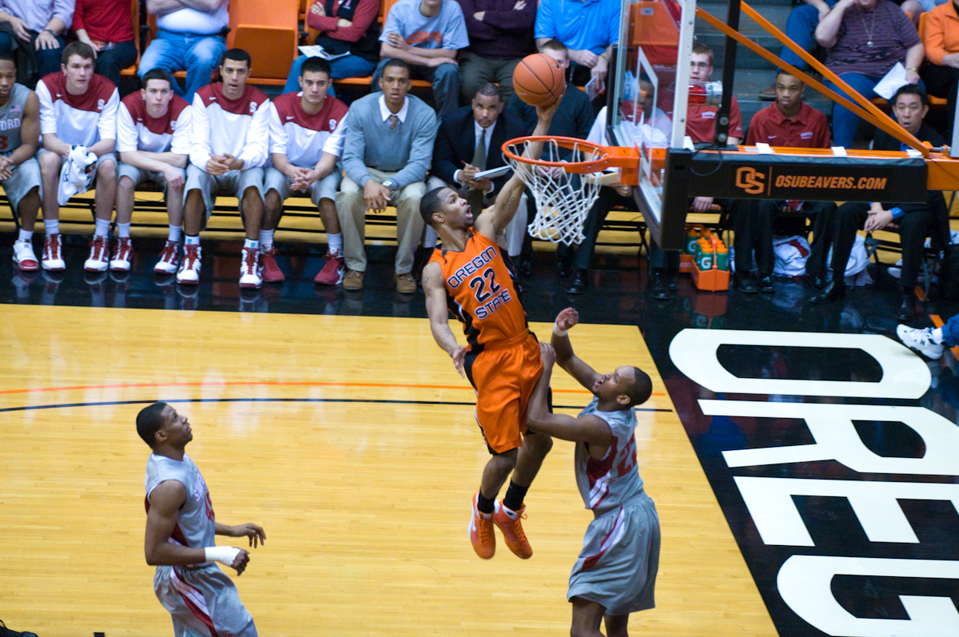
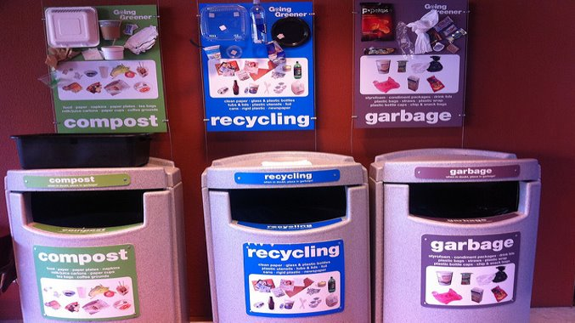
SMILE Workshop – Systems Thinking

Slide 2
Introductions
Malaia Jacobsen
Mary Marshall
AnneMarie Minniti
Daniel Stoddard

Slide 3
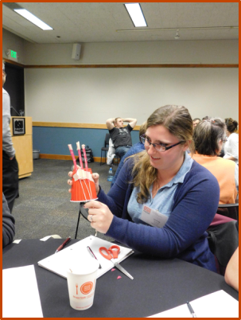
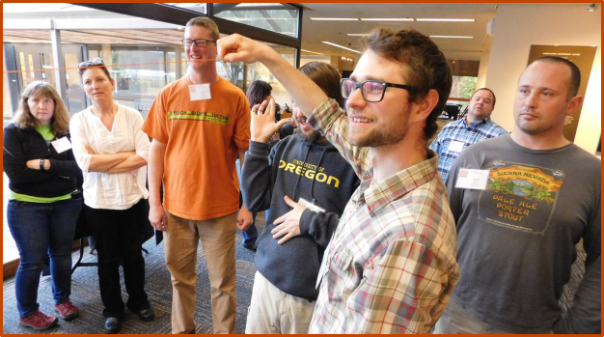
Introductions
Capstone design team of seniors in Industrial Engineering
Continuation of project with the SMILE program
Recap:
Workshop sessions held previous two years
Module of six systems thinking lessons developed

Slide 4
Warm-Up Activity

Slide 5
Lesson

Slide 6
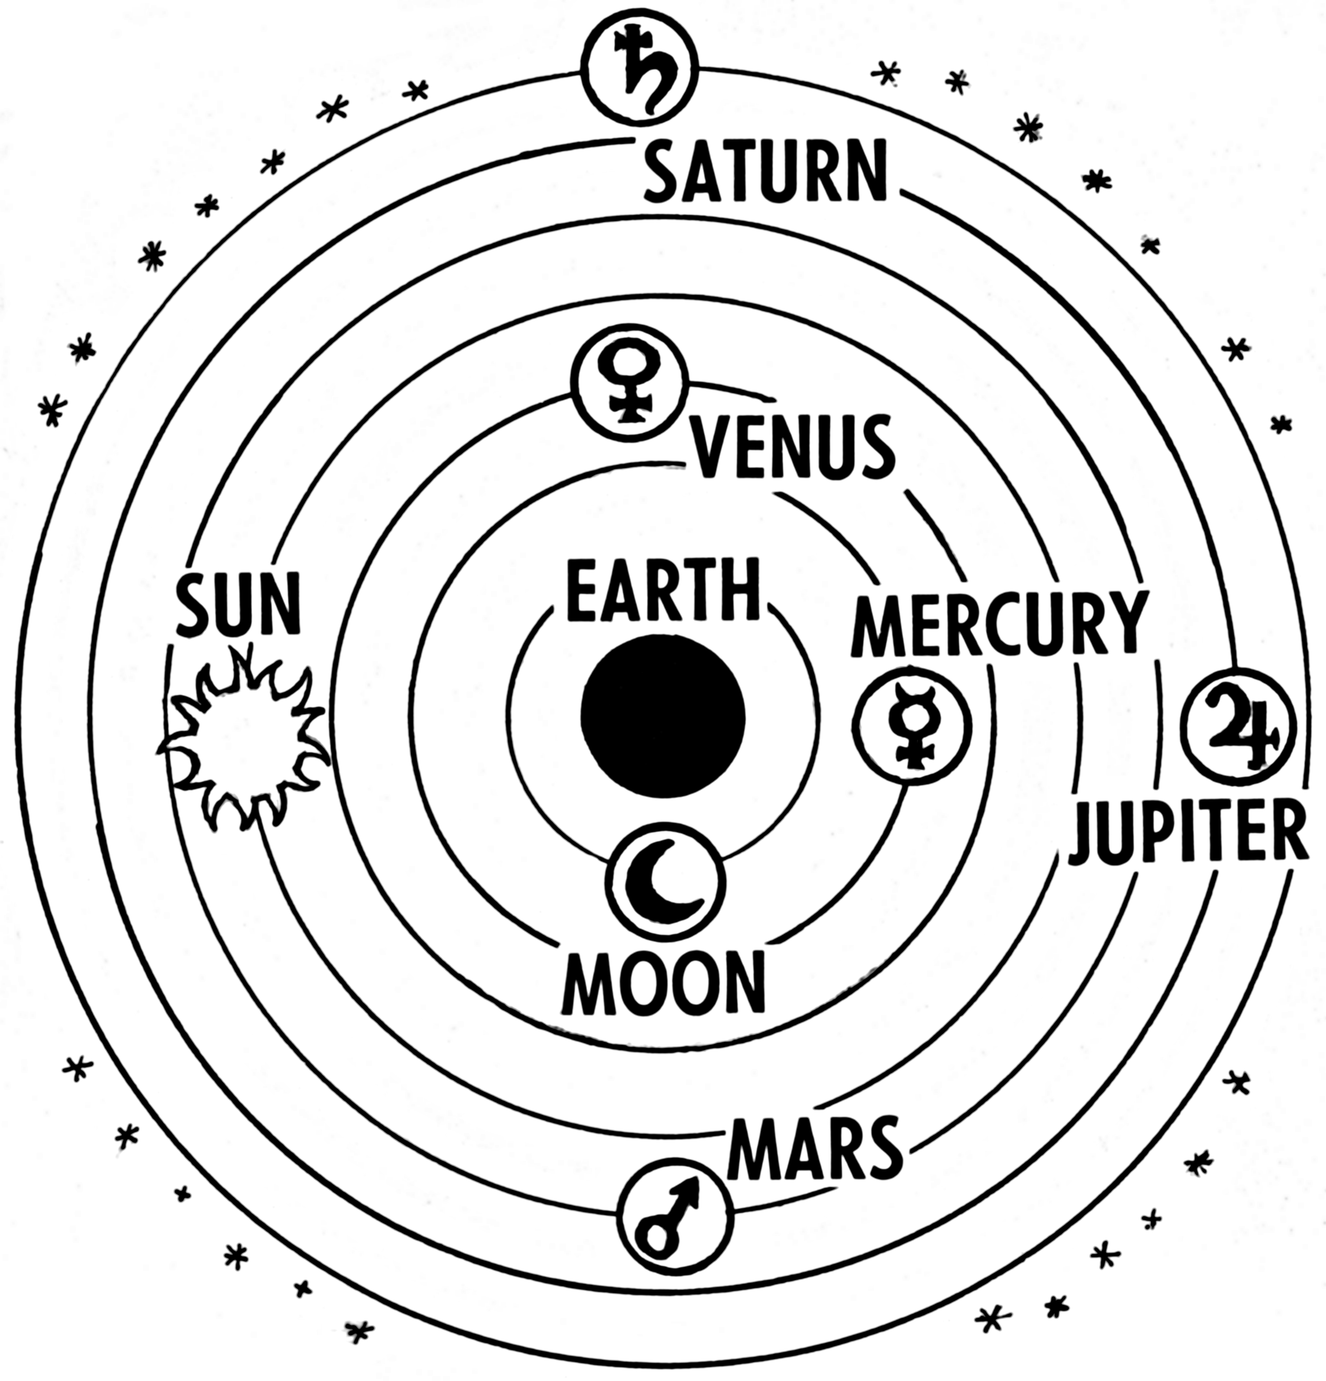
Preview of Systems Thinking Concepts
Distinctions
Relationships
Perspectives
Emergent Properties
Subsystems
Patterns
This Photo by Unknown author is licensed under CC BY-SA.

Slide 7
Fish Tank Example: What is the Problem?
Problem Statement: The water in your fish tank is turning green in color.
Why is the problem statement important for effectively using systems thinking?

Slide 8
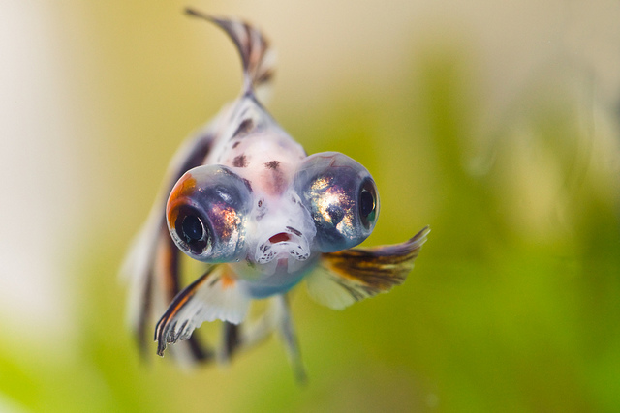
Fish Tank Example: Discussion Questions
What were some common elements in your systems?
How did you determine what elements were included in your fish tank system? Elements outside of the system?

Slide 9
Systems Thinking Concept #1: Distinctions
Definition: Distinctions are how we draw or define the boundaries of an element or a system of elements. This boundary defines what is and what is not that element or system.

Slide 10
Systems Thinking Concept #1: Distinctions
Definition: Distinctions are how we draw or define the boundaries of an element or a system of elements. This boundary defines what is and what is not that element or system.
Shapes Example:

Slide 11
Systems Thinking Concept #1: Distinctions
Definition: Distinctions are how we draw or define the boundaries of an element or a system of elements. This boundary defines what is and what is not that element or system.
Shapes Example:
System: Shapes with only straight edges

Slide 12
Systems Thinking Concept #1: Distinctions
Definition: Distinctions are how we draw or define the boundaries of an element or a system of elements. This boundary defines what is and what is not that element or system.
Shapes Example:
System: White shapes

Slide 13
Fish Tank Example: Discussion Questions
How do the different elements in the fish tank interact with each other?

Slide 14
Systems Thinking Concept #2: Relationships
Definition: Relationships help us understand how the elements within a system interact with each other.

Slide 15
Systems Thinking Concept #2: Relationships
Definition: Relationships help us understand how the elements within a system interact with each other.
Shapes Example:
Relationship?
Lines
Rectangle

Slide 16
Systems Thinking Concept #2: Relationships
Definition: Relationships help us understand how the elements within a system interact with each other.
Shapes Example:
Four lines form a rectangle
Lines
Rectangle

Slide 17
Fish Tank Example: Discussion Questions
What kind of fish tank did you picture from the provided problem statement?
Did any prior experiences with fish tanks influence your answers?

Slide 18
Systems Thinking Concept #3: Perspectives
Definition: A perspective is a particular point of view that we use to understand a system.

Slide 19
Systems Thinking Concept #3: Perspectives
Definition: A perspective is a particular point of view that we use to understand a system.
Shape Example:
Front View

Slide 20
Systems Thinking Concept #3: Perspectives
Definition: A perspective is a particular point of view that we use to understand a system.
Shape Example:
Front View
Angled View

Slide 21
Systems Thinking Concept #3: Perspectives
Definition: A perspective is a particular point of view that we use to understand a system.
Shape Example:
Front View
Angled View
Side View

Slide 22
Fish Tank Example: Discussion Questions
What would happen in a fish tank if you removed the water? The filter? The fish?

Slide 23
Systems Thinking Concept #4: Emergent Properties
Definition: Emergent properties are things that a whole system can do, but that its elements cannot do by themselves.

Slide 24
Systems Thinking Concept #4: Emergent Properties
Definition: Emergent properties are things that a whole system can do, but that its elements cannot do by themselves.
Shapes Example:
Individual Shapes

Slide 25
Systems Thinking Concept #4: Emergent Properties
Definition: Emergent properties are things that a whole system can do, but that its elements cannot do by themselves.
Shapes Example:
Individual Shapes
Emergent Property: Forms a star

Slide 26
Systems Thinking Concept #4: Emergent Properties
Definition: Emergent properties are things that a whole system can do, but that its elements cannot do by themselves.
What emergent properties exist within the fish tank?

Slide 27
Fish Tank Example: Discussion Questions
What smaller systems exist within the fish tank?

Slide 28
Systems Thinking Concept #5: Subsystems
Definition: Subsystems are smaller systems that together make up a larger system.

Slide 29
Systems Thinking Concept #5: Subsystems
Definition: Subsystems are smaller systems that together make up a larger system.
Shapes Example:
System of small triangles

Slide 30
Systems Thinking Concept #5: Subsystems
Definition: Subsystems are smaller systems that together make up a larger system.
Shapes Example:
System of small triangles
System of larger triangles

Slide 31
Fish Tank Example: Discussion Questions
Patterns helped us discover the given problem statement.
What is another possible pattern that could indicate that something is changing within the system?

Slide 32
Systems Thinking Concept #6: Patterns
Definition: Patterns exist within systems. Patterns can help us predict what will happen in a system.

Slide 33
Systems Thinking Concept #6: Patterns
Definition: Patterns can help us predict what will happen in a system. Systems are composed of patterns.
Shape Example:
?
?
?
How can patterns help answer this question?

Slide 34
Systems Thinking Concept #6: Patterns
Definition: Patterns can help us predict what will happen in a system. Systems are composed of patterns.
Shape Example:

Slide 35
Summary of Systems Thinking Concepts
Distinctions
Relationships
Perspectives
Emergent Properties
Subsystems
Patterns

Slide 36
Why Systems Thinking?

Slide 37
Systems Thinking – A Tool for Problem Solving
Three real-world examples
The German Economy Post World War I
The Disaster at Chernobyl
Recycling Initiatives at Sabre Holdings

Slide 38
Post World War I Germany
The Treaty of Versailles was signed in this railcar in 1919
Notes:
https://www.theholocaustexplained.org/the-nazi-rise-to-power/the-weimar-republic/invasion-of-the-ruhr/
https://www.britannica.com/event/Treaty-of-Versailles-1919

Slide 39
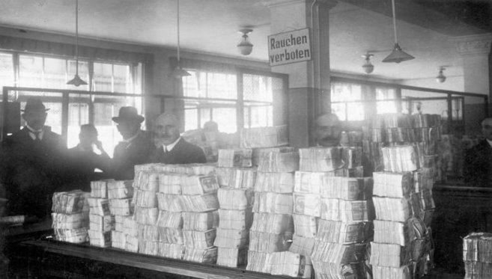
Post World War I Germany
Printing more money resulted in hyper-inflation
Notes:
https://www.theholocaustexplained.org/the-nazi-rise-to-power/the-weimar-republic/invasion-of-the-ruhr/
https://www.britannica.com/event/Treaty-of-Versailles-1919

Slide 40
Post World War I Germany
Costs of goods skyrocketed and people lost their jobs
Notes:
https://www.theholocaustexplained.org/the-nazi-rise-to-power/the-weimar-republic/invasion-of-the-ruhr/
https://www.britannica.com/event/Treaty-of-Versailles-1919

Slide 41
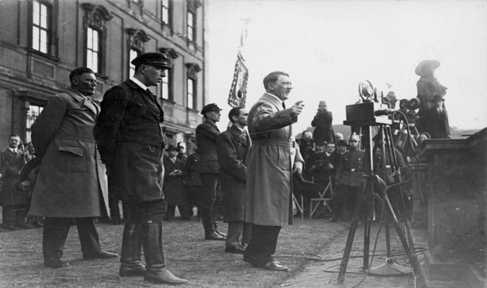
Post World War I Germany
The frustration of the German people set the stage for political uprising
Notes:
https://www.theholocaustexplained.org/the-nazi-rise-to-power/the-weimar-republic/invasion-of-the-ruhr/
https://www.britannica.com/event/Treaty-of-Versailles-1919

Slide 42
Disaster at Chernobyl
The Chernobyl nuclear powerplant
Notes:
http://www.world-nuclear.org/information-library/safety-and-security/safety-of-plants/chernobyl-accident.aspx

Slide 43
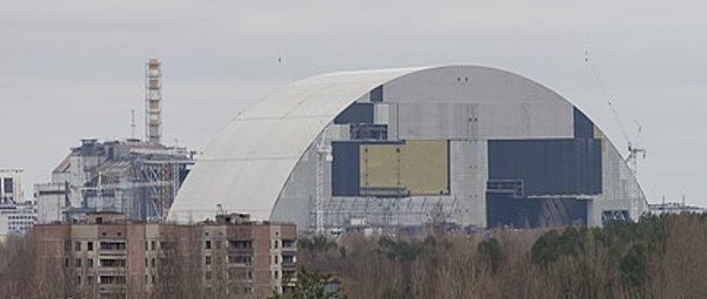
Disaster at Chernobyl
This new safety dome was added in 2016, 30 years after the Chernobyl incident
Notes:
http://www.world-nuclear.org/information-library/safety-and-security/safety-of-plants/chernobyl-accident.aspx

Slide 44
Recycling Initiatives
Of the 15 trash bags, only 2 contained trash; 13 bags could have been recycled or composted
Notes:
https://www.sabre.com/images/uploads/A_Tale_of_Three_Bins_Sabre_Holdings_Case_Story.pdf

Slide 45
Recycling Initiatives
Centralized waste bins with clear examples of how to properly sort waste
Notes:
https://www.sabre.com/images/uploads/A_Tale_of_Three_Bins_Sabre_Holdings_Case_Story.pdf

Slide 46
Recycling Initiatives
Lunchrooms began using washable dishes instead of disposable items
Notes:
https://www.sabre.com/images/uploads/A_Tale_of_Three_Bins_Sabre_Holdings_Case_Story.pdf

Slide 47
Why Systems Thinking?
Allows us to think holistically about a problem
Can show us how to identify and avoid unintended consequences
Broadens our thinking and helps us articulate problems in new and different ways
Helps us develop lasting solutions

Slide 48
Problem Solving Activity

Slide 49
Problem Solving Activity Example
Problem statement: The OSU men's basketball coach is trying to improve his team's scoring by next week's game
Goal: Increase the number of points scored in next week's game.

Slide 50
Problem Solving Activity Example
Elements
Player skill
Teamwork
Player health
Fan support
Strategy

Slide 51
Problem Solving Activity Example
Elements
Player skill
Teamwork
Player health
Fan support
Strategy
Sub-Elements
Reviewing game tape
Injuries
Locker room culture
Playbook
Recruiting
Practice drills
Game location
Lineup/Rotation
Date of game

Slide 52
Problem Solving Activity Example
Elements
Player skill
Teamwork
Player health
Fan support
Strategy
Sub-Elements
Reviewing game tape
Injuries
Locker room culture
Playbook
Recruiting
Practice drills
Game location
Lineup/Rotation
Date of game

Slide 53
Problem Solving Activity Example
Elements
Player skill
Teamwork
Player health
Fan support
Strategy
Sub-Elements
Reviewing game tape
Injuries
Locker room culture
Playbook
Recruiting
Practice drills
Game location
Lineup/Rotation
Date of game

Slide 54
Problem Solving Activity Example
Elements
Player skill
Teamwork
Player health
Fan support
Strategy
Sub-Elements
Reviewing game tape
Injuries
Locker room culture
Playbook
Recruiting
Practice drills
Game location
Lineup/Rotation
Date of game

Slide 55
Problem Solving Activity Example
Elements
Player skill
Teamwork
Player health
Fan support
Strategy
Sub-Elements
Reviewing game tape
Injuries
Locker room culture
Playbook
Recruiting
Practice drills
Game location
Lineup/Rotation
Date of game

Slide 56
Problem Solving Activity Example
Elements
Player skill
Teamwork
Player health
Fan support
Strategy
Sub-Elements
Reviewing game tape
Injuries
Locker room culture
Playbook
Recruiting
Practice drills
Game location
Lineup/Rotation
Date of game

Slide 57
Problem Solving Activity Example
Elements
Player skill
Teamwork
Player health
Fan support
Strategy
Sub-Elements
Reviewing game tape
Injuries
Locker room culture
Playbook
Recruiting
Practice drills
Game location
Lineup/Rotation
Date of game

Slide 58
Problem Solving Activity Example
Elements
Player skill
Teamwork
Player health
Fan support
Strategy
Sub-Elements
Reviewing game tape
Injuries
Locker room culture
Playbook
Recruiting
Practice drills
Game location
Lineup/Rotation
Date of game

Slide 59
Problem Solving Activity Example
Elements
Player skill
Teamwork
Player health
Fan support
Strategy
Sub-Elements
Reviewing game tape
Injuries
Locker room culture
Playbook
Recruiting
Practice drills
Game location
Lineup/Rotation
Date of game

Slide 60
Problem Solving Activity Example
Elements
Player skill
Teamwork
Player health
Fan support
Strategy
Sub-Elements
Reviewing game tape
Injuries
Locker room culture
Playbook
Recruiting
Practice drills
Game location
Lineup/Rotation
Date of game

Slide 61
Problem Solving Activity Example
What are the sub-elements for strategy?
Perspective 1
Reviewing game tape
Playbook
Practice Drills
Lineup/Rotation
Perspective 2
Reviewing game tape
Recruiting
Lineup/Rotation

Slide 62
Problem Solving Activity Example
What element can be altered as a possible solution?
List all the elements
Elements | Impact | Can this be controlled? Y/N | Level of Control | Score

Slide 63
Problem Solving Activity Example
What element can be altered as a possible solution?
List all the elements
Elements | Impact | Can this be controlled? Y/N | Level of Control | Score
Player Skill
Strategy
Teamwork
Player Health
Fan Support

Slide 64
Problem Solving Activity Example
What element can be altered as a possible solution?
Rank the elements based on perceived impact
Elements | Impact | Can this be controlled? Y/N | Level of Control | Score
Player Skill
Strategy
Teamwork
Player Health
Fan Support

Slide 65
Problem Solving Activity Example
What element can be altered as a possible solution?
Rank the elements based on perceived impact
Elements | Impact | Can this be controlled? Y/N | Level of Control | Score
Player Skill | 1
Strategy
Teamwork
Player Health
Fan Support

Slide 66
Problem Solving Activity Example
What element can be altered as a possible solution?
Rank the elements based on perceived impact
Elements | Impact | Can this be controlled? Y/N | Level of Control | Score
Player Skill | 1
Strategy
Teamwork | 2
Player Health
Fan Support

Slide 67
Problem Solving Activity Example
What element can be altered as a possible solution?
Rank the elements based on perceived impact
Elements | Impact | Can this be controlled? Y/N | Level of Control | Score
Player Skill | 1
Strategy | 3
Teamwork | 2
Player Health
Fan Support

Slide 68
Problem Solving Activity Example
What element can be altered as a possible solution?
Rank the elements based on perceived impact
Elements | Impact | Can this be controlled? Y/N | Level of Control | Score
Player Skill | 1
Strategy | 3
Teamwork | 2
Player Health
Fan Support | 4

Slide 69
Problem Solving Activity Example
What element can be altered as a possible solution?
Rank the elements based on perceived impact
Elements | Impact | Can this be controlled? Y/N | Level of Control | Score
Player Skill | 1
Strategy | 3
Teamwork | 2
Player Health | 5
Fan Support | 4

Slide 70
Problem Solving Activity Example
What element can be altered as a possible solution?
Can the elements be controlled?
Elements | Impact | Can this be controlled? Y/N | Level of Control | Score
Player Skill | 1 | N
Strategy | 3
Teamwork | 2
Player Health | 5
Fan Support | 4

Slide 71
Problem Solving Activity Example
What element can be altered as a possible solution?
Can the elements be controlled?
Elements | Impact | Can this be controlled? Y/N | Level of Control | Score
Player Skill | 1 | N | -
Strategy | 3
Teamwork | 2
Player Health | 5
Fan Support | 4

Slide 72
Problem Solving Activity Example
What element can be altered as a possible solution?
Can the elements be controlled?
Elements | Impact | Can this be controlled? Y/N | Level of Control | Score
Player Skill | 1 | N | -
Strategy | 3 | Y
Teamwork | 2
Player Health | 5
Fan Support | 4

Slide 73
Problem Solving Activity Example
What element can be altered as a possible solution?
Can the elements be controlled?
Elements | Impact | Can this be controlled? Y/N | Level of Control | Score
Player Skill | 1 | N | -
Strategy | 3 | Y
Teamwork | 2 | Y
Player Health | 5
Fan Support | 4

Slide 74
Problem Solving Activity Example
What element can be altered as a possible solution?
Can the elements be controlled?
Elements | Impact | Can this be controlled? Y/N | Level of Control | Score
Player Skill | 1 | N | -
Strategy | 3 | Y
Teamwork | 2 | Y
Player Health | 5 | Y
Fan Support | 4

Slide 75
Problem Solving Activity Example
What element can be altered as a possible solution?
Can the elements be controlled?
Elements | Impact | Can this be controlled? Y/N | Level of Control | Score
Player Skill | 1 | N | -
Strategy | 3 | Y
Teamwork | 2 | Y
Player Health | 5 | Y
Fan Support | 4 | N

Slide 76
Problem Solving Activity Example
What element can be altered as a possible solution?
Can the elements be controlled?
Elements | Impact | Can this be controlled? Y/N | Level of Control | Score
Player Skill | 1 | N | -
Strategy | 3 | Y
Teamwork | 2 | Y
Player Health | 5 | Y
Fan Support | 4 | N | -

Slide 77
Problem Solving Activity Example
What element can be altered as a possible solution?
Can the elements be controlled?
Elements | Impact | Can this be controlled? Y/N | Level of Control | Score
Player Skill | 1 | N | -
Strategy | 3 | Y | 1
Teamwork | 2 | Y
Player Health | 5 | Y
Fan Support | 4 | N | -

Slide 78
Problem Solving Activity Example
What element can be altered as a possible solution?
Can the elements be controlled?
Elements | Impact | Can this be controlled? Y/N | Level of Control | Score
Player Skill | 1 | N | -
Strategy | 3 | Y | 1
Teamwork | 2 | Y | 2
Player Health | 5 | Y
Fan Support | 4 | N | -

Slide 79
Problem Solving Activity Example
What element can be altered as a possible solution?
Can the elements be controlled?
Elements | Impact | Can this be controlled? Y/N | Level of Control | Score
Player Skill | 1 | N | -
Strategy | 3 | Y | 1
Teamwork | 2 | Y | 2
Player Health | 5 | Y | 3
Fan Support | 4 | N | -

Slide 80
Problem Solving Activity Example
What element can be altered as a possible solution?
Score the remaining elements
Elements | Impact | Can this be controlled? Y/N | Level of Control | Score
Player Skill | 1 | N | - | -
Strategy | 3 | Y | 1
Teamwork | 2 | Y | 2
Player Health | 5 | Y | 3
Fan Support | 4 | N | - | -

Slide 81
Problem Solving Activity Example
What element can be altered as a possible solution?
Score the remaining elements
Elements | Impact | Can this be controlled? Y/N | Level of Control | Score
Player Skill | 1 | N | - | -
Strategy | 3 | Y | 1 | 3
Teamwork | 2 | Y | 2
Player Health | 5 | Y | 3
Fan Support | 4 | N | - | -

Slide 82
Problem Solving Activity Example
What element can be altered as a possible solution?
Score the remaining elements
Elements | Impact | Can this be controlled? Y/N | Level of Control | Score
Player Skill | 1 | N | - | -
Strategy | 3 | Y | 1 | 3
Teamwork | 2 | Y | 2 | 4
Player Health | 5 | Y | 3
Fan Support | 4 | N | - | -

Slide 83
Problem Solving Activity Example
What element can be altered as a possible solution?
Score the remaining elements
Elements | Impact | Can this be controlled? Y/N | Level of Control | Score
Player Skill | 1 | N | - | -
Strategy | 3 | Y | 1 | 3
Teamwork | 2 | Y | 2 | 4
Player Health | 5 | Y | 3 | 15
Fan Support | 4 | N | - | -

Slide 84
Problem Solving Activity Example
What element can be altered as a possible solution?
Choose the element with the lowest score
Elements | Impact | Can this be controlled? Y/N | Level of Control | Score
Player Skill | 1 | N | - | -
Strategy | 3 | Y | 1 | 3
Teamwork | 2 | Y | 2 | 4
Player Health | 5 | Y | 3 | 15
Fan Support | 4 | N | - | -

Slide 85
Problem Solving Activity Example
What element can be altered as a possible solution?
Choose the element with the lowest score
Elements | Impact | Can this be controlled? Y/N | Level of Control | Score
Player Skill | 1 | N | - | -
Strategy | 3 | Y | 1 | 3
Teamwork | 2 | Y | 2 | 4
Player Health | 5 | Y | 3 | 15
Fan Support | 4 | N | - | -

Slide 86
Problem Solving Activity Example
What sub-element can be changed?
List the sub-elements for strategy
Sub-Elements | Impact | Can this be controlled? Y/N | Level of Control | Score
Reviewing Game Tape
Playbook
Practice Drills
Lineup/Rotation

Slide 87
Problem Solving Activity Example
What sub-element can be changed?
Rank the impact on the goal
Sub-Elements | Impact | Can this be controlled? Y/N | Level of Control | Score
Reviewing Game Tape | 4
Playbook | 1
Practice Drills | 2
Lineup/Rotation | 3

Slide 88
Problem Solving Activity Example
What sub-element can be changed?
Can the sub-elements be controlled?
Sub-Elements | Impact | Can this be controlled? Y/N | Level of Control | Score
Reviewing Game Tape | 4 | Y
Playbook | 1 | Y
Practice Drills | 2 | Y
Lineup/Rotation | 3 | Y

Slide 89
Problem Solving Activity Example
What sub-element can be changed?
Rank the level of control
Sub-Elements | Impact | Can this be controlled? Y/N | Level of Control | Score
Reviewing Game Tape | 4 | Y | 2
Playbook | 1 | Y | 4
Practice Drills | 2 | Y | 3
Lineup/Rotation | 3 | Y | 1

Slide 90
Problem Solving Activity Example
What sub-element can be changed?
Score each sub-element
Sub-Elements | Impact | Can this be controlled? Y/N | Level of Control | Score
Reviewing Game Tape | 4 | Y | 2 | 8
Playbook | 1 | Y | 4 | 4
Practice Drills | 2 | Y | 3 | 6
Lineup/Rotation | 3 | Y | 1 | 3

Slide 91
Problem Solving Activity Example
What sub-element can be changed?
Choose the sub-element with the lowest score
Sub-Elements | Impact | Can this be controlled? Y/N | Level of Control | Score
Reviewing Game Tape | 4 | Y | 2 | 8
Playbook | 1 | Y | 4 | 4
Practice Drills | 2 | Y | 3 | 6
Lineup/Rotation | 3 | Y | 1 | 3

Slide 92
Problem Solving Activity Example
What is a possible solution given Lineup/Rotation had the lowest score?

Slide 93
Problem Solving Activity Example
What is a possible solution given Lineup/Rotation had the lowest score?
Have as many seniors start as possible.

Slide 94
Problem Solving Activity Example
What is a possible solution given Lineup/Rotation had the lowest score?
Have as many seniors start as possible.
Choose a player from the bench to start as the center.

Slide 95
Problem Solving Activity Example
What is a possible solution given Lineup/Rotation had the lowest score?
Have as many seniors start as possible.
Choose a player from the bench to start as the center.
Have two complete rotations that will sub into the game every 5 minutes.

Slide 96
Problem Solving Activity
Complete the provided worksheet with a partner
Ensure the possible solution meets the goal
Discuss the questions on the back when you are finished

Slide 97
Lesson Matrix Activity

Slide 98
Lesson Matrix Activity
In groups of 2, visit each station and read the lesson summaries
Determine what you believe is the primary concept
Mark this on your matrix
Groups will have 2 minutes at each station before rotating and 5 minutes to go back to any station at the end if needed
Once your group is finished, put a tally on the whiteboard next to the concept you chose for each lesson

Slide 99
Lesson Matrix Activity
Activity A:
Activity B:
Activity C:
Activity D:
Activity E:
Activity F:

Slide 100
Lesson Matrix Activity
Activity A: Distinctions
Activity B:
Activity C:
Activity D:
Activity E:
Activity F:

Slide 101
Lesson Matrix Activity
Activity A: Distinctions
Activity B: Subsystems
Activity C:
Activity D:
Activity E:
Activity F:

Slide 102
Lesson Matrix Activity
Activity A: Distinctions
Activity B: Subsystems
Activity C: Emergent Properties
Activity D:
Activity E:
Activity F:

Slide 103
Lesson Matrix Activity
Activity A: Distinctions
Activity B: Subsystems
Activity C: Emergent Properties
Activity D: Relationships
Activity E:
Activity F:

Slide 104
Lesson Matrix Activity
Activity A: Distinctions
Activity B: Subsystems
Activity C: Emergent Properties
Activity D: Relationships
Activity E: Perspectives
Activity F:

Slide 105
Lesson Matrix Activity
Activity A: Distinctions
Activity B: Subsystems
Activity C: Emergent Properties
Activity D: Relationships
Activity E: Perspectives
Activity F: Patterns

Slide 106
Wrap-up Discussion
Systems thinking is a holistic way to solve problems
What tools did you learn and develop today?
Please answer the questions on the provided sheet and hand it to one of us as you leave
Hand the fish tank sheet to one of us on the way out
This Photo by Unknown author is licensed under CC BY-NC.

Slide 107
Contact Information
Malaia Jacobsen – jacobsma@oregonstate.edu
Mary Marshall – marsmary@oregonstate.edu
AnneMarie Minniti – minnitia@oregonstate.edu
Daniel Stoddard – stoddard@oregonstate.edu

